Slide 1
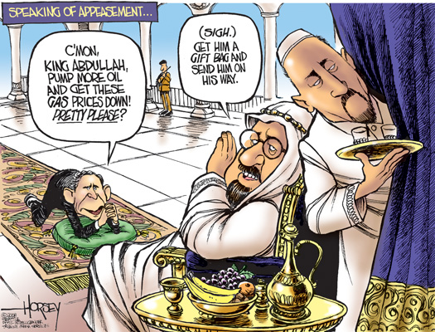

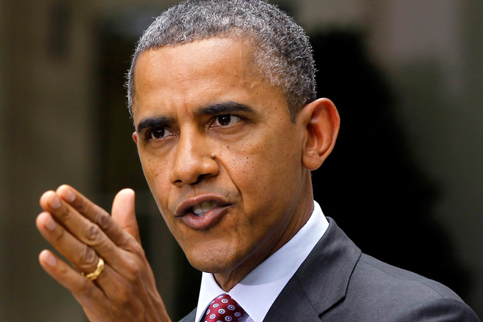
Markets NOW 2015 January
History rhymes Mark Twain (Tom Sawyer)
Notes:
Notes for WIT – World Investment Talk m2015 January
PowerPoint is stored at N:\WIT\WIT201506.pptx

Slide 2
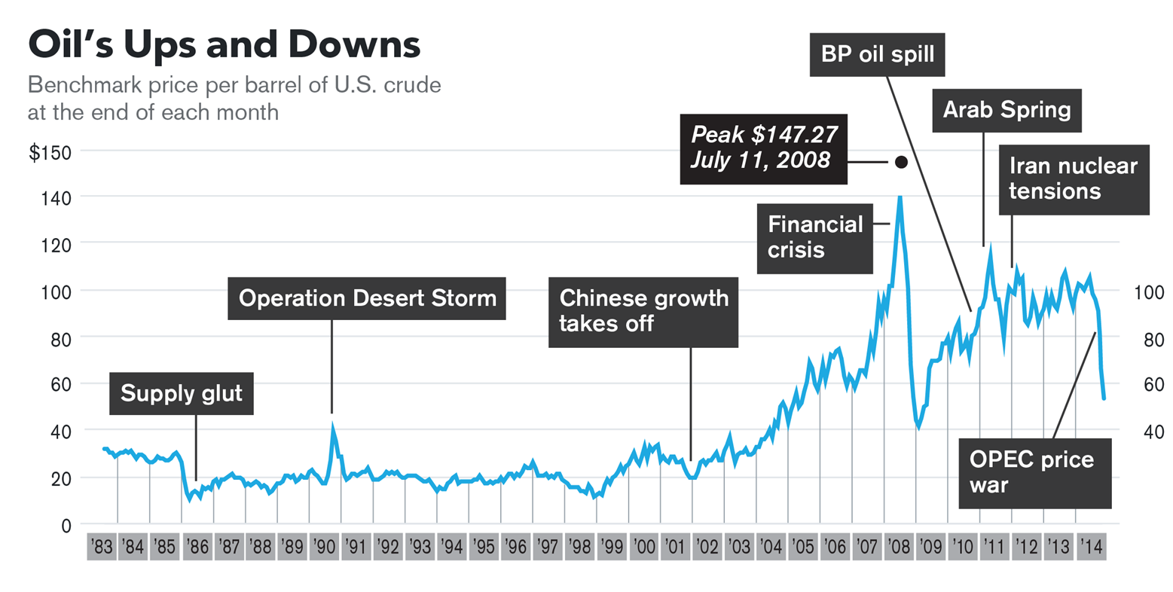

Slide 3
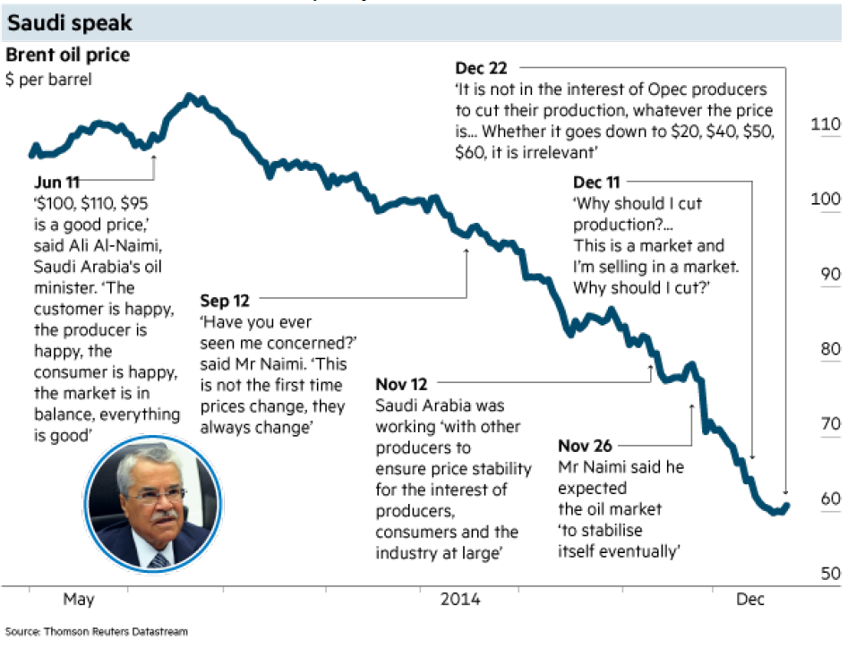
Issues – Oil – OPEC View

Slide 4
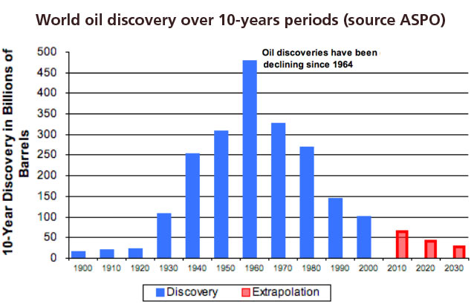

Slide 5
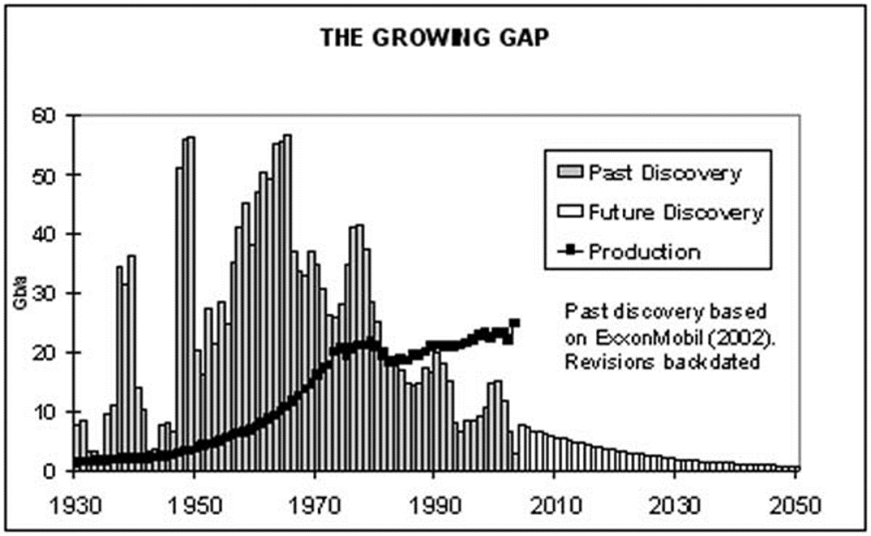

Slide 6
US Oil Balance
In 2013, US oil production had the largest increase in the country’s history. The US produced 84% of its domestic energy demand, up from the all-time low of 69% in 2005.
US oil production reached 10 Mb/d, the highest level since 1986. Output grew by 1.1Mb/d in 2013, the largest increase in the world and in the country’s history. The US was the third largest oil producer in 2013.
US energy production grew by 3.2% in 2013 –the largest increase in the world. Domestic energy production reached an all-time high for the 4th year in a row.
Oil (37% of total US demand) remains the dominant fuel followed by gas (30%), coal (20%), nuclear (8%), hydro (3%), and renewables in power (3%).
US net oil imports fell to 6.5 Mb/d, 47% below the 2005 peak. Net imports of natural gas dropped 13%.
Oil Production |  |  |  |  |  |  |  |  |  |  |  | Change | 2013
 |  |  |  |  |  |  |  |  |  |  |  | 2013 over | share
Thousand barrels daily | 1965 | 1970 | 1975 | 1980 | 1985 | 1990 | 1995 | 2000 | 2005 | 2010 | 2013 | 2012 | of total
US - Oil Production | 9014 | 11297 | 10008 | 10170 | 10580 | 8914 | 8322 | 7734 | 6903 | 7552 | 10003 | 13.50% | 10.80%
Oil Consumption |  |  |  |  |  |  |  |  |  |  |  | Change | 2013
 |  |  |  |  |  |  |  |  |  |  |  | 2013 over | share
Thousand barrels daily | 1965 | 1970 | 1975 | 1980 | 1985 | 1990 | 1995 | 2000 | 2005 | 2010 | 2013 | 2012 | of total
US - Oil Consumption | 11522 | 14710 | 16334 | 17062 | 15726 | 16988 | 17725 | 19701 | 20802 | 19180 | 18887 | 2.00% | 19.90%

Slide 7
Canada Oil Balance
North America is unique among regions in that it will switch from being a net energy importer to an exporter
Canada's oil sands are a significant contributor to the recent growth and expected future growth in the world's liquid fuel supply, and they comprise most of the country's proved oil reserves, which rank third globally.
Canada is the world's fifth-largest oil producer, and virtually all of its crude oil exports are directed to U.S. refineries.
Almost 97% of Canadian oil exports were directed to the United States in 2013, and Canada is the largest supplier of foreign oil to the United States
Canada accounted for one-third of U.S. crude oil imports in 2013.
Canada's proved oil reserve levels from 1980 to 2002 were well below 10 billion barrels. In 2003, they rose to 180 billion barrels after oil sands resources were deemed to be technically and economically recoverable.
Oil Consumption |  |  |  |  |  |  |  |  |  |  |  | Change | 2013
 |  |  |  |  |  |  |  |  |  |  |  | 2013 over | share
Thousand barrels daily | 1965 | 1970 | 1975 | 1980 | 1985 | 1990 | 1995 | 2000 | 2005 | 2010 | 2013 | 2012 | of total
Canada - Oil Consumption | 1108 | 1472 | 1682 | 1898 | 1556 | 1747 | 1848 | 2043 | 2288 | 2316 | 2385 | -0.50% | 2.50%
Oil Production |  |  |  |  |  |  |  |  |  |  |  | Change | 2013
 |  |  |  |  |  |  |  |  |  |  |  | 2013 over | share
Thousand barrels daily | 1965 | 1970 | 1975 | 1980 | 1985 | 1990 | 1995 | 2000 | 2005 | 2010 | 2013 | 2012 | of total
Canada - Oil Production | 920 | 1473 | 1735 | 1764 | 1813 | 1968 | 2402 | 2703 | 3041 | 3332 | 3948 | 6.00% | 4.70%

Slide 8
Saudi Arabia Oil Balance
Saudi Arabia has 16% of the world's proved oil reserves, is the largest exporter of total petroleum liquids in the world, and maintains the world's largest crude oil production capacity.
n 2013, Saudi Arabia was the world's second-largest petroleum liquids producer behind the United States and was the world's second-largest crude oil producer behind Russia.
The region was the largest exporter of oil(crude and products), contributing 35% of total exports. Three quarters of exports were destined for the Asia Pacific region.
Oil consumption in Israel fell by 60 Kb/d or 22%. Oil that had been used for power generation in 2012 was backed out by increased gas production and LNG imports in 2013. Saudi oil demand growth was also limited by gas gaining share in its power sector.
Saudi Arabia's economy remains heavily dependent on petroleum. Petroleum exports accounted for 85% of total Saudi export revenues in 2013, according to OPEC.
Oil: Consumption |  |  |  |  |  |  |  |  |  |  |  | Change | 2013
 |  |  |  |  |  |  |  |  |  |  |  | 2013 over | share
Thousand barrels daily | 1965 | 1970 | 1975 | 1980 | 1985 | 1990 | 1995 | 2000 | 2005 | 2010 | 2013 | 2012 | of total
Saudi Arabia - Oil Consumption | 391 | 408 | 366 | 607 | 955 | 1158 | 1299 | 1578 | 2012 | 2803 | 3075 | 3.1% | 3.2%
Oil: Production |  |  |  |  |  |  |  |  |  |  |  | Change | 2013
 |  |  |  |  |  |  |  |  |  |  |  | 2013 over | share
Thousand barrels daily | 1965 | 1970 | 1975 | 1980 | 1985 | 1990 | 1995 | 2000 | 2005 | 2010 | 2013 | 2012 | of total
Saudi Arabia - Oil Production | 2219 | 3851 | 7216 | 10270 | 3601 | 7105 | 9092 | 9470 | 10931 | 10075 | 11525 | -1.1% | 13.1%

Slide 9
Canada Oil Balance
North America is unique among regions in that it will switch from being a net energy importer to an exporter
Canada's oil sands are a significant contributor to the recent growth and expected future growth in the world's liquid fuel supply, and they comprise most of the country's proved oil reserves, which rank third globally.
Canada is the world's fifth-largest oil producer, and virtually all of its crude oil exports are directed to U.S. refineries.
Almost 97% of Canadian oil exports were directed to the United States in 2013, and Canada is the largest supplier of foreign oil to the United States
Canada accounted for one-third of U.S. crude oil imports in 2013.
Canada's proved oil reserve levels from 1980 to 2002 were well below 10 billion barrels. In 2003, they rose to 180 billion barrels after oil sands resources were deemed to be technically and economically recoverable.
Oil Consumption |  |  |  |  |  |  |  |  |  |  |  | Change | 2013
 |  |  |  |  |  |  |  |  |  |  |  | 2013 over | share
Thousand barrels daily | 1965 | 1970 | 1975 | 1980 | 1985 | 1990 | 1995 | 2000 | 2005 | 2010 | 2013 | 2012 | of total
Canada - Oil Consumption | 1108 | 1472 | 1682 | 1898 | 1556 | 1747 | 1848 | 2043 | 2288 | 2316 | 2385 | -0.50% | 2.50%
Oil Production |  |  |  |  |  |  |  |  |  |  |  | Change | 2013
 |  |  |  |  |  |  |  |  |  |  |  | 2013 over | share
Thousand barrels daily | 1965 | 1970 | 1975 | 1980 | 1985 | 1990 | 1995 | 2000 | 2005 | 2010 | 2013 | 2012 | of total
Canada - Oil Production | 920 | 1473 | 1735 | 1764 | 1813 | 1968 | 2402 | 2703 | 3041 | 3332 | 3948 | 6.00% | 4.70%

Slide 10
Saudi Arabia Oil Balance
Saudi Arabia has 16% of the world's proved oil reserves, is the largest exporter of total petroleum liquids in the world, and maintains the world's largest crude oil production capacity.
n 2013, Saudi Arabia was the world's second-largest petroleum liquids producer behind the United States and was the world's second-largest crude oil producer behind Russia.
The region was the largest exporter of oil(crude and products), contributing 35% of total exports. Three quarters of exports were destined for the Asia Pacific region.
Oil consumption in Israel fell by 60 Kb/d or 22%. Oil that had been used for power generation in 2012 was backed out by increased gas production and LNG imports in 2013. Saudi oil demand growth was also limited by gas gaining share in its power sector.
Saudi Arabia's economy remains heavily dependent on petroleum. Petroleum exports accounted for 85% of total Saudi export revenues in 2013, according to OPEC.
Oil: Consumption |  |  |  |  |  |  |  |  |  |  |  | Change | 2013
 |  |  |  |  |  |  |  |  |  |  |  | 2013 over | share
Thousand barrels daily | 1965 | 1970 | 1975 | 1980 | 1985 | 1990 | 1995 | 2000 | 2005 | 2010 | 2013 | 2012 | of total
Saudi Arabia - Oil Consumption | 391 | 408 | 366 | 607 | 955 | 1158 | 1299 | 1578 | 2012 | 2803 | 3075 | 3.1% | 3.2%
Oil: Production |  |  |  |  |  |  |  |  |  |  |  | Change | 2013
 |  |  |  |  |  |  |  |  |  |  |  | 2013 over | share
Thousand barrels daily | 1965 | 1970 | 1975 | 1980 | 1985 | 1990 | 1995 | 2000 | 2005 | 2010 | 2013 | 2012 | of total
Saudi Arabia - Oil Production | 2219 | 3851 | 7216 | 10270 | 3601 | 7105 | 9092 | 9470 | 10931 | 10075 | 11525 | -1.1% | 13.1%

Slide 11
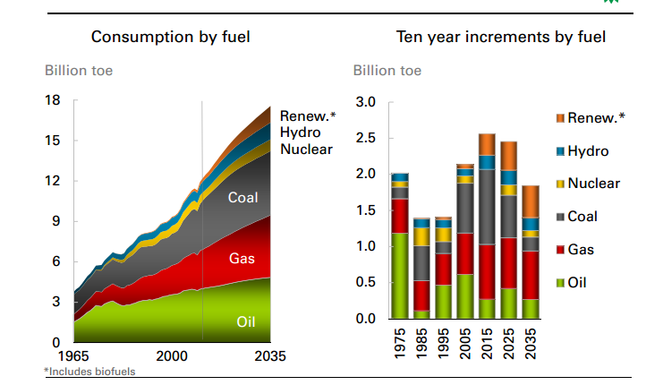

Slide 12
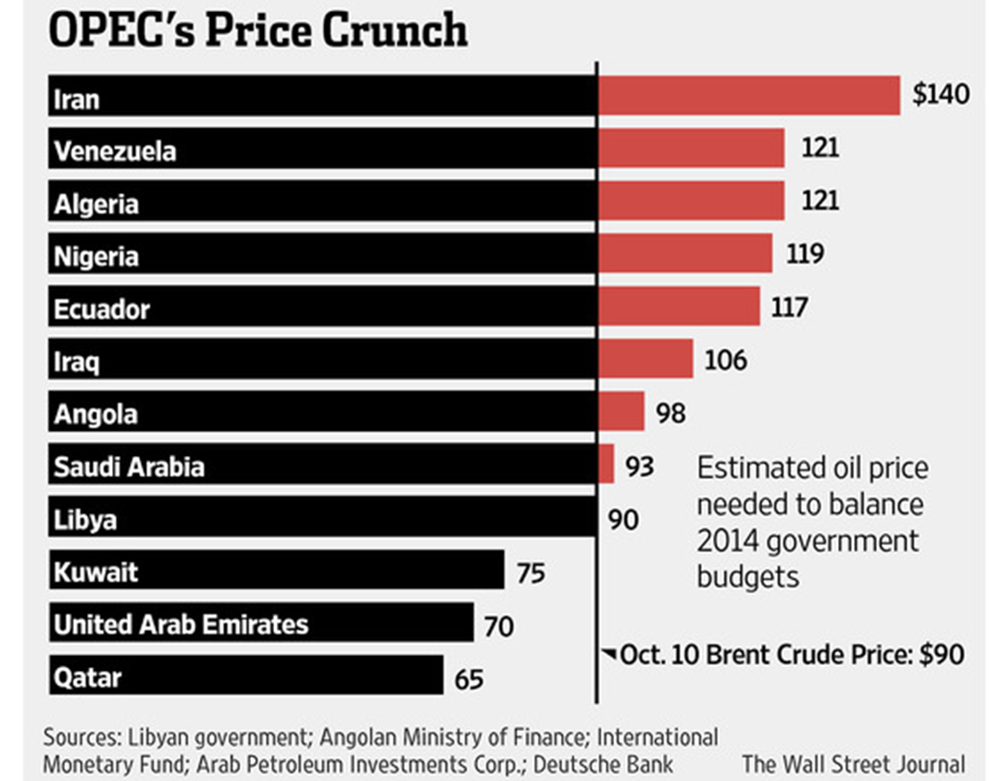

Slide 13
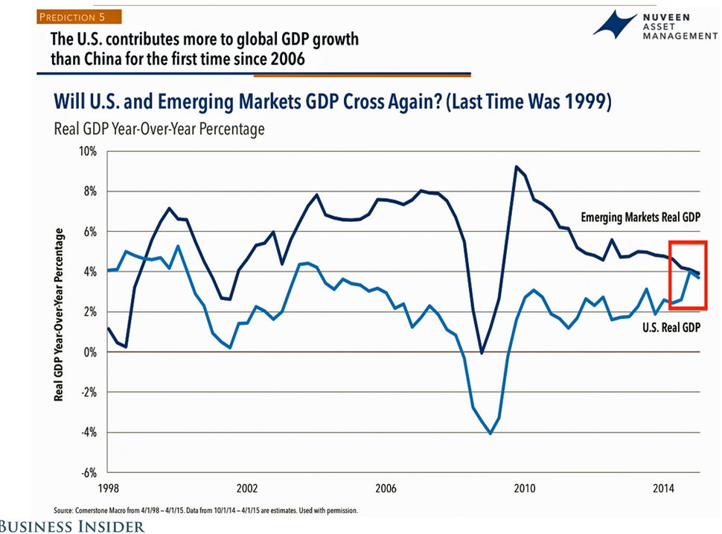
World-Economic Growth

Slide 14
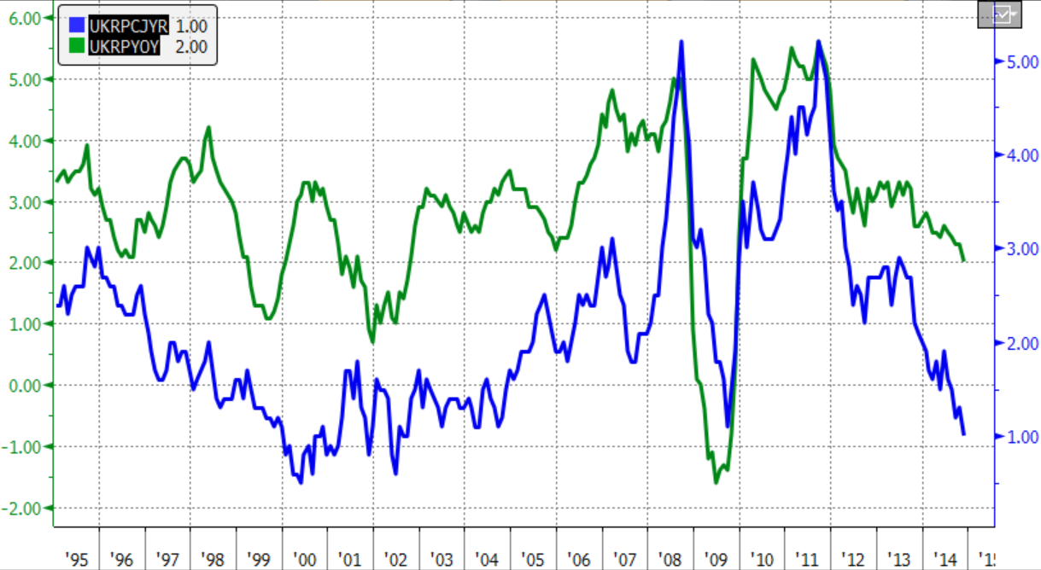
Country-UK-Inflation
UK CPI
UK RPI
Notes:
The CPI calculates the average price increase as a percentage for a basket of 700 different goods and services. Around the middle of each month it collects information on prices of these commodities from 120,000 different retailing outlets. Note that unlike the RPI, the CPI takes the geometric mean of prices to aggregate items at the lowest levels, instead of the arithmetic mean. This means that the CPI will generally be lower than the RPI. The rationale is that this accounts for the fact that consumers will buy less of something if its price goes up, and more if its price goes down; it also ensures that if prices go up and then revert to the previous level, the CPI also reverts to its previous level (which is not the case with the calculation method used for the RPI). According to the ONS, this difference in averaging method is the largest contributing factor to the differences between the RPI and the CPI.[3]
The change in the CPI over the 12 months to August 2008 was 4.7%, while the corresponding figure for RPIX (which excludes mortgage interest) was 5.2% and that for RPI (which includes mortgage interest) was 4.8%.[4] The CPI, the RPIX, and the RPI are published monthly by the Office for National Statistics. A history of CPI and RPIX going back to 1989 can be found at the Office for National Statistics website.[5]
There has been criticism of CPI as being a less effective measure of price rises than the Retail Prices Index, accusing it of being easier to manipulate and less broad based (for example excluding housing). John Redwood, the Conservative MP, has said that CPI targeting meant that interest rates were set lower at a time of rising (RPI) inflation.[6]

Slide 15
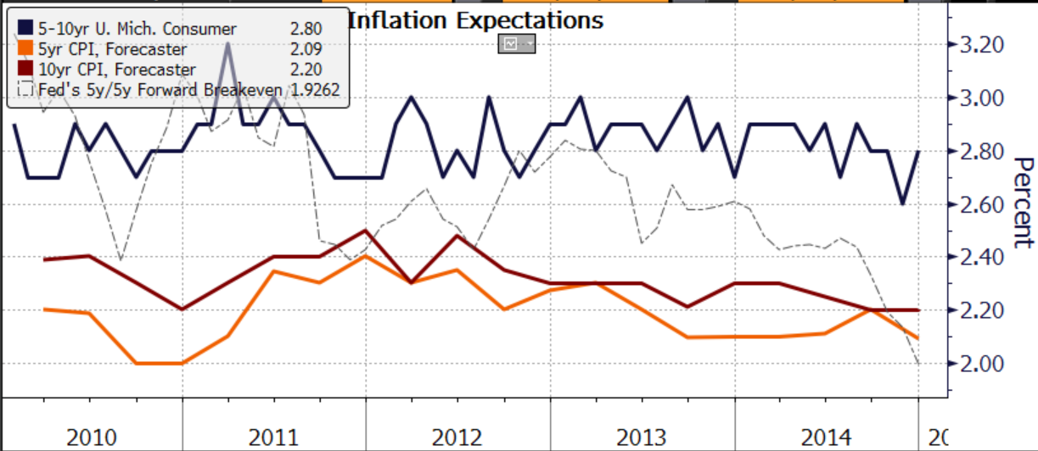
Country-USA-Inflation

Slide 16
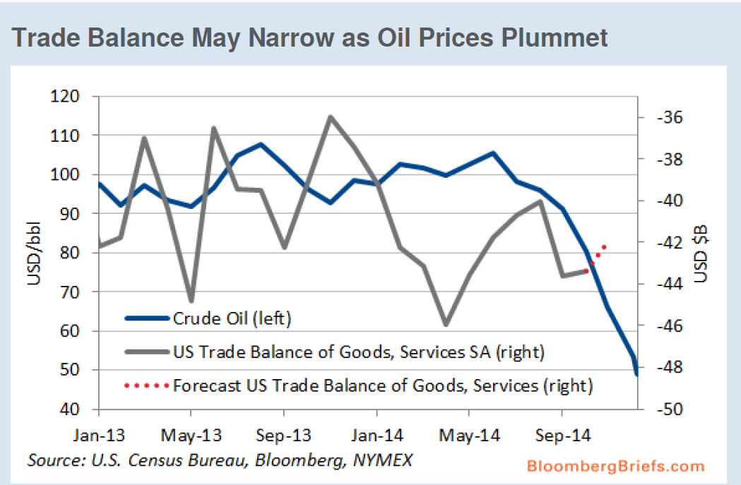
Country-USA-Trade Balance

Slide 17
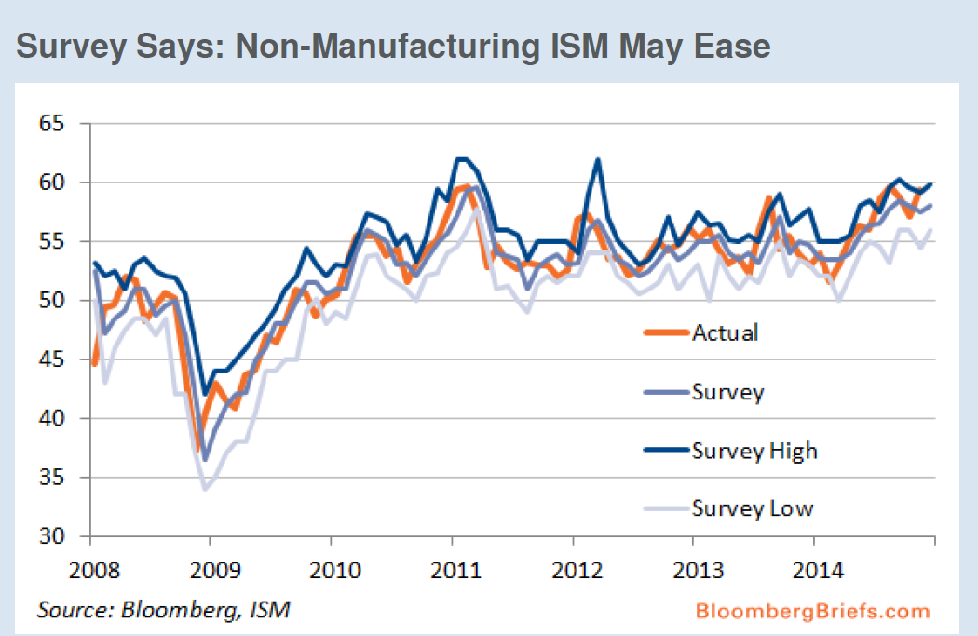
Country – USA –ISM Indicator

Slide 18
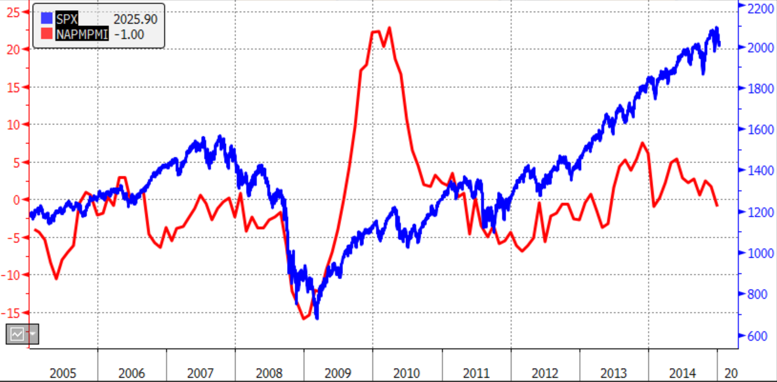
Country – USA – ISM-PMI Manu – S&P
US Equity – S&P 500 actual values
ISM – As reported
Notes:
A key feature of the PMI surveys is that they ask only for factual information. They are not surveys of opinions, intentions or expectations and the data therefore represent the closest[2] one can get to “hard data” without asking for actual figures from companies.[2]
Questions asked relate to key variables such as output, new orders, prices and employment. Questions take the form of up/down/same replies. For example, “Is your company’s output higher, the same or lower than one month ago?”[2]

Slide 19
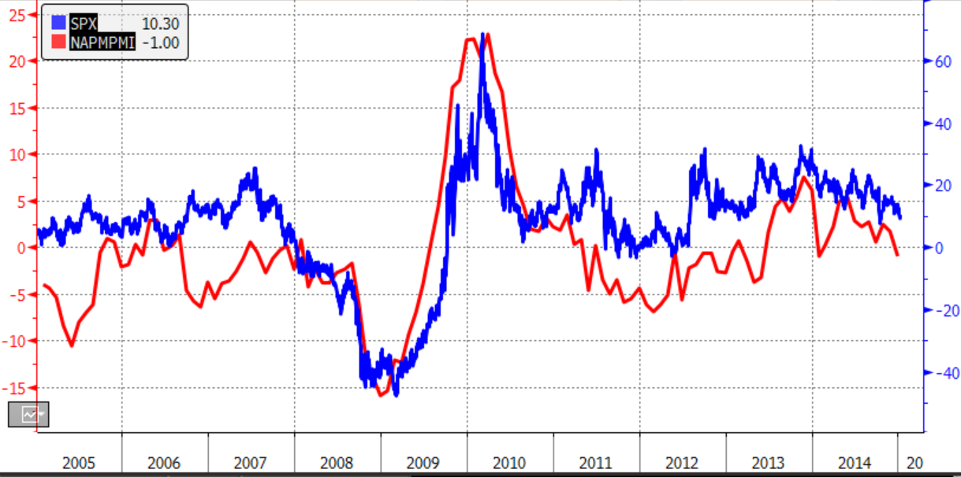
Country – USA – ISM-PMI Manu – S&P
US Equity – YoY% change
ISM – YoY difference

Slide 20
Issues – Oil – OPEC View

Slide 21
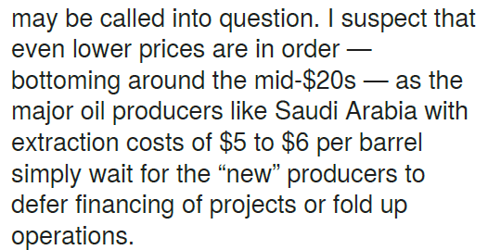
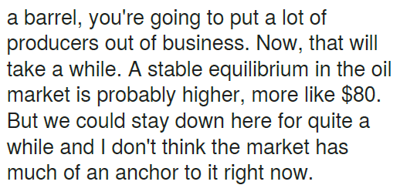
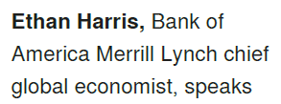
Issues-Oil-Forecasts
Mid $20 / barrel
2015 Jan 7
$80 / barrel after a while

Slide 22







Issues – QE - USA
FED says QE is temporary
  Means no permeant expansion of money base and hence no Friedman style inflation
  Method would be to NOT roll bonds at maturity
  Can only work if economy is growing such that Government can refinance FED debt purchase

Slide 23
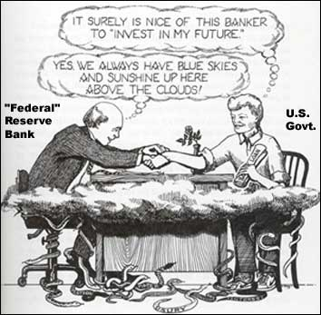
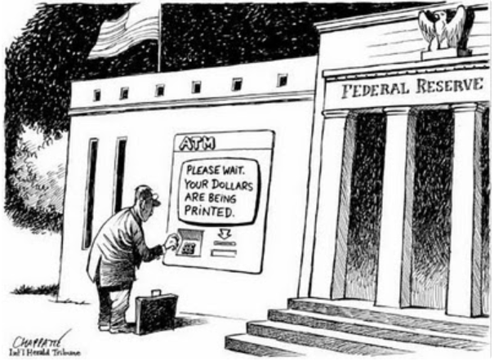
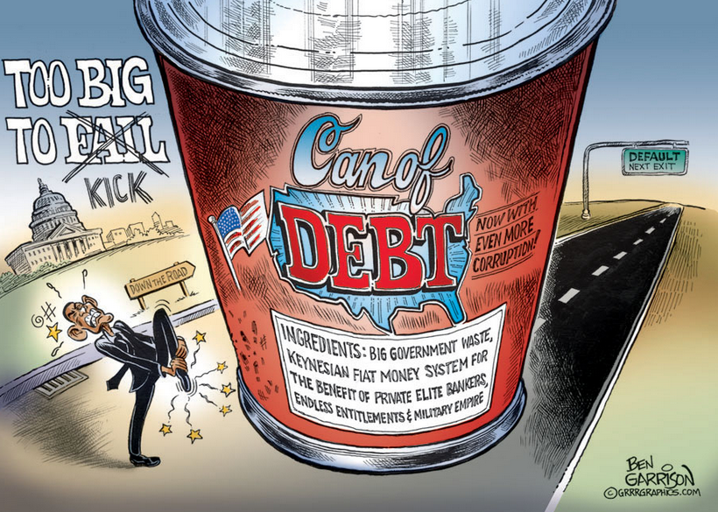
Issues – QE - USA

Slide 24
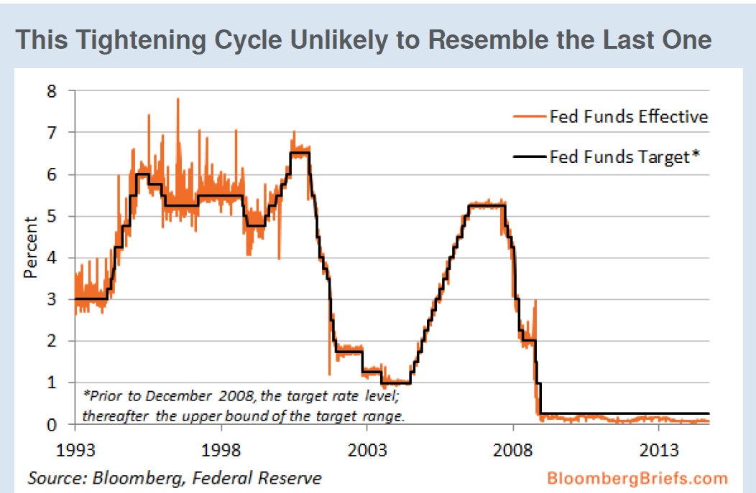
Issues – Interest Rates – USA FED

Slide 25
Issues – Interest Rates - ECB

