Slide 1
Where are we in the long-term
global market cycle,
and what can we look forward to?
David Fuller
Chairman, FT Money
The Caledonian Club Seminar
November 14, 2013

Slide 2
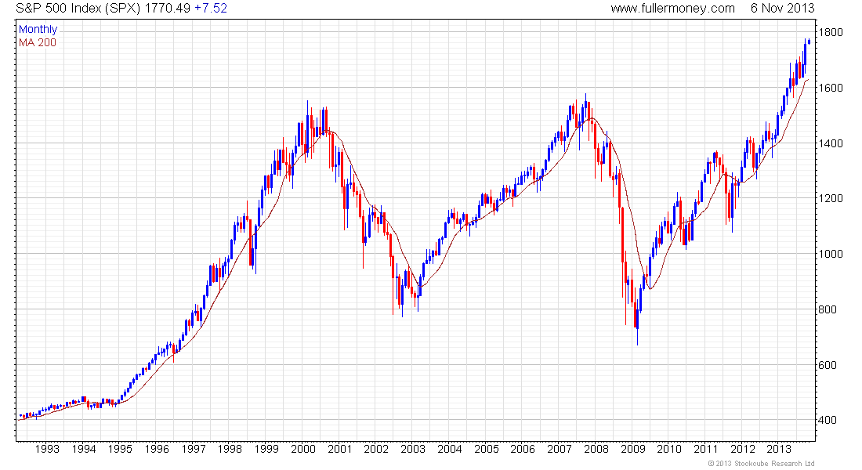
S&P 500 Index (monthly) 1993 - 2013
5-Year Bull
5-Year Bull
5-Year Bull

Slide 3
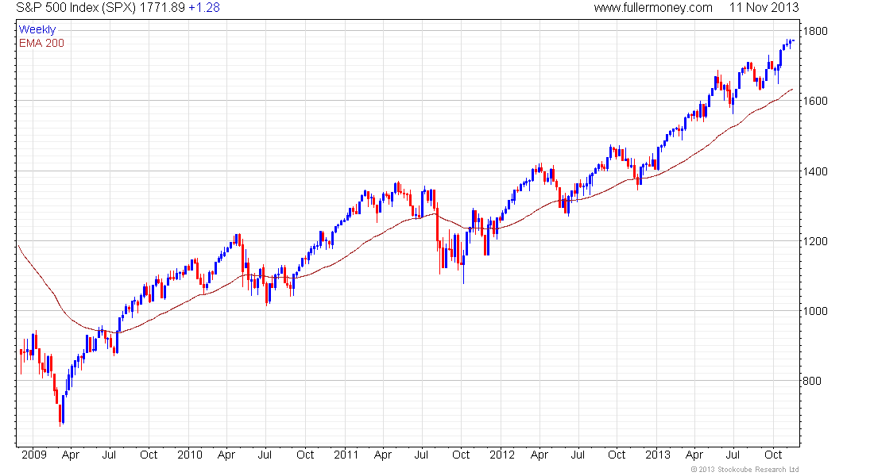
S&P 500 Index (weekly) 2009 - 2013
Not cheap at current
PER of 16.8
and Yield of 2%
Watch for a break in the sequence of higher reaction lows

Slide 4
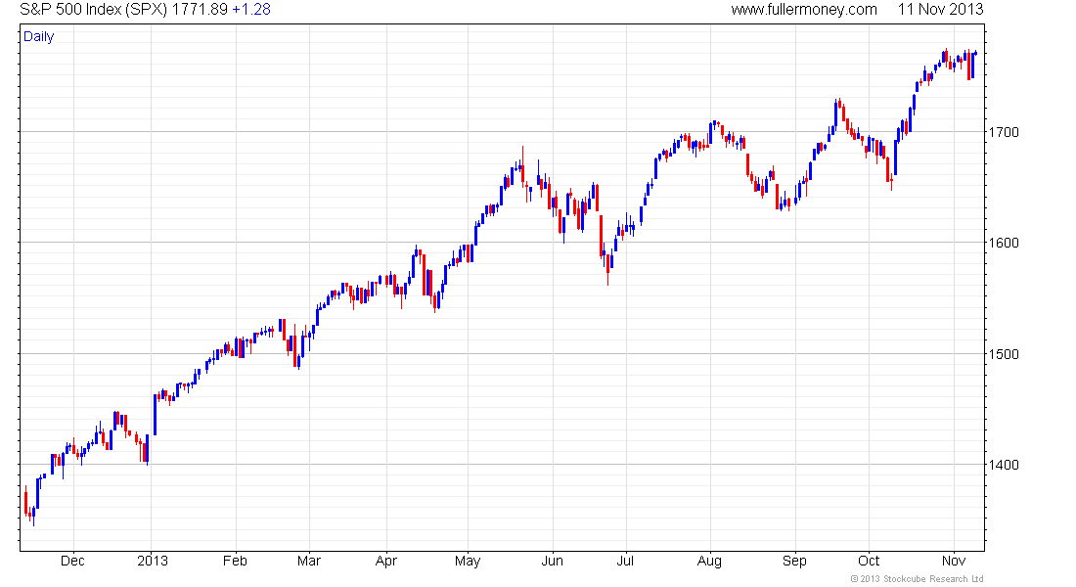
S&P 500 Index (daily) 1-Year
What are they saying here?
What was the crowd saying exactly a year ago?

Slide 5
OK, but where are we in the big cycle?
What is likely to happen in the next
10, 20 or 30 years?

Slide 6
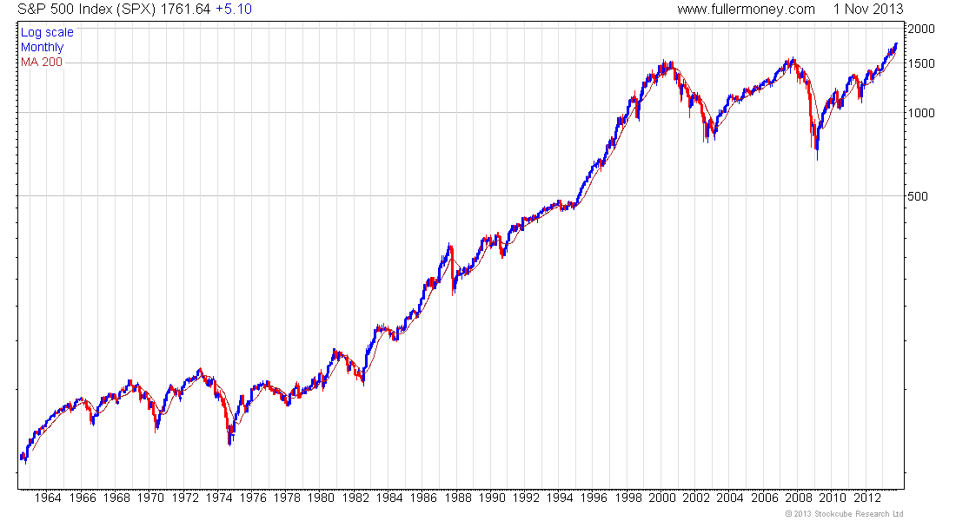
S&P 500 (monthly) 1963 – 2013
Wall Street will be the
biggest influence on
global stock market trends
Secular Bull Market
Valuation Contraction Cycle
Valuation Contraction Cycle

Slide 7
What will fuel the next secular bull market?
Accelerating technological innovation
Lower energy costs in real terms
Globalisation by capitalist economies
Corporate ‘Autonomies’
A rapidly increasing global middleclass

Slide 8
What could prevent or significantly delay the
next secular bull market, however unlikely?
Severe climate change
Nuclear war between superpowers
A doomsday asteroid collides with Earth
A global plague of catastrophic proportions
The rise of socialism due to unemployment

Slide 9
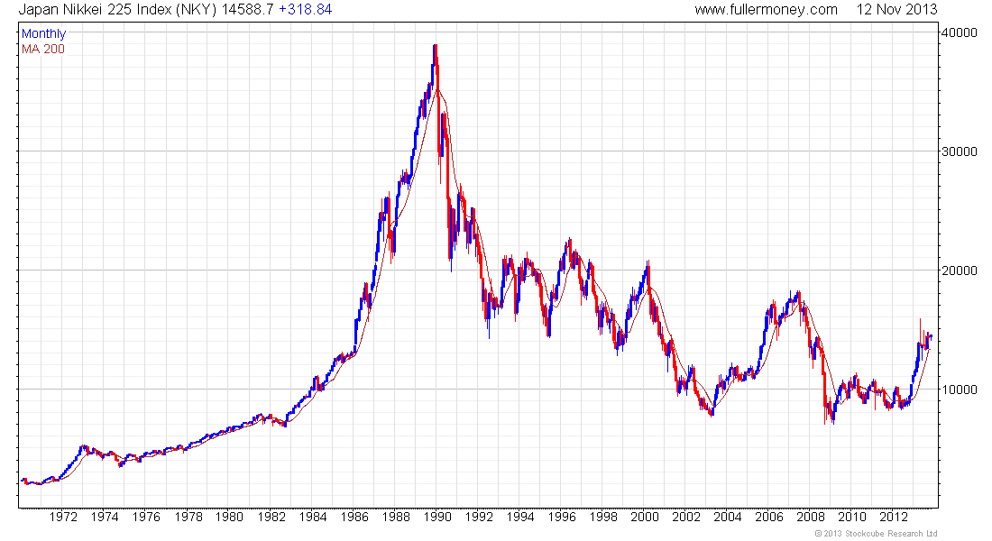
Japan’s Nikkei 225 (monthly) 1970 - 2013
Best developed economy
recovery candidate?
Potentially, subject to
governance
B

Slide 10
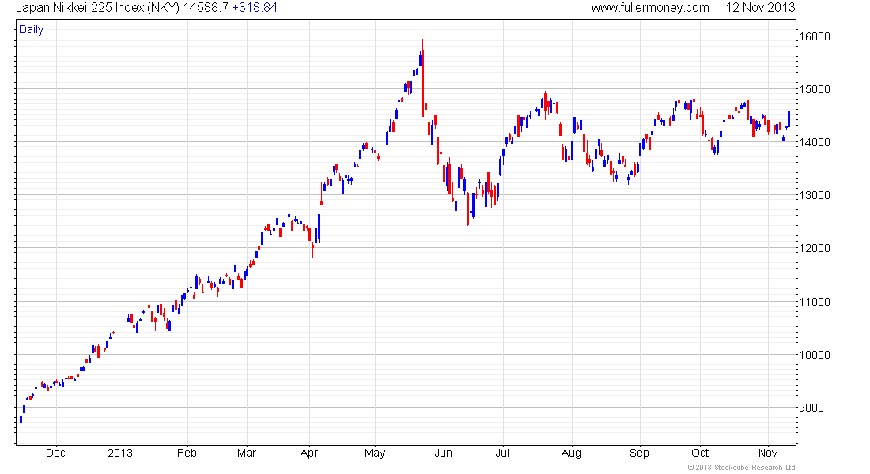
Japan’s Nikkei 225 over 1 year
A sustained break above
15,000 will reaffirm the
bull market recovery
Appeal – cheap at approx half the
S&P’s book value, and high tech
Risks – energy costs are too high,
and old style Japanese politics
if Shinzo Abe stumbles

Slide 11
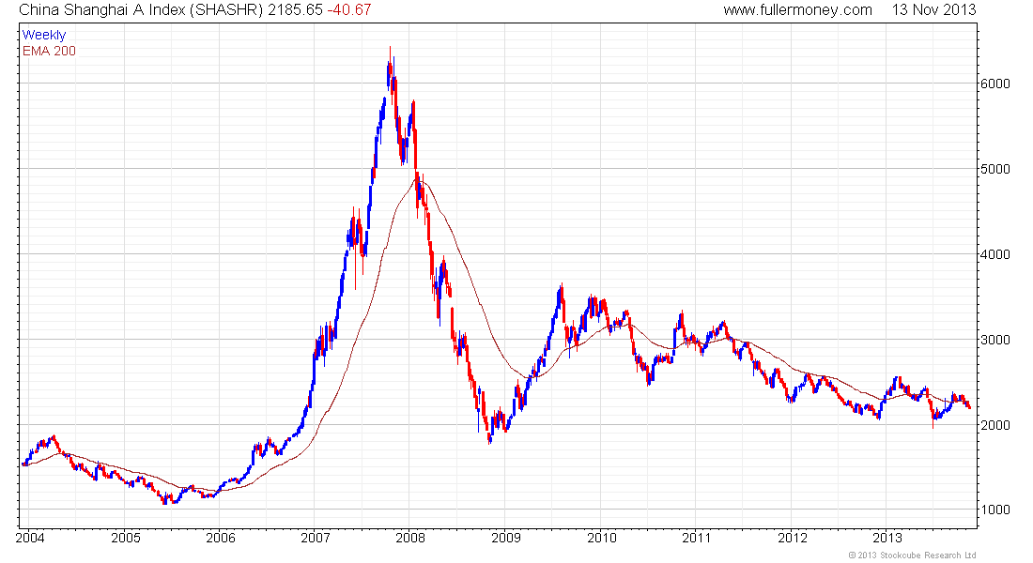
China Shanghai Index 2004 – 2013
Cheap relative to many
other markets at PER 10+
and Yield 3%, but dominated
by State controlled industries
and supply has been a problem

Slide 12
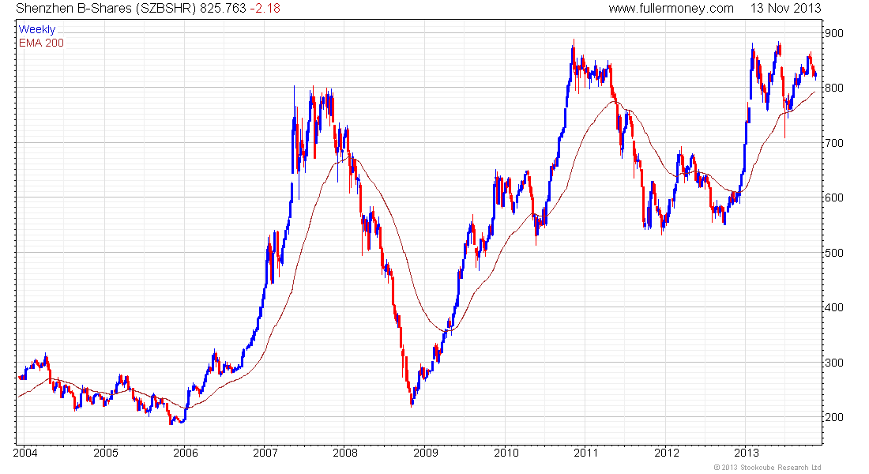
Shenzhen B-Shares 2004 – 2013
This Index has no State
shares and is therefore more representative of China’s private sector.
It is also relatively cheap
with a PER of 10.6 and
Yield of 2%.

Slide 13
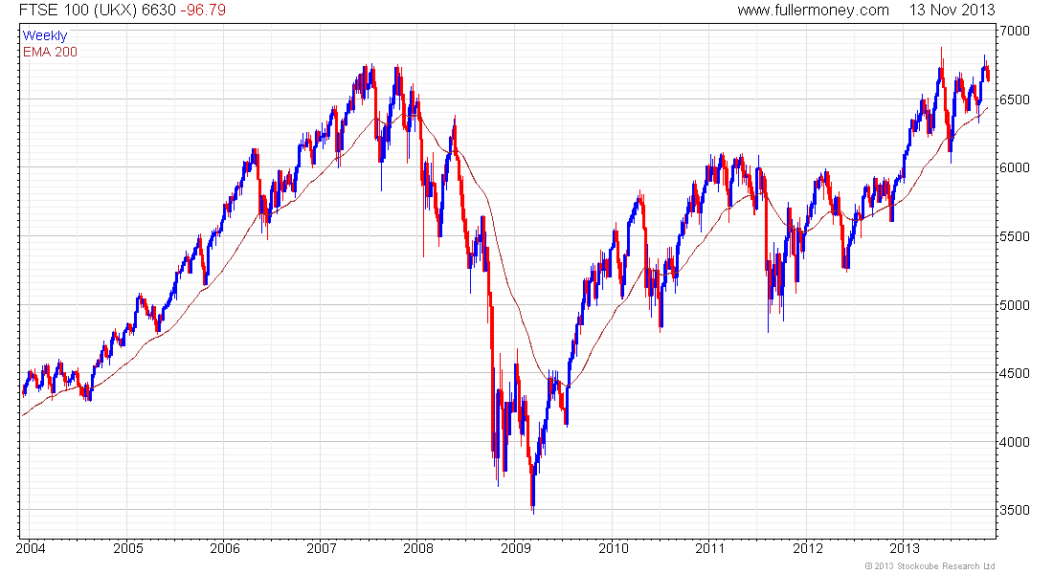
UK’s FTSE 100 2003 – 2013
Steady near historic highs,
PER 16.5 Yield 3.7%.

Slide 14
“We have Stone Age emotions. We have medieval institutions. And we have god-like technology.”
Edward O. Wilson
My view - Technology is the greatest testament to human intelligence. I think it will solve most of our problems and be the key driver of the next secular bull market, which should be underway before the end of this decade.

Slide 15
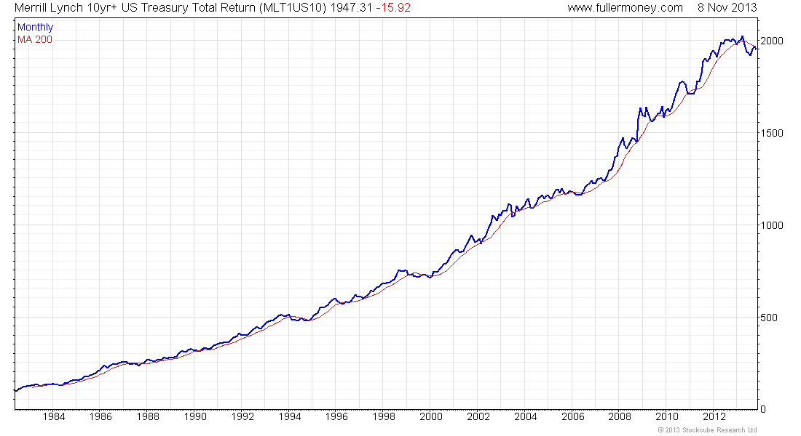
Merrill Lynch 10Yr Treasury Futures Total Return Index 1982 - 2013
This secular bull market is over, which means that a secular bear market has begun.

Slide 16
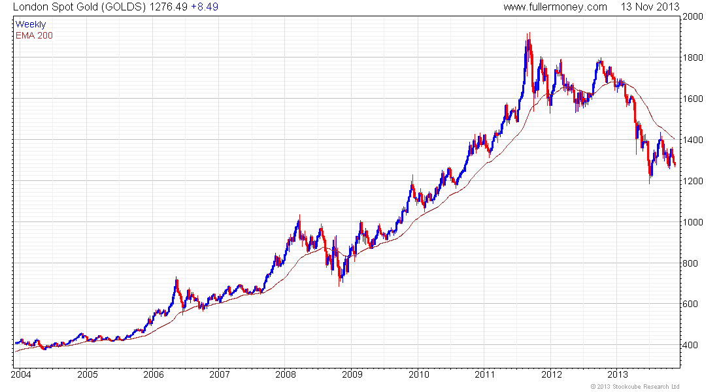
London Spot Gold 2004 - 2013
Possibly support building above $1180…? Needs
more evidence.
Possible support building
above $1180…? Needs
more evidence.

Slide 17
Thank you, and please visit the
Fullermoney Global Strategy Service
www.fullermoney.com
Which will shortly evolve into the
FT (for Fuller, Treacy) Money
Global Strategy Service
www.FTMoney.com

