Slide 1


Slide 2


Slide 3
The Contrary
Opinion Forum
Goes To L
Walter Deemer
October 2012

Slide 4
In Defense Of
Technical Analysis

Slide 5
Technical Analysis:
Why Is It Such A
Necessary Part Of The
Investment Process?

Slide 6
A Stock Is Not
The Same As
The Company!

Slide 7


Slide 8
And Investors
Buy Stocks –
Not Companies!

Slide 9
Stock Price Analysis –
Technical Analysis –
Is Thus The Most
Basic Part Of The
Investment Process

Slide 10
“The only reason to buy a stock
is to be able to sell it
to someone else later on
at a higher price.”

Slide 11
Secular
Valuation
Contractions

Slide 12
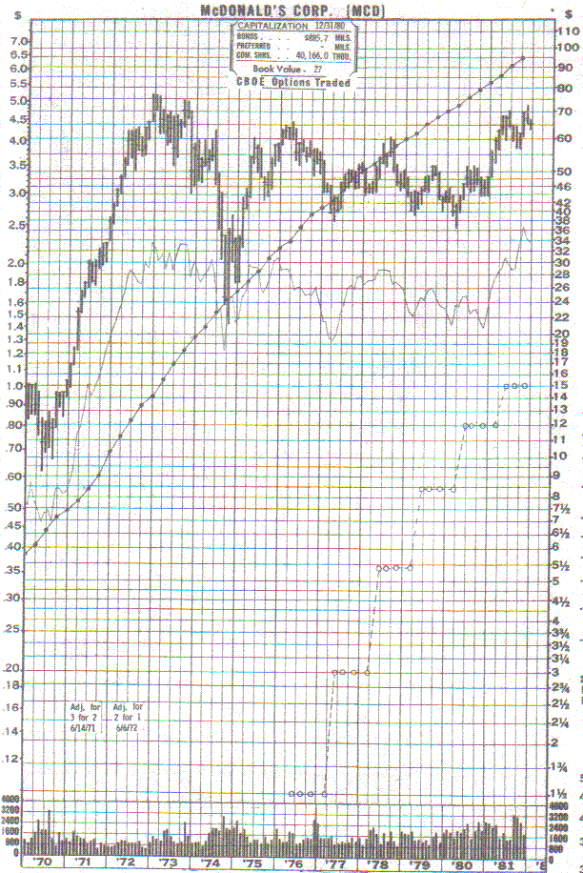

Slide 13
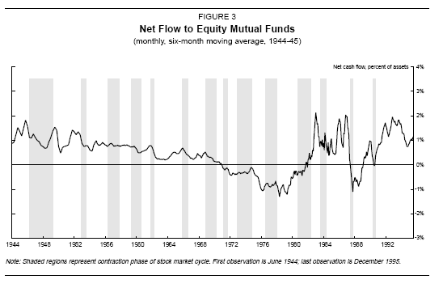

Slide 14
My Life
In Books

Slide 15


Slide 16
