Slide 1
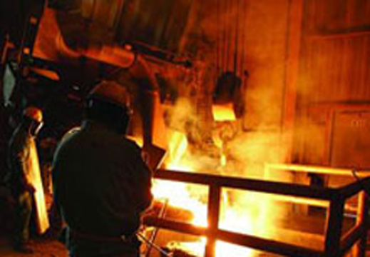
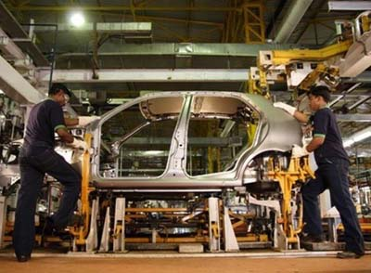



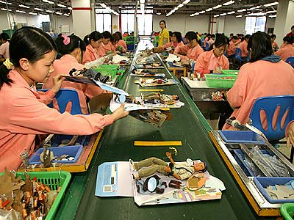
Global Growth
Whose Global?

Slide 2
USA in very wide light blue
In the 1990s the USA grew similar to other countries
But in the 2000s the USA sees a lost decade due to no growth in Industrial Production . A very different view was held by many “emerging” economies.

