Slide 1
The Markets Now
Investment Strategies Before the
‘Sweet Spot’ Ends
David Fuller – 7th July 2014
fullertreacymoney.com
East India Club – 16 St. James Square
London SW1Y 4LH, UK

Slide 2
At this stage of the stock market cycle, I favour laggards
as they come into form

Slide 3
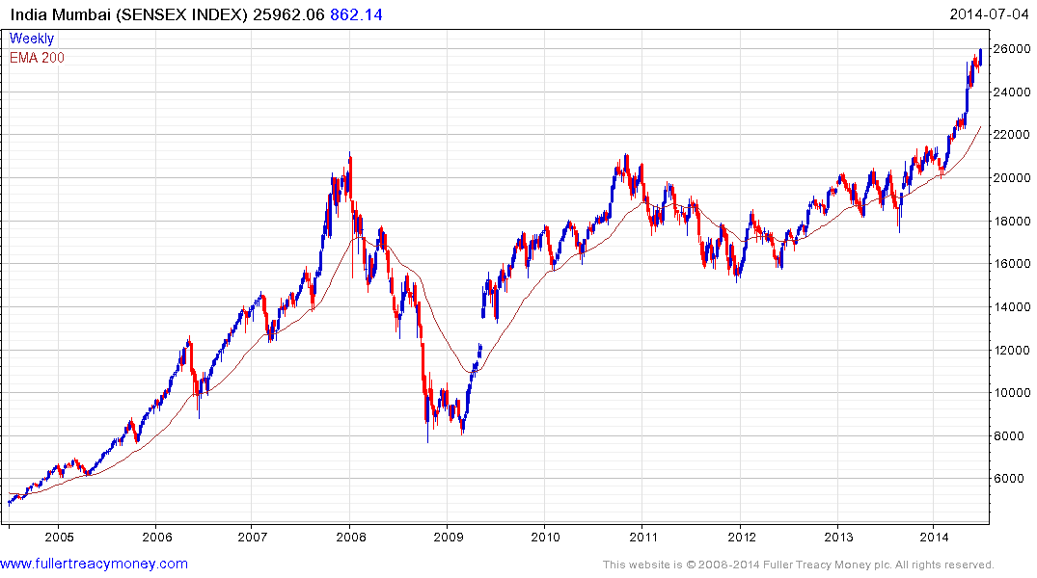

Slide 4
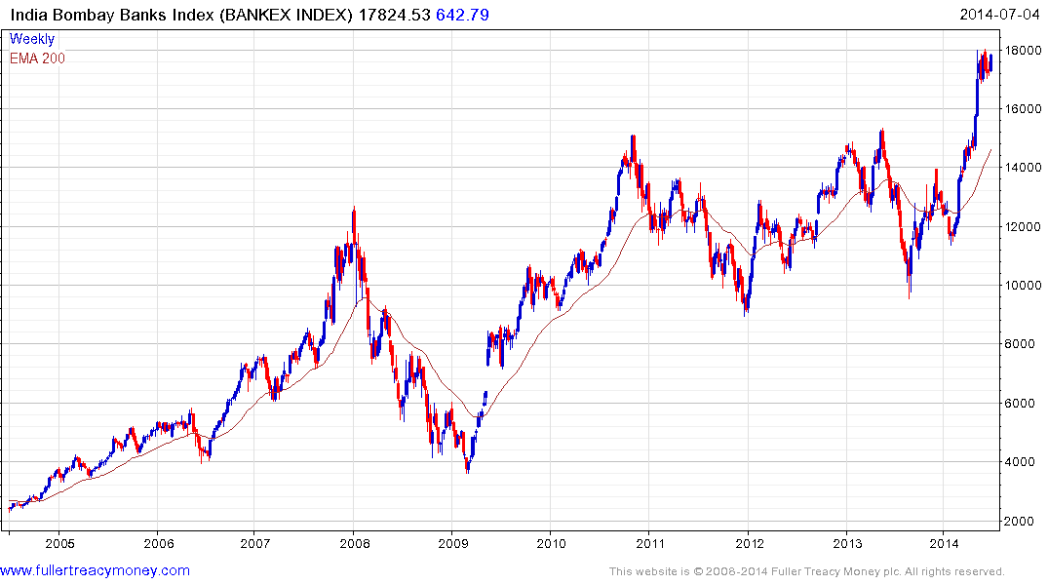

Slide 5
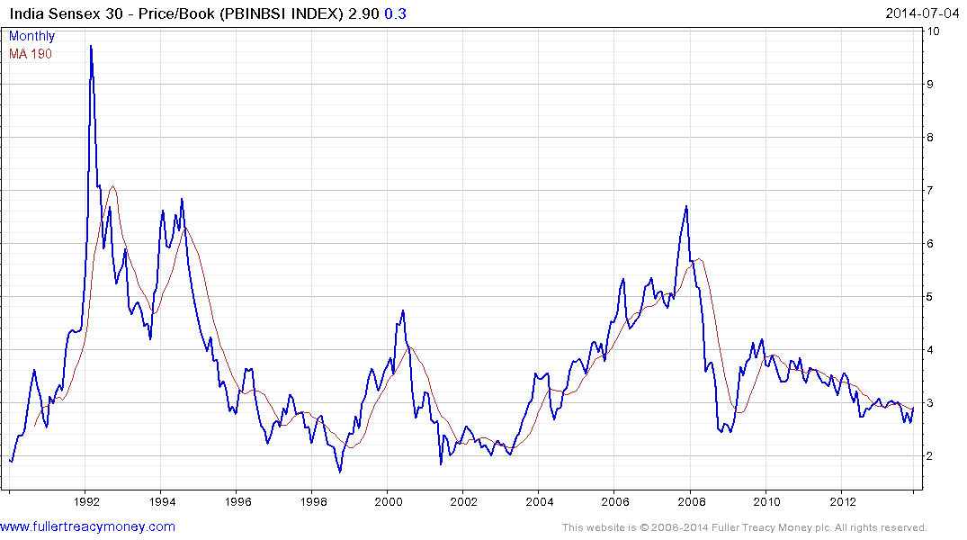

Slide 6
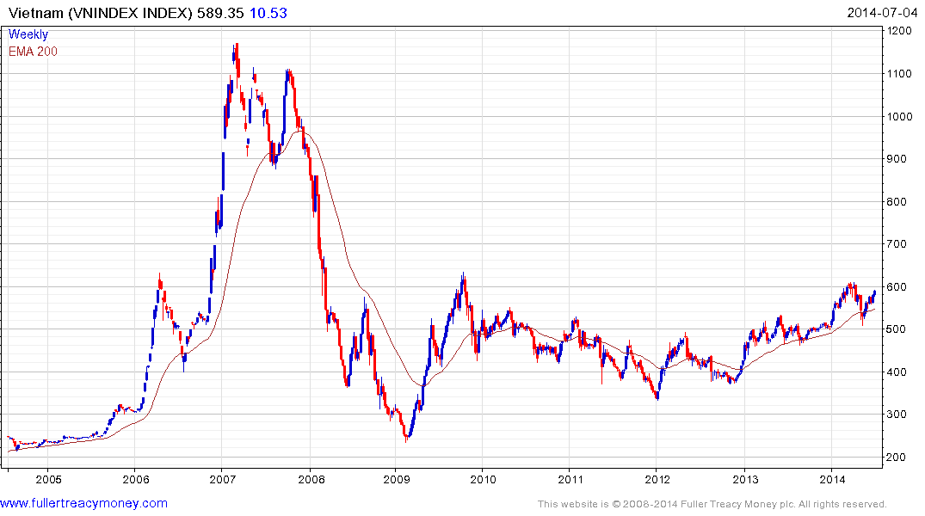
Biggest risk?
China

Slide 7
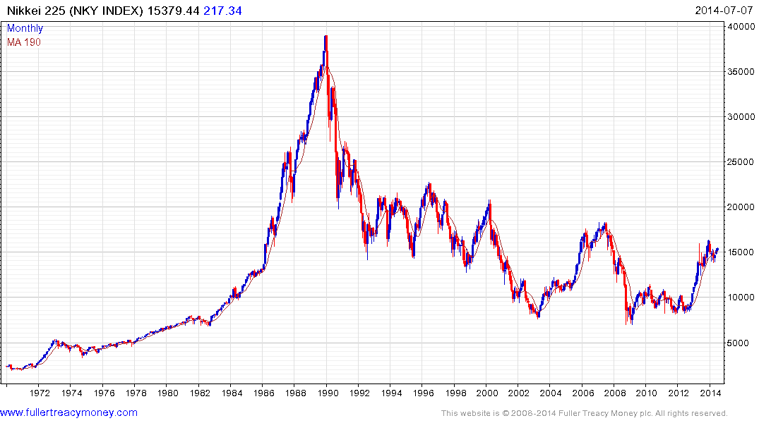

Slide 8
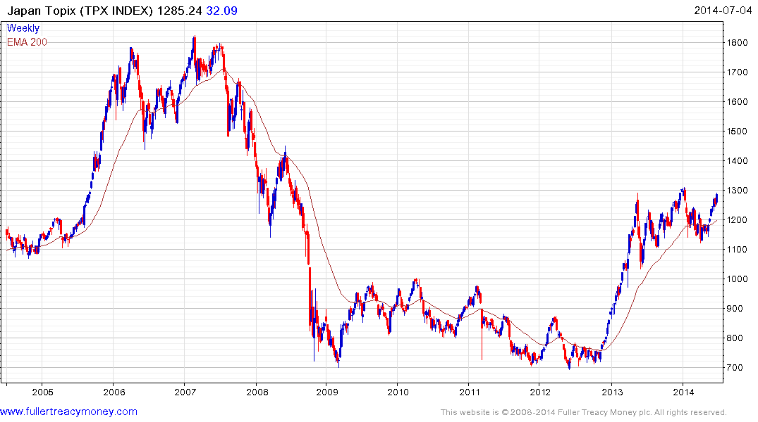

Slide 9
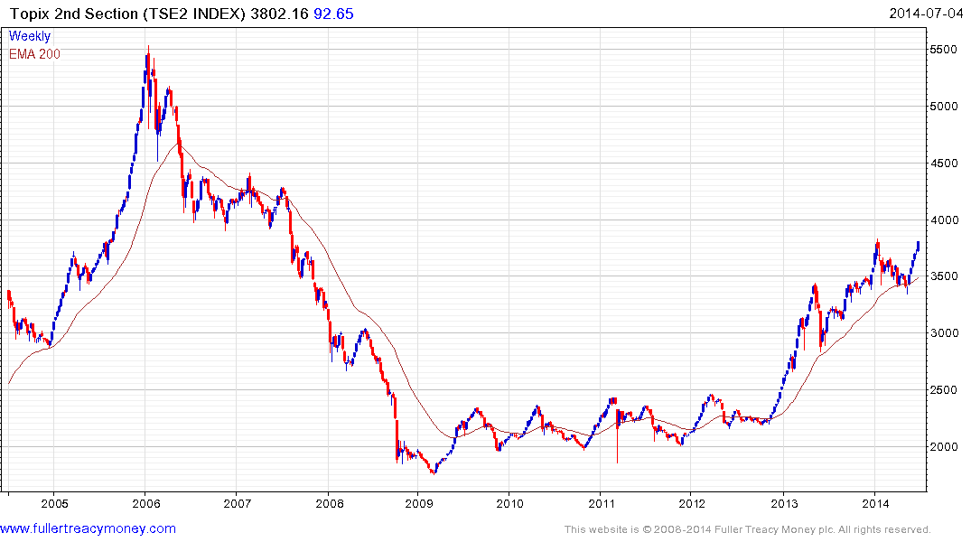

Slide 10
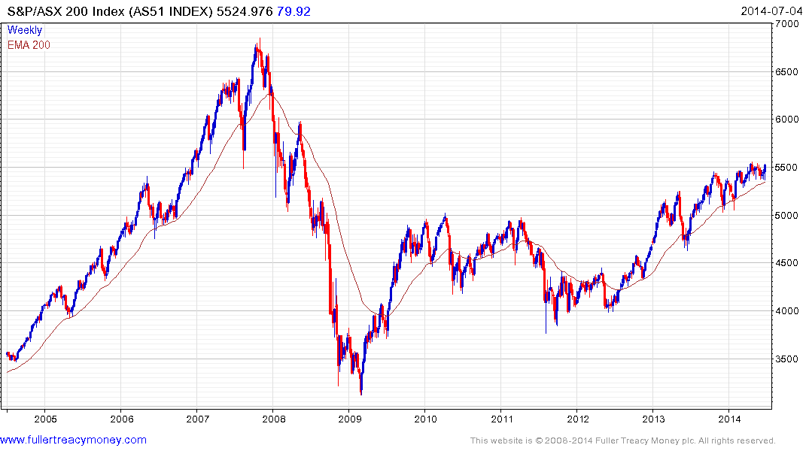

Slide 11
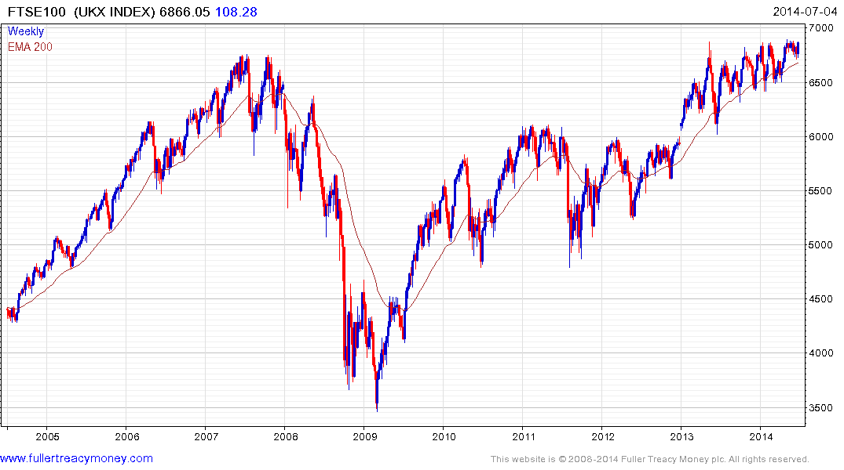

Slide 12
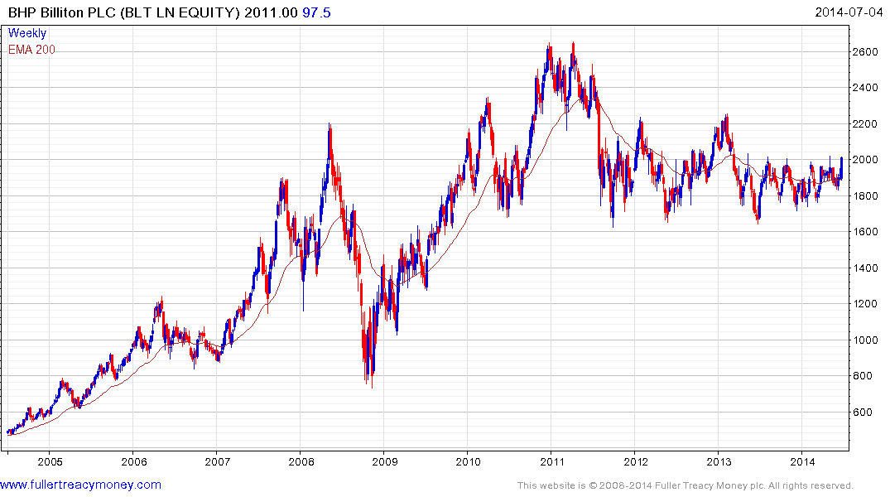

Slide 13
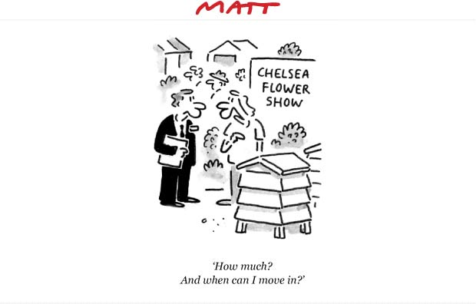

Slide 14
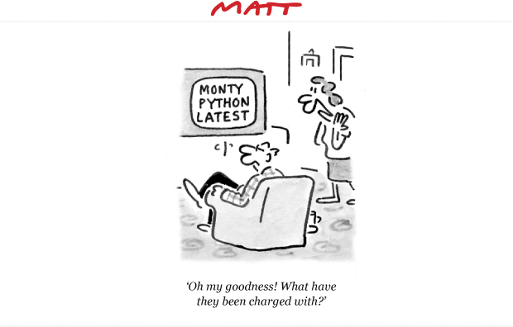

Slide 15
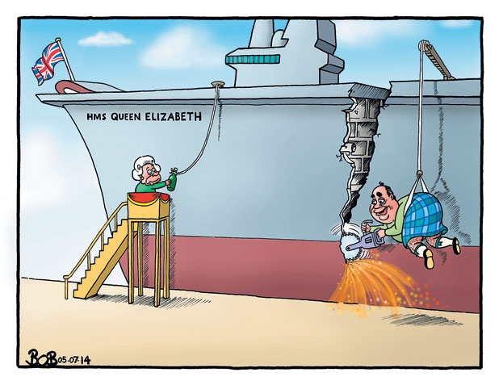

Slide 16
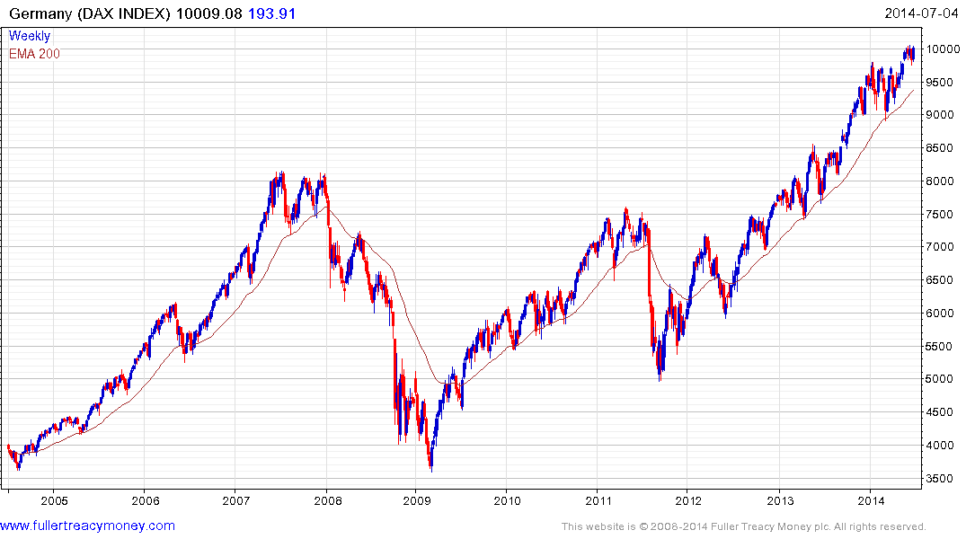

Slide 17
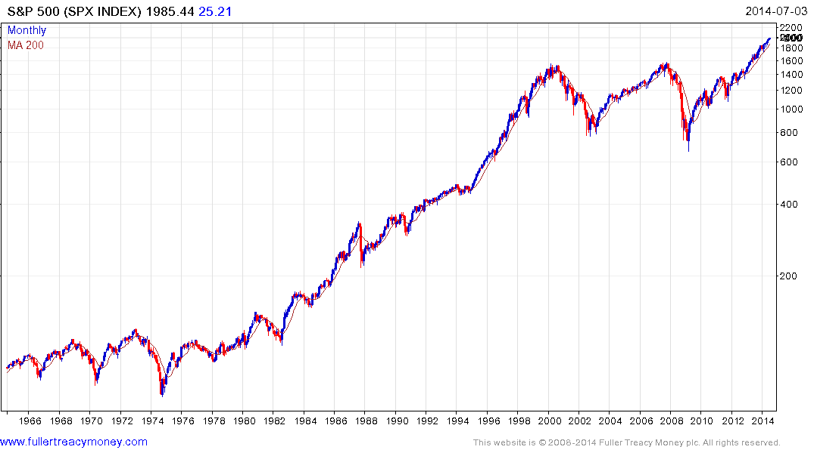
Is Wall Street’s
next secular bull
market underway?

Slide 18
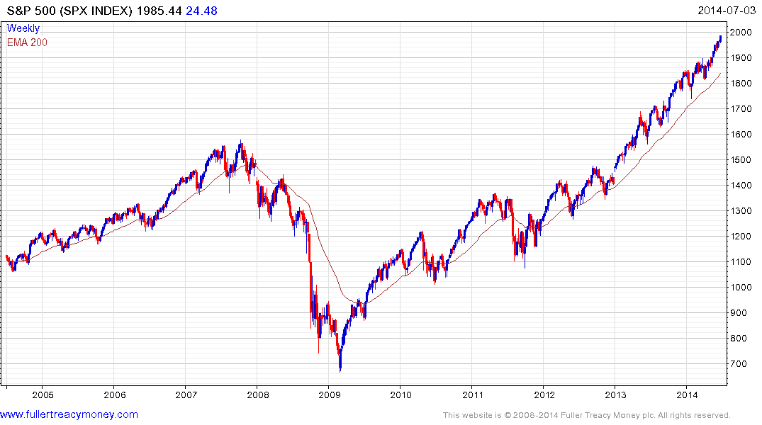

Slide 19
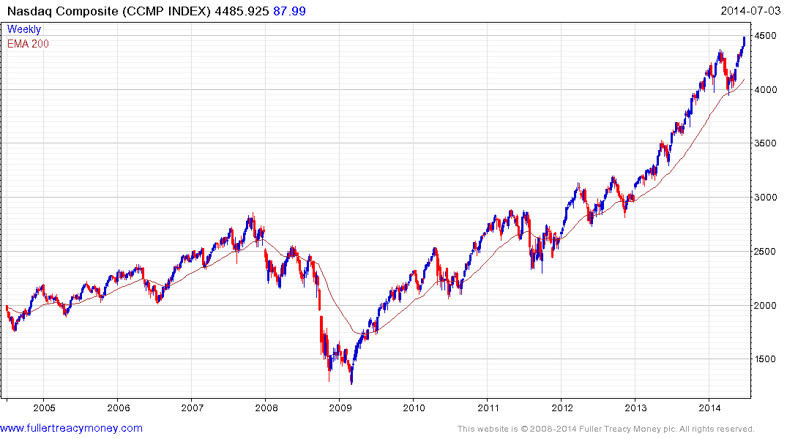

Slide 20
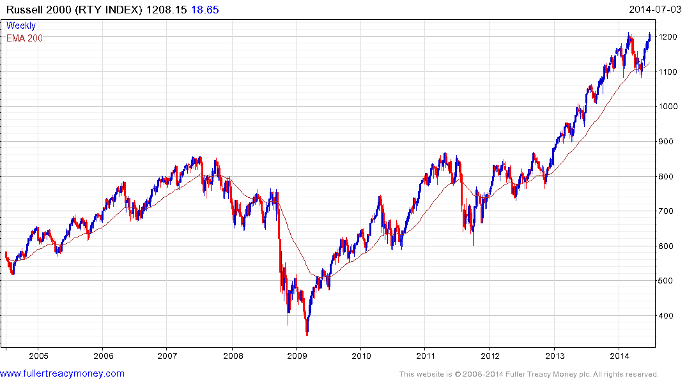

Slide 21
What could end Wall Street’s bull run?

Slide 22
What could end Wall Street’s bull run?
A spike in the price of Brent Crude oil
A surge in US 10-Yr Government Bond Yields
An exogenous shock to the financial system

Slide 23
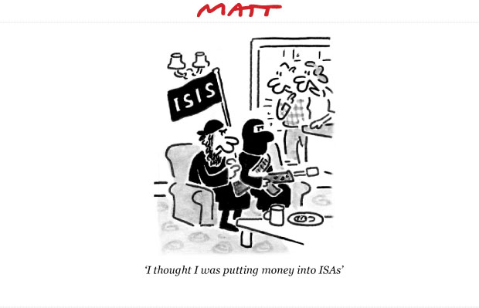

Slide 24
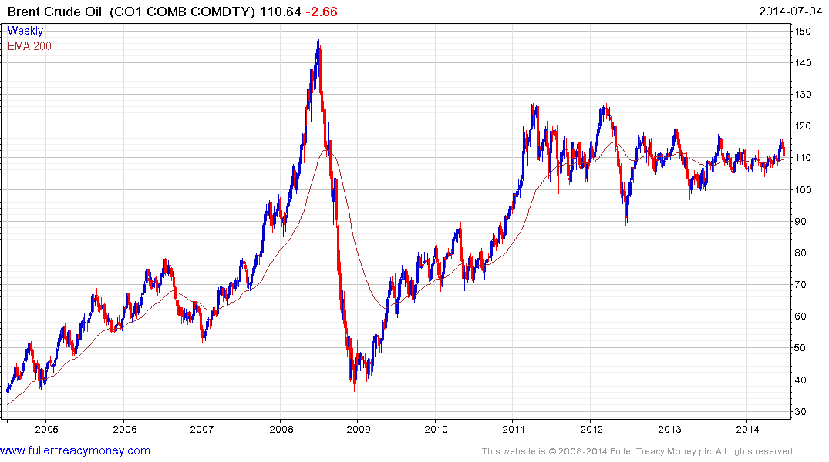

Slide 25
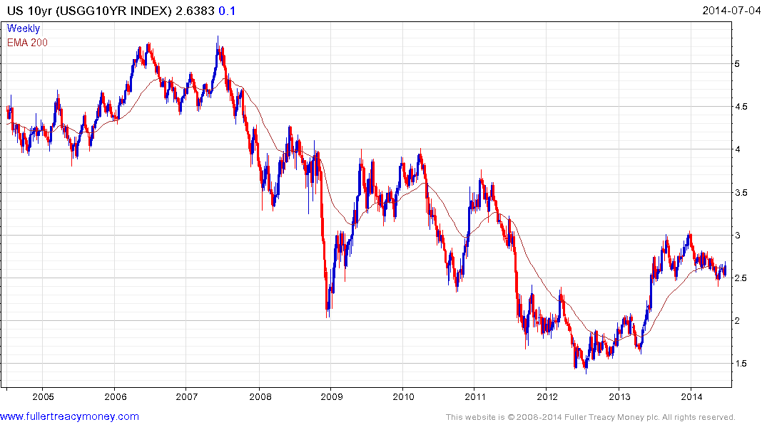
Warning levels

Slide 26
What about precious metals?

Slide 27
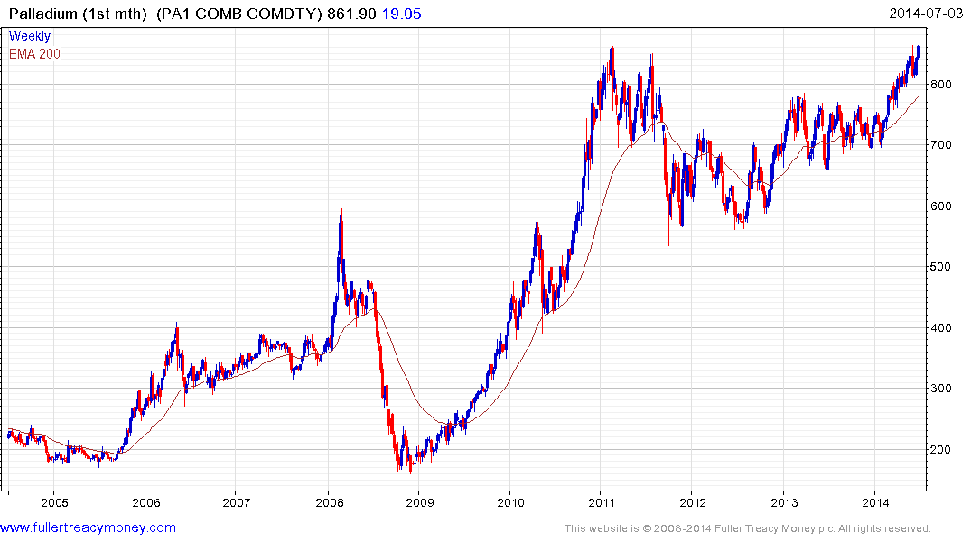

Slide 28
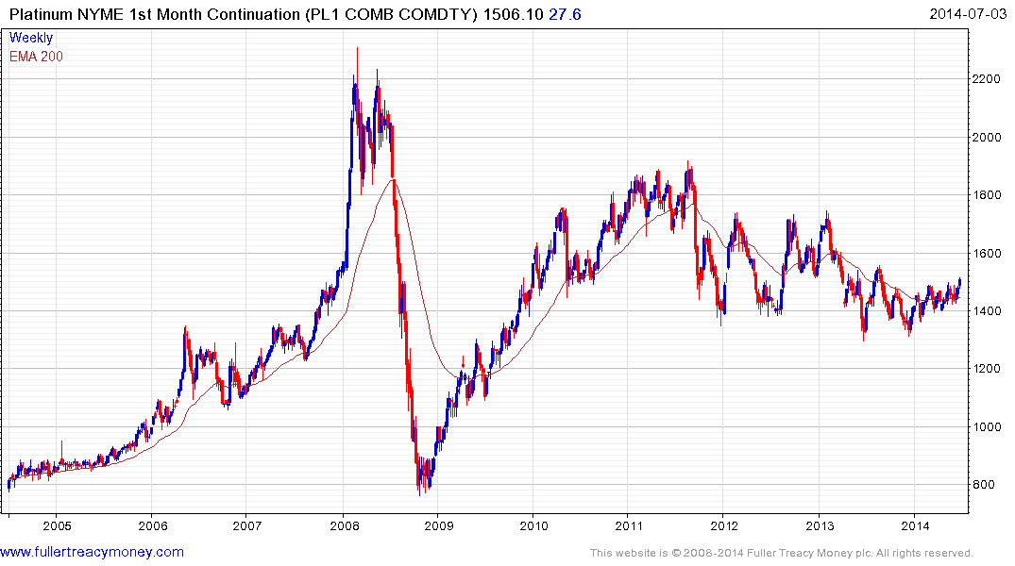

Slide 29
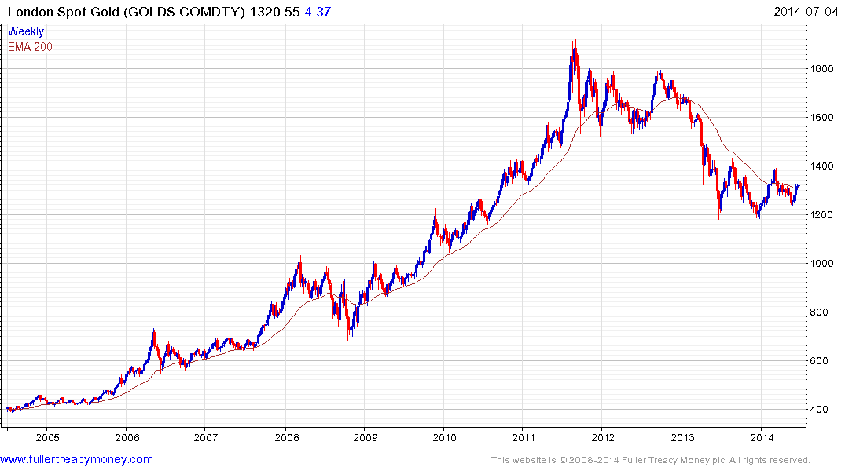

Slide 30
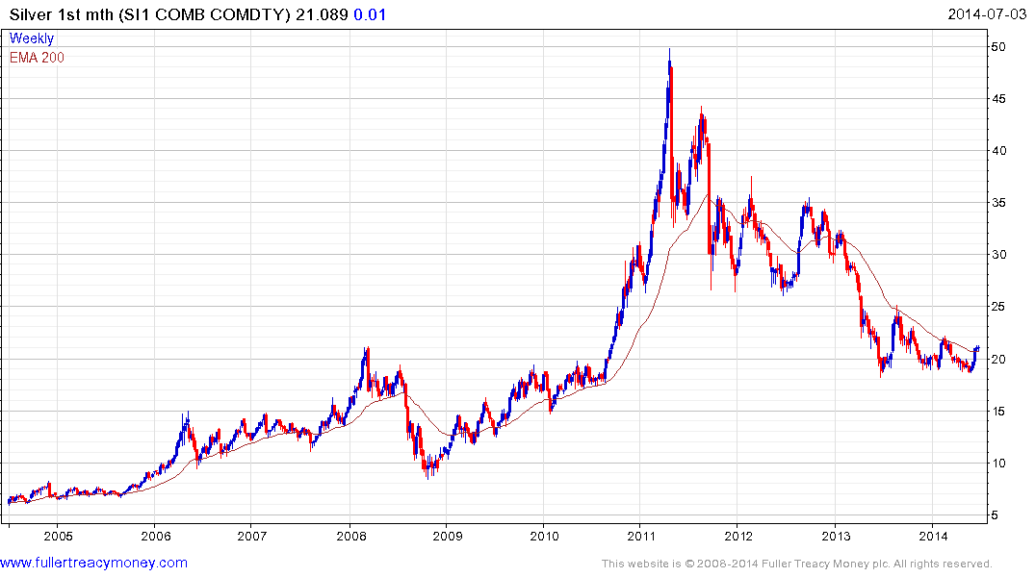

Slide 31
Many thanks for your interest!
Any more questions?
Please visit our site:
www.fullertreacymoney.com

Slide 32
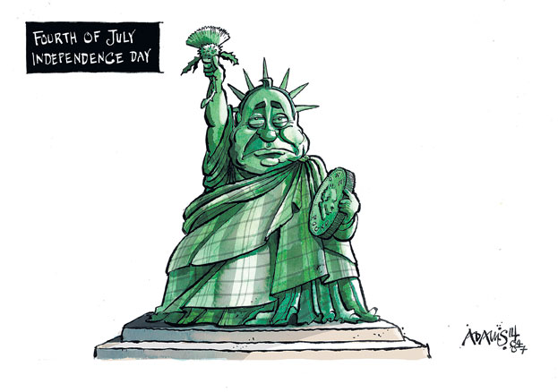

Slide 33


Slide 34
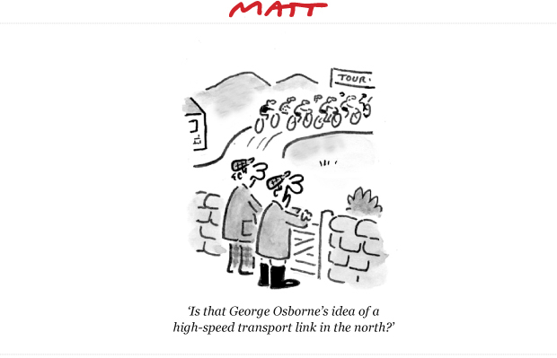

Slide 35
