Slide 1
The Markets Now
“Buy on the cannons, sell on the trumpets”
Attributed to Nathan Mayer Rothschild (1777-1836) in 1810
“Buy when there’s blood in the streets, even if the blood is your own”
Attributed to Baron Rothschild, cited in Passport to Profits, by Mark Mobius
“Be fearful when others are greedy, and be greedy when others are fearful”
Warren Buffett
David Fuller – 28th September 2015
fullertreacymoney.com
East India Club – 16 St. James Square
London SW1Y 4LH, UK

Slide 2
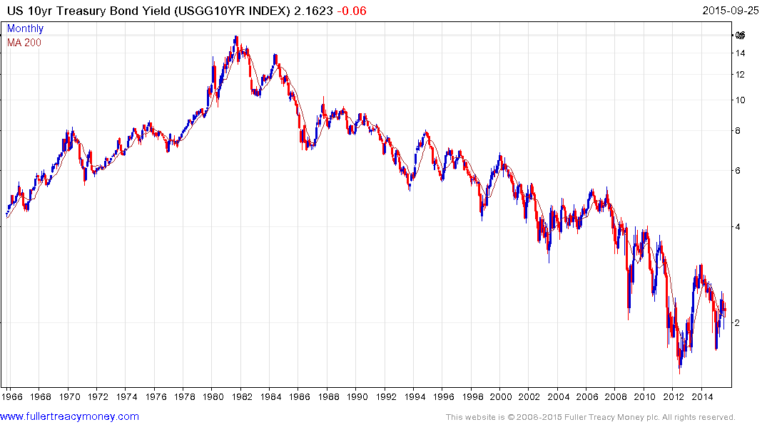
10-Year T-Bond
US T-Bond bull market by yield
extended by credit crisis recession and QE
Is sentiment among T-Bond investors
more reminiscent of trumpets or cannon?

Slide 3
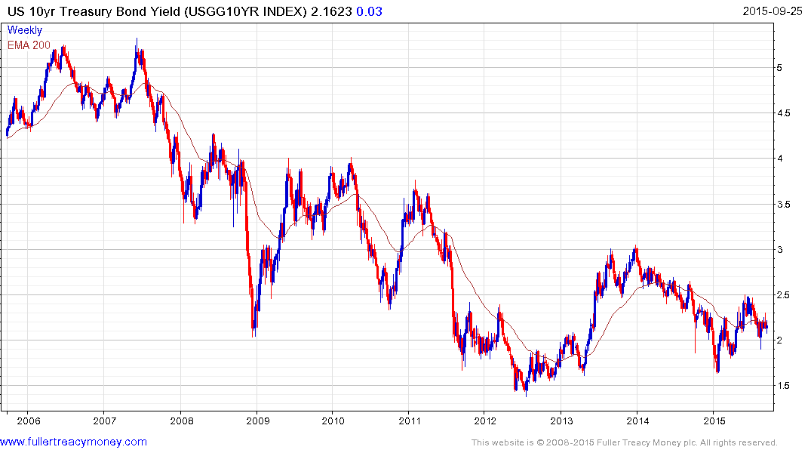
10-Yr T-Bond over last 10 years
Difficult question: does this chart show any recognisable
long-term pattern(s)?

Slide 4
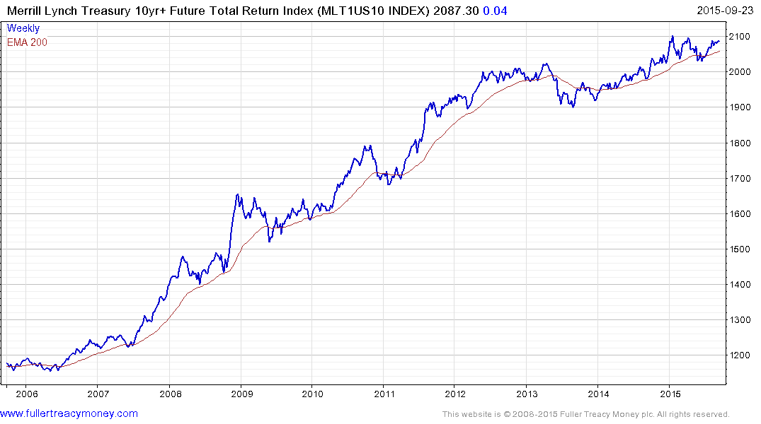
Total return
Needs sustained move above 2100
to reaffirm uptrend
Needs sustained move above 2100
to reaffirm uptrend
What might happen to bond
investor sentiment if / when
the last important low is broken?

Slide 5
Global stock markets
1) Just experiencing a correction?
2) From a correction to cyclical bear markets?
3) Cyclical to significant bear markets?
4) The seasonal period of underperformance, on
average, is between May and the end of October
5) US Presidential Election year usually ends on a
bullish note

Slide 6
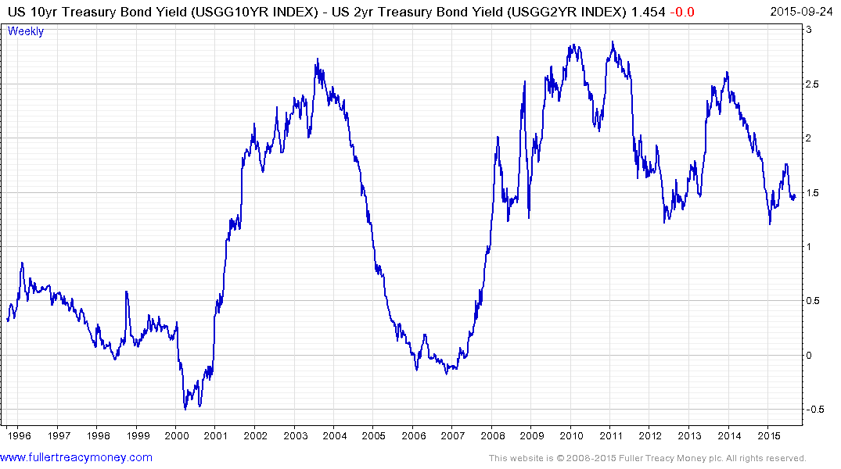
US Yield Curve
Yield curve over 20 years
CB-created bear market danger zone below zero
However, there is clearly a loss of form by indices

Slide 7
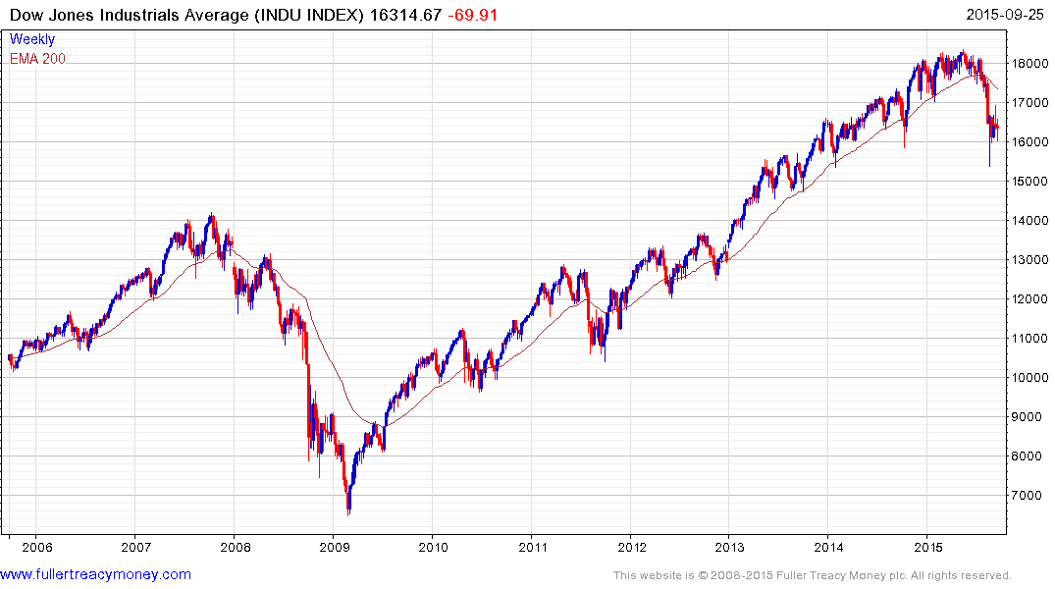
DJIA (p/e 14.23 & yield 2.62%)
First 10% plus correction
in 5 years

Slide 8
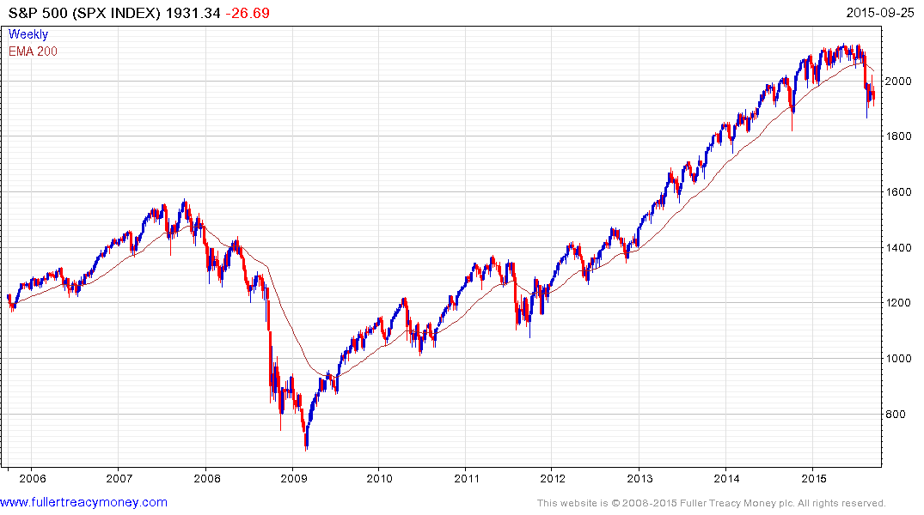
SPX (17.07 & yield 2.24%)
A climactic low occurred
on 24th September, which
is still holding for US Indices

Slide 9
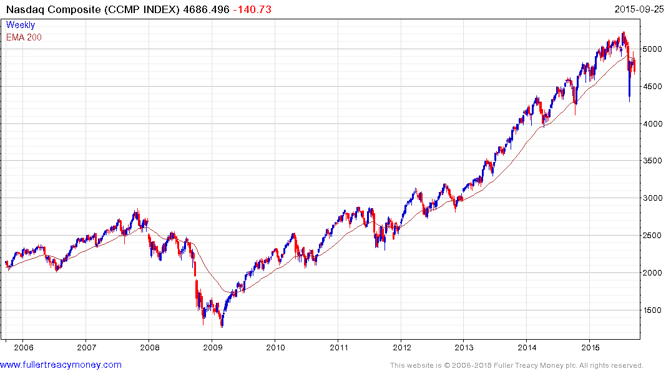
CCMP (p/e 26.59 & yield 1.32%)
24/08
Broken uptrend
but still showing
relative strength

Slide 10
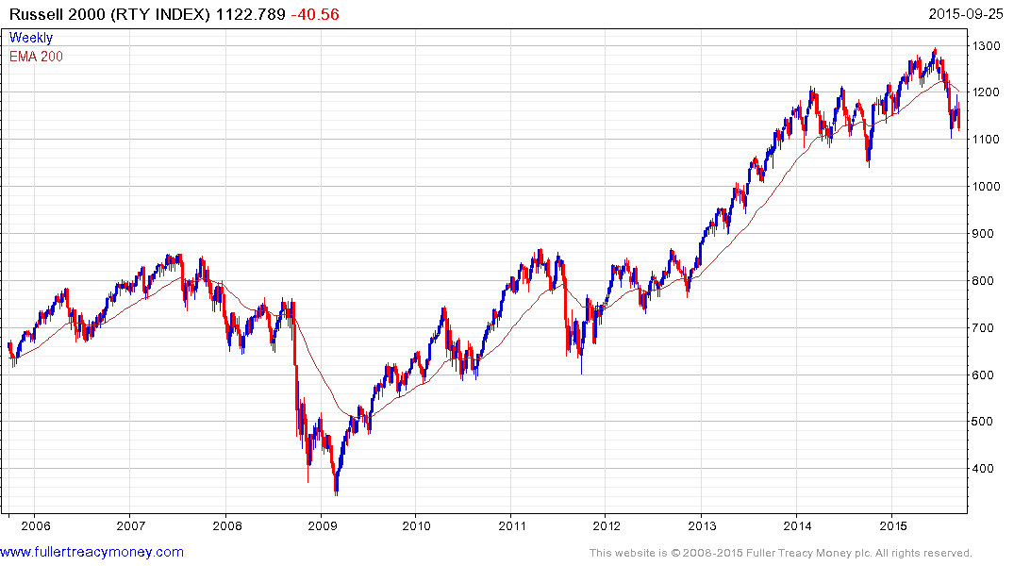
RTY (p/e 18.67 & yield 1.62%)
Unable to maintain year’s
earlier improvement and
close to 24/08 low

Slide 11
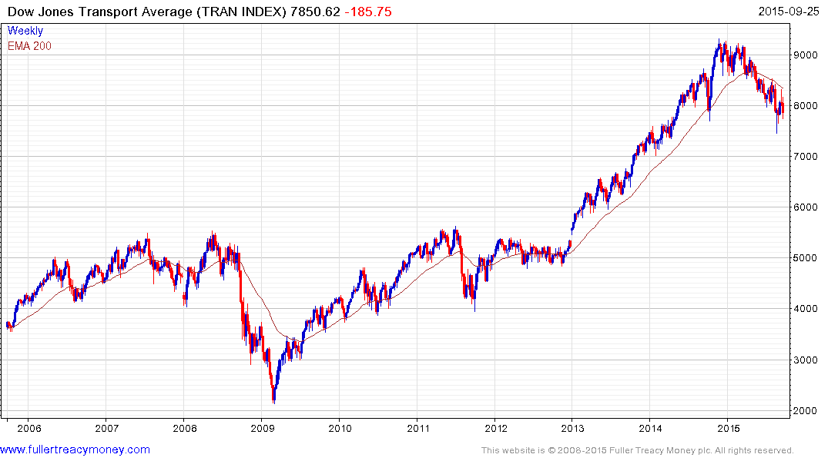
Early weakness
peaking on 28/11
2014
TRAN (p/e 15.48 & yield 1.45%)
And still in
downtrend

Slide 12
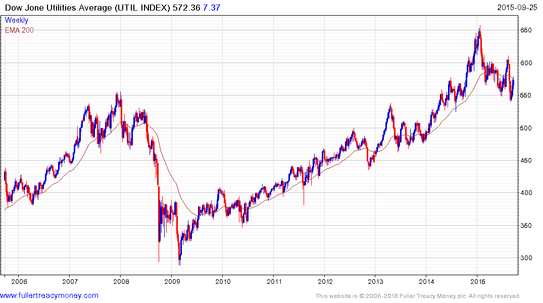
Early weakness
peaking on 28/01
2015
UTIL (p/e 15.46 & yield 3.71%)
Held just above climactic
low on 24/08

Slide 13
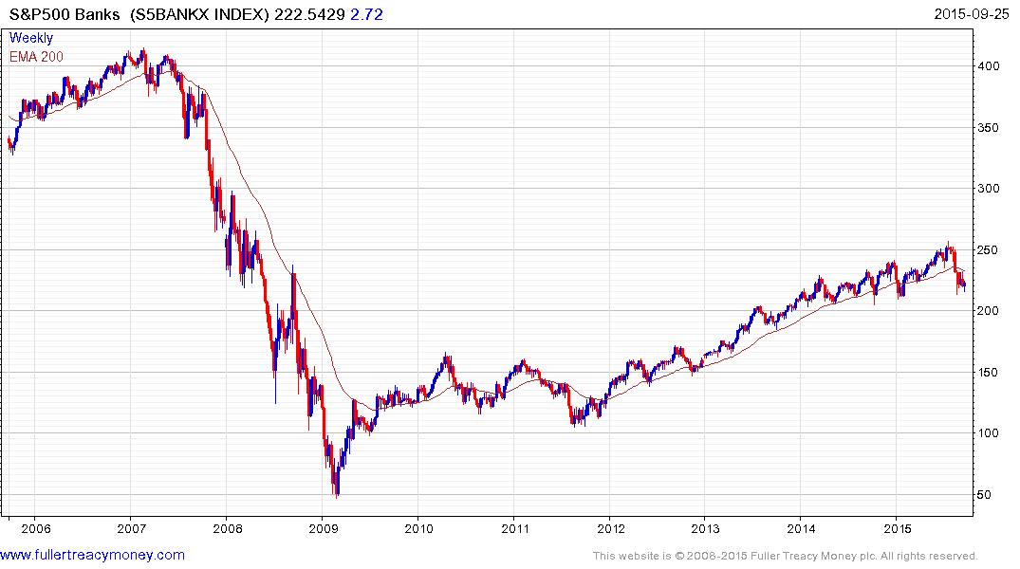
S&P500 Banks
S5BANKX (p/e 11.24 & yield 2.04%)
Just above 24/8
climactic low

Slide 14
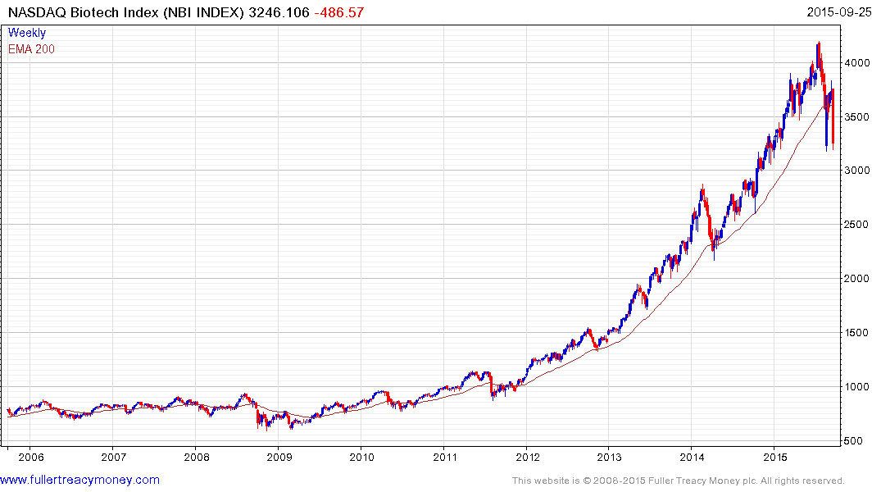
NASDAQ Biotech Index
NBI (p/e 65.48 & yield 0.30%)
Leading upside performer
clear break of uptrend still
unwinding high valuations

Slide 15
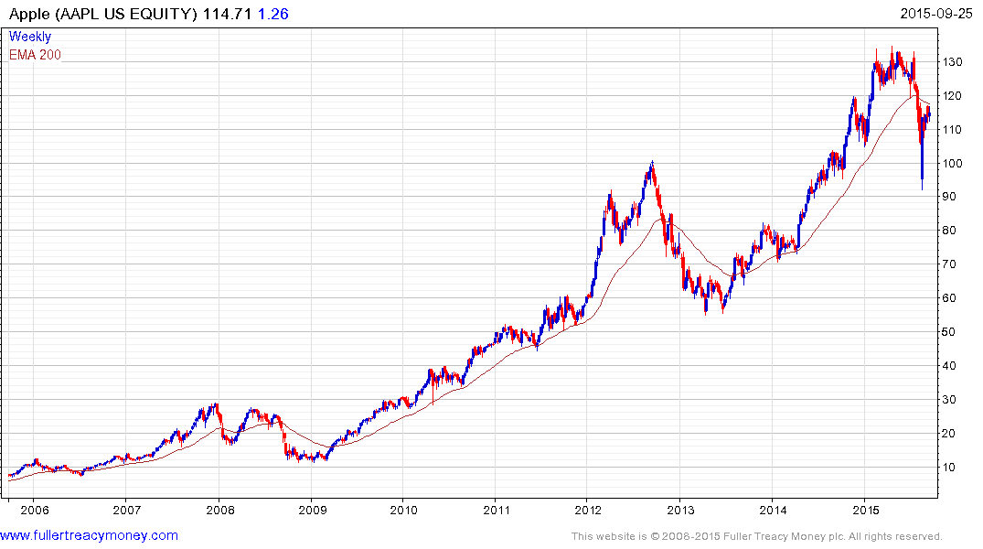
Iconic Apple est (p/e 12.55 & yield 1.81%)
Well above 24/8 climactic low

Slide 16
Asia Pacific
China – forever more the big elephant in the room
India – a candidate for top GDP growth while led by Narendra Modi
Most other Asian Pacific economies remain heavily dependent on exports to China

Slide 17
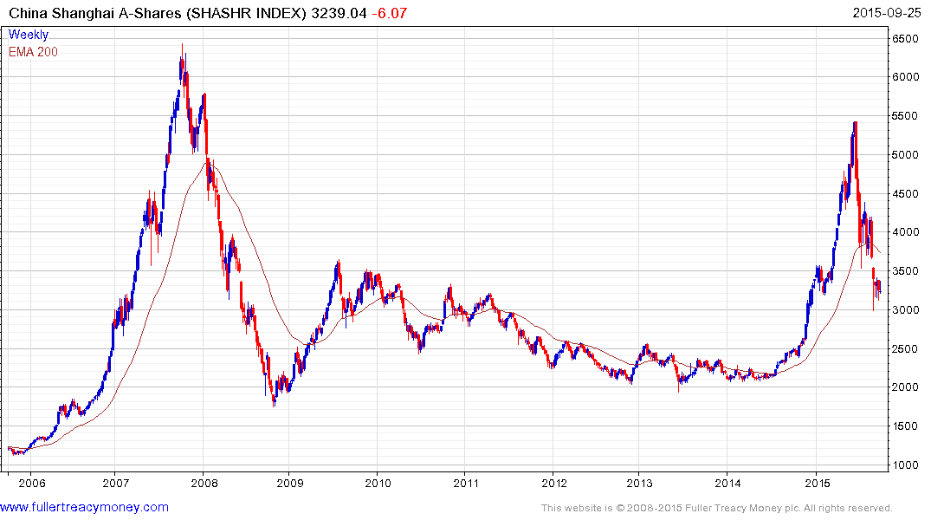
SHASHR (p/e 15/36 & yield 2.00%)
No longer at bubble valuations but investor
confidence may take time to recover
Climactic low on 26/08 still holding but only just

Slide 18
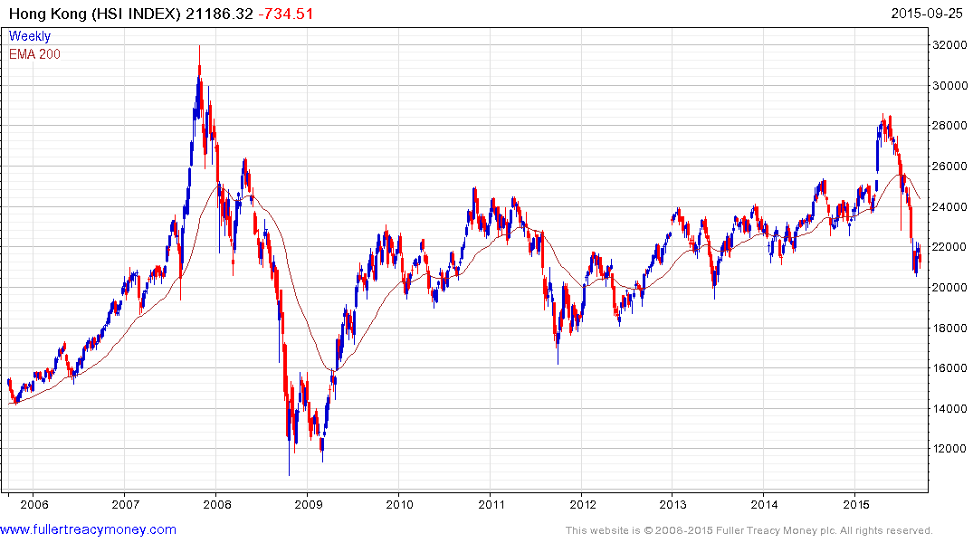
HSI (p/e 9,03 & yield 4.04%)
Deeply oversold, excellent medium to longer-term recovery prospects
Climactic low on 25/08 only
slightly exceeded to date

Slide 19
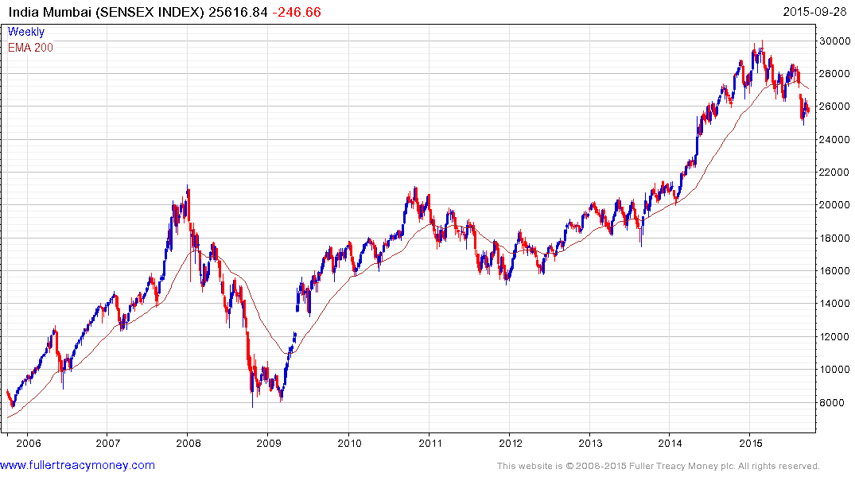
SENSEX (p/e 20.23 & yield 1.45%)
Still in a corrective phase but excellent medium to longer-term prospects
25/8 low

Slide 20
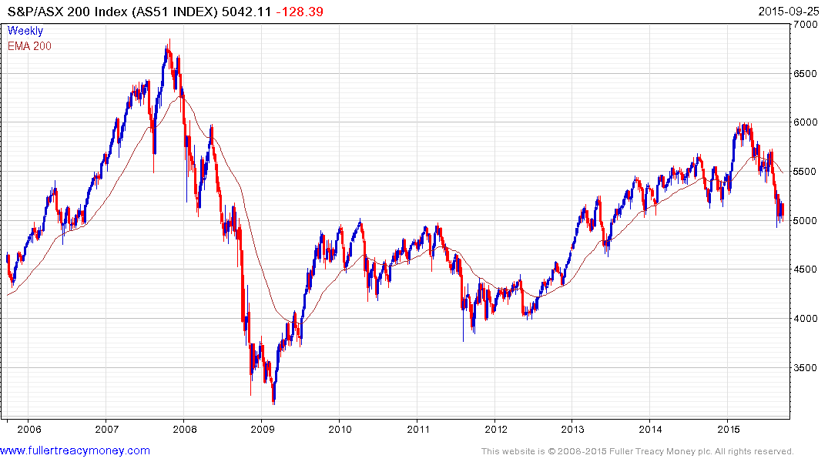
AS51 (p/e18.42 & yield 5.20 for locals)
Longer-term potential based on China’s
recovery and stronger commodity prices
Climactic low on
25/08 still holding
but only just

Slide 21
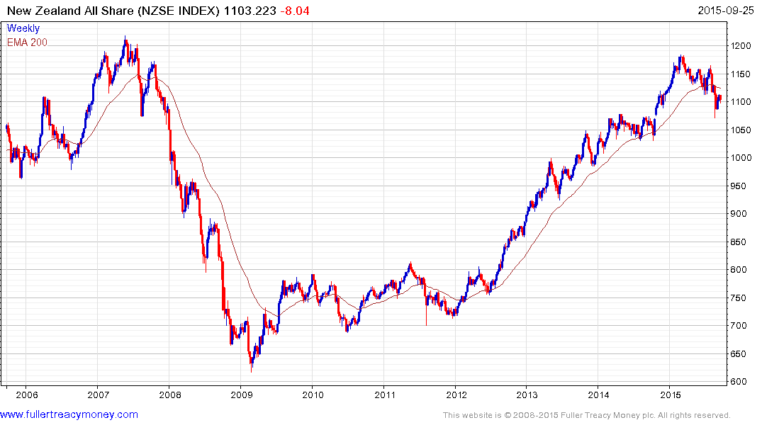
NZSE (p/e 18.52 & yield 5.18% for locals)
Comparative relative strength but
uptrend clearly broken
Climactic low on
25/08 still holding

Slide 22
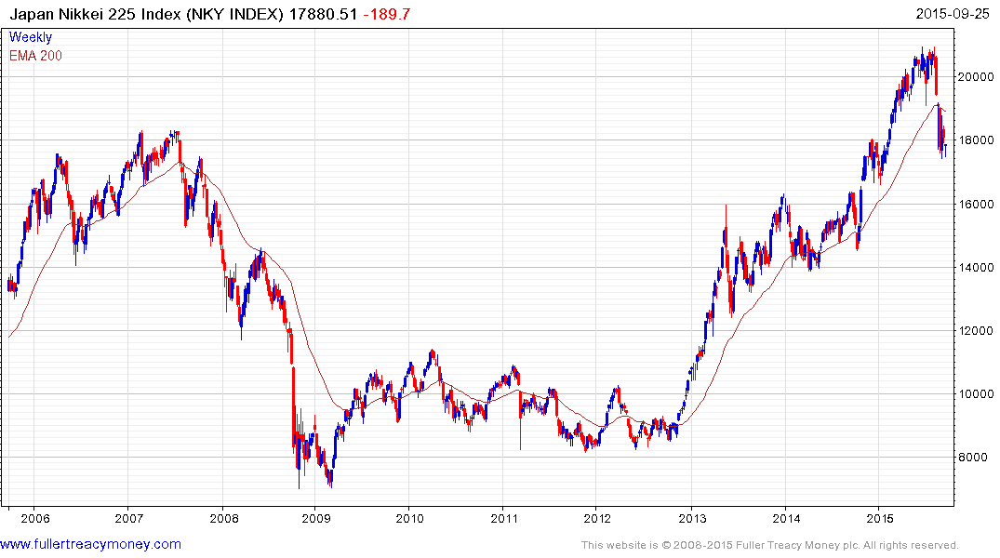
NKY (p/e 18.68 & yield 1.66)
Some loss of momentum
near 26/8
climactic lows
but barely steady

Slide 23
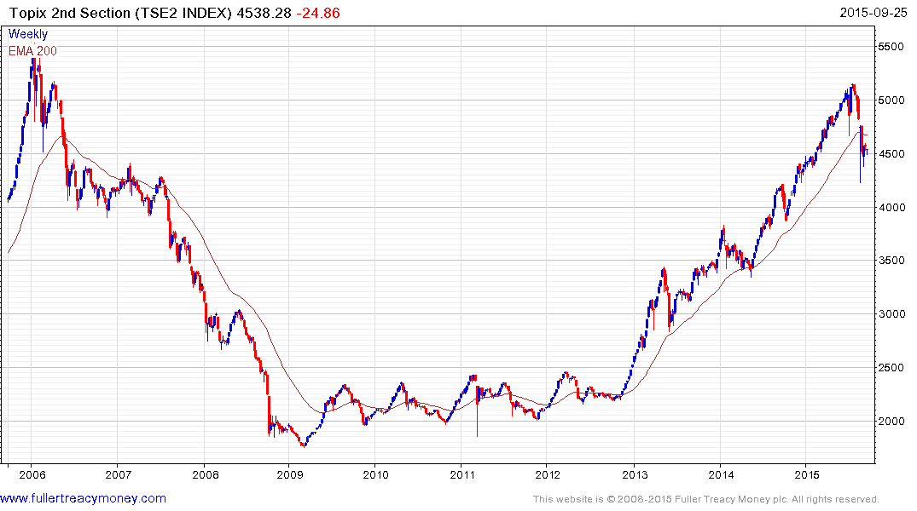
TSE2 (15.35 & yield 1.50%)
This 2nd Section Index usually leads
Holding above
25/8 climactic low

Slide 24
European Union
Variously roiled by Putin, Sanctions, Grexit, Brexit, slow GDP growth, high unemployment, political dissatisfaction, rule by unelected EU commissioners, a divisive and out of control migrant crisis, and now the diesel emissions scandal
Share valuations are competitive and QE continues

Slide 25
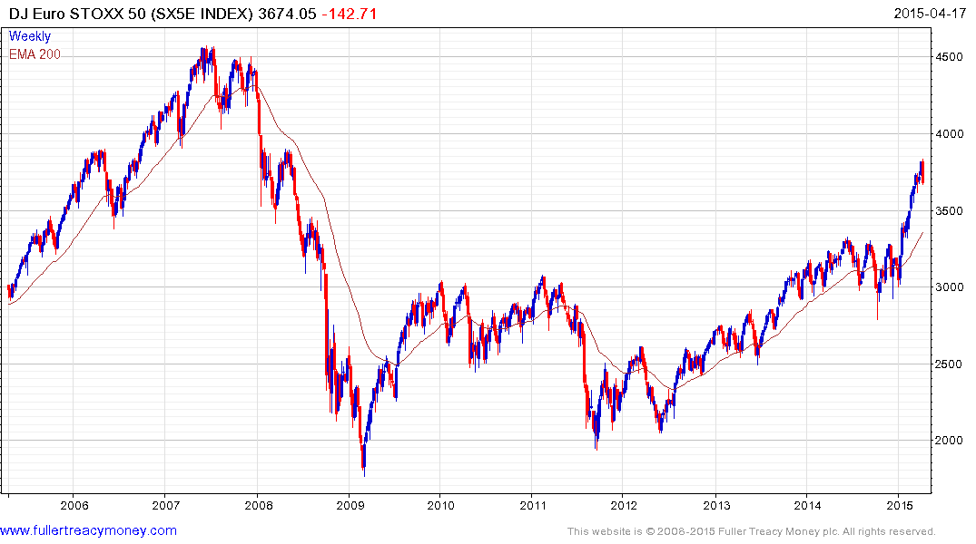
Ten-year chart of SX5E
Note: this slide is
from the April 17th
presentation
Temporarily overextended,
weekly key reversal indicates beginning
of a corrective phase

Slide 26
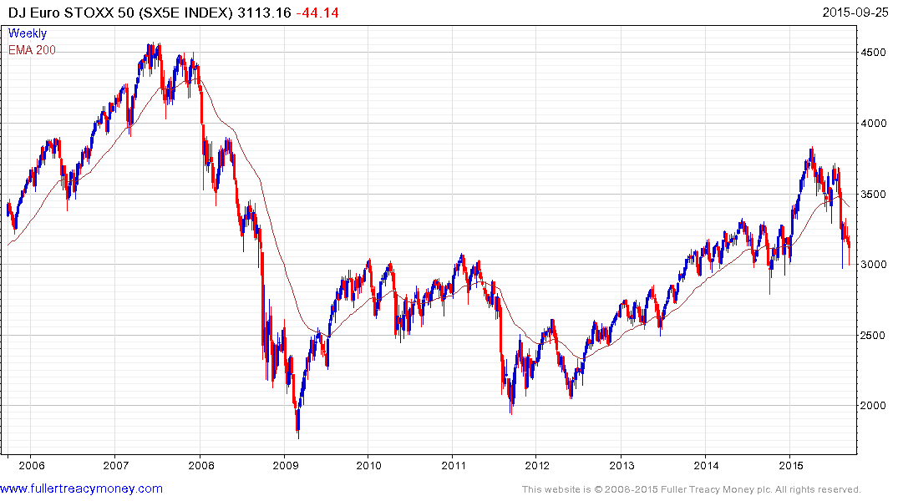
SX5E (p/e 17.12 & yield 3.82)
24/8 climactic low

Slide 27
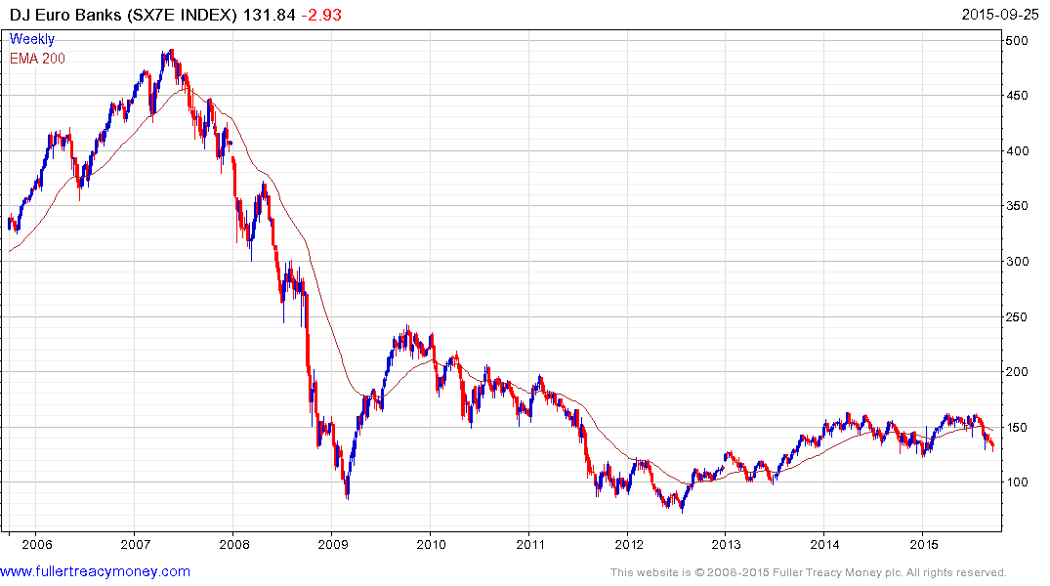
SX7E (p/e 19.28 & yield 4.01%)
Serial underperformer since mid-2007

Slide 28
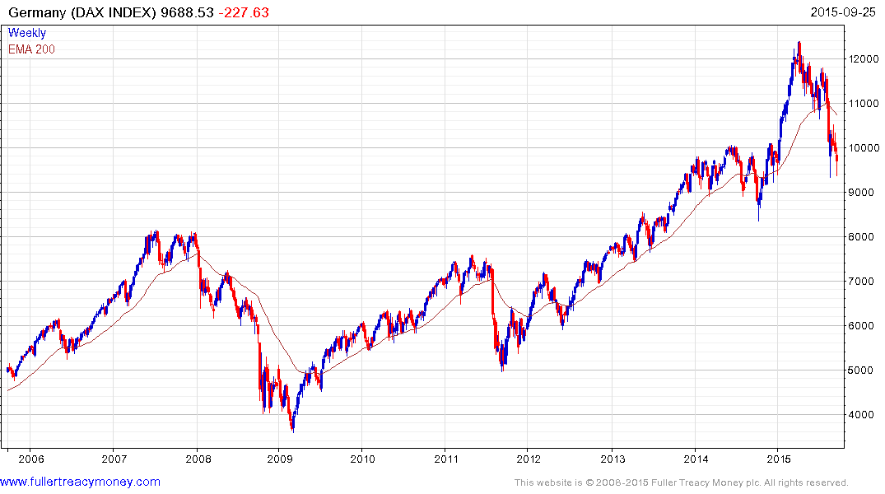
DAX (p/e 15.06 3.11%)
valuations improved but
hit by China’s soft economy
and EU turmoil
Just above 24/8
climactic low

Slide 29
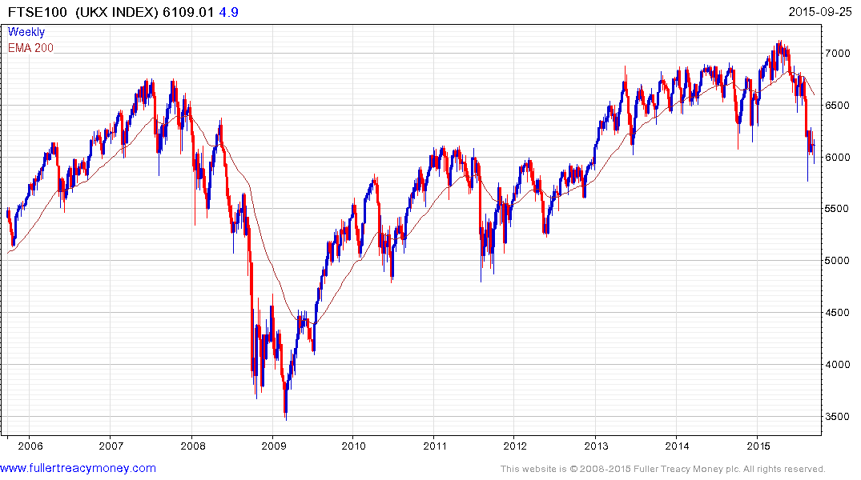
UKX (p/e 21.79 & yield 4.34%)
p/e has edged higher mainly
due to weak resources shares
Still above 24/8
climactic low
There will inevitably be some uncertainty over next year’s UK referendum on the EU

Slide 30
Many thanks for your interest!
Any questions?
Please visit our site:
www.fullertreacymoney.com

Slide 32
Technical warning signs to watch for among indices
Trend acceleration relative to 200-day moving averages
Declining market breadth (fewer shares rising)
Failed upside breakouts from trading ranges
Loss of uptrend consistency characteristics
Churning price action relative to recent trading ranges
Breaks of 200-day moving averages
Broadening patterns relative the last several trading ranges
200-day moving averages turn downwards
Resistance is encountered beneath declining 200-day MAs
Previous rising lows are replaced by lower rally highs
Indices fall faster than they rose to their highs

Slide 33
