Slide 1
The Markets Now
Opportunities and Risks
for Financial Markets
In 2015’s Changing Environment
David Fuller – 12th January 2015
fullertreacymoney.com
East India Club – 16 St. James Square
London SW1Y 4LH, UK

Slide 2

Hopes, Dreams and Fears
(They are always with us)

Slide 3
Nervous markets because…
● It’s all about oil!
● Or is it all about deflation?
● Political or algorithmic risks?
The main answer is more benign; it is about technological innovation, which creates mostly positive deflation.

Slide 4
The accelerating rate of technological innovation is the single most bullish factor for the long term
A couple of examples:
● Consider energy: oil, gas, solar, new nuclear
● Consider also: The Internet of Everything

Slide 5
Specific Known Market Risks
US public offerings are the highest in over a decade
Leverage by hedge funds & traders has soared in the USA
Leverage in other performing stock markets is increasing
EU breakup risks increase if ECB’s Mario Draghi resigns
Some emerging market currencies slump on USD rise
Bond market yields will eventually rise with GDP growth

Slide 6
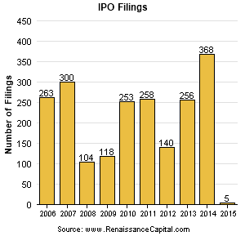

Slide 7
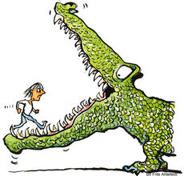
Surging new
issues are a
characteristic
of expensive
markets and
coincide with
tops because
they devour
buying power
We are not
there yet
but this is
a potential
problem for
the future

Slide 8
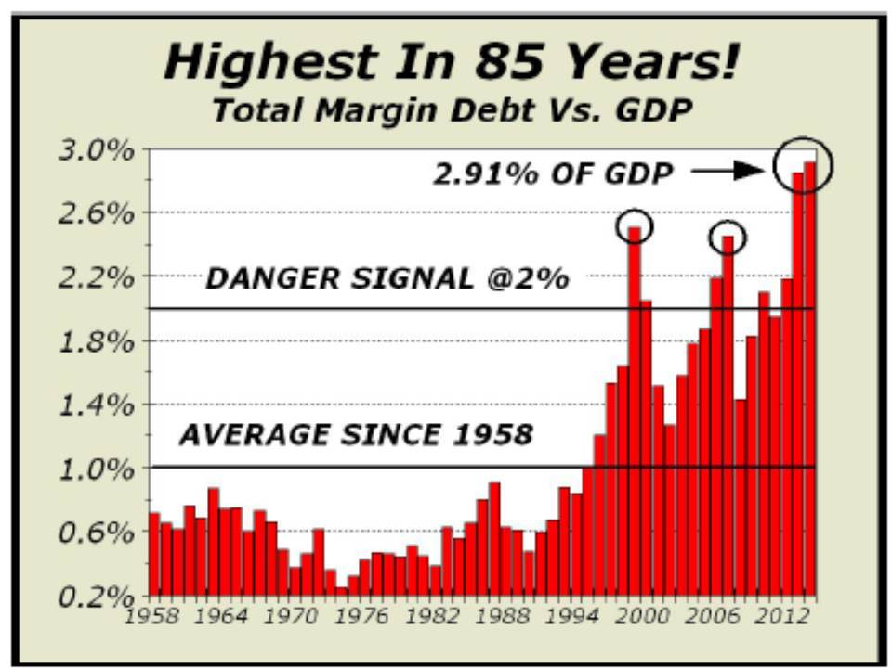

Slide 9
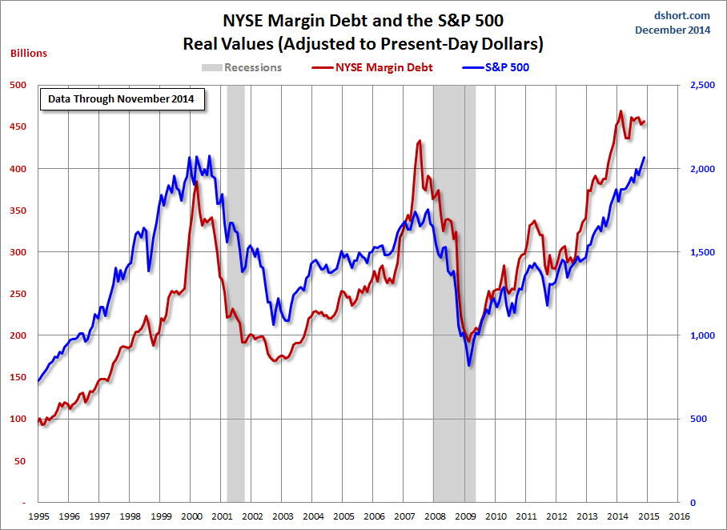

Slide 10
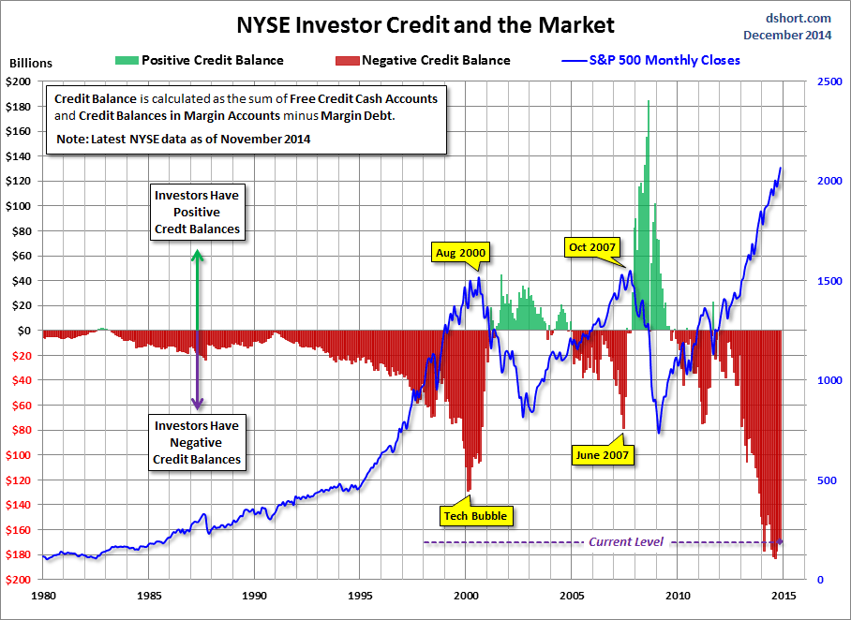

Slide 11
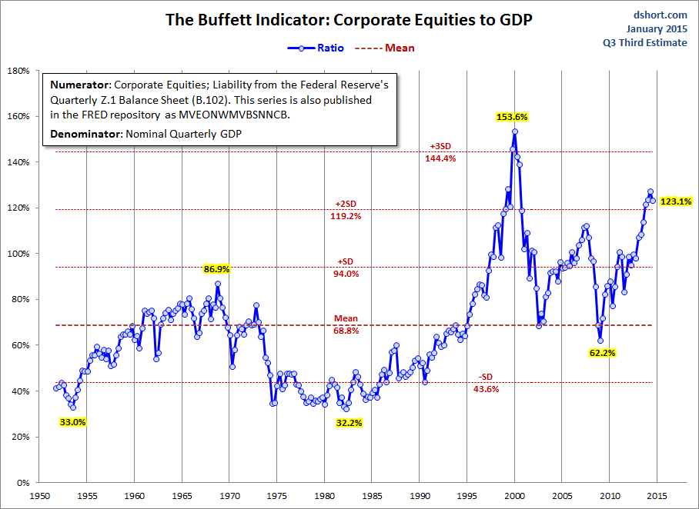

Slide 12
Technical warning signs to watch for among indices
Trend acceleration relative to 200-day moving averages
Declining market breadth (fewer shares rising)
Failed upside breakouts from trading ranges
Loss of uptrend consistency characteristics
Churning price action relative to recent trading ranges
Breaks of 200-day moving averages
Broadening patterns relative the last several trading ranges
200-day moving averages turn downwards
Resistance is encountered beneath declining 200-day MAs
Previous rising lows are replaced by lower rally highs
Indices fall faster than they rose to their highs

Slide 13
Bullish Points for Stock Markets
S&P up15.3% on average 6 months after mid-term election
Global monetary policy is still extremely accommodative
Central banks are worried about deflation, not inflation
Capitalism increasingly dominates on a global basis
Globalisation spurs rapid emerging market development
Growth in middleclass consumers surges, led by Asia-Pac

Slide 14
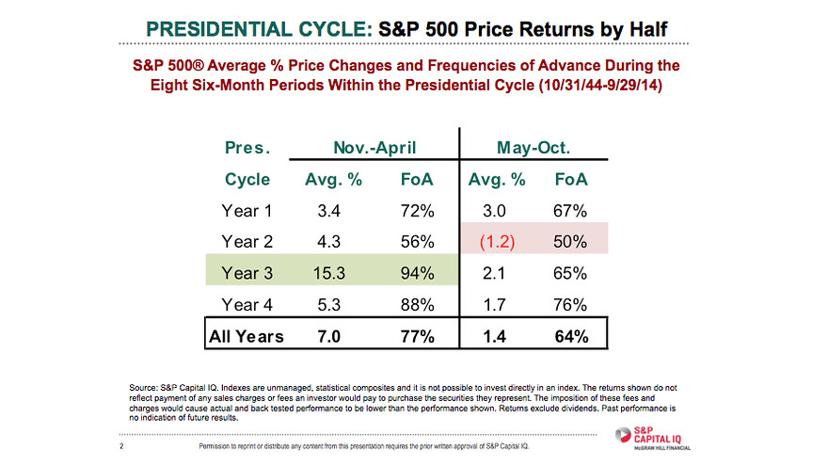

Slide 15
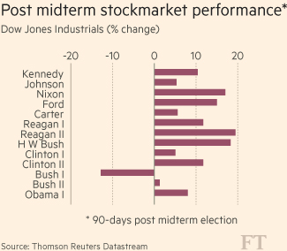
Since 1950
4 Nov 2014

Slide 16
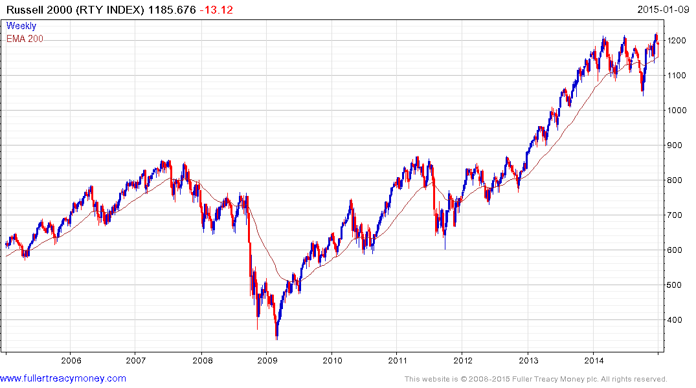
Wall Street’s canary in the coalmine is still singing near 1200

Slide 17
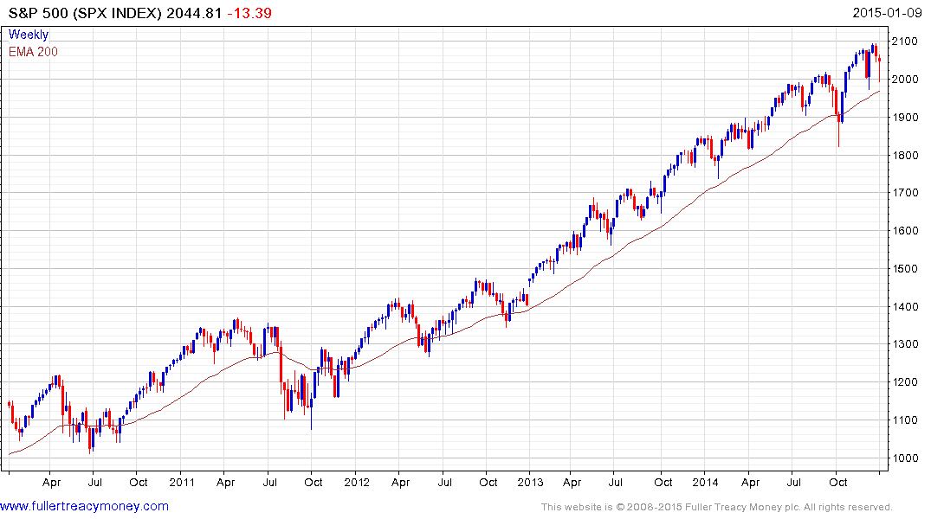
Roundophobia
Some loss of
staircase uptrend
consistency

Slide 18
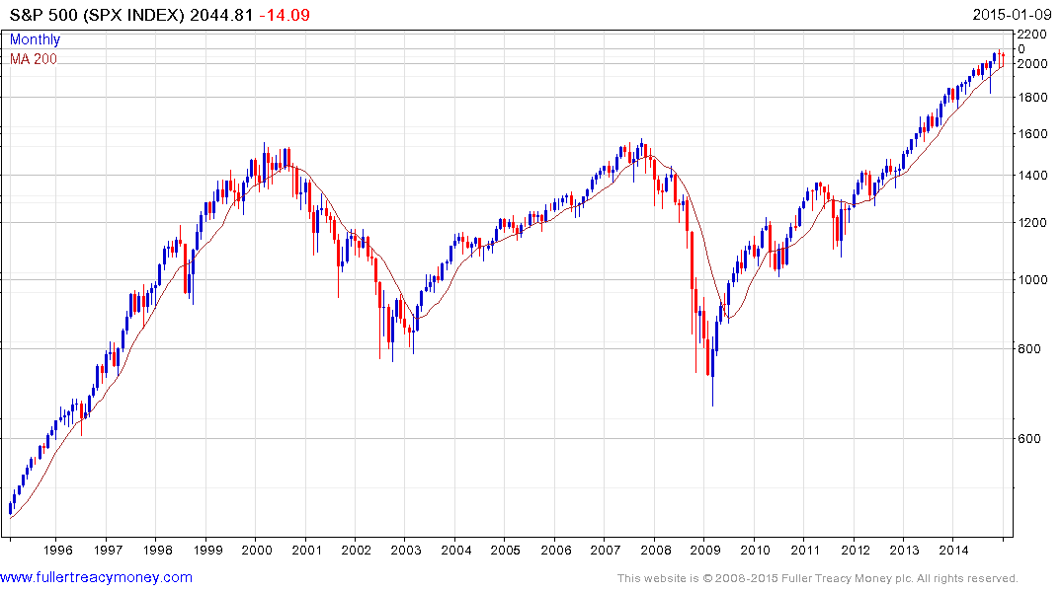
No inflation?
This gain above the 2000
peak is due mainly to CPI inflation
S&P 500 over 20 years

Slide 19
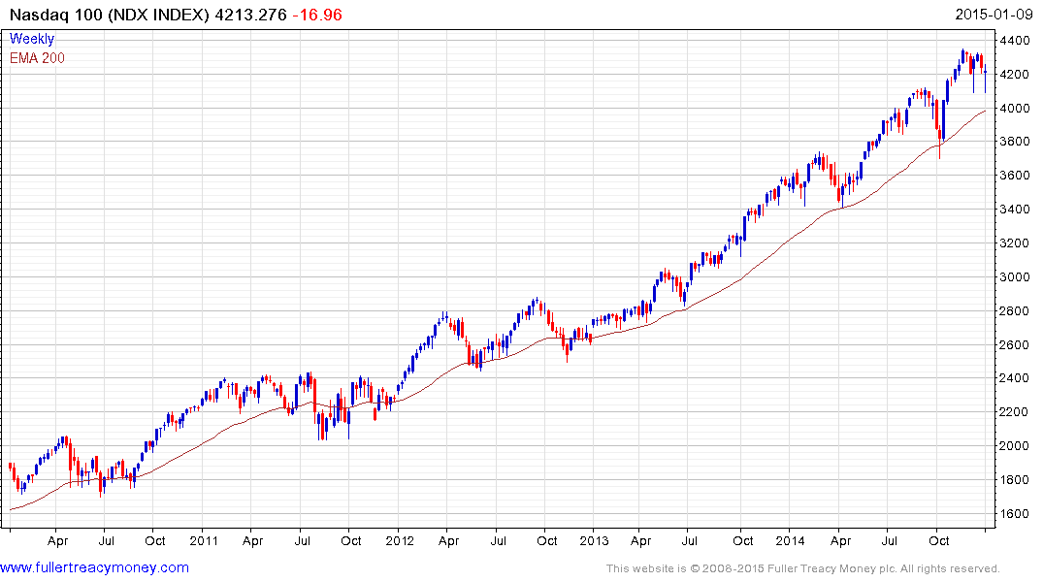
Diversified technology is still in form

Slide 20
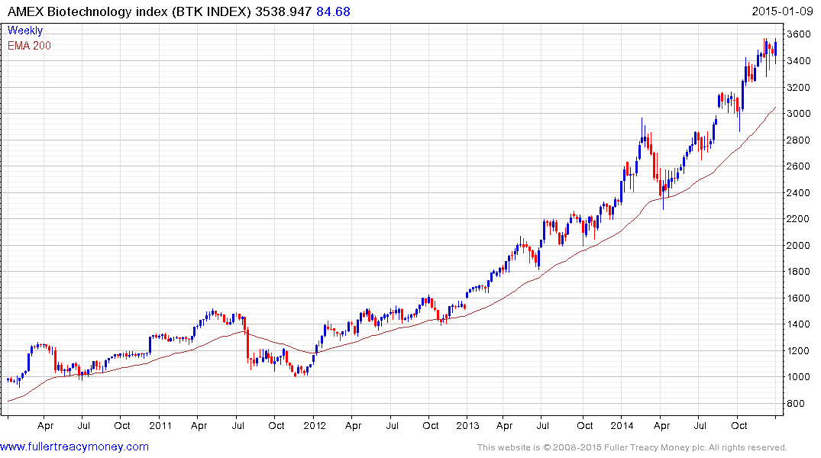
Biotechnology is currently a leading
indicator and somewhat overextended relative to the MA

Slide 21
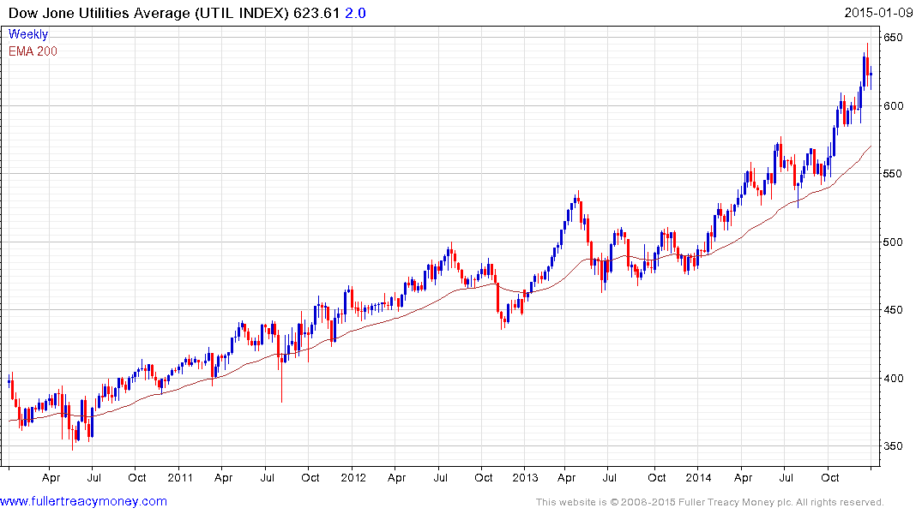
Utilities are also a current leader and
somewhat overextended relative to MA

Slide 22
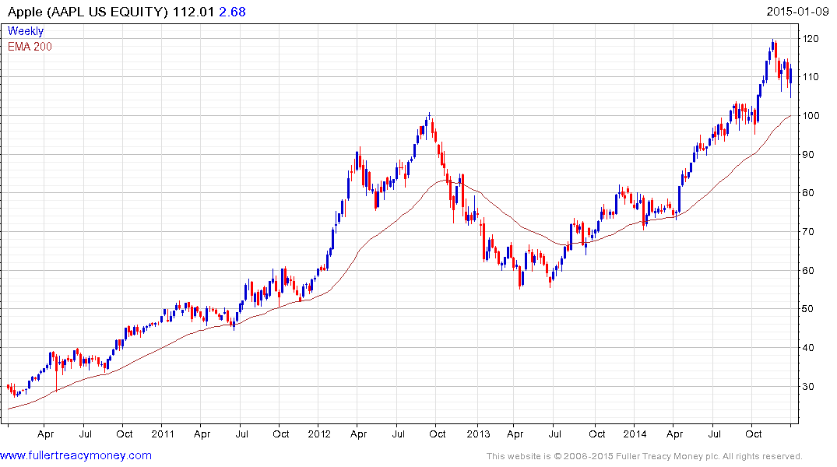
Apple
Wall Street’s iconic share for this bull market to date
and therefore influential – just corrected a short-term overbought condition

Slide 23
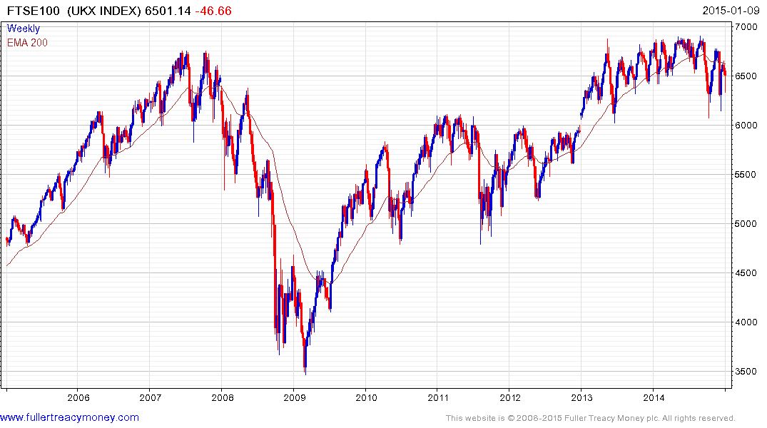
Still at risk from broadening
pattern but yields 4.7% - needs to hold above 6000

Slide 24
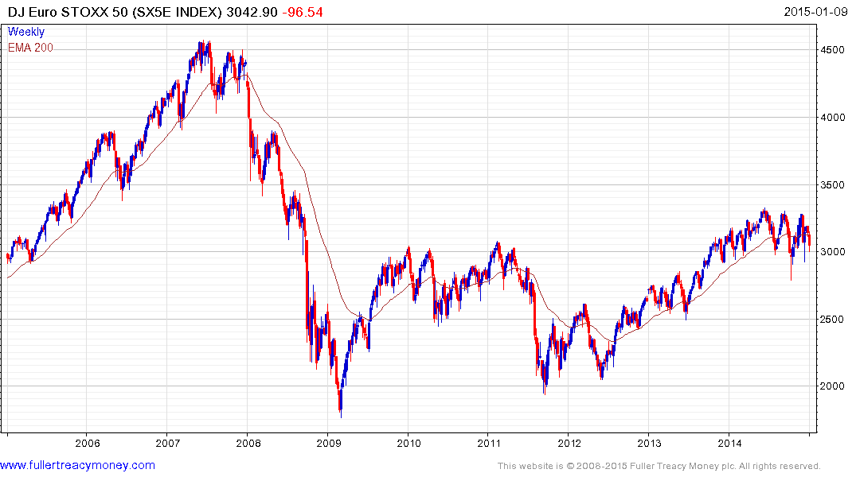
Unable to break up out of current broadening pattern as Eurozone uncertainties persist but yields 3.83%

Slide 25
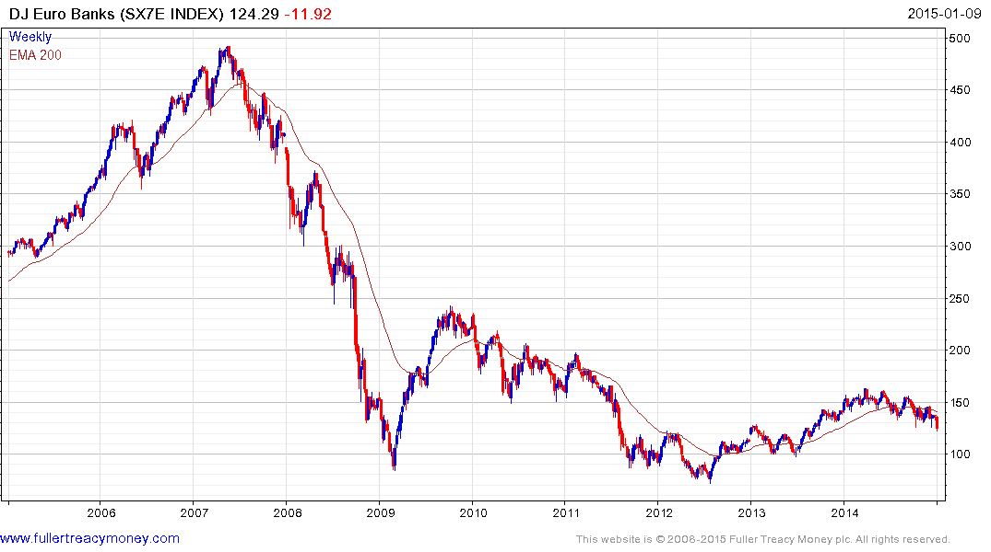
EU banks remain a concern
despite considerable assistance
from the European Central Bank

Slide 26
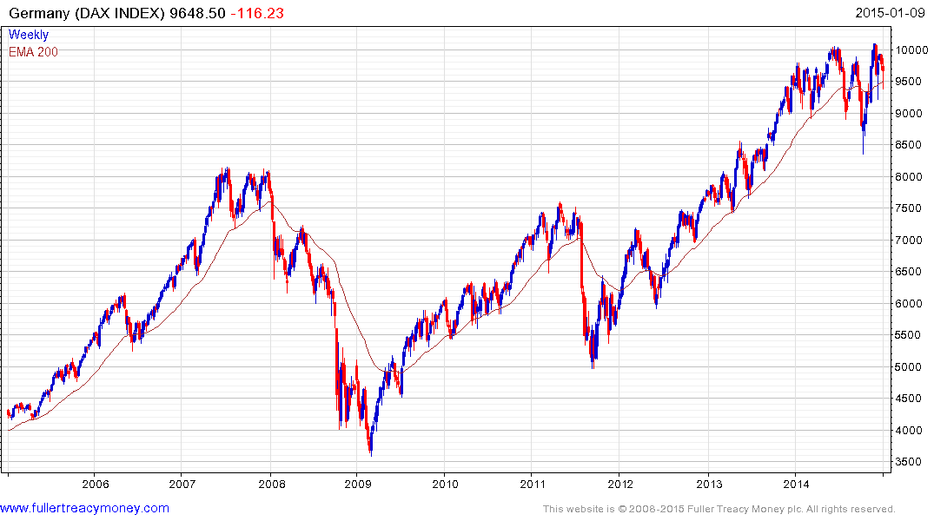
Rallied well following October’s failed
downside break but still in broadening
pattern beneath 10,000 roundophobia
level and needs sustain upward break
to reaffirm bull market

Slide 27
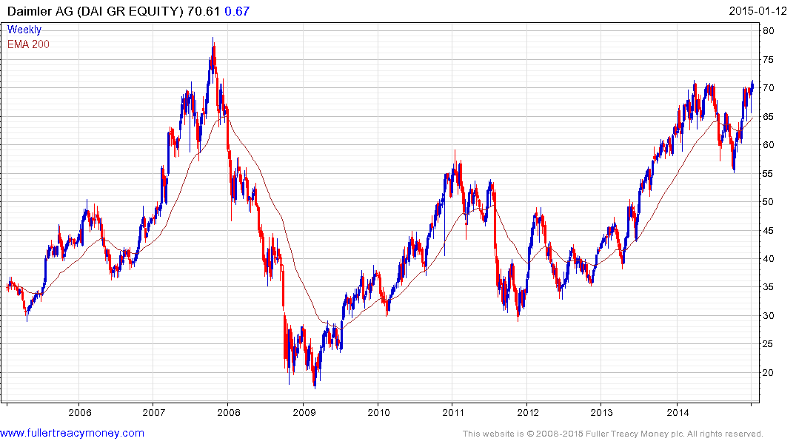
An inexpensive German Autonomy
(est p/e 10.86, yield 3.32%)
but needs sustained break
above 70 to reaffirm uptrend

Slide 28
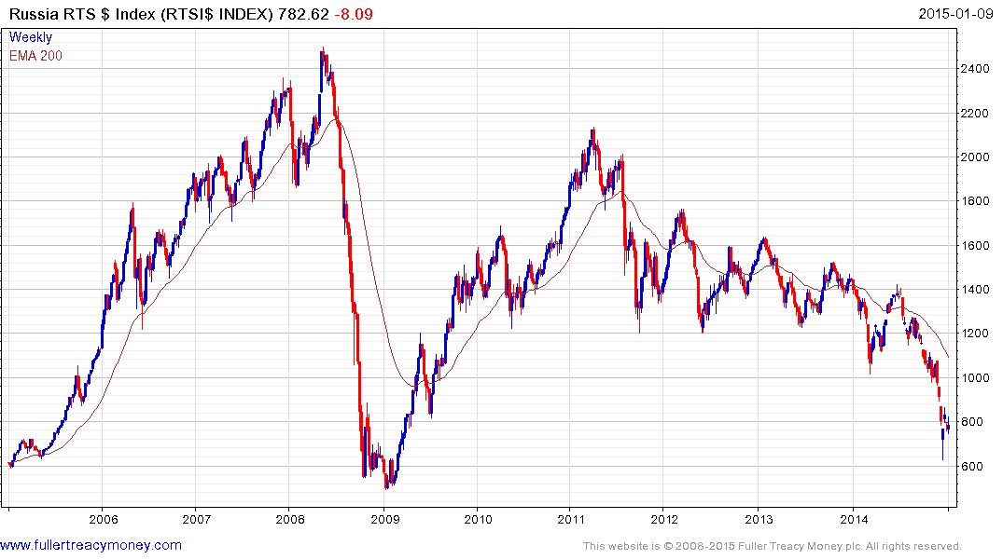
Governance is Everything - favourable
regime change would make Russia a
recovery candidate on cheap valuations

Slide 29
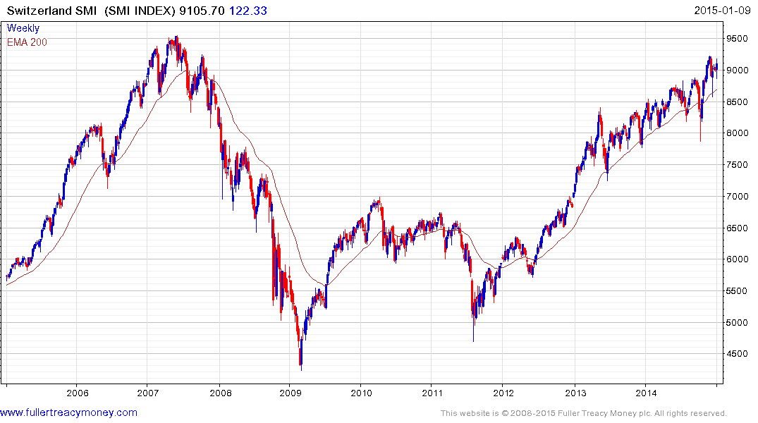
Perennially one of Europe’s
better performers and still
ranging higher

Slide 30
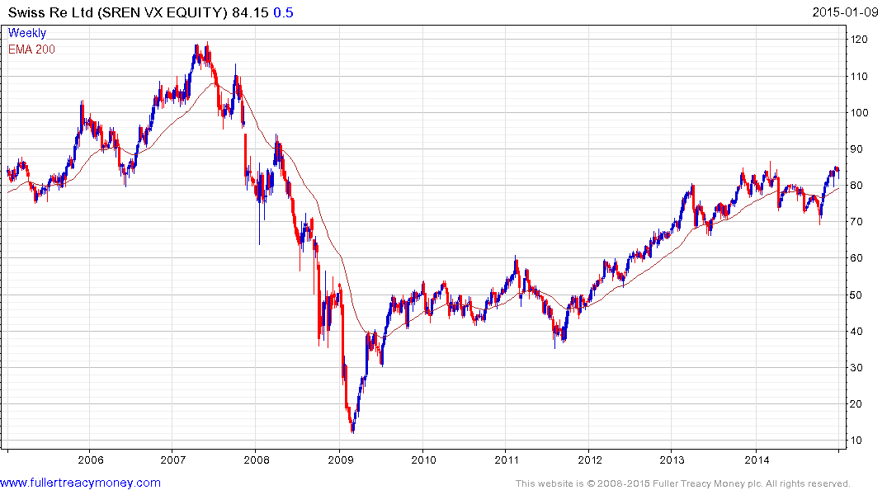
An inexpensive Swiss Autonomy
(est p/e 8.45 yield 4.58%)
but needs sustained upward break
to reaffirm uptrend

Slide 31
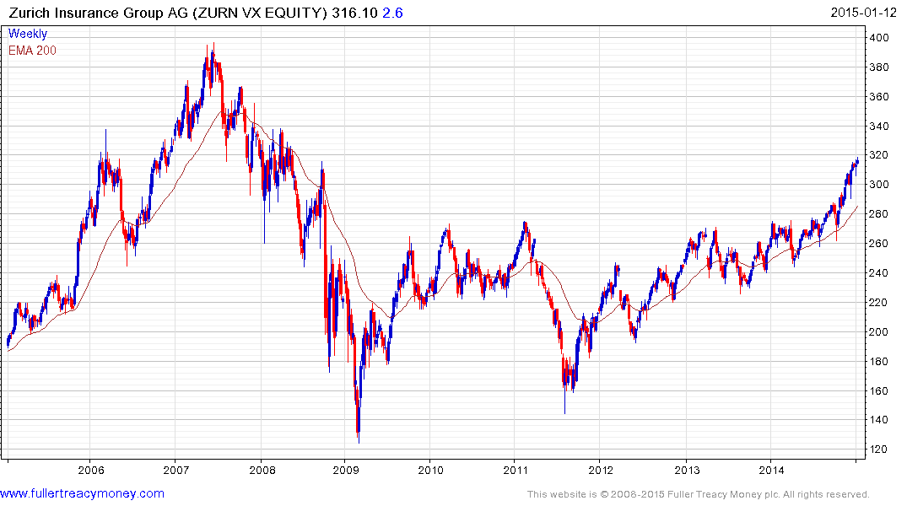
An inexpensive Swiss Autonomy
(est p/e 11.98 yield 5.42%)
slightly overextended relative to MA

Slide 32
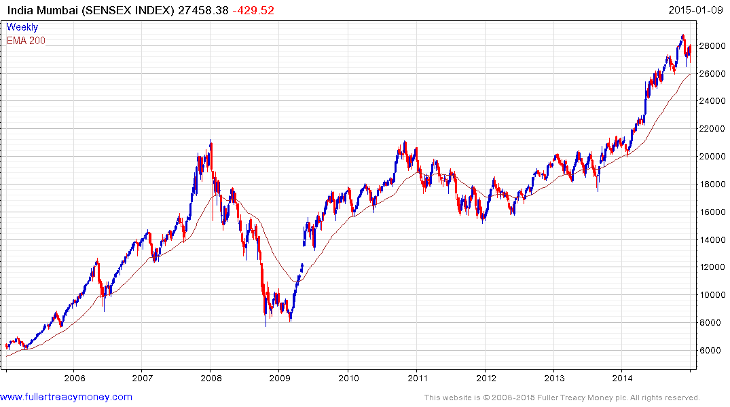
Some loss of uptrend consistency
with bigger pullback since the high
but no longer O/B
Remains a strong long-term favourite of mine due to Narendra Modi

Slide 33
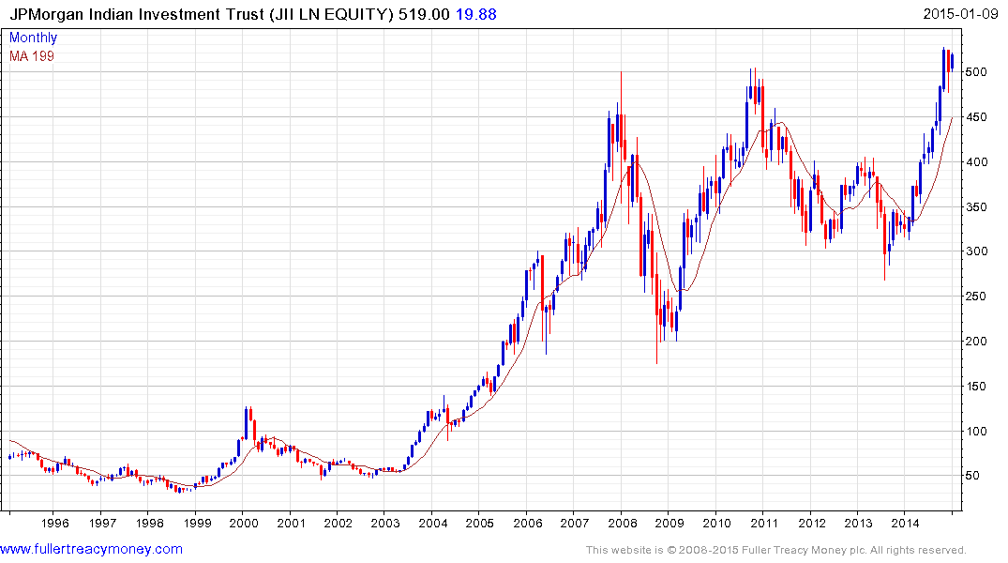
My investment vehicle for India since
mid-2003, adding on setbacks - JII is
currently short-term O/B and selling
at a discount of -10.951 to NAV

Slide 34
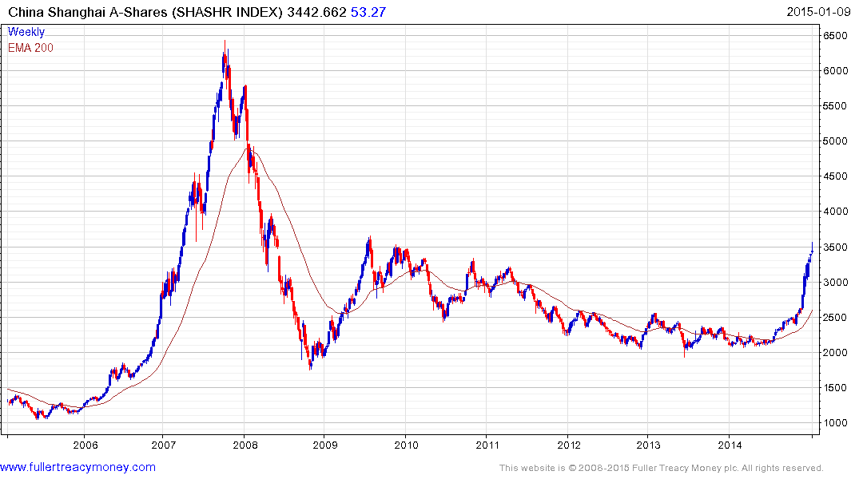
Likely to be a long-term favourite of mine, subject to governance – note what happened when the lengthy
sequence of lower rally highs was finally broken (p/e 15.7 yield 2%) currently O/B

Slide 35
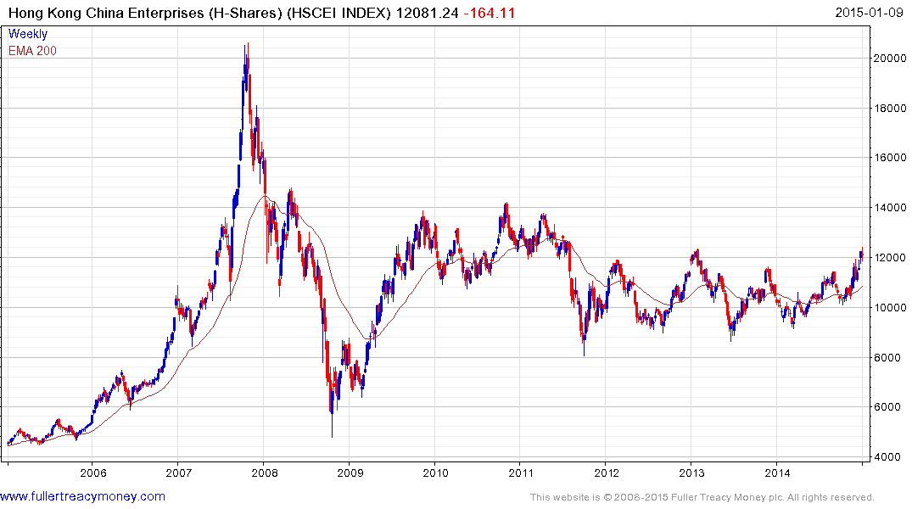
Completing lengthy base extension
And currently has China’s lowest
Valuations (p/e 8.45 yield 3.61) mostly government controlled shares

Slide 36
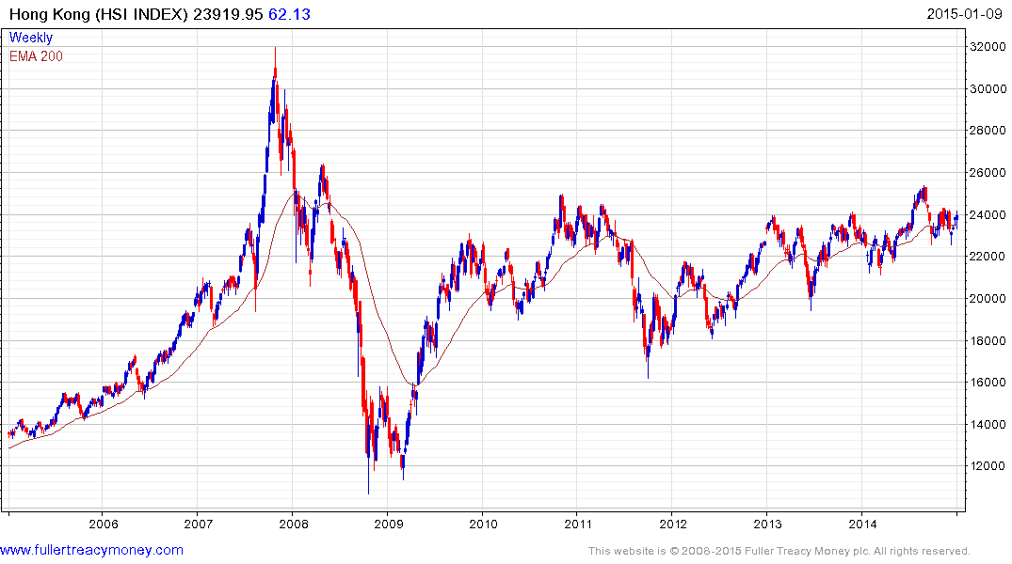
Probably coming back into form
following the Hong Kong voting
demonstrations (p/e 10.12 yield 3.7%

Slide 37
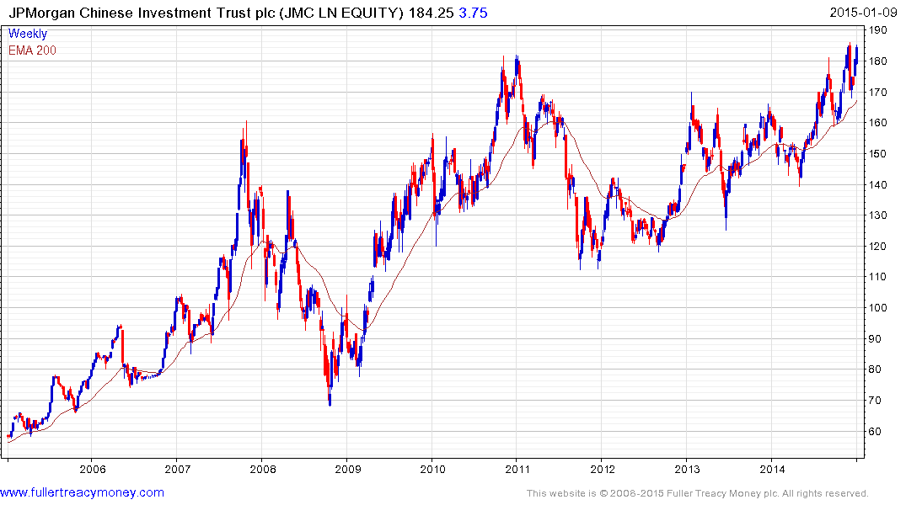
My vehicle for investing in China,
short-term O/B,
discount to NAV – 11.4%

Slide 38
Long-term bull factors for stock markets
Accommodative monetary policies, until growth accelerates
An accelerating rate of technological innovation
Lower energy prices in real terms, thanks to innovation
The triumph of capitalism, both democratic & authoritarian
Globalisation, hastening development of emerging markets
Middleclass growth in emerging markets
Continued growth in the global population

Slide 39
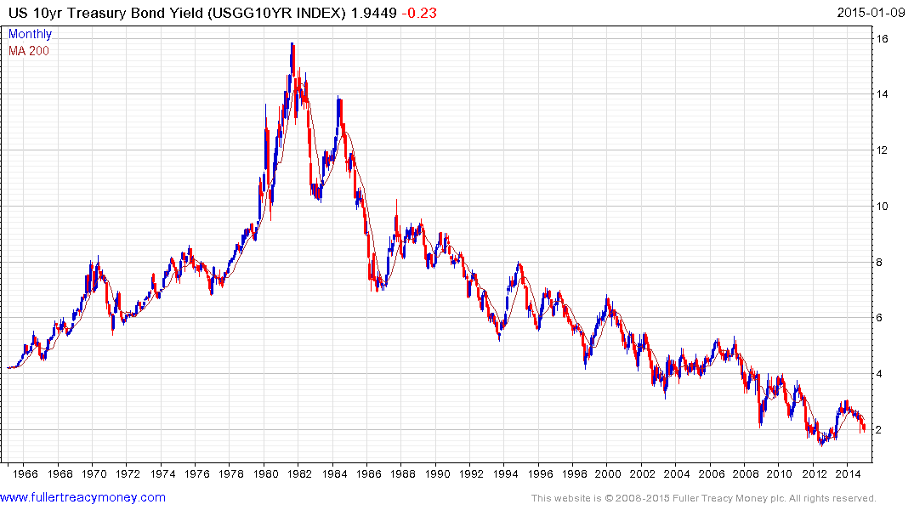
1) Probable lengthy base building
2) Above 3% base maturing
3) Above 4% probable base completion

Slide 40
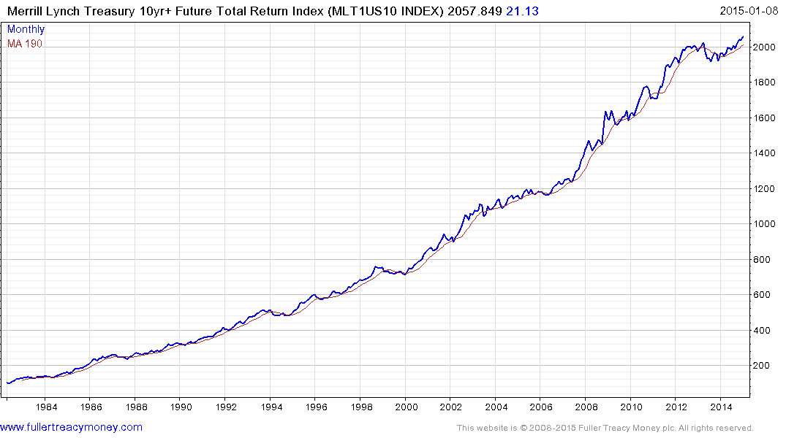
US bondholders are still making money
but top completion occurs when this
total return pattern breaks downwards

Slide 41
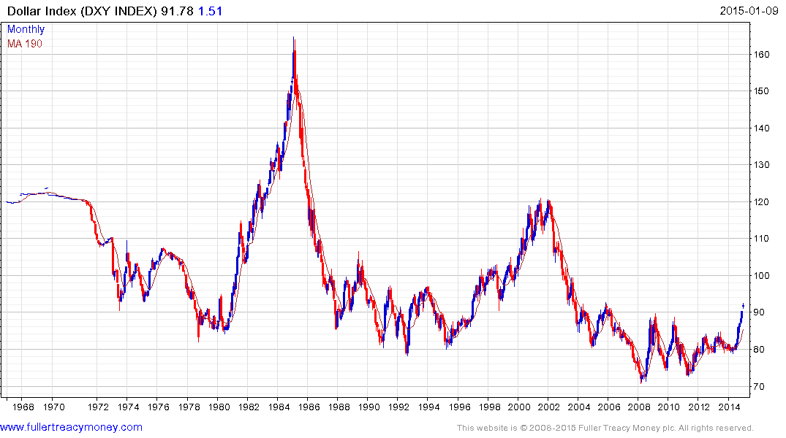
US Dollar Index completing a base formation
driven by energy independence & tech lead
Fed & Treasury will control speed of $ recovery

Slide 42
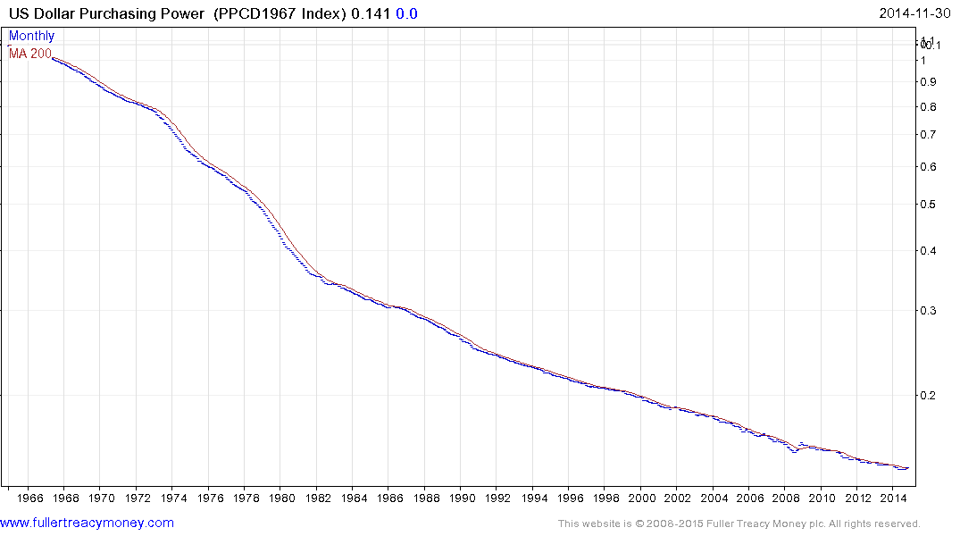
Nevertheless the US dollar is still a fiat currency, which
has lost most of its purchasing power since only 1968

Slide 43
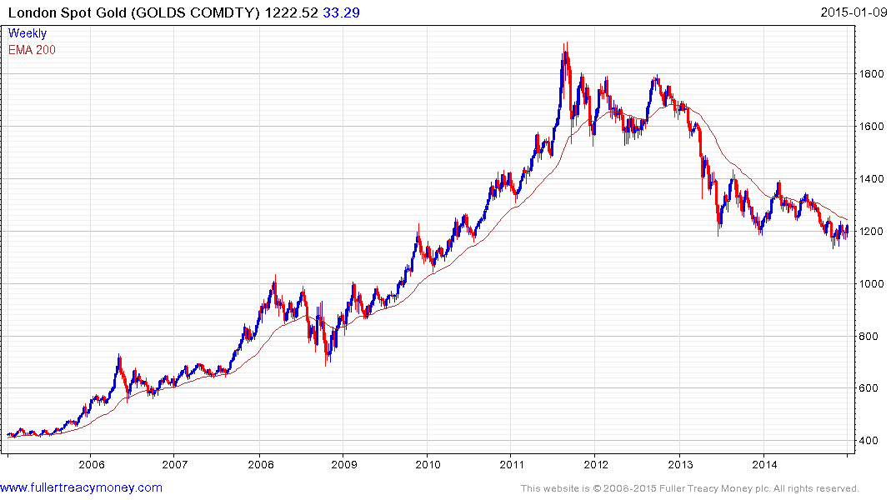
Gold is hard money, albeit with
a fluctuating price, just like
anything else which can be
bought or sold.
Potential downside failure
Traders mostly short
ETF long holds of gold still liquidating
4. Indians & Chinese buying

Slide 44
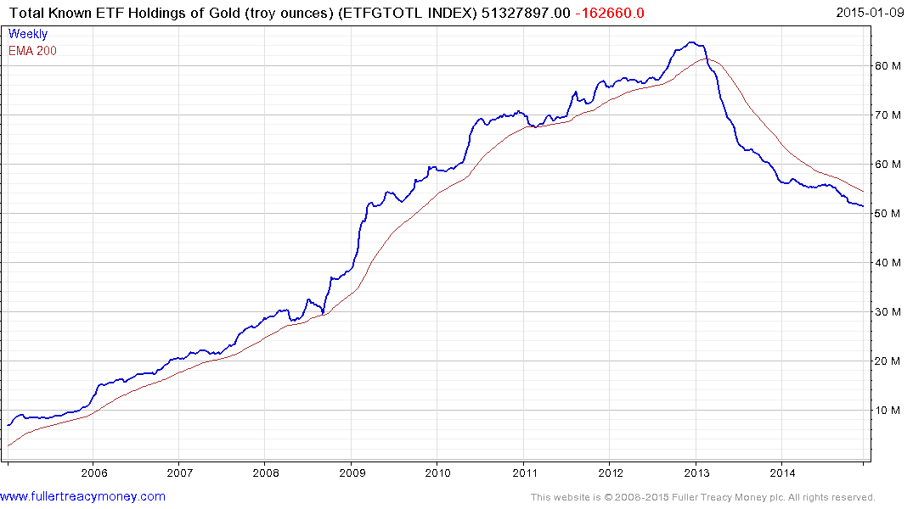
ETF holders of Gold bullion are
mostly Westerners and they are
still liquidating long positions

Slide 45
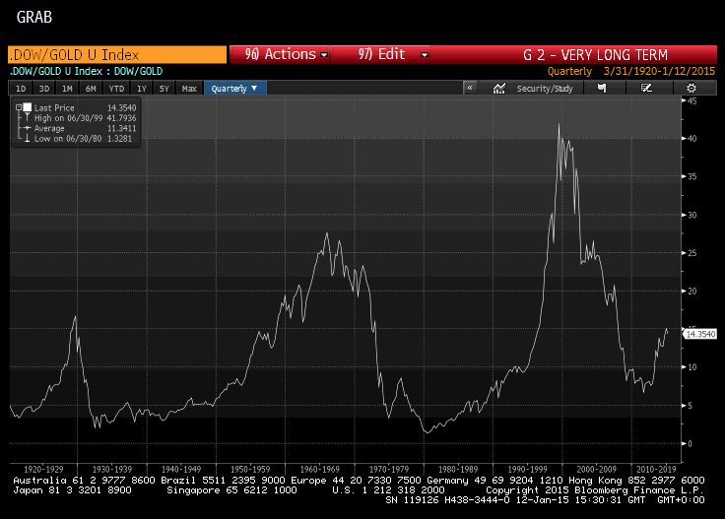
Gold has been
out of favour
with Western
Investors who
are mainly in
stocks & bonds

Slide 46
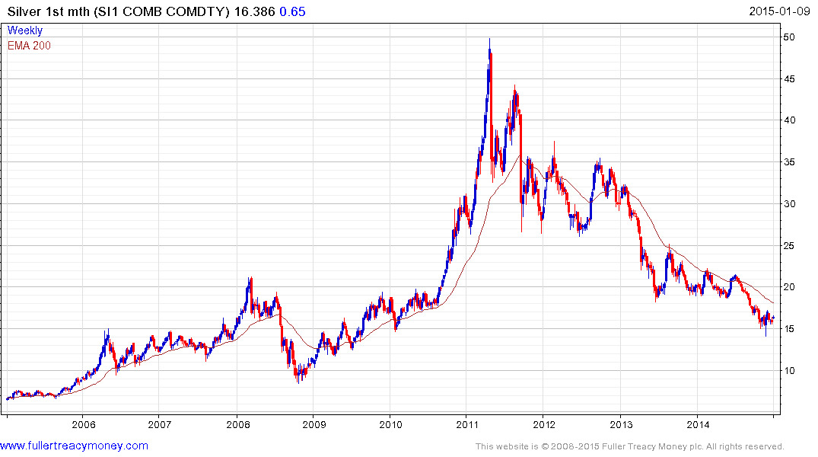
Silver is high-beta gold so it will
outperform when the yellow
metal really has bottomed

Slide 47
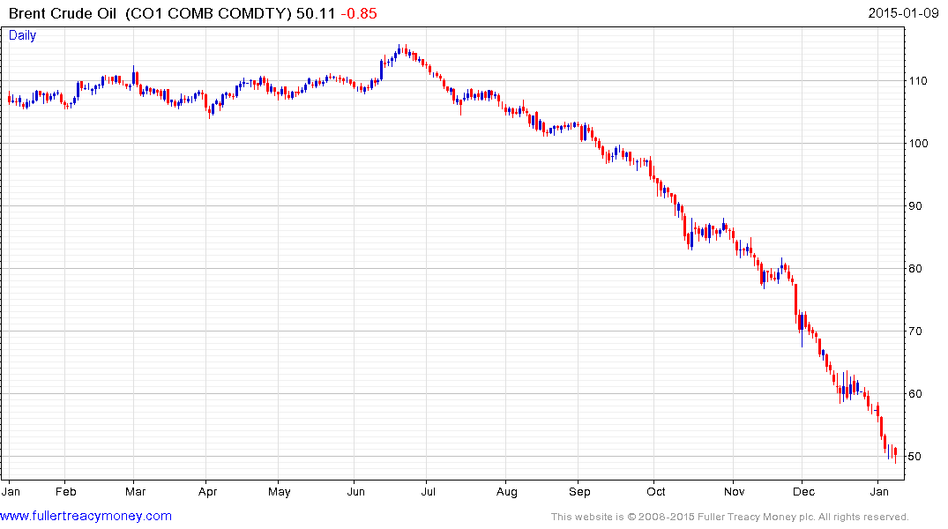
Needs a $5 upward dynamic
to check downside consistency -
trading at $47.48 at 3:40pm today

Slide 48
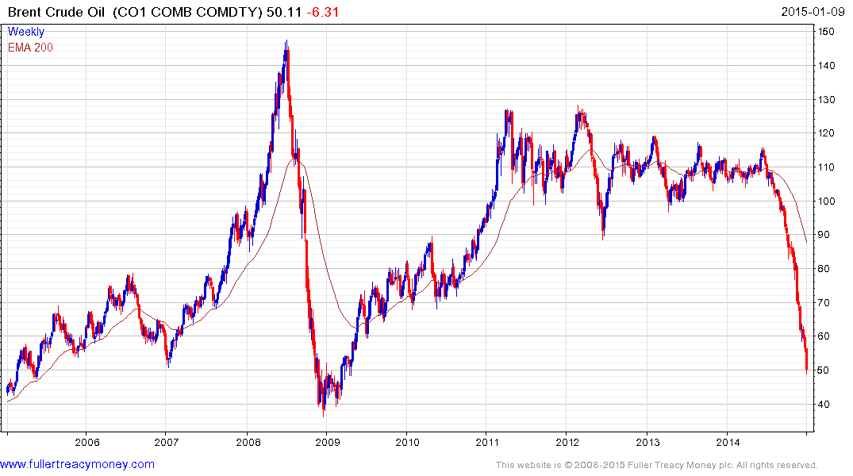
The end of an era for producers of crude oil who have lost price control of this market
No more price spikes
such as 2008, despite
turmoil in many producer
regions and an eventual
global economic recovery

Slide 49
Many thanks for your interest!
Any questions?
Please visit our site:
www.fullertreacymoney.com

