Slide 1
The Markets Now
Risks Versus Rewards
for Financial Markets
Through Yearend and to mid-2015
David Fuller – 10th November 2014
fullertreacymoney.com
East India Club – 16 St. James Square
London SW1Y 4LH, UK

Slide 2
What are the main known risks
for stock markets, in your opinion?

Slide 3
Geopolitical Political & Economic Risks
The war against ‘Islamic State’ is expensive and divisive
Putin is a weakened loose cannon but can still lash out
China’s arriviste military strength risks territorial aggression
The UK General Election result in 2015 is uncertain & risky
The US Dollar’s Strength for emerging market borrowers
Europe’s deflationary slump and growing political unrest

Slide 4
Specific Market Risks
US public offerings are the highest in over a decade
Leverage by hedge funds & traders has soared in the USA
Leverage in other performing stock markets is increasing
EU breakup risks increase if ECB’s Mario Draghi resigns
Some emerging market currencies slump on USD rise
Bond market yields will eventually rise with GDP growth

Slide 5
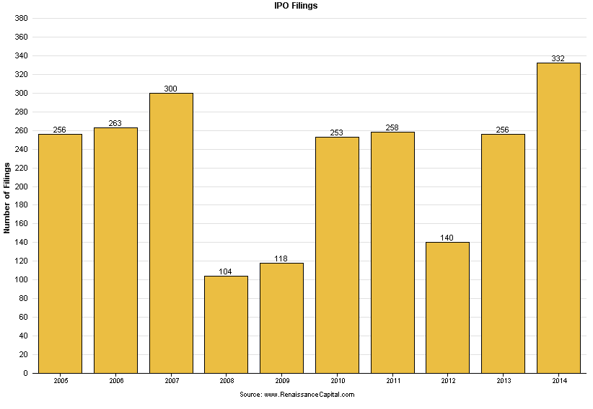

Slide 6
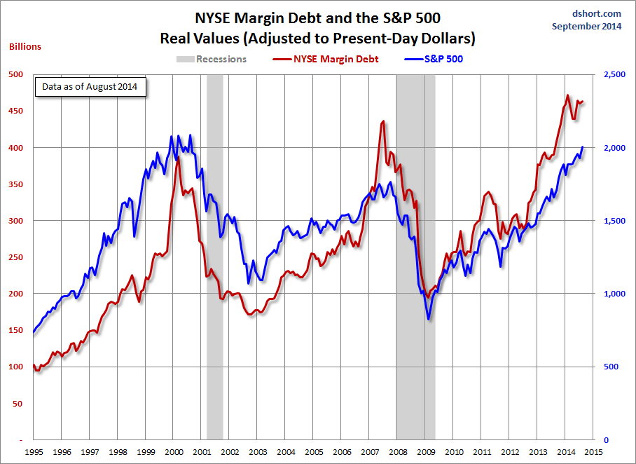

Slide 7
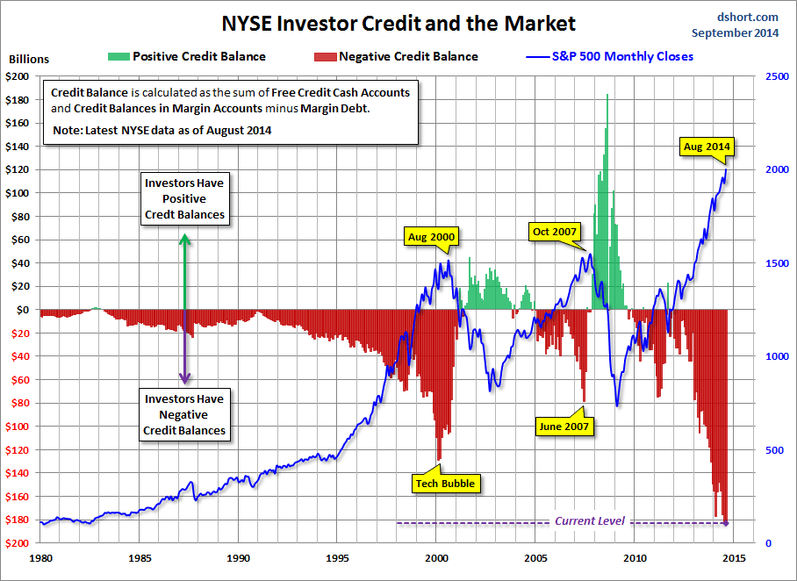

Slide 8
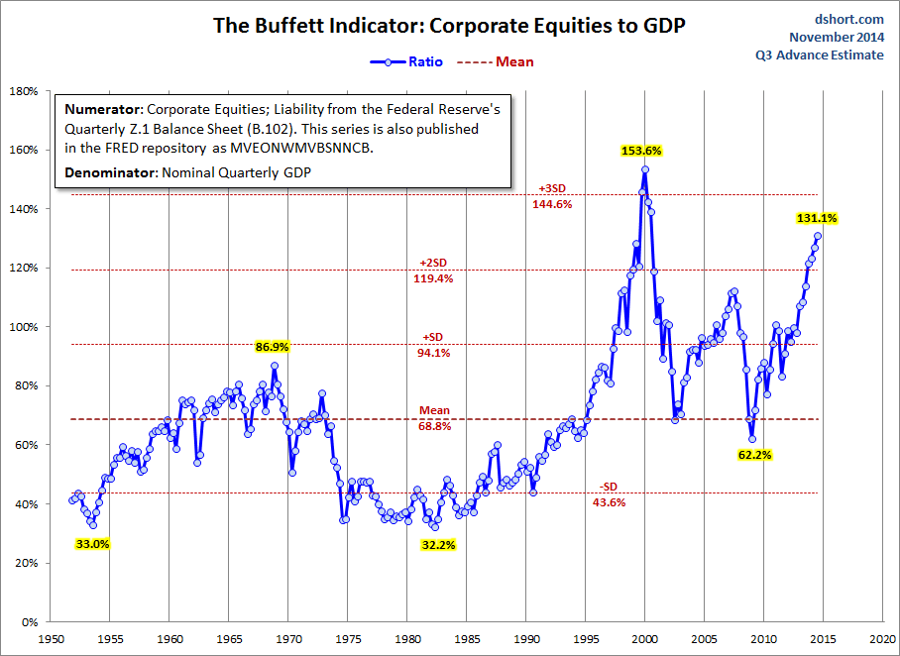

Slide 9
Technical warning signs to watch for among indices
Trend acceleration relative to 200-day moving averages
Declining market breadth (fewer shares rising)
Failed upside breakouts from trading ranges
Loss of uptrend consistency characteristics
Churning price action relative to recent trading ranges
Breaks of 200-day moving averages
Broadening patterns relative the last several trading ranges
200-day moving averages turn downwards
Resistance is encountered beneath declining 200-day MAs
Previous rising lows are replaced by lower rally highs
Indices fall faster than they rose to their highs

Slide 10
Bullish Points for Stock Markets
S&P up15.3% on average 6 months after mid-term election
Global monetary policy is still extremely accommodative
Central banks are worried about deflation, not inflation
Capitalism increasingly dominates on a global basis
Globalisation spurs rapid emerging market development
Growth in middleclass consumers surges, led by Asia-Pac

Slide 11
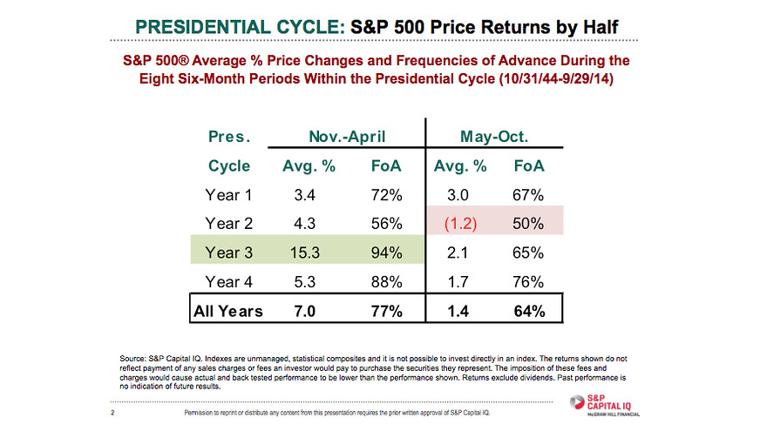

Slide 12
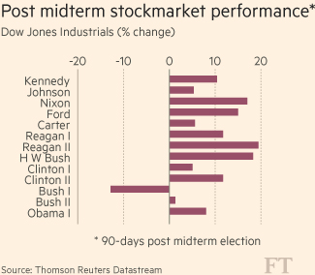
Since 1950
2002

Slide 13
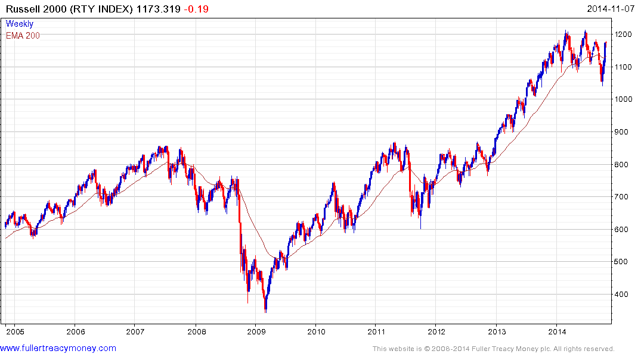
Wall Street’s canary in the coal mine
Downside
failure

Slide 14
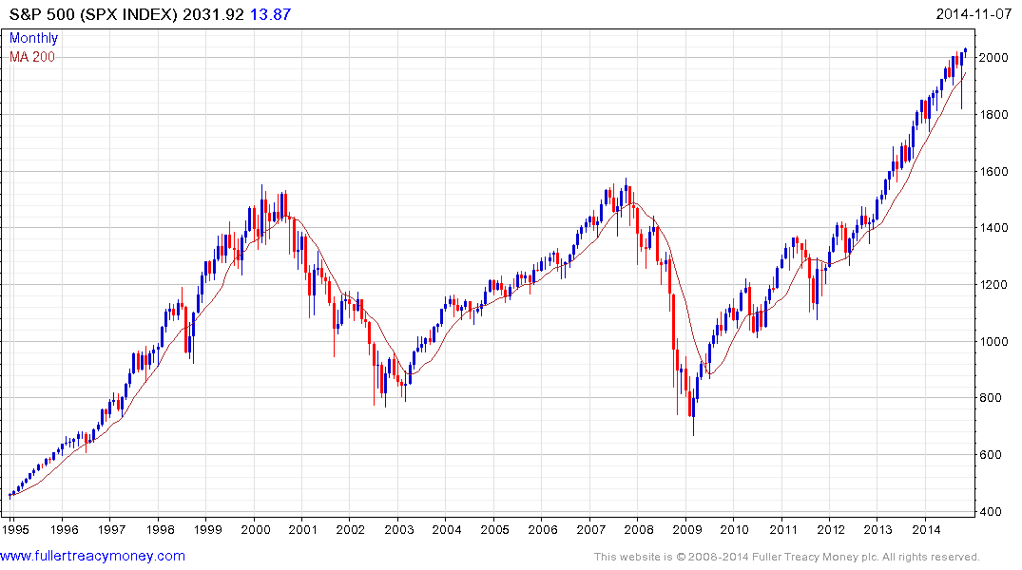
No inflation?
This gain above the 2000
peak is due to CPI inflation
S&P 500 over 20 years

Slide 15
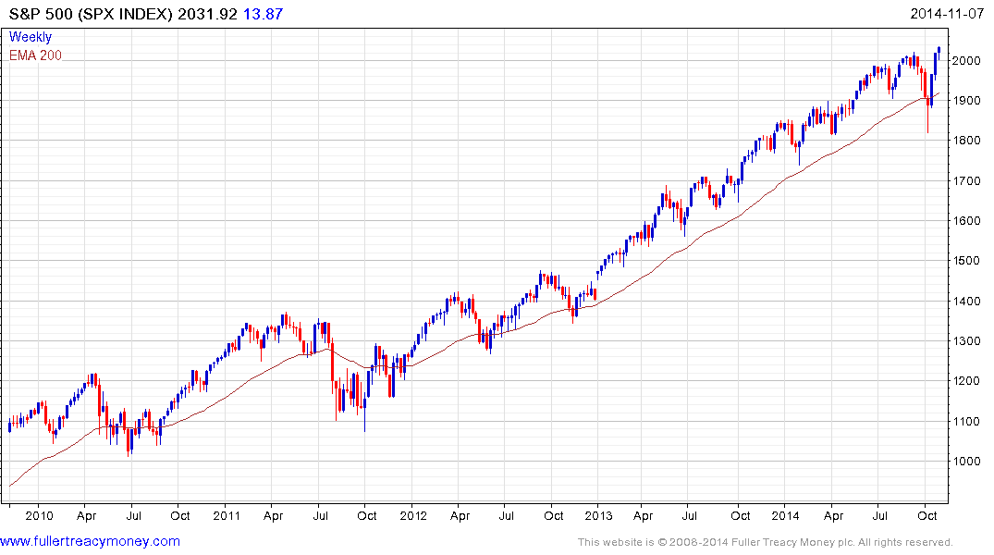
Roundophobia
Failed breaks
but warnings?
What were the uptrend consistency
characteristics from here, and have they changed?

Slide 16
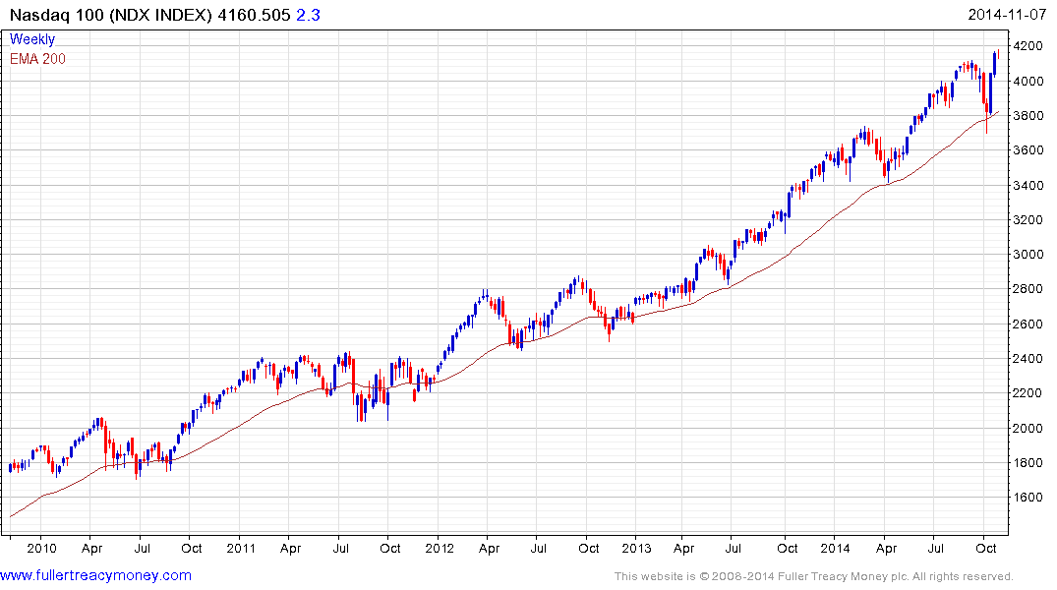
Tech still very much in form

Slide 17
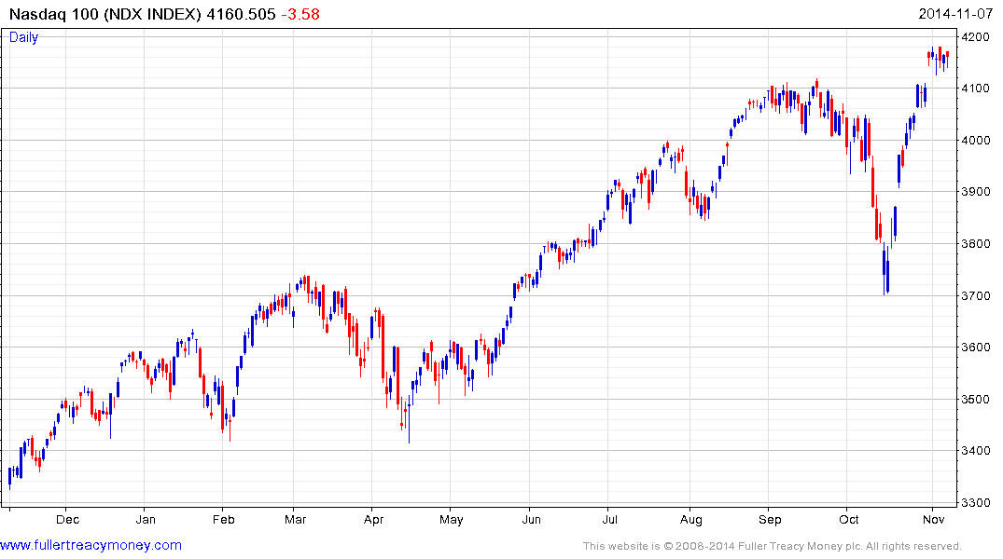
Significantly, recovered even
faster than it fell, showing liquidity
on the sidelines and a growing belief in the ‘Buy the Dips’ mantra.

Slide 18
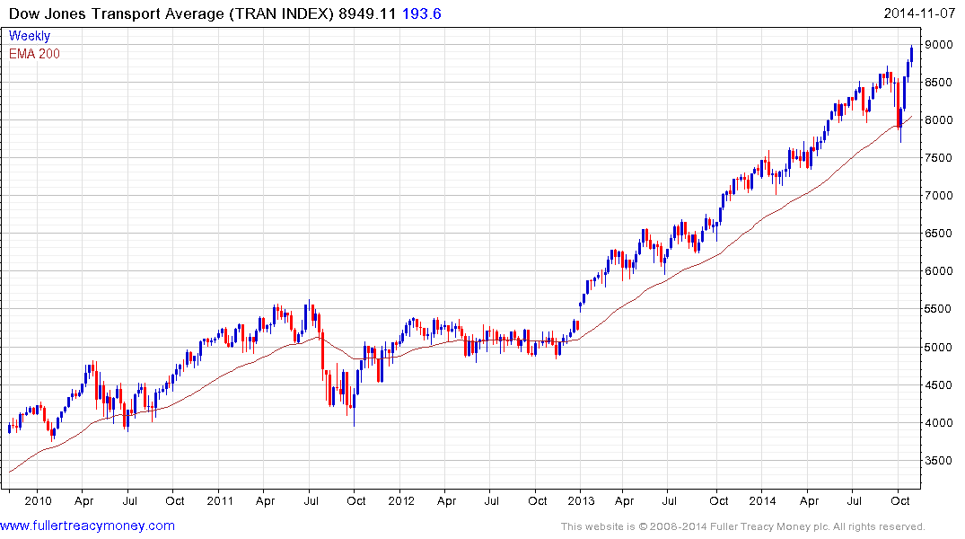
Transports have led the move to new highs,
confirming the strength of the US economy

Slide 19
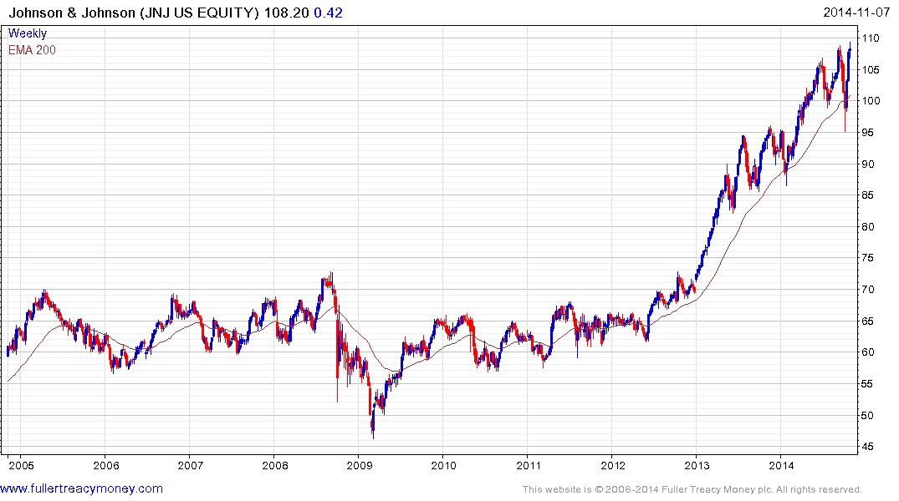
JNJ example of a still-inform Autonomy,
provided it holds above $95
est p/e 18, yield 2.59%

Slide 20
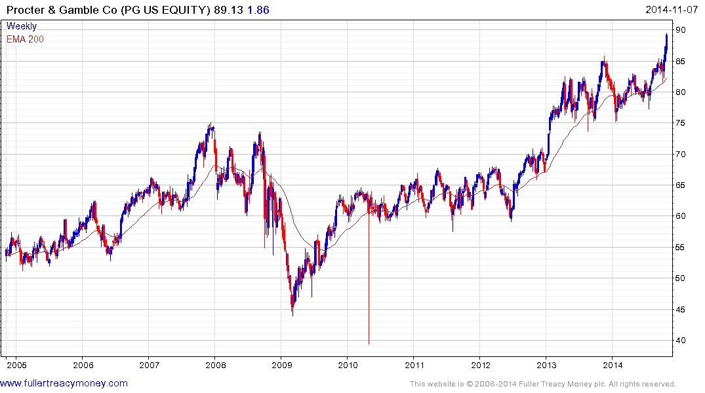
PG another example of an inform Autonomy,
provided it holds above $75
est p/e 20.39, yields 2.89%

Slide 21
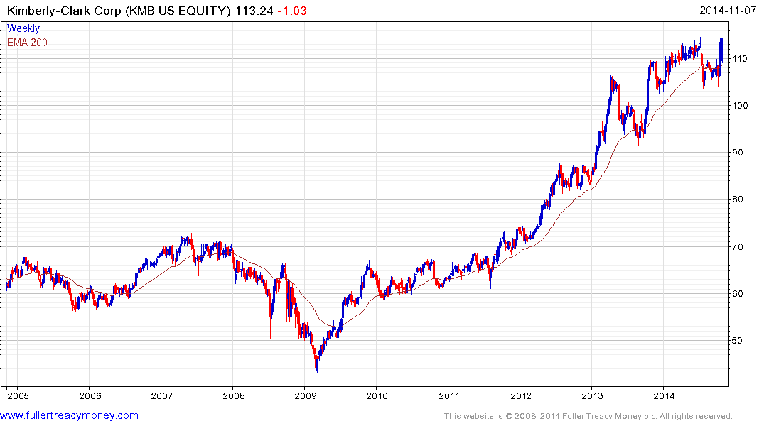
KMB another example of an inform Autonomy,
provided it holds above $104
est p/e 18.82, yields 2.97%

Slide 22
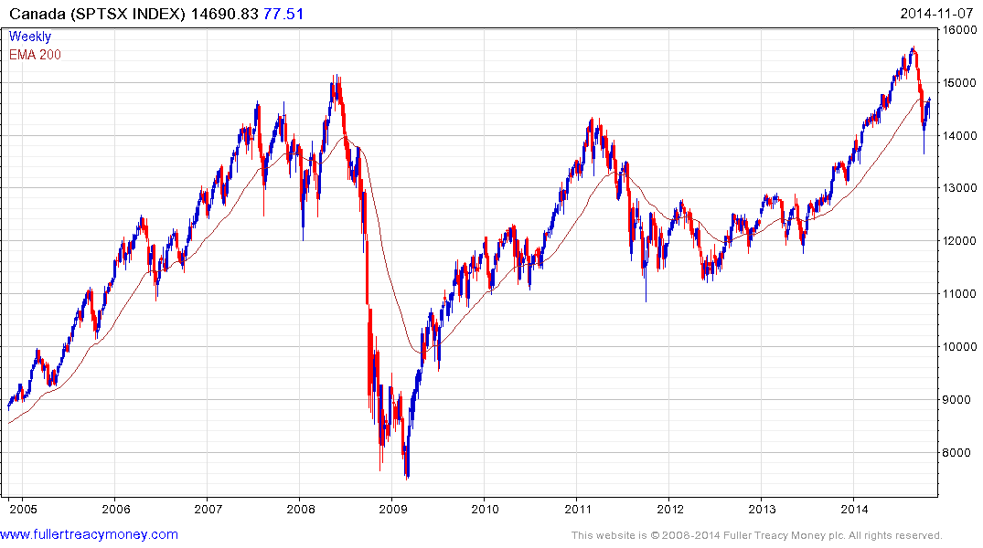
Lengthy correction due to
the sharp drop in oil prices

Slide 23
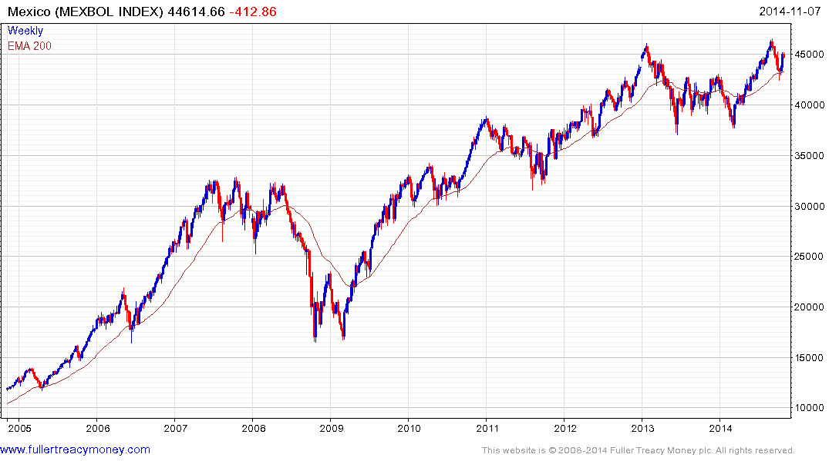
Can you see all the overextensions
and mean reversions on this chart?
The moving average is a wonderful
tool for identifying overextensions
and potential for mean reversion

Slide 24
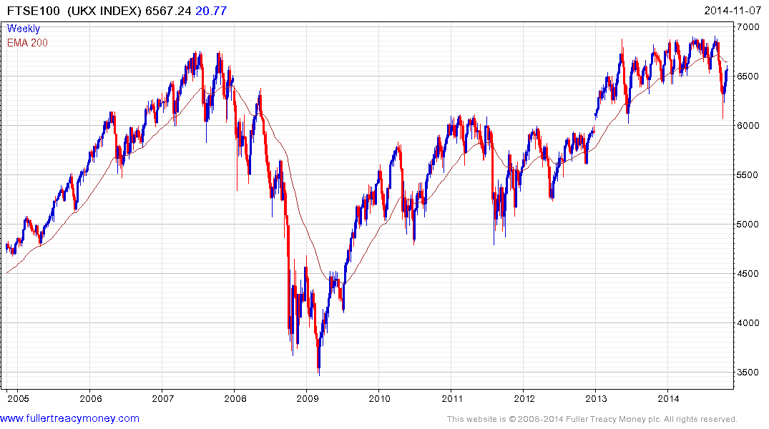
Significant breakdown from broadening
pattern, ending sequence of higher
reaction lows – 6000 level is important

Slide 25
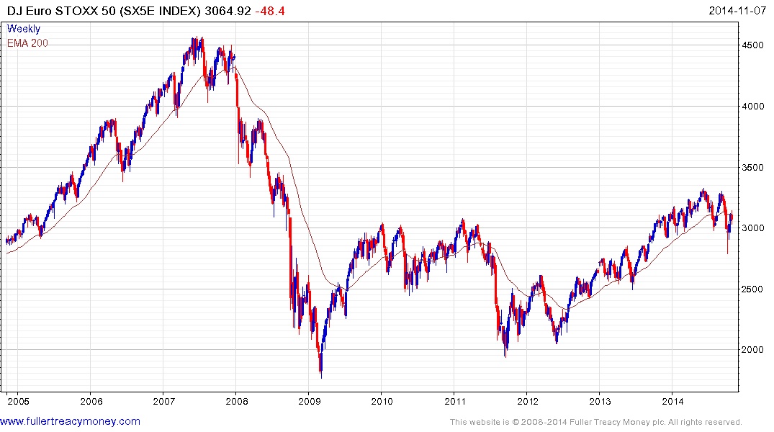
Did not maintain break beneath 3000 but overhead supply may still be a problem

Slide 26
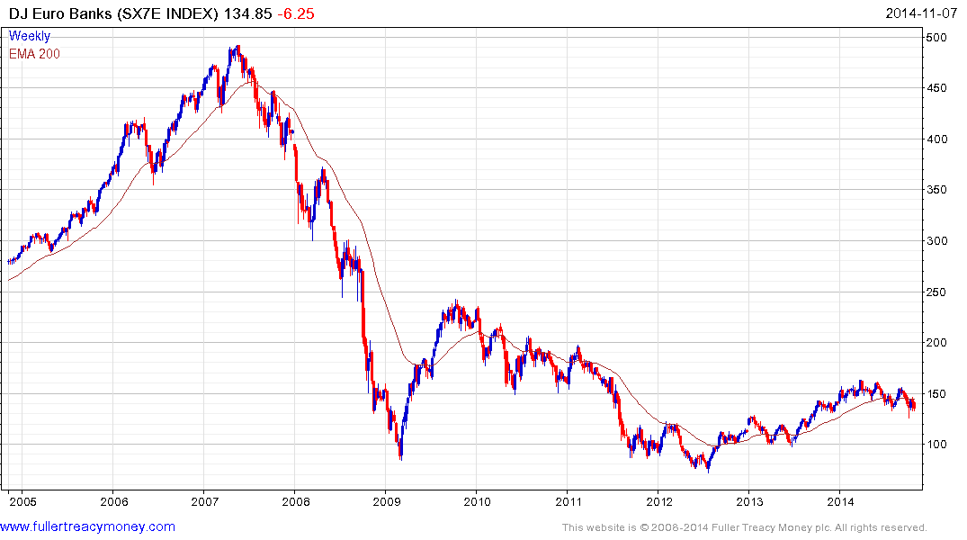
EU banks remain a concern
despite significant assistance
from the European Central Bank

Slide 27
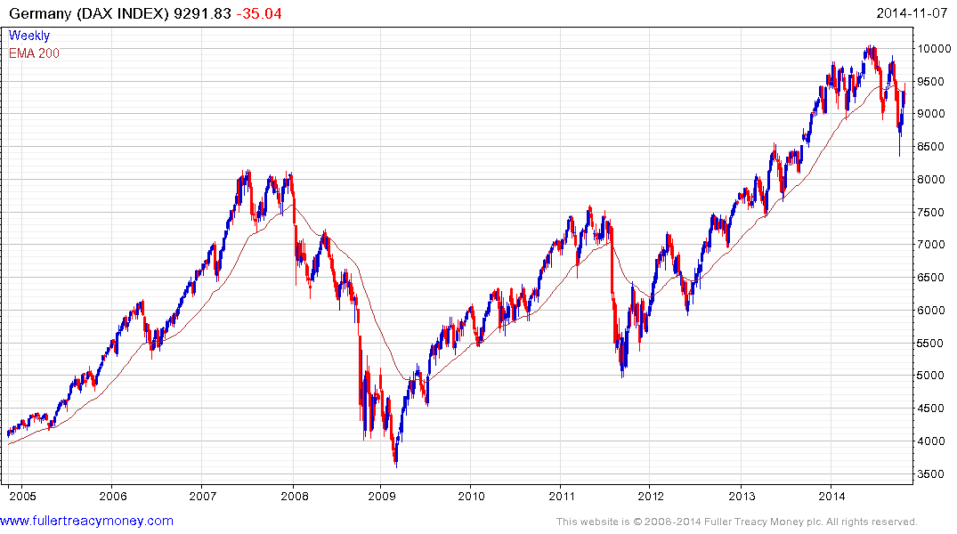
German DAX Index did not maintain
break beneath 8900 but has paused
beneath the declining MA and there is
plenty of overhead supply

Slide 28
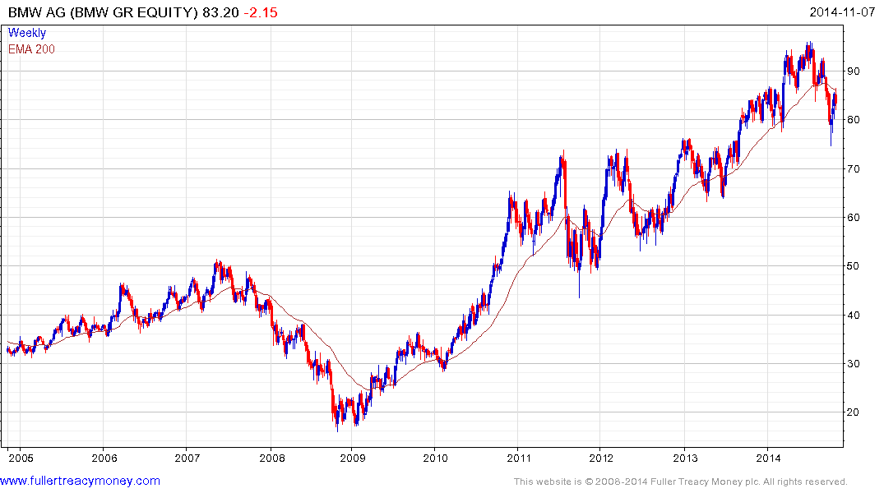
BMW is a cheap Autonomy,
Est p/e 9.24, yield 3.11%,
but needs to move above
and hold above the MA

Slide 29
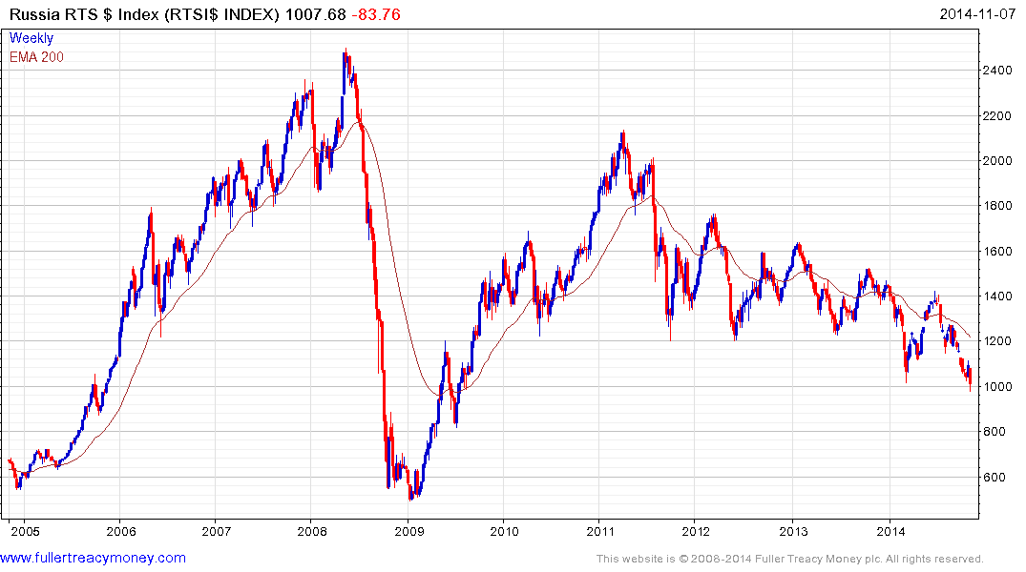
Governance is Everything - favourable
regime change would make Russia a
recovery candidate on cheap valuations

Slide 30
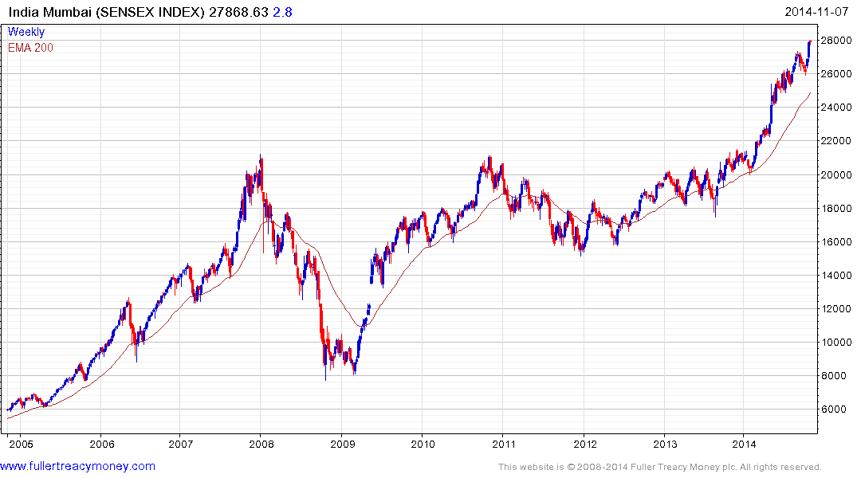
Watch the current trend’s consistency
characteristics for signs of medium-term
corrections and buying opportunities
My 5-year plus favourite,
due to Narendra Modi -
currently short-term O/B

Slide 31
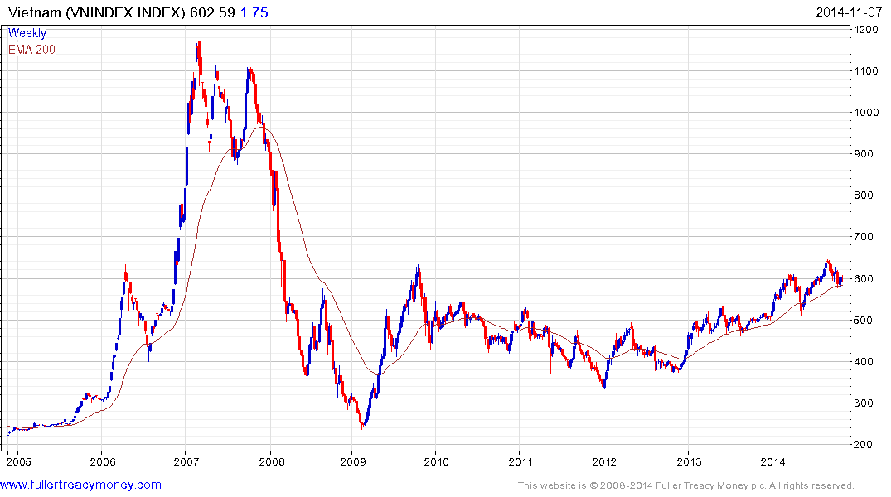
Still a very promising frontier market
Biggest risk – China’s potential aggression

Slide 32
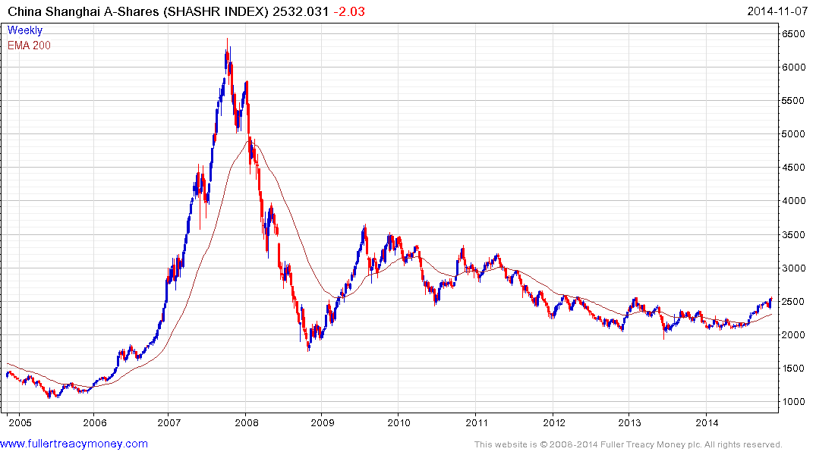
Enigmatic but attractively valued
and coming back into form – a
long-term favourite subject to governance

Slide 33
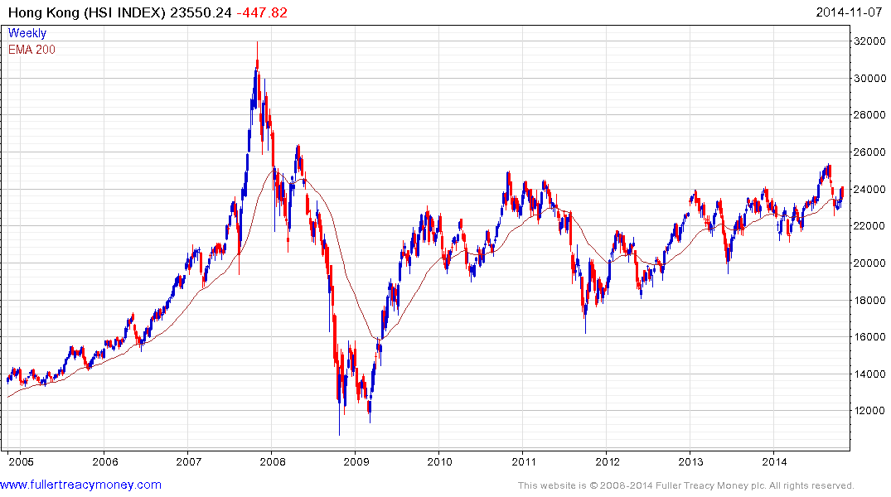
A long-term favourite
Biggest risk – if China erodes its freedoms

Slide 34
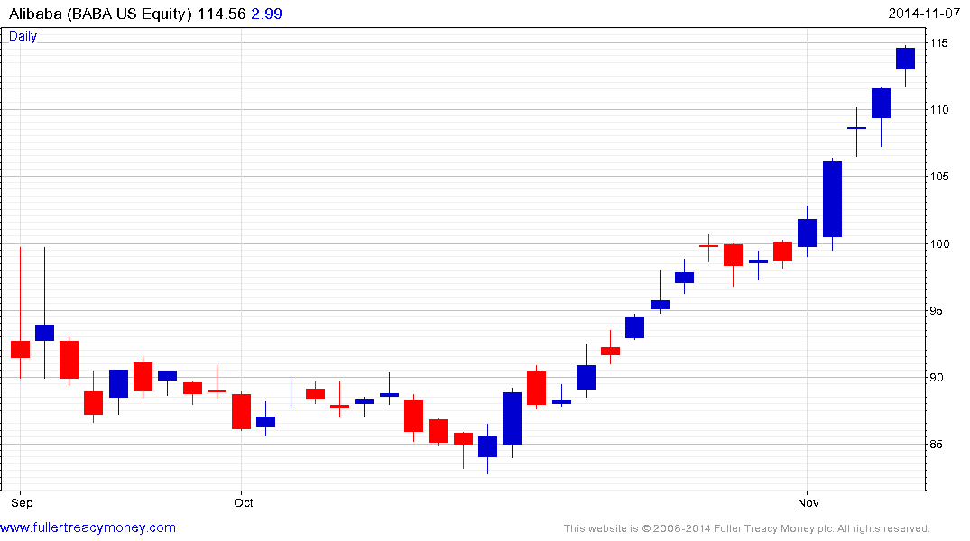
Is this reincarnation the new
corporate showpiece of China?

Slide 35
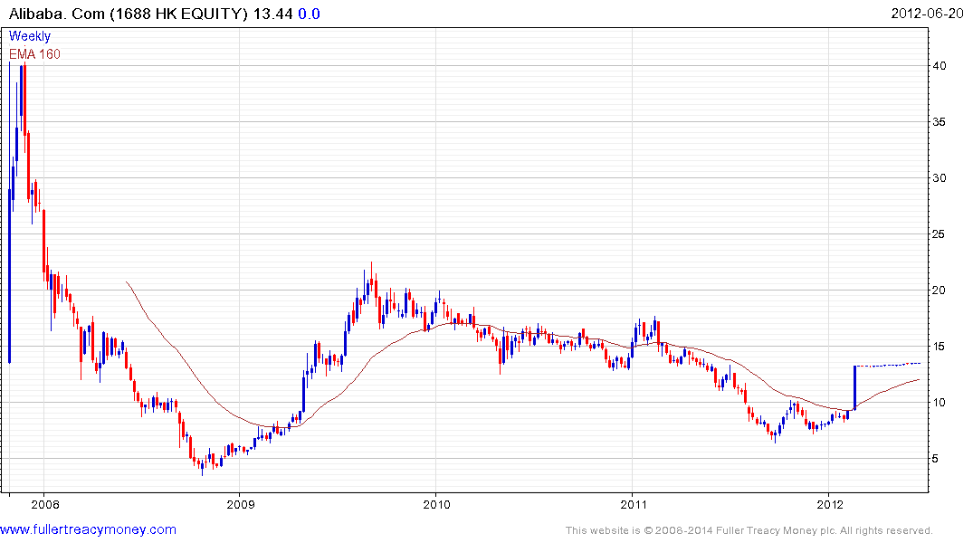
Acquired by Alibaba US

Slide 36
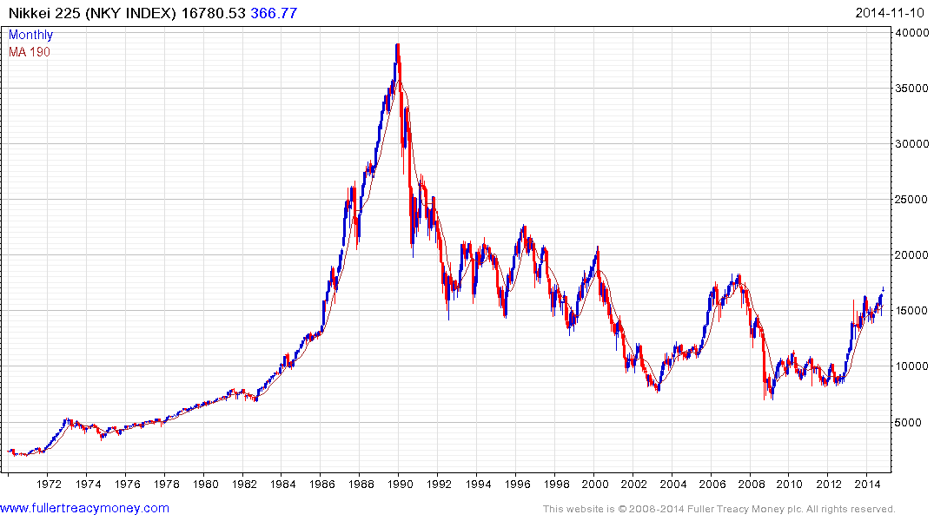
Still a classic recovery candidate
Following governance changes

Slide 37
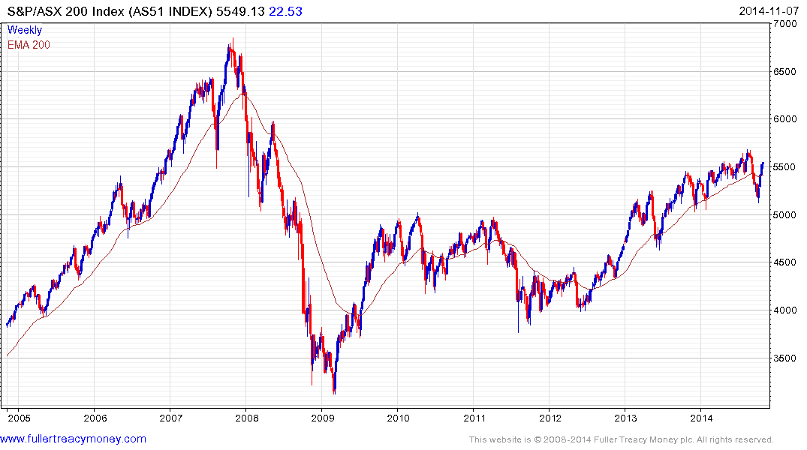
A long-term favourite
Shrugging off the resources slump?

Slide 38
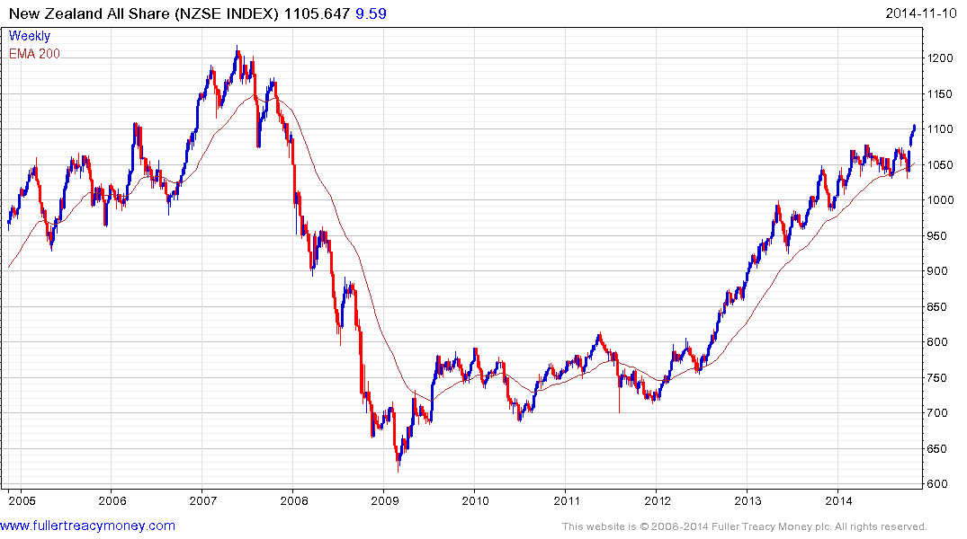
Still a long-term recovery favourite
provided it stays above 1030

Slide 39
Long-term bull factors for stock markets
Accommodative monetary policies, until growth accelerates
An accelerating rate of technological innovation
Lower energy prices in real terms, thanks to innovation
The triumph of capitalism, both democratic & authoritarian
Globalisation, hastening development of emerging markets
Middleclass growth in emerging markets
Continued growth in the global population

Slide 40
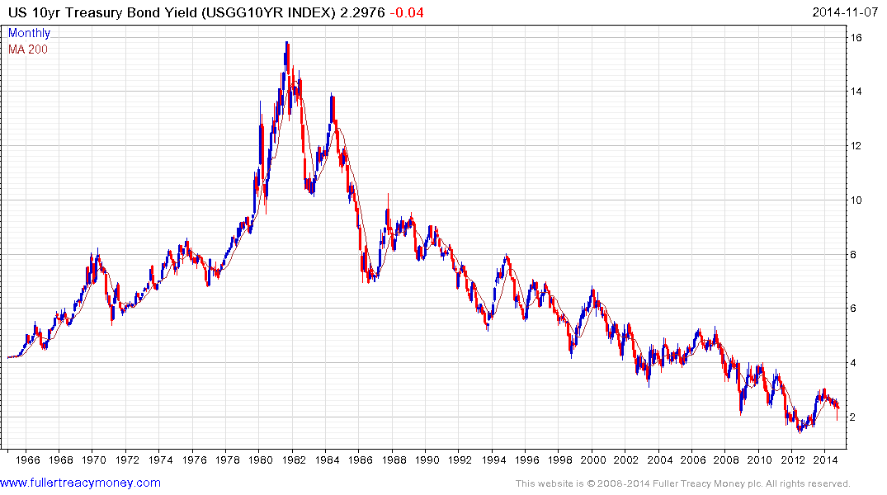
1) Probable lengthy base building
2) Above 3% base maturing
3) Above 4% probable base completion

Slide 41
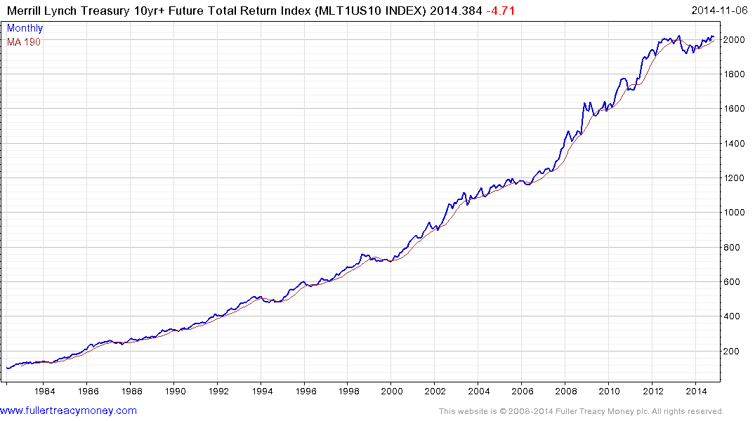
Top completion for US bondholders
when this total return
pattern breaks downwards

Slide 42
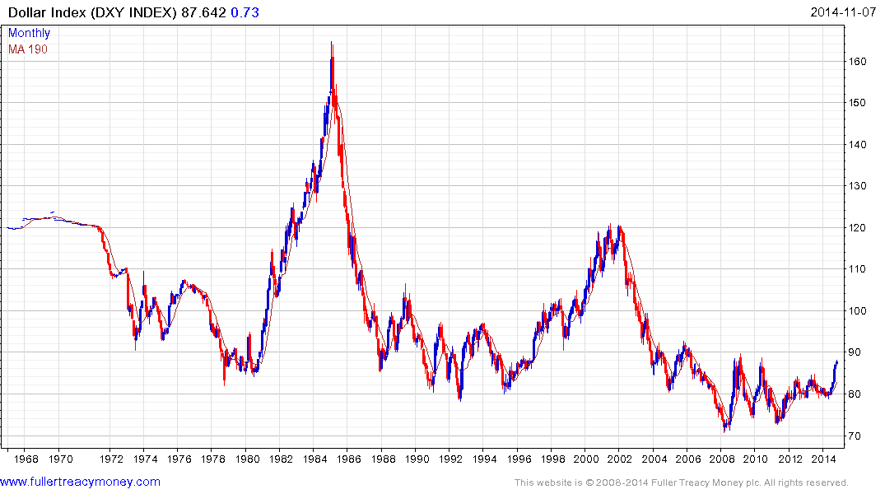
US Dollar Index completing a base formation
Driven by energy independence & tech lead
Fed & Treasury will control speed of $ recovery

Slide 43
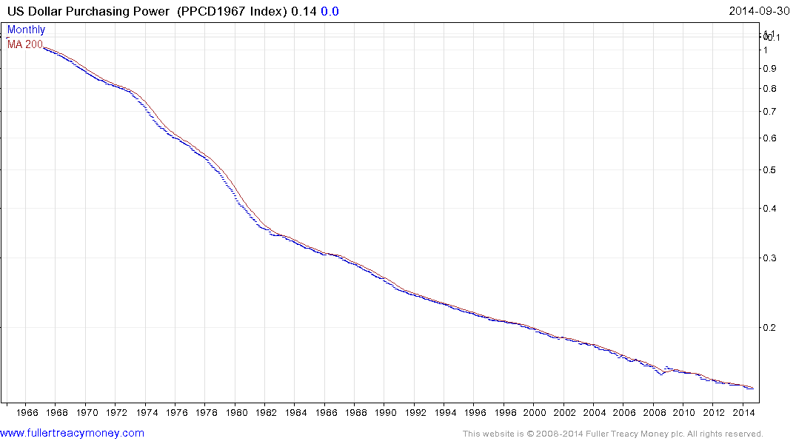
Nevertheless the US dollar is still a fiat currency, which
has lost most of its purchasing power since only 1968

Slide 44
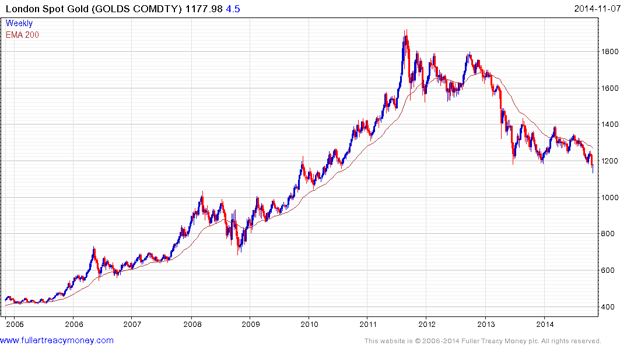
Gold is hard money, albeit with
a fluctuating price, just like
anything else which can be
bought or sold.
1. Broke critical juncture
2. Traders heavily short
3. Yet to reach sufficient revulsion stage for investor
or trader longs?
4. Indians & Chinese buying

Slide 45
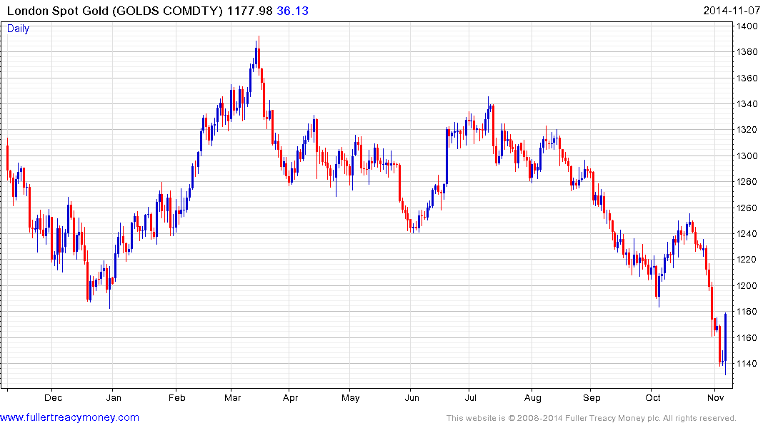
Big upside key day reversal
last Friday

Slide 46
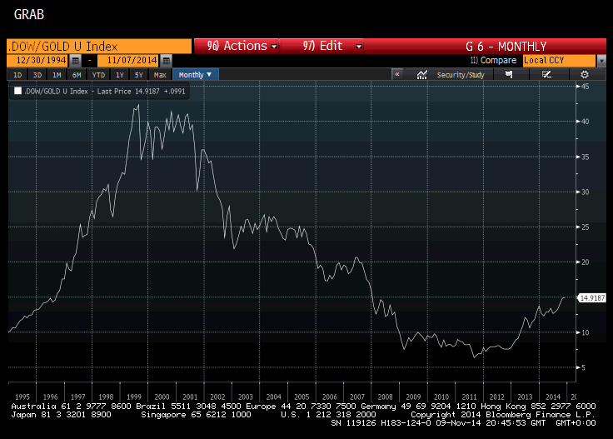
Gold has been out of favour
with Western investors
who are in stocks & bonds

Slide 47
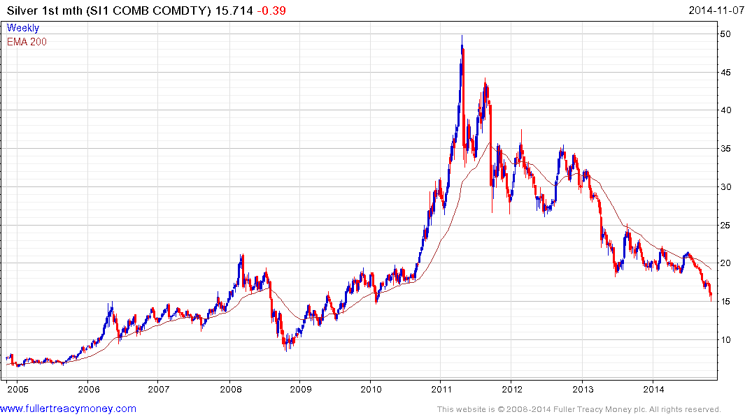
Silver is high-beta gold
It will outperform When the
yellow metal really has bottomed

Slide 48
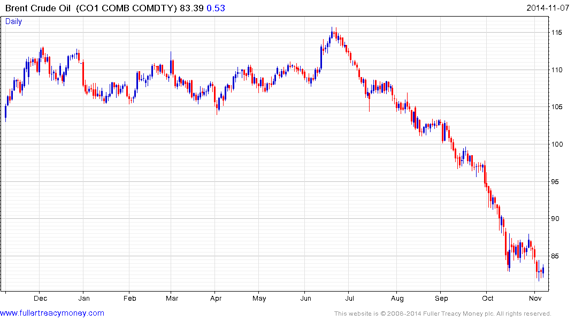
Currently oversold but rallies $105
are unlikely to hold

Slide 49
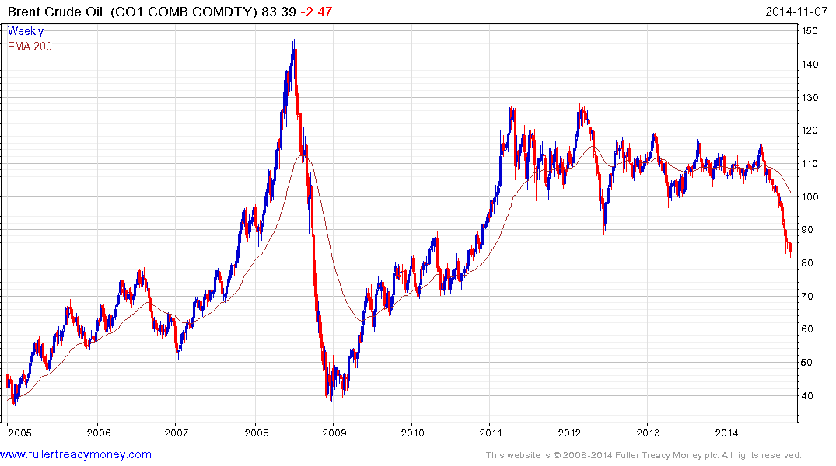
The ending of an era for producers of crude oil
They are losing price control in this market
No more price spikes
such as 2008, despite
turmoil in many producer
regions and an eventual
global economic recovery

Slide 50
Many thanks for your interest!
Any more questions?
Please visit our site:
www.fullertreacymoney.com

Slide 51
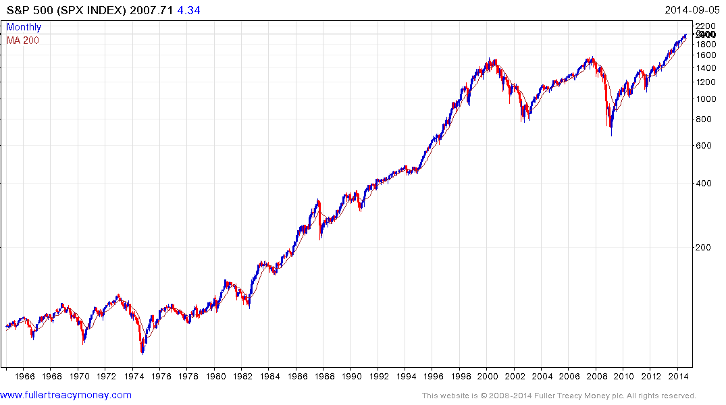
Is Wall Street’s next
secular bull market
Underway?
If so, it will be led by
Accelerated technological innovation
Lower energy costs in real terms
Worldwide acceptance of capitalism
Globalisation
An increasing global population
A rapidly growing global middleclass

