Slide 1
Investing in Technology
• Tech Investing: The Big Picture-Online (almost) Everywhere.
• Today’s MegaTech: The FAANGs & The Nifty Nine.
• Tomorrow’s World: DIY Tech tools, Automation from SMBs to the Home Cooking.
Charles Elliott
Founder, Inflection Point Investments
charles.elliott@ipinv.com

Slide 2
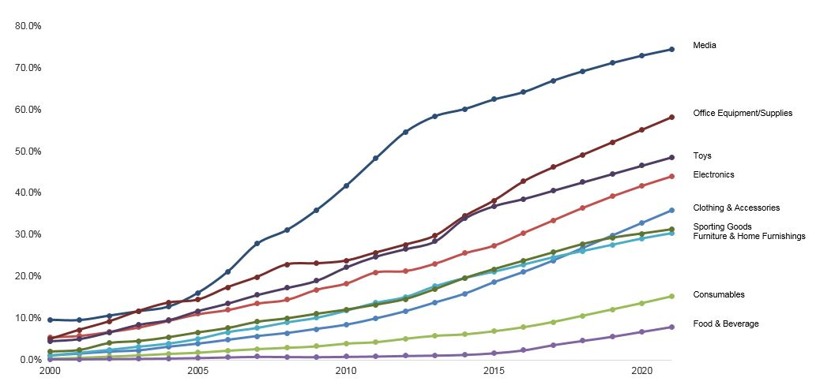
U.S. e-Commerce Penetration by Vertical '00-'22

Slide 3
Each new Technology wave exceeds the last
1970s Tech winners were the mainframe Computer companies. The world has 32,000 mainframe sites.
The ‘PC’ was able to handle most mainframe tasks from the early 1980s. The PC installed base is approximately 945Mn units
The Smartphone installed base is forecast to reach 3bn in 2017, 4bn by 2019.

Slide 4
Ruthless Obsolescence
Mainframes
IBM, Burroughs, UNIVAC, NCR, Control Data Corporation (CDC), and Honeywell.
PCs:
Microsoft + Intel = 90% of industry earnings 1989-2009
Smartphones:
iPhone + Android dominant
Online Advertising :
Google / Facebook
Online Retailing:
Amazon

Slide 5
Factors Driving Leadership Changes
Incumbents hate disrupting their own models. It could mean changing the entire workforce.
Scepticism that the new product works. “Everybody thinks everybody else is doing it, hardly anybody is-and, among those…it is not safe”.
“If it turns out it works-we’ll acquire it”.
Result: Massive premiums paid to buy promising new leaders. The assets (especially R&D engineers) typically leave, often for new start-ups.

Slide 6
FOMO & FOGEG
Reflecting this pattern, Tech Titans often have undemanding valuations on decent growth prospects, while Emerging Tech can look very expensive.
High valuations on Emerging Tech are often attributed to FOMO: Investor Fear of Missing Out (on new Technologies)-however, these more often produce major earnings beats, or be acquisition targets, or both.
Low valuations on maturing Tech should probably be attributed to FOGEG: Investor Fear of Going Ex-Growth.

Slide 7
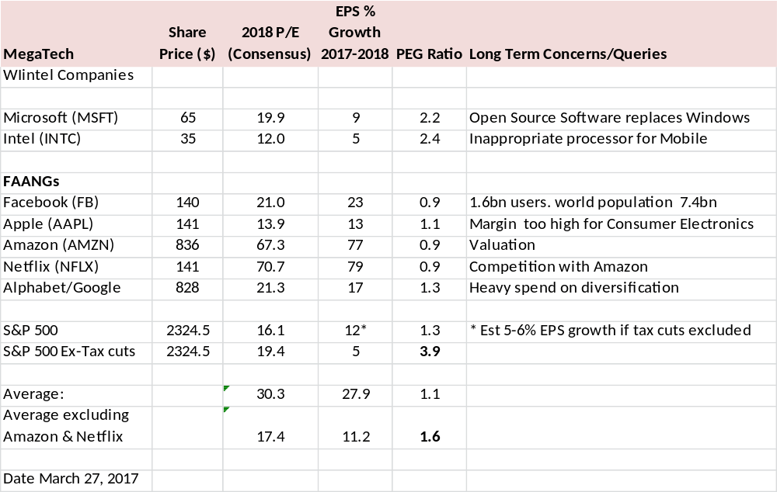
Valuations on ‘maturing’ Tech

Slide 8
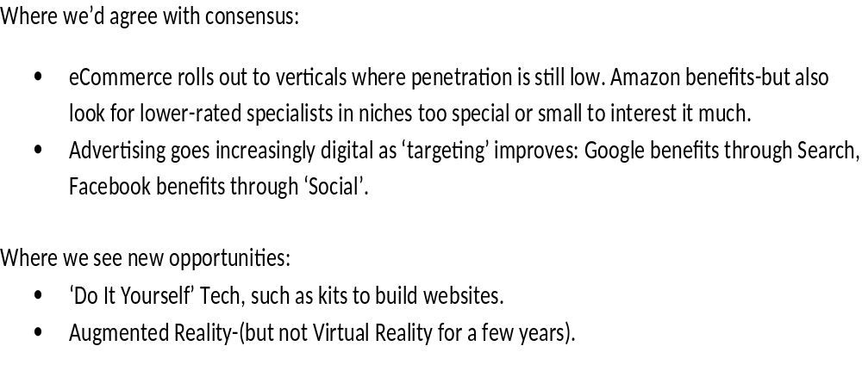
New MegaTech Trends
Up to 2020

Slide 9
Small to 2020, Big Beyond
Electric Vehicles, Driverless Cars, Flying Cars: Apple, Google, Tesla & Uber disrupt conventional car makers. Their advantages:
  Battery price/power (Tesla)
  Software capabilities (Apple, Google,Tesla)
  High utilisation capability (Uber, car-share companies)
Artificial Intelligence, Machine Learning, Voice Recognition, Virtual Reality-evolving well now, but beware ‘hype’.

Slide 10
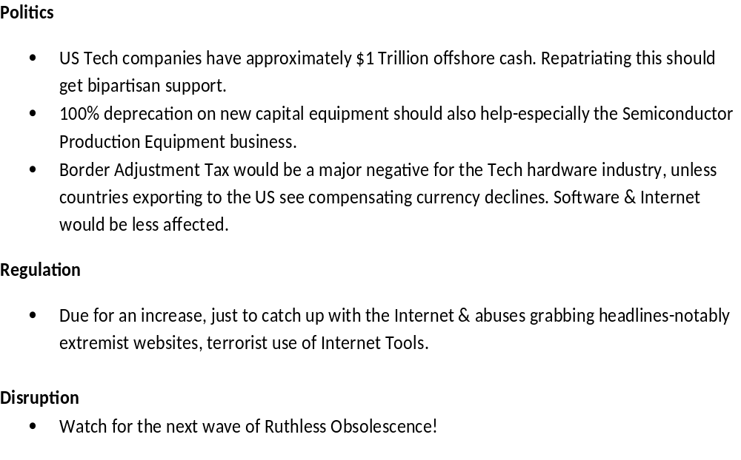
New Issues & Risks

Slide 11
Stock Picks
Tech Titans:
  Amazon for the roll-out of e-commerce, barriers to entry, and cash flow greatly exceeding stated earnings.
  Google & Facebook for continued growth existing earnings and strong next-generation product lines.
Small & Mid-Cap:
  Controversial catch-all name here: Rocket Internet: 50% minimum discount to Sum of the Parts, upside option on Internet models for Emerging markets.
Holding | SOTP value per share (€)
Hello Fresh | 3.8
Delivery Hero | 8.7
Other “Proven Winners” | 4.8
Regional Internet Groups | 2.6
New Businesses | 3.2
Investments | 1.2
Net Cash (discounted by 25%) | 6.1
Total | 30.4

Slide 12
Disclaimers
Inflection Point Investments LLP is authorised and regulated by the Financial Conduct Authority (UK) under FCA register no: 465103. Registered office: 59 Ravenscourt Road, London W6 0UJ
This document is issued in the United Kingdom by Inflection Point Investments LLP (“Inflection Point Investments”), which is authorised and regulated by the Financial Conduct Authority (“FCA”). Inflection Point Investments Company Limited (the “Fund”) is not a recognised collective investment scheme for the purposes of the Financial Services and Markets Act 2000 of the United Kingdom (the “Act”). The promotion of the Fund and the distribution of this document is accordingly restricted by law. This document is exempt from the scheme promotion restriction (in Section 238 of the Act) on the communication of invitations or inducements to participate in unrecognised collective investment schemes on the grounds that it is being issued to and/or directed at only persons who are professional clients or eligible counterparties for the purposes of the FCA’s Conduct of Business Sourcebook.
To the extent that this document is issued by Inflection Point Investments, the opportunity to invest in the Fund is only available to such persons and this document must not be relied or acted upon by any other persons. Any recipient of this document who is an authorised person may (if and to the extent it is permitted to do so by the FCA rules applicable to it) distribute it or otherwise promote the Fund in accordance with Section 238 of the Act but not otherwise. Any recipient of this document who is not an authorised person may not distribute it to any other person. This document does not constitute or form part of any offer to issue or sell, or any solicitation of any offer to subscribe or purchase, any investment, nor shall it or the fact of its distribution or communication form the basis of, or be relied on in connection with, any contract therefor.
Applications for investment in the Fund can only be made on the basis of the current prospectus. The information and opinions contained in this document are for background purposes only, do not purport to be full or complete, and do not constitute investment advice. Inflection Point Investments neither provides investment advice to, nor receives and transmits orders from, investors in the Fund, nor does it carry on any other activities with or for such investors that constitute "MiFID or equivalent third country business" for the purposes of the FCA Rules. Past performance is not a reliable indicator of future results. Inflection Point Investments gives no representations or warranty that any indicative performance or return will be achieved in the future or that the investment objectives and policies from time to time of the Fund will be achieved. You should note that, if you choose to invest in the Fund, your capital will be at risk and you may therefore lose some or all of any amount that you choose to invest.
This material is not intended to constitute, and should not be construed as, investment advice. Information and opinions presented in this material have been obtained or derived from sources believed by Inflection Point Investments to be reliable, but Inflection Point Investments makes no representation as to their accuracy or completeness. No representation, warranty or undertaking, express or implied, is given as to the accuracy or completeness of the information or opinions contained in this document by any of Inflection Point Investments, the Fund, or any of their directors, officers, shareholders or employees and no liability is accepted by such persons for the accuracy or completeness of any such information or opinions. Investing in the Fund may expose an investor to a significant risk of losing all of the amount invested. Any person who is in any doubt about investing in the Fund should consult an authorised person specialising in advising on such investments.

