Slide 1
Increasing Risk of Medium-Term
Correction Within Ongoing Bull Market
This is a Markets Now Seminar
March 27th 2017
By David Fuller
fullertreacymoney.com
The Caledonian Club – 9 Halkin Street
London SW1Y 4LH, UK

Slide 2
The crowd’s animal spirits following Trump’s
election on 8th Nov drove stock markets
higher on promises of tax cuts, fiscal spending and repatriation of capital
However, share valuations have run far
ahead of 3% GDP growth forecasts and potential additional earnings increases,
which may not occur before 2018, at best

Slide 3
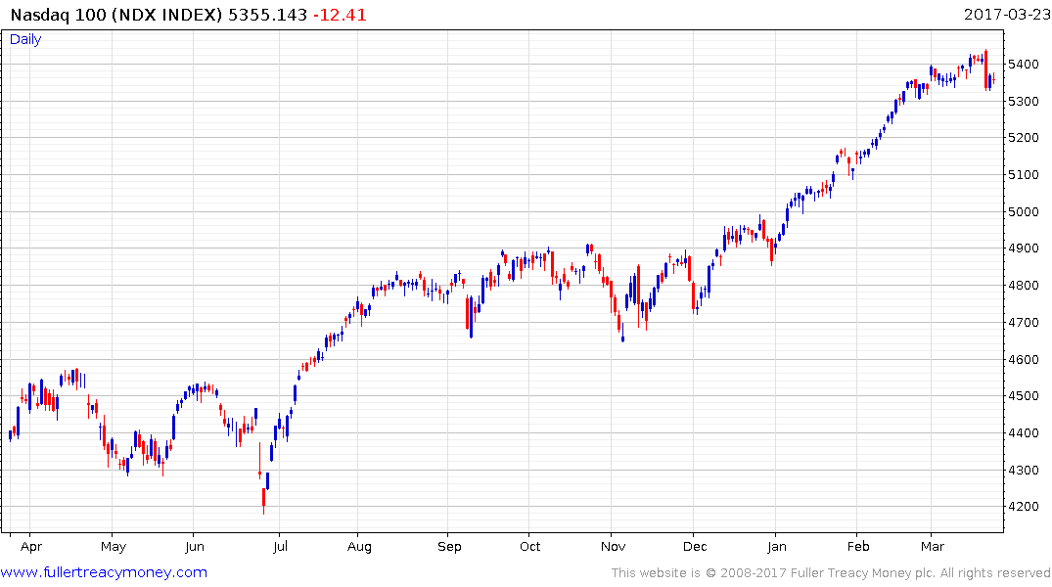
Nasdaq 100 (daily)
Trump wins
Downside key day
reversal on Tuesday
21st March signals
start of a correction
Pre-election caution

Slide 4
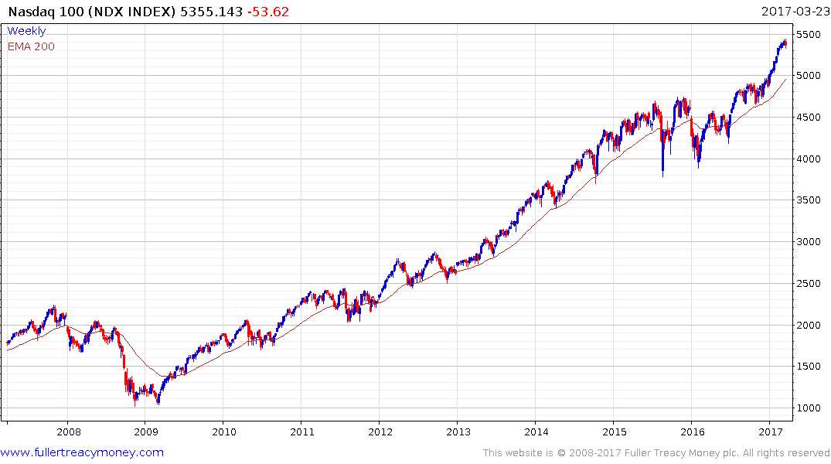
Nasdaq 100 (weekly)
Temporarily overextended
but above large support range
some mean reversion likely

Slide 5
Trump’s economic stimulus had been
discounted well before any surge in GDP
& proportionally higher corporate profits
Stock markets underperform, on average,
in 2Q and 3Q of each year
Meanwhile, investors’ worst fears about
Trump have not gone away

Slide 6
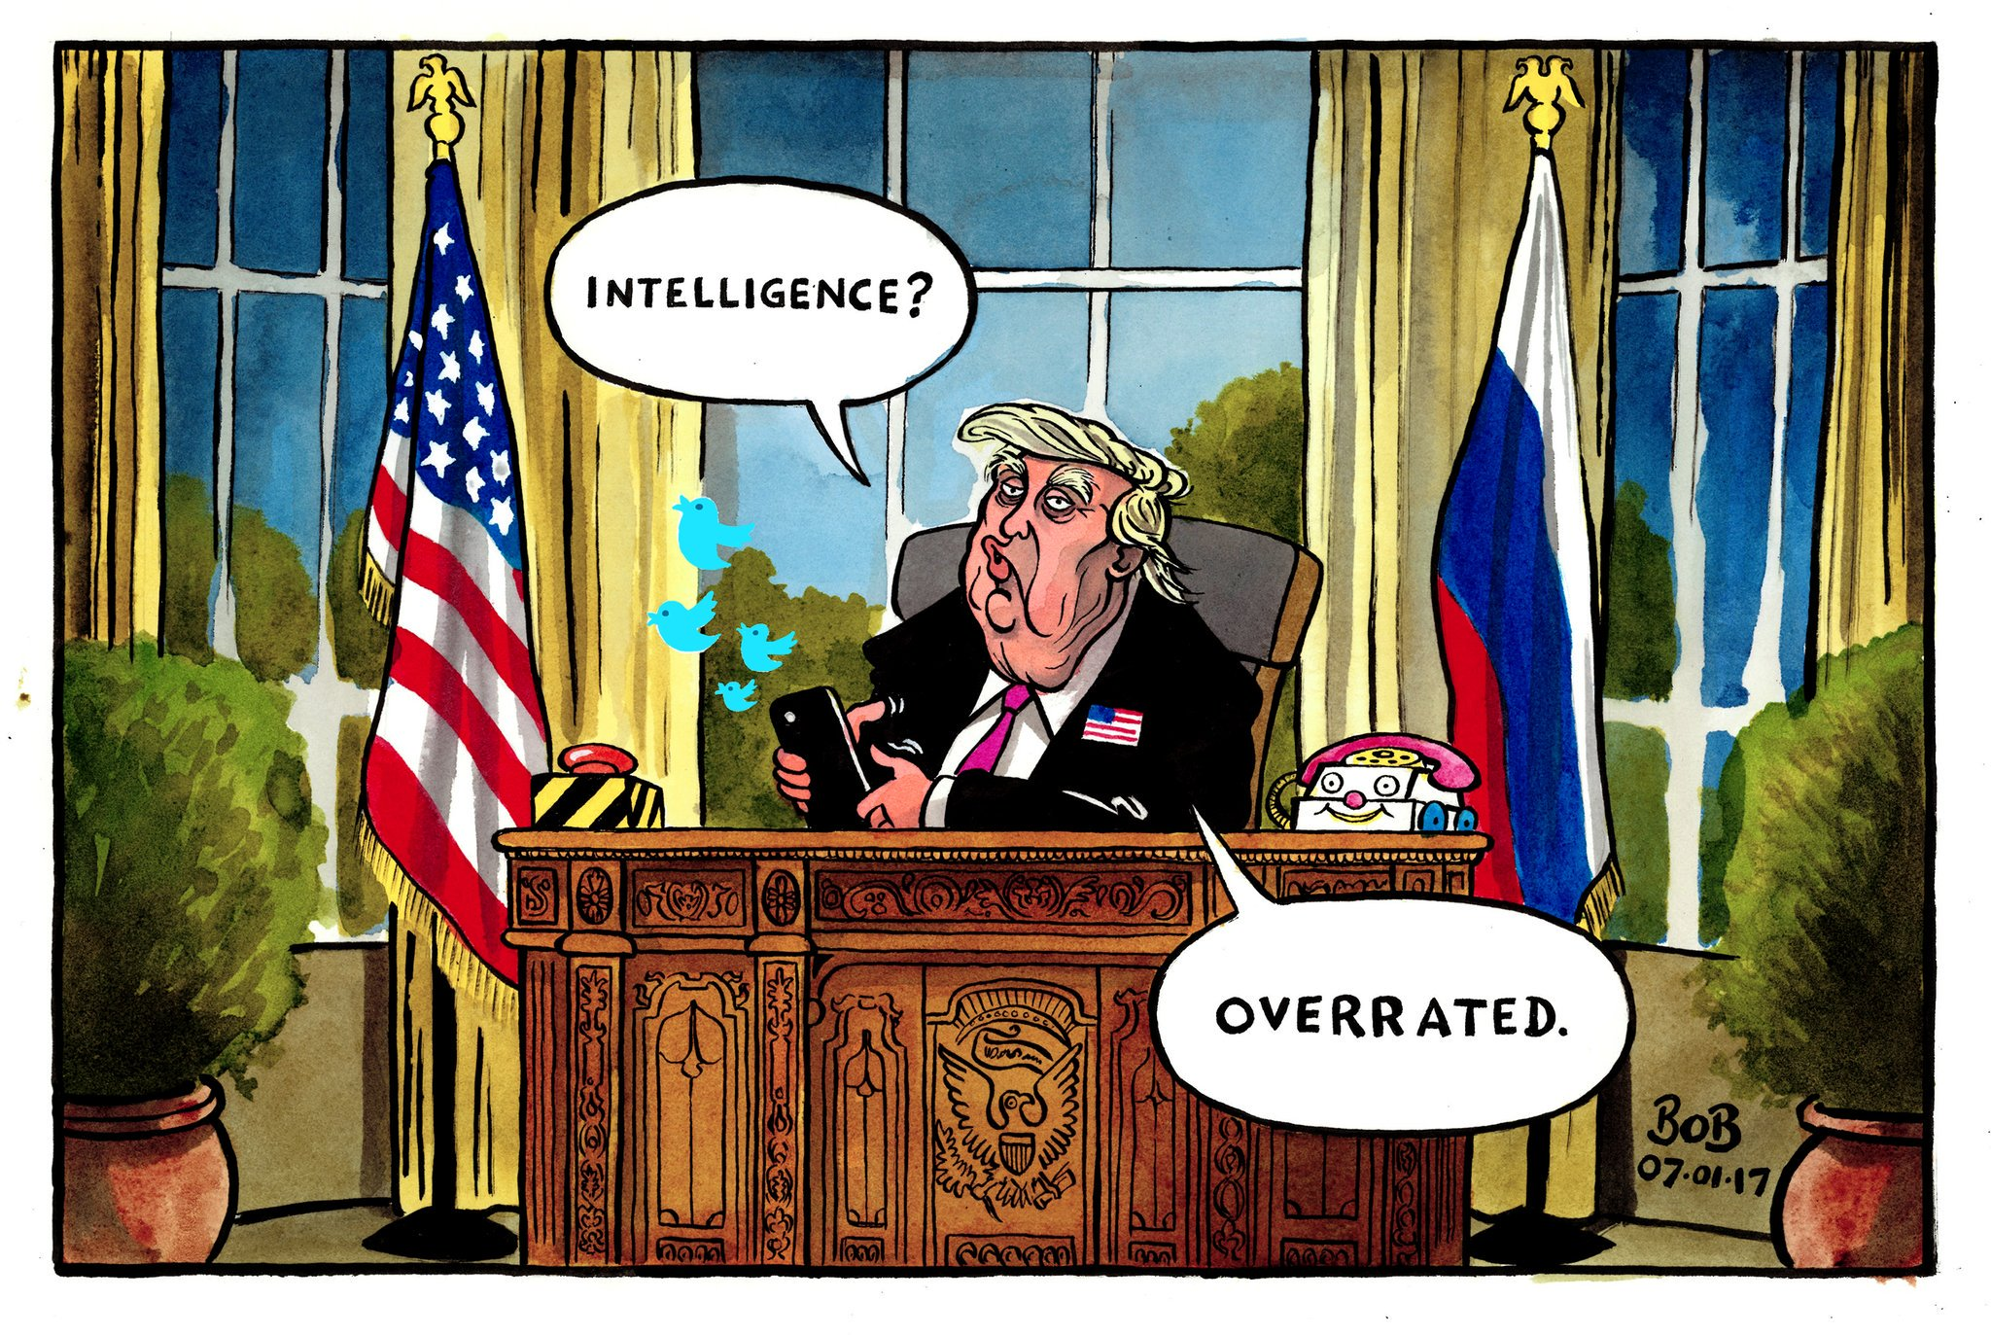

Slide 7
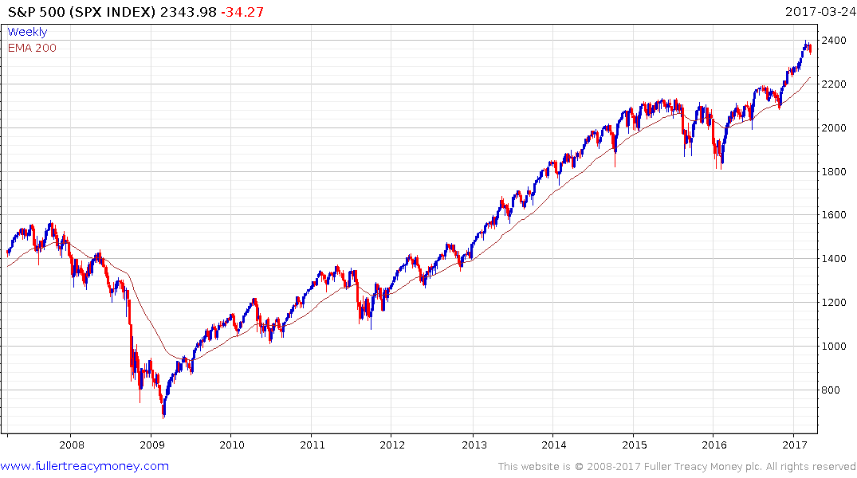
S&P 500 Index
Most other diversified US indices have
similar patterns, losing upside momentum
from temporarily overbought conditions
relative to their 200-day MAs

Slide 8
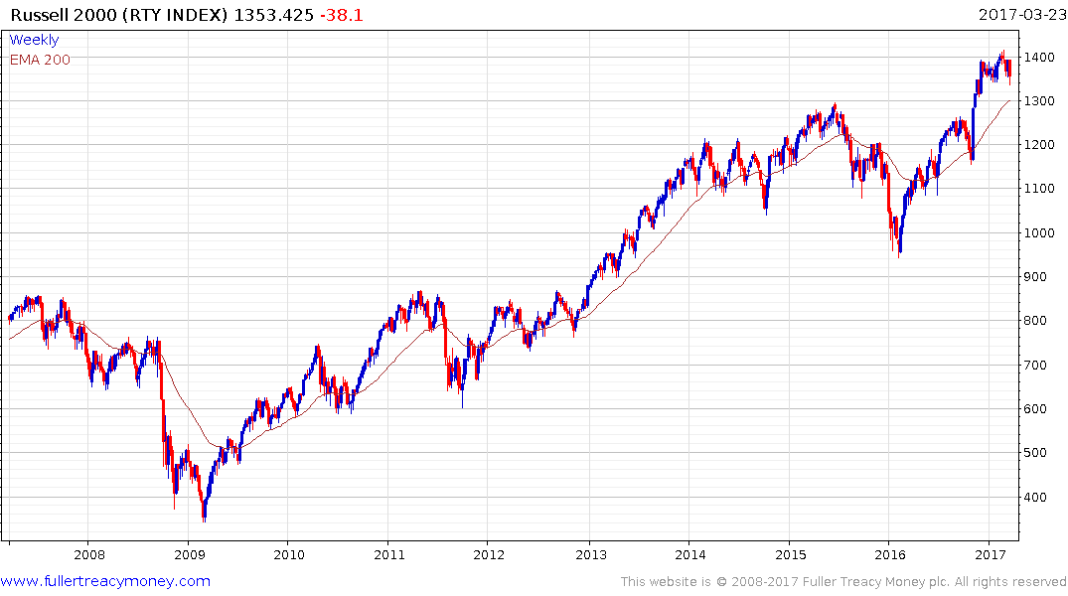
Russell 2000
Medium-cap shares are now
underperforming once again
as stock market breadth has
deteriorated

Slide 9
Market corrections occur periodically
They can be frightening but they also
create buying opportunities which we will see once again after investor sentiment
turns bearish

Slide 10
Looking further ahead (2017/18)
There is little evidence of another significant bear market, which many commentators have been predicting since 2008, although their greater optimism recently is another indication of an imminent correction

Slide 11
Over the next 10 years, we are very likely to see a cyclical bear market or two in stock markets but they will move higher overall
The known and likely bear market triggers:
1) After the US yield curve inverts
2) Treasury Bond yields rise towards 4%
3) The Dollar Index moves sharply higher

Slide 12
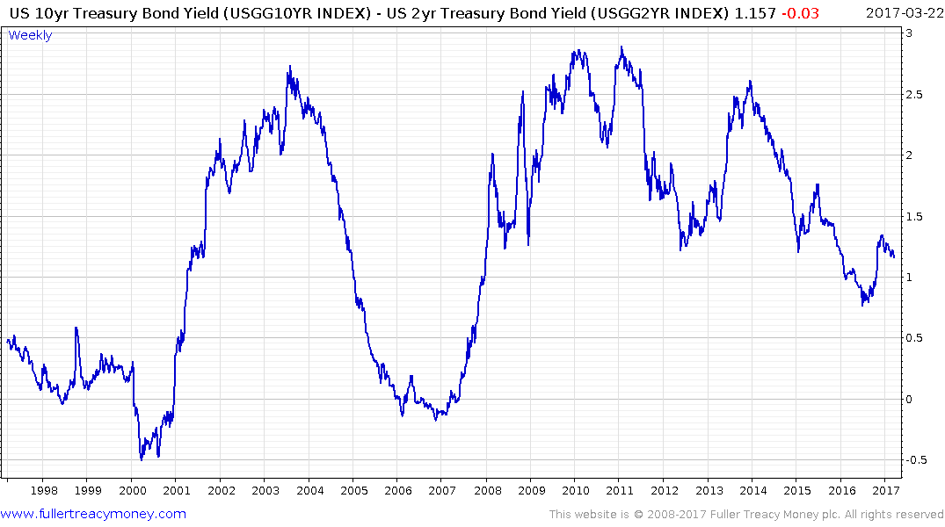
Monetary tightening causes
most bear markets, after
10 versus 2 year T-bond rates
invert
This is normally a leading indicator

Slide 13
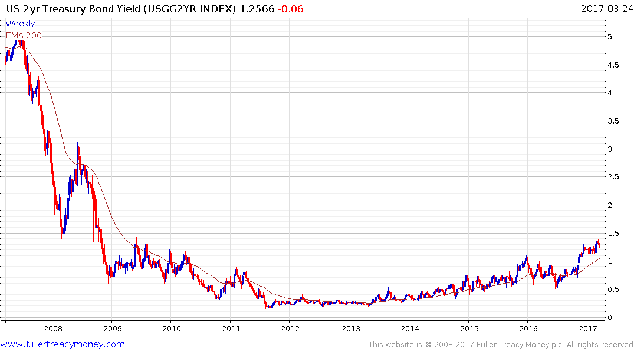
US 2yr Treasury Bond Yield
First step above
the base
Multi-year base

Slide 14
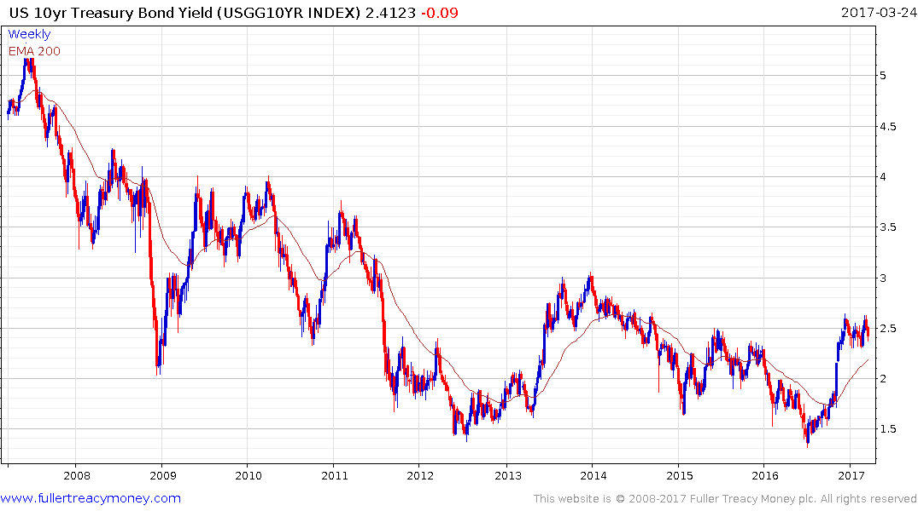
US 10-Yr Treasury Bond Yield
Historic low of 1.3180% on 6th July 2016 - I don’t think we will ever see that low again
Bond yields risky for equities above 4%
Bond yields start to become a
headwind for stocks above 3%
Some money trickling out of
bonds is going into equities

Slide 15
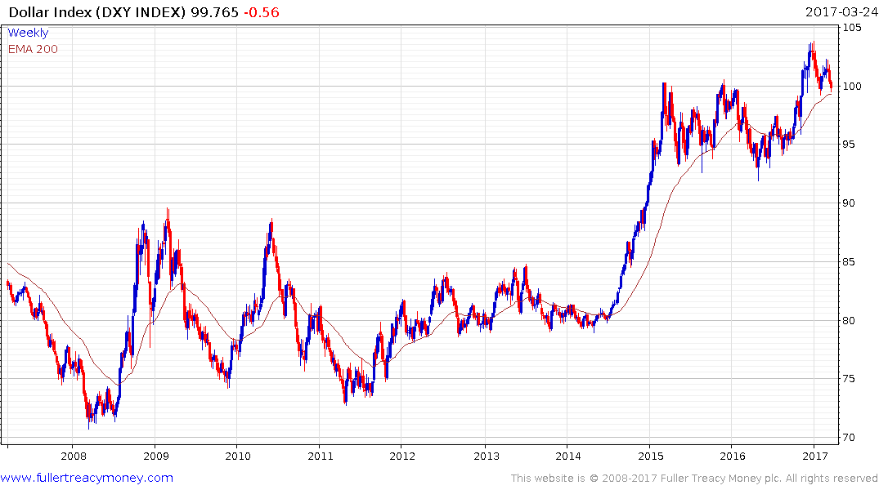
US Dollar Index (DXY)
A secular bull market is underway
which started from a very low base
Trump wins
Presidential
election but
is trying to
slow $ rise
Another sharp rise by the Dollar Index
would be risky for the US stock market

Slide 16
A quick look at
a few other stock markets
which may be of interest to you

Slide 17
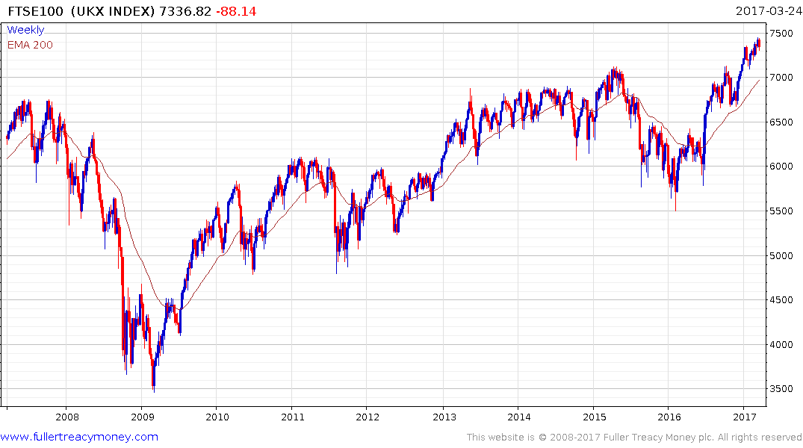
UK FTSE 100 Index
Brexit vote win
Holding up well following Brexit
vote, helped by soft sterling, a
steady economy and the
post-Trump election rally, but now
somewhat overextended

Slide 18
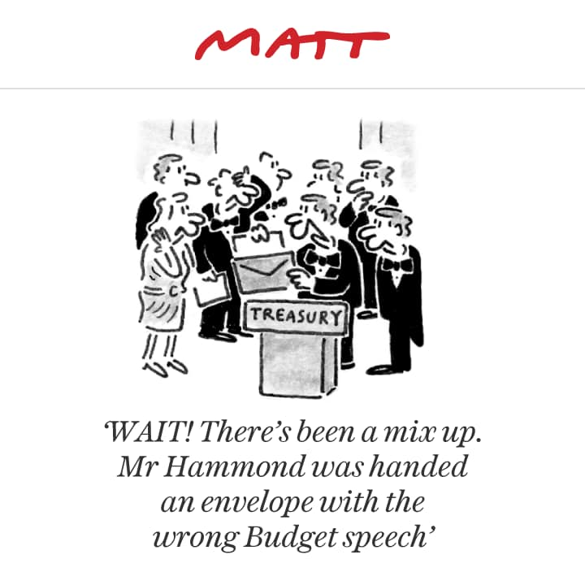

Slide 19
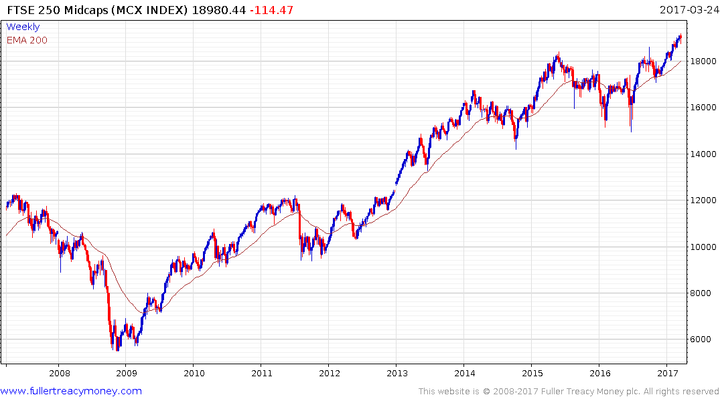
FTSE 250 Midcaps
Healthy overall pattern;
less affected by Brexit
concerns

Slide 20
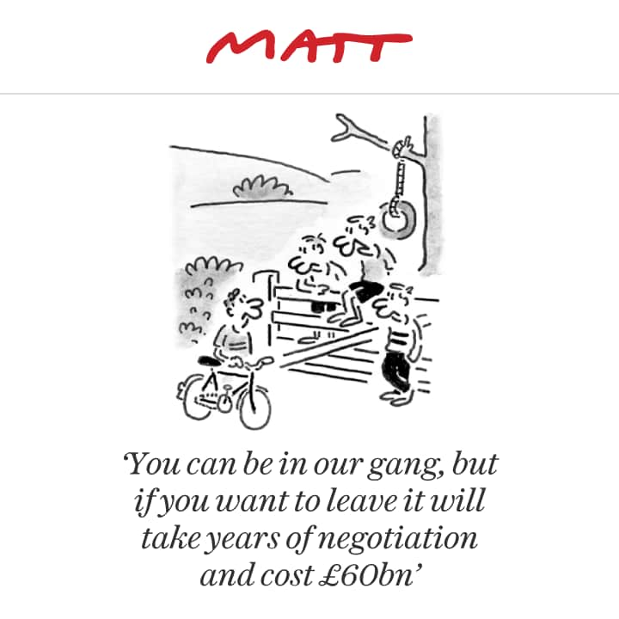

Slide 21
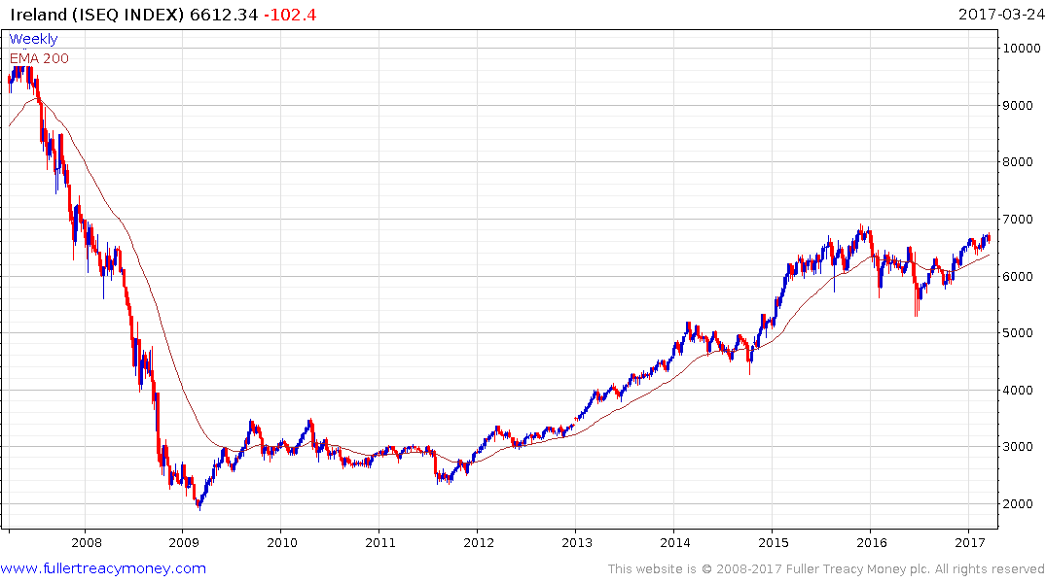
Ireland ISEQ Index
Gradually eroding resistance
within 2-year trading range
but needs to maintain sequence
of higher reaction lows since mid-2016

Slide 22
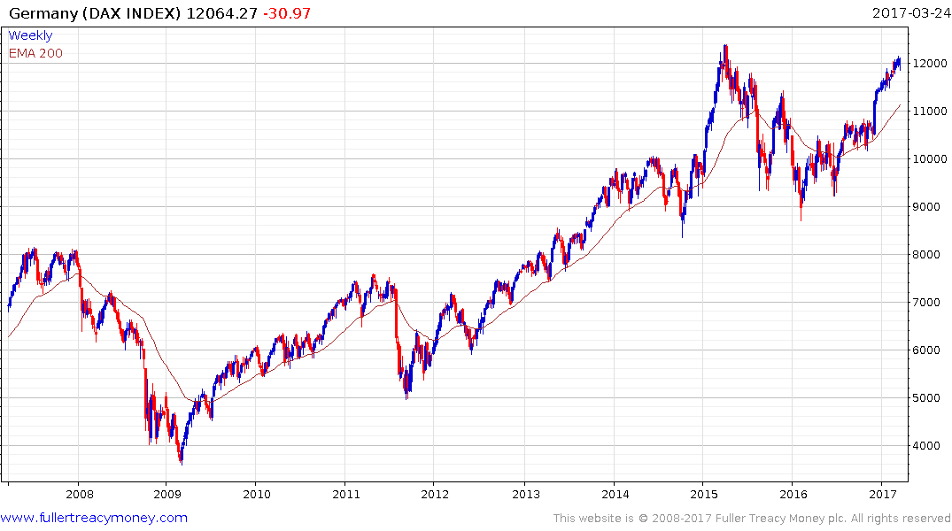
German DAX Index
Best market in terms of risk
and diversity within the EU
Temporarily overbought
but well underpinned by
large area of underlying
support

Slide 23
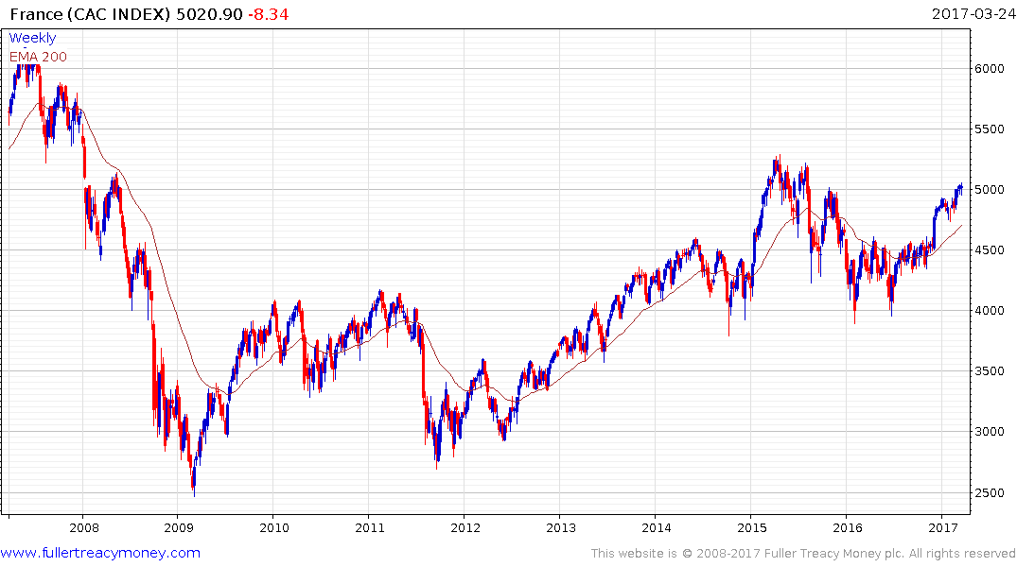
French CAC Index
Similar pattern to DAX although
considerably underperforming
Germany since 2009 lows

Slide 24
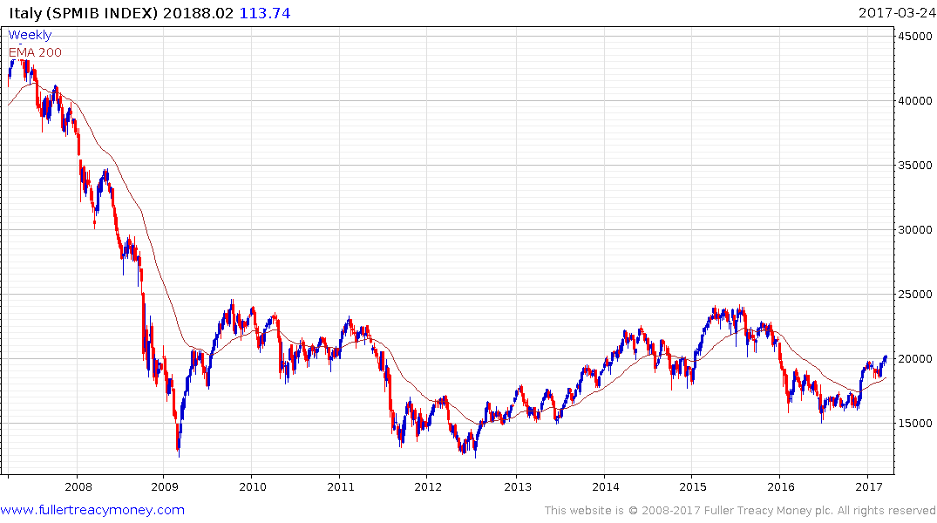
Italy SPMIB Index
A major victim of the Euro but
some recover from lower side
of trading range since 2009

Slide 25
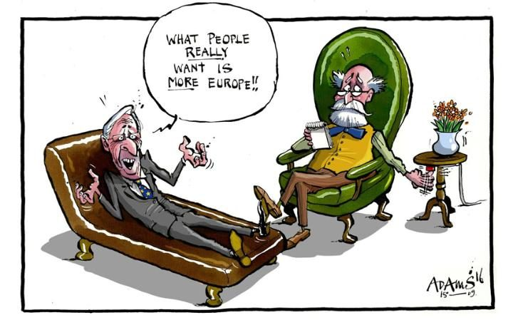

Slide 26
Asia Pacific
stock markets

Slide 27
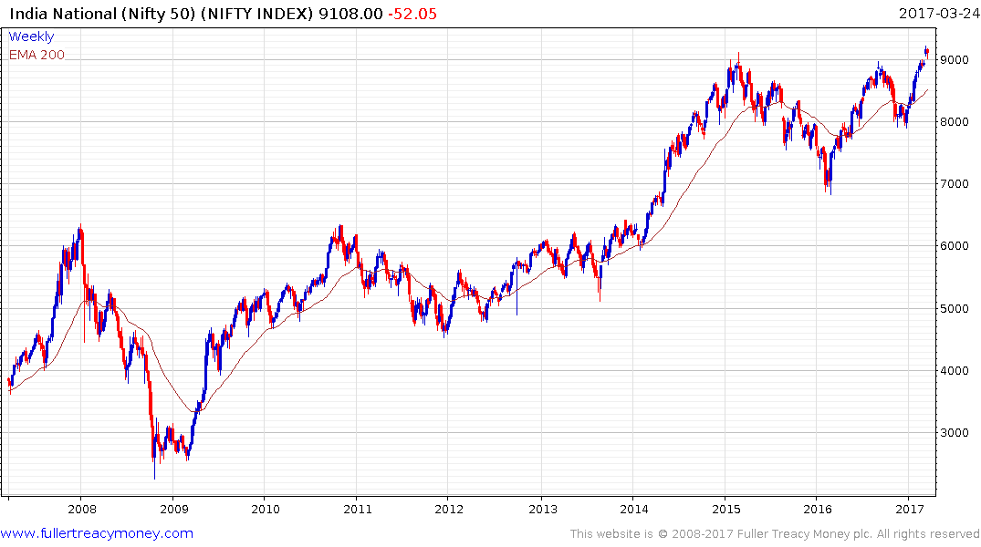
India Nifty 50 Index
A leading growth engine while
Narendra Modi remains President
Governance is Everything
The most successful
strategy for India has
been to buy the dips

Slide 28
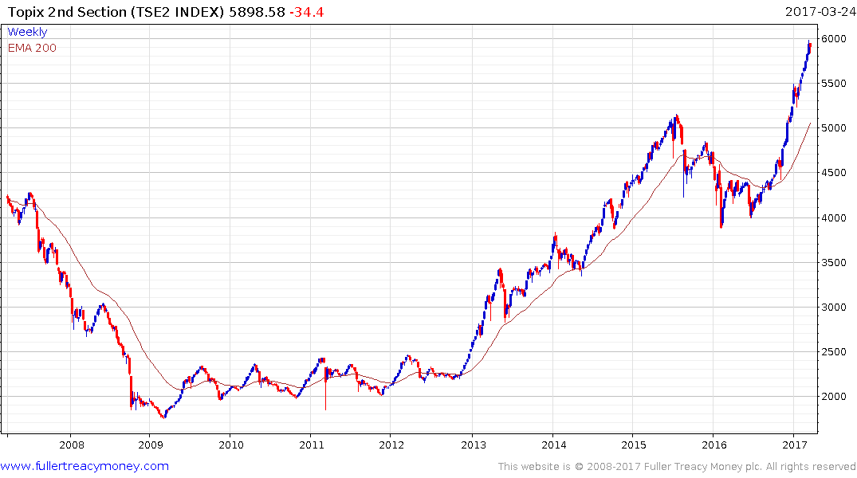
Japan Topix 2nd Section
TSE2 has long been a leading indicator
for Japan and it is now due for a lengthy
reaction and consolidation

Slide 29
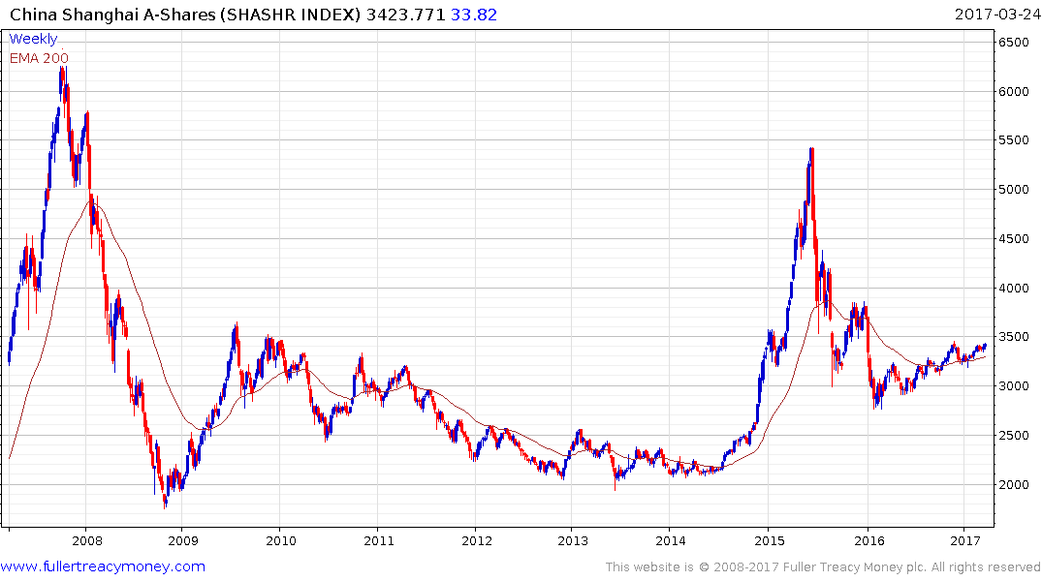
China Shanghai A-Shares
Edging higher with the help of government
stimulus and a soft currency but watch out
when the progression of higher reaction lows
is broken

Slide 30
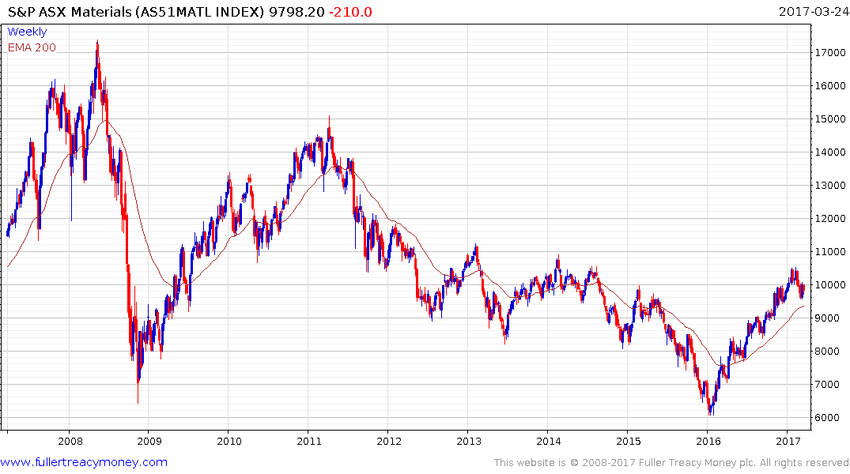
Australia Materials
Some loss of form including a
larger reaction and dip into
the previous trading range – this
Is likely to be a lengthier corrective
phase

Slide 31
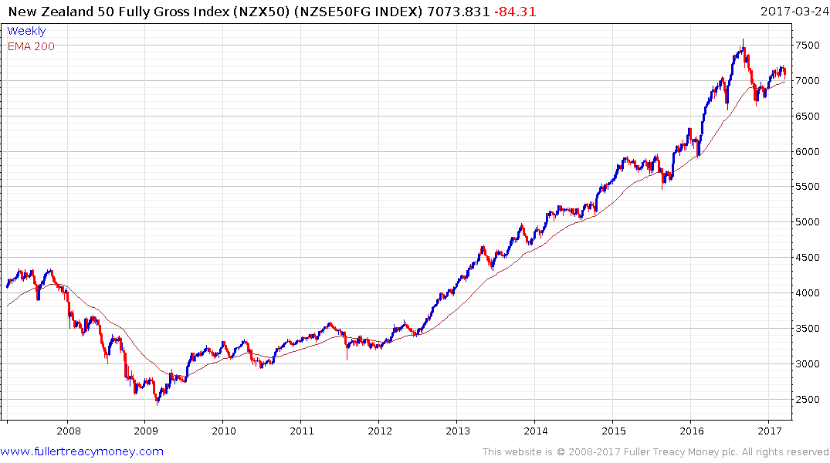
The first clear uptrend inconsistency was the overextension
relative to the MA in early September – the second was a far bigger reaction than seen previously. These confirmed that New Zealand had seen a peak of lengthy duration. It subsequently unwound a short-term oversold condition
and is likely to range sideways to somewhat lower.

Slide 32
Several Key
Commodities

Slide 33
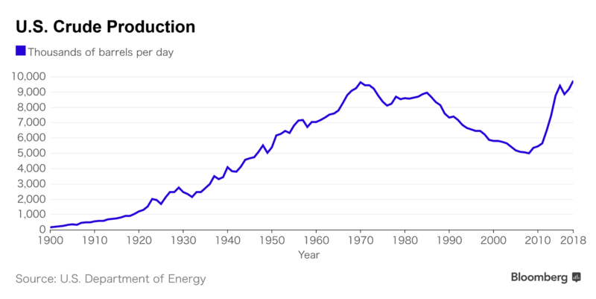
3. A new secular
bull market begins
1. A 70-year bull market
2. A 50-year bear market

Slide 34
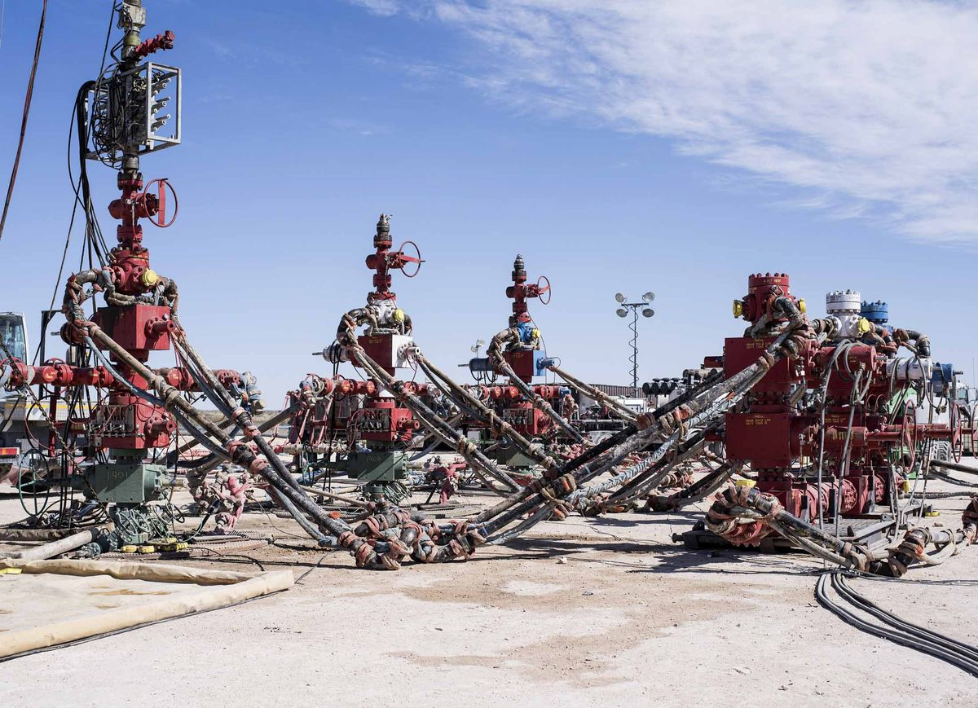
Take me to your leader

Slide 35
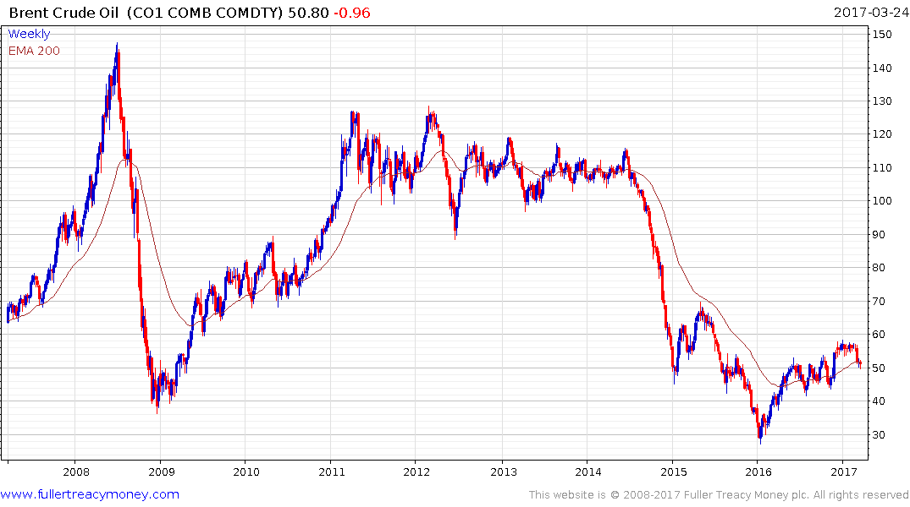
Brent Crude Oil
Weak recovery -
too much supply

Slide 36
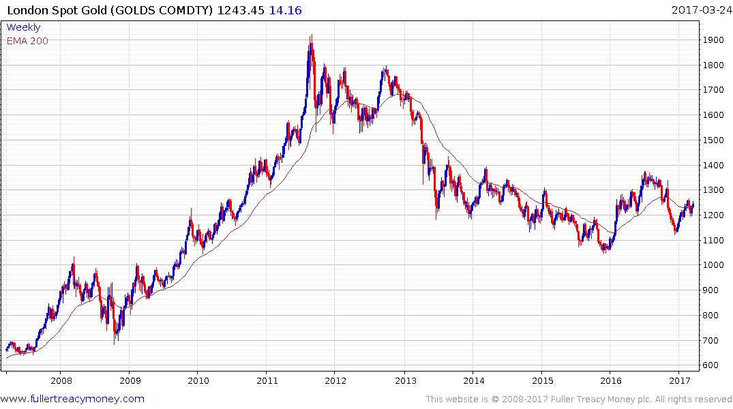
London Spot Gold
Plenty of uncertainty to
support gold but we are
currently seeing mainly
HFT moves in response
to Dollar Index’s direction
Currently firming in choppy range
as USD weakens but susceptible
to the next $ rally

Slide 37
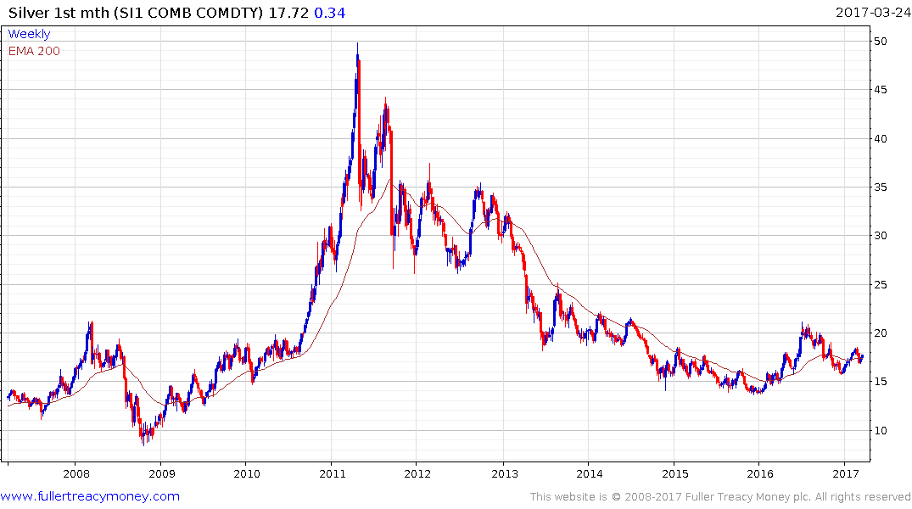
Silver
Silver trades like
high-beta gold which
it often leads on
significant moves, but
currently has a similar
pattern

Slide 38
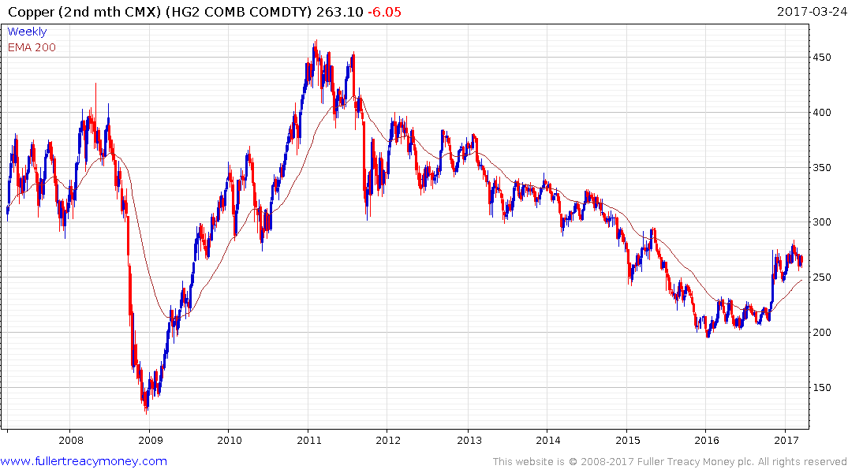
Copper (CMX)
Completed base formation with upside surge in Oct/Nov 2016– currently still consolidating initial gains

Slide 39
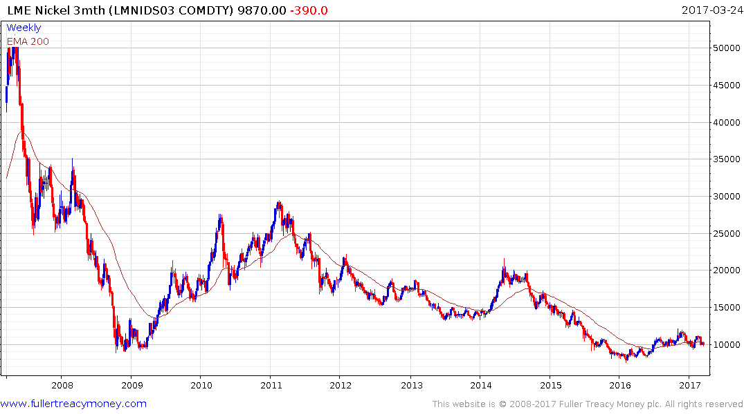
LME Nickel 3mth
The lagging industrial metal,
Nickel currently requires
production cuts – Russia is the
biggest producer - and a
stronger global economy to
resume a recovery

Slide 40
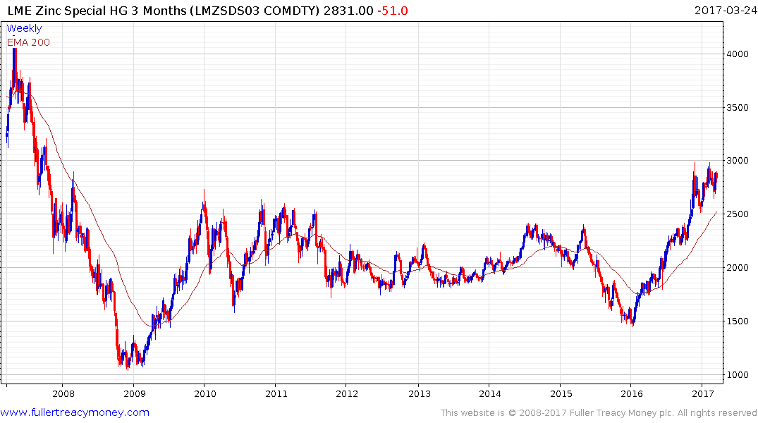
LME Zinc 3mth
Zinc has seen the best recovery
among LME metals, with the help
of Australian production cuts

Slide 41
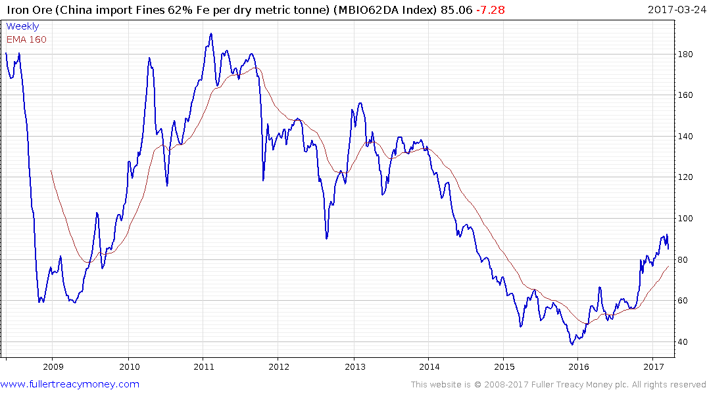
Iron Ore
Both Australia and
China have reduced
Iron Ore production
to create this partial
recovery which is
temporarily overextended

Slide 42
Many thanks for your interest
Any questions?
www.fullertreacymoney.com

