Slide 1
Continued Risk of Medium-Term
Correction Within Ongoing Bull Market
This is a Markets Now Seminar
June 12th 2017
By David Fuller
fullertreacymoney.com
The Caledonian Club – 9 Halkin Street
London SW1Y 4LH, UK

Slide 2
Theresa May’s Election Blunder
(discussion)
1. A disaster for her
2. A political risk for the UK economy
3. But also an opportunity
4. Provided strong, inspired, inclusive
Tory leadership emerges quickly
Governance is everything!

Slide 3
“I fear we may be in an era when
the political parties compete to bribe
us with our own money.”
Roger Bootle, 10 June 2017

Slide 4
The crowd’s animal spirits following Trump’s
election on 8th Nov drove stock markets
higher on promises of tax cuts, fiscal spending and repatriation of capital
However, share valuations have run far
ahead of 3% GDP growth forecasts and potential additional earnings increases,
which may not occur before 2018, at best

Slide 5
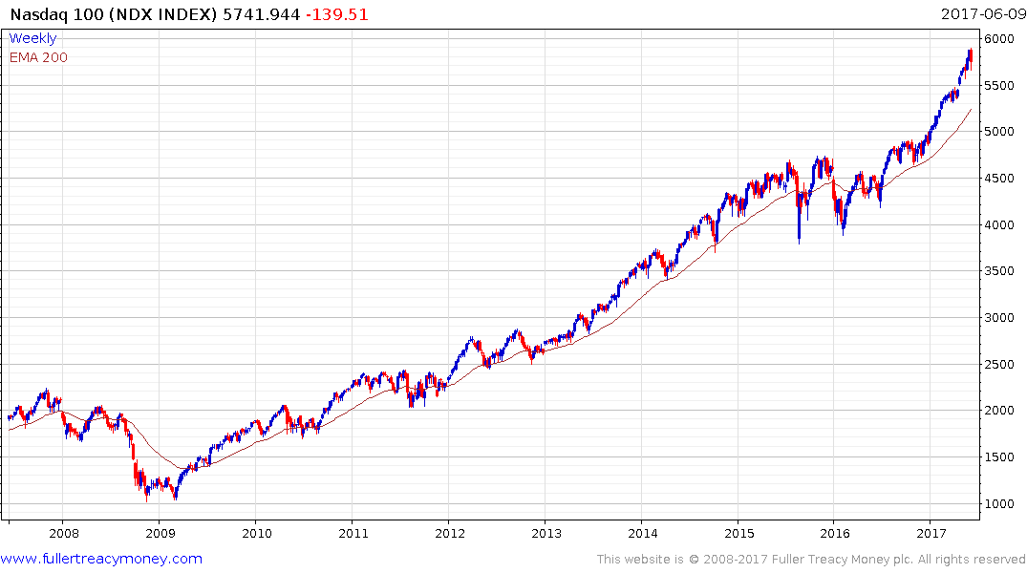
Nasdaq 100 (weekly)
Temporarily overextended

Slide 6
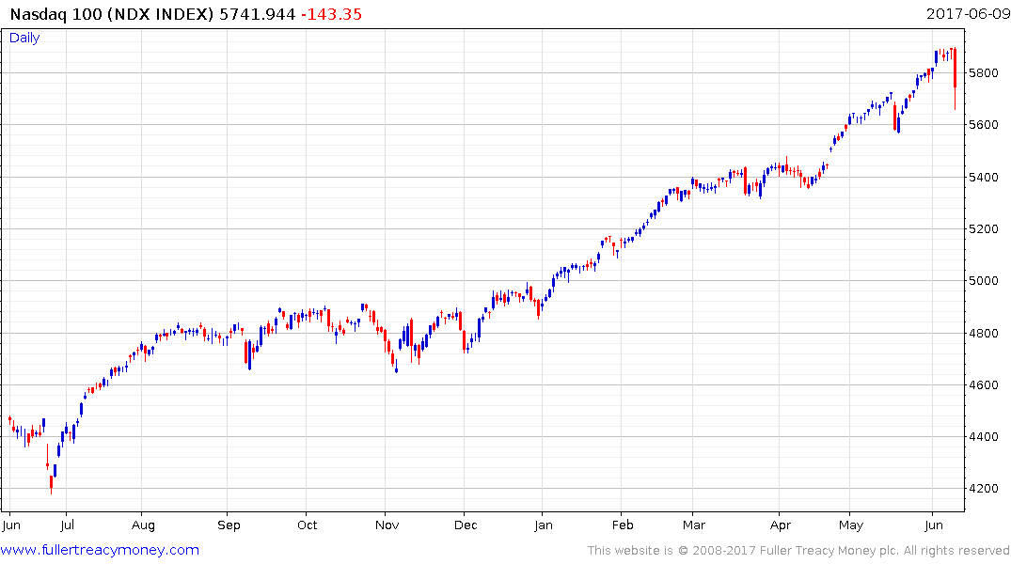
Nasdaq 100 (daily)
Downward dynamics are warning
shots across the bow but no further
downside confirmation to date

Slide 7

Trump’s economic stimulus had been
discounted well before any surge in GDP
& proportionally higher corporate profits
Stock markets underperform, on average,
in 2Q and 3Q of each year
Meanwhile, investors’ worst fears about
Trump have not gone away

Slide 8
Fortunately, we are in a secular bull market
which very few investors recognise

Slide 9
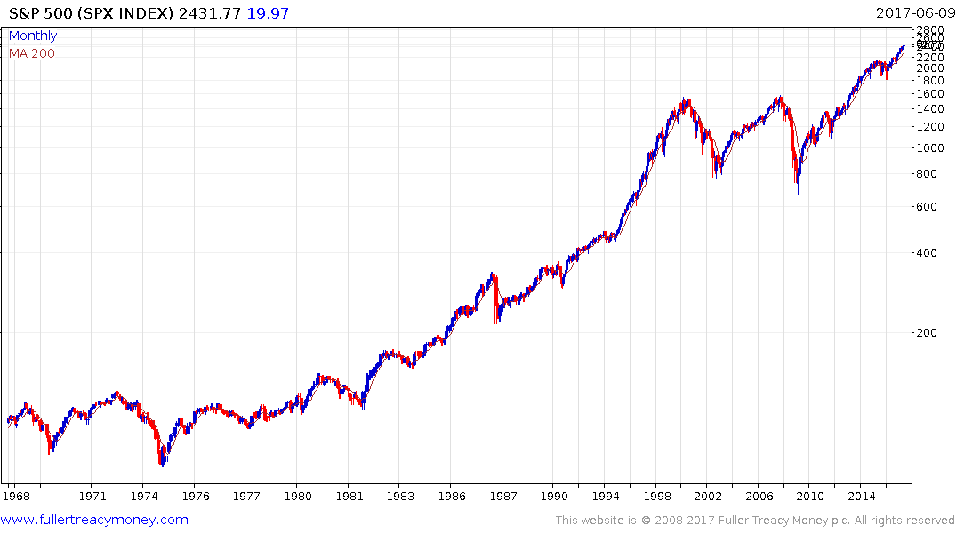
S&P 500 (monthly 50 years)
a
c
1
3
Market history often rhymes
b
Blow off
Preceded by post-WW2
secular bull market
2
4
Secular bull
c
Secular bull
3
a
1
b
2
4

Slide 10
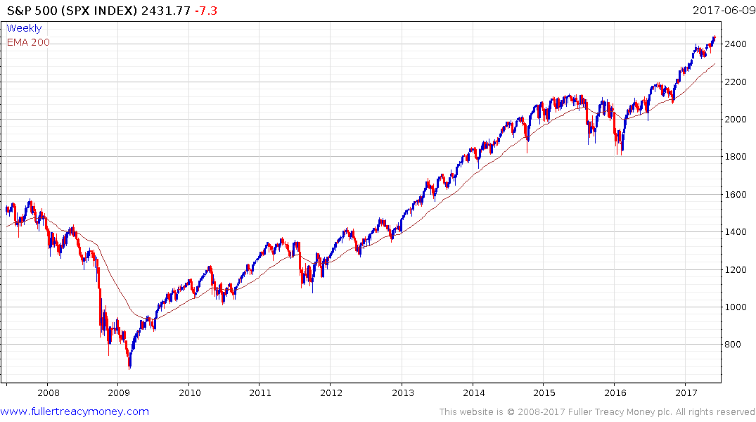
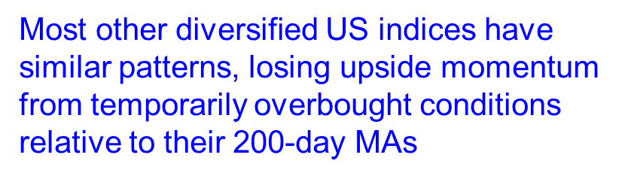
S&P 500 (weekly)

Slide 11
Market corrections occur periodically
They can be frightening but they also
create buying opportunities which we will see once again after investor sentiment
turns bearish

Slide 12
Looking further ahead (2nd-half 2017/18)
There is little evidence of another significant bear market, which many commentators have been predicting since 2008, although their greater optimism recently is another indication of an imminent correction

Slide 13
Over the next 10 years, we are very likely to see a cyclical bear trend or two in stock markets but they will move higher overall
Three potential bear market triggers:
1) After the US yield curve inverts
2) Treasury Bond yields rise towards 4%
3) The Dollar Index moves sharply higher
Presently, none of these is a problem, although
political risks have increased

Slide 14
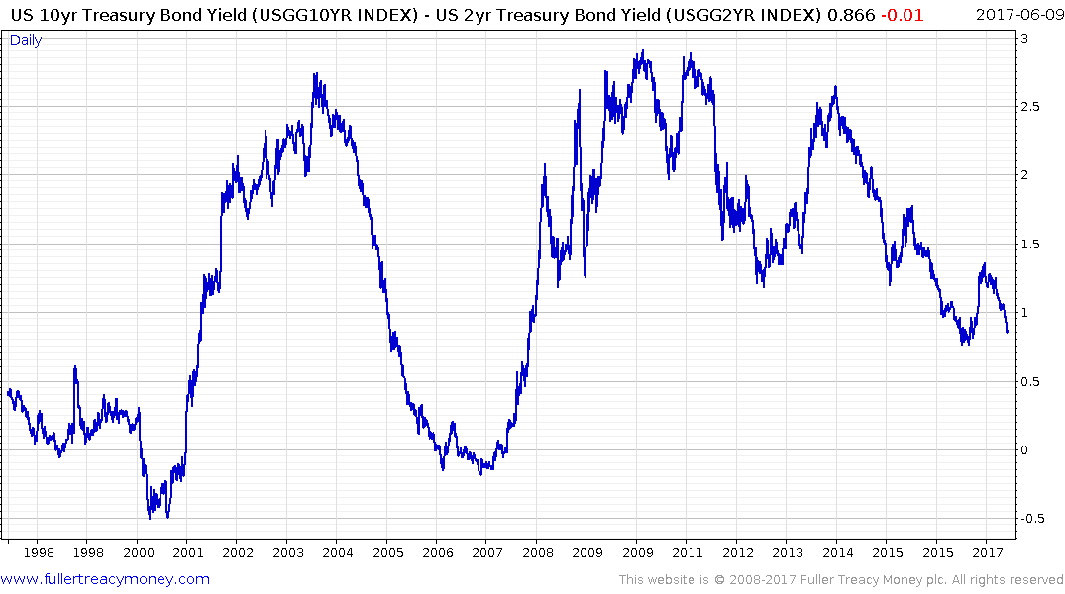
Bear market danger zone although timing highly variable

Slide 15
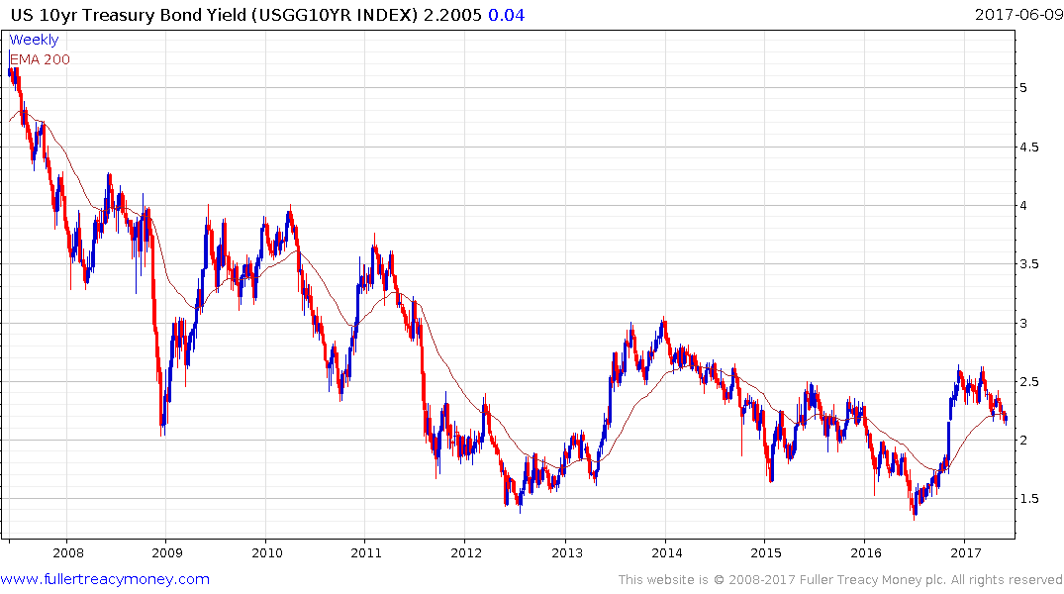

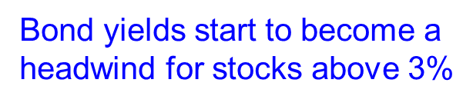
US 10-Yr Treasury Bond Yield
Historic low of 1.3180% on 6th July 2016 - I don’t think we will ever see that low again
Fear has driven more money
into bonds and some of this
will revert to equities as rates rise

Slide 16
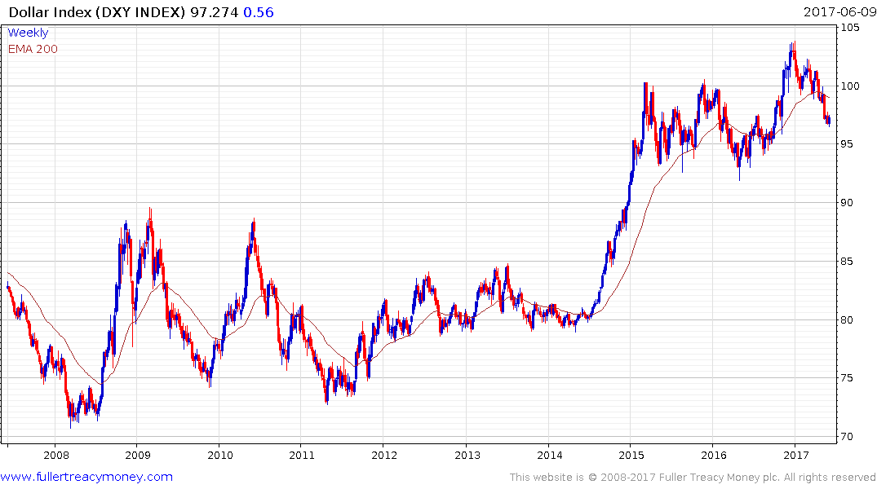
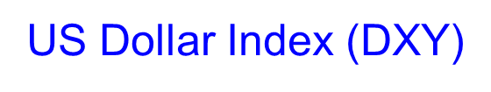
A secular bull market is underway but these spend
far more time ranging than trending and Trump has
jawboned the Dollar lower this year

Slide 17
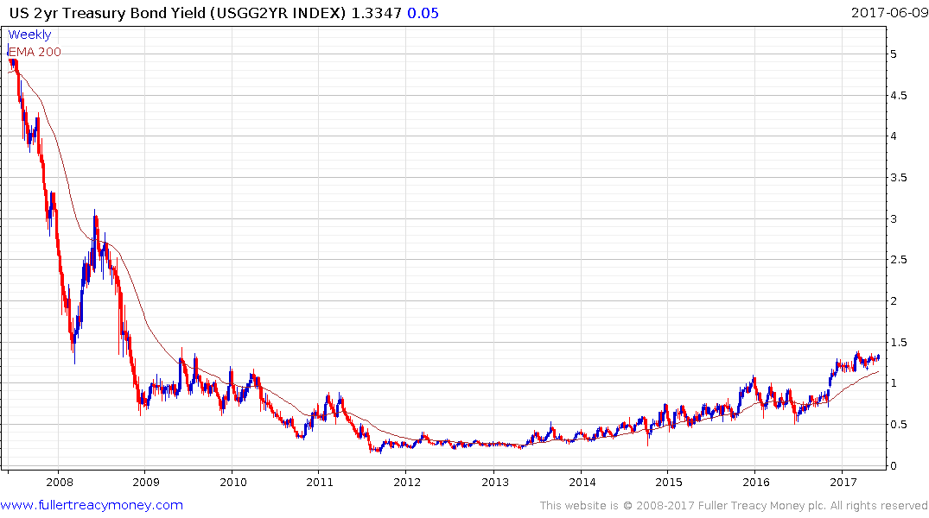
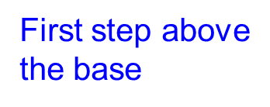

US 2yr Treasury Bond Yield

Slide 18
The two sectors which will continue
to dominate the secular bull market

Slide 19
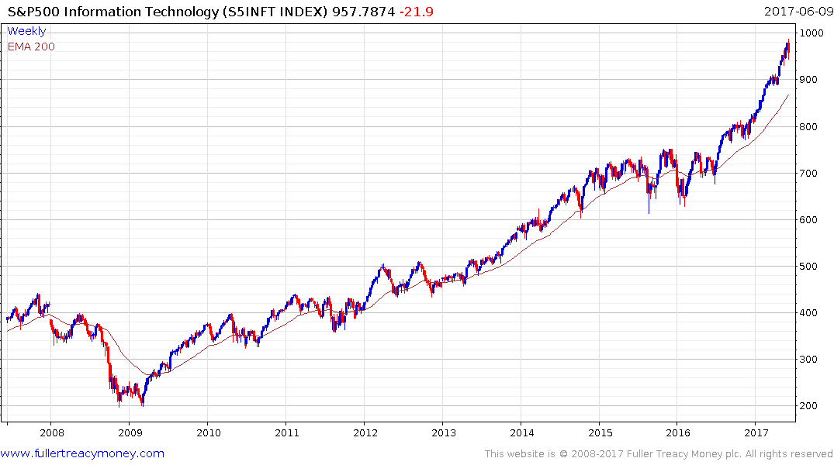
Information technology
Currently short-term overbought

Slide 20
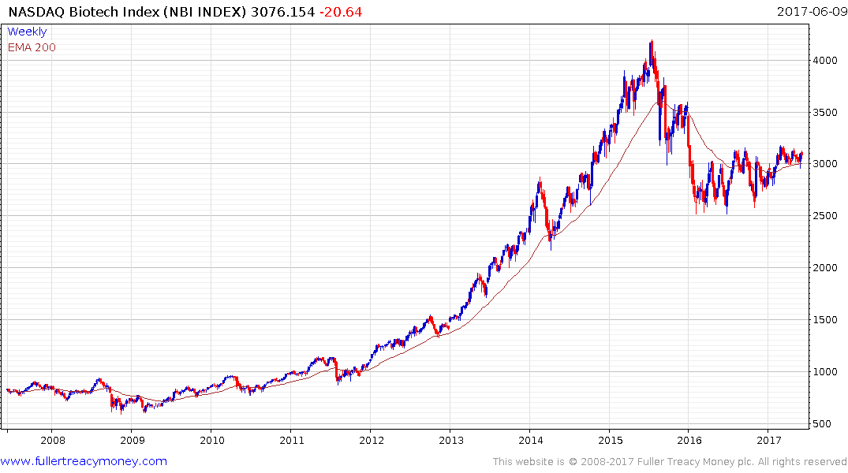
Nasdaq Biotech Index
Completed lengthy medium-term
reaction and consolidation

Slide 21
A few of the greatest tech shares
All of which have commenced
at least short-term overbought
reactions and corrections

Slide 22
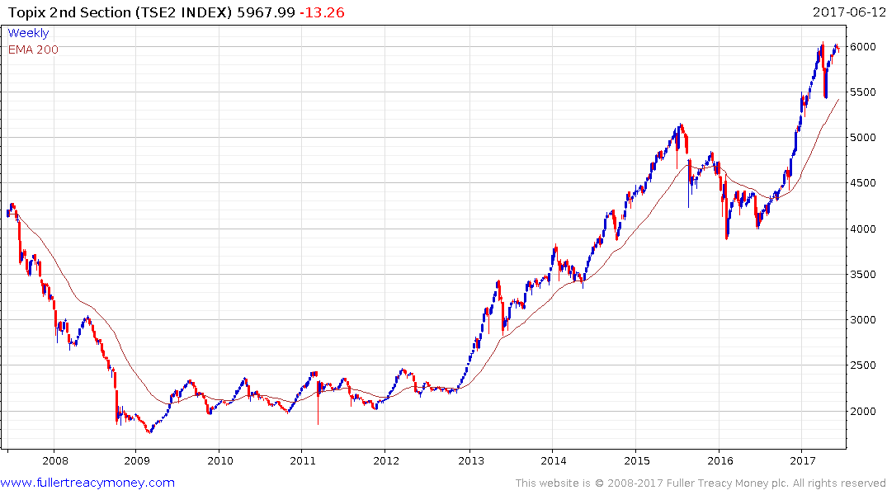
Apple

Slide 23
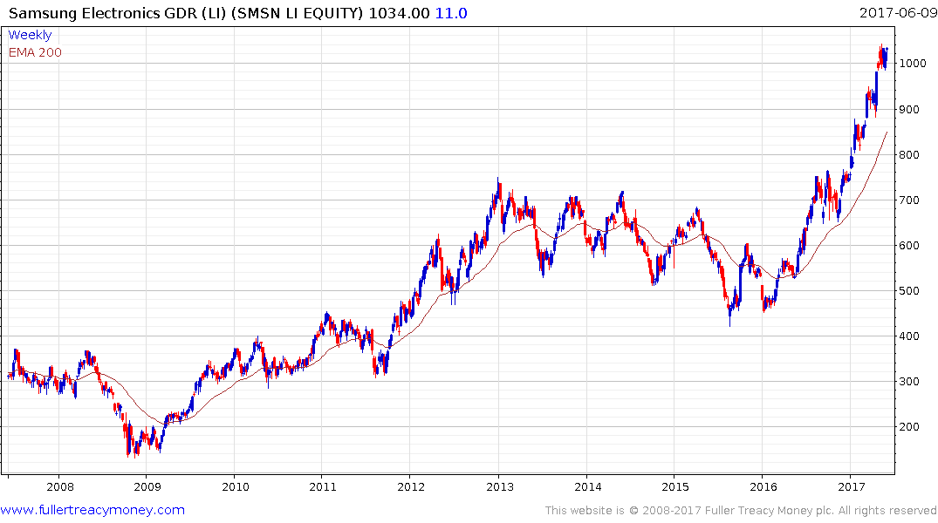
Samsung Electronics

Slide 24
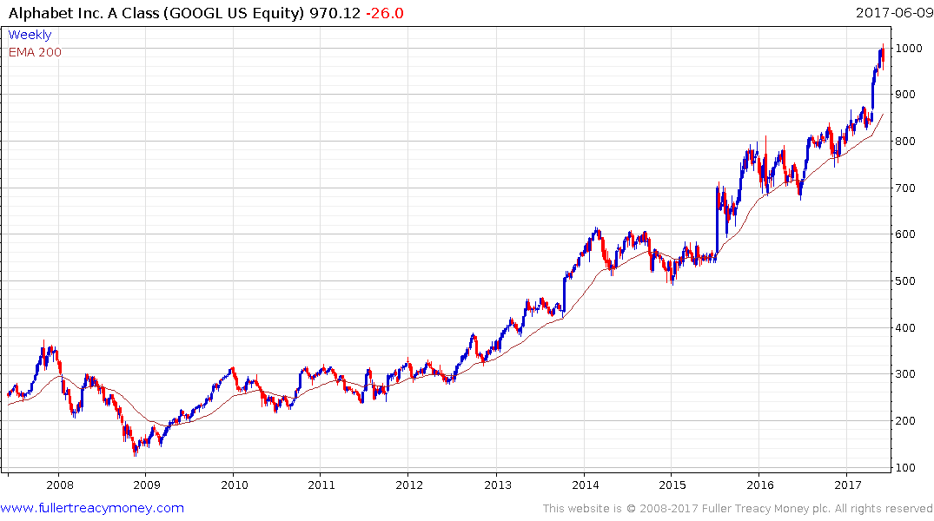
Alphabet (Google)

Slide 25
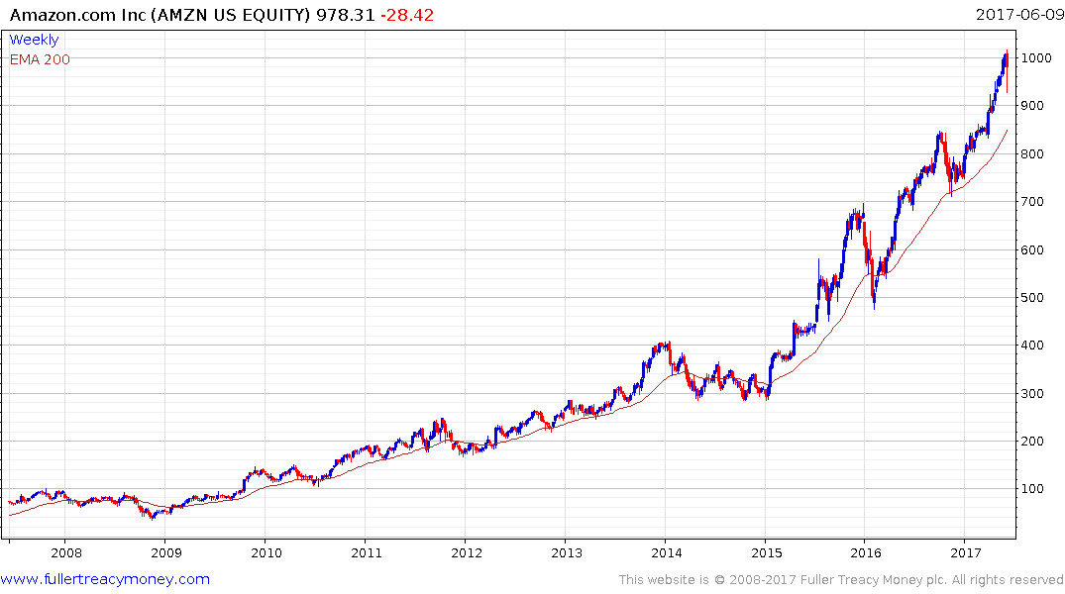
Amazon

Slide 26
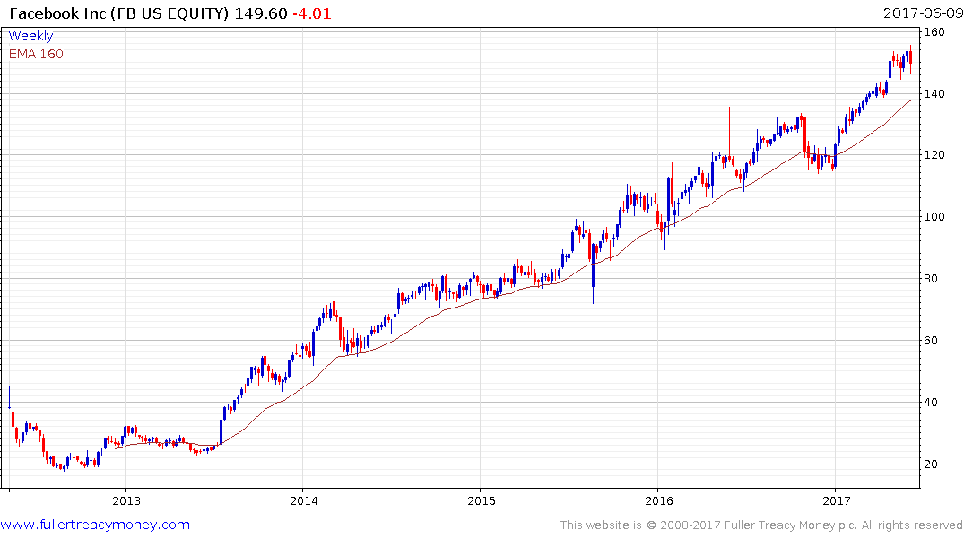
Facebook

Slide 27
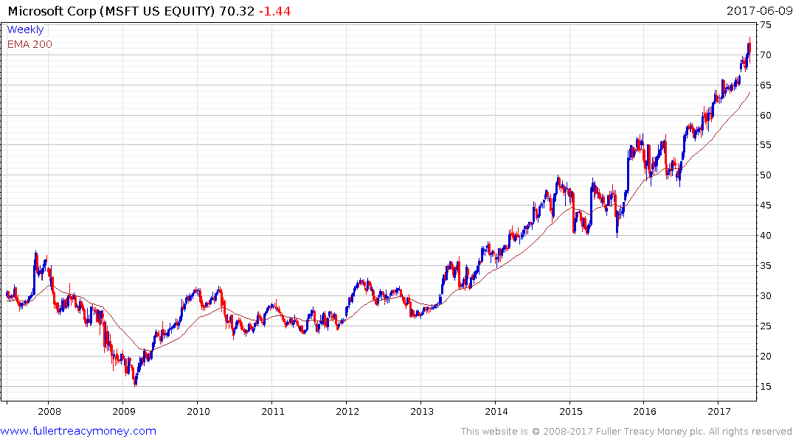
Microsoft

Slide 28
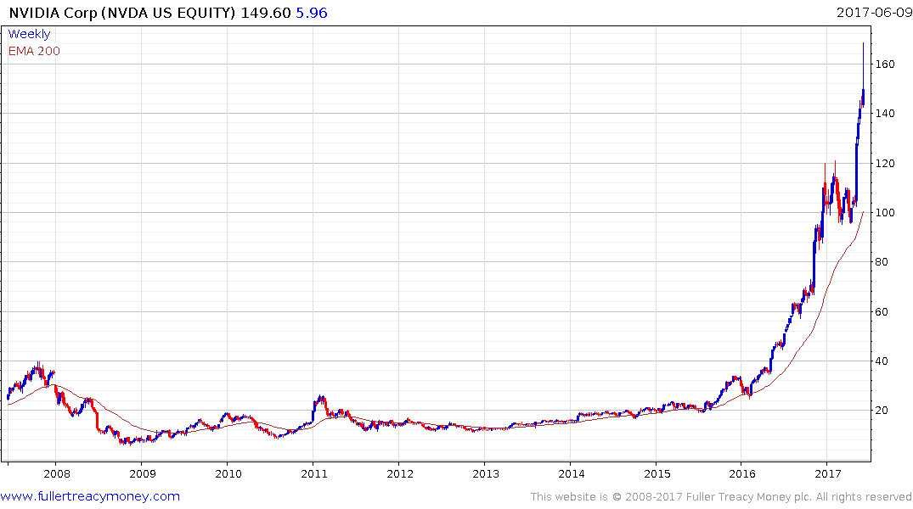
Nvidia

Slide 29
A quick look at
a few other stock markets
which are likely to be among
the leaders of the secular bull trend

Slide 30
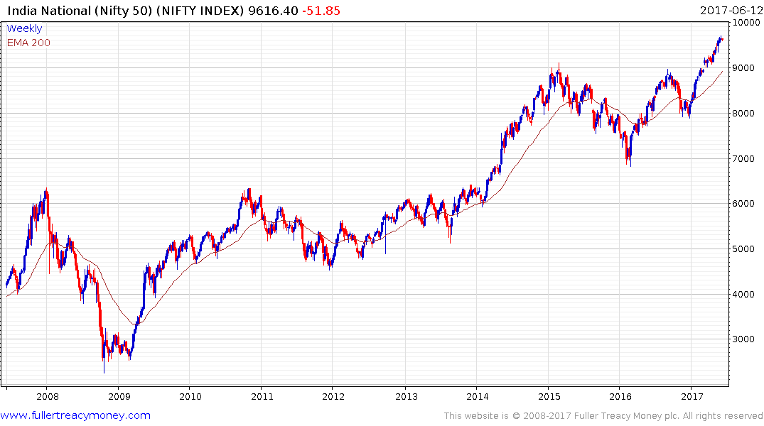
India National (Nifty 50)
At least while Narendra Modi
remains Prime Minister –
currently short-term OB

Slide 31
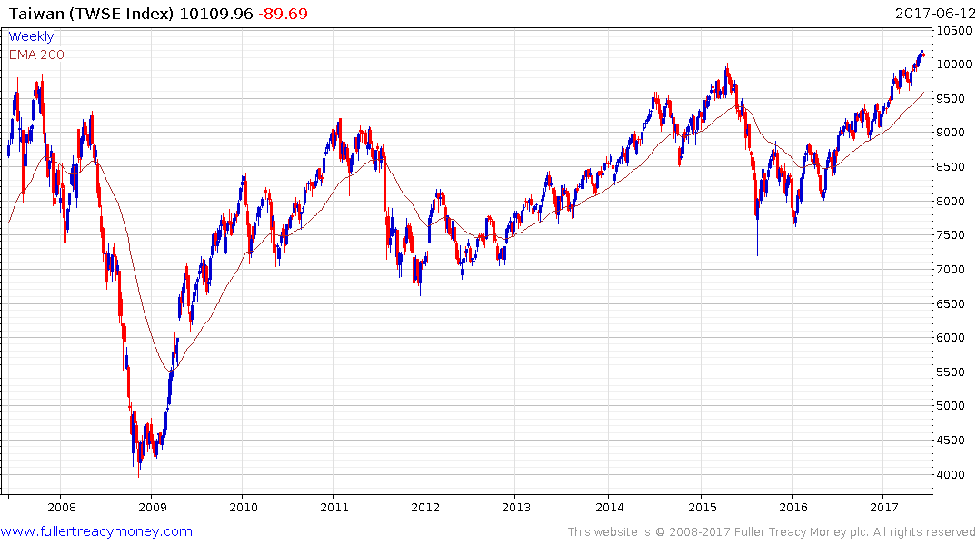
Taiwan

Slide 32
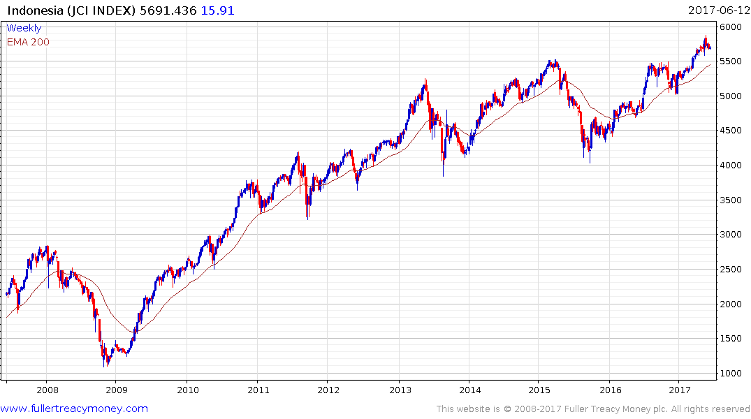
Indonesia

Slide 33
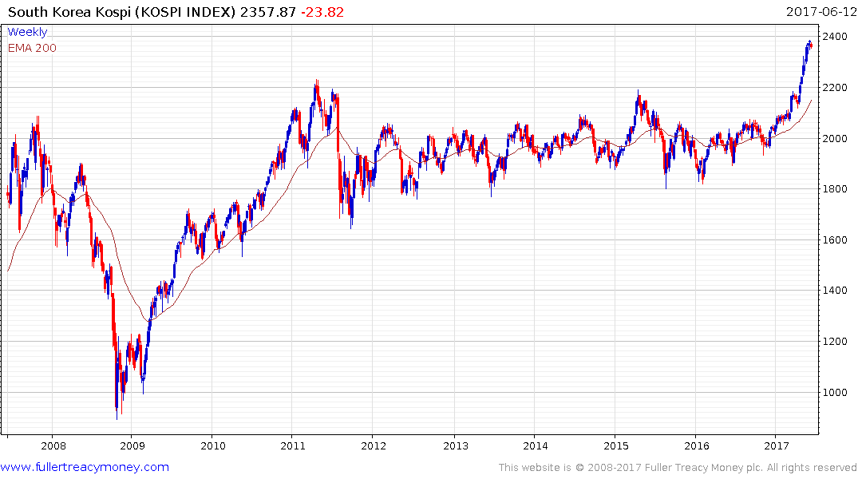
South Korea
Short-term OB

Slide 34
Japan’s Topix 2nd Section
Short-term OB

Slide 35
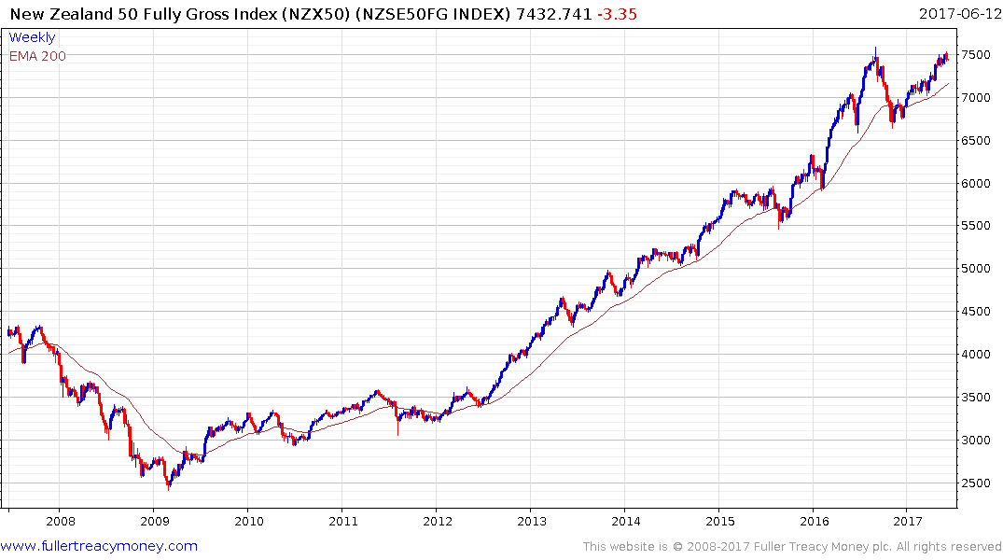
New Zealand
May still be in a medium-term
corrective phase

Slide 36
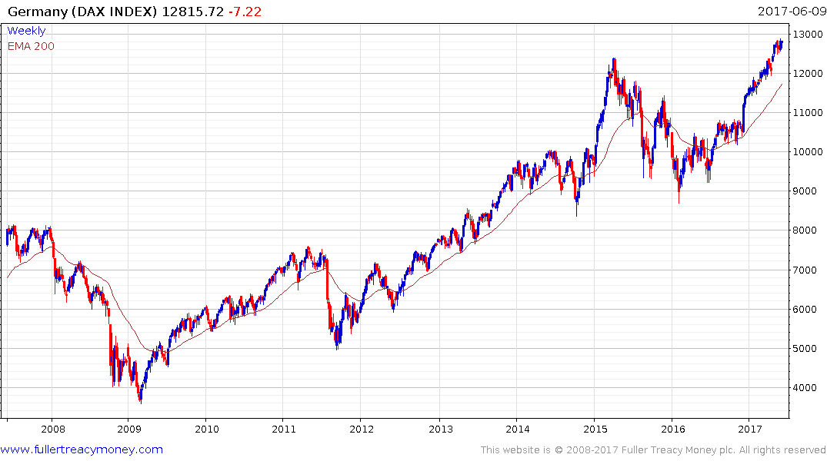
Germany
Short-term OB

Slide 37
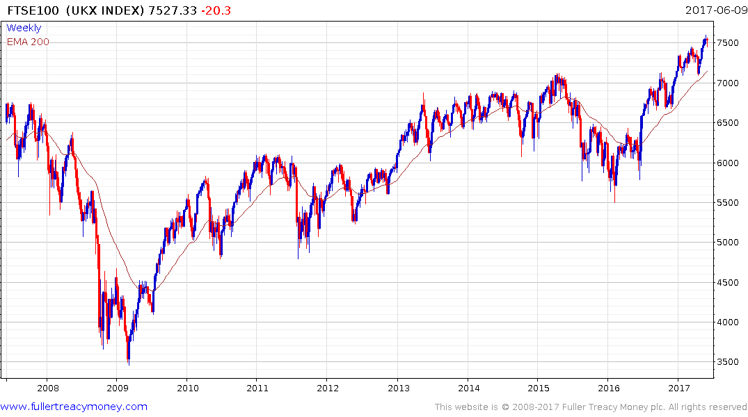
United Kingdom
Subject to governance during
lengthy separation from EU

Slide 38
Many thanks for your interest
Any questions?
www.fullertreacymoney.com

Slide 41
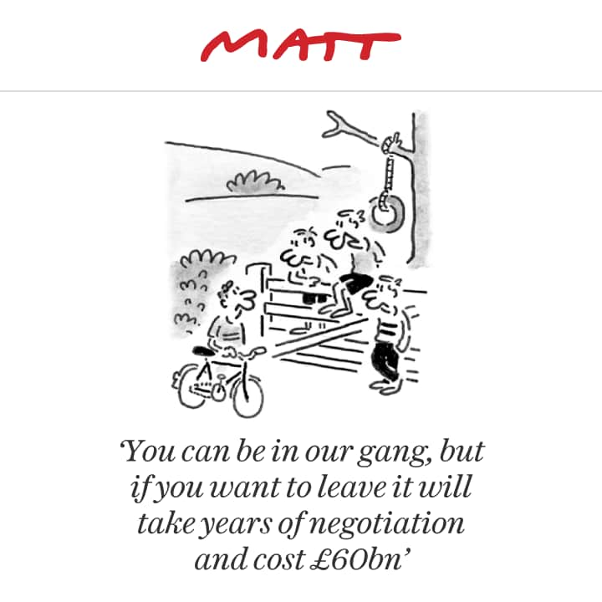

Slide 42
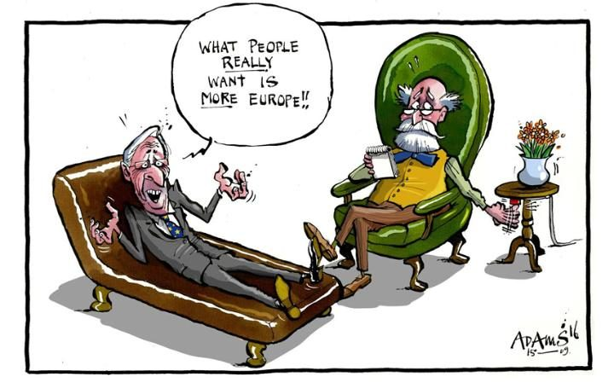

Slide 43
Several Key
Commodities

Slide 44
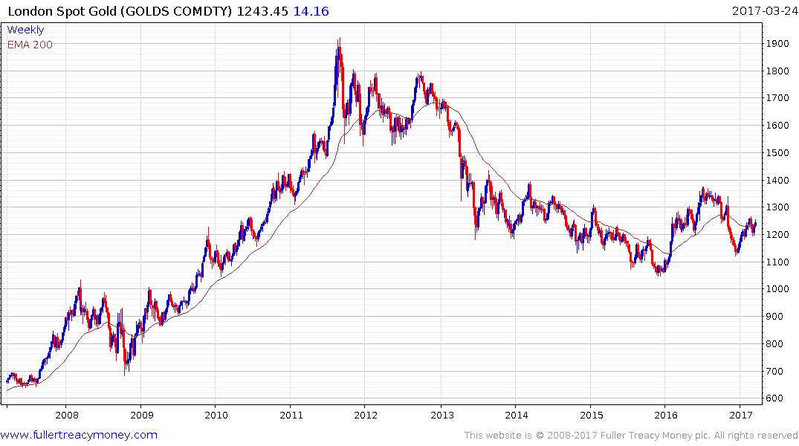
London Spot Gold
Plenty of uncertainty to
support gold but we are
currently seeing mainly
HFT moves in response
to Dollar Index’s direction
Currently firming in choppy range
as USD weakens but susceptible
to the next $ rally

Slide 45
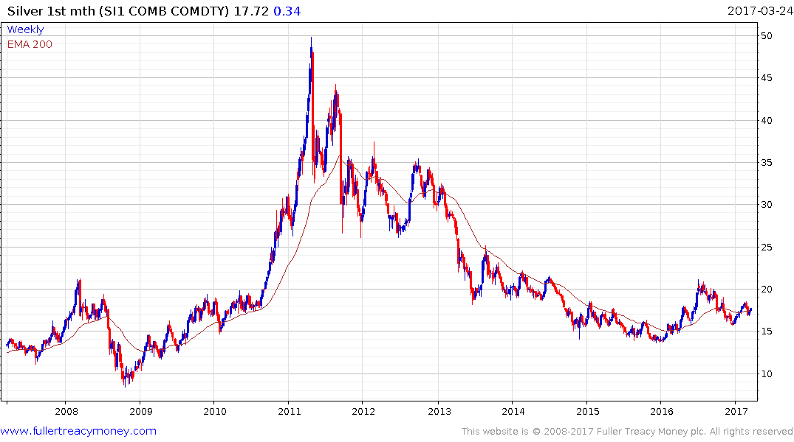
Silver
Silver trades like
high-beta gold which
it often leads on
significant moves, but
currently has a similar
pattern

Slide 46
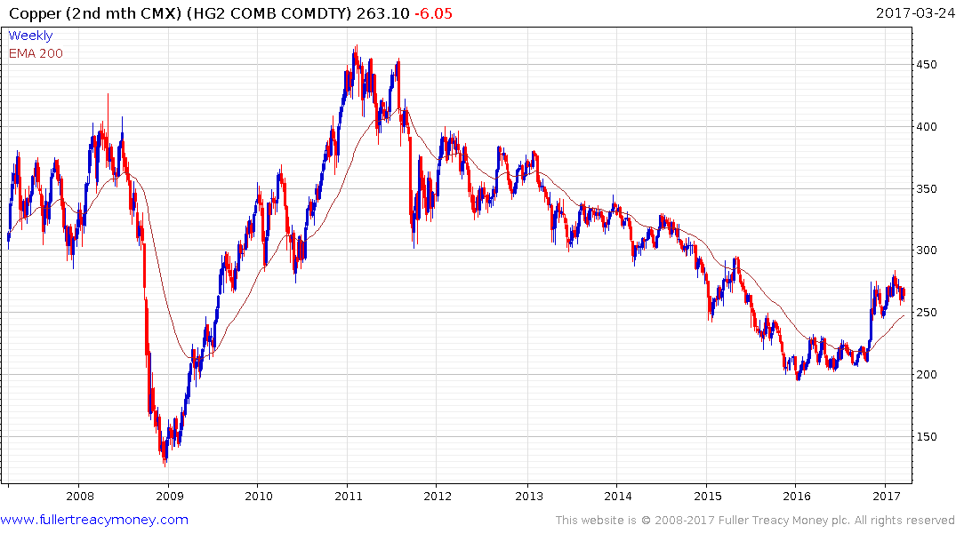
Copper (CMX)
Completed base formation with upside surge in Oct/Nov 2016– currently still consolidating initial gains

Slide 47
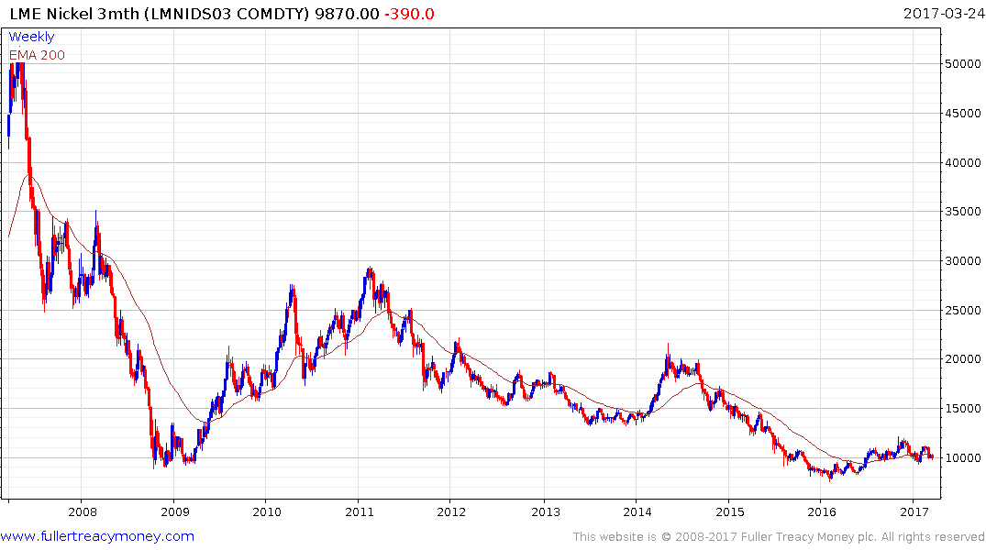
LME Nickel 3mth
The lagging industrial metal,
Nickel currently requires
production cuts – Russia is the
biggest producer - and a
stronger global economy to
resume a recovery

Slide 48
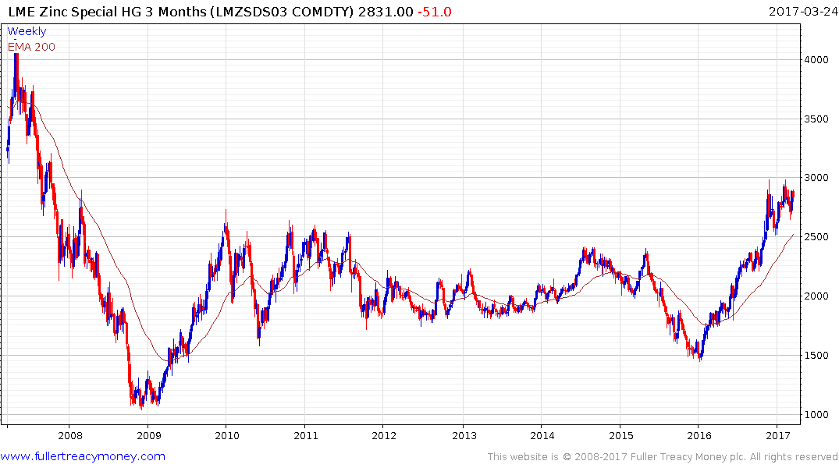
LME Zinc 3mth
Zinc has seen the best recovery
among LME metals, with the help
of Australian production cuts

Slide 49
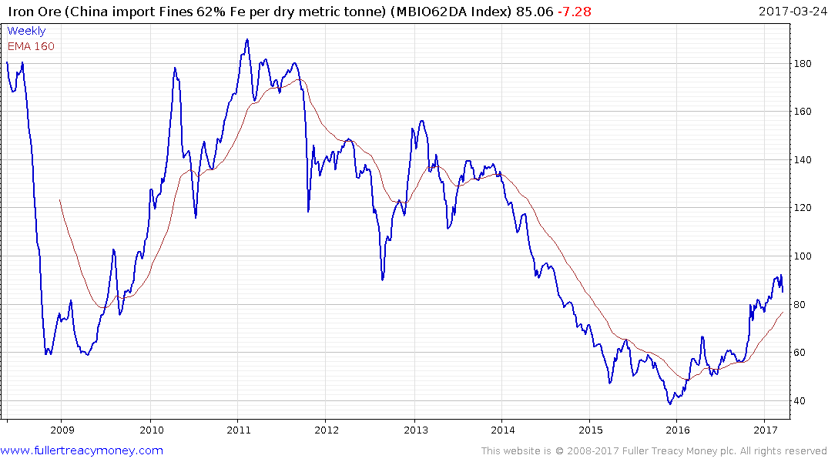
Iron Ore
Both Australia and
China have reduced
Iron Ore production
to create this partial
recovery which is
temporarily overextended

