Slide 1
The Donald Trump
Bull Market Extension
How long will it last?
This is a Markets Now Seminar
January 16th 2017
By David Fuller
fullertreacymoney.com
The Caledonian Club – 9 Halkin Street
London SW1Y 4LH, UK

Slide 2
Potentially, it can last for a long time,
provided Trump’s economic programme
leads to a surge in GDP & higher corporate profits
… and people’s worst fears about Trump
are not realised
Currently, we know more about Trump’s
shortcomings rather than his potential,
although his economic proposals have
increased his ratings

Slide 3
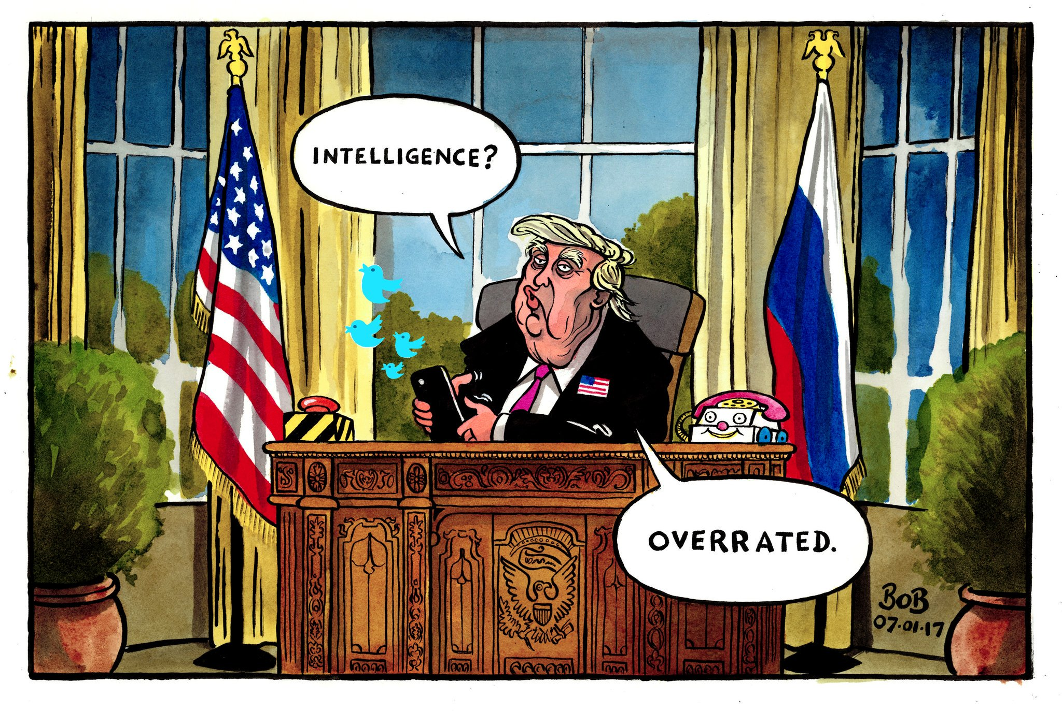

Slide 4
Some key charts to watch
during this year of uncertainty

Slide 5
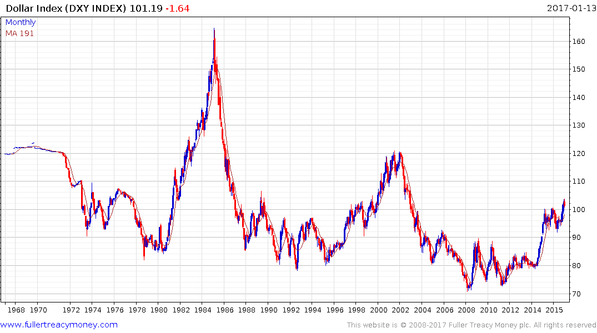
US Dollar Index (DXY)
50-years - arithmetic scale

Slide 6
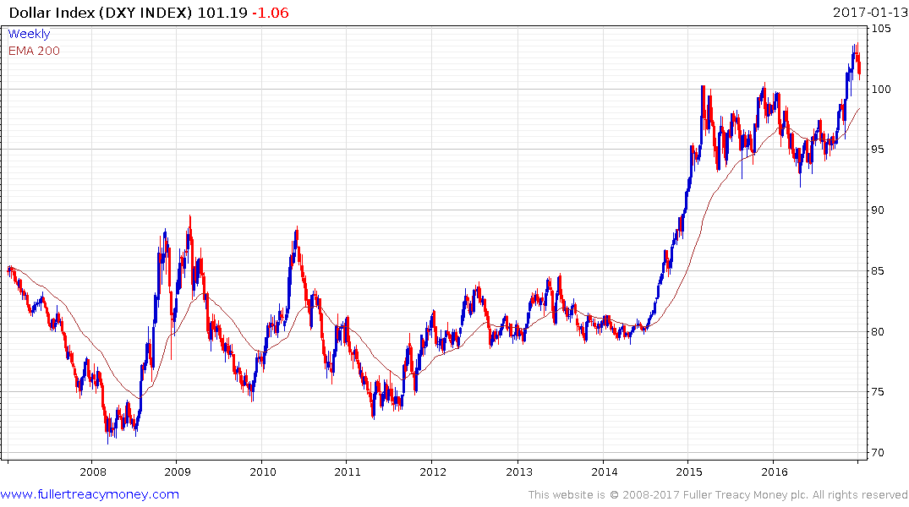
DXY
A secular bull market is underway
which started from a very low base
Trump wins
Presidential
election

Slide 7
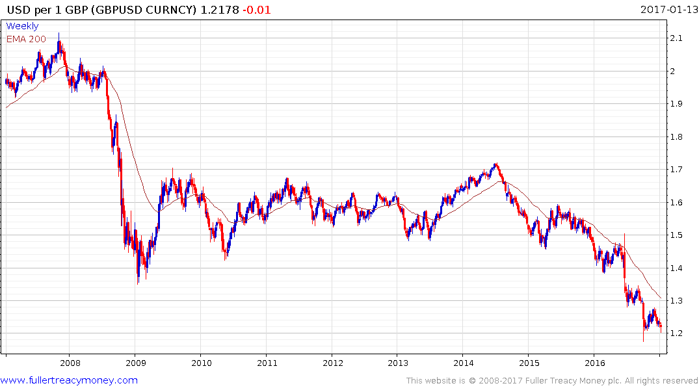
GBPUSD
Testing lows on Brexit uncertainty
Traders are short ahead of
PM May’s speech

Slide 8
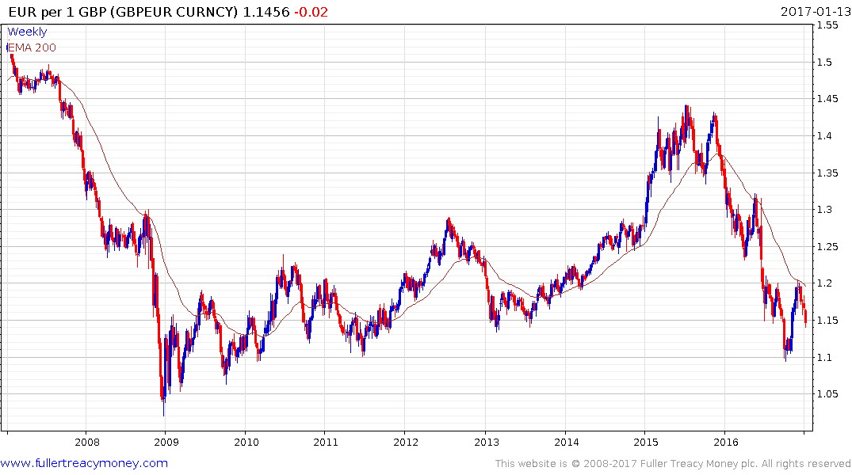
GBP/EUR
This is much more important for the UK
during Brexit discussions and implementation
A soft pound vs the euro
ensures UK competitiveness

Slide 9
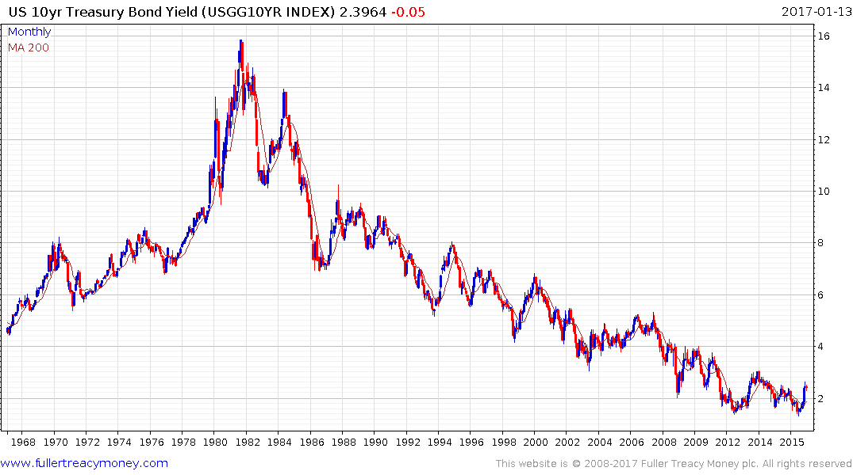
Fantastic buy
US 10-Yr Treasury Bond Yield
50-years – arithmetic scale
Fantastic sell

Slide 10
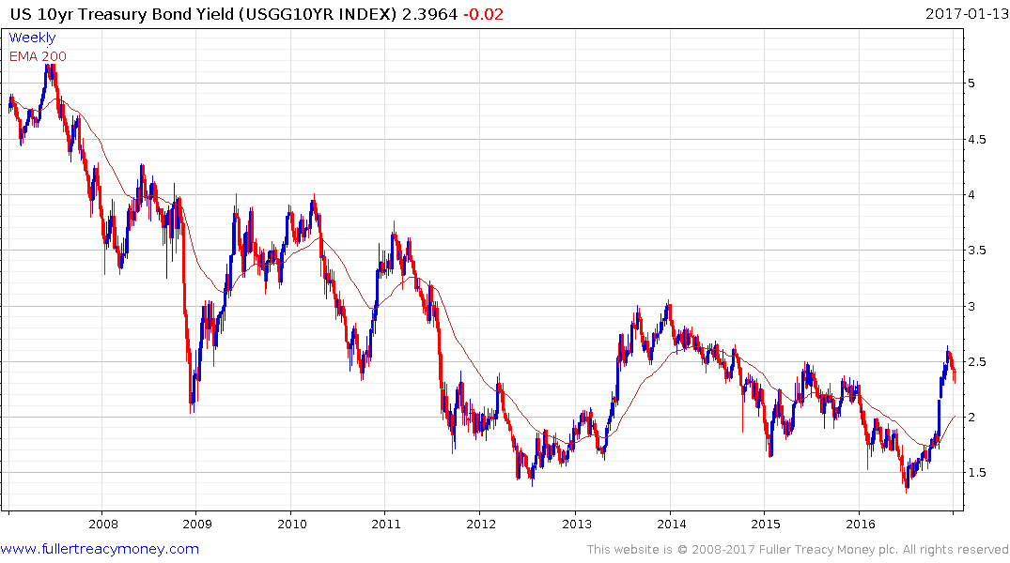
US 10-Yr Treasury Bond Yield
Historic low of 1.3180% on 6th July 2016
I don’t think we will ever see that low again
Bonds very competitive above 4%
Bonds start to become
more competitive at 3%
Some money trickling out of
bonds is going into equities
Historic low

Slide 11
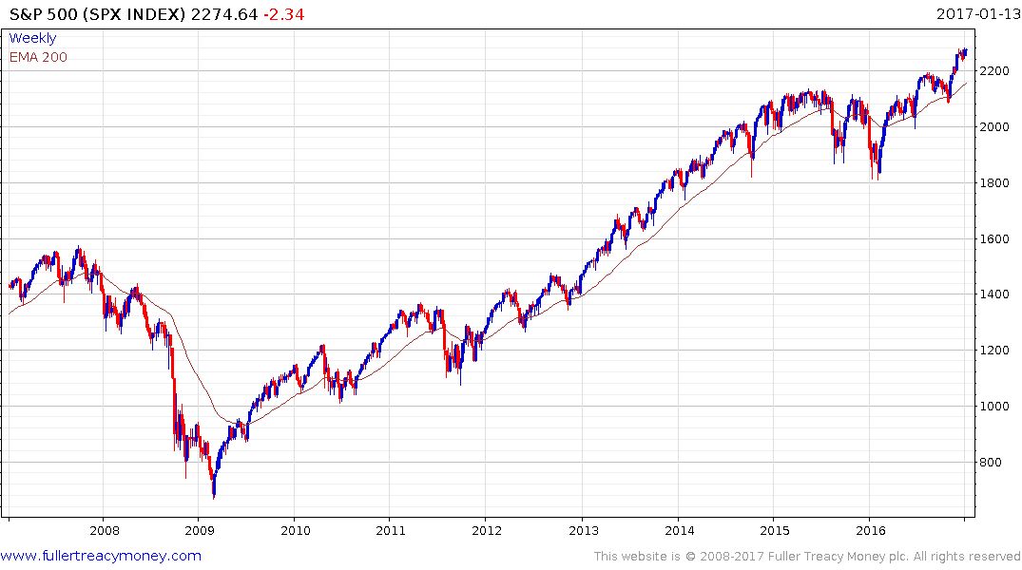
S&P 500 Index
Trump rally: give upside the benefit of the doubt, while higher reaction lows hold
Warning
if broken
2) serious deterioration
3) bear market
underway

Slide 12
For those who thought Trump was a bad omen, check this headline from Business Insider:
“A type of vampire bat has started feeding on
humans in Brazil for the first known time”
14/01/2017

Slide 13
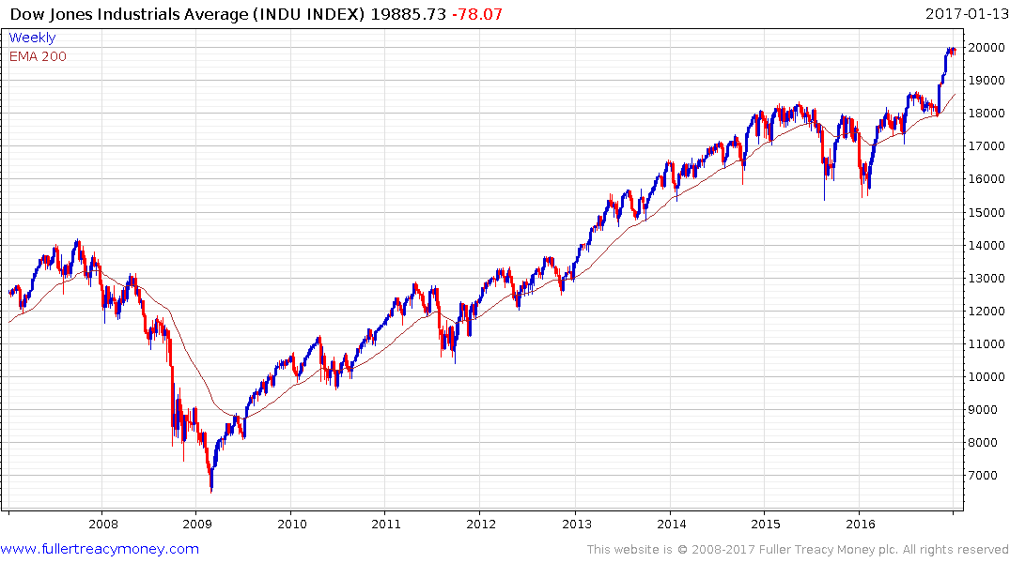
Dow Jones Industrial Average
Trump rally: DJIA led move
to new all-time highs
Give upside the benefit of
the doubt, while sequence
of higher reaction lows
continues

Slide 14
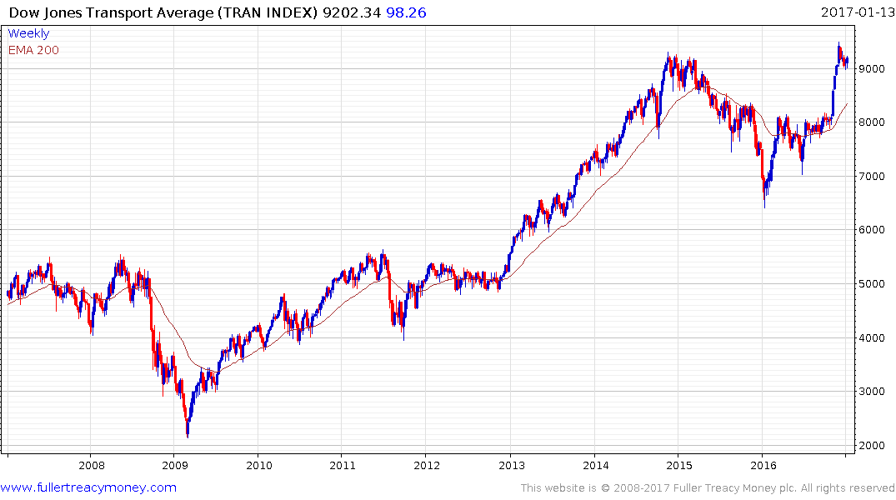
Dow Jones Transport Average
Trump rally: Dec close above the 2014 high
confirmed Dow Theory bull market

Slide 15
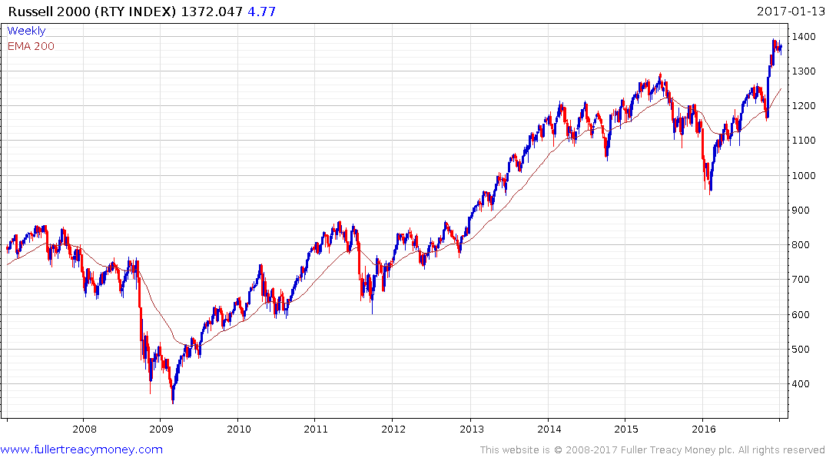
Russell 2000 Index
Trump rally: first new high in nearly 3 years
confirms the breadth of this advance

Slide 16
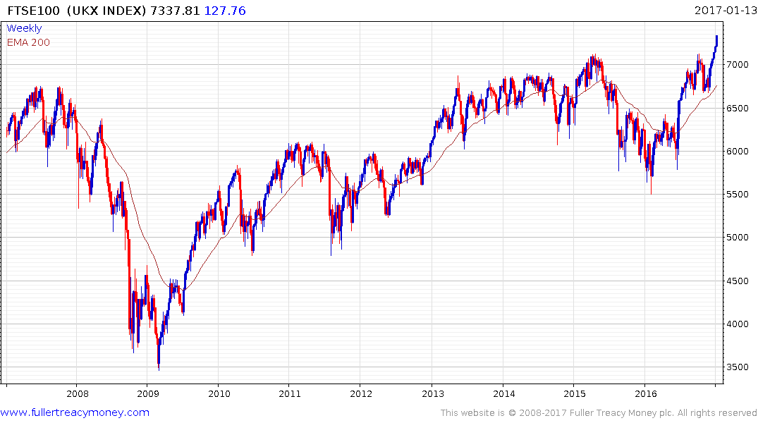
UK FTSE 100 Index
Brexit vote win
Give upside the benefit of the doubt
while FTSE 100 remains above 6500

Slide 17
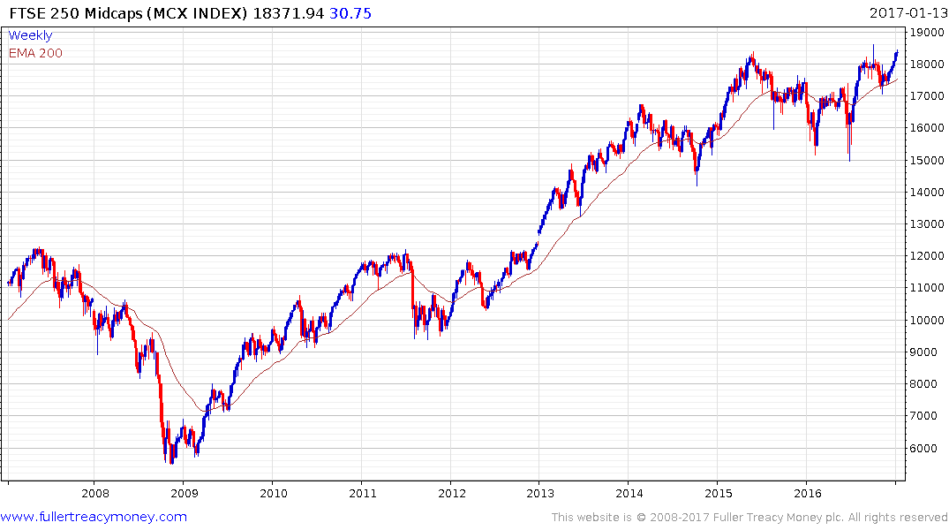
FTSE 250
UK medium-sized shares,
Shows breadth of current rally
Brexit vote
Important
initial support
at 17000

Slide 18
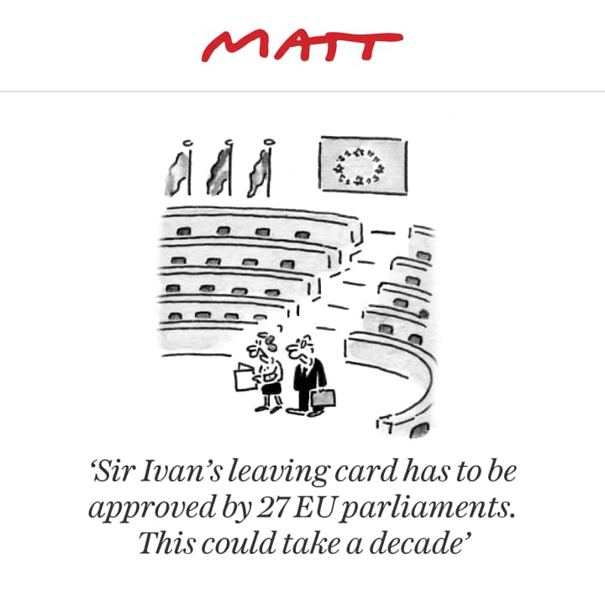

Slide 19
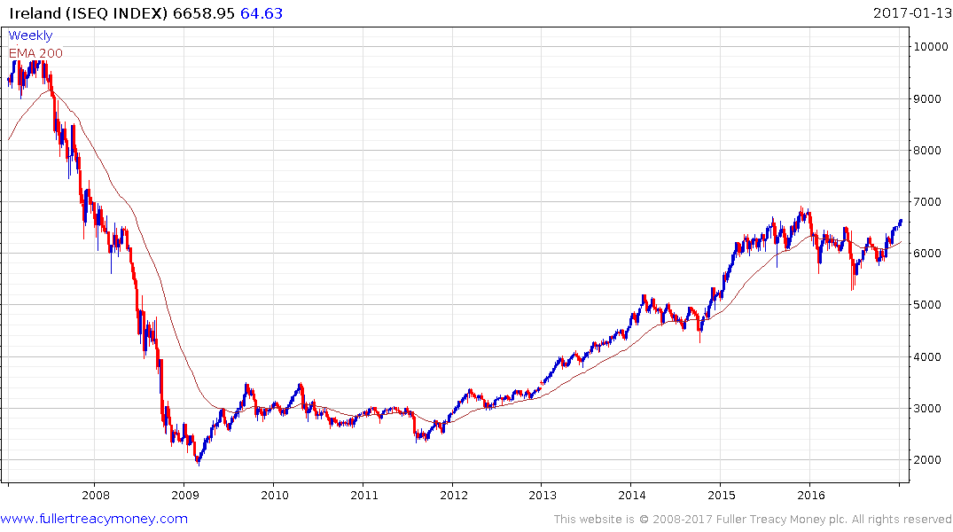
Ireland ISEQ Index
Gradually eroding resistance
within 2-year trading range

Slide 20
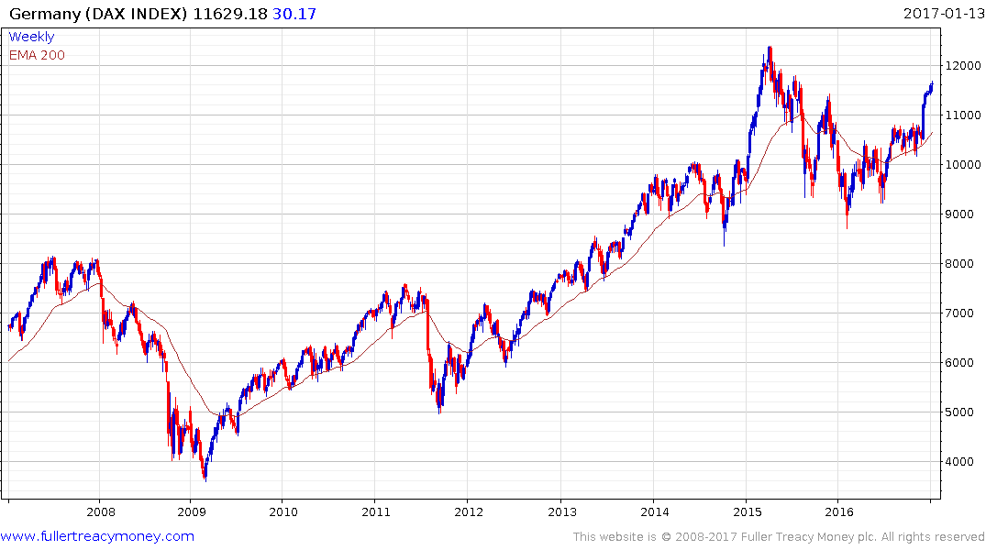
Germany DAX Index
Best market in terms of risk
within the troubled EU
Needs to maintain
sequence of higher
reaction lows since
the Feb 2016 low

Slide 21
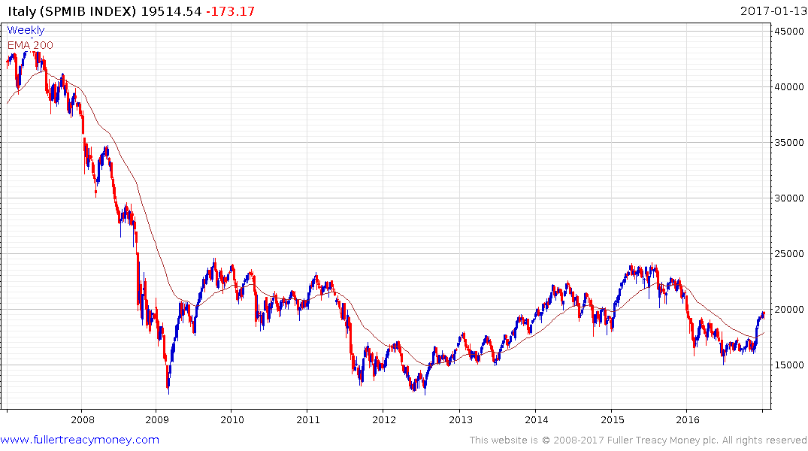
Italy SPMIB Index
Good bounce from 15000 but Italy’s
future within the EU is in question

Slide 22
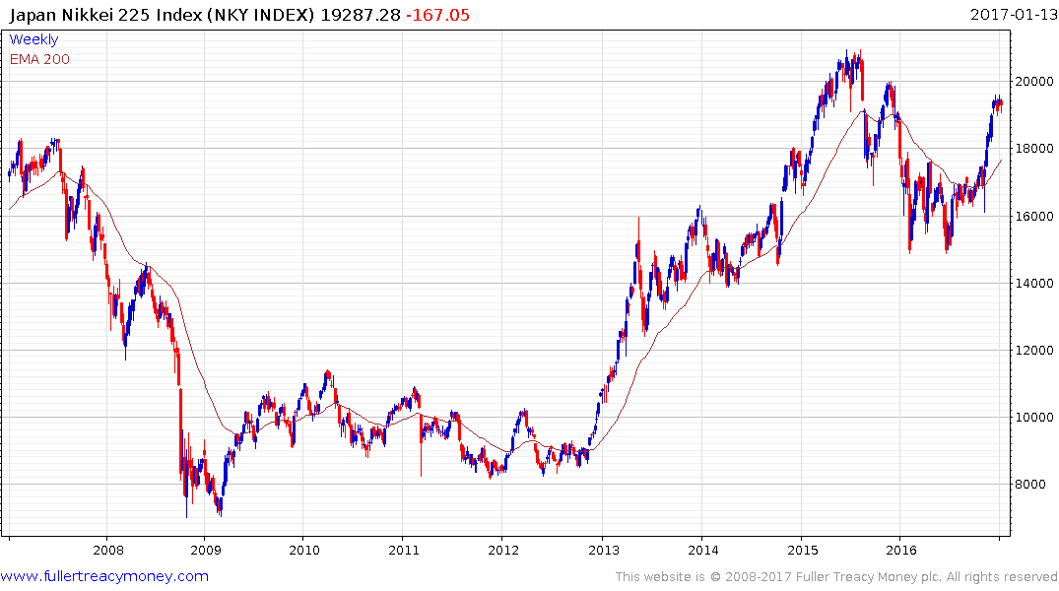
Japan Nikkei 225 Index
Rallied well on Trump win and
weaker yen, but may still needs a
soft currency to extend gains

Slide 23
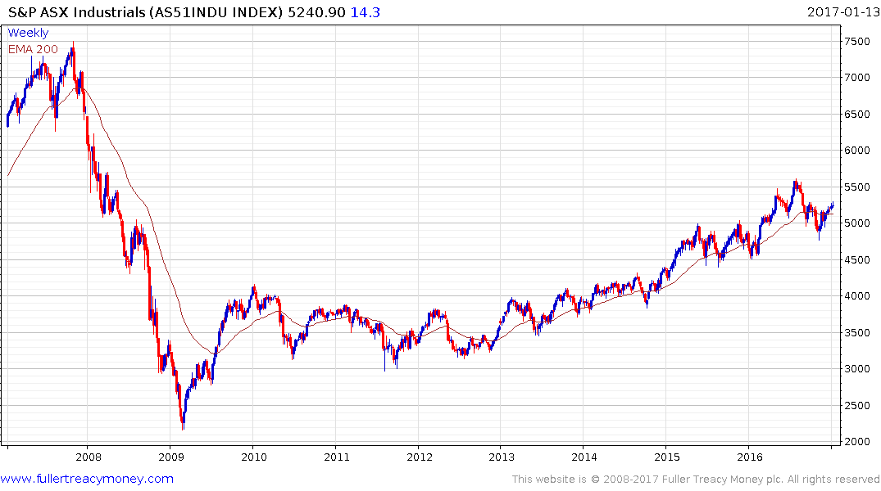
Australia S&P ASX Industrials
Still in a gradual overall uptrend but
Australian Minerals look more interesting

Slide 24
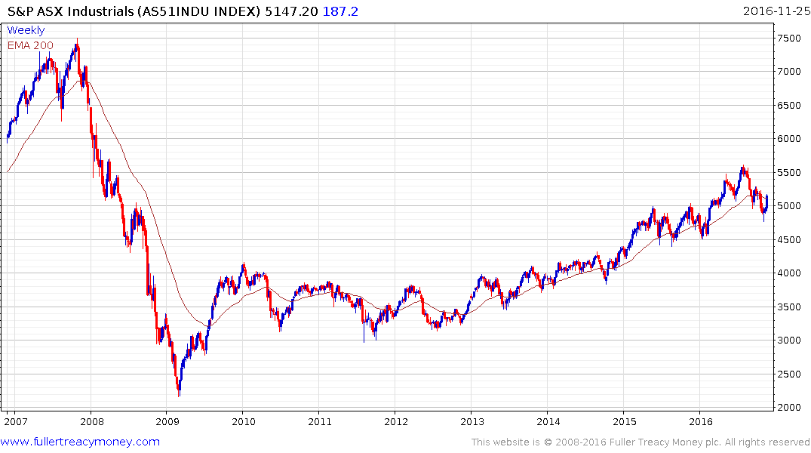
Australia S&P ASX Industrials
Still in a gradual overall uptrend but
the next chart is more interesting

Slide 25
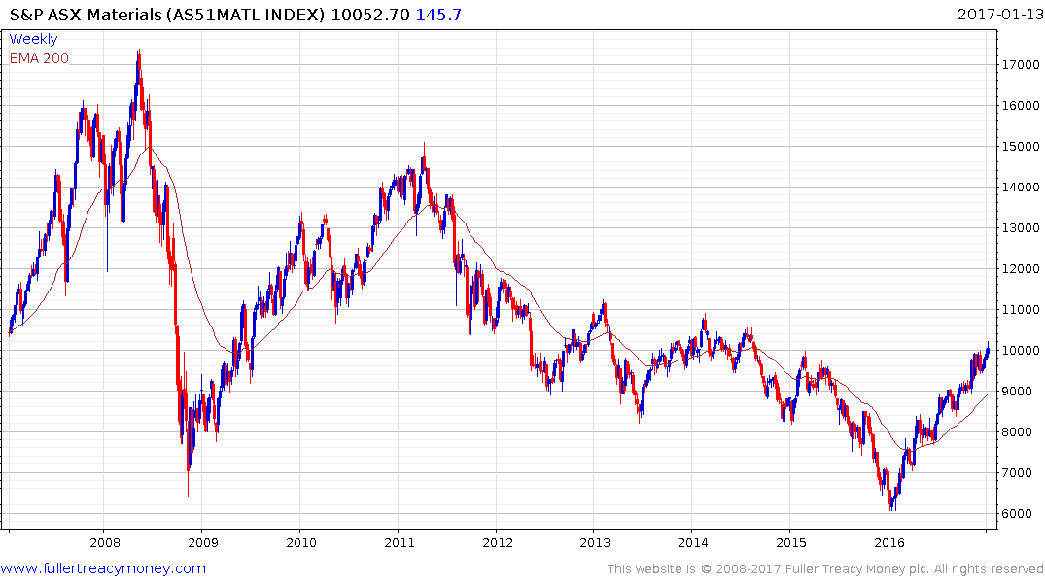
Australia S&P ASX Materials
Australia S&P ASX Materials
No problem while
staircase uptrend
maintains consistency

Slide 26
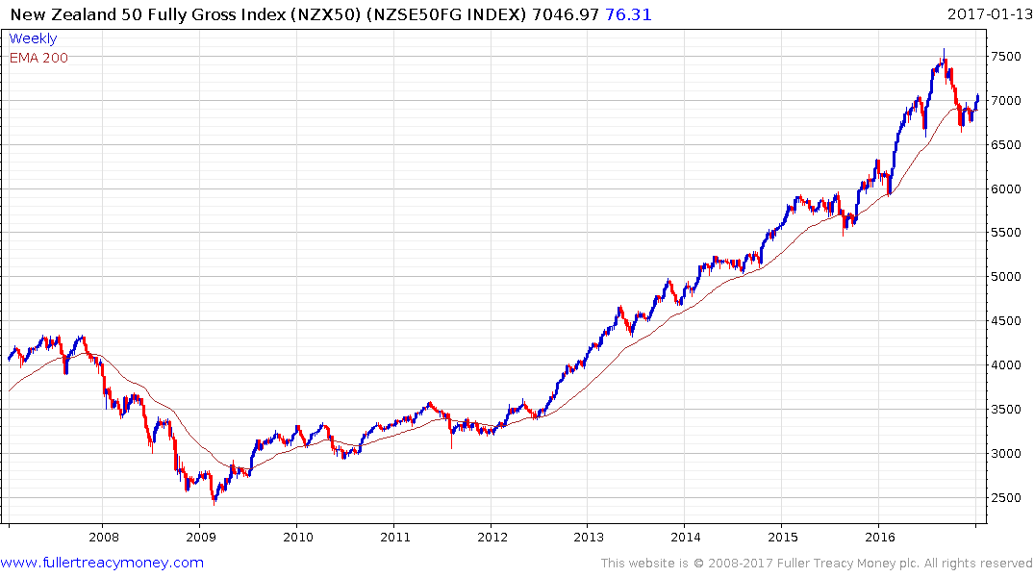
New Zealand
The first clear uptrend inconsistency was the overextension
relative to the MA in early September – the second was a far
bigger reaction than seen previously. These confirmed that
New Zealand has seen a peak of lengthy duration, although
it is currently unwinding a short-term oversold condition

Slide 27
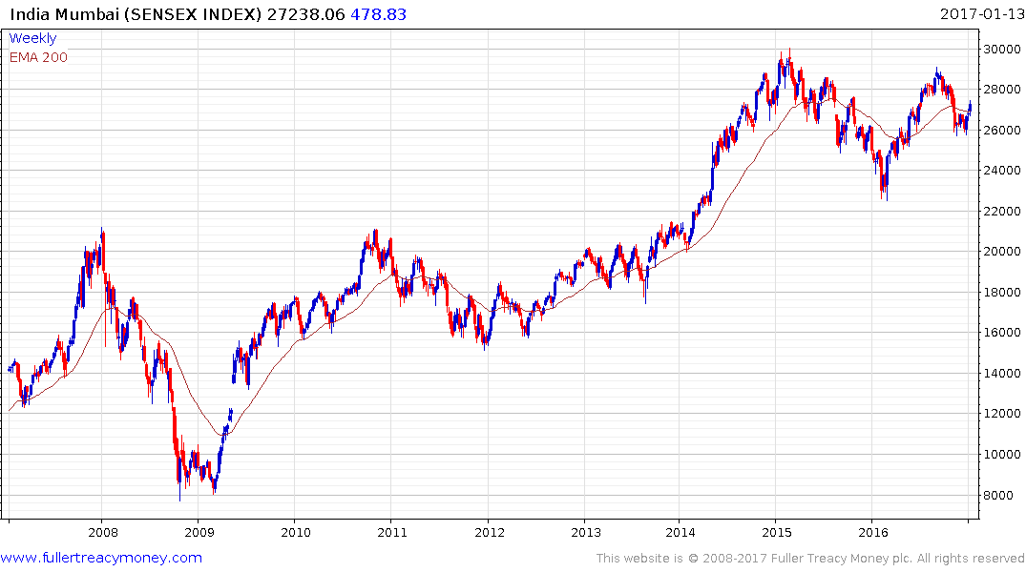
India Mumbai Sensex Index
Similar top formation characteristics of overextension
relative to MA followed by large correction as seen by
NZ on previous slide
Will need to clear August 2016 high to
indicate current range is a lengthy
consolidation prior to further medium-term
gains by what has been a regional outperformer

Slide 28
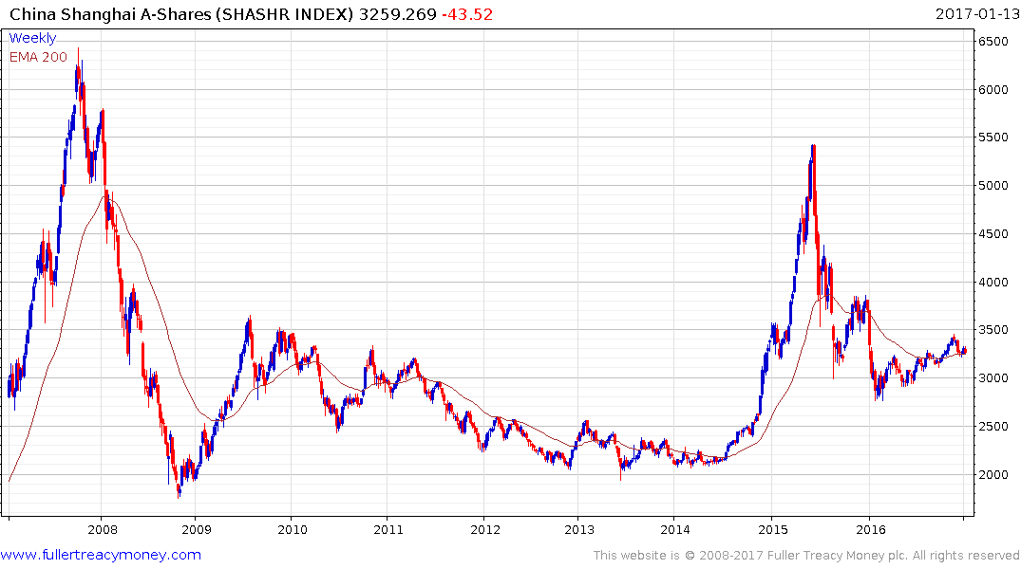
China Shanghai Composite Index
To much uncertainty? Investors remain
wary of China which has continued to lag,
despite a soft currency. Nevertheless, the
rising lows from early 2016 have yet to be
broken.

Slide 29
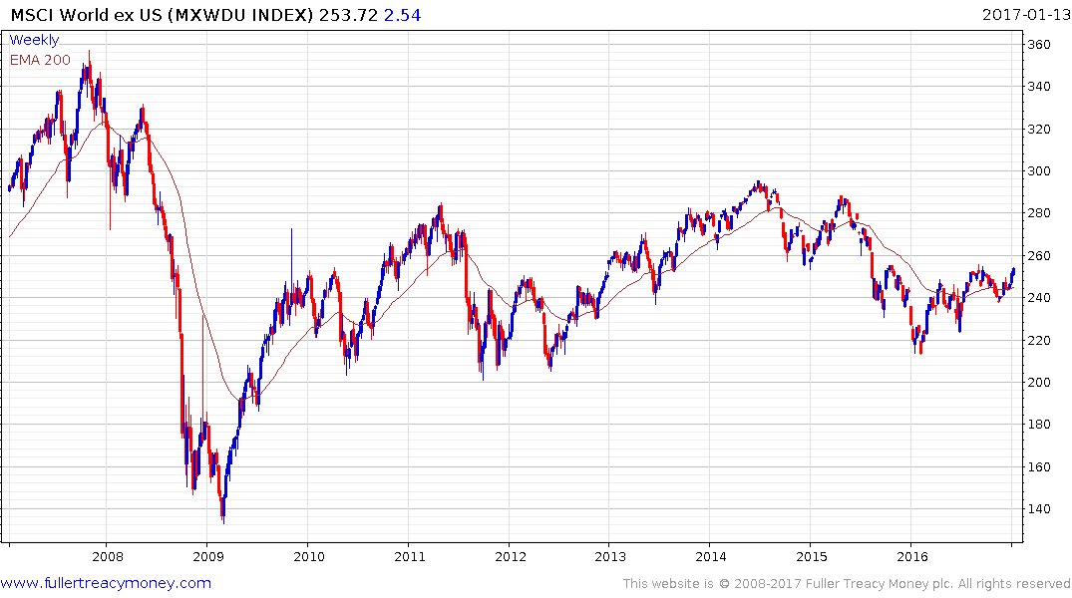
MSCI World ex US
(shown in USD)
Serial underperformer but sequence
of higher reaction lows since early-2016
is mildly encouraging

Slide 30
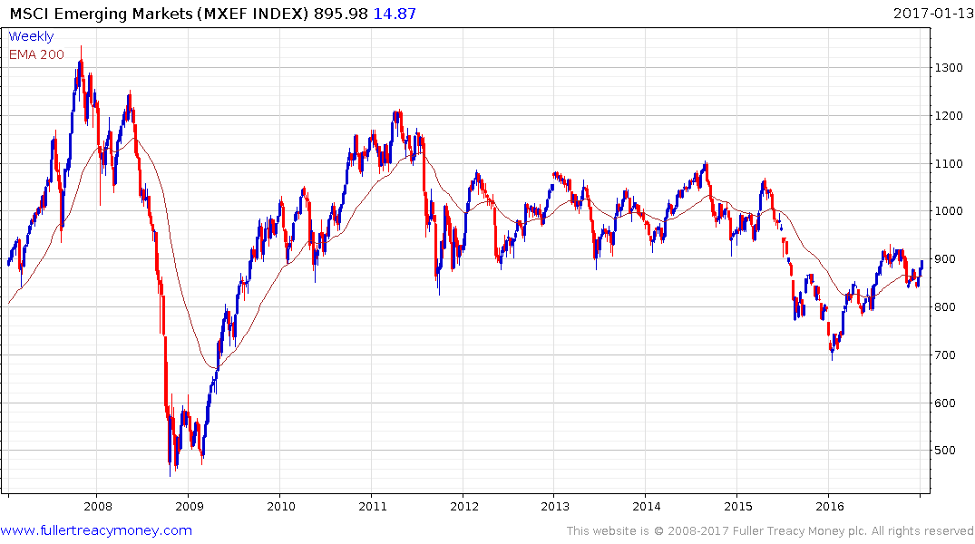
MSCI Emerging Markets
Has underperformed since 2011
but sequence of higher reaction
lows since Feb 2016 is mildly
encouraging

Slide 31
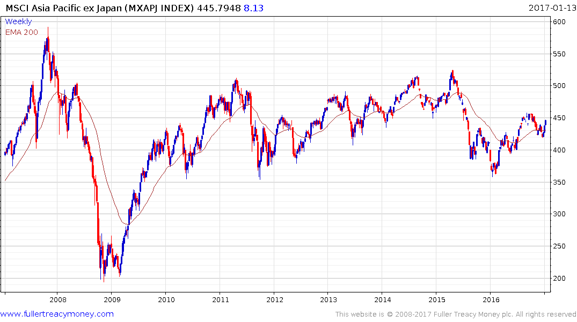
MSCI Asia Pacific ex Japan Small Caps Index
Mildly encouraging since Feb 2016

Slide 32
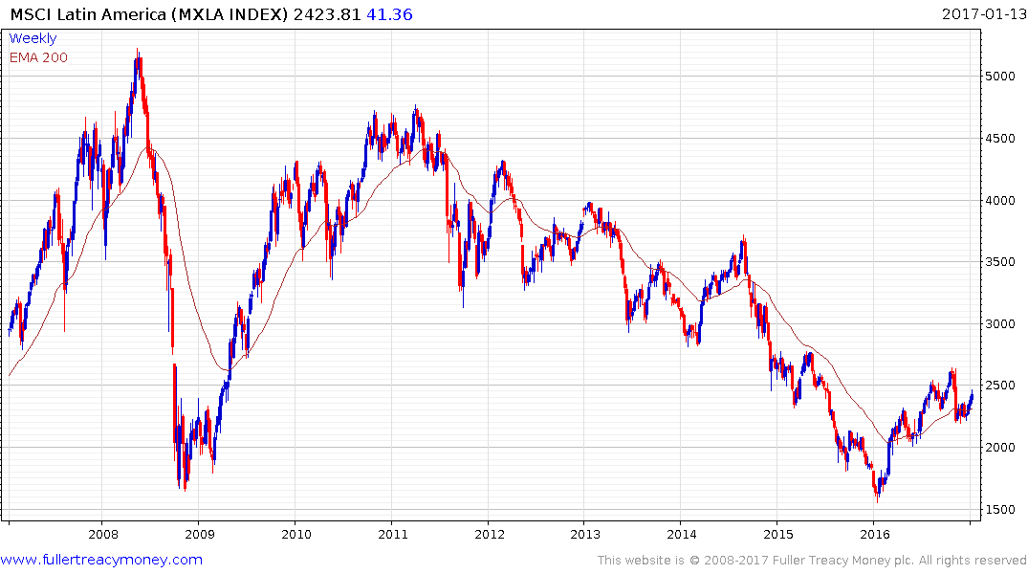
MSCI Latin America
Serial underperformer in USD
terms but recovering since climactic
retest of 2008/9 trough

Slide 33
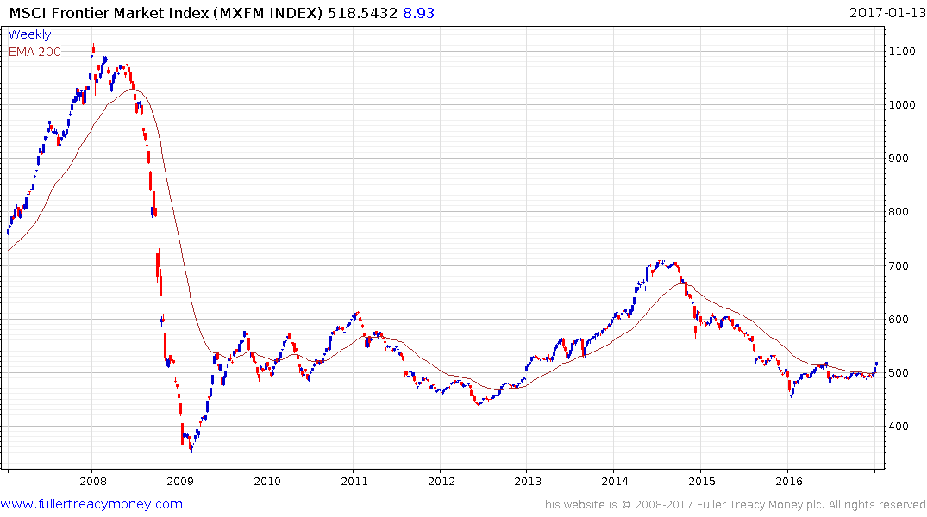
MSCI Frontier Market Index
Serial underperformer finally showing
signs of recovery as global GDP improves

Slide 34
Arguably, these underperforming markets in the MSCI indices are interesting on a buy-low, sell-high basis but it might be best to wait until we have seen a sharp sell-off on Wall Street.

Slide 35
Industrial metals remain in favour
Biggest risk is a surging USD

Slide 36
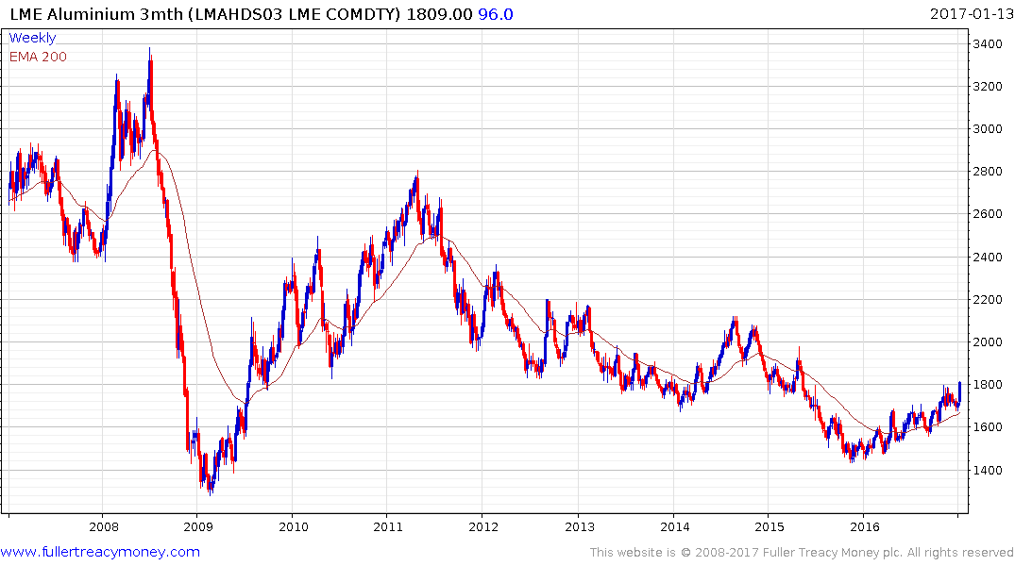
LME Aluminium (3m)
Ranging higher and a close
beneath $1670 would be required
to delay recovery beyond a brief
pause

Slide 37
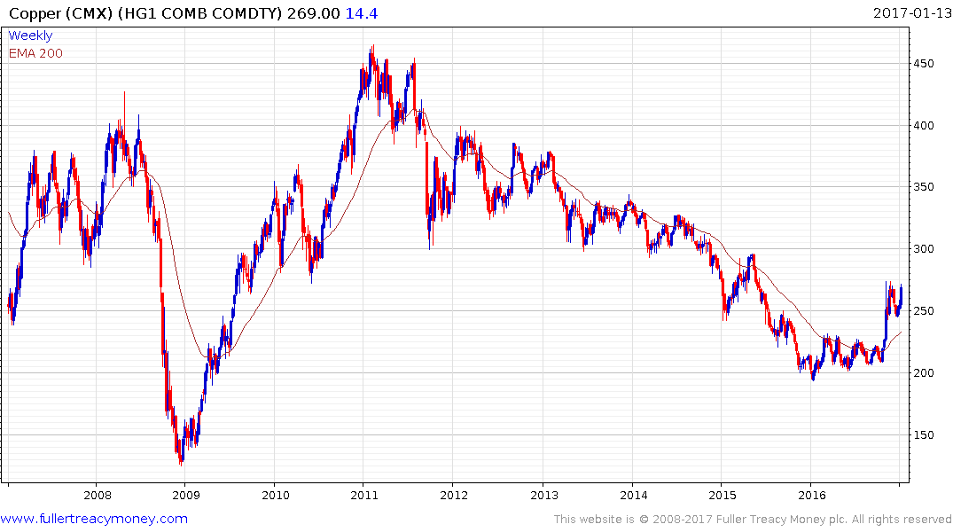
Copper (CMX)
The last to commence a recovery
after a decisive upside breakout
from base formation – currently
consolidating initial gains

Slide 38
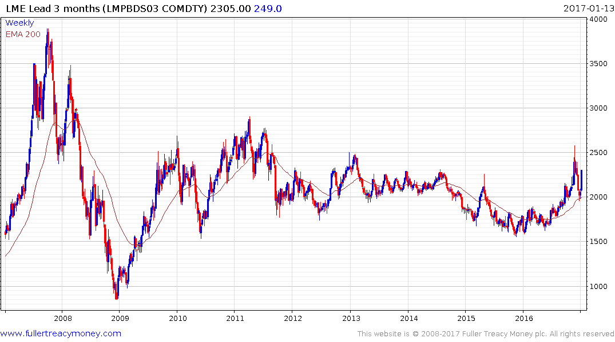
LME Lead (3m)
Sharp correction from short-term
overextended condition but bounced
off MA – likely to range higher over
medium term

Slide 39
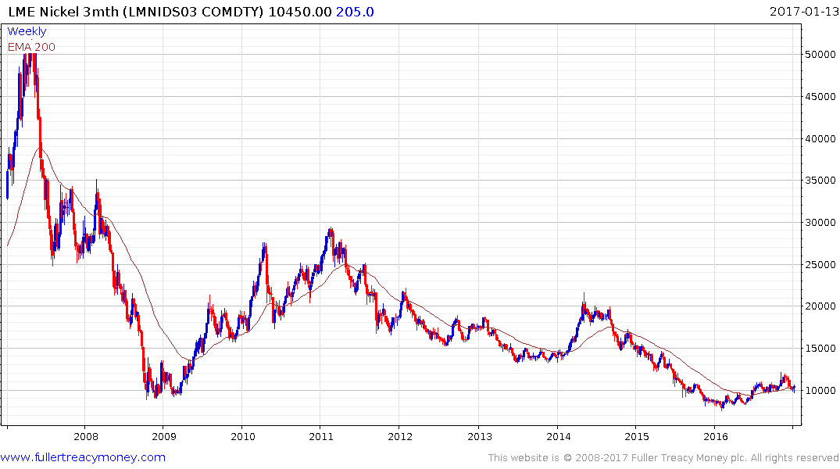
LME Nickel (3m)
Recent slight dip beneath $10000
suggests some additional base
formation development before the
recovery resumes

Slide 40
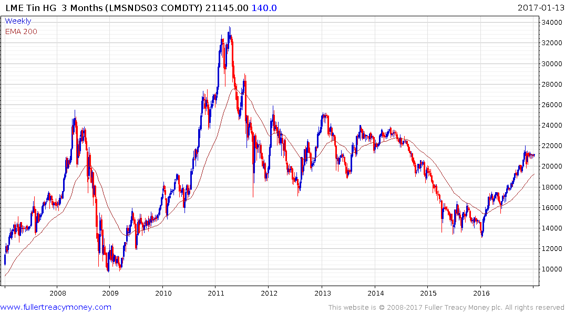
LME Tin (3m)
Currently steady but still temporarily overextend so some further reaction
and consolidation is likely before
uptrend resumes

Slide 41
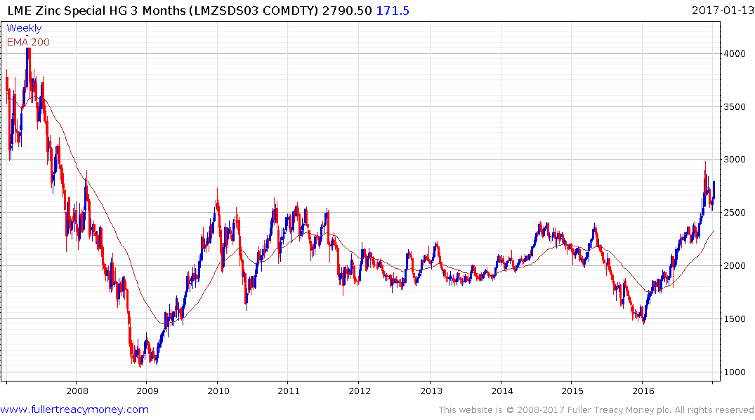
LME Zinc (3m)
Still somewhat overextended so current ranging consolidation may continue
until rising MA catches up

Slide 42
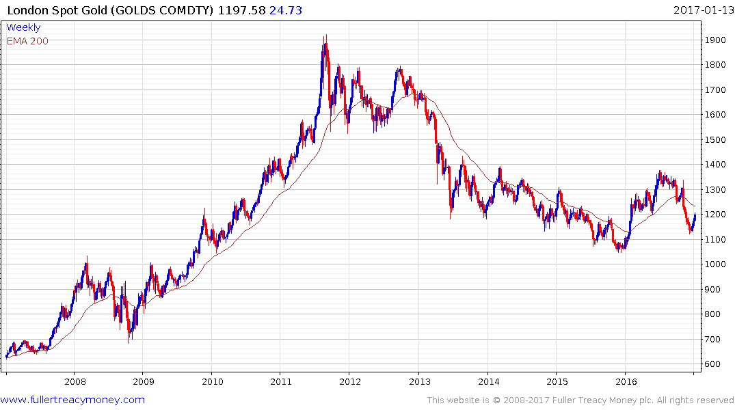
London Spot Gold
Recovering from oversold correction
but further USD strength would be an
additional headwind

Slide 43
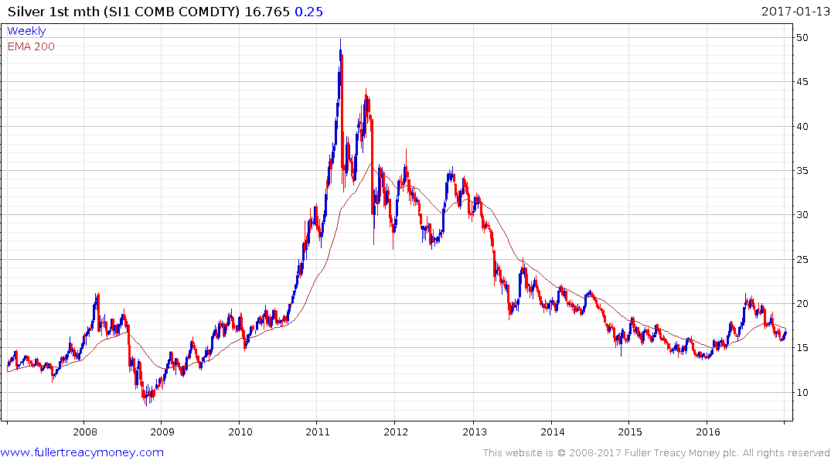
Silver
Steadying in former support but risk of a USD headwind remains

Slide 44
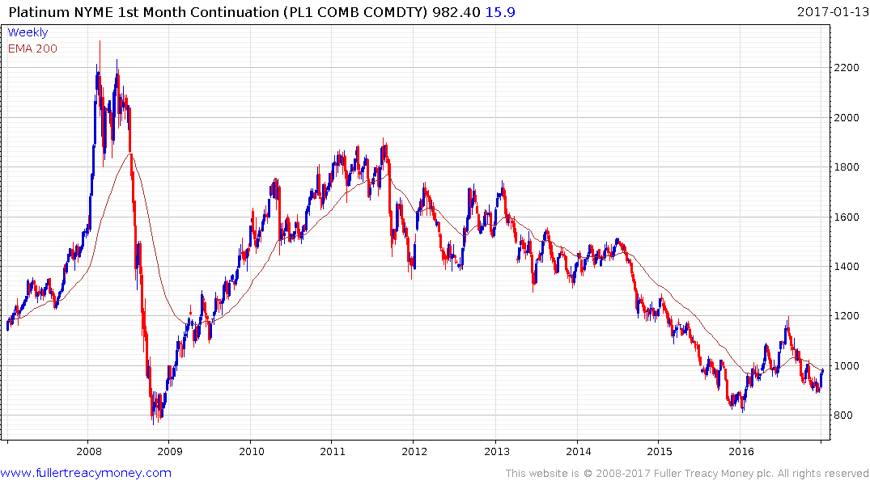
Platinum
Steadier but risk of a
USD headwind remains

Slide 45
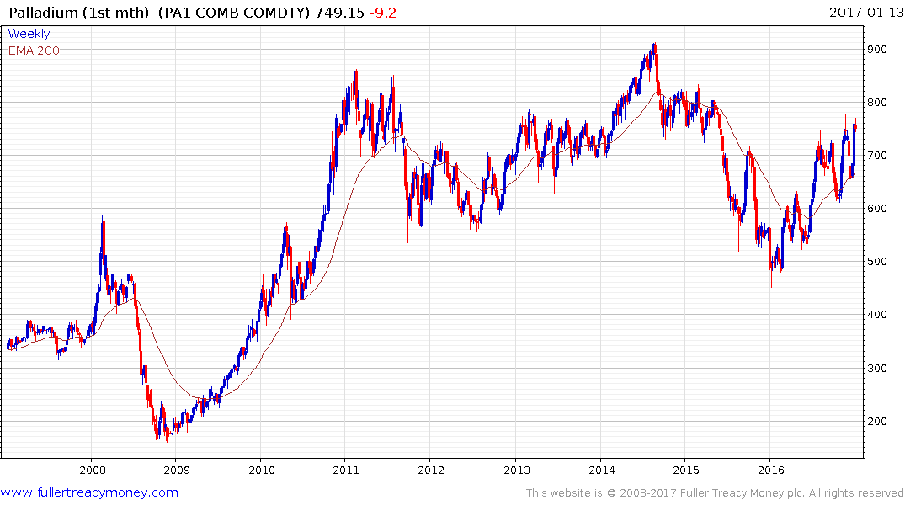
Palladium
The strongest ‘precious metal’ by far
being much more of an industrial metal,
now temporarily overbought but building
up support within choppy uptrend

Slide 46
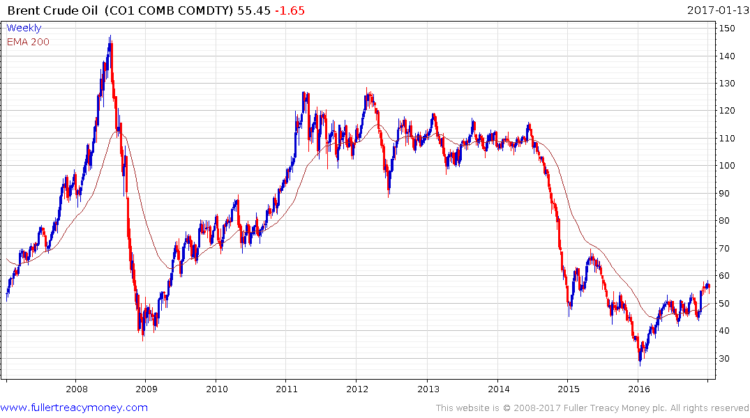
Brent Crude Oil
OPEC plus Russian production
‘cuts’ and slightly stronger GDP
growth

Slide 47
And now
it’s Trump coronation time!
Here are some early photos
for you to treasure

Slide 48
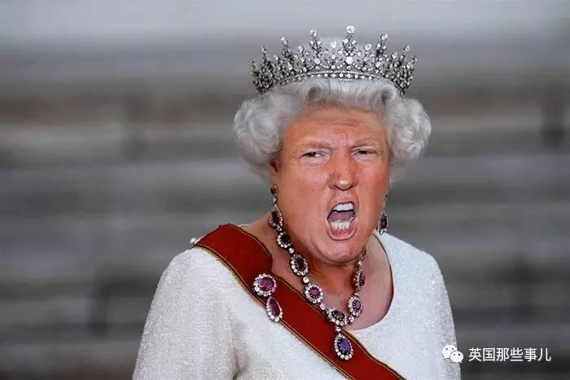

Slide 49
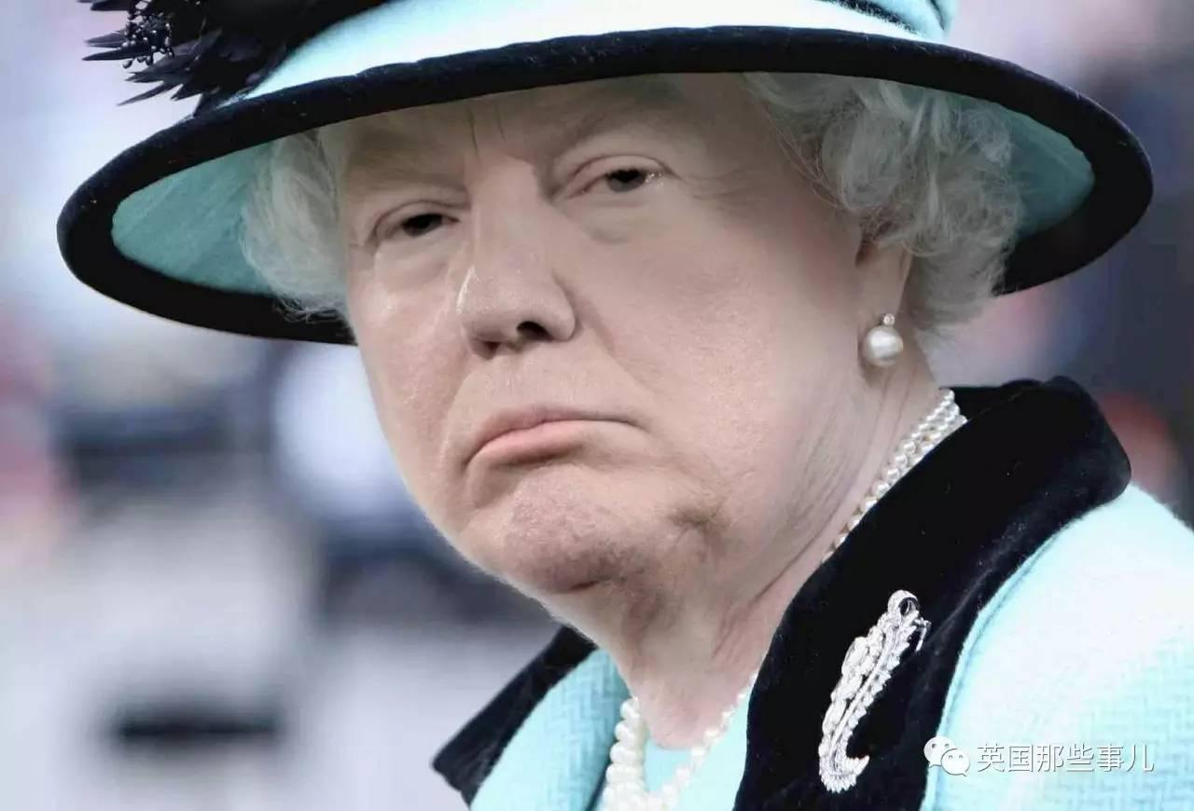

Slide 50
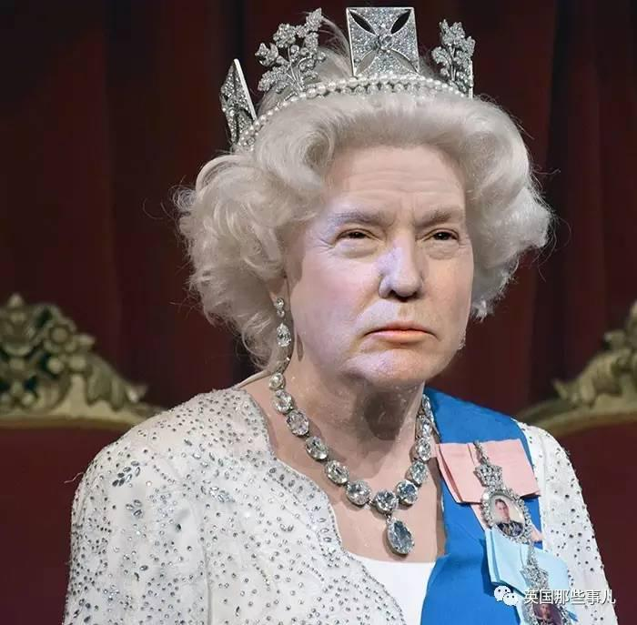

Slide 51
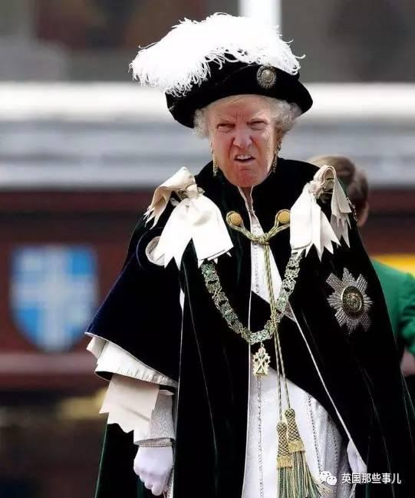

Slide 52
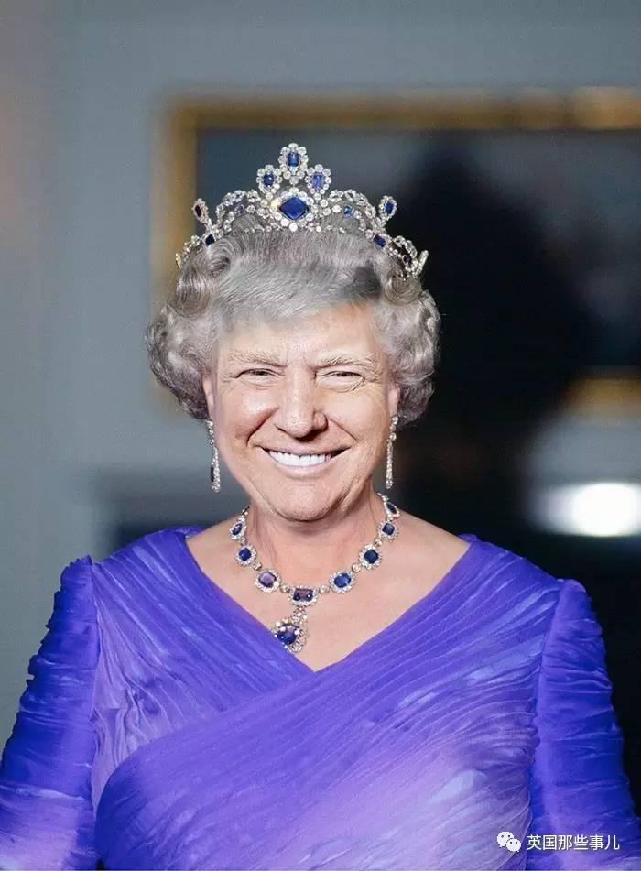

Slide 53
All In Good Fun
The president-elect likes the UK
and that will help us in our Brexit negotiations

Slide 54


Slide 58

Well, it’s somewhat like this

Slide 59
Some trade-offs to consider
1. Investors were often terrified during nearly eight years of this bull trend – now they are more confident.
2. The UK and most other leading stock markets will be affected by Wall Street, which is somewhat expensive.
3. A US rate hike in Dec increases the probability of a stronger US$, which would not help corporate profits.
4. However, seasonal factors improve next month.
5. Presidential elections (Clinton I assume) are usually followed by at least a relief rally as uncertainty ends.
6. Recession risks during the next three to four years will produce some cyclical bear markets.
7. Thereafter, we should enjoy a secular bull market.

Slide 60
Post-Brexit Probabilities
From 11th July
Markets Now
1. This is not a global repeat of 2008.
2. The UK is susceptible to a medium-term recession.
3. Free-floating Sterling will cushion UK economic risk.
4. Good governance led by a new PM is now required.
5. UK consensus: love Europe but not the EU.
6. EU citizens working in the UK are welcome to remain.
7. UK welcomes immigration but will control the process.
8. Brexit will enable the UK to be more international.
9. Brexit has shone a new light on the EU’s deficiencies.
10. UK Brexit negotiations will resemble the Grand National and the EU would be wise to lower the fences.

Slide 61
“Social democracy and capitalism both need hitting over the head from time to time. It detoxifies them of bureaucracy, monopoly and cronyism. Britain is experiencing such a time. It
Should do us no end of good.”
Simon Jenkins, EU Referendum Opinion for The Guardian

Slide 62
“I agree that the intransigent and punishing approach emerging from the EU is actually a blessing for the UK. A rapid 'hard Brexit', in much less than 2 years, may actually be the BEST scenario for our country. Yes there will be losers, and they will kick and scream, but there will be winners too (who will be quieter). In the mid-term I think it likely the winners from Brexit will out-number the losers and we will have a better society too.”
David Brown 08/10/2016 13:28
(from Comment of the Day)

Slide 63
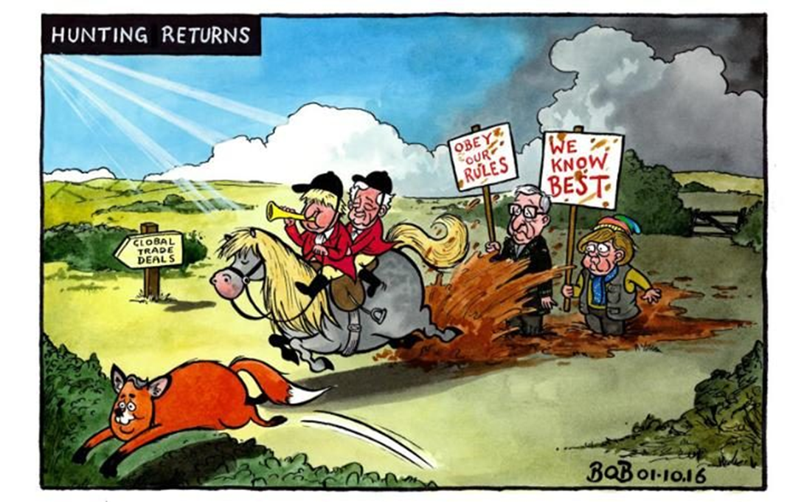

Slide 64
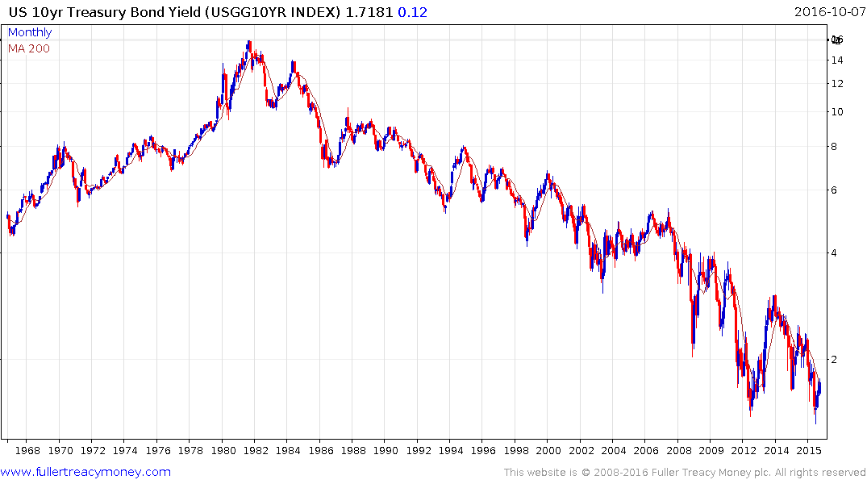
US 10Yr Treasury Bond Yield
Are long-dated government bonds
the biggest bubble in our lifetime?
Yes, unless you think the global
economy will not recover.
The yield was on its low at our
11th July Markets Now, so a little
air is escaping but this bubble
has yet to burst

Slide 65
1. Technology and Bio-Technology are the sectors most likely to boom in the next secular bull market.
2. However, many of them are expensive today, although the strongest may be among the last to fall as the next cycle bear market commences.

Slide 66
Commodities
1. The cure for low prices is low prices, as supply declines and demand begins to increase.
2. Contra-cyclical commodities are underowned by investors.
3. Global uncertainty, competitive devaluations and
low interest rates can revive the ‘hard money’ appeal of gold and other precious metals but rising interest
rates and Dollar strength will be headwinds.

Slide 67
The last word on the
US Presidential Election
from New York City

Slide 68
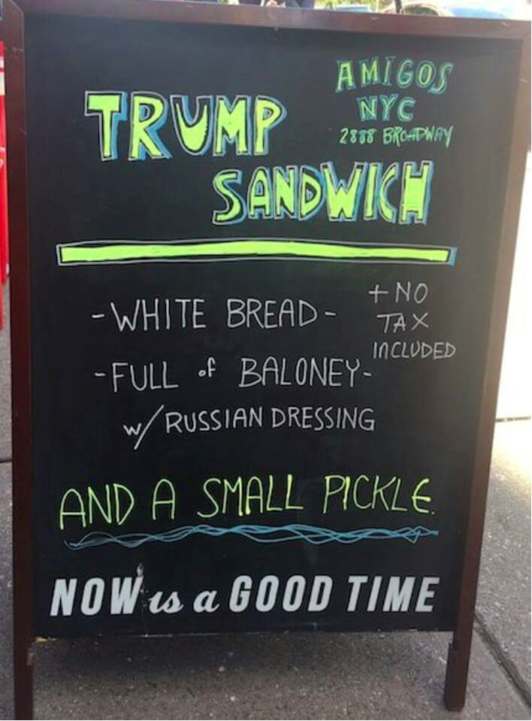

Slide 71
Technical warning signs to watch for among indices
Trend acceleration relative to 200-day moving averages
Declining market breadth (fewer shares rising)
Failed upside breakouts from trading ranges
Loss of uptrend consistency characteristics
Churning price action relative to recent trading ranges
Breaks of 200-day moving averages
Broadening patterns for trading ranges following uptrends
200-day moving averages turn downwards
Resistance is encountered beneath declining 200-day MAs
Previous rising lows are replaced by lower rally highs
Indices fall faster than they rose to their highs

