Slide 1
Is This the Beginning of the End,
Or the End of the Beginning
For Global Investors?
October 10th 2016
By David Fuller
fullertreacymoney.com
The Caledonian Club – 9 Halkin Street
London SW1Y 4LH, UK

Slide 2

Well, it’s somewhat like this

Slide 3
Some trade-offs to consider
1. Investors were often terrified during nearly eight years of this bull trend – now they are more confident.
2. The UK and most other leading stock markets will be affected by Wall Street, which is somewhat expensive.
3. A US rate hike in Dec increases the probability of a stronger US$, which would not help corporate profits.
4. However, seasonal factors improve next month.
5. Presidential elections (Clinton I assume) are usually followed by at least a relief rally as uncertainty ends.
6. Recession risks during the next three to four years will produce some cyclical bear markets.
7. Thereafter, we should enjoy a secular bull market.

Slide 4
Post-Brexit Probabilities
From 11th July
Markets Now
1. This is not a global repeat of 2008.
2. The UK is susceptible to a medium-term recession.
3. Free-floating Sterling will cushion UK economic risk.
4. Good governance led by a new PM is now required.
5. UK consensus: love Europe but not the EU.
6. EU citizens working in the UK are welcome to remain.
7. UK welcomes immigration but will control the process.
8. Brexit will enable the UK to be more international.
9. Brexit has shone a new light on the EU’s deficiencies.
10. UK Brexit negotiations will resemble the Grand National and the EU would be wise to lower the fences.

Slide 5
“Social democracy and capitalism both need hitting over the head from time to time. It detoxifies them of bureaucracy, monopoly and cronyism. Britain is experiencing such a time. It
Should do us no end of good.”
Simon Jenkins, EU Referendum Opinion for The Guardian

Slide 6
“I agree that the intransigent and punishing approach emerging from the EU is actually a blessing for the UK. A rapid 'hard Brexit', in much less than 2 years, may actually be the BEST scenario for our country. Yes there will be losers, and they will kick and scream, but there will be winners too (who will be quieter). In the mid-term I think it likely the winners from Brexit will out-number the losers and we will have a better society too.”
David Brown 08/10/2016 13:28
(from Comment of the Day)

Slide 7
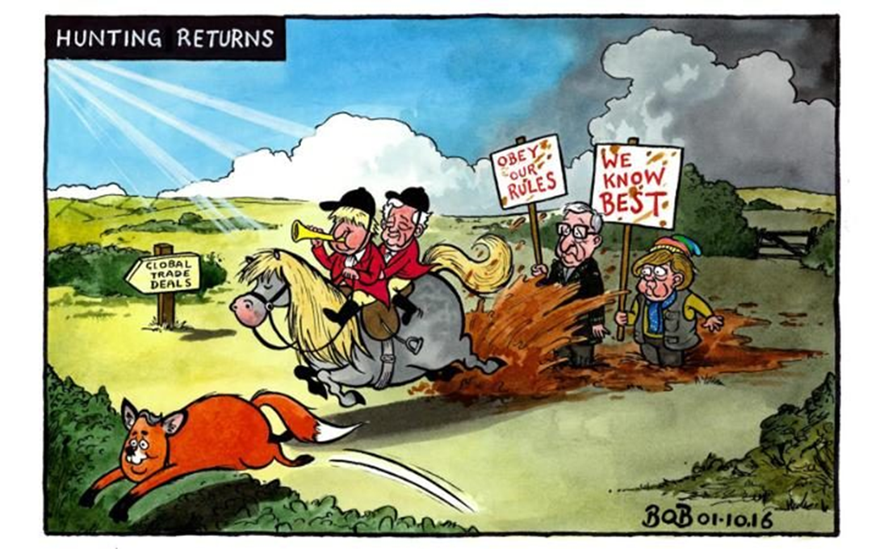

Slide 8
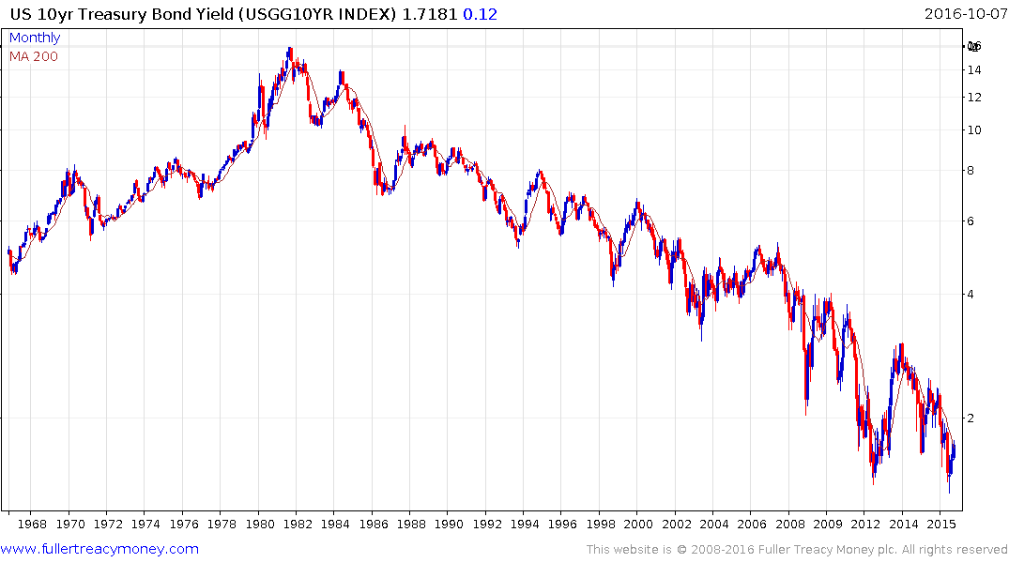
US 10Yr Treasury Bond Yield
Are long-dated government bonds
the biggest bubble in our lifetime?
Yes, unless you think the global
economy will not recover.
The yield was on its low at our
11th July Markets Now, so a little
air is escaping but this bubble
has yet to burst

Slide 9
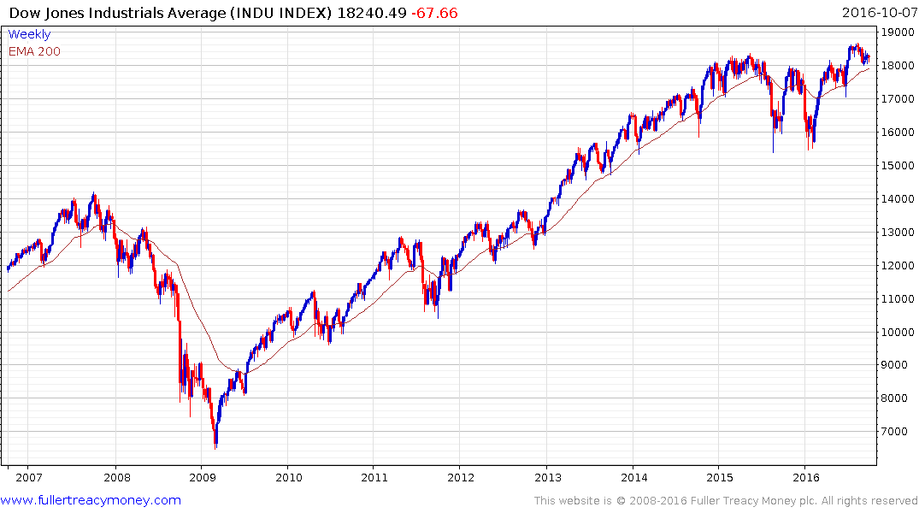
Dow Jones Industrial Average
(P/E 17.55 & Yield 2.58%)
Is this big trading range
since 2Q 2014 an upside
continuation pattern?
Not according to
Dow Theory as
the DJ Transport
Average, which follows,
continues to lag.

Slide 10
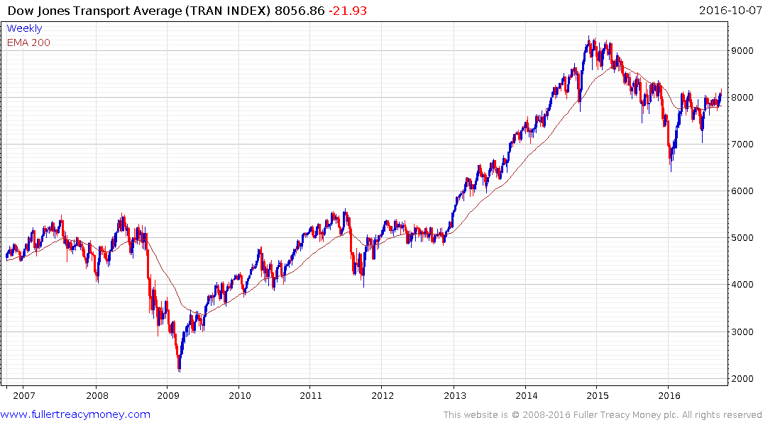
DJ Transport Average
(P/E 13.39 & Yield 1.47%)
No Dow Theory confirmation
of S&P and DJIA marginal
new highs in August

Slide 11
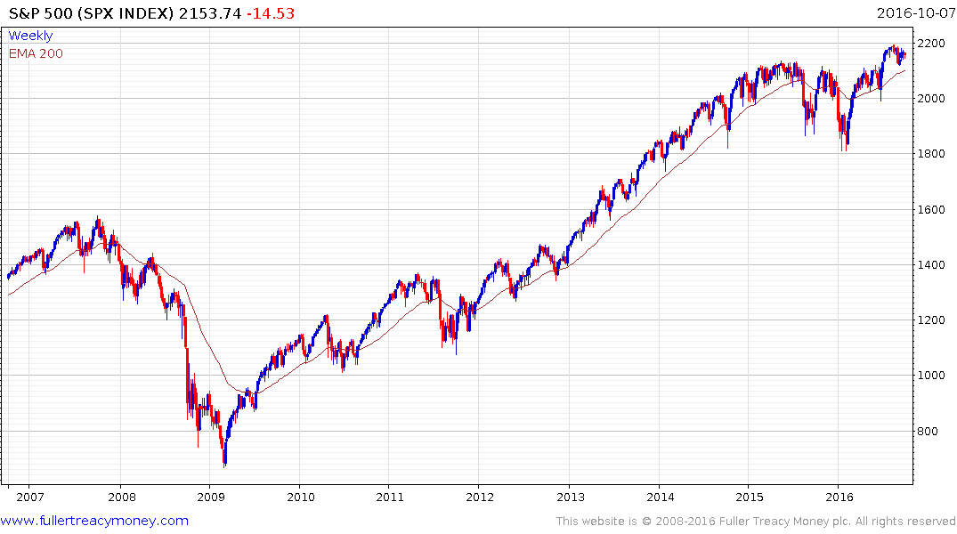
S&P 500 Index p/e 20.28
(P/E 20.28 & Yield 2.14%)
Is this big trading range since
2Q 2014 an upside continuation
pattern?
A break above 2200
would reaffirm some
additional upward bias
but this year’s firmness
has been fuelled by
liquidity rather than
earnings.

Slide 12
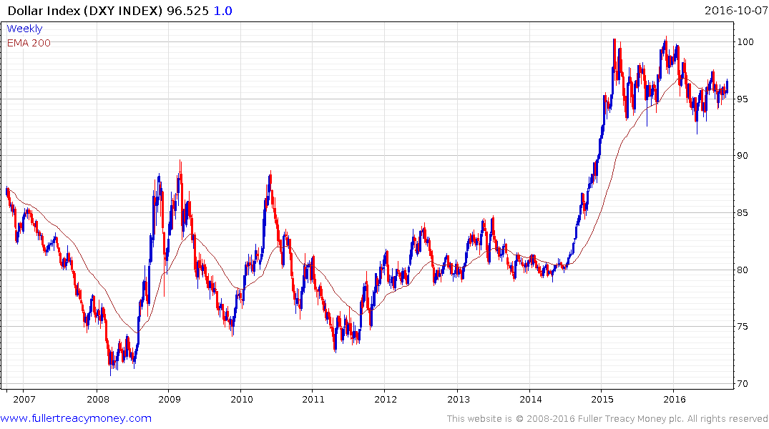
Dollar Index
The next big move will be a sustained
move above the 100 level, which will be
a challenge for the USA if it occurs too
quickly.

Slide 13
1. Technology and Bio-Technology are the sectors most likely to boom in the next secular bull market.
2. However, many of them are expensive today, although the strongest may be among the last to fall as the next cycle bear market commences.

Slide 14
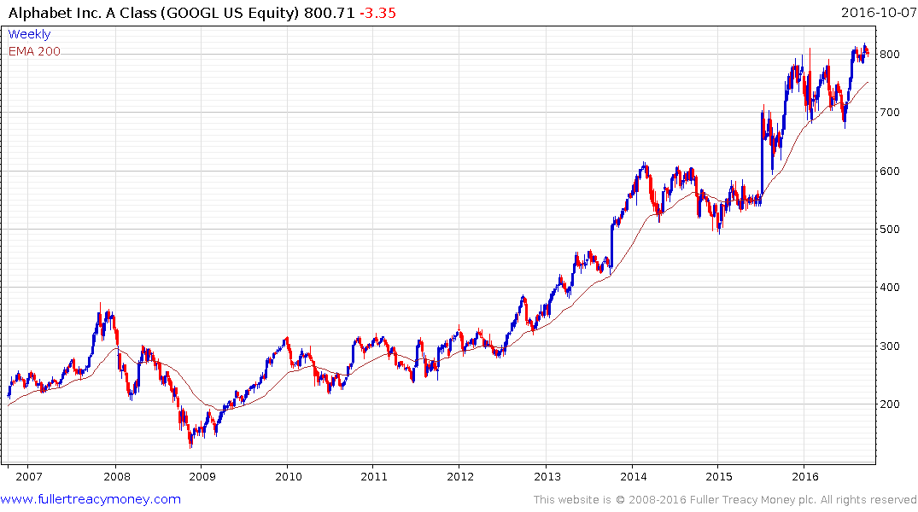
Alphabet (formerly Google
(Est P/E 23.42 & Yield N.A.)
Ranging higher and becoming less expensive
– Brilliant CEO/Co-Founder Larry Page &
President/Co-Founder Sergey Brin

Slide 15
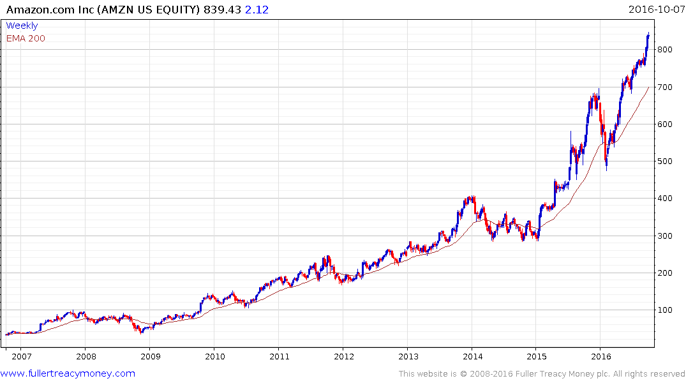
Amazon
(Est P/E 208.45 & Yield N.A.)
The most disruptive company
in the world and also one of
the most successful – currently
overstretched relative to MA.
Brilliant Founder & CEO, Jeff
Bezos

Slide 16
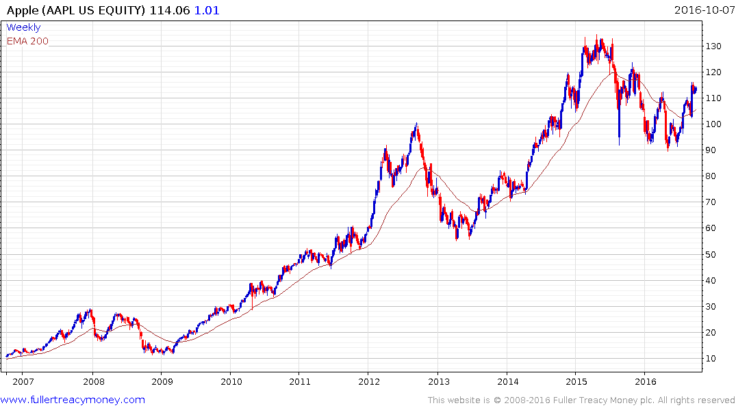
Apple
(Est P/E 13.82 & Yield 2.00%)
An iconic company and not expensive
but overly dependent on the iPhone
and with a tough rival in Samsung,
albeit temporarily under pressure.
Downtrend since mid-2015 has
been broken, indicating higher scope.

Slide 17
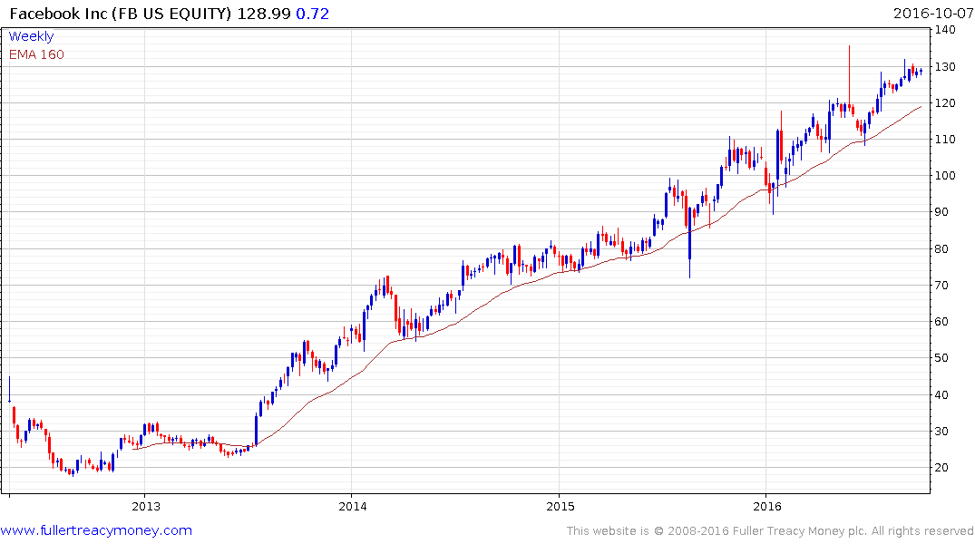
Facebook
(Est P/E 32.52 & Yield N.A.)
Still in an orderly ascent.
Brilliant Founder & CEO
Mark Zuckerberg

Slide 18
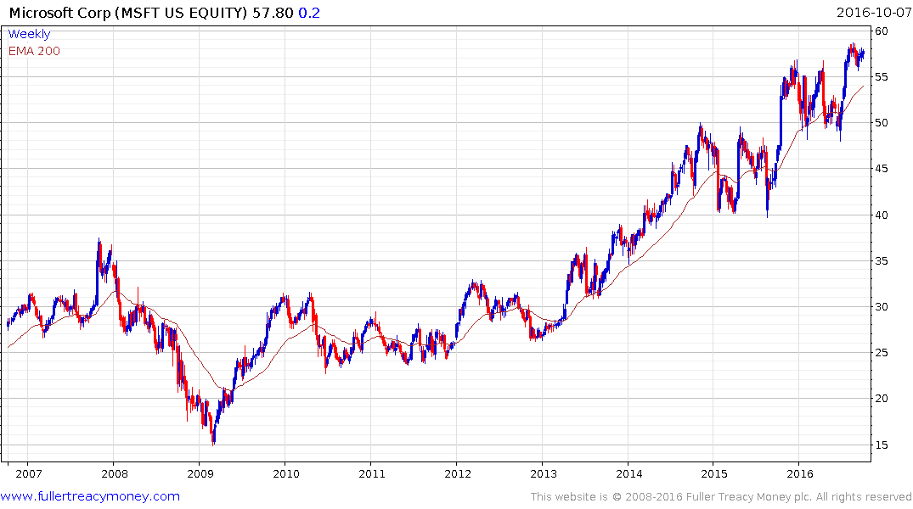
Microsoft
(Est P/E 19.92 & Yield 2.7%)
Ranging higher and becoming less expensive –
brilliant founder Bill Gates is now Technology
Advisor, and current CEO Satya Nadella is
proving to be successful.

Slide 19
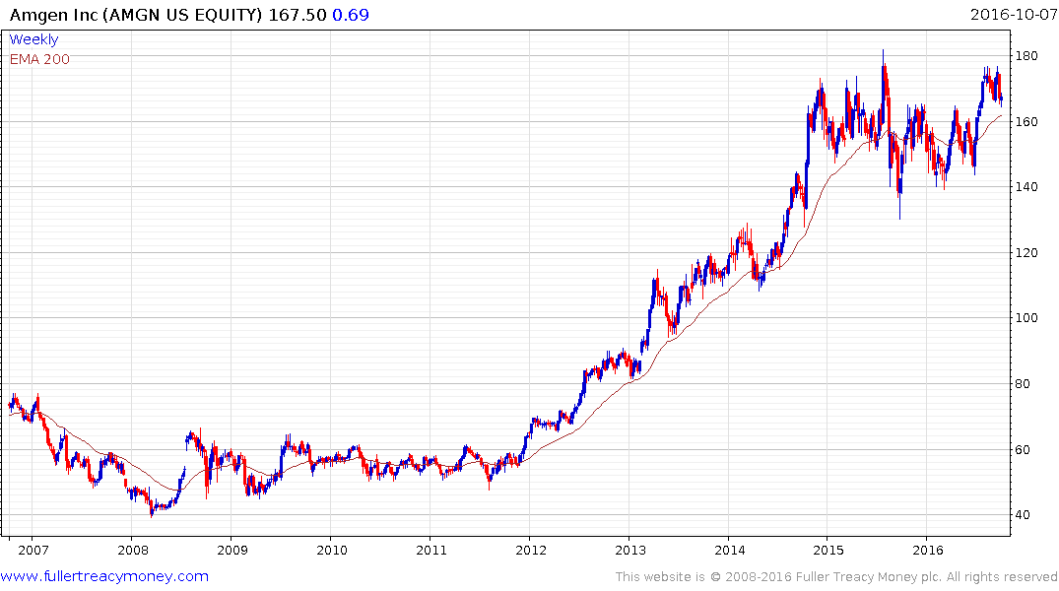
Amgen
(Est P/E 14.76 & Yield 2.39%)
Two year range in potential upside
launch pad but must maintain
sequence of higher reaction lows.

Slide 20
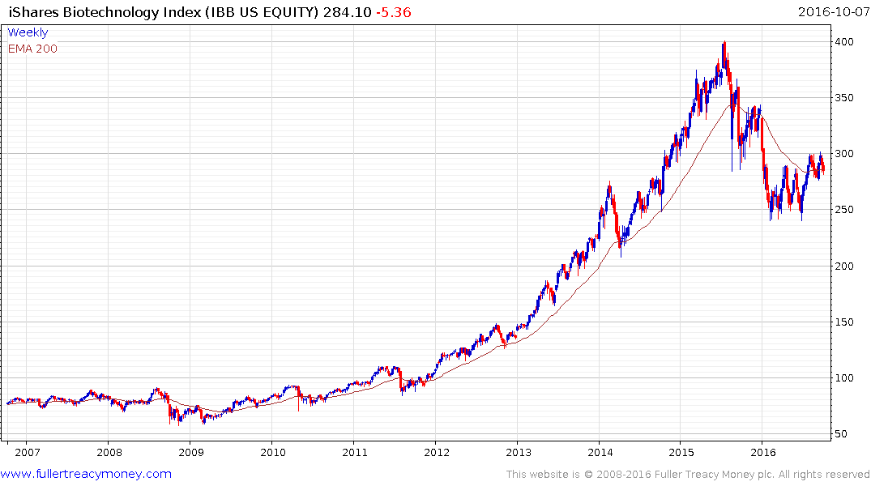
iShares Nasdaq Biotechnology ETF
(discount to NAV -0,018%)
Better value after shakeout following
overextended advance but needs to
sustain break above $300 to confirm
recovery.

Slide 21
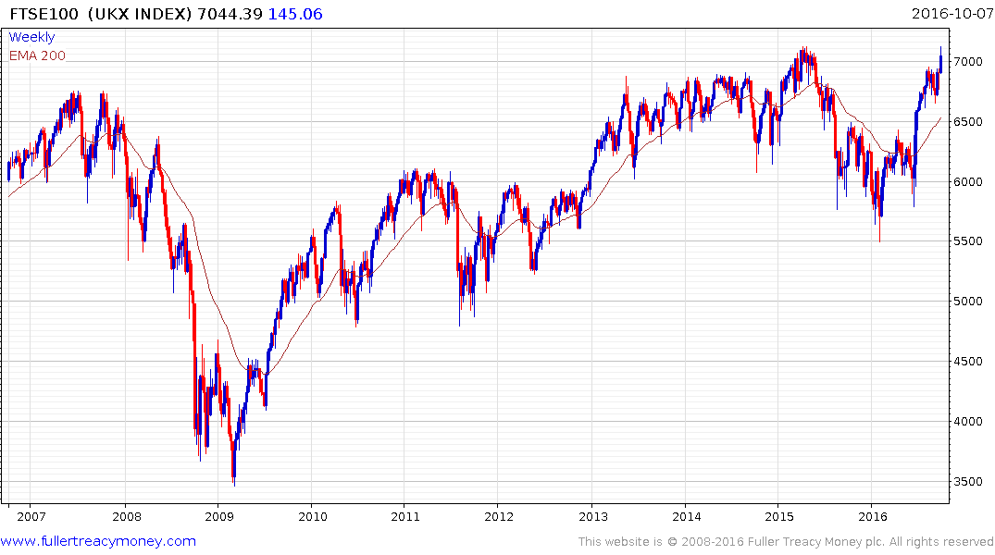
FTSE 100
P/E 59.67 & Yield 3.97%)
A competitively priced
Pound Sterling is good
for exporters, although
there will be a risk of
higher inflation as the
global economy recovers.

Slide 22
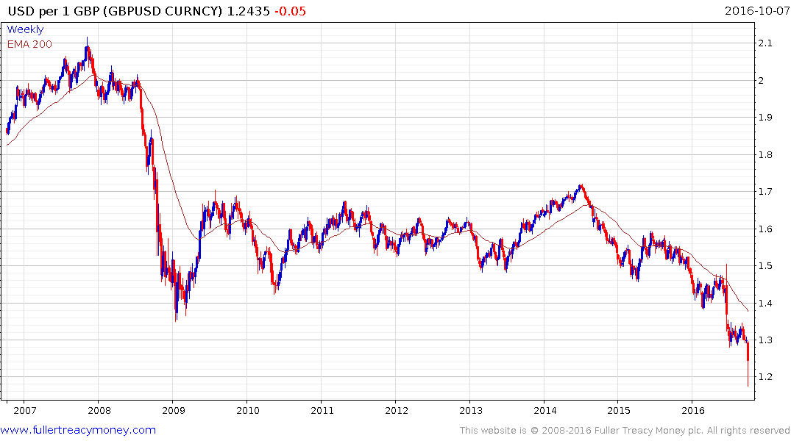
GBP/USD
This is mostly good
for the UK economy
and the balance of trade.

Slide 23
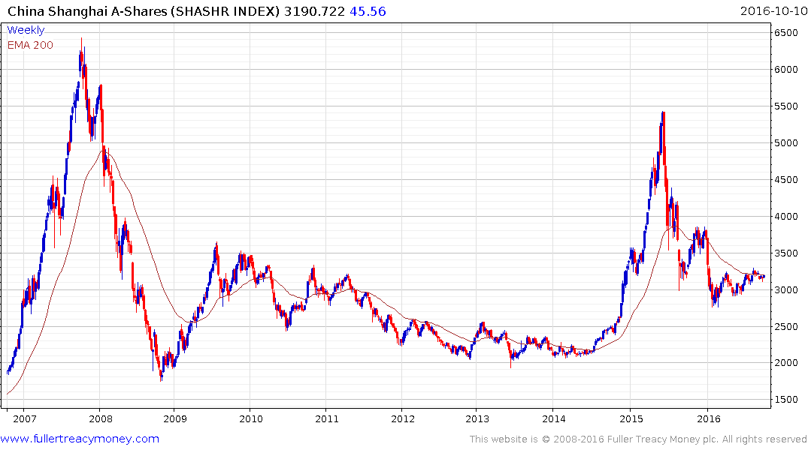
China Shanghai A-Shares
(P/E 17.70 & Yield 1.92%)
An economic recovery by China is needed to
support the global economy. China’s economic
tradeoff: a system of mostly organised communism.
The stock market remain in a recovery phase
while the bigger reaction lows continue to rise.

Slide 24
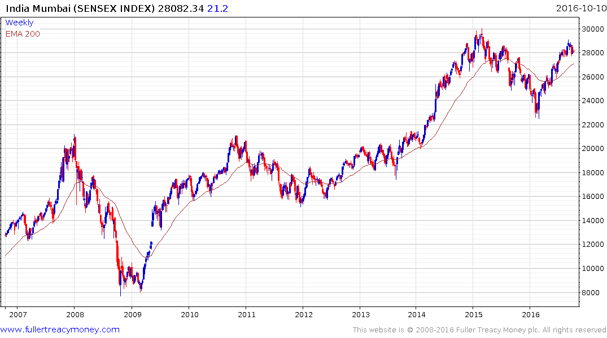
India Mumbai Sensex
(P/E 20.89 & Yield 1.51%)
Some loss of upside momentum
near the early 2015 highs
India’s economic tradeoff:
disorganised capitalism.
Governance is everything.

Slide 25
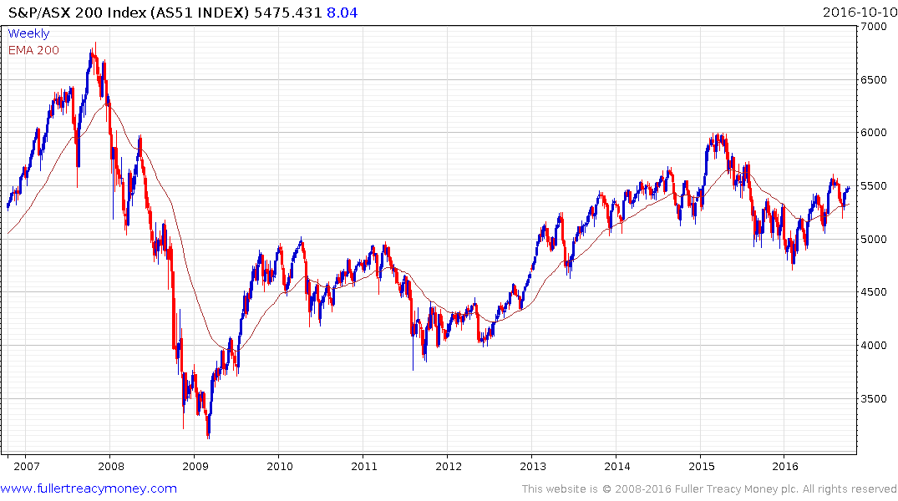
Australia
(P/E 24.56 & Yield 4.29%)
Give upside the benefit of the doubt
while the sequence of rising lows
is maintained.

Slide 26
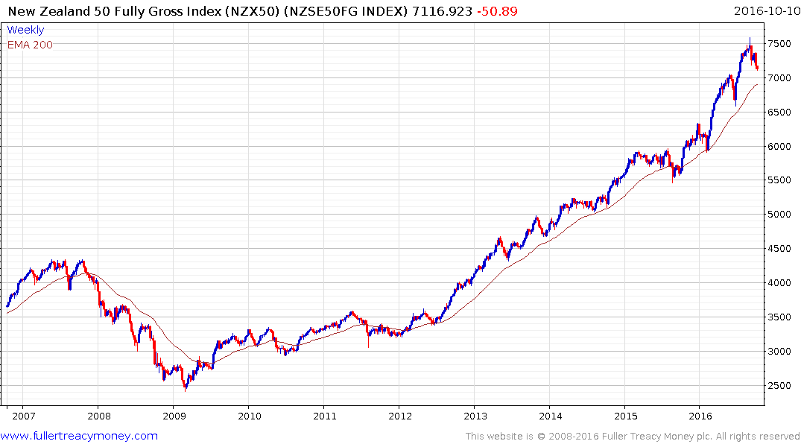
New Zealand
(P/E 18.75 & Yield 4.28%)
Another similar sized pullback since 2015 –
needs to firm once again to maintain
impressive uptrend consistency.

Slide 27
Commodities
1. The cure for low prices is low prices, as supply declines and demand begins to increase.
2. Contra-cyclical commodities are underowned by investors.
3. Global uncertainty, competitive devaluations and
low interest rates can revive the ‘hard money’ appeal of gold and other precious metals but rising interest
rates and Dollar strength will be headwinds.

Slide 28
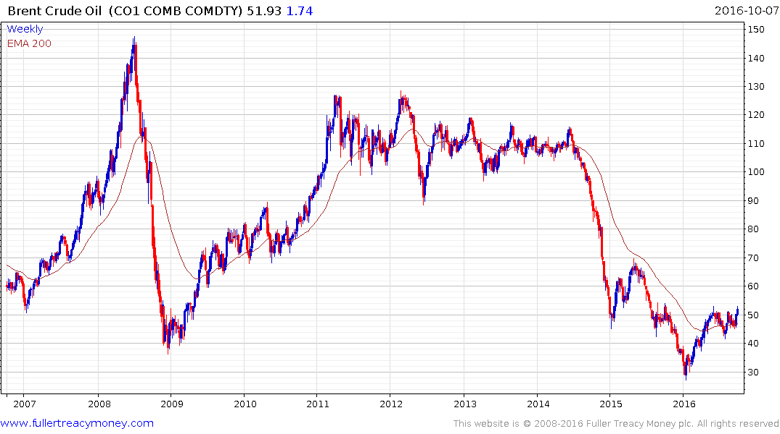
Brent Crude Oil
Will remain steady while
hopes of supply freezes
remain

Slide 29
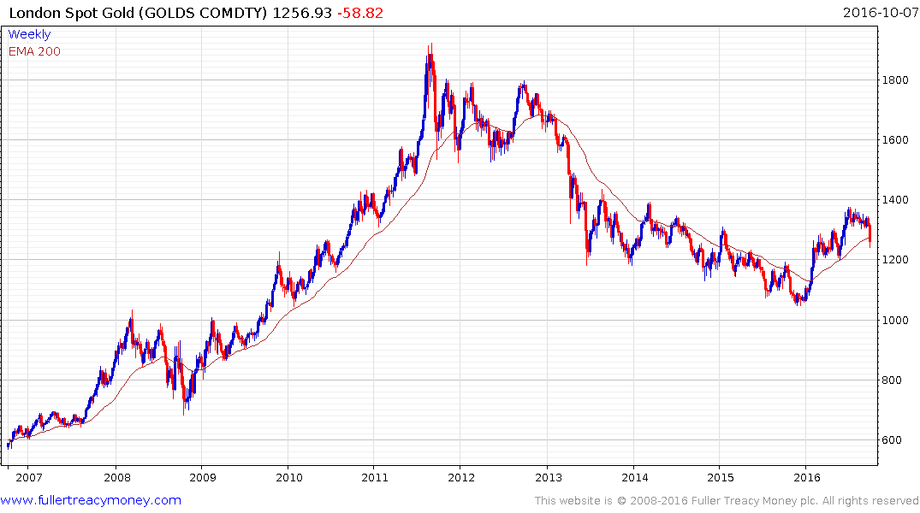
London Spot Gold
Currently oversold but
loss of uptrend consistency

Slide 30
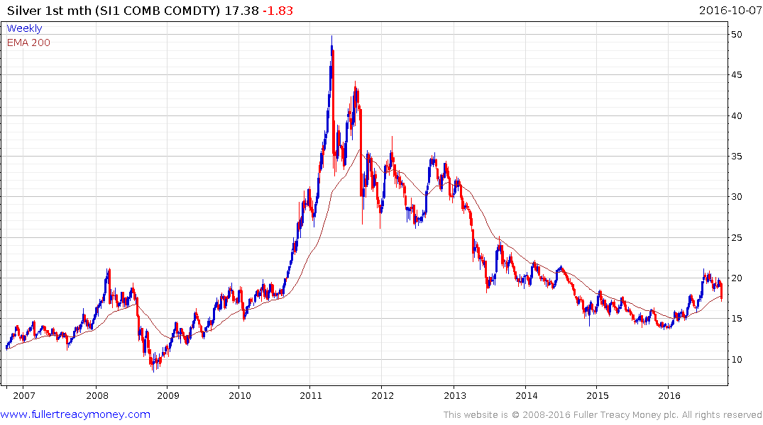
Silver
Similarly, oversold but
loss of uptrend consistency

Slide 31
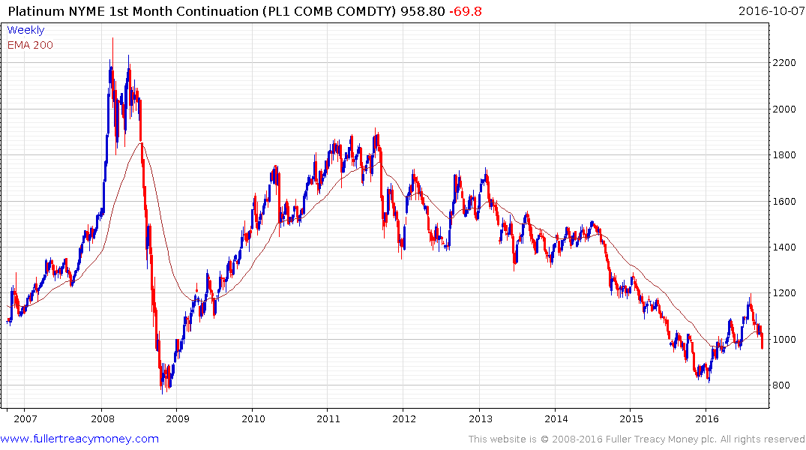
Currently very oversold but significant
loss of uptrend consistency

Slide 32
The last word on the
US Presidential Election
from New York City

Slide 33
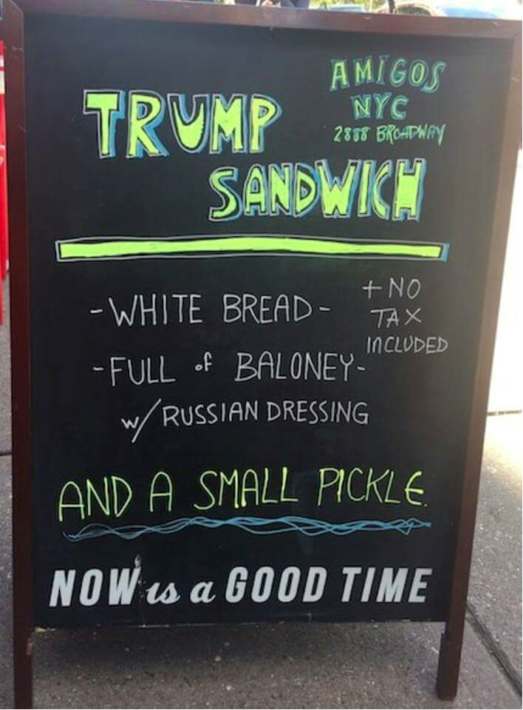

Slide 34


Slide 37
Technical warning signs to watch for among indices
Trend acceleration relative to 200-day moving averages
Declining market breadth (fewer shares rising)
Failed upside breakouts from trading ranges
Loss of uptrend consistency characteristics
Churning price action relative to recent trading ranges
Breaks of 200-day moving averages
Broadening patterns for trading ranges following uptrends
200-day moving averages turn downwards
Resistance is encountered beneath declining 200-day MAs
Previous rising lows are replaced by lower rally highs
Indices fall faster than they rose to their highs

