Slide 1
The Donald Trump Rally!
Can you believe it?
How long will it last?
This is a Markets Now Seminar
November 28th 2016
By David Fuller
fullertreacymoney.com
The Caledonian Club – 9 Halkin Street
London SW1Y 4LH, UK

Slide 2
The two most important charts
in the world right now –
any views as to what they are?

Slide 3
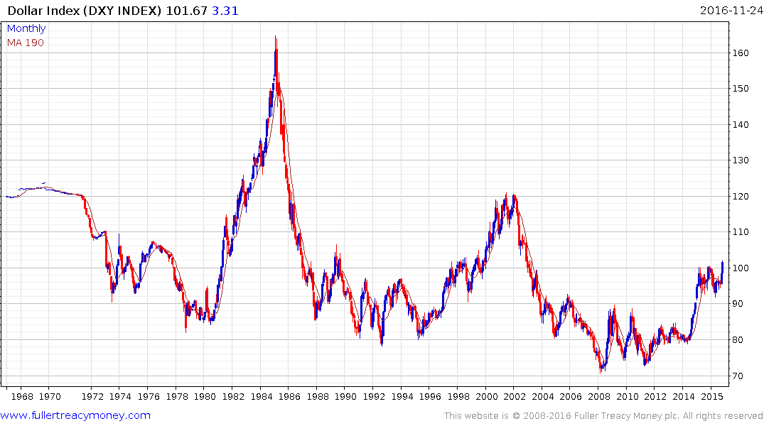
US Dollar Index (DXY)
50-years - arithmetic scale

Slide 4
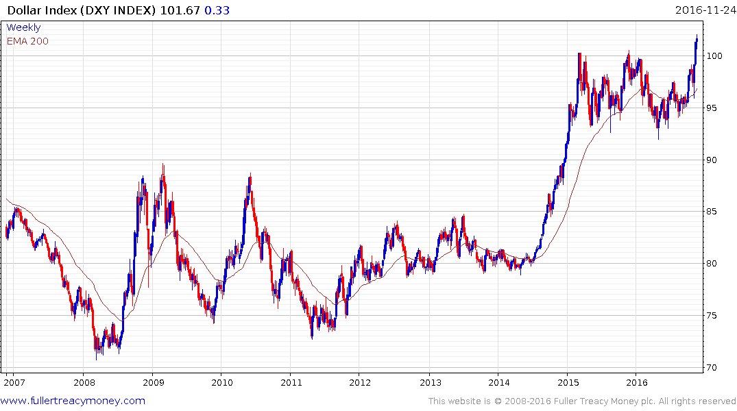
DXY
A secular bull market is underway
which started from a very low base
Trump wins
Presidential
election

Slide 5
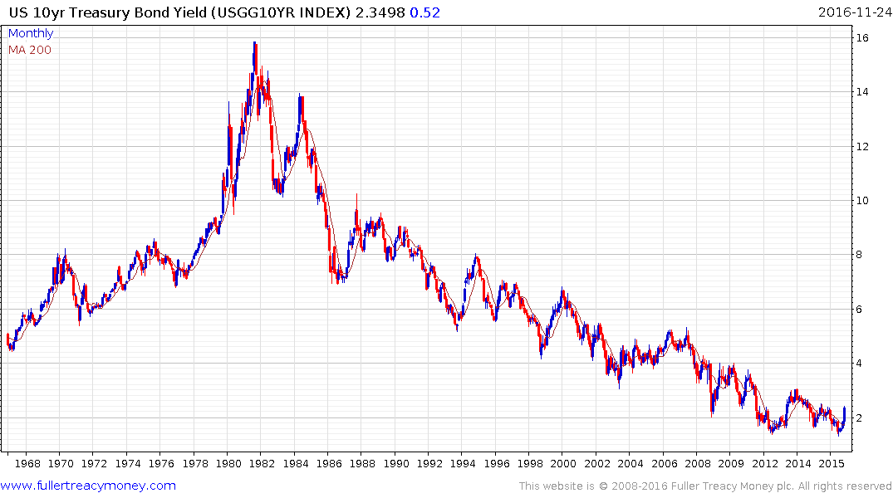
Fantastic buy
US 10-Yr Treasury Bond Yield
50-years – arithmetic scale
Fantastic sell

Slide 6
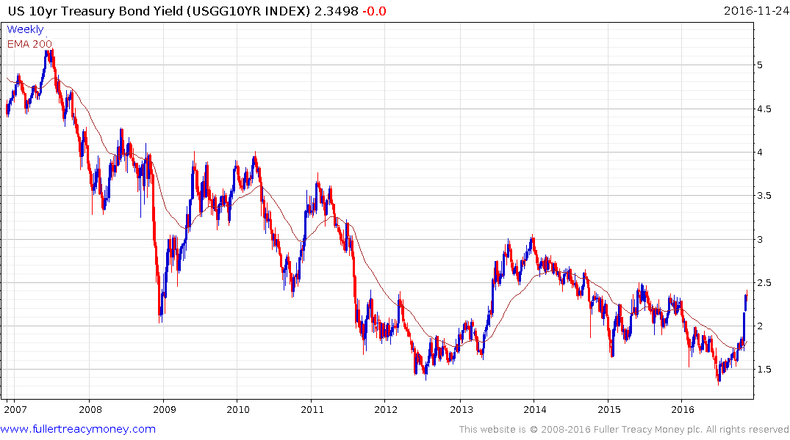
US 10-Yr Treasury Bond Yield
Historic low of 1.3180% on 6th July 2016
I don’t think we will ever see that low again
Bonds very competitive above 4%
Bonds start to become
more competitive at 3%
Some money trickling out of
bonds is going into equities

Slide 7
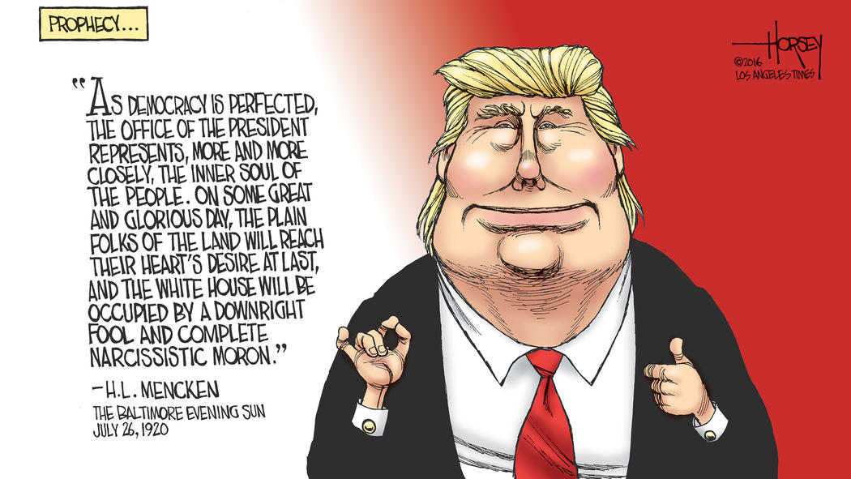

Slide 8
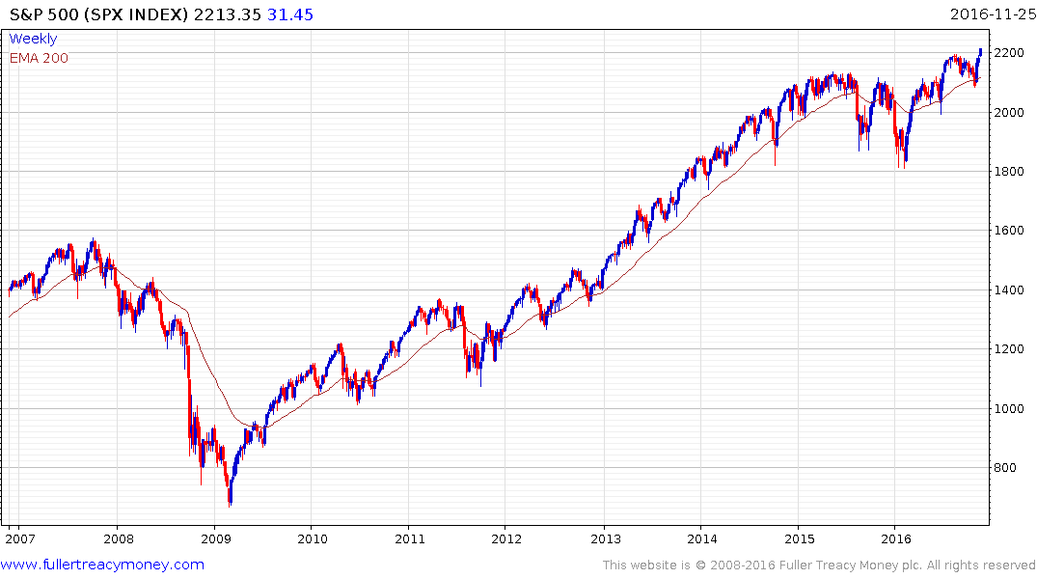
S&P 500 Index
Trump rally: give upside the benefit of the
doubt, while higher reaction lows hold
1) warning
2) serious deterioration
3) bear market
underway

Slide 9
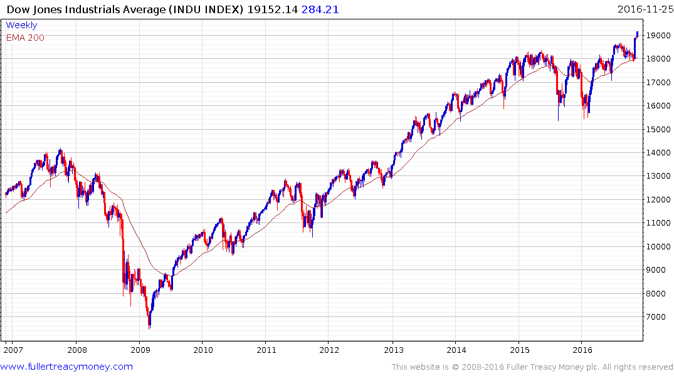
Dow Jones Industrial Average
Trump rally: DJIA leads
move to new highs

Slide 10
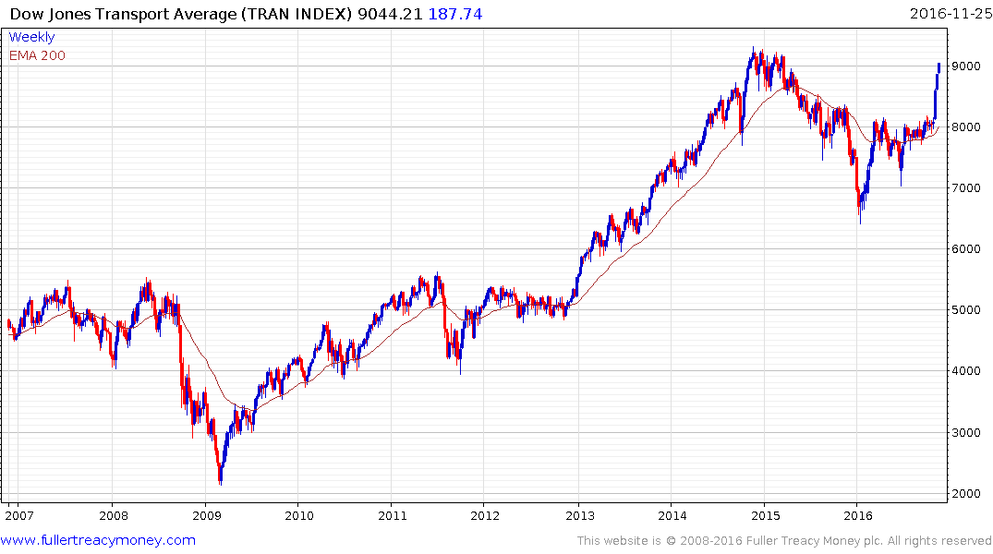
Dow Jones Transport Average
Trump rally: a close above the 2014 high
would confirm Dow Theory bull market
confirmation

Slide 11
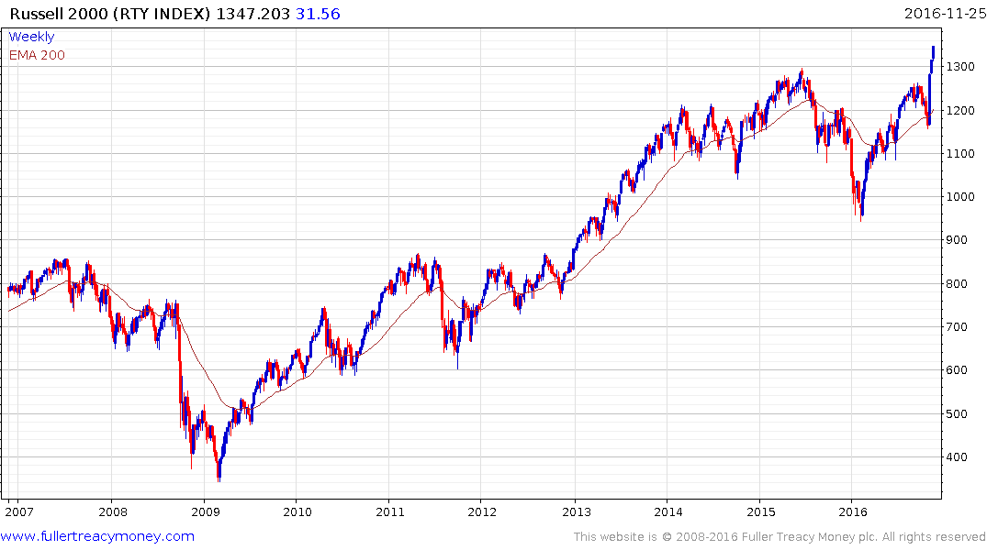
Russell 2000 Index
Trump rally: first new high
in nearly 3 years

Slide 12
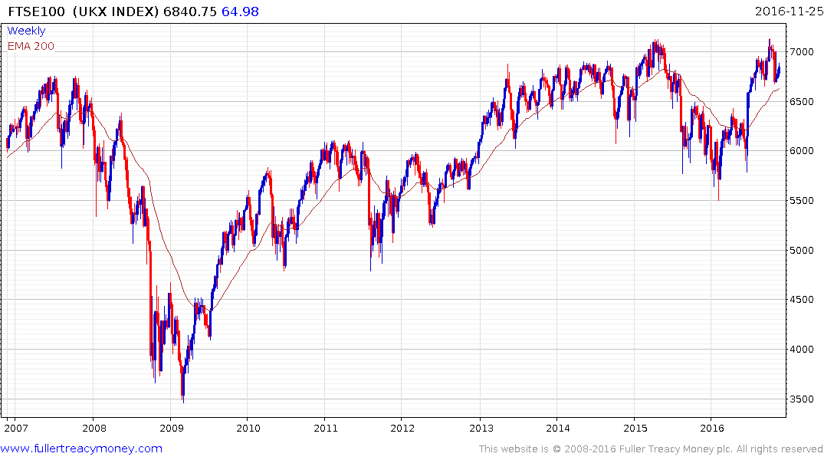
UK FTSE 100 Index
Brexit vote win
Give upside the benefit of the doubt
while FTSE 100 remains above 6500

Slide 13
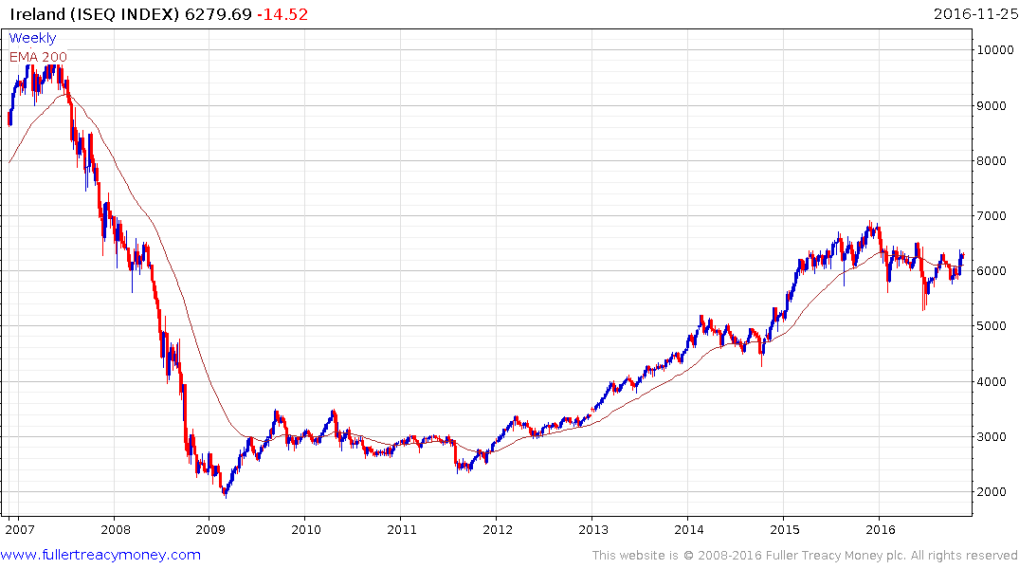
Ireland ISEQ Index
Demand regaining
the upper hand

Slide 14
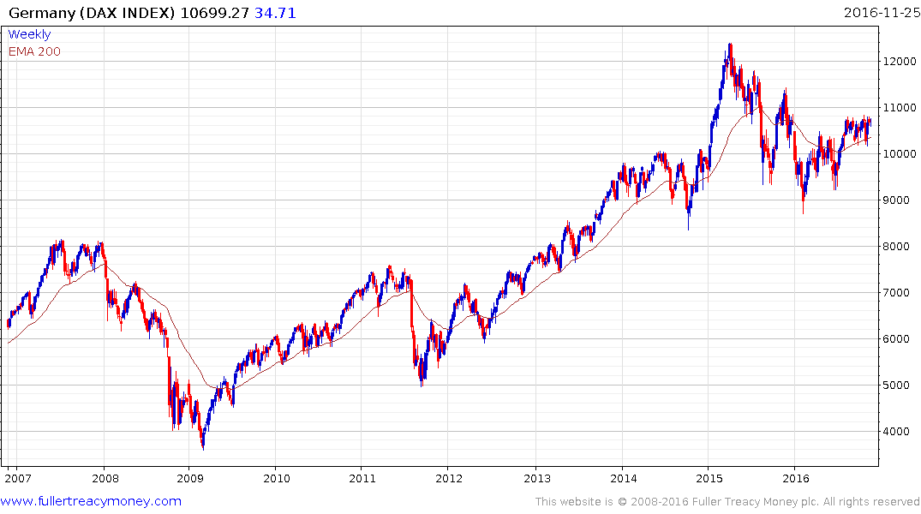
Germany DAX Index
Helped by soft
Euro but needs
to hold above
10,000

Slide 15
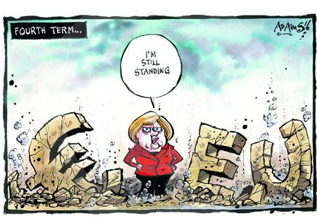

Slide 16
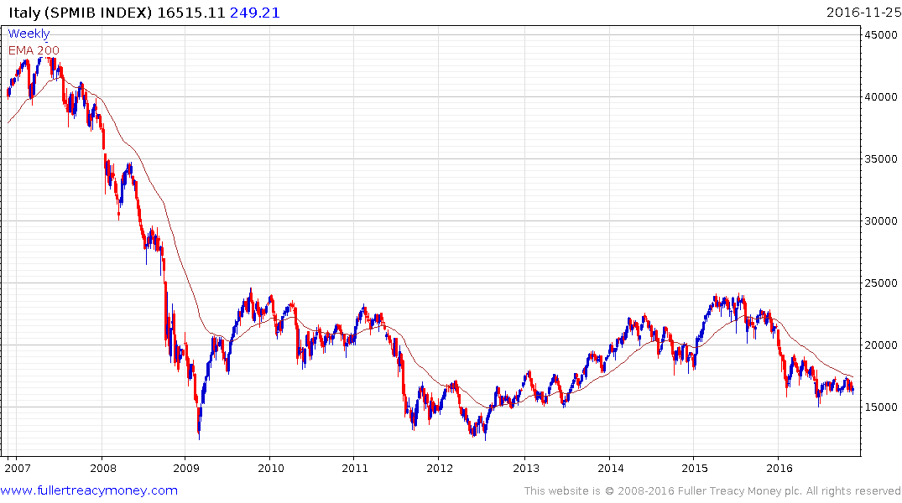
Italy SPMIB Index
Is Italy an even bigger problem
for the EU than Brexit? Yes, Italy
will most likely exit the Euro
within the next year or two.

Slide 17
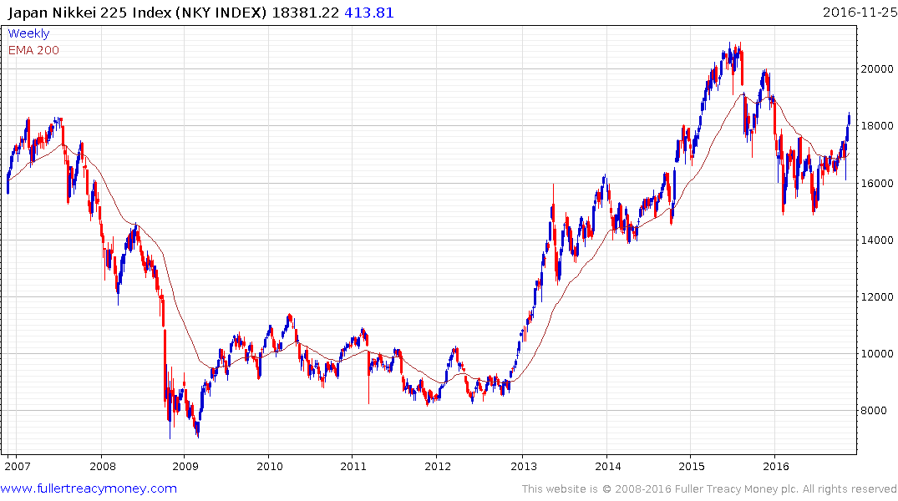
Japan Nikkei 225 Index
Trump elected
Dollar rises
Yen weakens

Slide 18
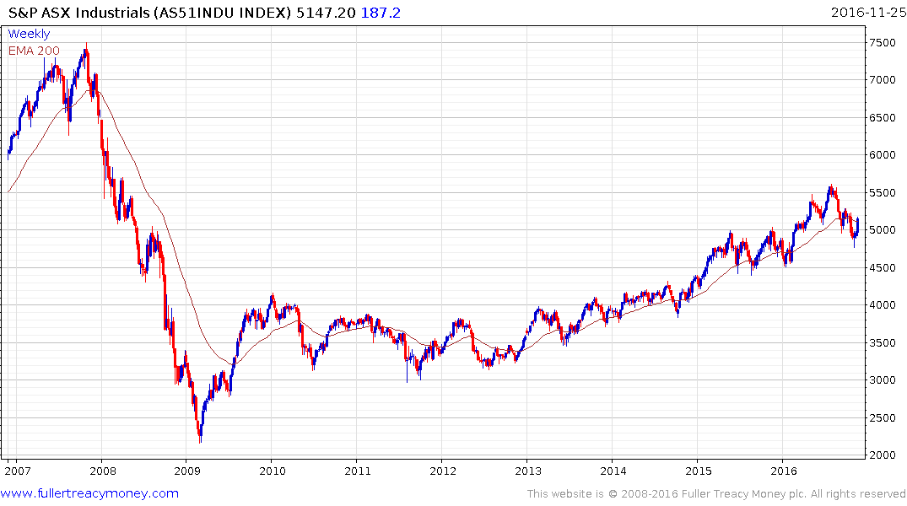
Australia S&P ASX Industrials
Still in a gradual overall uptrend but
the next chart is more interesting

Slide 19
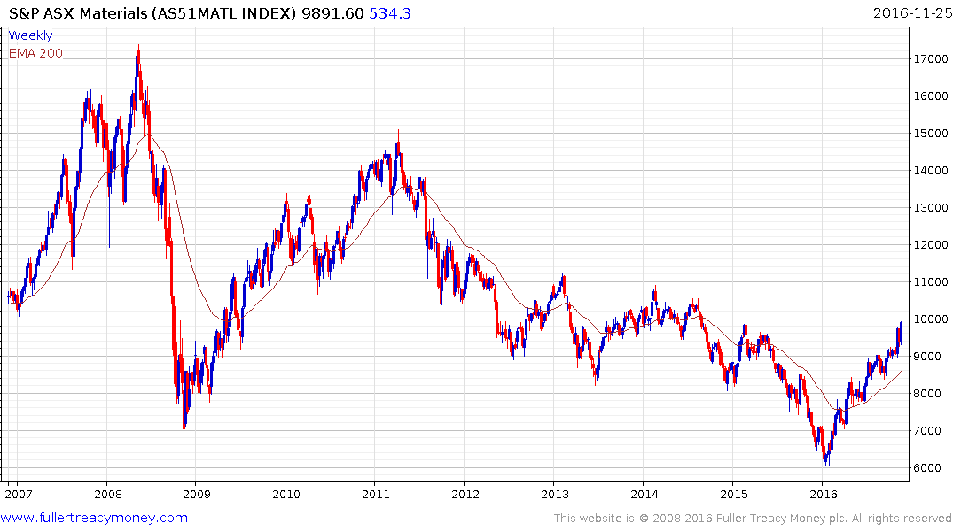
Australia S&P ASX Materials
No problem while
staircase uptrend
continues

Slide 20
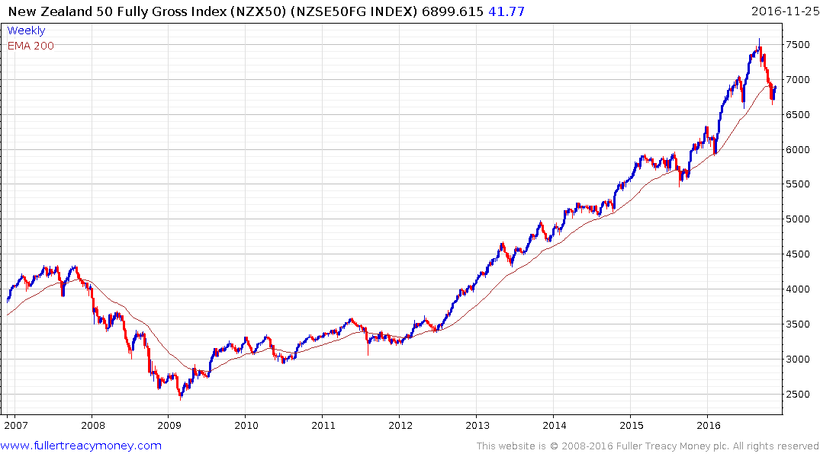
New Zealand
The first clear uptrend inconsistency was the overextension
relative to the MA in early September – the second was a far
bigger reaction than seen previously. These indicate that
New Zealand has seen a peak of lengthy duration, although
it is short-term oversold.

Slide 21
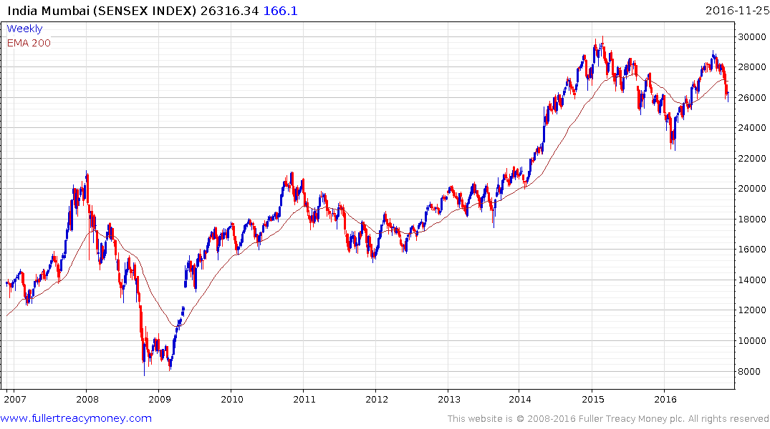
India Mumbai Sensex Index
Similar top formation characteristics of overextension
relative to MA followed by large corrections as seen by NZ on previous slide

Slide 22
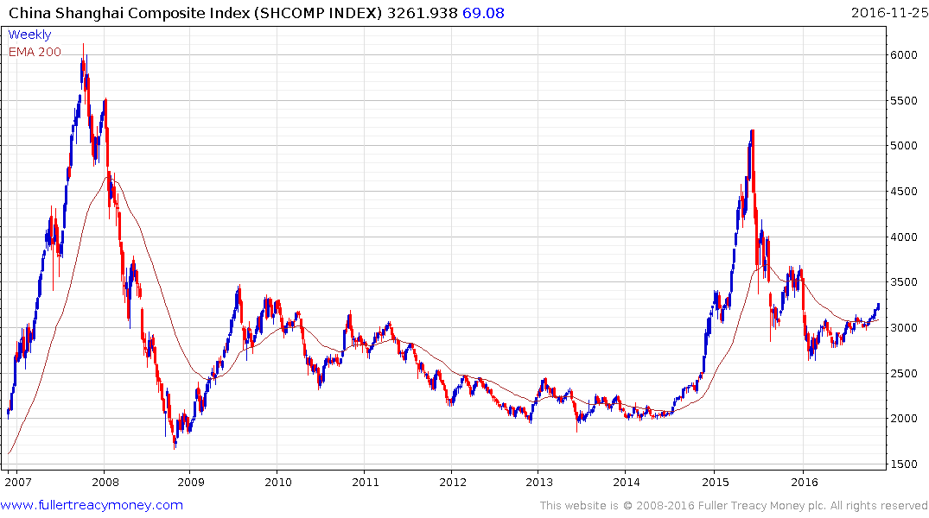
China Shanghai Composite Index
Give upside the benefit of the doubt
while this year’s progression of higher
reaction lows is maintained

Slide 23
The rest of the world’s stock markets
are struggling, particularly when quoted
in US Dollars

Slide 24
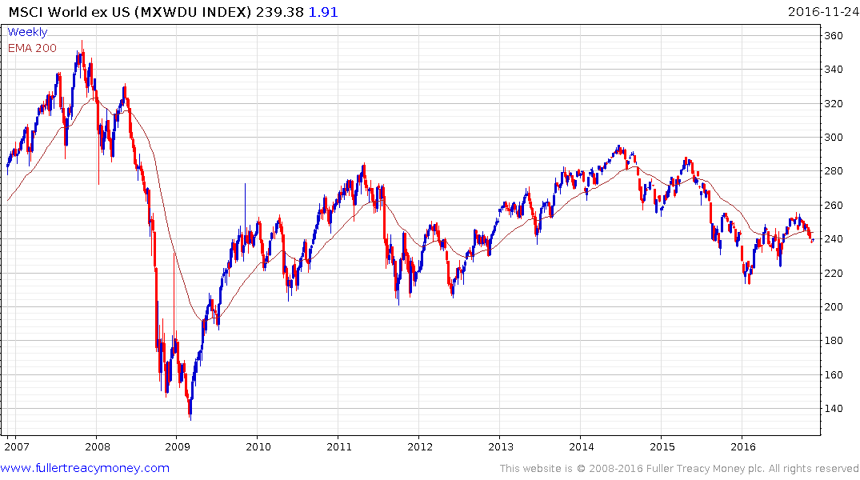
MSCI World ex US

Slide 25
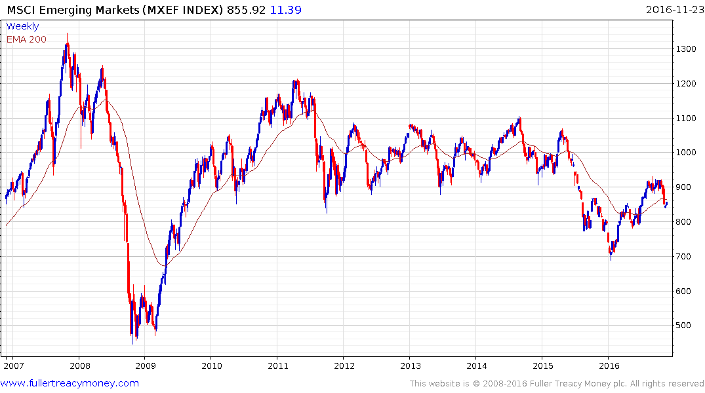
MSCI Emerging Markets

Slide 26
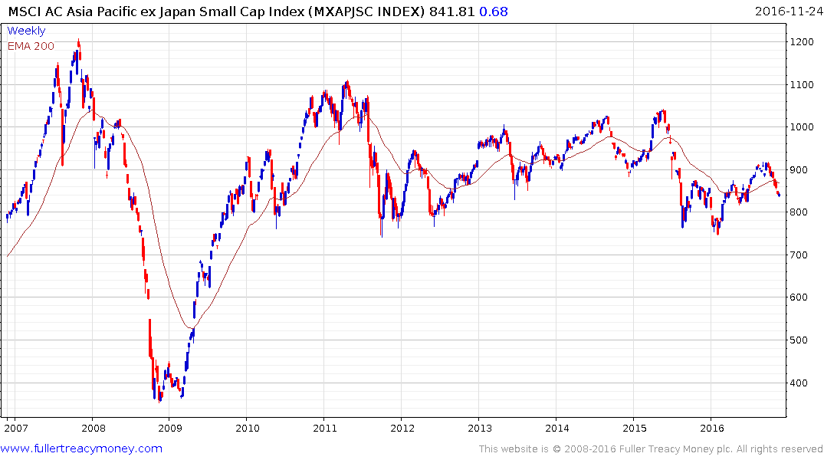
MSCI Asia Pacific ex Japan Small Caps Index

Slide 27
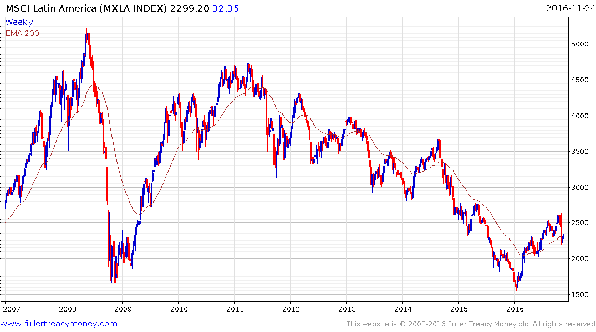
MSCI Latin America

Slide 28
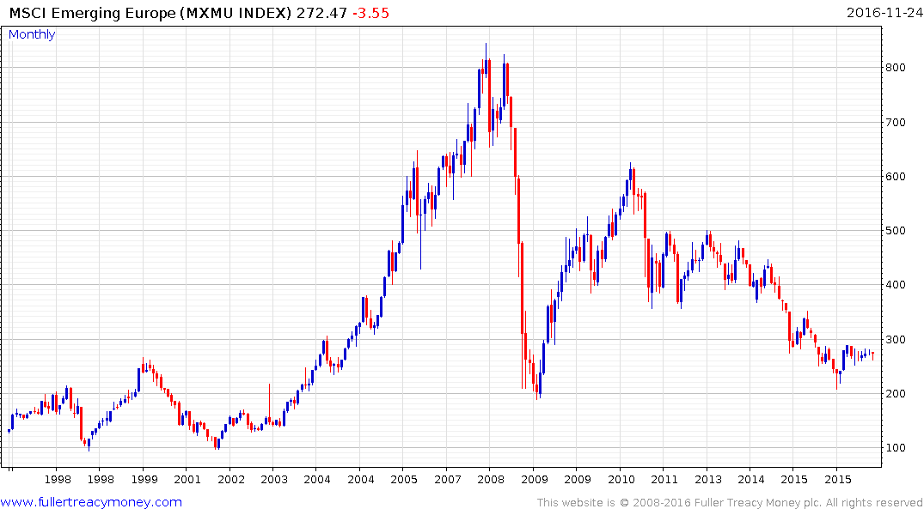
MSCI Frontier Market Index

Slide 29
Arguably, these underperforming markets in the MSCI indices are interesting on a buy-low, sell-high basis but it might be best to wait until we have seen a sharp sell-off on Wall Street.

Slide 30
Industrial metals remain in favour
Biggest risk is a surging USD

Slide 31
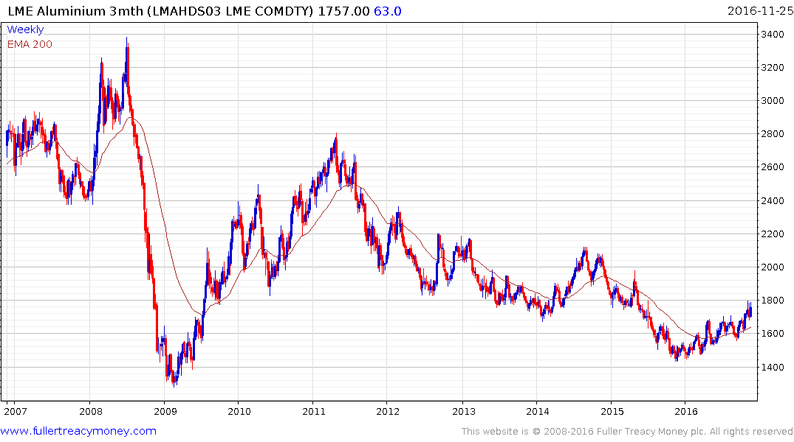
LME Aluminium (3mo)
Ranging higher and a close
beneath $1600 would be required
to delay recovery beyond a brief
pause

Slide 32
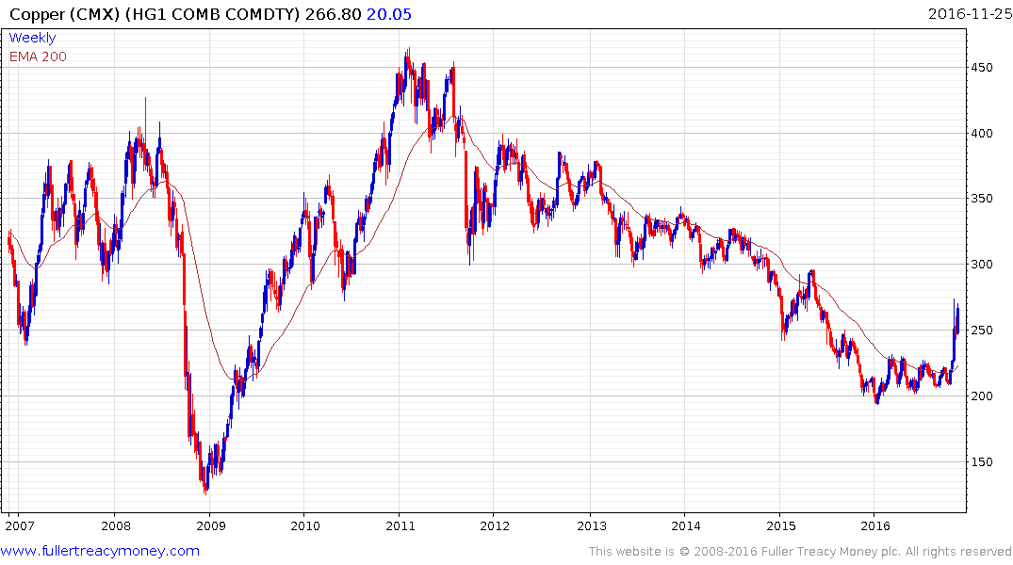
Copper (CMX)
The last to commence a recovery,
this is a decisive upside breakout
from base formation

Slide 33
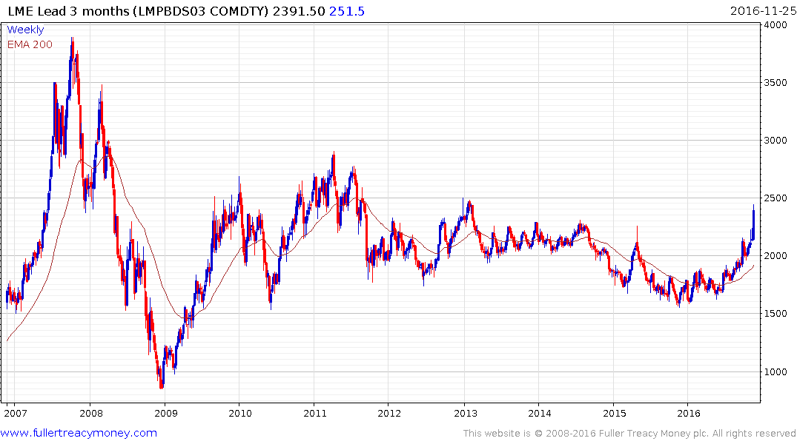
LME Lead (3m)
Temporarily overextended but break
in sequence of higher reaction lows
would be required to indicate more
than another consolidation

Slide 34
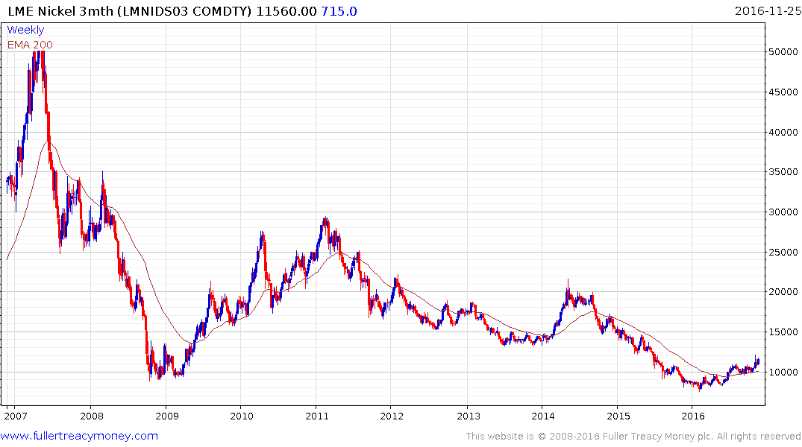
LME Nickel (3m)
Probable completed base formation;
close beneath $10,000 required to
delay recovery beyond a brief pause

Slide 35
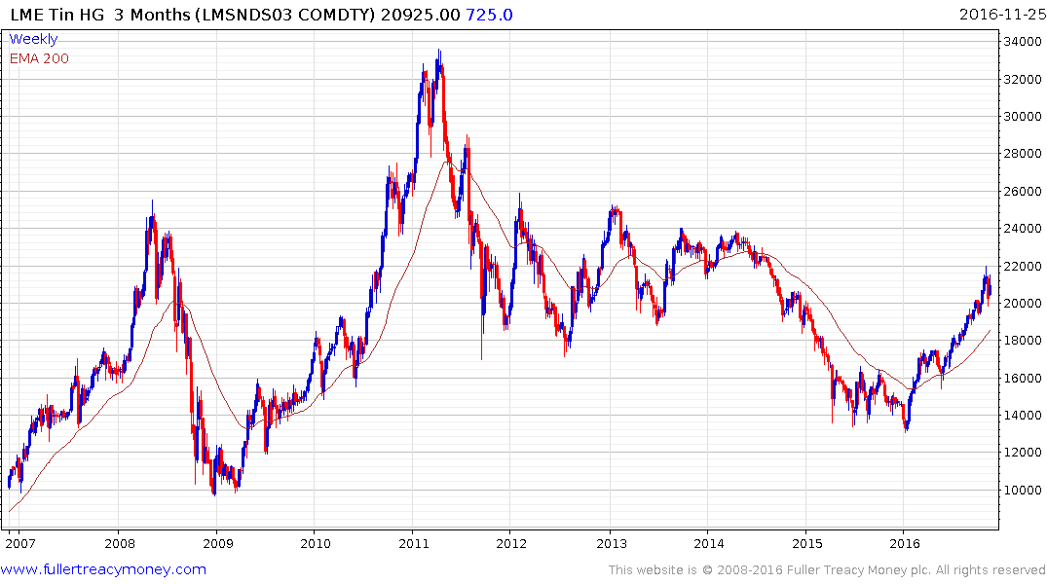
LME Tin (3m)
Temporarily overextend and
some loss of momentum,
suggesting longer consolidation

Slide 36
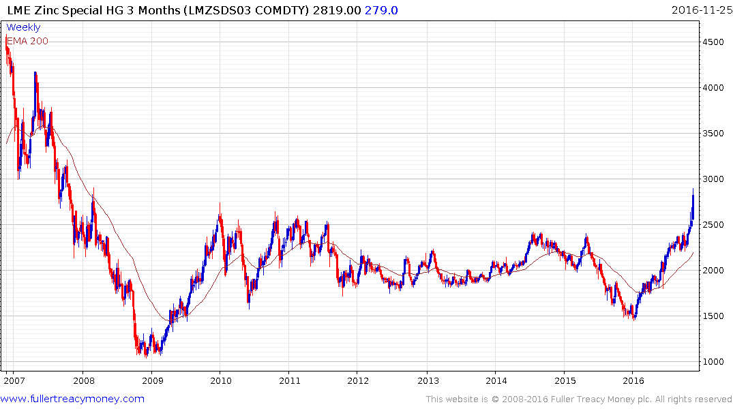
LME Zinc 3m)
Overextended and susceptible to
a reaction and consolidation

Slide 37
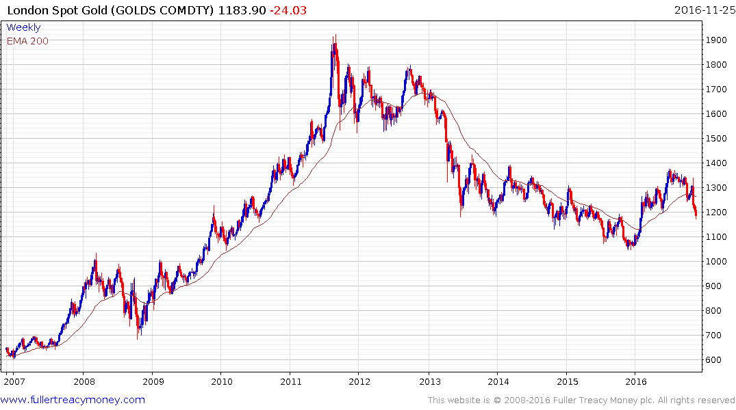
London Spot Gold
Arguably oversold but appreciating
USD remains a strong headwind

Slide 38
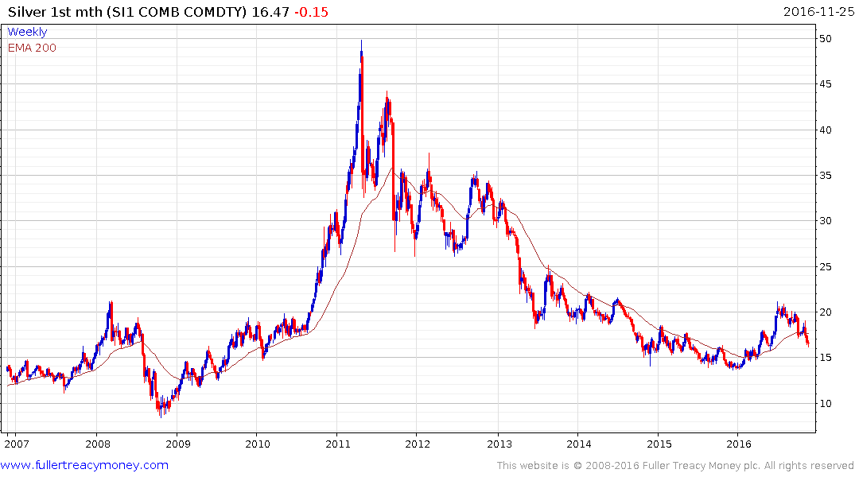
Silver
Oversold but rising
USD remains a
headwind

Slide 39
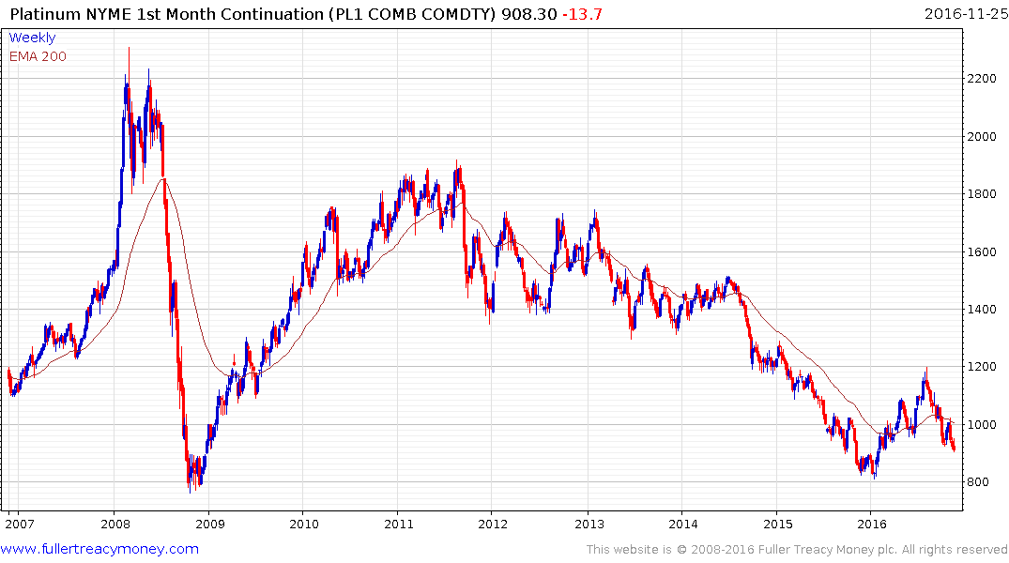
Platinum
Very oversold but
strong USD remains
a headwind

Slide 40
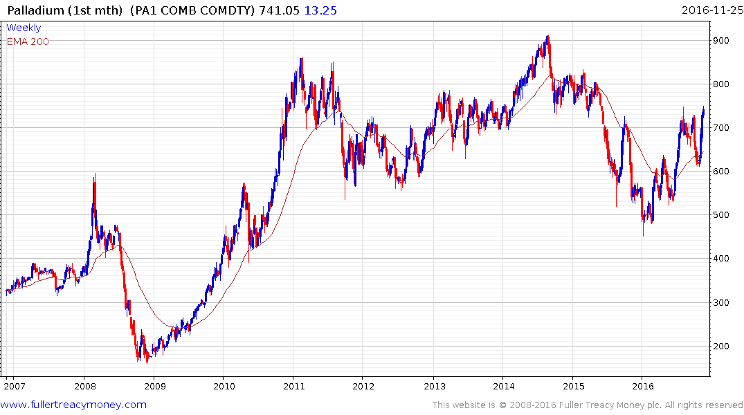
Palladium
The strongest ‘precious metal’ by far
being much more of an industrial metal,
now temporarily overbought

Slide 41
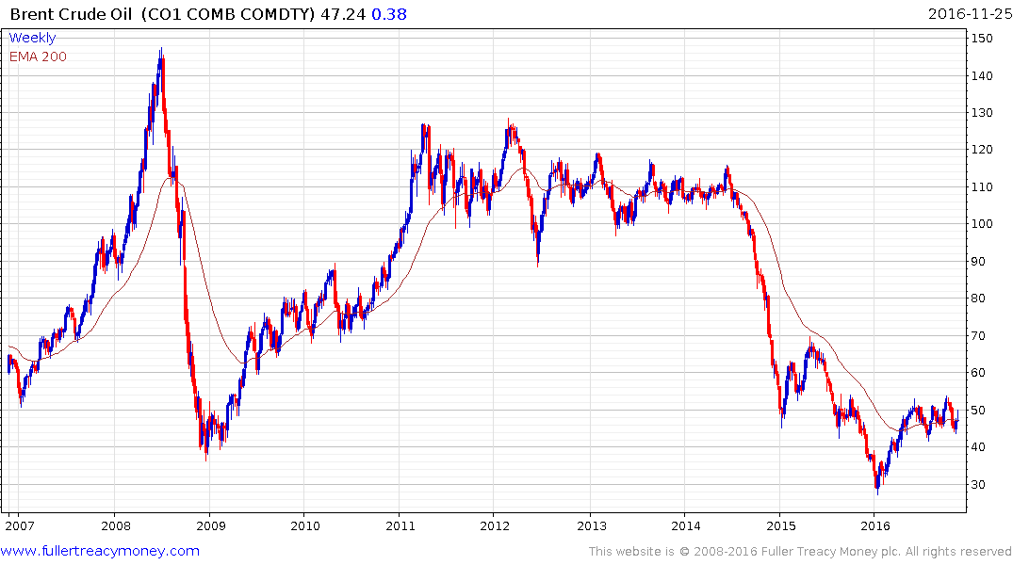
Brent Crude Oil
OPEC plus Russia need to
cut production before some
further recovery can occur

Slide 42


Slide 45
Technical warning signs to watch for among indices
Trend acceleration relative to 200-day moving averages
Declining market breadth (fewer shares rising)
Failed upside breakouts from trading ranges
Loss of uptrend consistency characteristics
Churning price action relative to recent trading ranges
Breaks of 200-day moving averages
Broadening patterns for trading ranges following uptrends
200-day moving averages turn downwards
Resistance is encountered beneath declining 200-day MAs
Previous rising lows are replaced by lower rally highs
Indices fall faster than they rose to their highs

