Slide 1
2016 - Global Markets Update
March 8th 2016
Eoin Treacy
FullerTreacyMoney.com

Slide 2
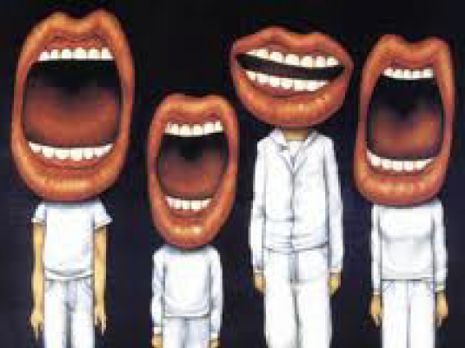
The talking heads have a lot to say. Energy, China, Emerging Markets, the Dollar, Biotech, Wall Street, the Presidential Cycle…so let’s boil it down to a few charts that might help bring it all together.

Slide 3
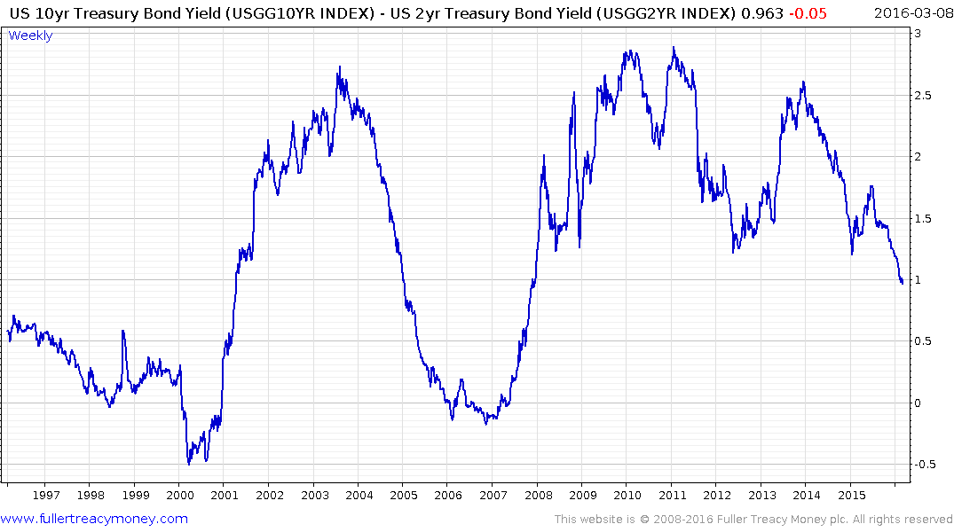
The Yield curve is still trading at a 100 basis point positive carry.
No recession but it will be close.

Slide 4
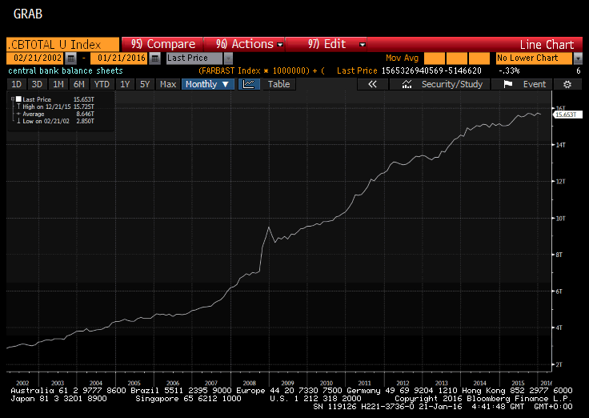
The combined Fed, ECB, BOJ, BoE and PBOC Balance Sheets rebased to US Dollars

Slide 5
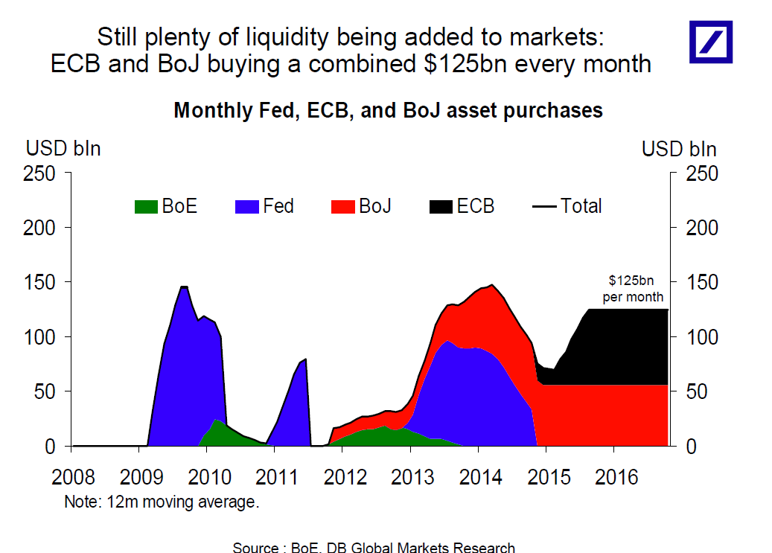

Slide 6
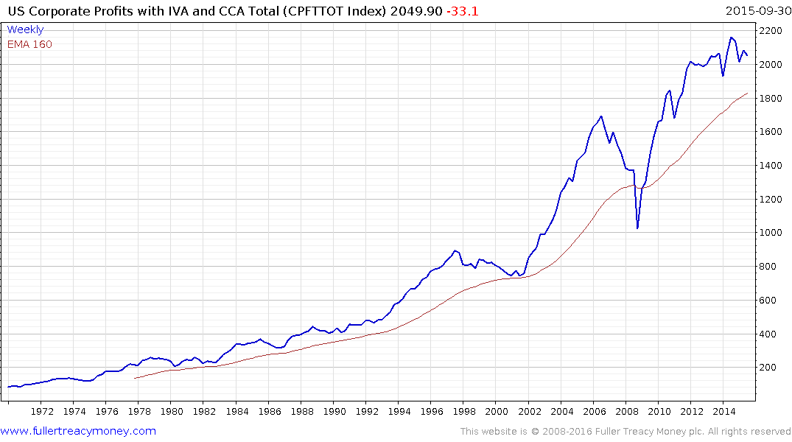
Corporate Profits have been static since 2012 which has resulted in multiple expansion.
2006
1997

Slide 7
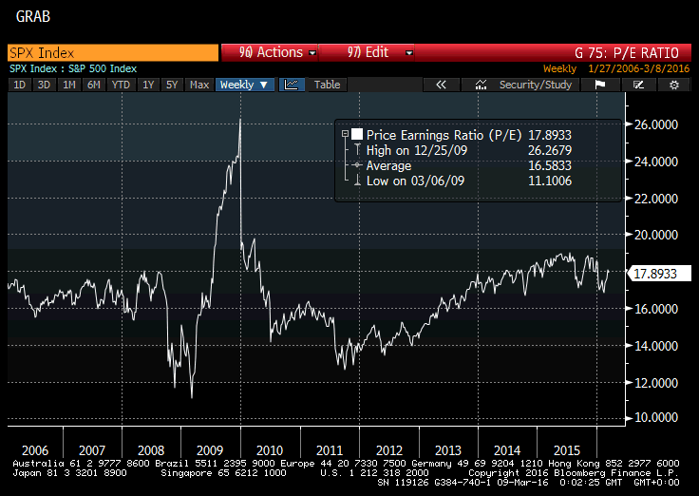
P/E ratios have been on a rollercoaster this year.

Slide 8
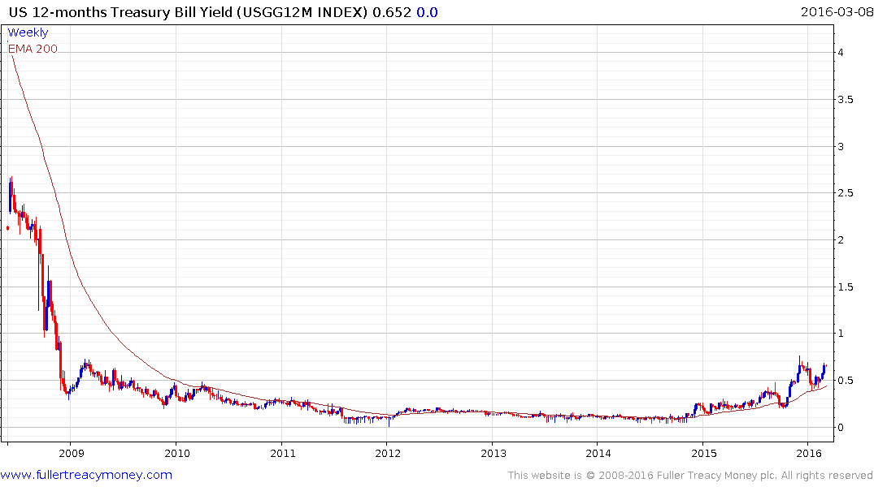
The Fed is pulling back from its ambition of raising rates 4 times this year. Howver the bond market is still worried about refinancing costs.

Slide 9
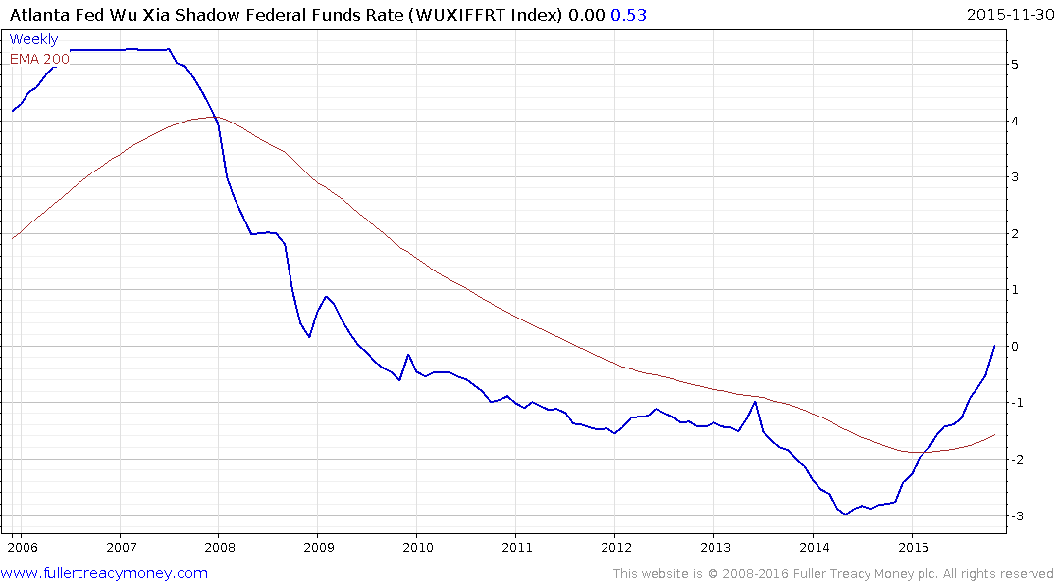
The Fed might have only raised once but the shadow banking sector has been under pressure since the end of QE and that tightening is almost done.

Slide 10
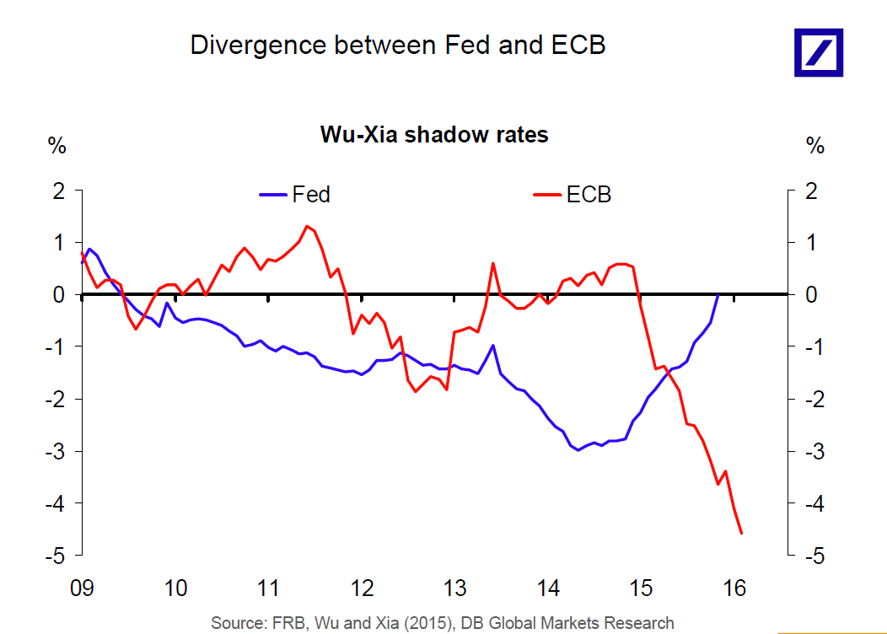
The red line shows us just how accommodative the ECB is being.

Slide 11
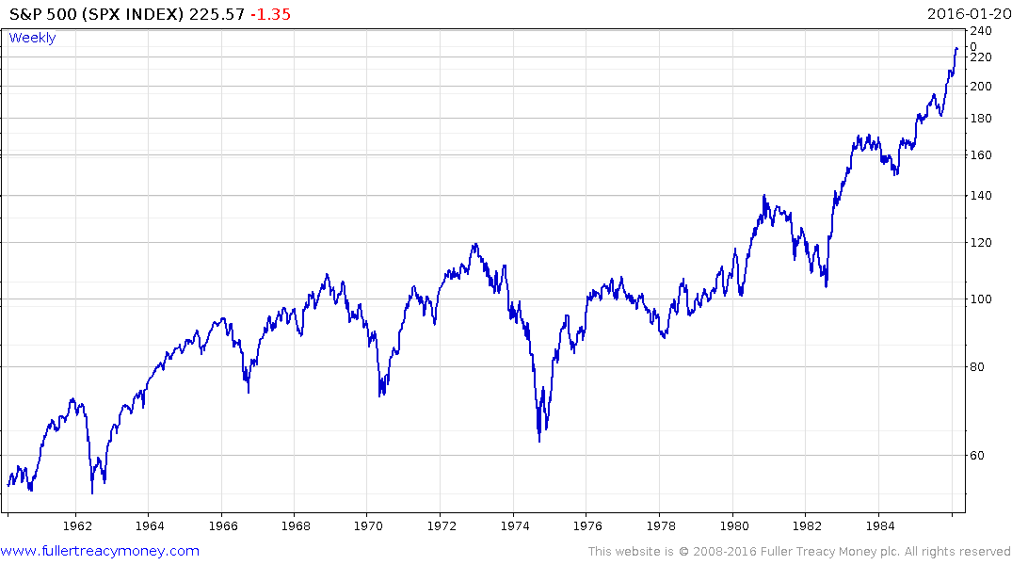
This is what the end of the 1970s bear market looked like

Slide 12
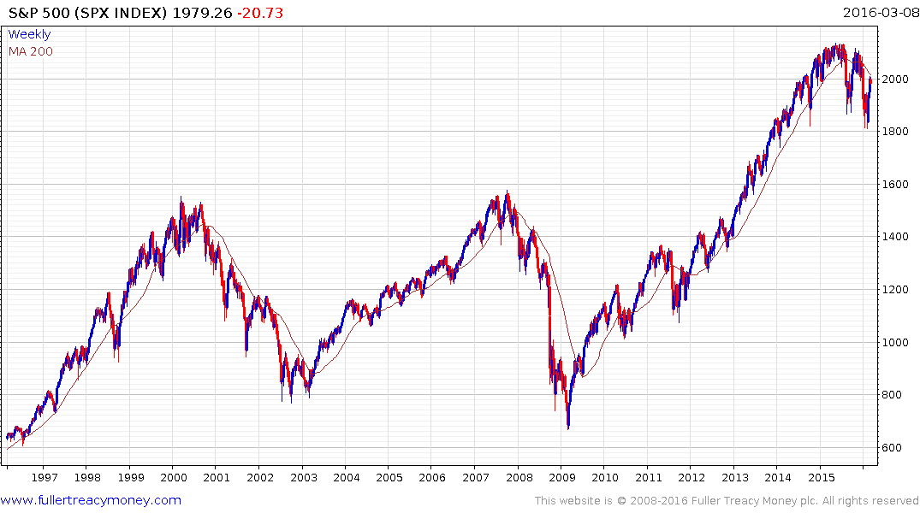
Does this look familiar?

Slide 13
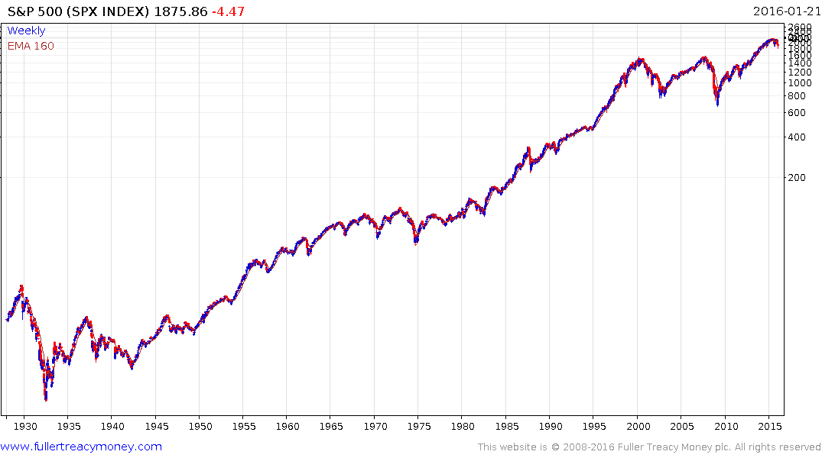
Let’s have some perspective:
This has been a major breakout from a very lengthy range and what we are now seeing is the first big consolidation in a secular bull market.

Slide 14
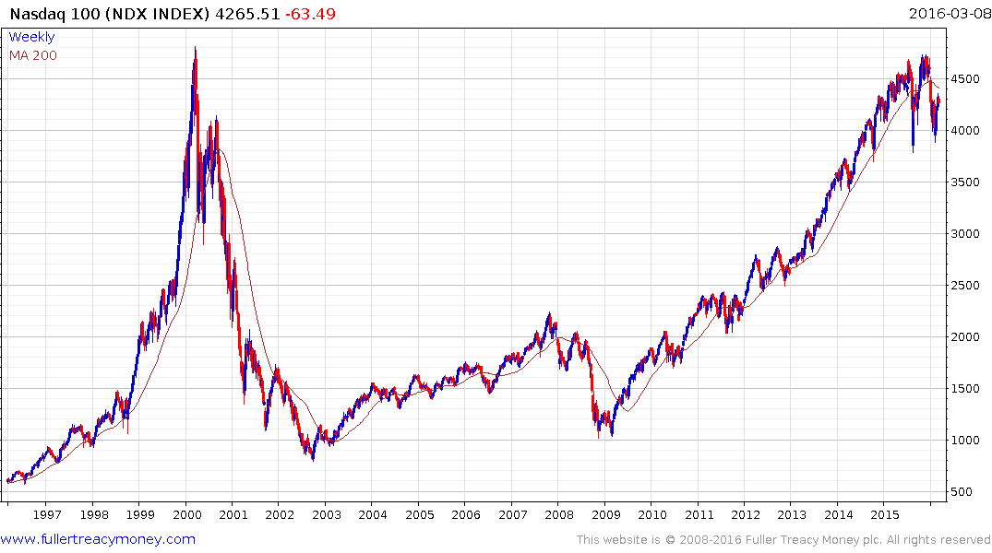
Do you think it reasonable for the Nasdaq to consolidate in the region of the previous peak for at least a while?

Slide 15
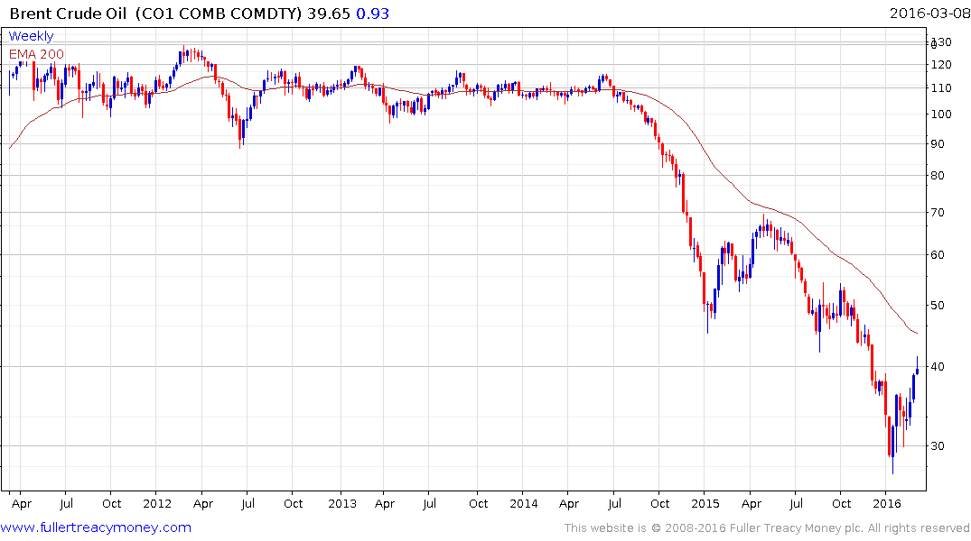
Oil prices have staged an impressive short covering rally which has chastened bears.

Slide 16
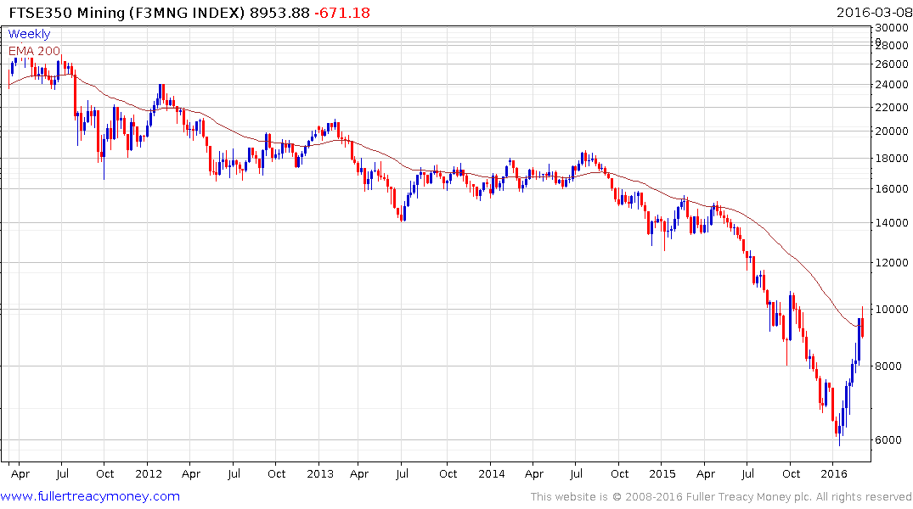
Oil’s rally has been the catalyst required to reignite interest in commodities and miners.

Slide 17
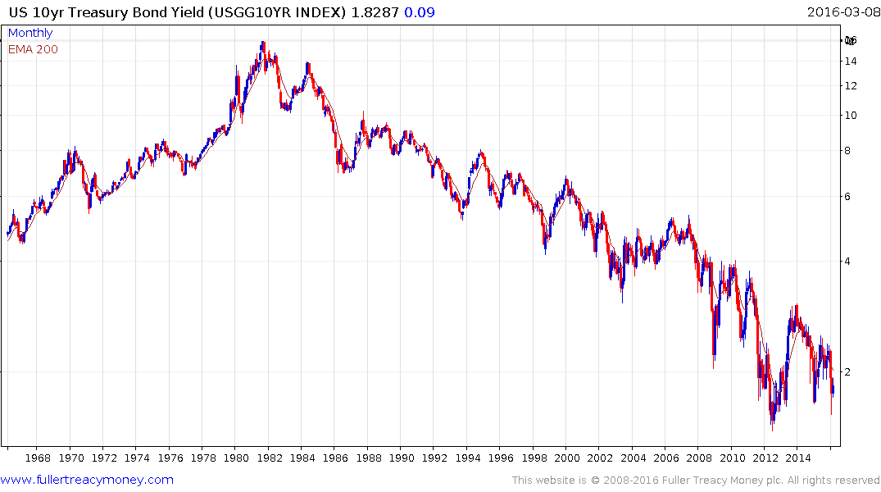
Treasury yields have a triangular pattern suggesting the breakout when it comes is going to be powerful.

Slide 18
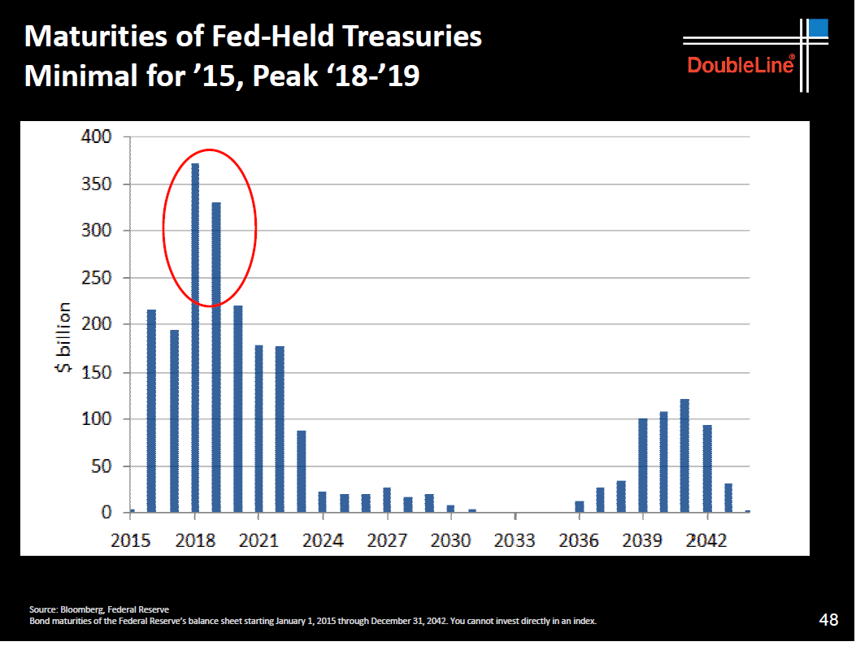
The Fed has some major decisions about refinancing coming due from 2018.

Slide 19
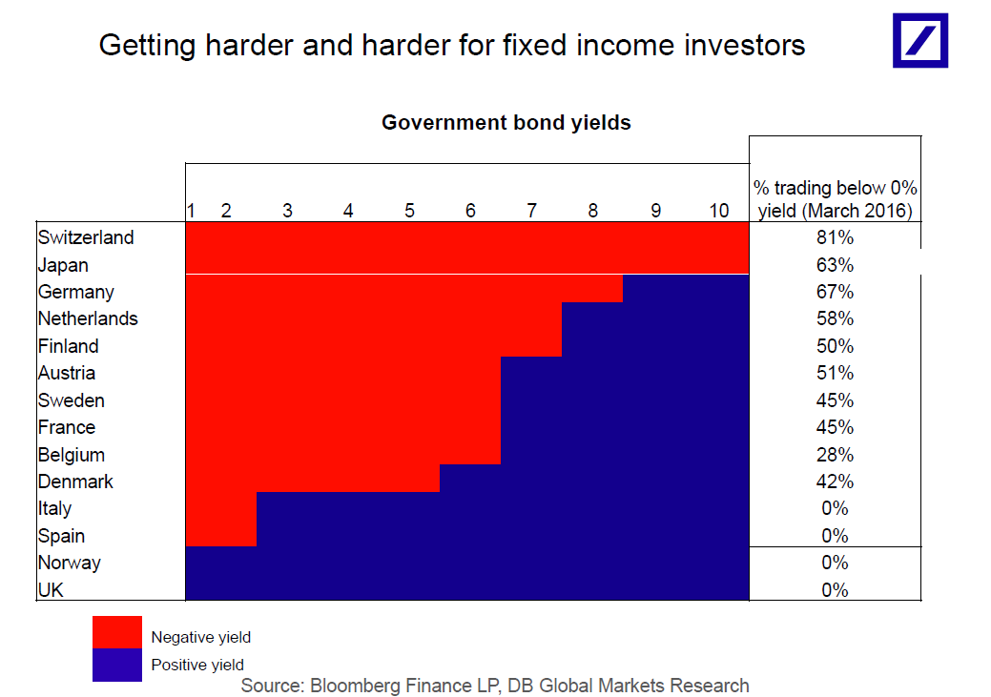
The Fed has some major decisions about refinancing coming due from 2018.

Slide 20
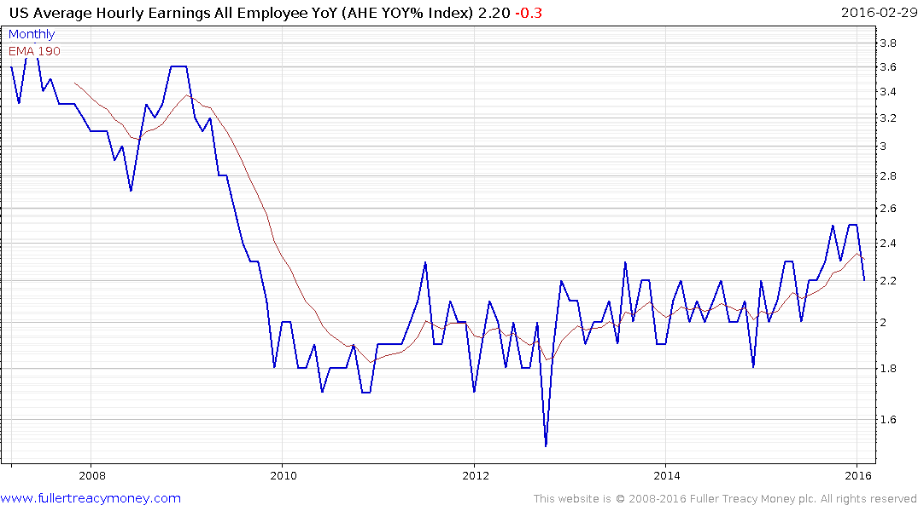
Wages are going to be an important arbiter for how the Fed tackles the question of when and how much to raise rates.

Slide 21
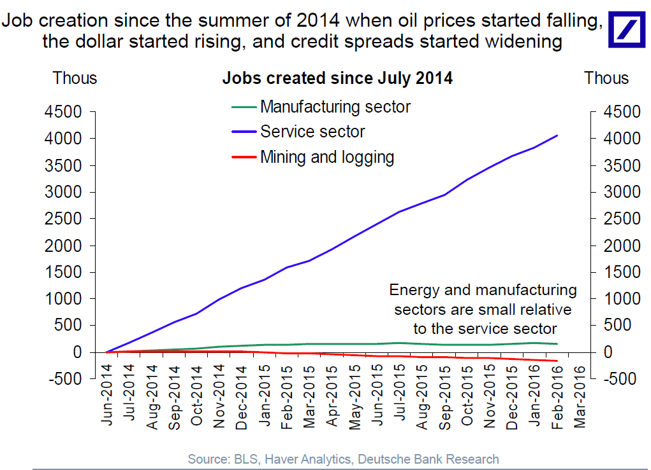

Slide 22
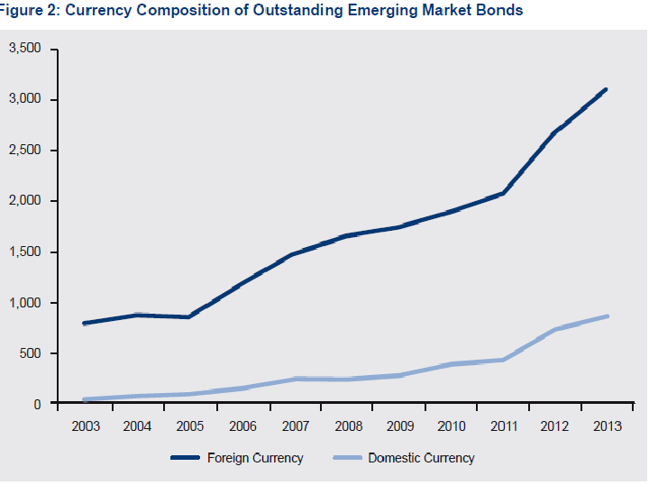
Could it be because ultra-low rates have caused a misallocation of capital?
Emerging market bond issuers have behaved like the Dollar’s bear market would last forever.

Slide 23
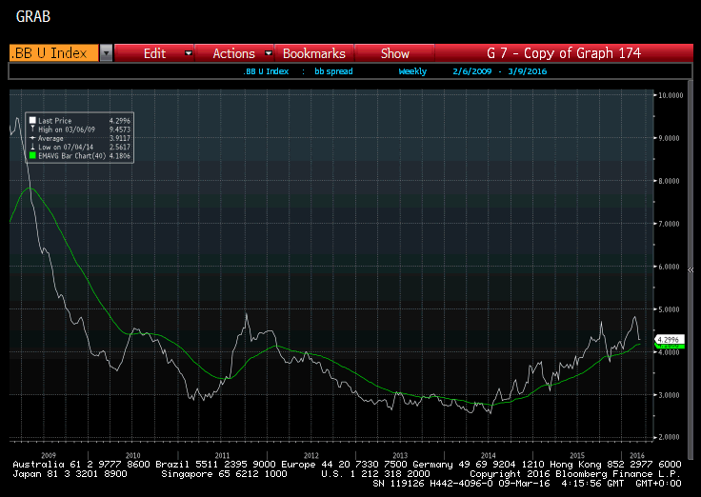
Junk Bond spreads are back at a potential area of support so what happens in the next couple of weeks will tell us a lot about the health of the bond markets.

Slide 24
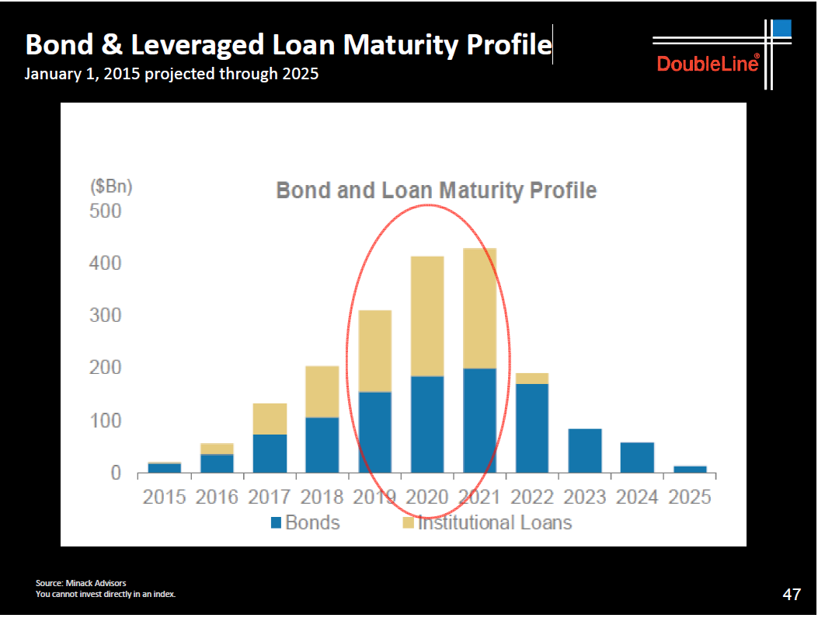
Corporations have a lot of debt to refinance in 2020 and 2021 but very little right now.

Slide 25
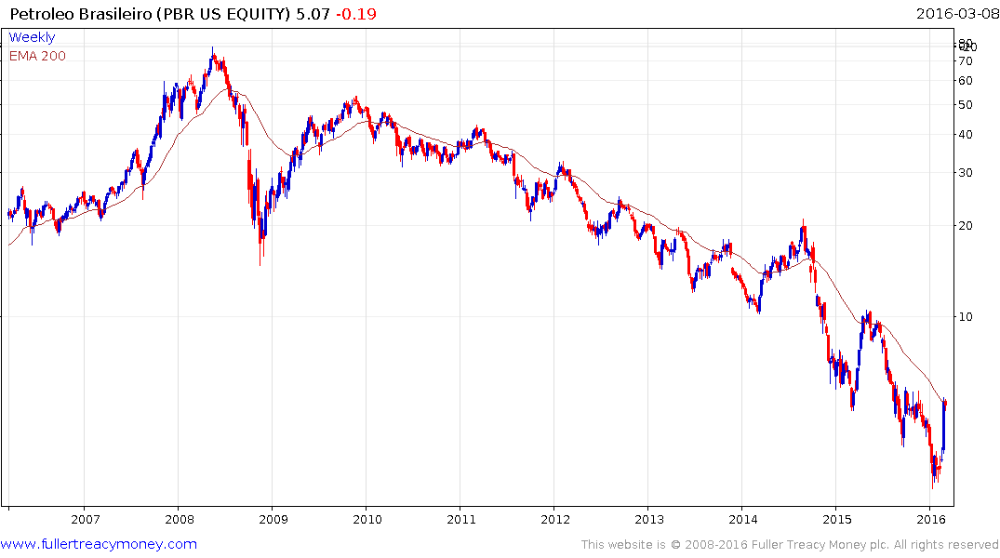
Petrobras is rallying on the back of oil’s rebound and heightened speculation that Dilma Rousseff may be impeached.

Slide 26
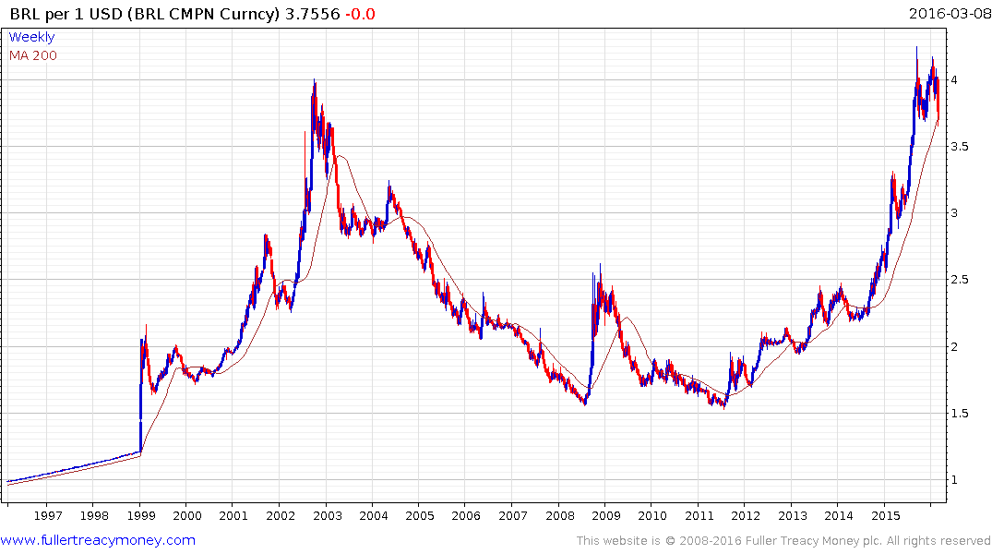
The weak Real makes US Dollar debt harder to pay but domestic debt easier.
Meanwhile Brazil’s competitiveness has improved considerably.

Slide 27
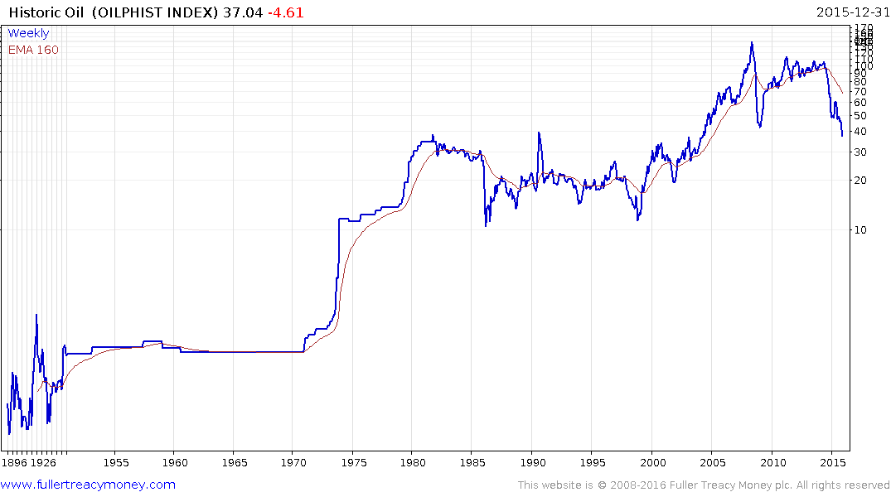
Oil also has long-term price cycles and could be ranging for a very long time.

Slide 28
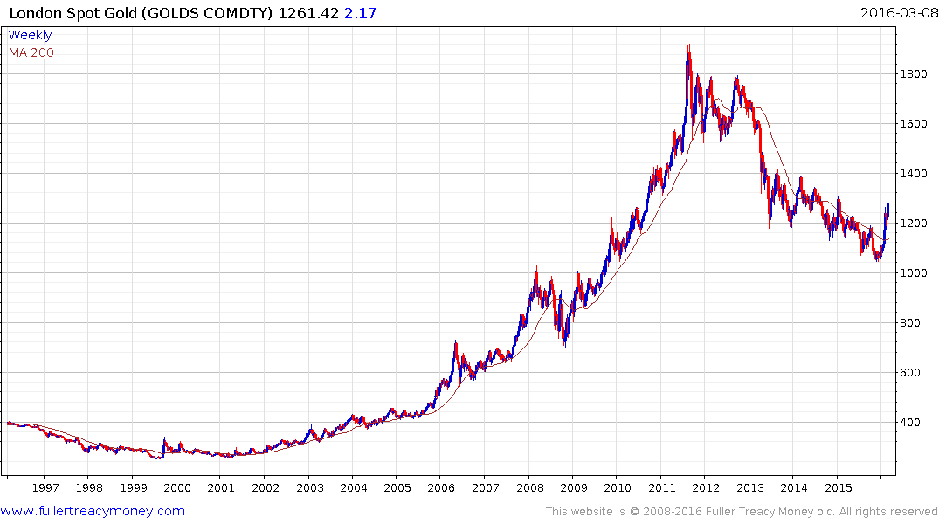
Gold has finally broken its medium-term downtrend.

Slide 29
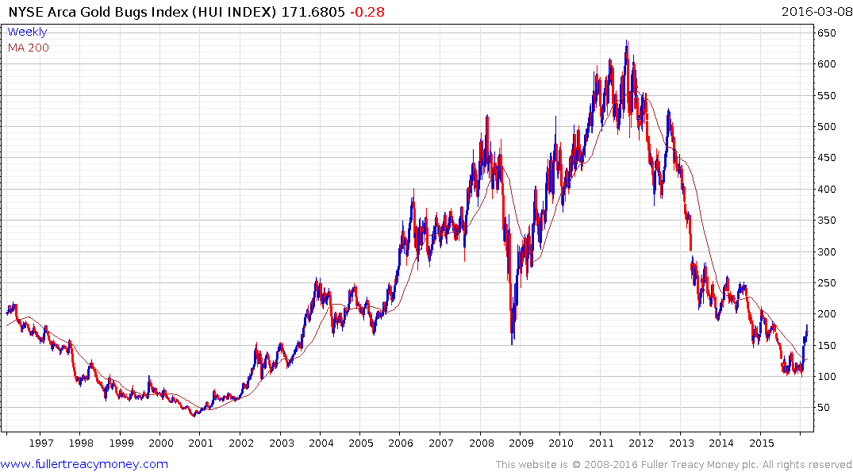
Gold shares have bottomed.

Slide 30
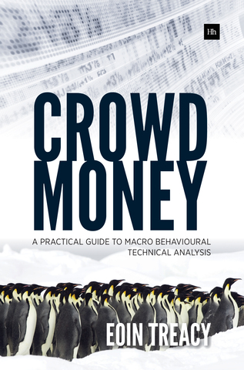
Please visit us on www.Fullertreacymoney.com and sign up for our FREE Comment of the Day.
Please email Sarah Barnes at sarah@fullertreacymoney.com for a one-month free trial.
Crowd Money – A Practical Guide to Macro Behavioural Technical Analysis is available on Amazon or Harriman House.

