Slide 1
Still A Very Challenging Environment
For Global Investors But Not
Without Opportunities
July 11th 2016
By David Fuller
fullertreacymoney.com
The East India Club – 16 St James’s Square
London SW1Y 4LH, UK

Slide 2
Post-Brexit Probabilities
1. This is not a global repeat of 2008.
2. The UK is susceptible to a medium-term recession.
3. Free-floating Sterling will cushion UK economic risk.
4. Good governance led by a new PM is now required.
5. UK consensus: love Europe but not the EU.
6. EU citizens working in the UK are welcome to remain.
7. UK welcomes immigration but will control the process.
8. Brexit will enable the UK to be more international.
9. Brexit has shone a new light on the EU’s deficiencies.
10. UK Brexit negotiations will resemble the Grand National and the EU would be wise to lower the fences.

Slide 3
“Social democracy and capitalism both need hitting over the head from time to time. It detoxifies them of bureaucracy, monopoly and cronyism. Britain is experiencing such a time. It
Should do us no end of good.”
Simon Jenkins, EU Referendum Opinion for The Guardian

Slide 4
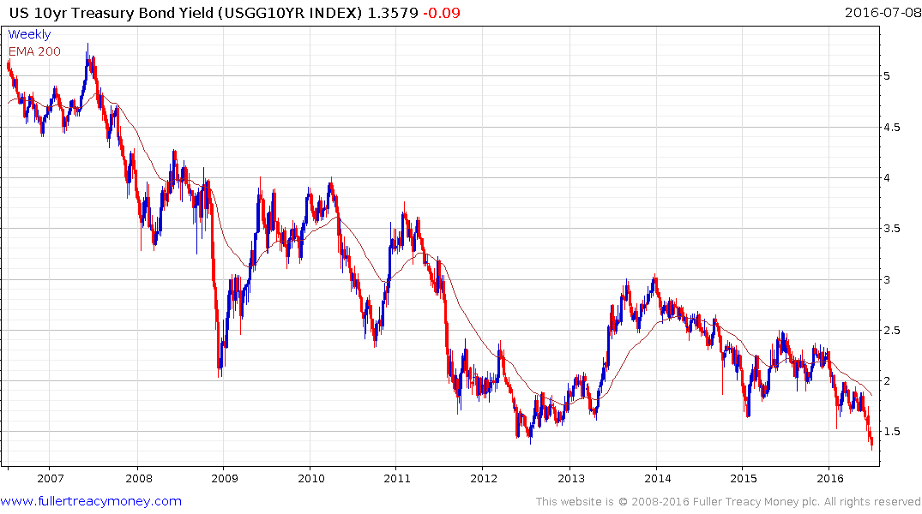
If you had just returned from ten years on Mars
and saw this chart, you might think the US economy was in severe recession, or perhaps even worse.

Slide 5
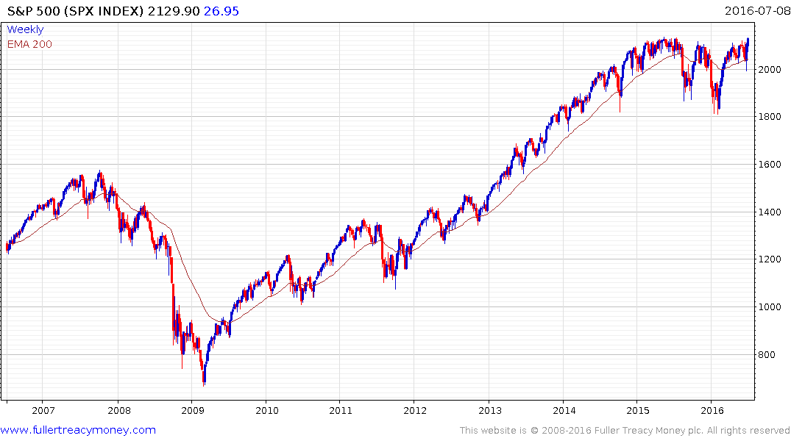
If you had just returned from ten years on Mars
and saw this chart, you might think the US
economy was heading for another growth spurt.

Slide 6
Such divergence is probably unprecedented, so what is going on?

Slide 7
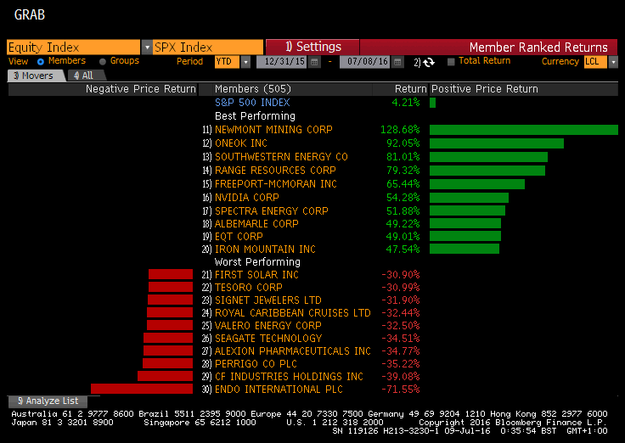

Slide 8
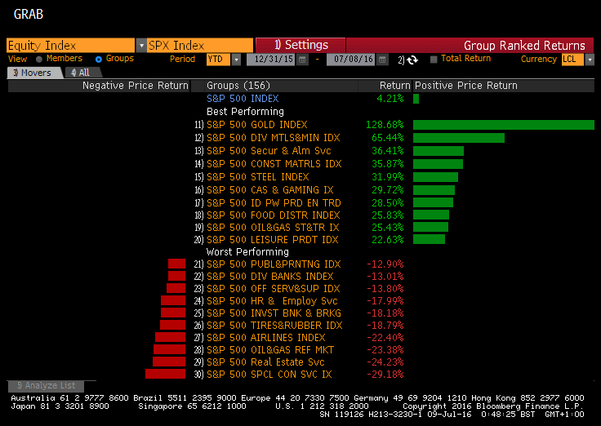

Slide 9
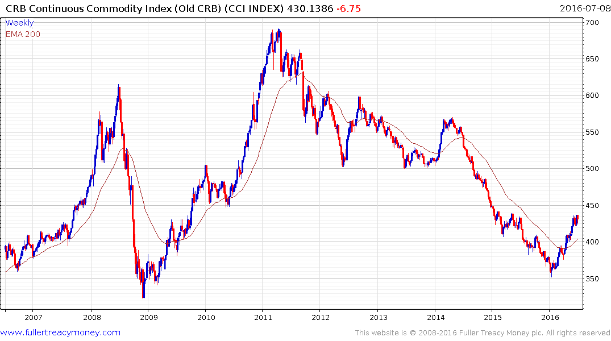
China led many of the
commodity rallies. Is it
happening again or is it
a contra-cyclical recovery
with fear helping to lift
precious metals?

Slide 10
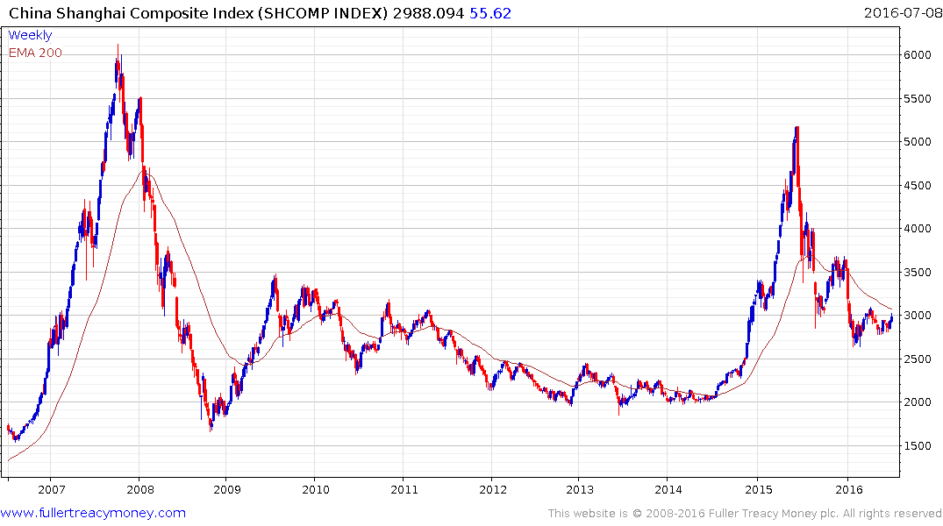
China has led many of the commodity rallies in
recent decades but it is certainly not the only
factor.

Slide 11
Commodities
1. The cure for low prices is low prices, as supply declines and demand begins to increase.
2. Contra-cyclical commodities are underowned by investors.
3. Global uncertainty, competitive devaluations and
low interest rates revive the ‘hard money’ appeal of
gold and other precious metals

Slide 12
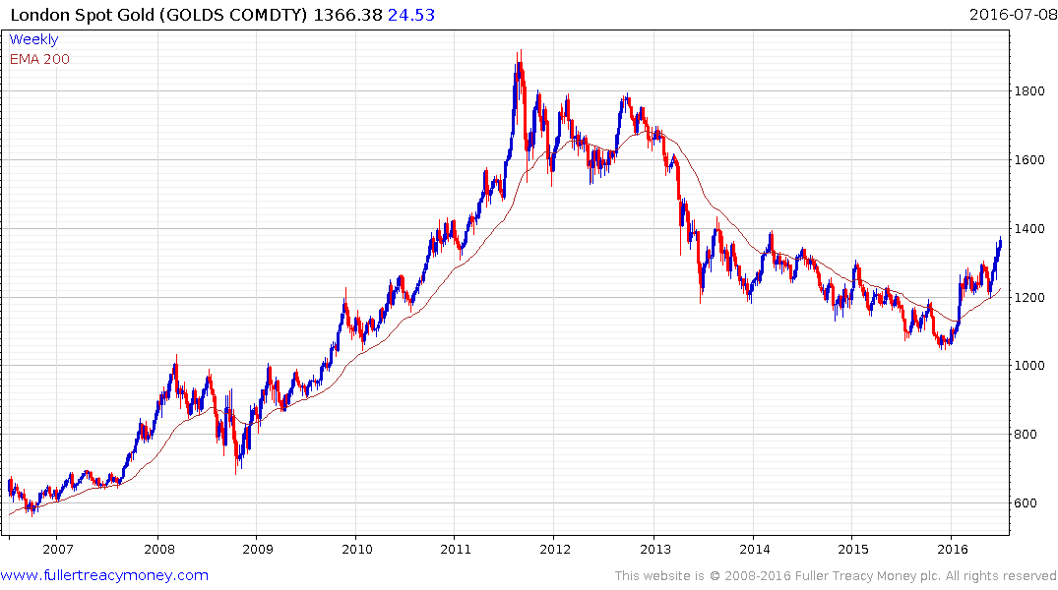

Slide 13
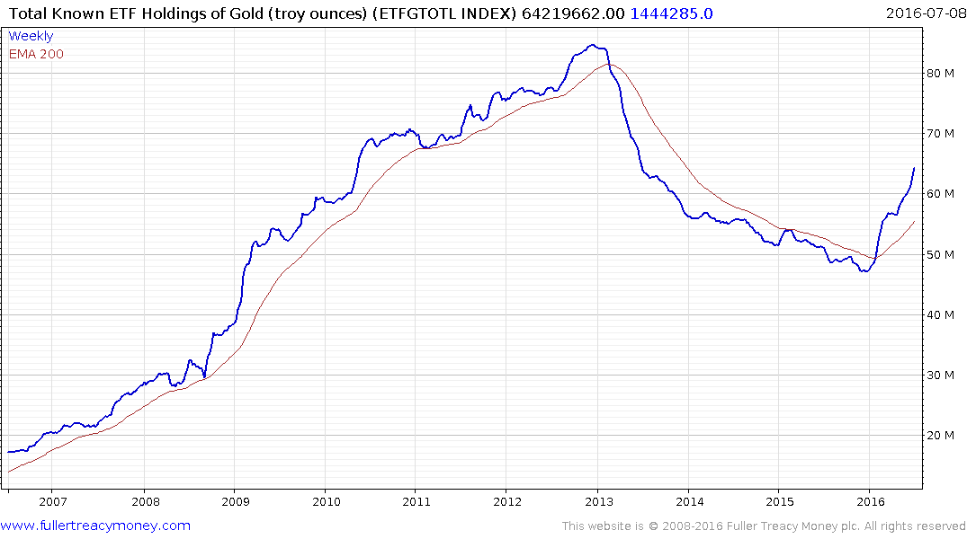
A lagging indicator as it reflects
investor sentiment but demand
is clearly increasing.

Slide 14
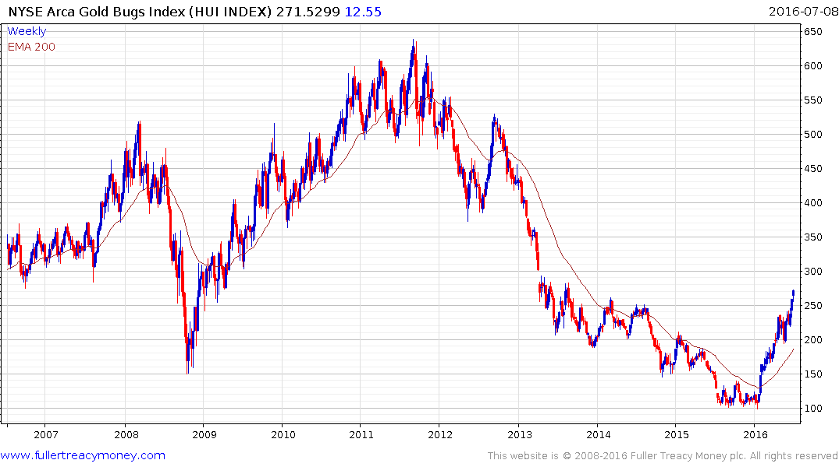

Slide 15
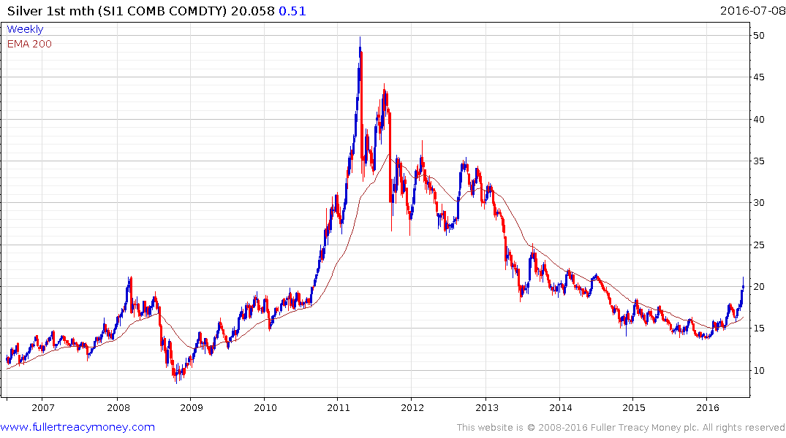
Silver is high-beta gold

Slide 16
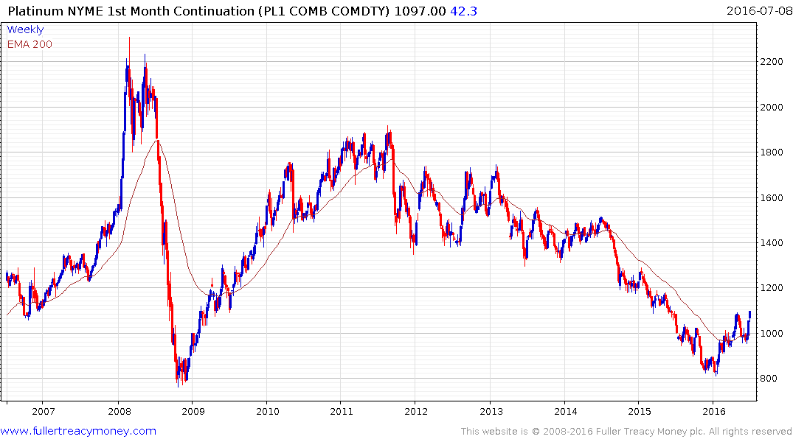
Interestingly, platinum usually
sells at a premium to gold but
has been lagging due to
industrial concerns. Platinum
has eventual catch-up potential.

Slide 17
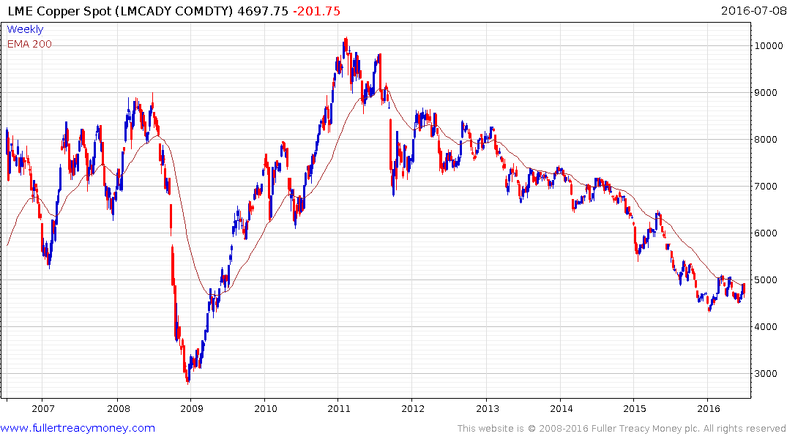
Potential base forming?
Needs to sustain break
above this year’s rally
highs near $5170 to
confirm recovery prospects.

Slide 18
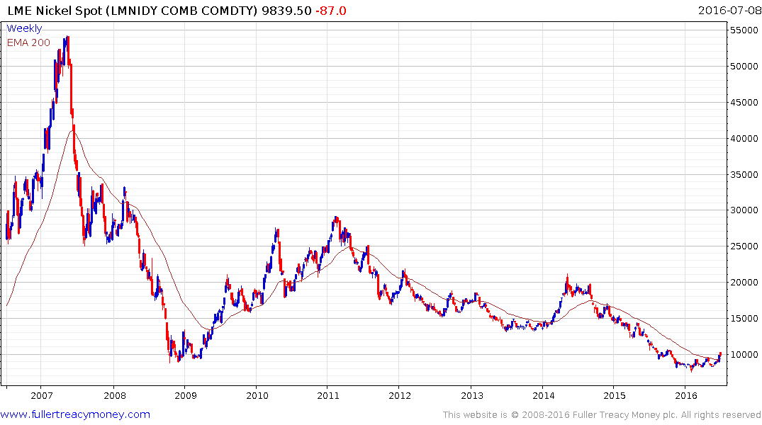
Probably completing saucer base and
needs to push back above $10,000
to confirm recovery potential.

Slide 19
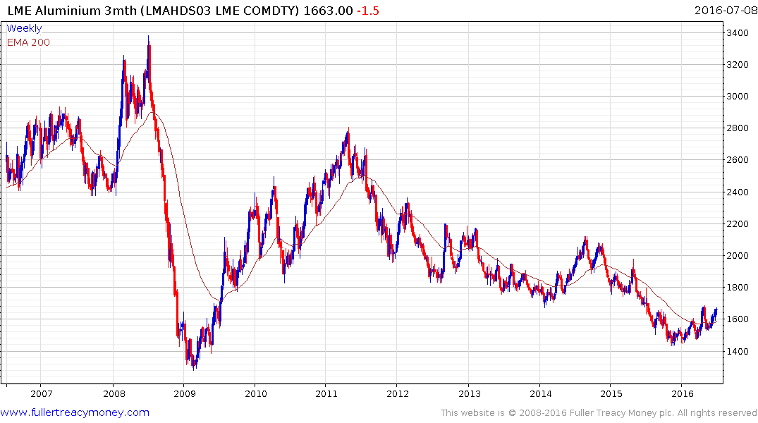
Basing characteristics and would
need to break sequence of rising
lows to significantly delay recovery
scope.

Slide 20
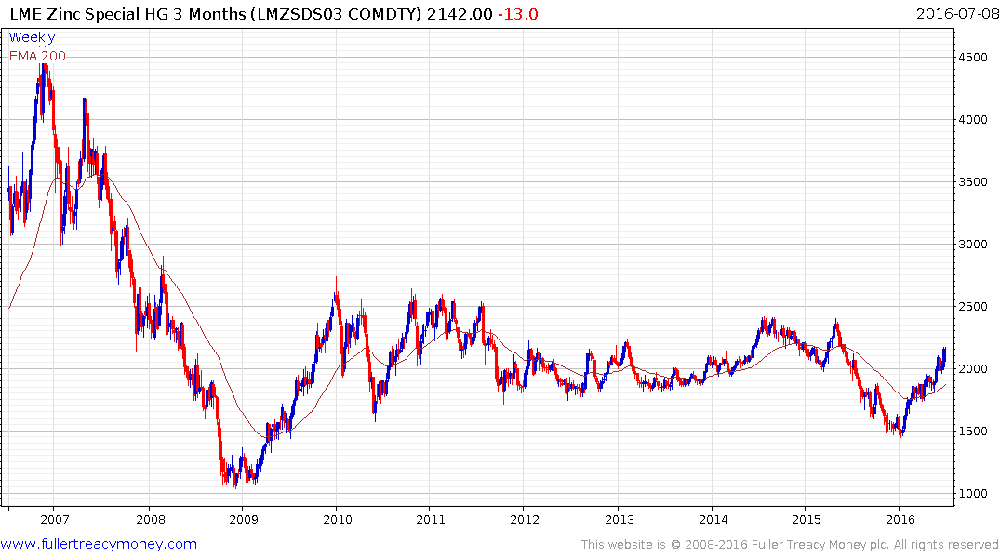
l
Leading recovery among
industrial metals

Slide 21
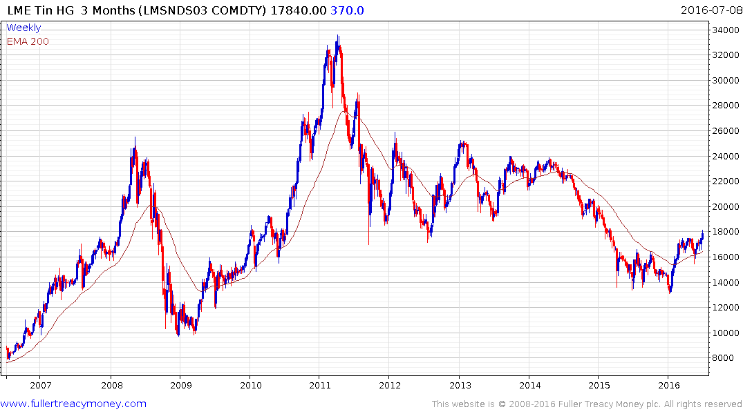
Leading recover among
industrial metals

Slide 22
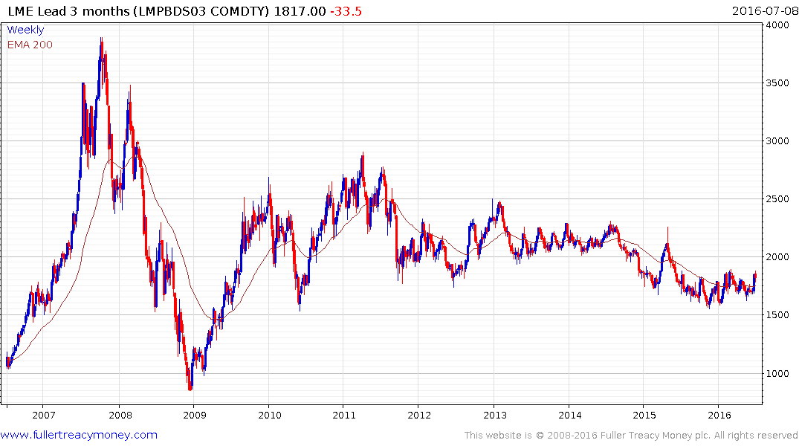
Potential base development but
needs sustained break above
$1900 to confirm

Slide 23
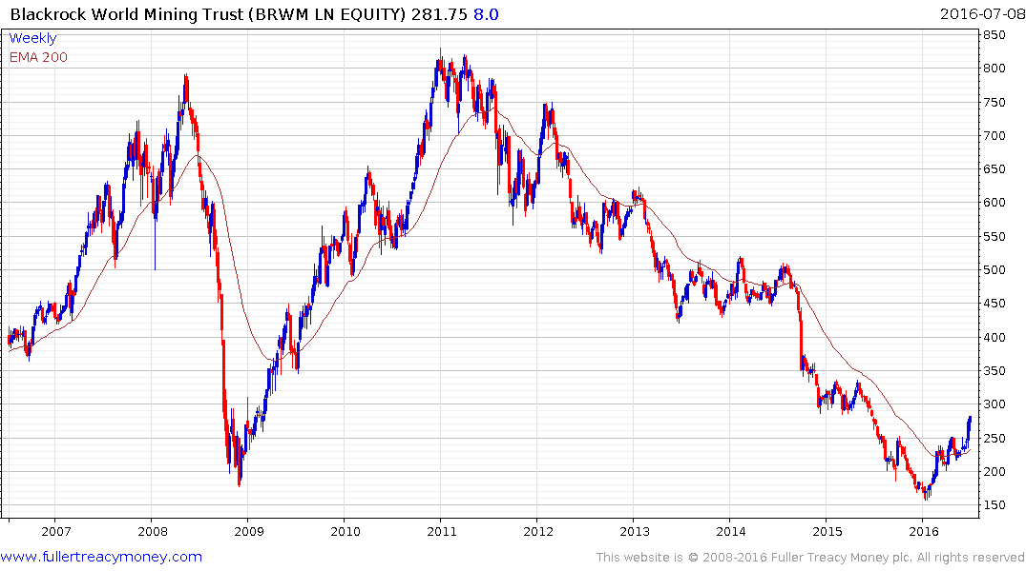
A leading sterling denominated
investment trust for participating
in this sector. Currently trading at
a discount to NAV of -13.14%,
according to Bloomberg. Caveat:
I have an investment position in BRWM.

Slide 24
Thanks to technology
the energy price bubble is over forever,
at least for countries with sensible energy policies,
including fracking, new nuclear and renewables.

Slide 25
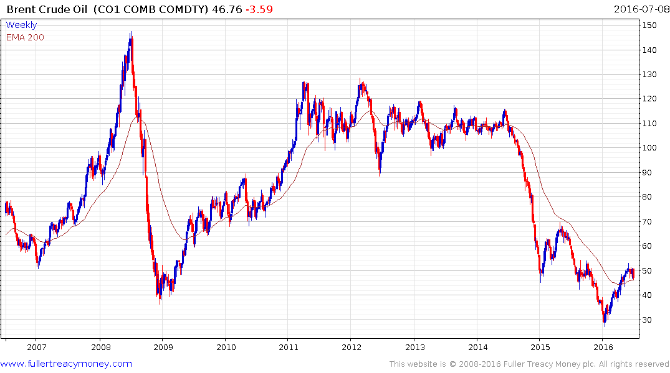
Susceptible to right-hand
reaction and consolidation
period before moving
somewhat higher.

Slide 26
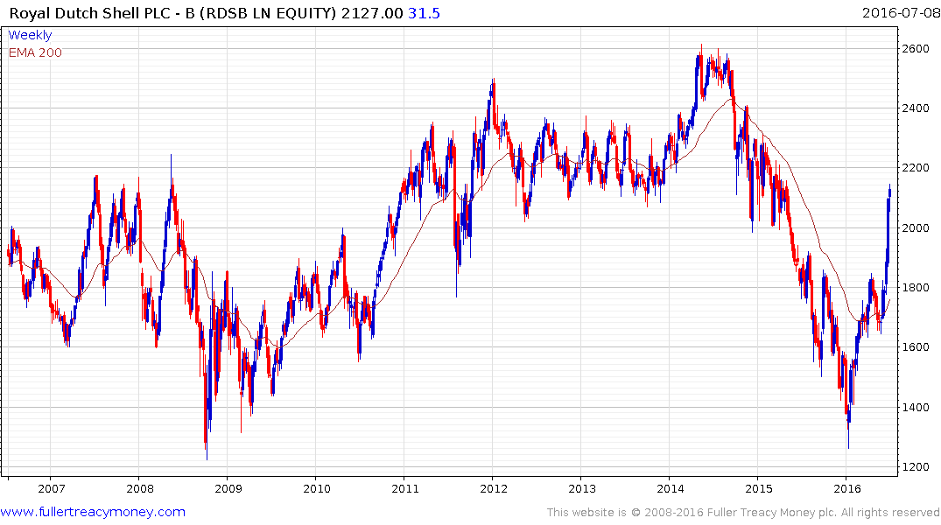
Temporarily overextend and
susceptible to a reaction and consolidation, but yields 6.03%.
Caveat: I hold an investment
position in RDSB.

Slide 27
A Few Currencies

Slide 28
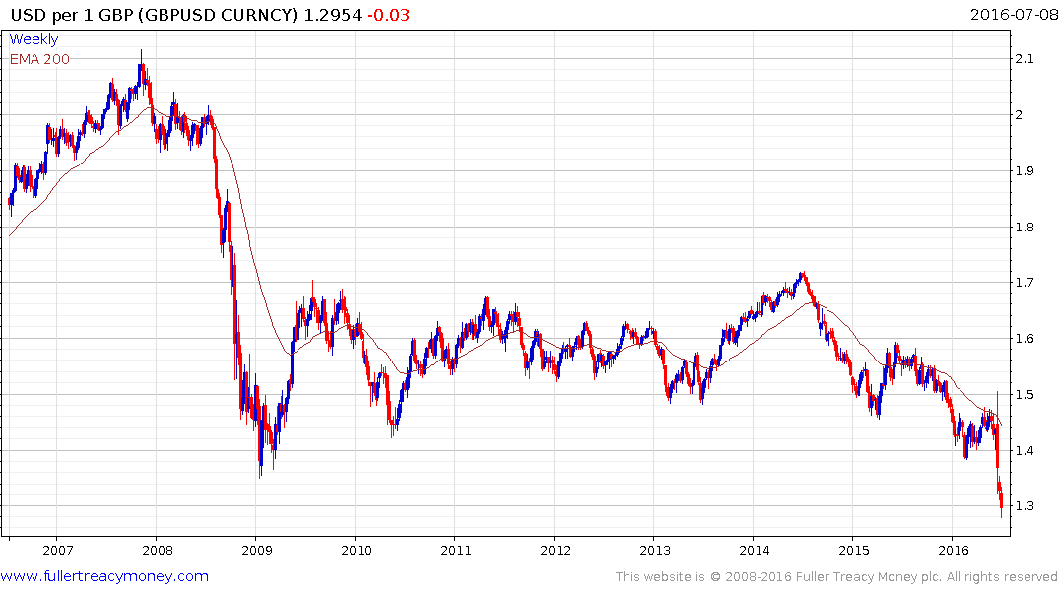
GBP/USD: a safety valve for the UK economy – some further downside scope but should be higher over the medium to longer term. Currently very competitive for UK exports.

Slide 29
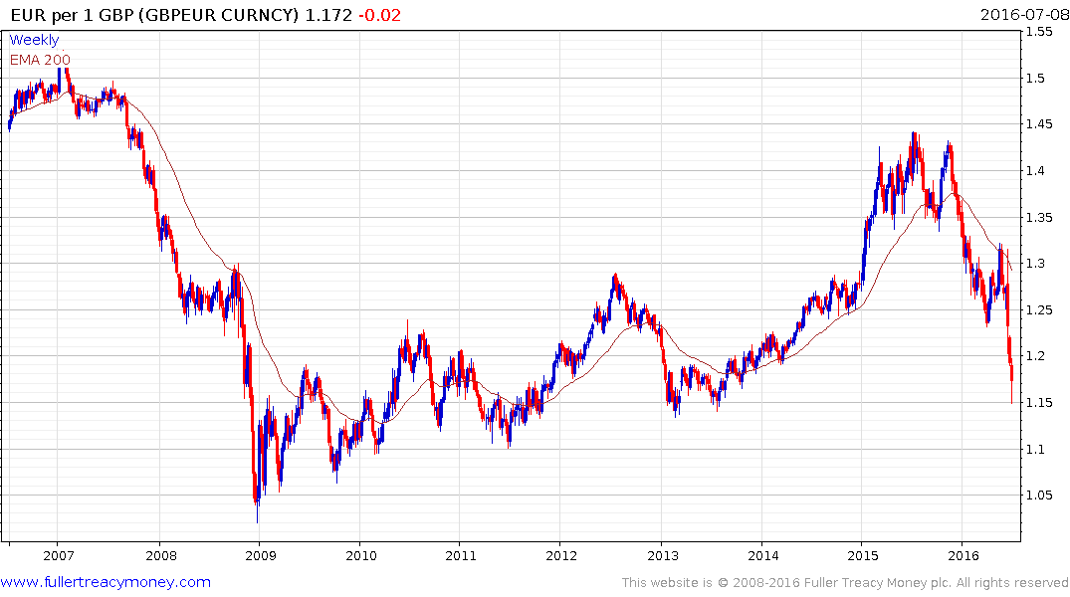
GBP/EUR: very competitive
for UK exports.

Slide 30
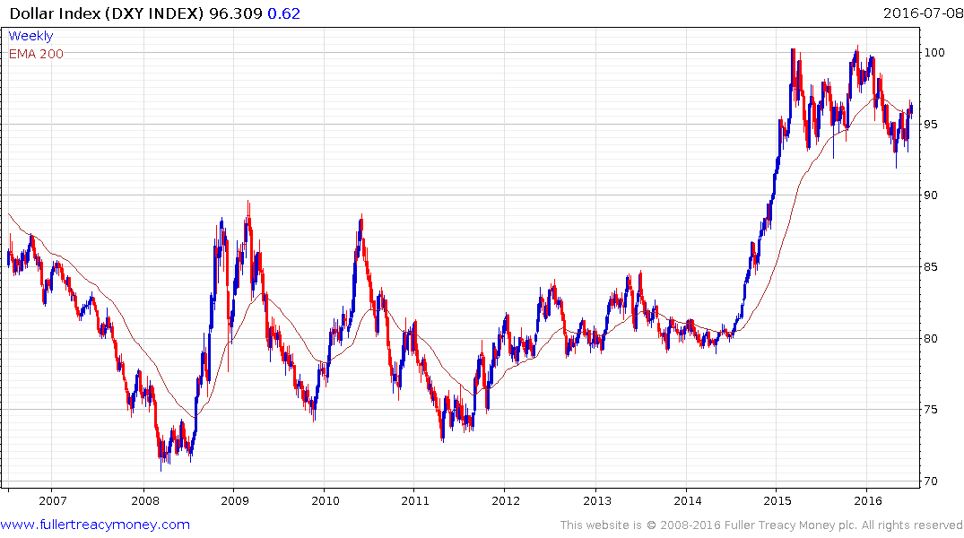
A secular bull market but Fed & US Treasury
need to keep it below 100 for at least the
remainder of 2016 to avoid recession risk.

Slide 31
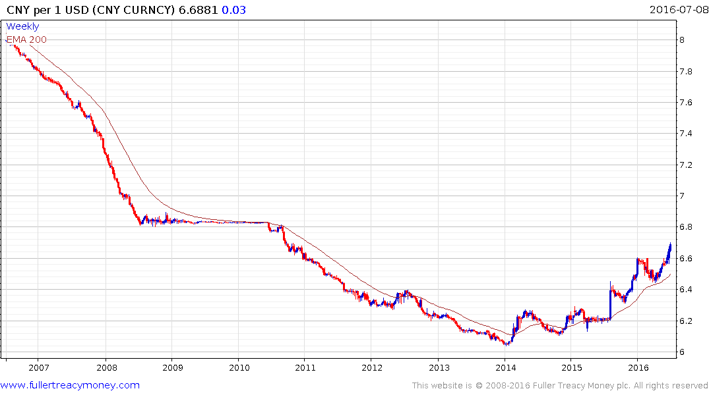
USD/CNY: This remains a controlled
devaluation of the Chinese Renminbi,
albeit from an over valued position in 2014.
It is also a risk for Asia Pacific stock markets.

Slide 32
A Few Stock Markets

Slide 33
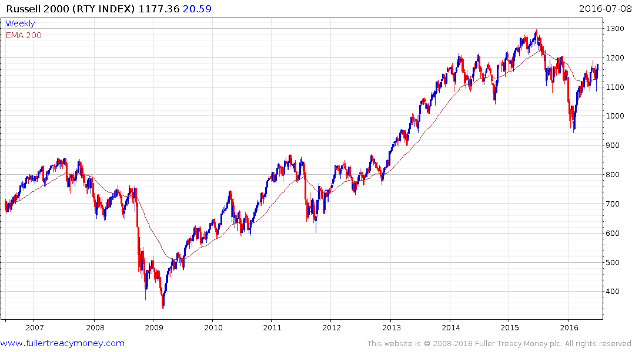
RTY: small-cap domestic shares
Still the canary
in the coal mine
for US shares

Slide 34
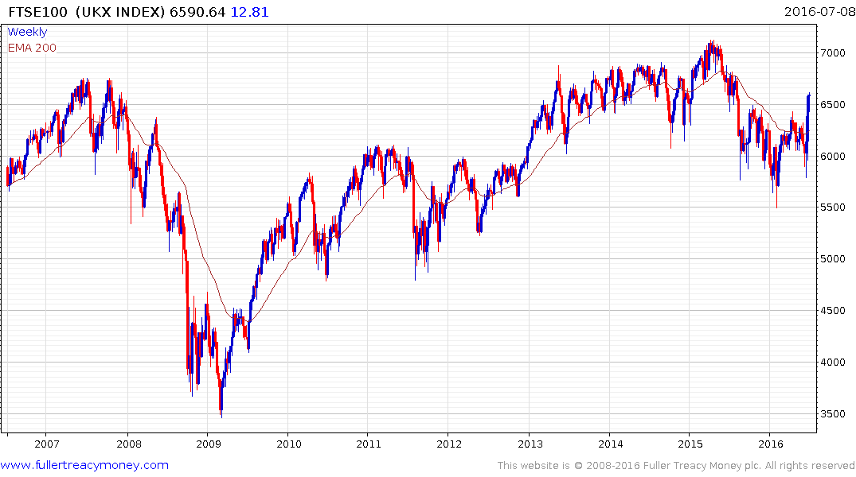
FTSE 100: boosted by
devaluation and overseas resources shares

Slide 35
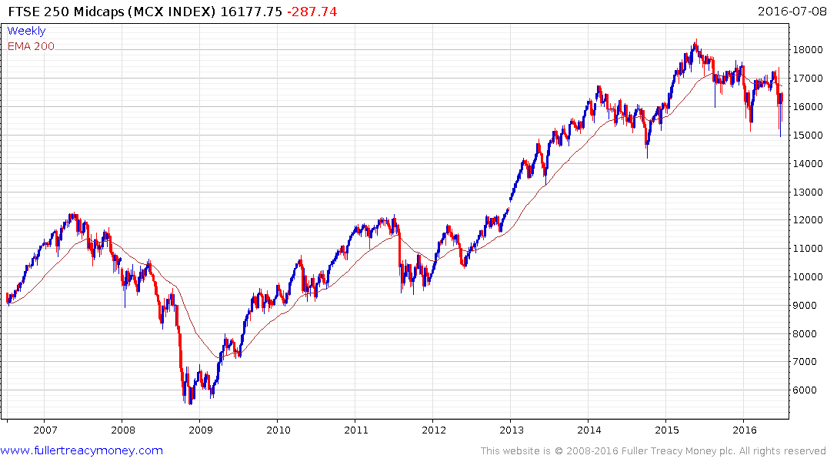
FTSE 250 Midcaps: more representative
of UK market; needs to break progression of lower rally highs to confirm that demand
is regaining the upper hand.

Slide 36
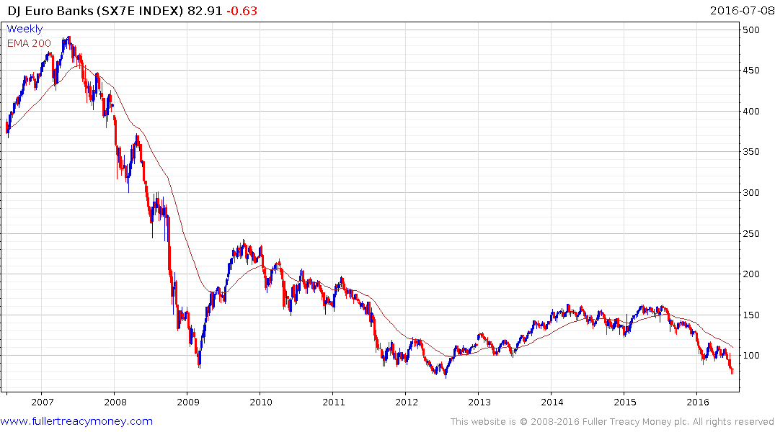
DJ Euro Banks: the EU’s Achilles Heel –
short-term oversold but worrying.

Slide 37
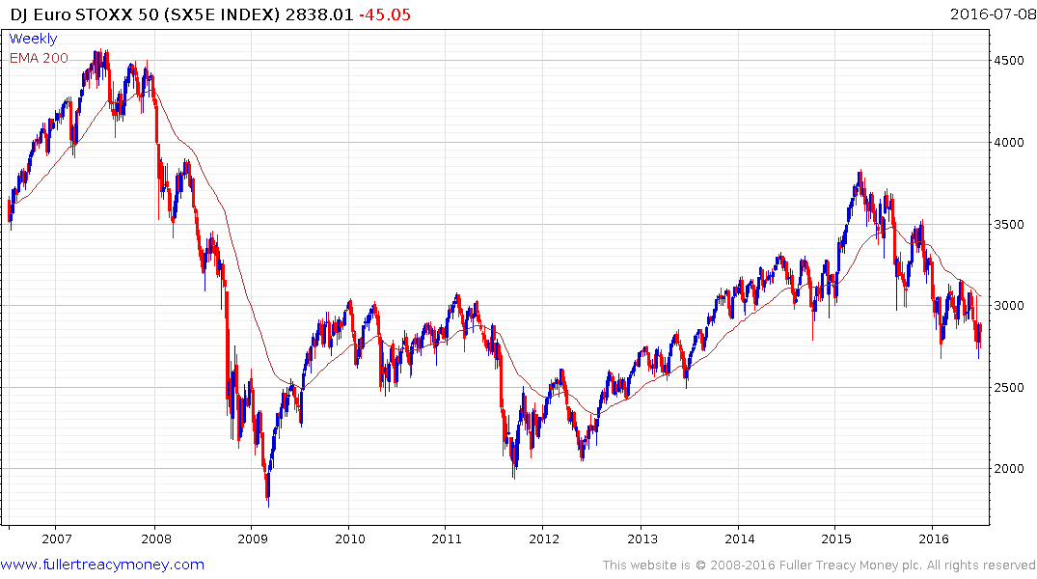
DJ Euro STOXX 50: still in a bear market -
needs a climactic selloff and or a break of the descending lows to indicate recovery scope.

Slide 38
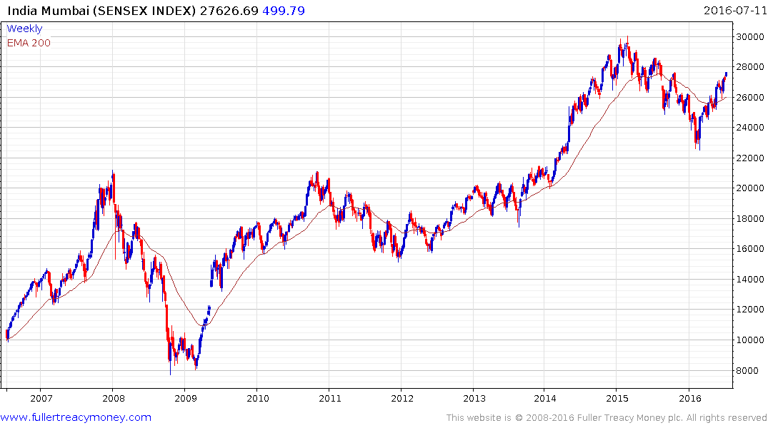
Still the best big economy growth story –
requires a break of this year’s rising lows,
with the latest near 26000, to question
the current upward bias.

Slide 39
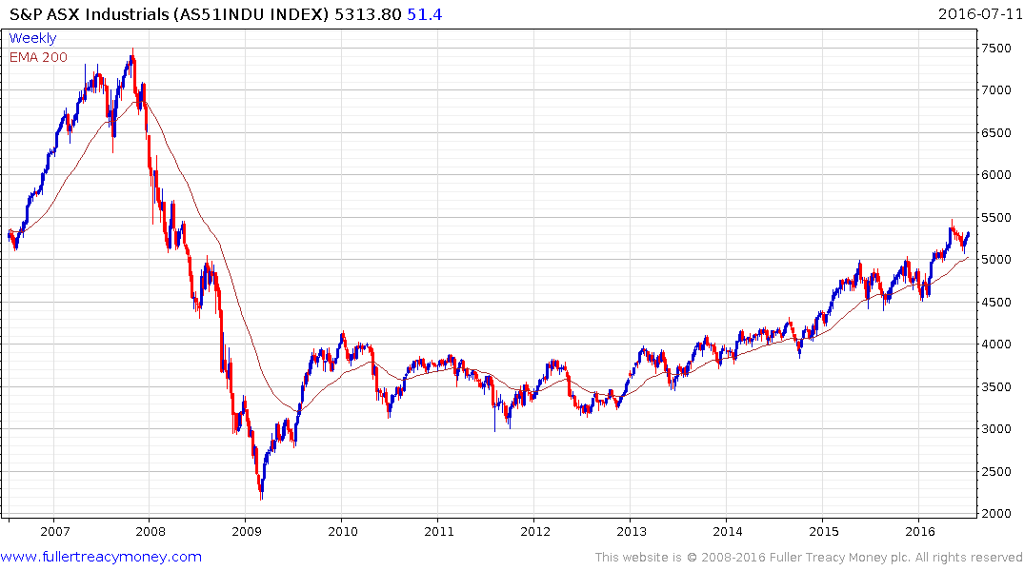
Australia: the revival of industrial resources
prices has turned this into one of the best
performing stock markets. It would require a
close beneath 5000 to question upward bias.

Slide 40
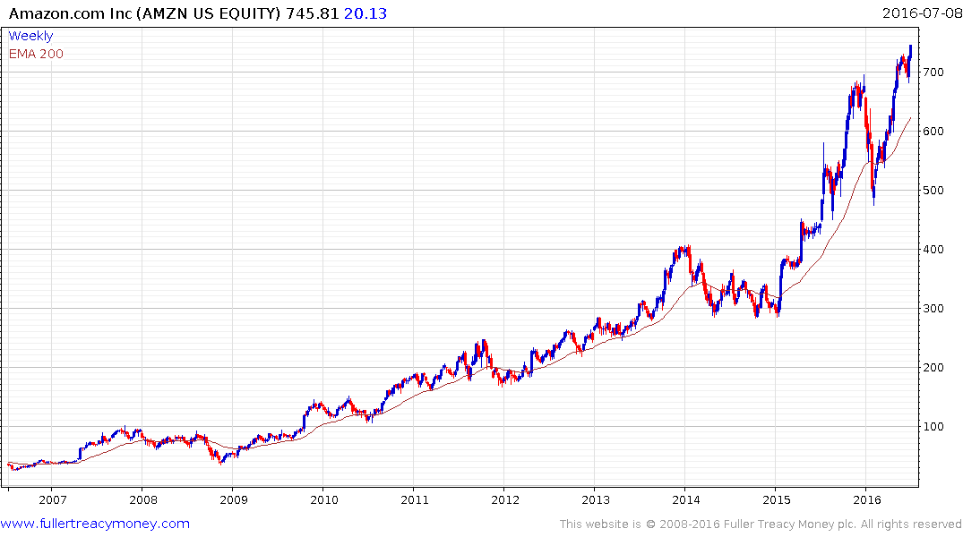
Amazon: is this the best managed tech share?
Possibly, and it is certainly one of the most
destructive in terms of retail competition.

Slide 41


Slide 44
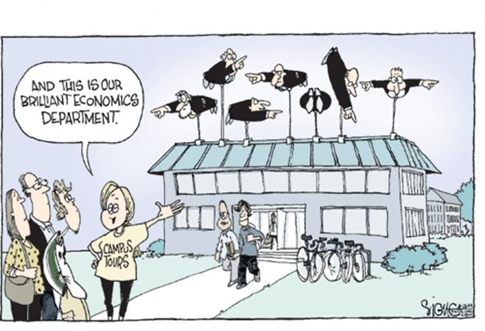

Slide 45
Many thanks for your interest!
Any questions?
Please visit our site:
www.fullertreacymoney.com

Slide 47
Technical warning signs to watch for among indices
Trend acceleration relative to 200-day moving averages
Declining market breadth (fewer shares rising)
Failed upside breakouts from trading ranges
Loss of uptrend consistency characteristics
Churning price action relative to recent trading ranges
Breaks of 200-day moving averages
Broadening patterns for trading ranges following uptrends
200-day moving averages turn downwards
Resistance is encountered beneath declining 200-day MAs
Previous rising lows are replaced by lower rally highs
Indices fall faster than they rose to their highs

