Slide 1
2016 - A year for caution but also opportunity
January 26th 2016
Eoin Treacy
FullerTreacyMoney.com

Slide 2

The talking heads have a lot to say. Energy, China, Emerging Markets, the Dollar, Biotech, Wall Street, the Oscars, the Presidential Cycle…so let’s boil it down to a few charts that might help bring it all together.

Slide 3
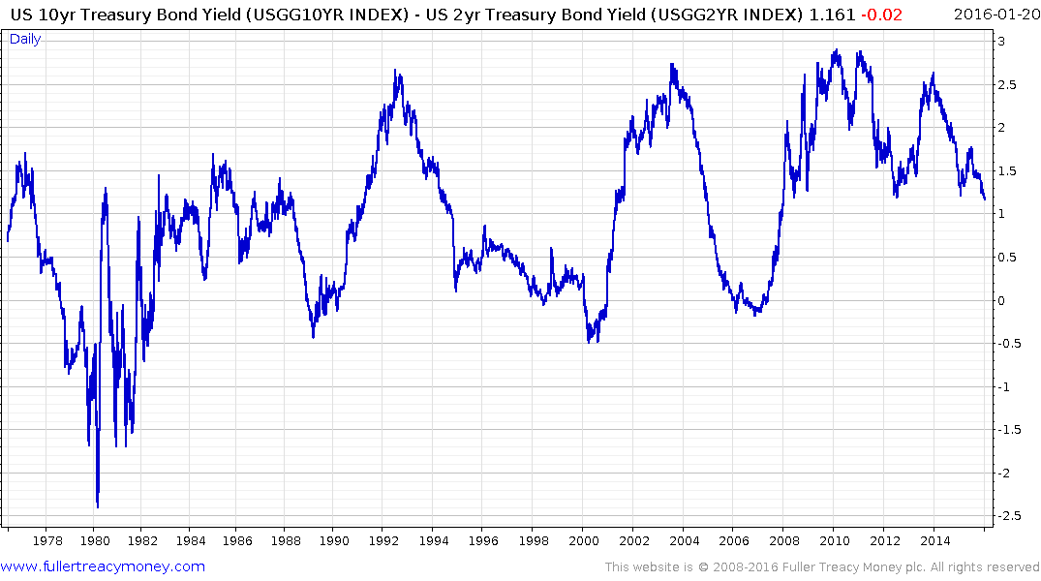
The Yield curve is still trading at a 100 basis point positive carry.
No recession but it will be close.

Slide 4
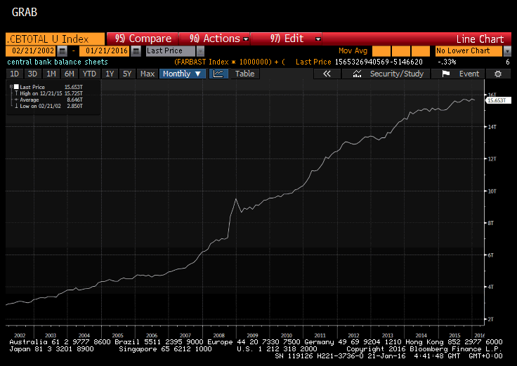
The combined Fed, ECB, BOJ, BoE and PBOC Balance Sheets rebased to US Dollars

Slide 5
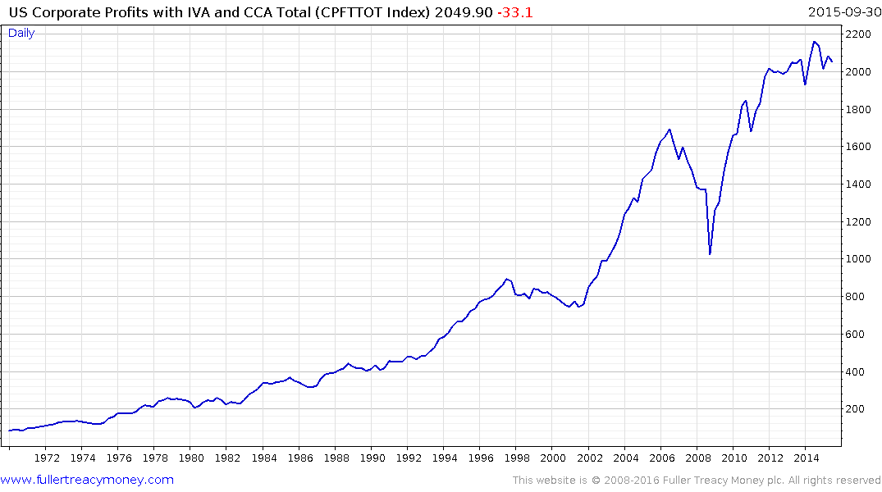
Corporate Profits have been static since 2012 which has resulted in multiple expansion.
2006
1997

Slide 6
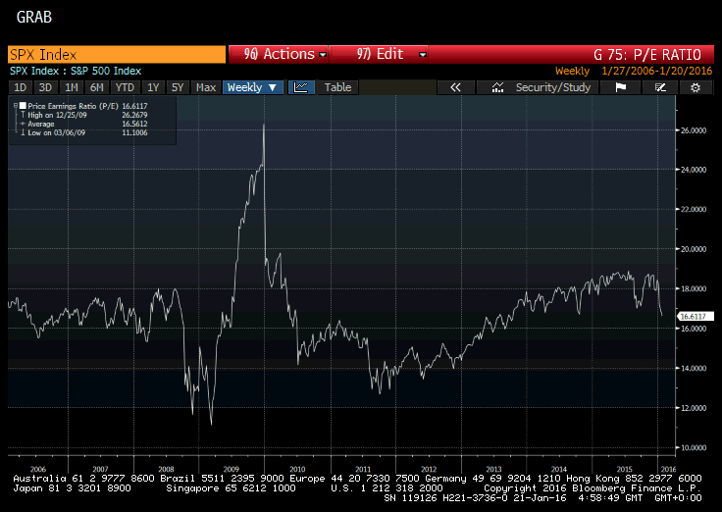
P/E ratios have contracted rapidly this year already.

Slide 7
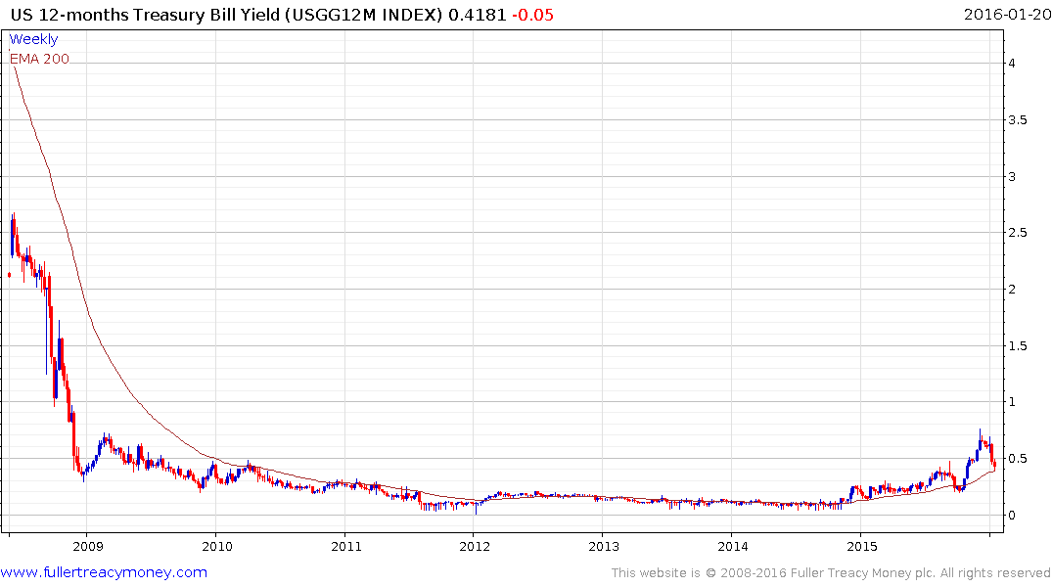
The Fed says they will raise rates 4 times this year, the bond market is sceptical. This is the basis for the whole argument right now.

Slide 8
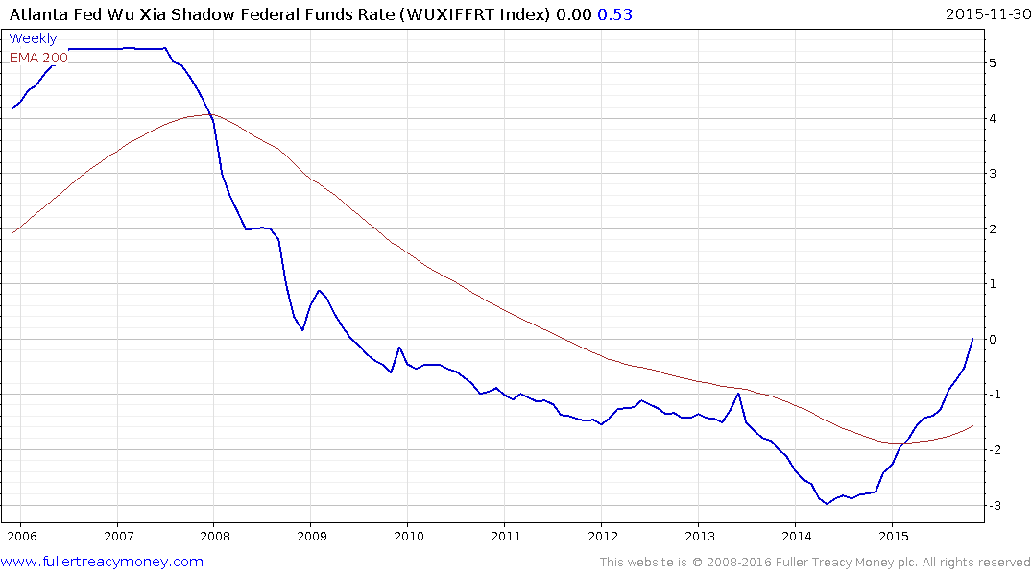
The Fed might have only raised once but the shadow banking sector has been under pressure since the end of QE and that tightening is almost done.

Slide 9
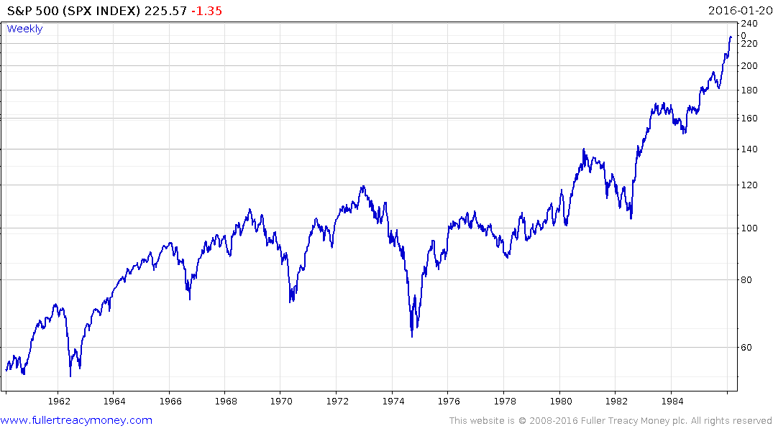
This is what the end of the 1970s bear market looked like

Slide 10
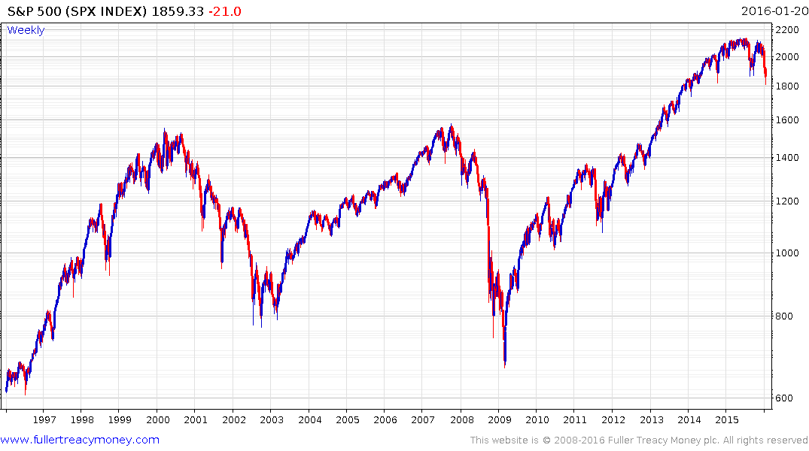
Does this look familiar?

Slide 11
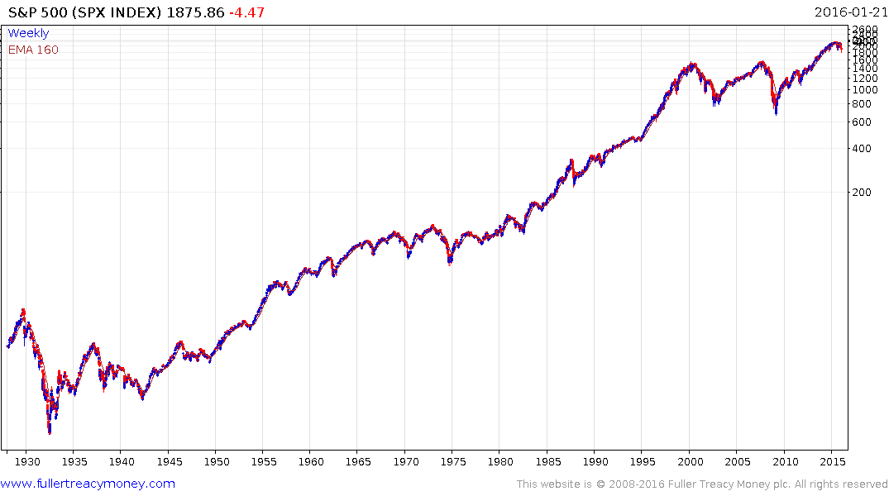
Let’s have some perspective:
This has been a major breakout from a very lengthy range and what we are now seeing is the first big consolidation in a secular bull market.

Slide 12
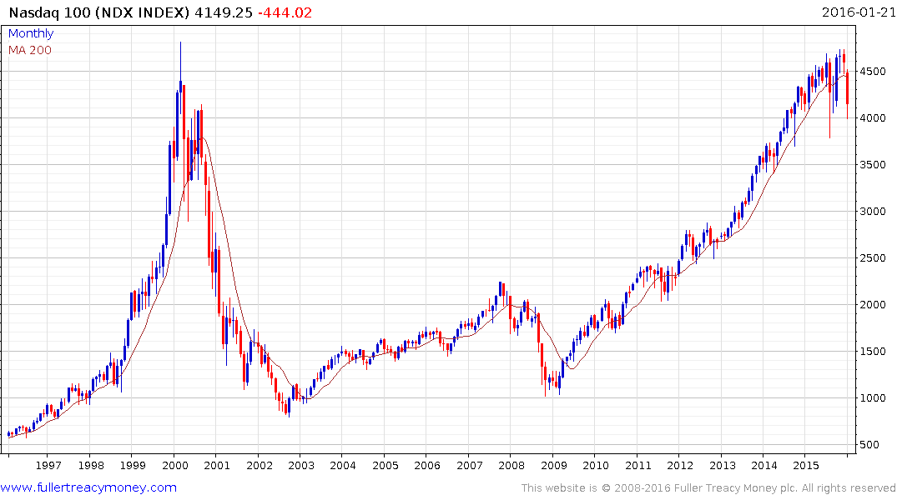
Do you think it reasonable for the Nasdaq to consolidate in the region of the previous peak for at least a while?

Slide 13
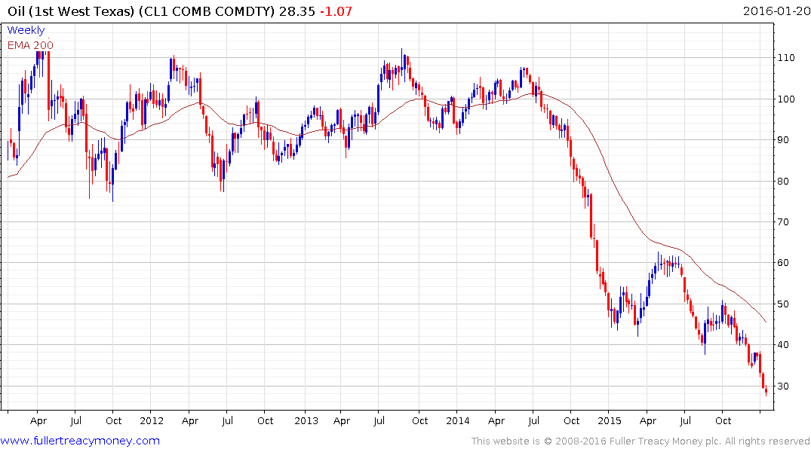
Oil prices are a headwind right now but will be a medium-term tailwind for the economy.

Slide 14
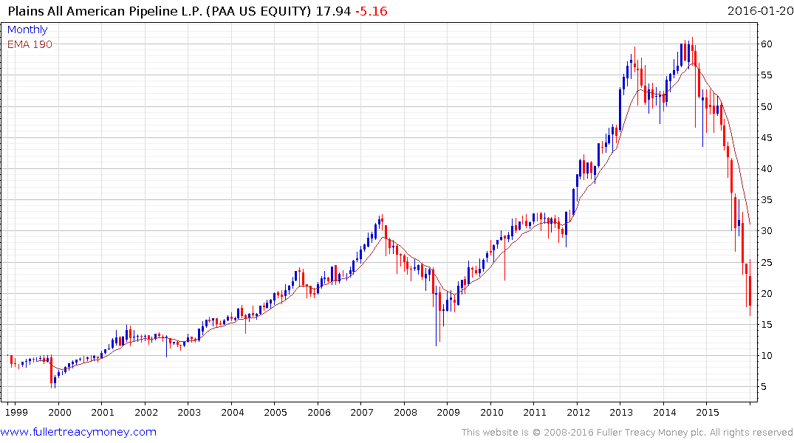
Pipelines are being priced like US oil production is going into permanent decline. I don’t think so.

Slide 15
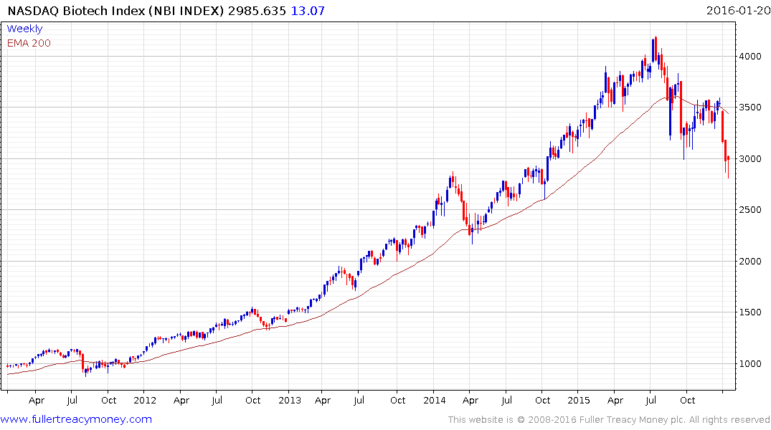
Selling pressure in leading sectors has not been evenly distributed. Valeant accounts for a lot of this underperformance.

Slide 16
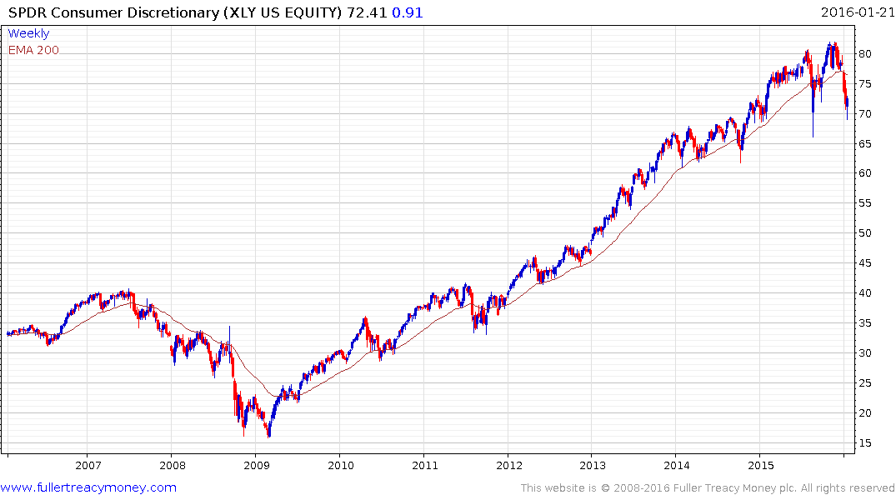
The consumer is about the strongest sector around.

Slide 17
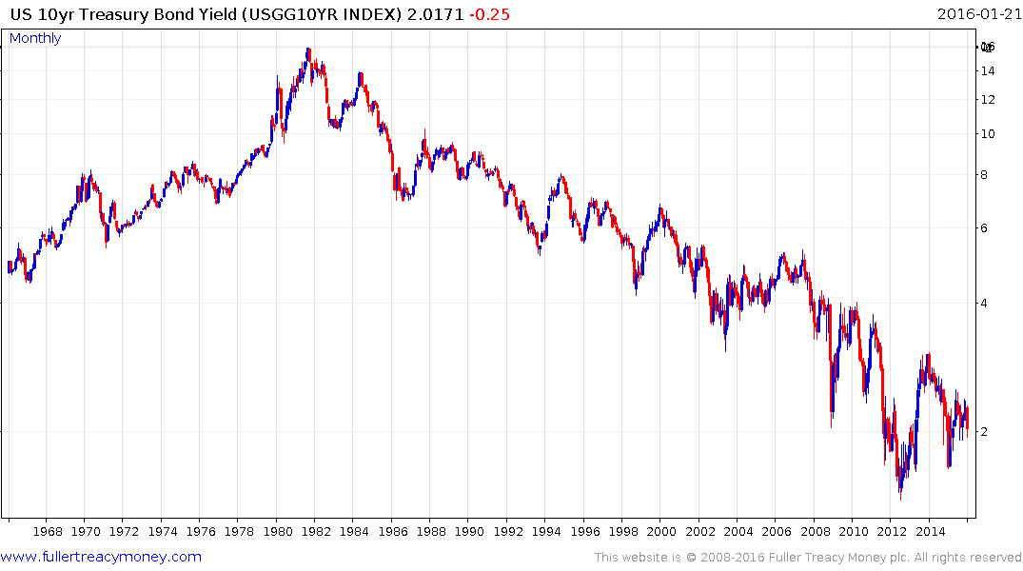
Treasury yields have a triangular pattern suggesting the breakout when it comes is going to be powerful.

Slide 18
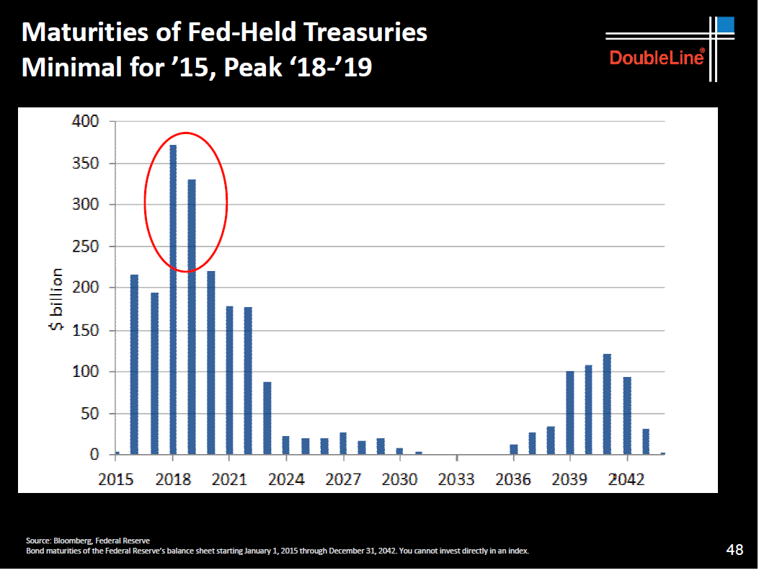
The Fed has some major decisions about refinancing coming due from next year.

Slide 19
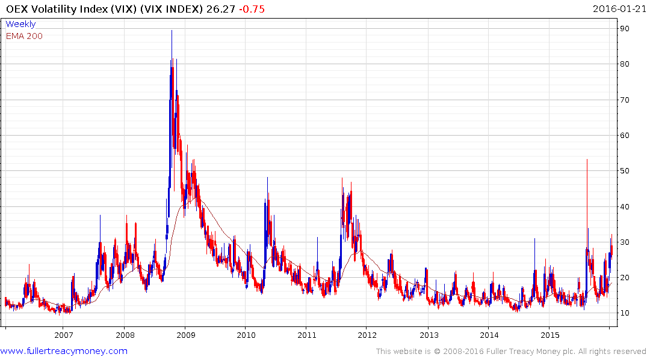
The VIX is how algorithmic trading systems calculate positions size.

Slide 20
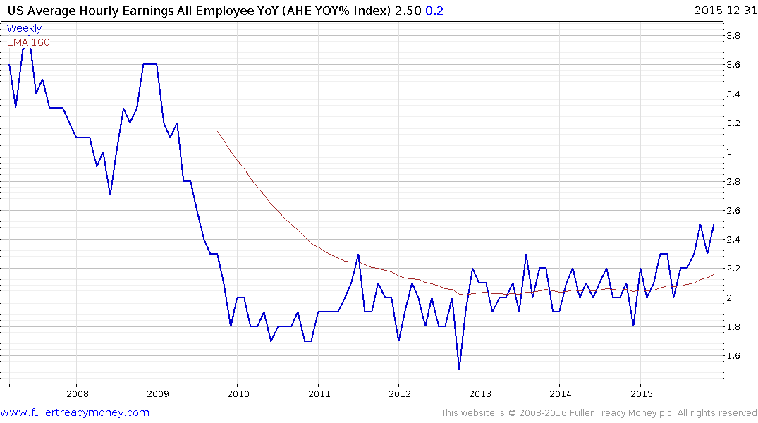
Wages have broken out and inflation is low, energy is cheap and the strong Dollar has already had a tightening effect so the Fed’s decision to raise rates is very finely balanced

Slide 21
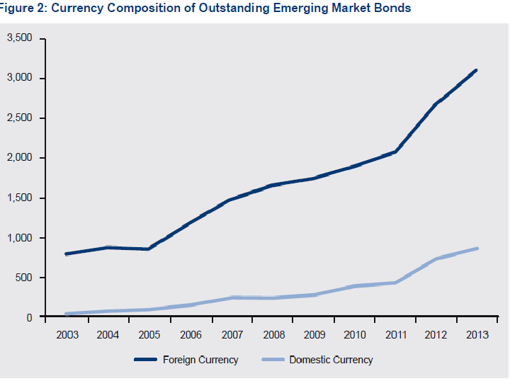
Could it be because ultra-low rates have caused a misallocation of capital?
Emerging market bond issuers have behaved like the Dollar’s bear market would last forever.

Slide 22
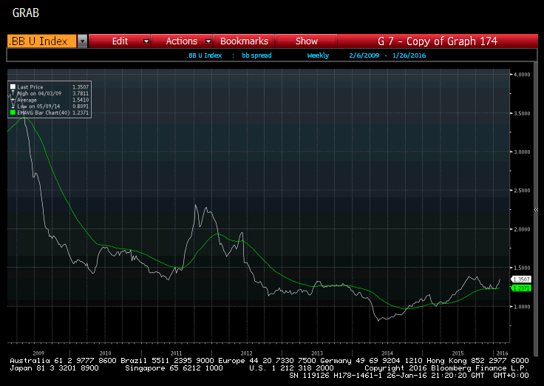
Junk Bond Yields are breaking out and against a background where issuance has surged.
The average is 6.5%
BB rated Transocean is 19%
Petrobras 2021s are at 13.1%.

Slide 23
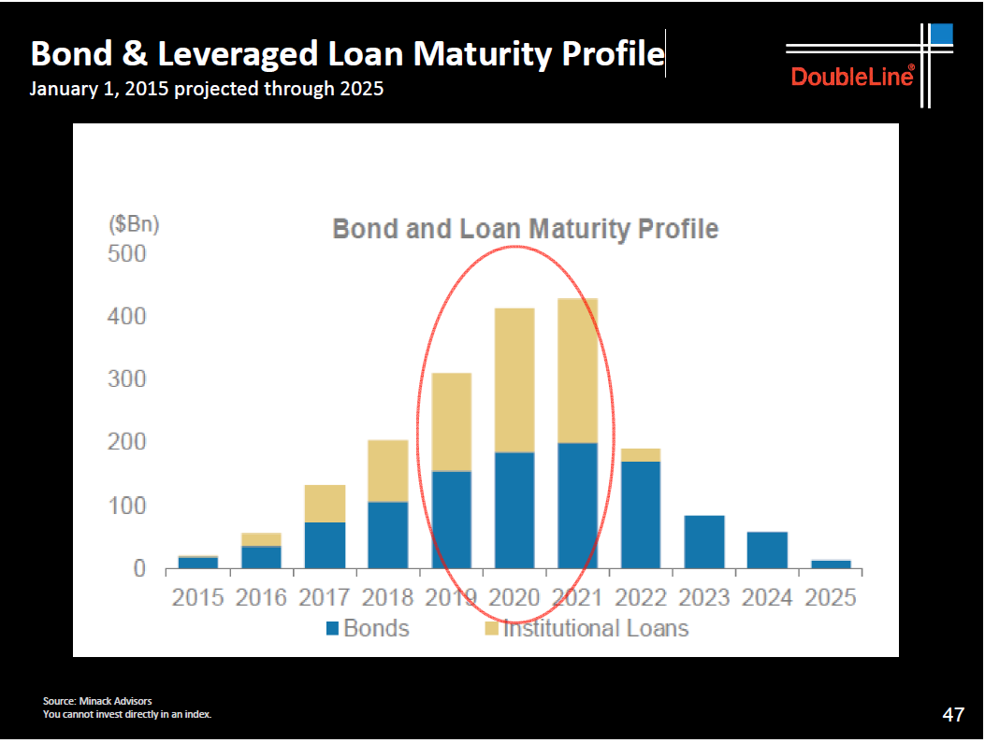
Corporations have a lot of debt to refinance in 2020 and 2021 but very little right now.

Slide 24
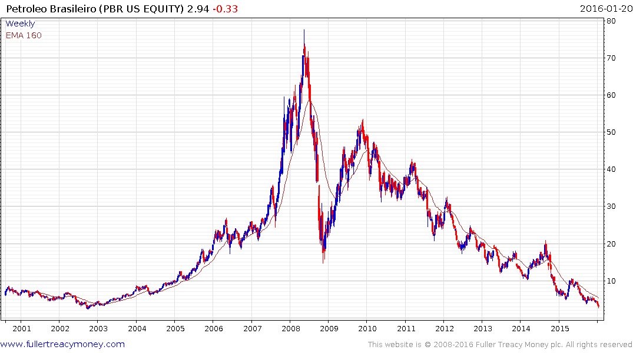
Petrobras successfully issued a $2.5 billion 100-year bonds in June!
With $90 billion in US Dollar debt out of a total $300 billion what happens to Petrobras matters.

Slide 25
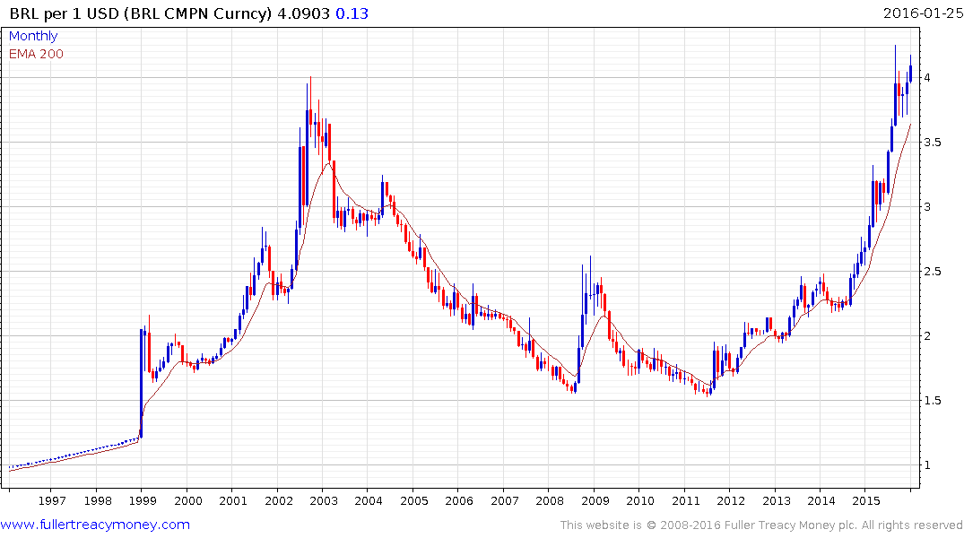
The swiftly declining Real make the Dollar debt harder to pay but the domestic debt easier.
Meanwhile Brazil’s competitiveness is improving rapidly.

Slide 26
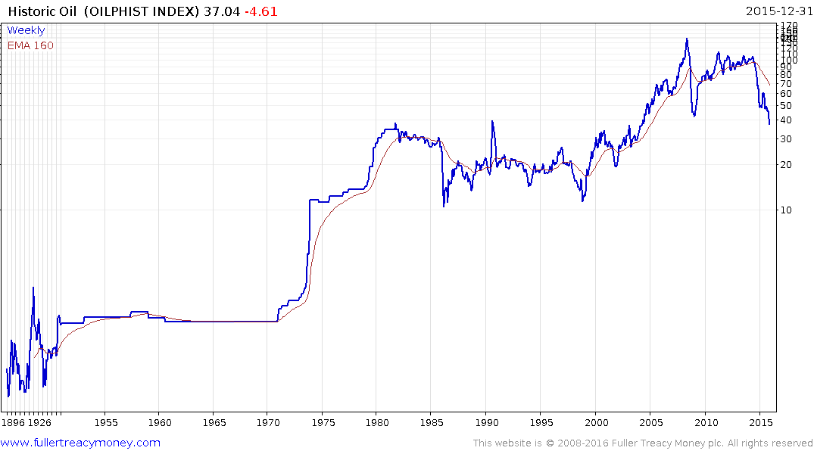
Oil also has long-term price cycles and could be ranging for a very long time.

Slide 27
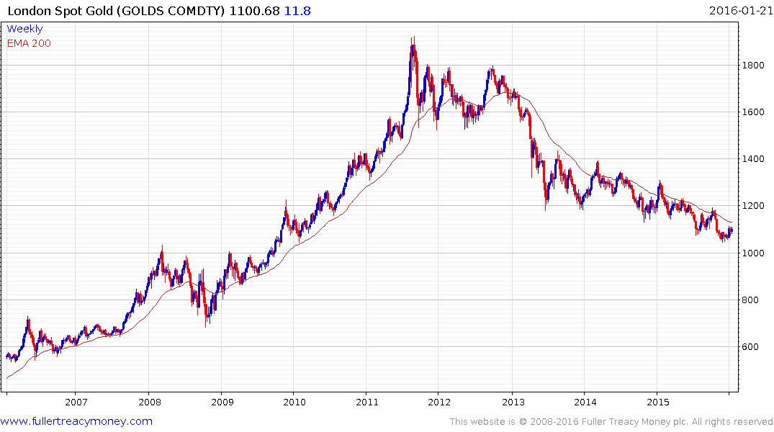
Gold remains a in medium-term downtrend and has benefitted recently from just doing nothing.

Slide 28
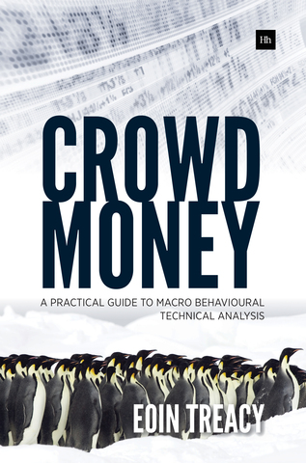
Please visit us on www.Fullertreacymoney.com and sign up for our FREE Comment of the Day.
Please email Sarah Barnes at sarah@fullertreacymoney.com for a one-month free trial.
Crowd Money – A Practical Guide to Macro Behavioural Technical Analysis is available on Amazon or Harriman House.

