Slide 1
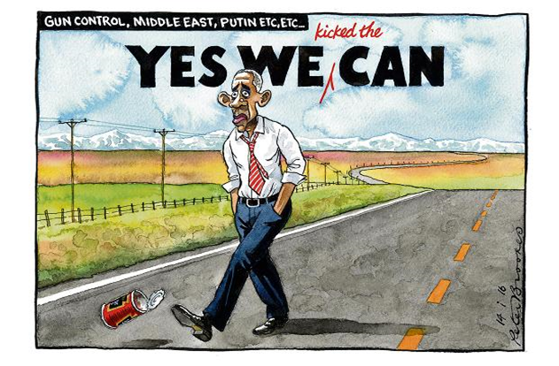
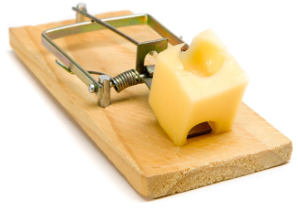
1. Trusts In Focus Up Date
2. What I’m Buying Today
3. The Gold Trap and “BS”
MARKETS NOW 18th JANUARY 2016
David Fuller, David Brown, Iain Little

Slide 2
What Is The Perfect Investment (Funds)?
    Long-term (does better than…..)
    Leverage, but only if needed
    Discounts to real asset value («Leverage at a discount»)
    Governance: proper auditing, proper board, transparency
    Know-How proven over 100+ years
    Liquid, but… (real time trading on SE)
    Low management costs (1/4 to 1/2 the cost of rivals)
    New money non-dilutive (if successful /at discount)
    Global but can be specialist?
    Daily valuations, daily reporting
    Yield. Growing dividend stream payable out of «Reserves»
    Elected management, retail participation, proper AGMs
    Information inefficiencies. Hated by brokers

Slide 3
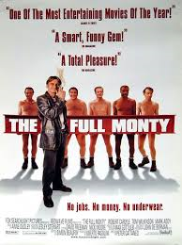
Trusts In Focus (TIF) SERVICE
Universe c300 closed end (mainly UK) investment trusts monitored
Up to 15 equally-weighted trusts held in Trusts In Focus (TIF)
If we sell an investment trust, we must replace it
Changes to trusts recorded (1.25% trading costs B/S)
Research available to «Markets Now» attendees
    3rd party adviser research referenced
    FullerTreacy Money one of 20+ 3rd party advisers
    In-House Cooking/ P&C research
Performance review / indecent striptease every «Markets Now»

Slide 4
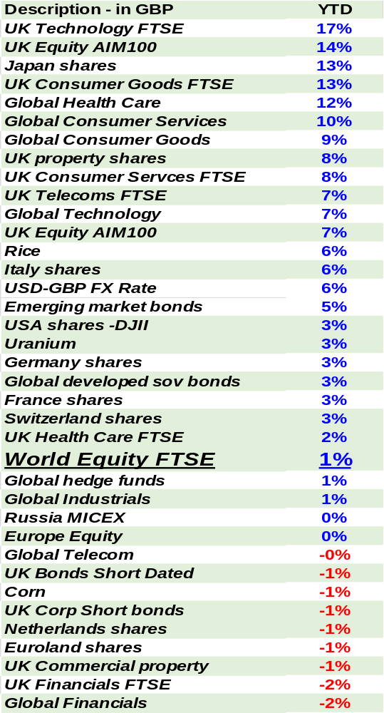
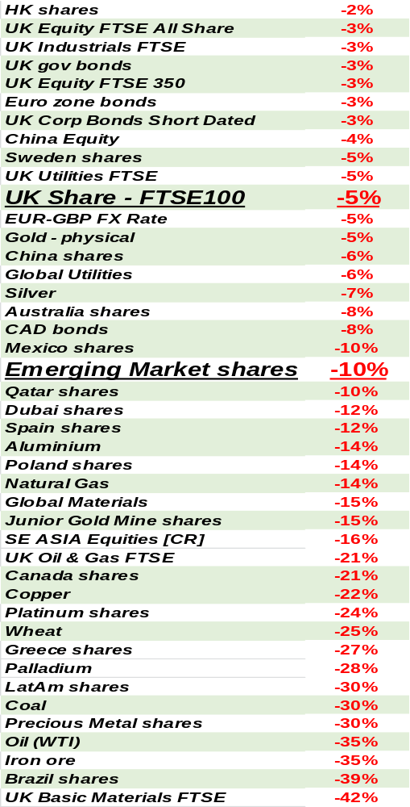
Market performance 2015 (GBP)
Major Asset Classes in GBP
2015: corrections in nearly all «risk» asset classes, with few places to hide World equities +1%, USA +3%, Euroland -1%, SE Asia -16% Within Euroland, Italy the best performer (+6%) and Germany and Switzerland «only» +3% UK equities -5% but UK AIM +7% Japan (+13%) the best major market as the JPY weakened… …But China -6% and HK -2% Yet again emerging mkts weak, -10% Commodity producers weak (Australia -8%, Canada -21%), as… …Oil -35% after 2014’s -50% fall Bonds weak despite «risk off» theme (Eurozone bonds -3%, UK government bonds -3%) Technology, healthcare and consumer goods did best amongst sectors Greece -27% and Brazil -39% the worst equity markets Rice +6% but commodities were generally weak Much more RED than BLUE in 2015

Slide 5
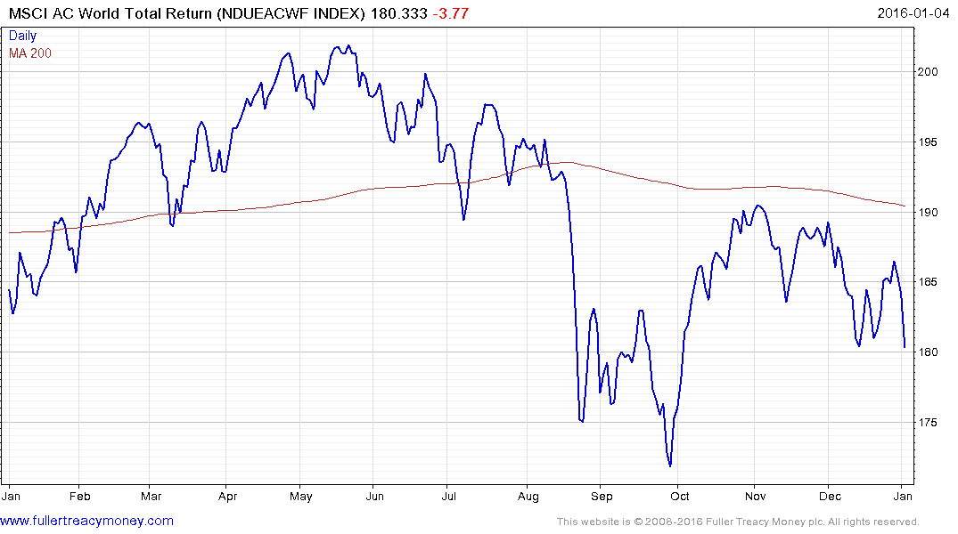
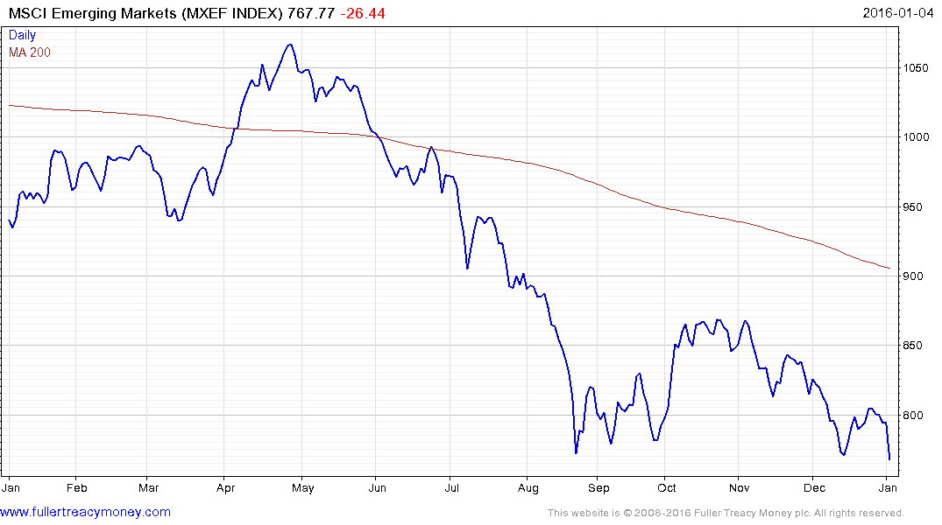
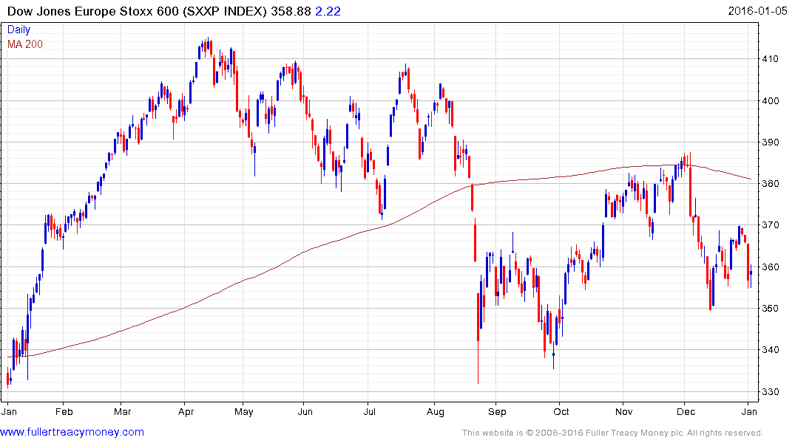
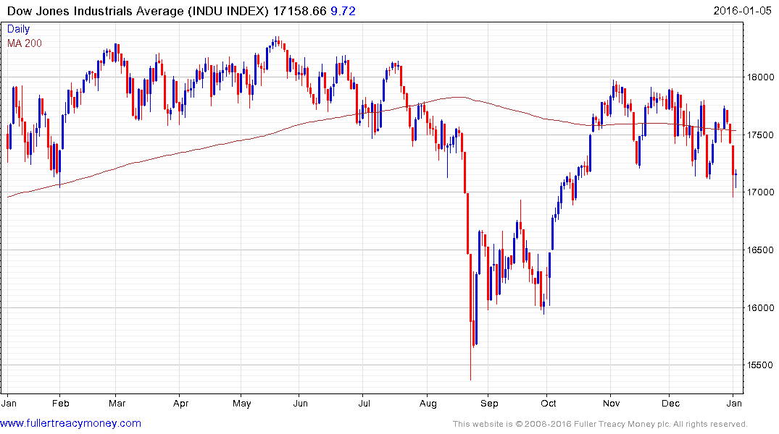
Market performance 2015
Major Equity Markets (local currency)
World equities 2015: a bumpy and unprofitable ride
Emerging markets: 2015 yet another horrible year
Europe better in 2015 (in depreciated EUR terms)
Dow recovered after summer falls, but unconvincingly

Slide 6
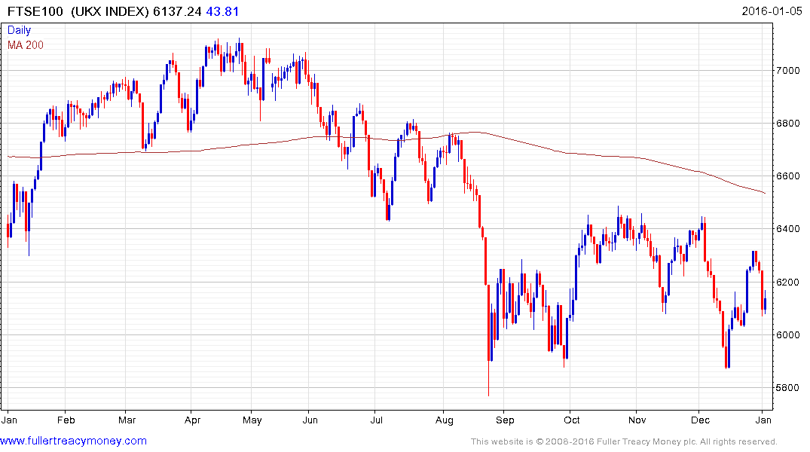
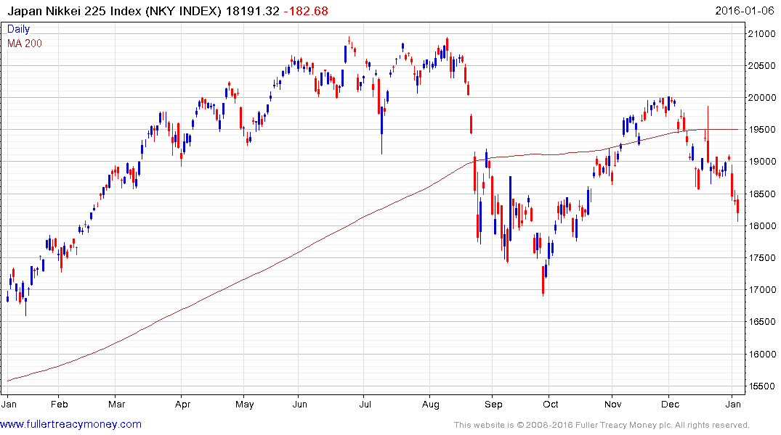
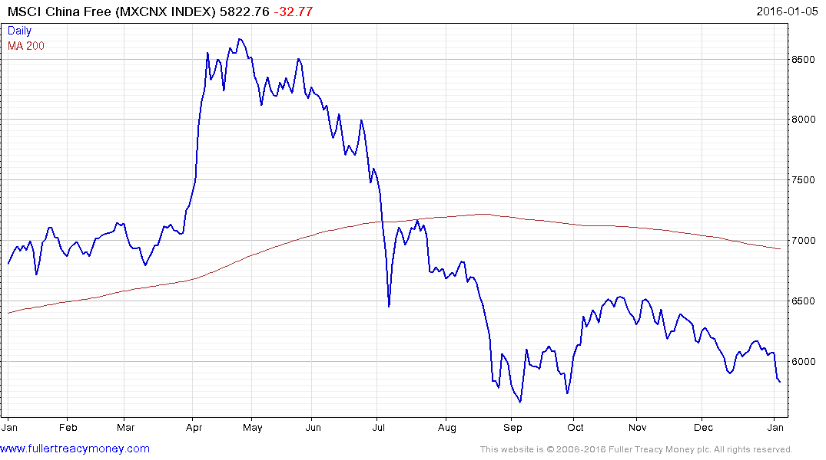
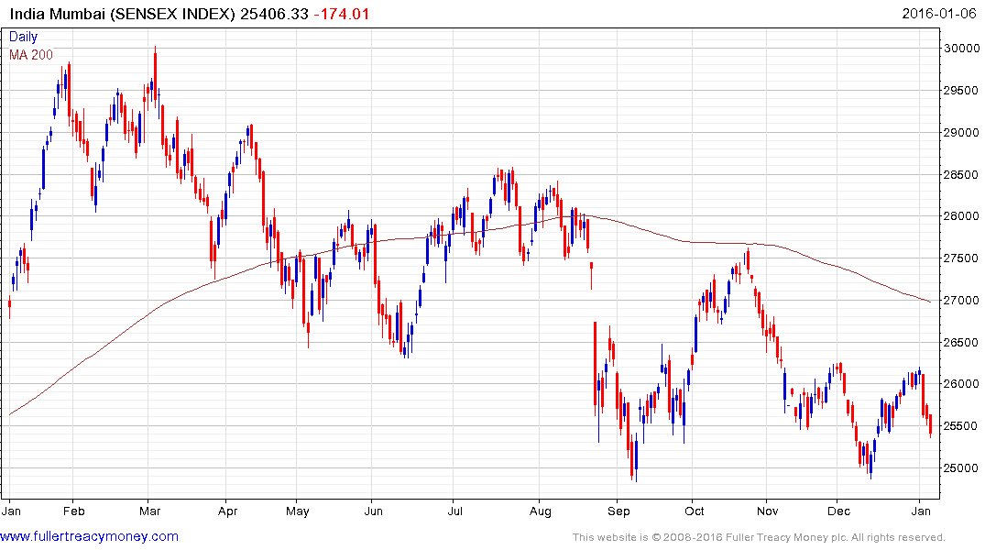
Market performance 2015
Other Equity Markets (local currency)
UK; 2015 another poor year, hit by weak resources and oil
Japan: a rare bright spot in 2015 with currency, fiscal and monetary stimulus
China slowdown as shifts from exports to domestic consumption
India, a recent leader, a fashion victim in 2015

Slide 7
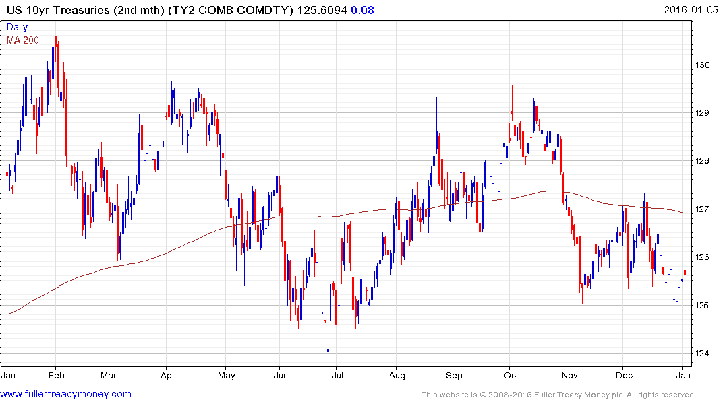
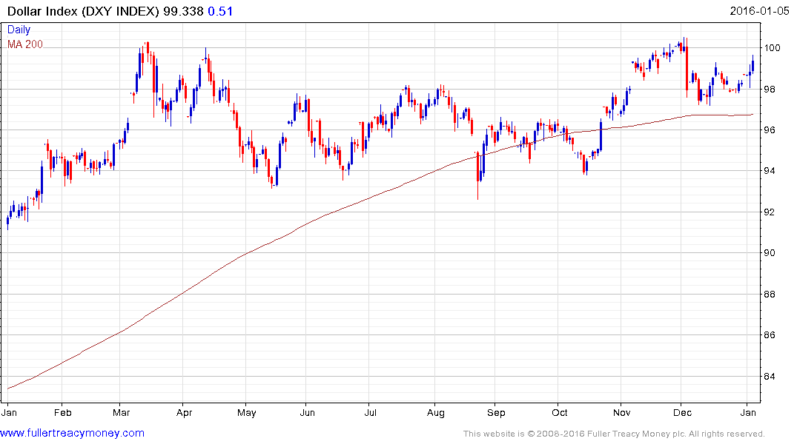
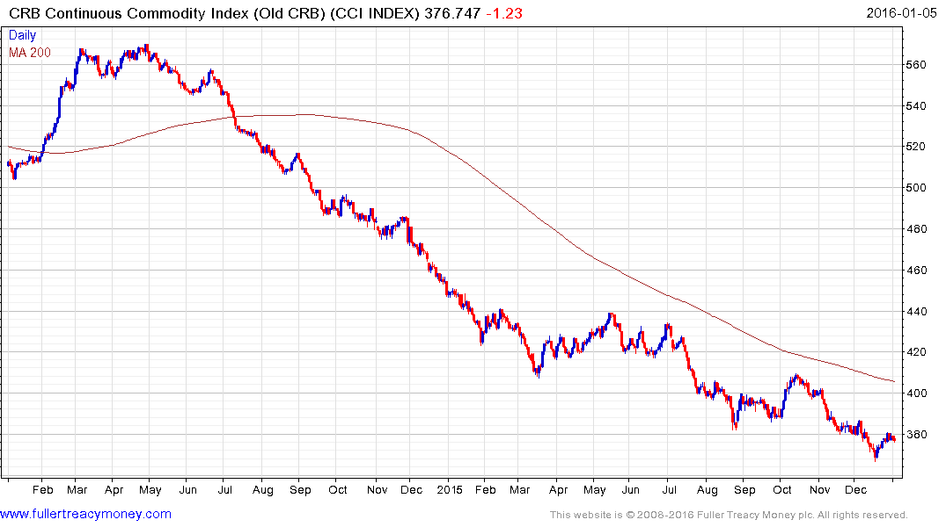
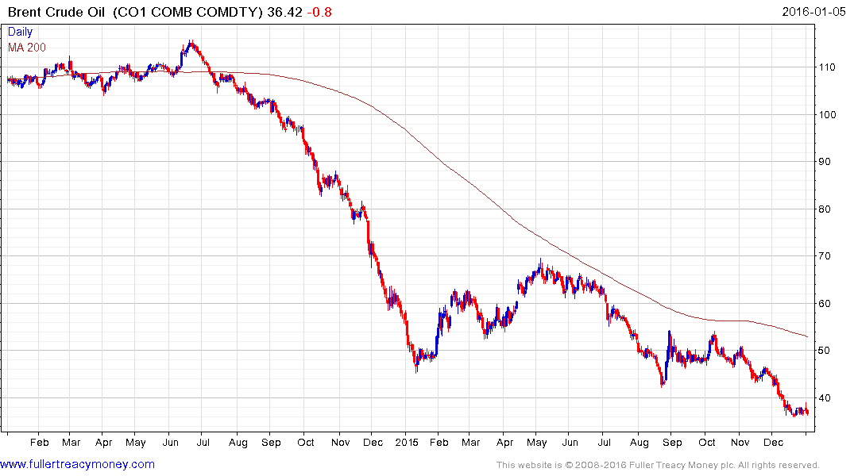
Market performance 2015
Bonds, currencies, oil, commodities (local currency)
10 yr US bonds spooked by FED rate rise went nowhere in 2015…
…As refugee currency USD strength pressured US corporate profits…
…and Big Oil continued its 2 year collapse…
…Mirrored by further falls in commodities generally

Slide 8
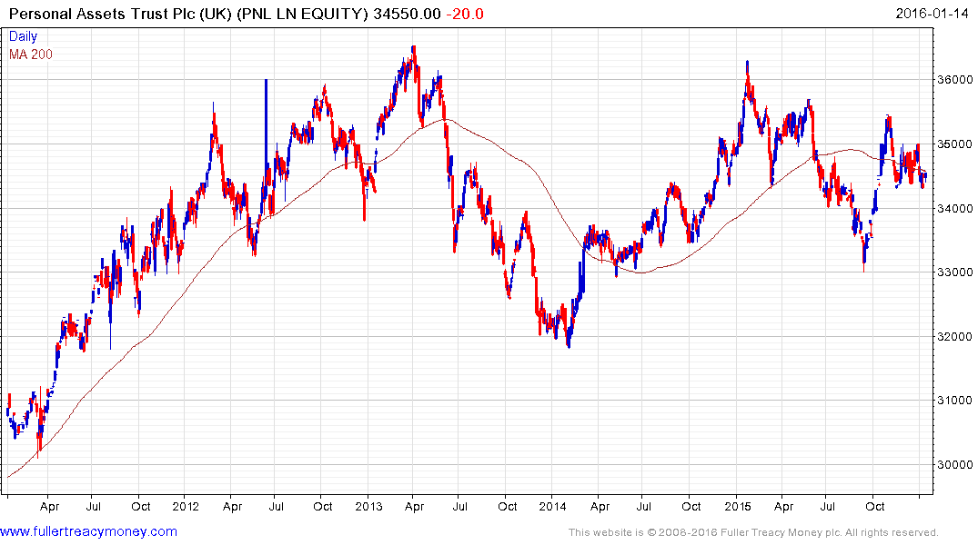
What I’m Buying Today (SATELLITE)
Personal Assets Trust (345.5p)

Slide 9
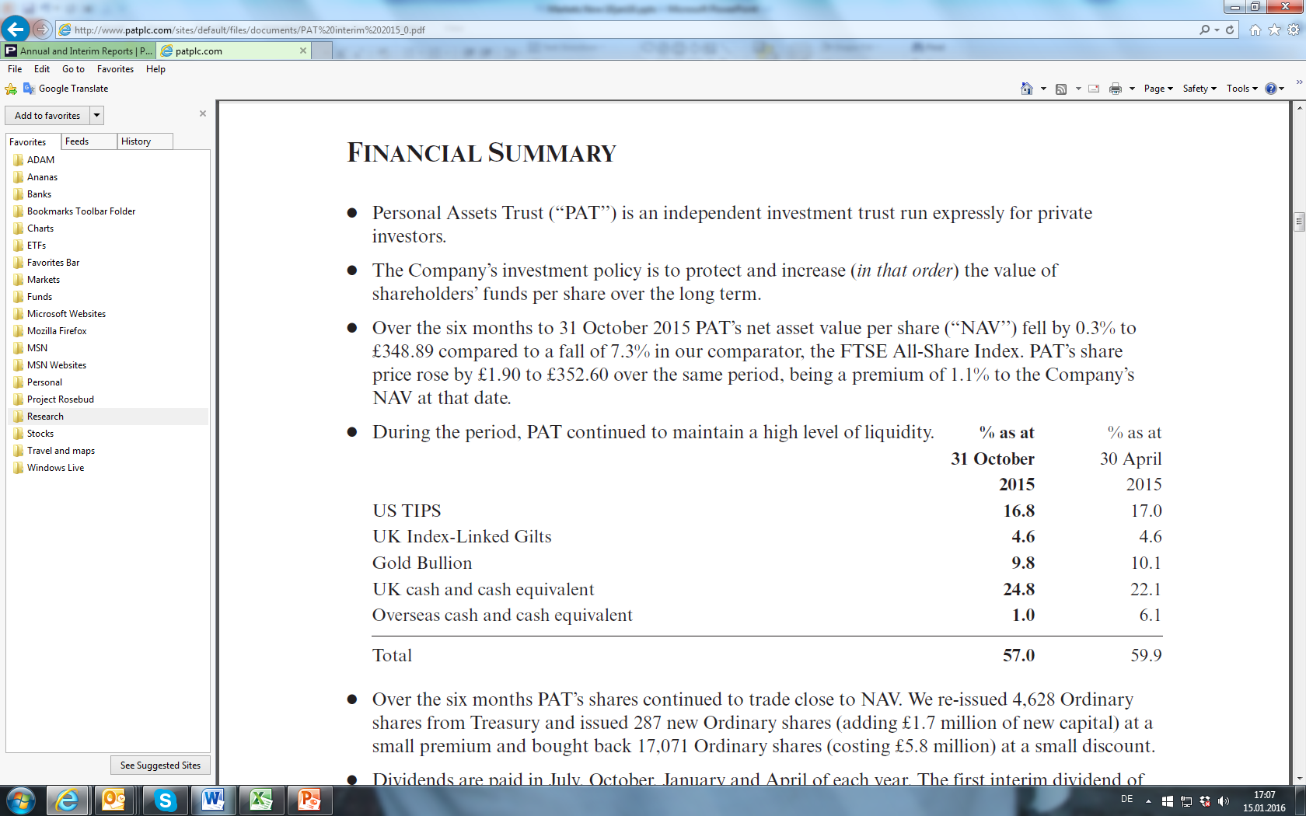
What I’m Buying Today (SATELLITE)
Personal Assets Trust (345.5p)
Source: PAT Interim Report 31st October 2015

Slide 10
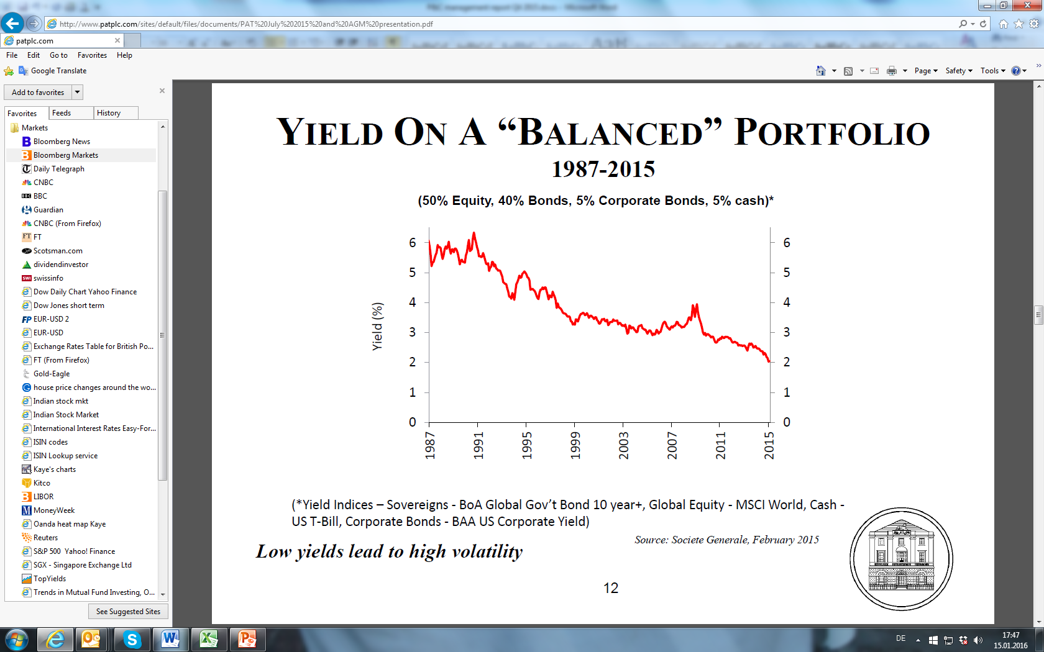
What I’m Buying Today (SATELLITE)
Personal Assets Trust (345.5p)
Private client problem in a nutshell
Source: PAT AGM 24th July 2015

Slide 11
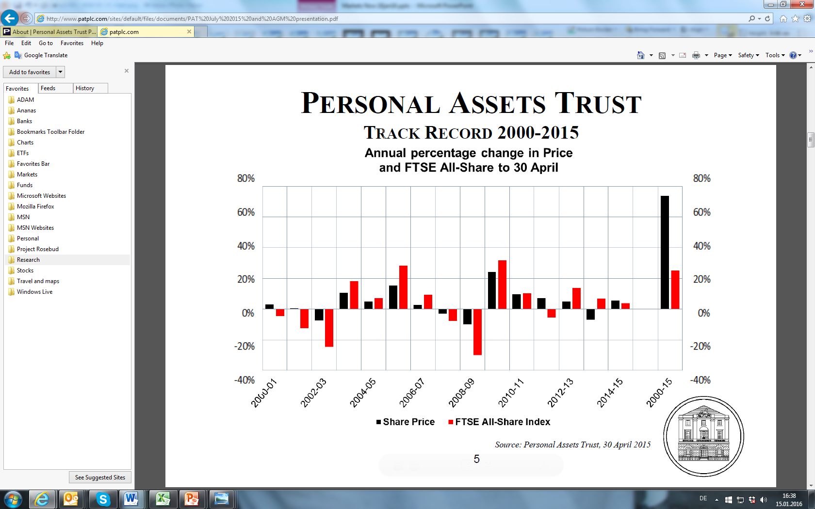


What I’m Buying Today (SATELLITE)
Personal Assets Trust (345.5p)
Tough to beat in tough times

Slide 12
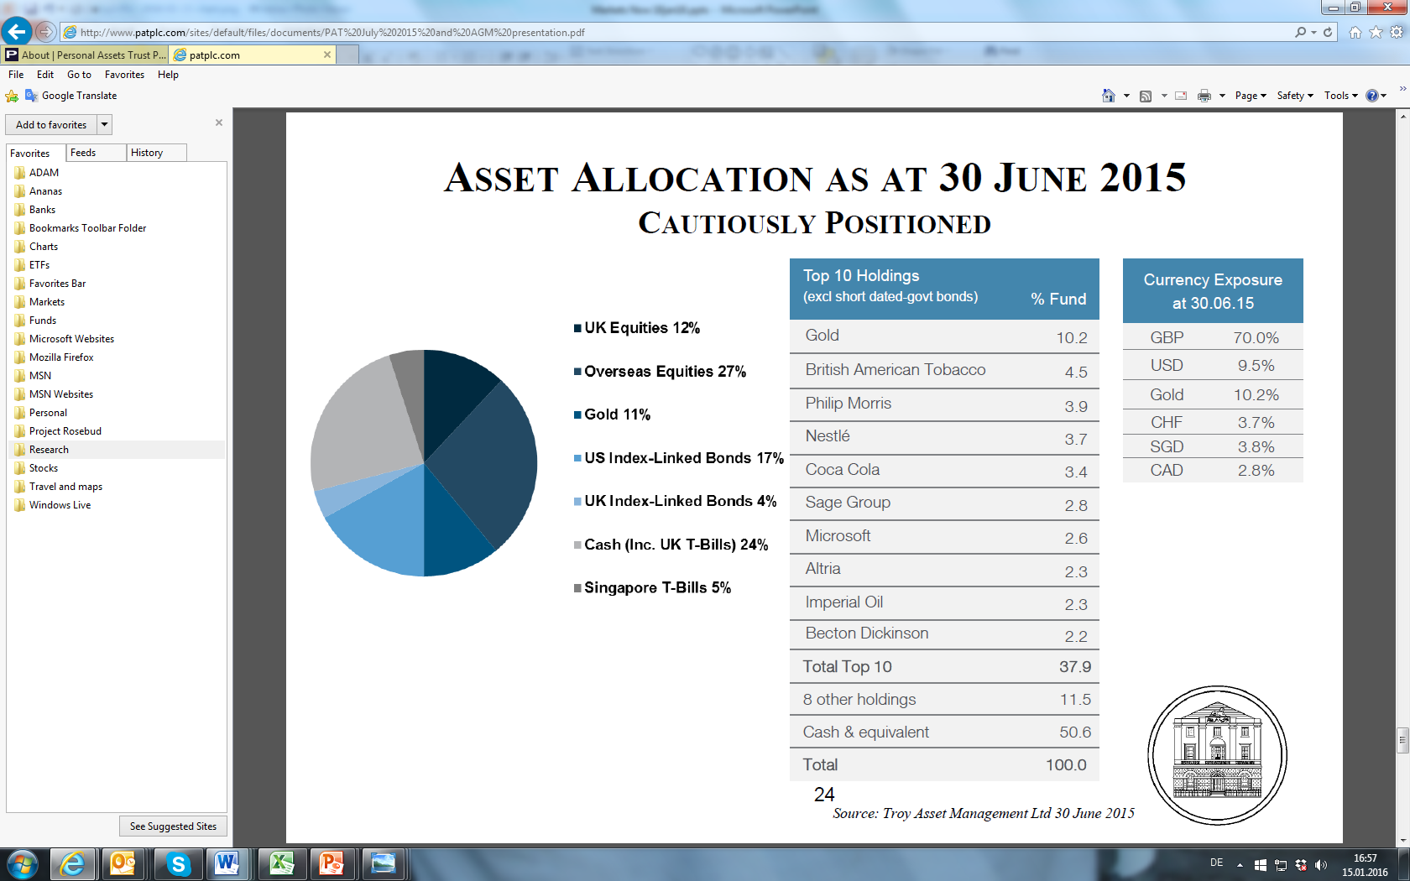
What I’m Buying Today (SATELLITE)
Personal Assets Trust (345.5p)
25% of 27% = USA

Slide 13
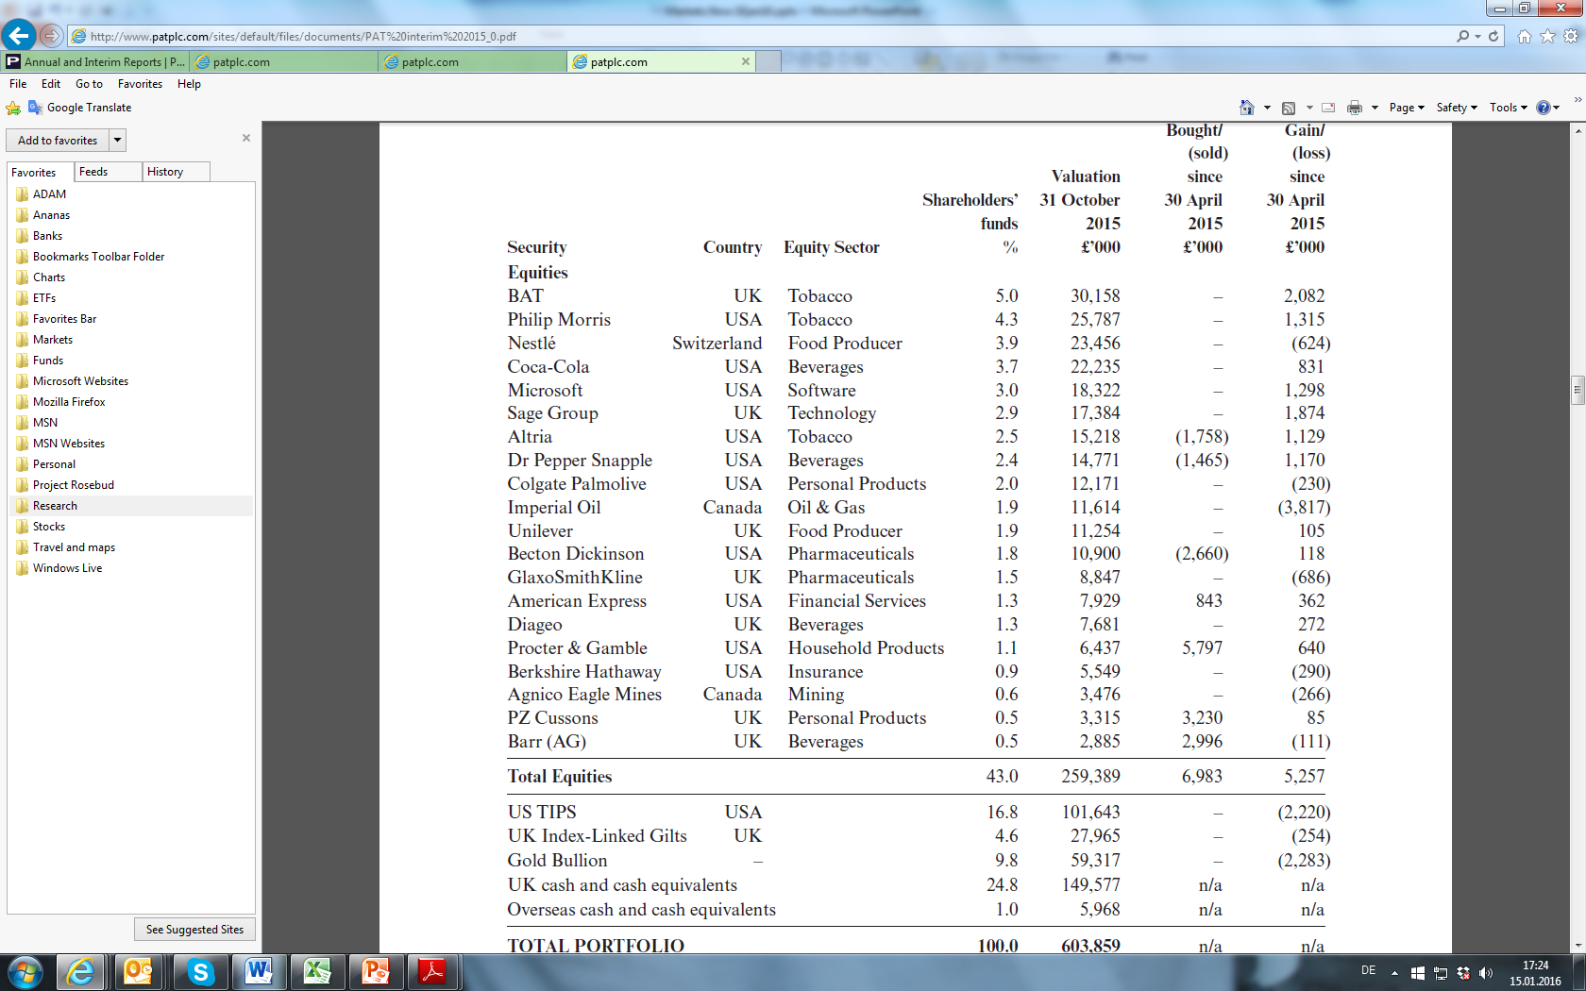
What I’m Buying Today (SATELLITE)
Personal Assets Trust (345.5p)
Defensive

Slide 14
What I’m Buying Today (CORE)
Personal Assets Trust (345.5p)
-1% discount to NAV, GBP 590mn Mkt Cap
PAT went 100% to cash in 2007 (!)
1.8% yield estimated, gearing nil (25% cash)
Objectives: (1) protect (2) increase capital
Real World Bogey: cash/inflation
Mgr Troy AM (Sebastian Lyon), fees c0.6% (TER 0.9% inc custody, audit, directors etc)
20 names, concentrated, defensive sectors

Slide 15
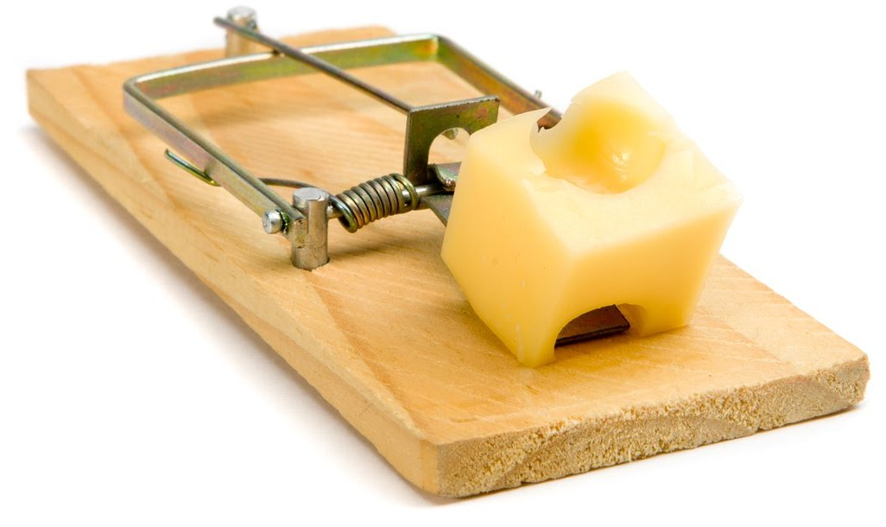
What’s Interesting Today
Miners: Where Are We in The Cycle?
The Gold Trap and «BS»

Slide 16
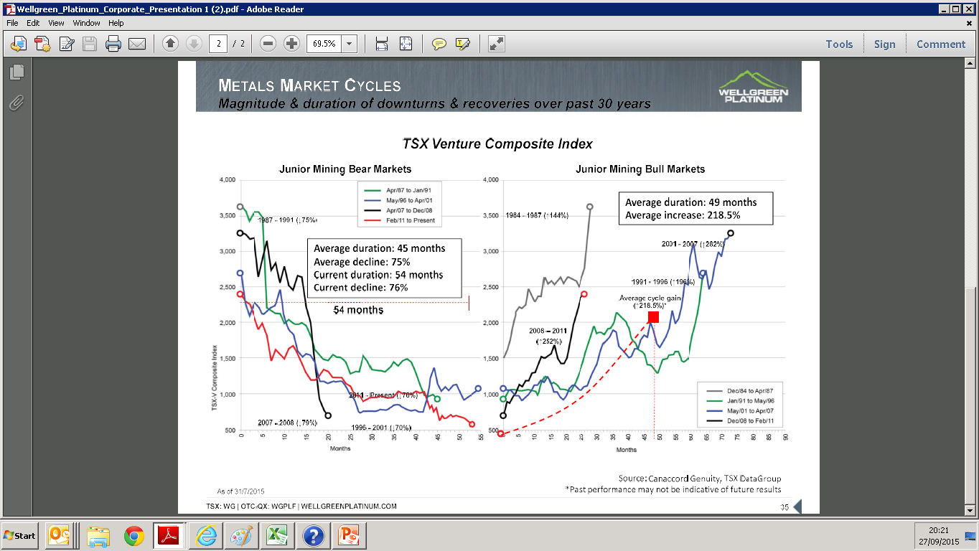
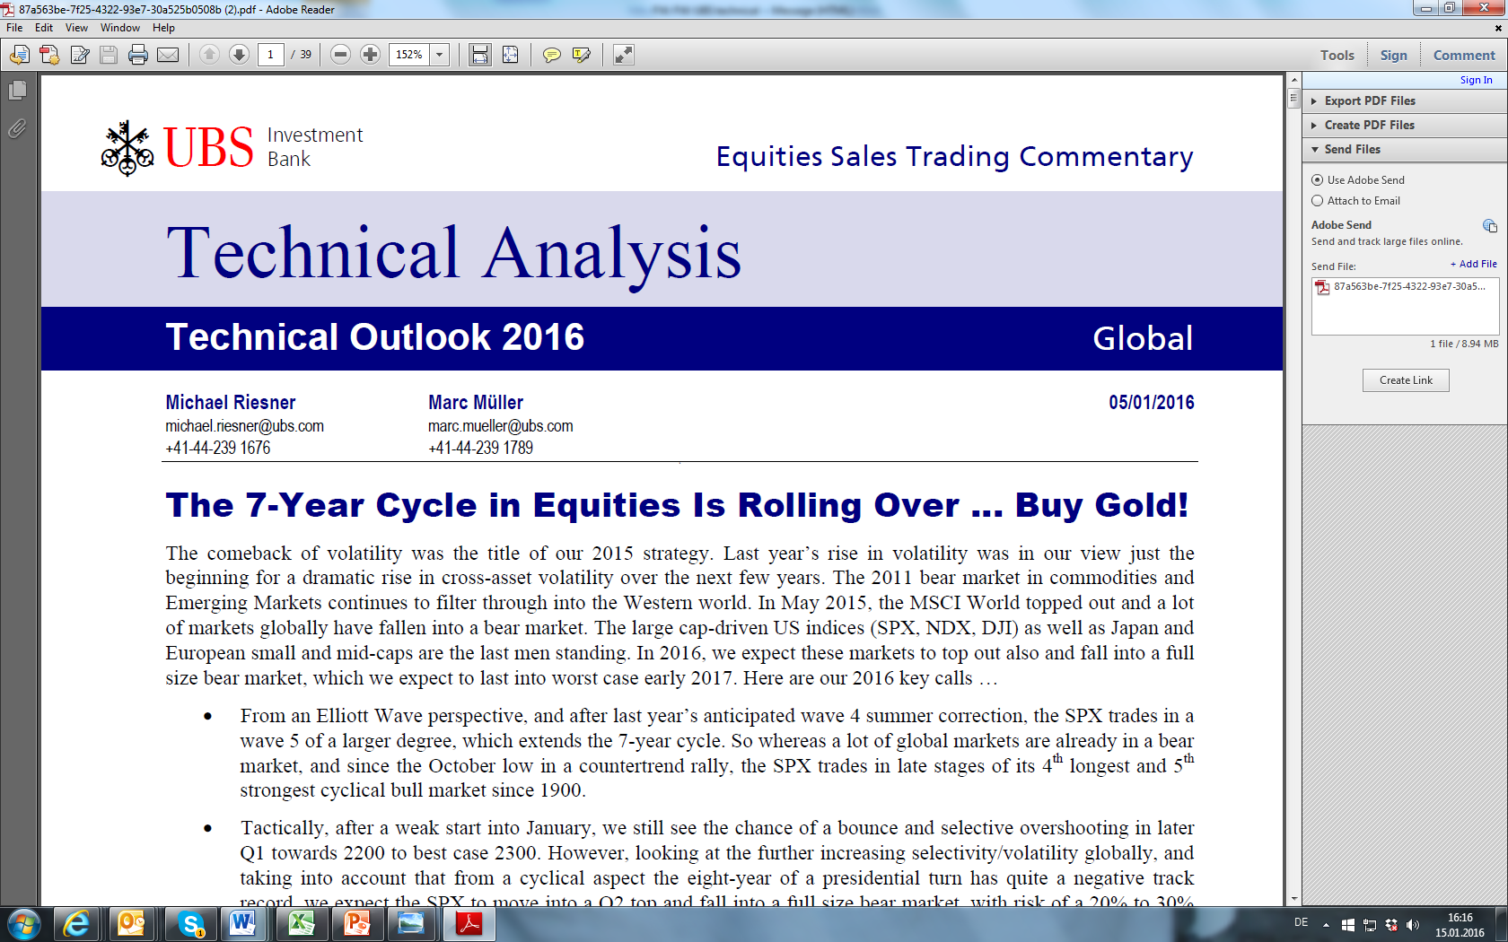
What’s Interesting Today
Miners: Where Are We in The Cycle?

Slide 17
What’s Interesting Today
Miners: Where Are We in The Cycle?
Current junior mining bear almost longest ever
96/2001 bear down 70%, lasted 59 mths
2011 bear down now 76%, lasted 55 mths
If 59 mths this takes us to January 2016
Average increase +218% after end bear market
Likely within 4 mths of start major move up
Time to add exposure GDXJ and junior mines?
«Source: «Markets Now» November 2015»

Slide 18
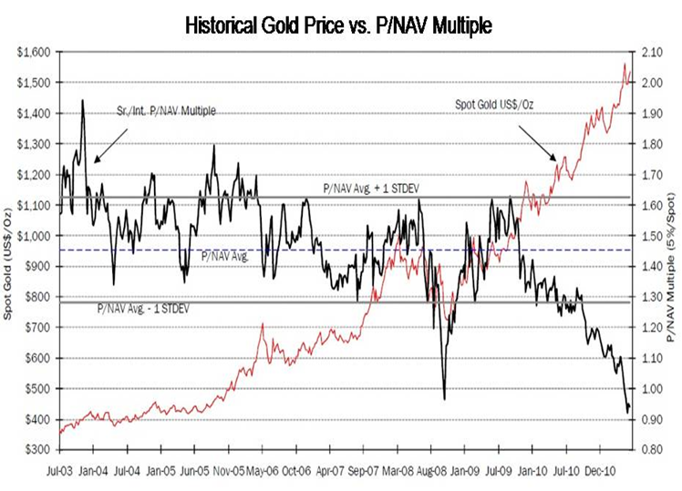
What’s Interesting Today
Miners: Where Are We in The Cycle?
Q3 2011, shares CHEAP by Value

Slide 19
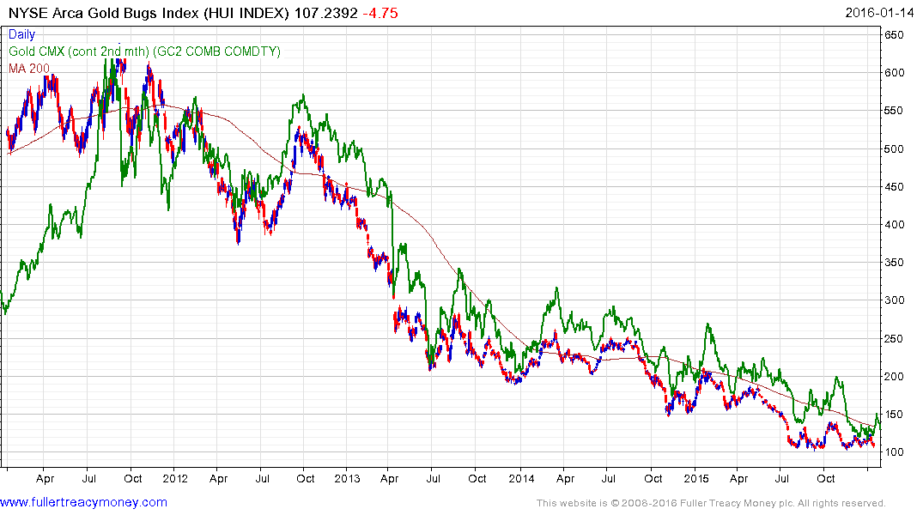
What’s Interesting Today
Miners: Where Are We in The Cycle?
After historic valuation lows in late 2011, you then lost 80% of your money in gold shares!
BUY??!!

Slide 20
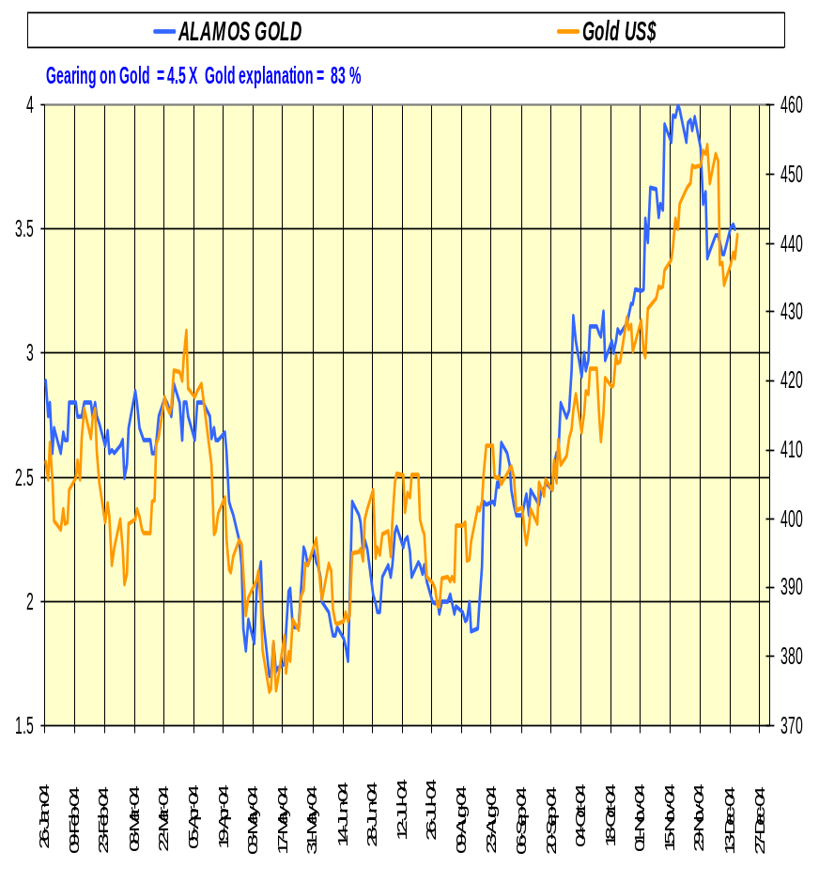
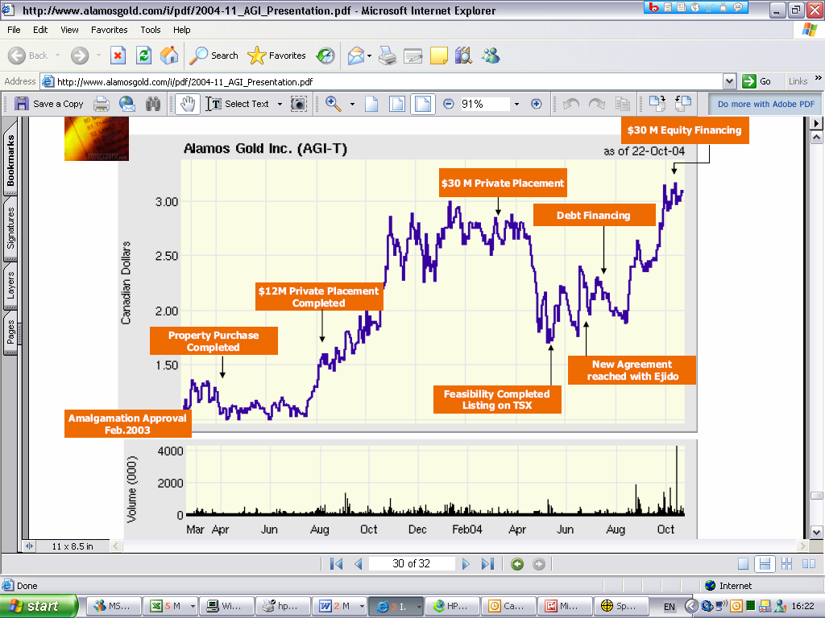
What’s Interesting Today
Miners: Where Are We in The Cycle?
Don’t fall for BS (Broker Stories)

Slide 21
What’s Interesting Today
Miners: Where Are We in The Cycle?
Only ONE thing mattered. The gold price. Not
        Earnings forecasts, analysts opinions
        Technology/ techniques
        New discoveries
        Depreciation policies
        Management changes
        Royalty and tax regimes
        Takeovers
        Rumours and chit chat
        Political factors

Slide 22
Important Notice
This document has been issued in a private capacity by Iain Little, an employee of European Wealth (Switzerland) SA, a member of the European Wealth Group Limited, for the information of experienced investors only. It is not and should not be construed as an offer to sell or the solicitation of an offer to purchase or subscribe for any investment.
Iain Little, an employee of European Wealth (Switzerland) SA, has based this document on information obtained from sources he believes to be reliable but which he has not independently verified; European Wealth (Switzerland) SA therefore makes no guarantee, representation or warranty and accepts no responsibility or liability as to its accuracy or completeness.

