Slide 1
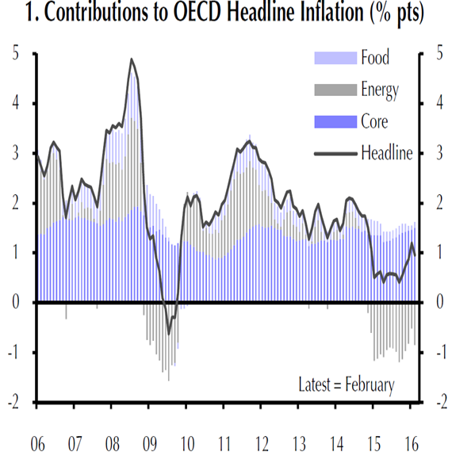
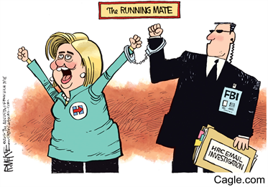
Trusts In Focus Up Date
Gold: In The Foothills of Recovery
What I’m Buying Today
MARKETS NOW 25th APRIL 2016
David Fuller, Charles Elliott, Iain Little

Slide 2



What is “Markets Now”?
A Lively Forum for Sharing Investment Ideas
Big Picture Strategy (DF, BA)
“Private client”high quality, long term ideas (IL)
Our promise:
  INDEPENDENT, GLOBAL INVESTMENT ADVICE
  NO SALES, NO HYPE, NO MARKETING
  NO PRODUCT PUSHING
Please contribute with:
  QUESTIONS
  CONCERNS
  IDEAS

Slide 3
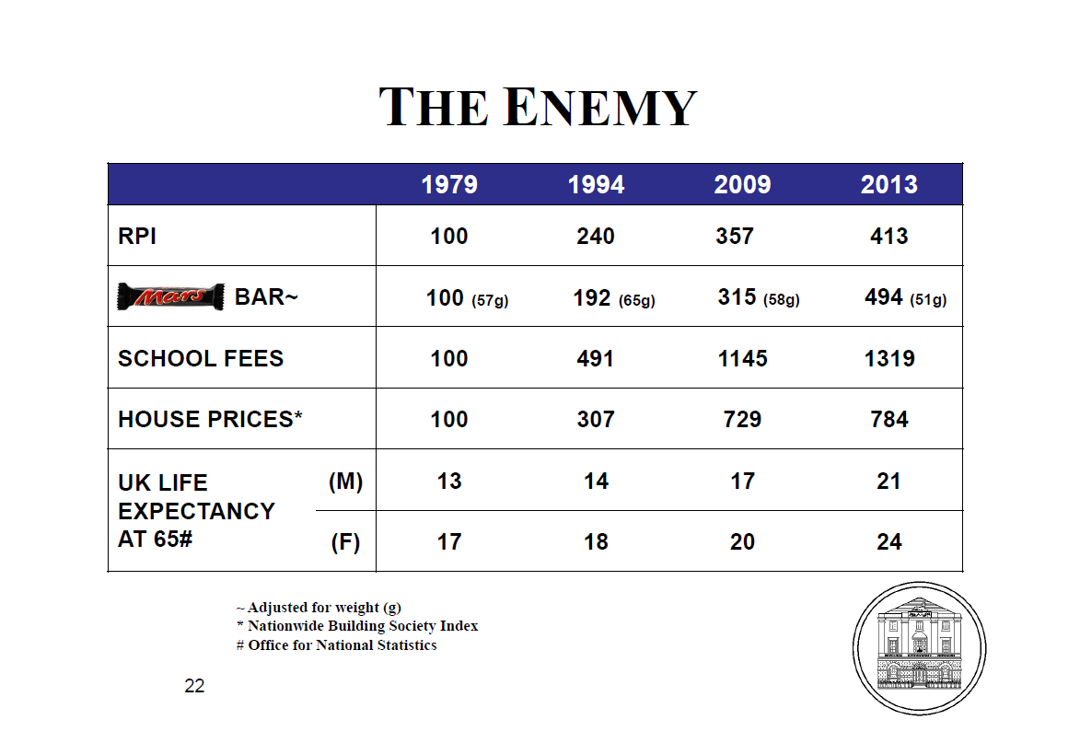
What Is The Biggest Risk for Private Investors?
Don’t believe a word of it! Your number is 1000+
That’s inflation too
Tell me about it!
21+24=45
45 x £50,000 pa = £2.25mn
50% healthcare costs last 2 yrs of life

Slide 4
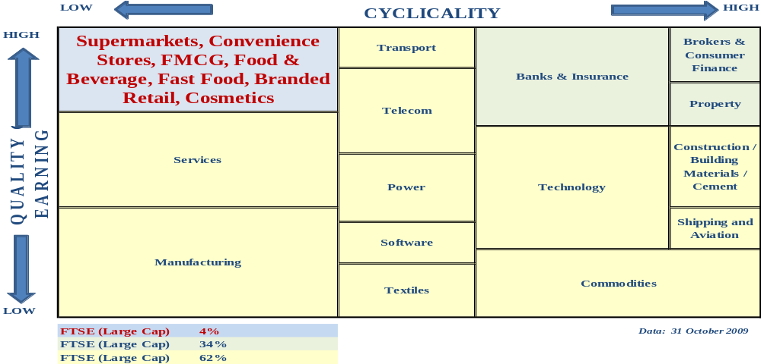
What Is The Perfect Investment (Equities)?
Source: Arisaig Partners
Quality Private Client investments mainly found Top Left Hand Corner: simple businesses, high cash flow, investor friendly

Slide 5
What Is The Perfect Investment (Funds)?
    Long-term (does better than…..)
    Leverage, but only if needed
    Discounts to real asset value («Leverage at a discount»)
    Governance: proper auditing, proper board, transparency
    Know-How proven over 100+ years
    Liquid, but… (real time trading on SE)
    Low management costs (1/4 to 1/2 the cost of rivals)
    New money non-dilutive (if successful /at discount)
    Global but can be specialist?
    Daily valuations, daily reporting
    Yield. Growing dividend stream payable out of «Reserves»
    Elected management, retail participation, proper AGMs
    Information inefficiencies. Hated by brokers

Slide 6
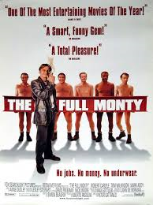
Trusts In Focus (TIF) SERVICE
Universe c300 closed end (mainly UK) investment trusts monitored
Up to 15 equally-weighted trusts held in Trusts In Focus (TIF)
If we sell an investment trust, we must replace it
Changes to trusts recorded (1.25% trading costs B/S)
Research available to «Markets Now» attendees
    3rd party adviser research referenced
    FullerTreacy Money one of 20+ 3rd party advisers
    In-House Cooking/ P&C research
Performance review / indecent striptease every «Markets Now»

Slide 7
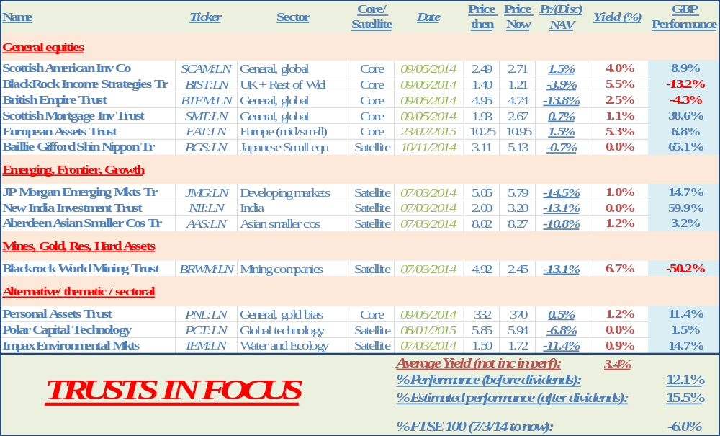
How Are We Doing: Trusts In Focus?
Performance So Far (since 7/3/14)

Slide 8
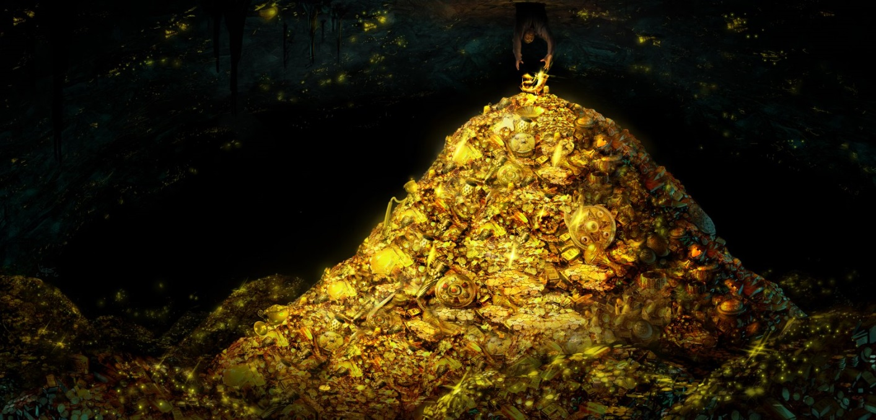
What’s Interesting Today
Gold & Miners: Where Are We in The Cycle?
GOLD
In The Foothills of Recovery

Slide 9
What’s Interesting Today (Sorry, last time!)
Gold & Miners: Where Are We in The Cycle?
Current junior mining bear almost longest ever
96/2001 bear down 70%, lasted 59 mths
2011 bear down now 76%, lasted 55 mths
If 59 mths this takes us to January 2016
Average increase +218% after end bear market
Likely within 4 mths of start major move up
Time to add exposure GDXJ and junior mines?
«Source: «Markets Now» November 2015»

Slide 10
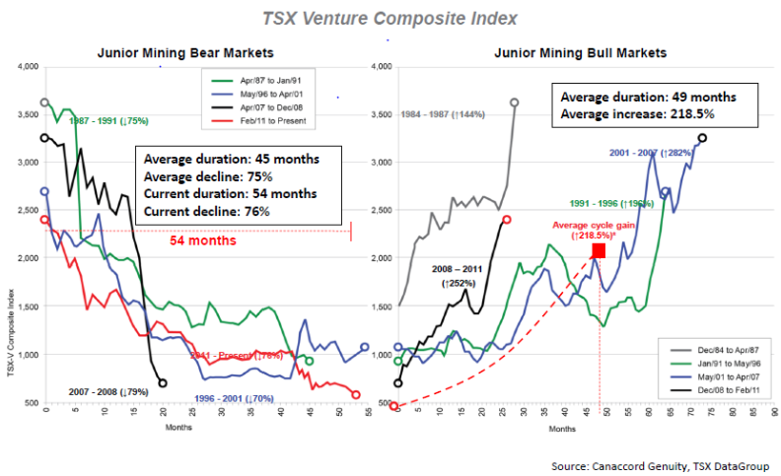
What’s Interesting Today (Sorry, last time!)
Gold & Miners: Where Are We in The Cycle?

Slide 11
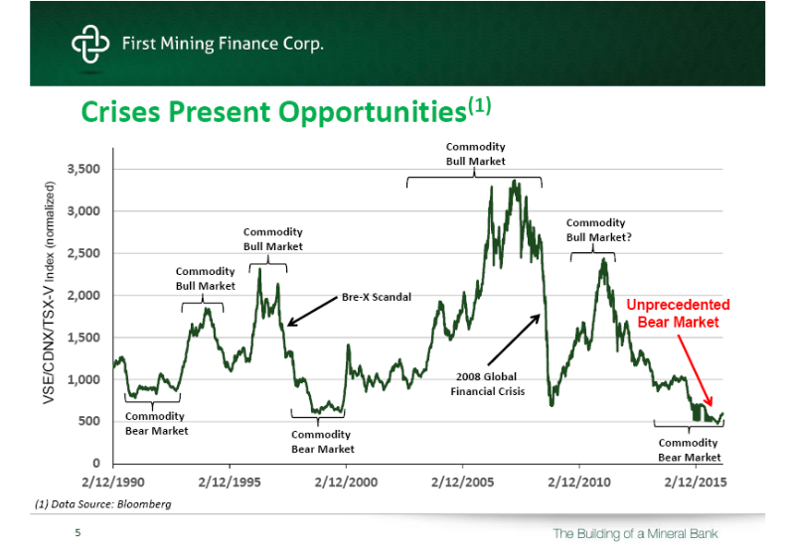
What’s Interesting Today (25 year view)
Gold & Miners: Where Are We in The Cycle?

Slide 12
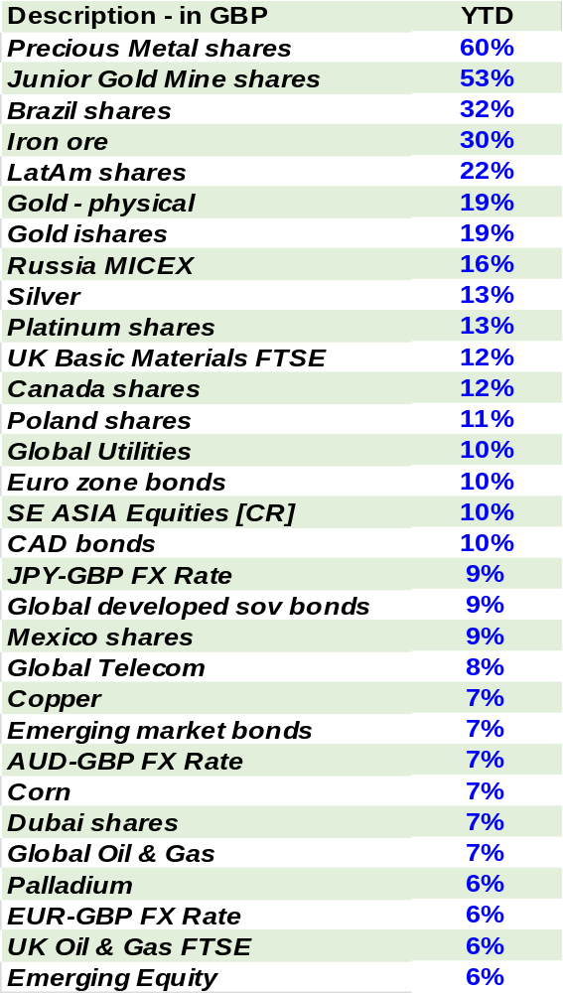
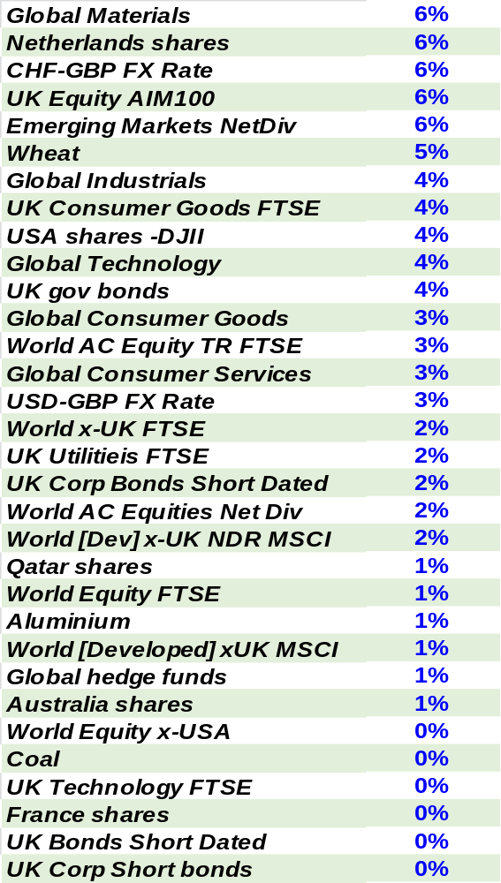
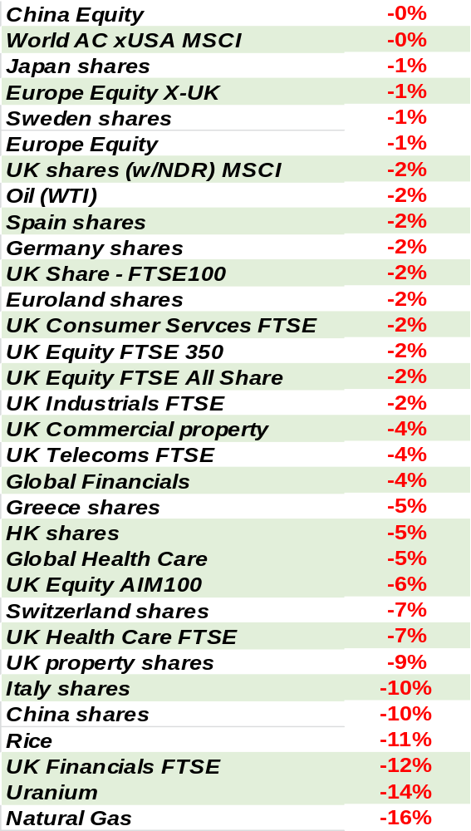

What’s Interesting Today (after Q1 2016)
Gold & Miners: Where Are We in The Cycle?

Slide 13
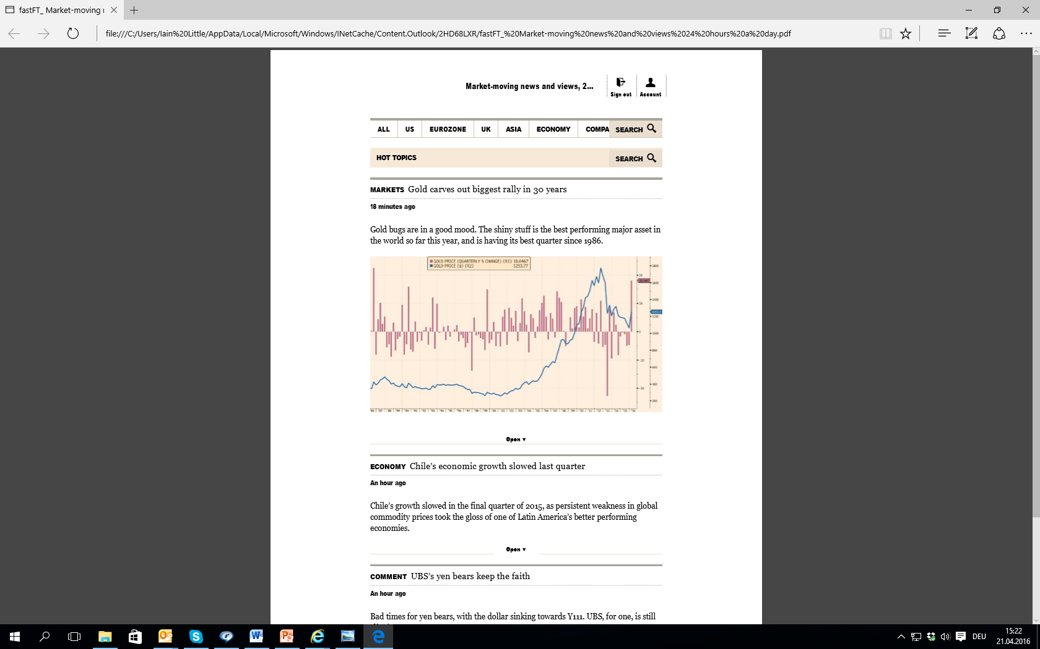
What’s Interesting Today (after Q1 2016)
Gold & Miners: Where Are We in The Cycle?
10 year bull 2000 to 2011 shows how short this cycle is so far

Slide 14
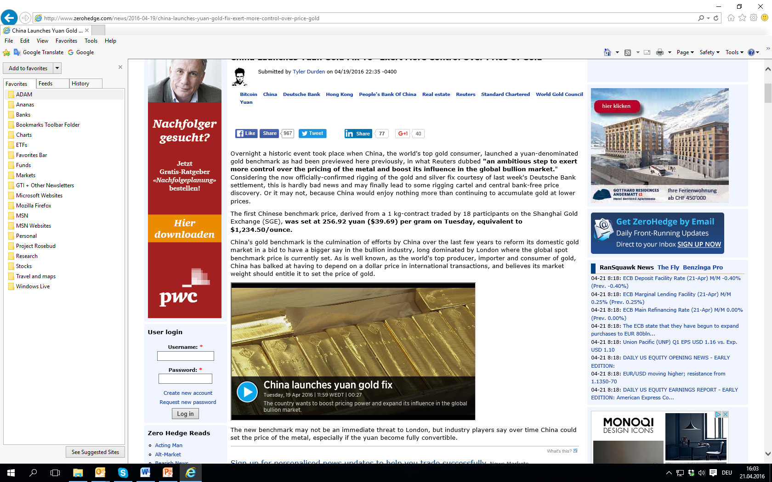
What’s Interesting Today
Gold & Miners: Where Are We in The Cycle?
China plays power game in gold

Slide 15
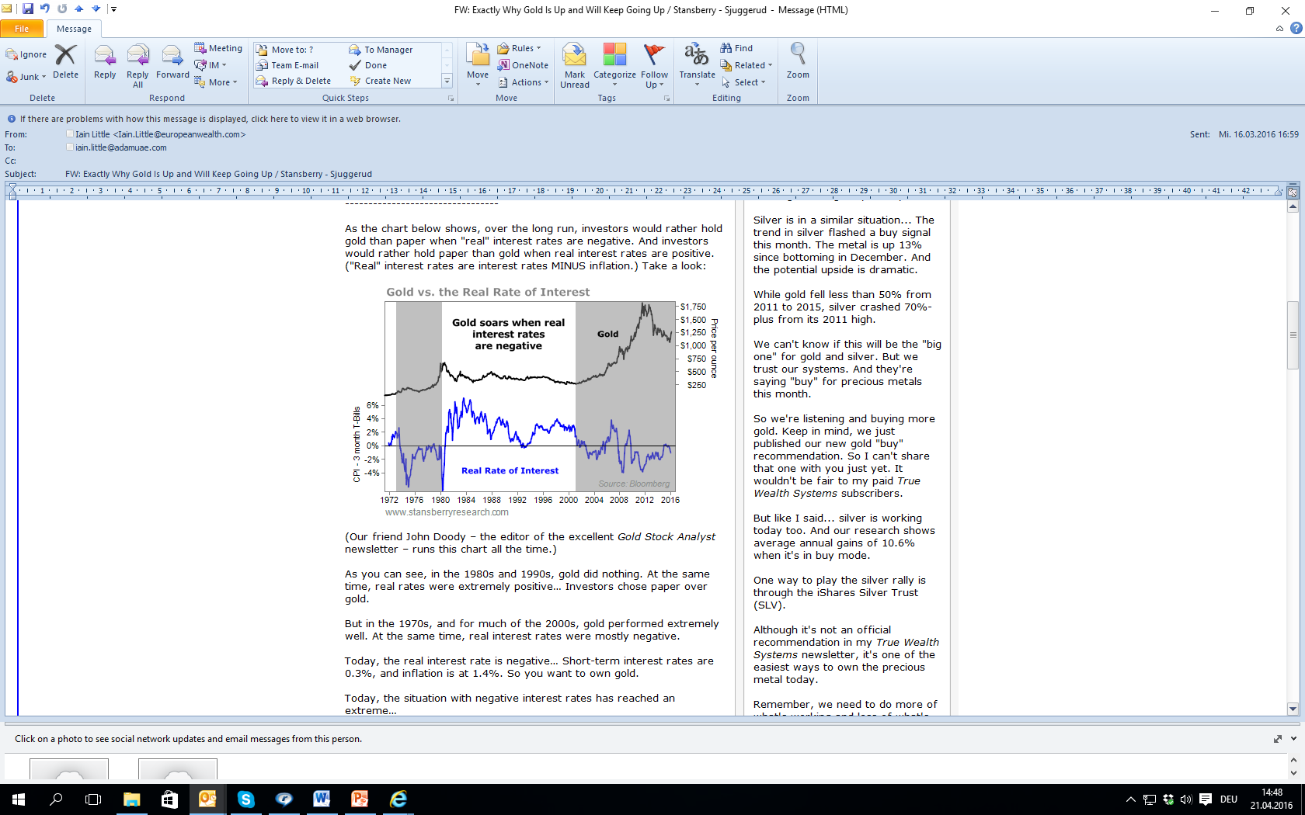
What’s Interesting Today
Gold & Miners: Where Are We in The Cycle?
Why did we have bear mkt last 4 years?

Slide 16
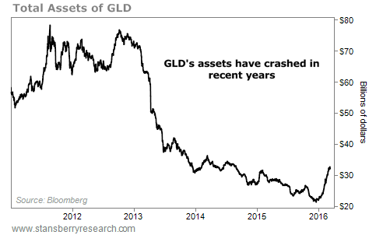
What’s Interesting Today
Gold & Miners: Where Are We in The Cycle?

Slide 17
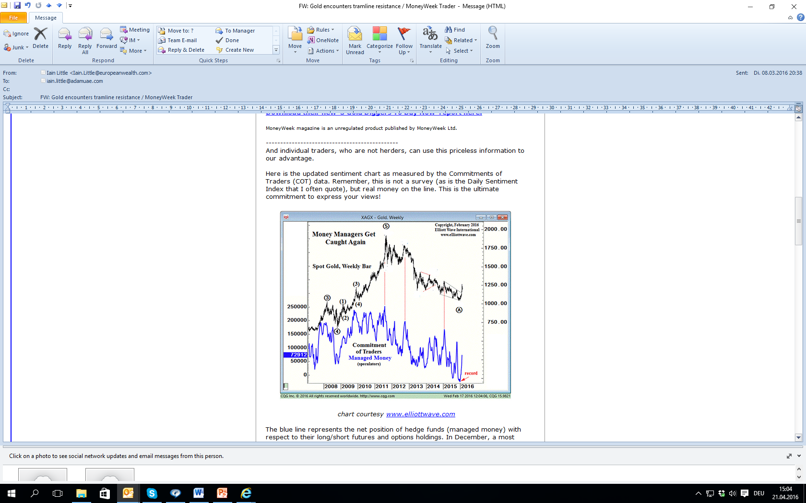
What’s Interesting Today
Gold & Miners: Where Are We in The Cycle?

Slide 18
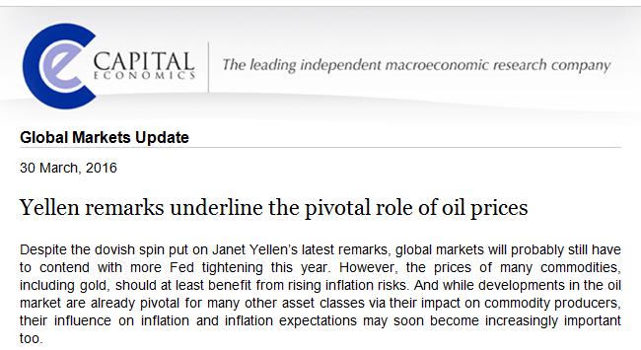
What’s Interesting Today
Gold & Miners: Where Are We in The Cycle?
Roger Bootle’s boys mention the “I” word

Slide 19
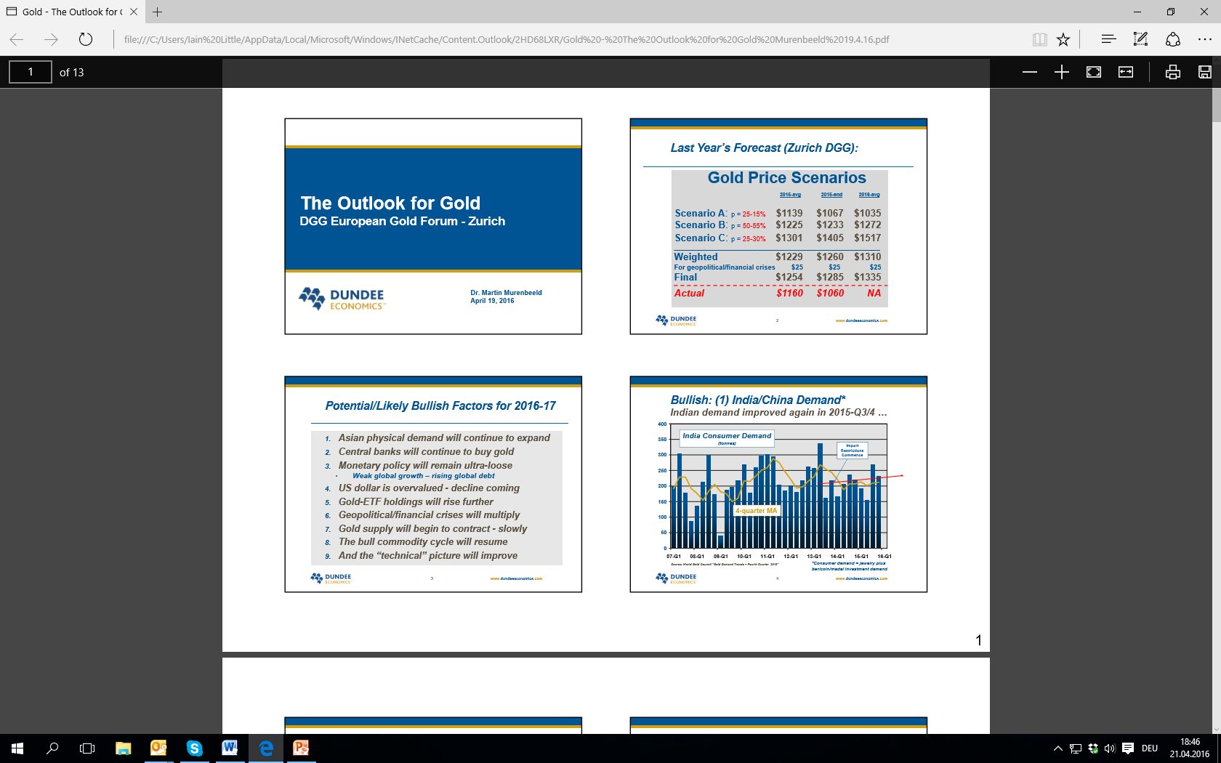
What’s Interesting Today
Gold & Miners: Where Are We in The Cycle?
Murenbeeld’s Bulls

Slide 20
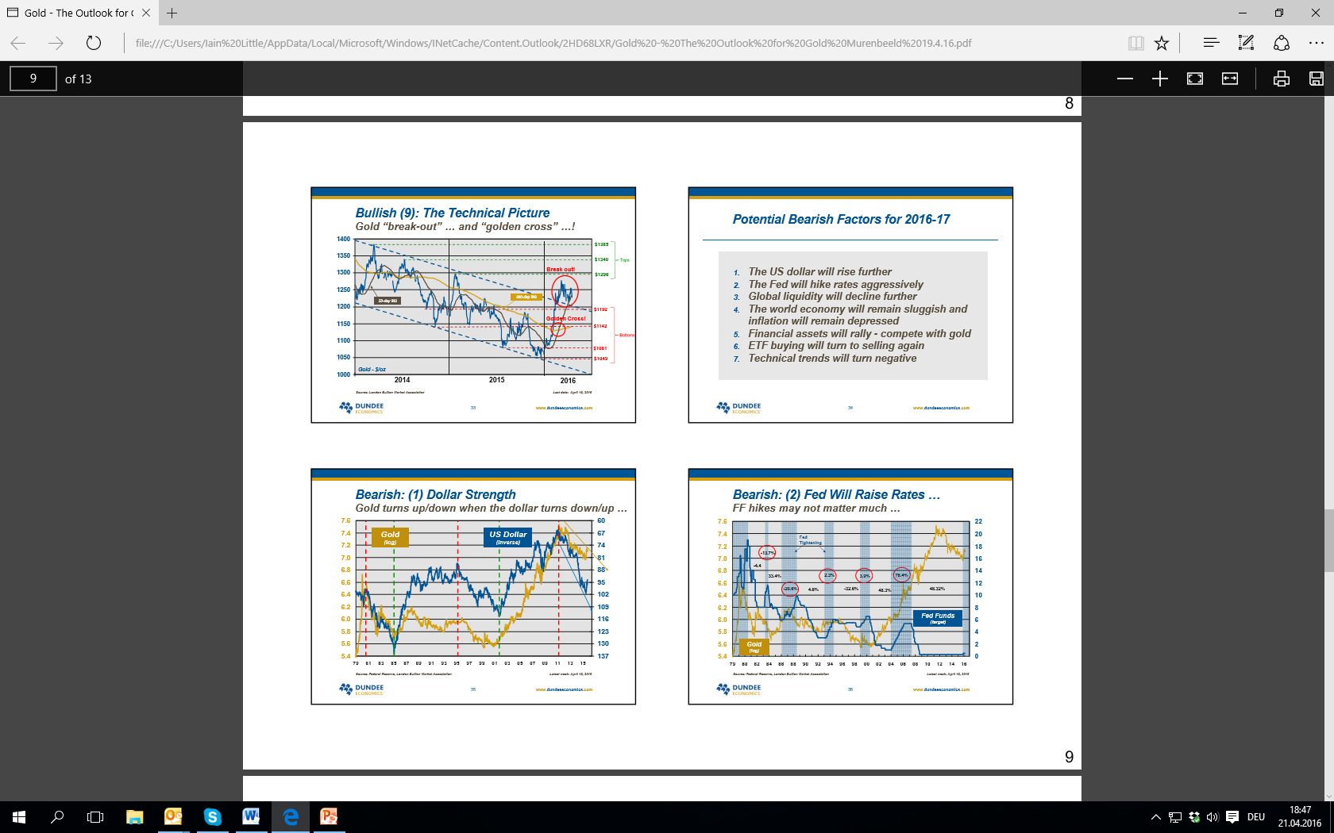
What’s Interesting Today
Gold & Miners: Where Are We in The Cycle?
Murenbeeld’s Bears

Slide 21
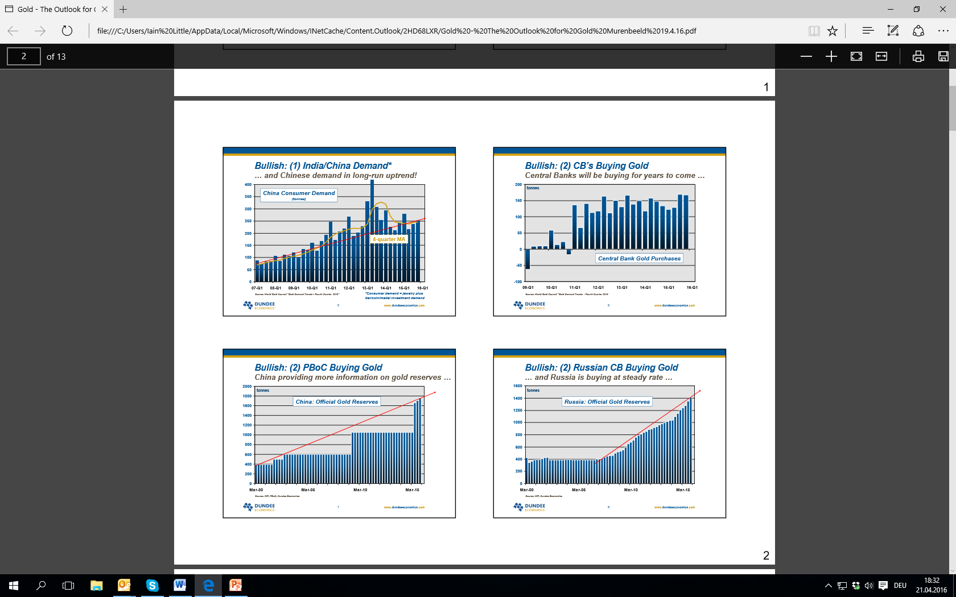
What’s Interesting Today
Gold & Miners: Where Are We in The Cycle?
Russia pact with China?

Slide 22
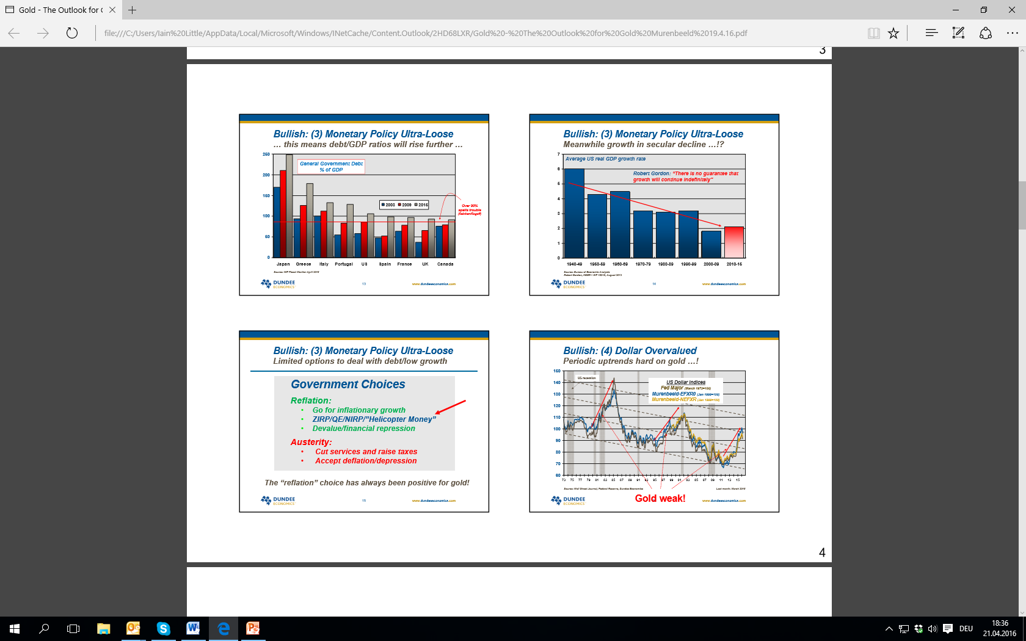
What’s Interesting Today
Gold & Miners: Where Are We in The Cycle?
Weak USD, rock bottom interest rates

Slide 23
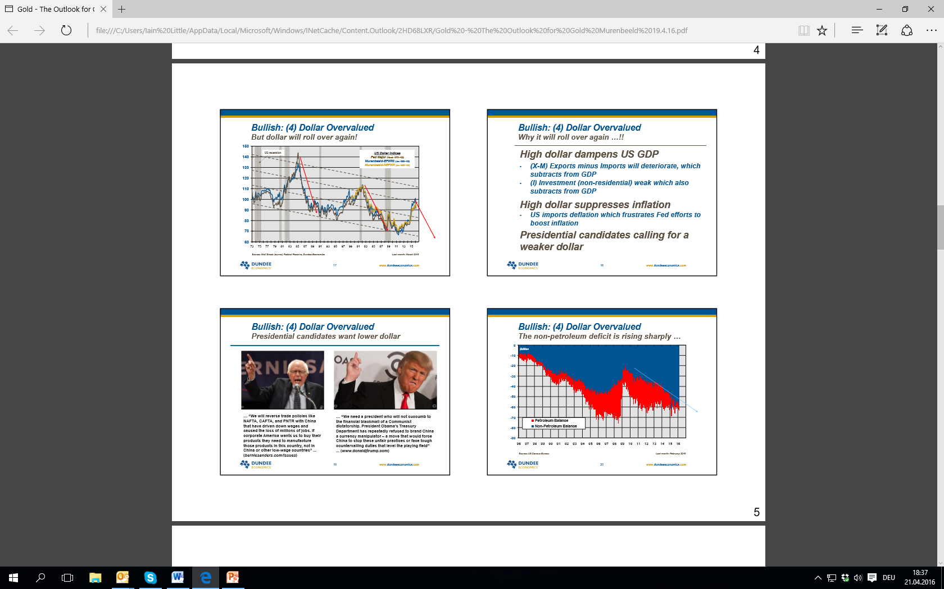
What’s Interesting Today
Gold & Miners: Where Are We in The Cycle?
Sanders and Trump bearish for USD?

Slide 24
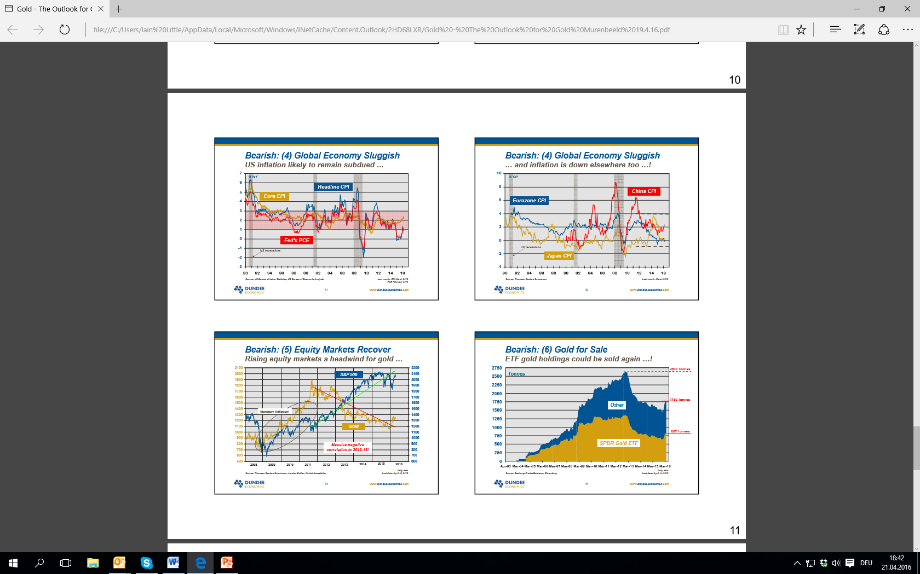
What’s Interesting Today
Gold & Miners: Where Are We in The Cycle?
Gold ETFs key factor; investment demand the rogue trader

Slide 25
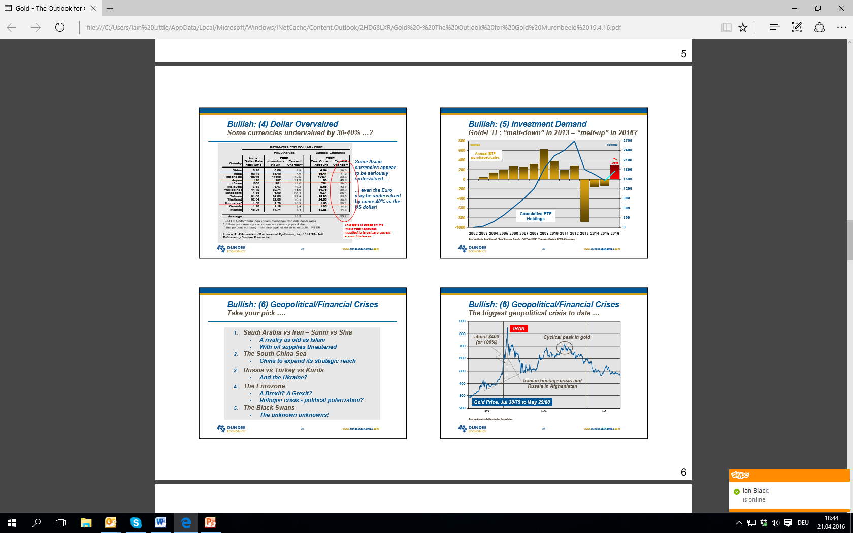
What’s Interesting Today
Gold & Miners: Where Are We in The Cycle?
Gold ETF vol easy to follow

Slide 26
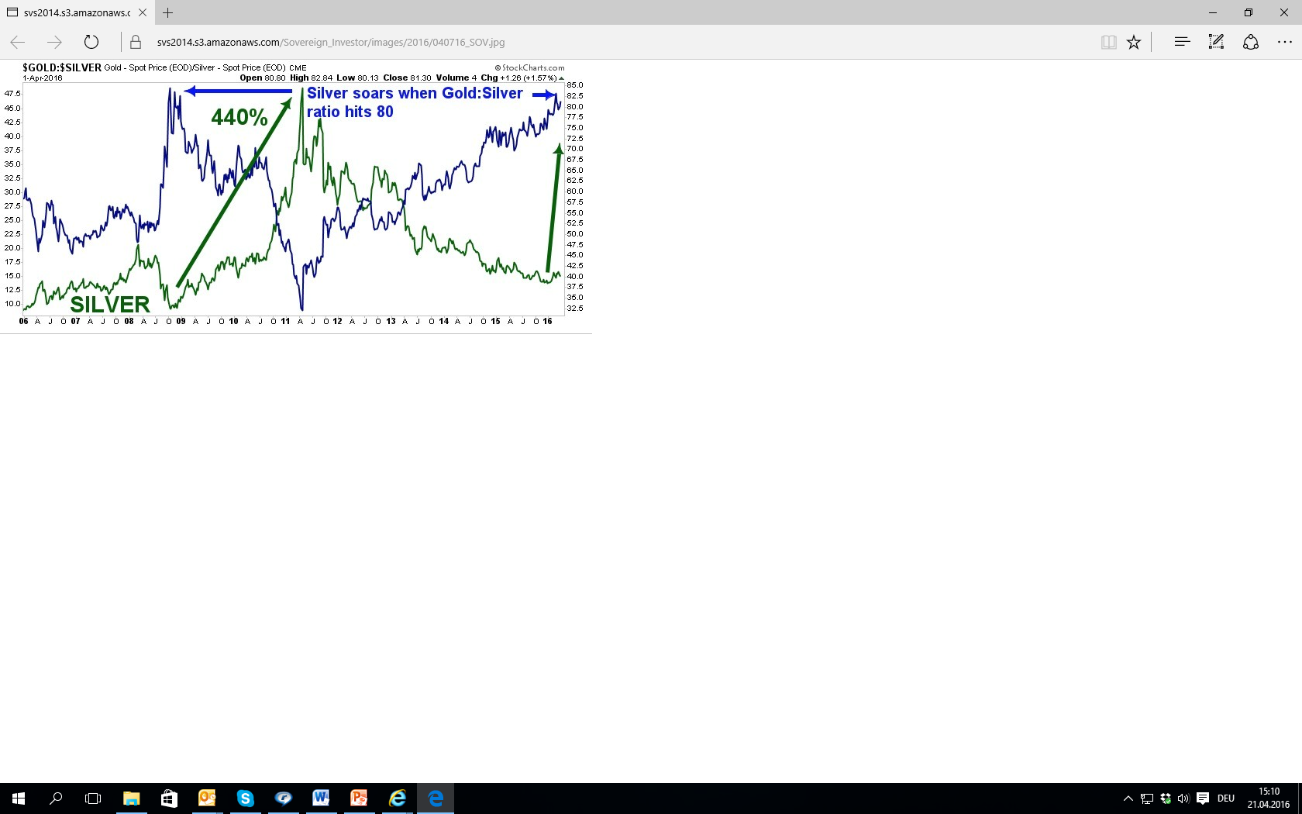
What’s Interesting Today
Gold & Miners: Where Are We in The Cycle?

Slide 27
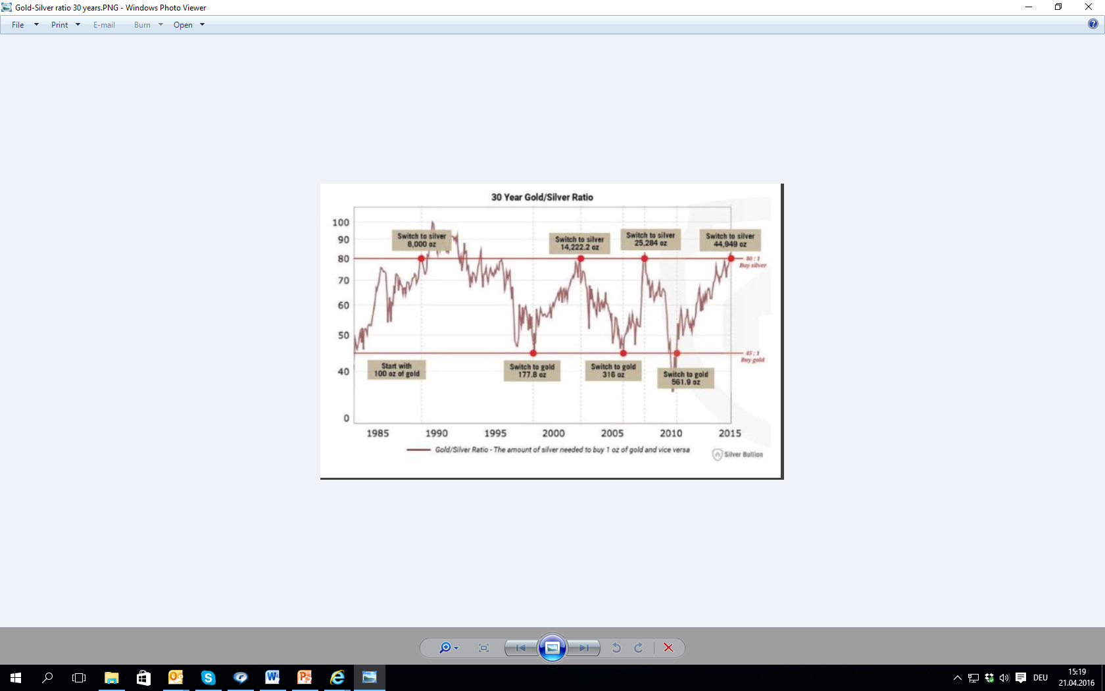
What’s Interesting Today
Gold & Miners: Where Are We in The Cycle?

Slide 28
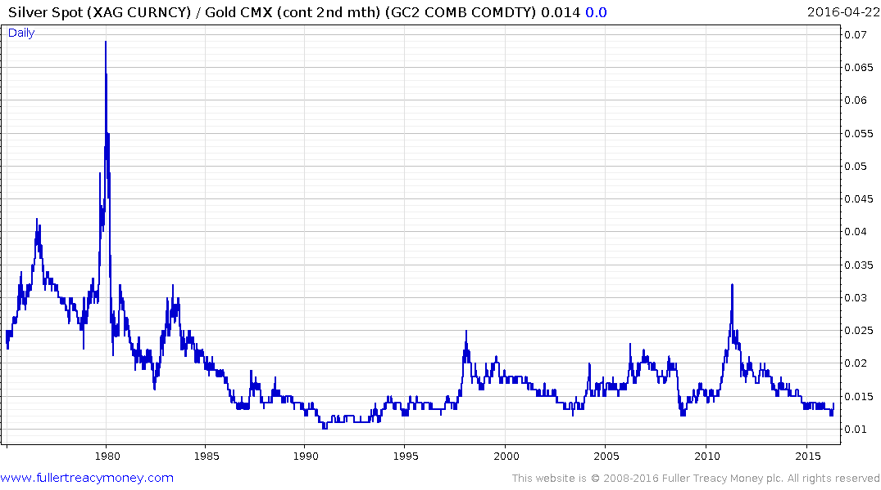
What’s Interesting Today
Gold & Miners: Where Are We in The Cycle?
When silver/ gold ratio hits 0.01, silver is cheap

Slide 29
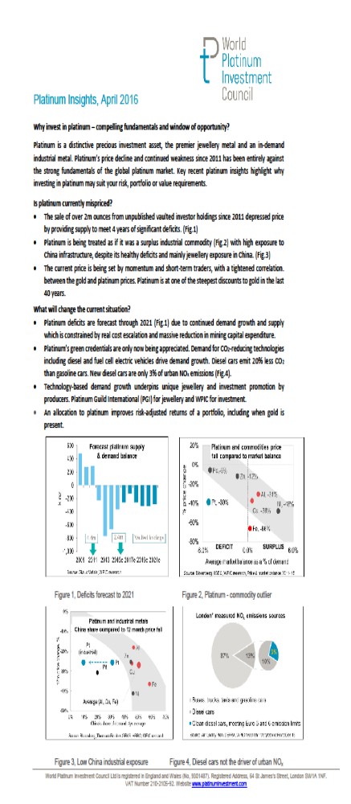
What’s Interesting Today
Gold & Miners: Where Are We in The Cycle?

Slide 30
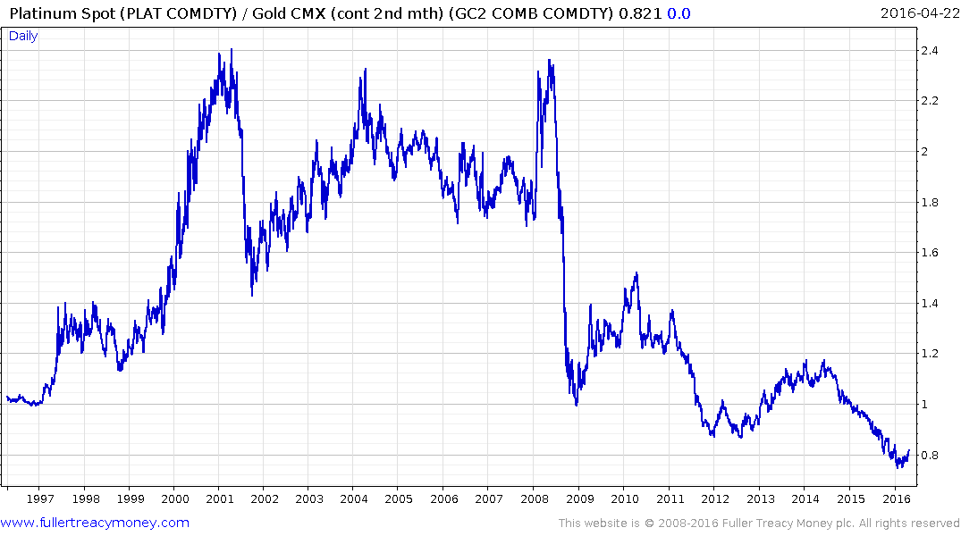
What’s Interesting Today
Gold & Miners: Where Are We in The Cycle?
When platinum/ gold ratio hits 0.8, platinum is cheap

Slide 31
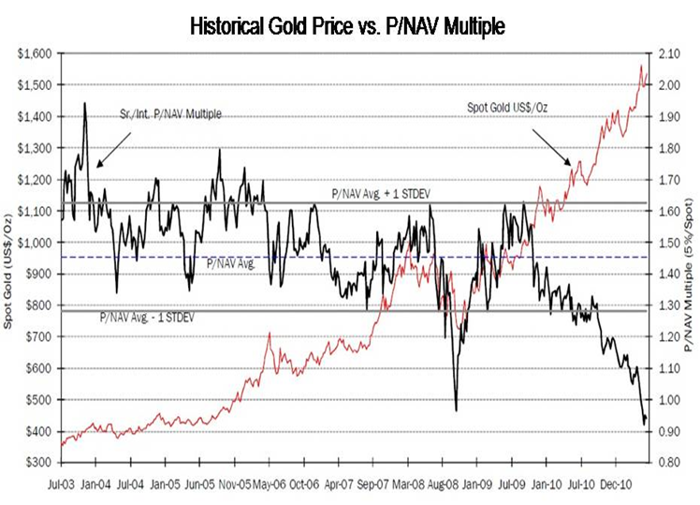
What’s Interesting Today (BUT CARE)
Gold & Miners: Where Are We in The Cycle?
Q3 2011, shares CHEAP by Value

Slide 32
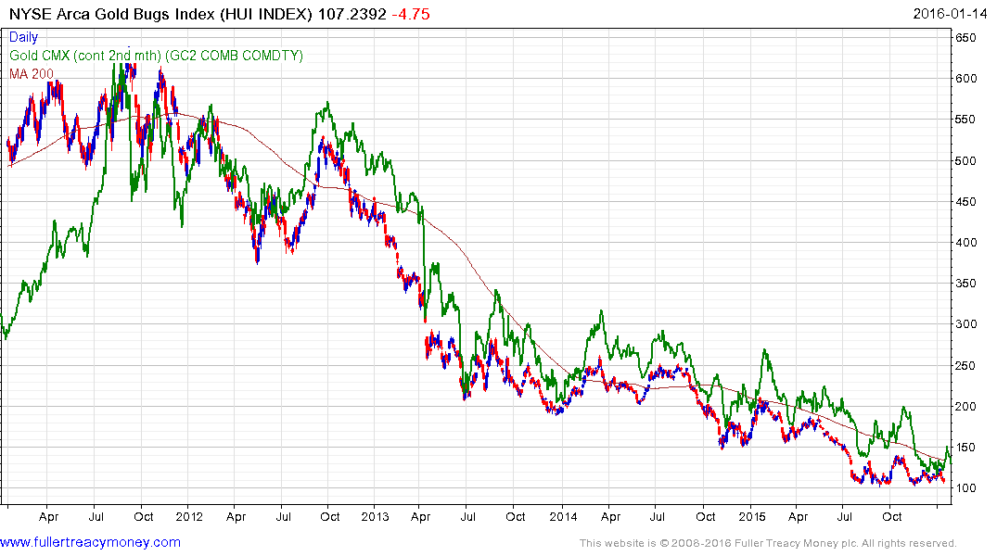
What’s Interesting Today
Gold & Miners: Where Are We in The Cycle?
After historic valuation lows in late 2011, you then lost 80% of your money in gold shares!
BUY??!!

Slide 33
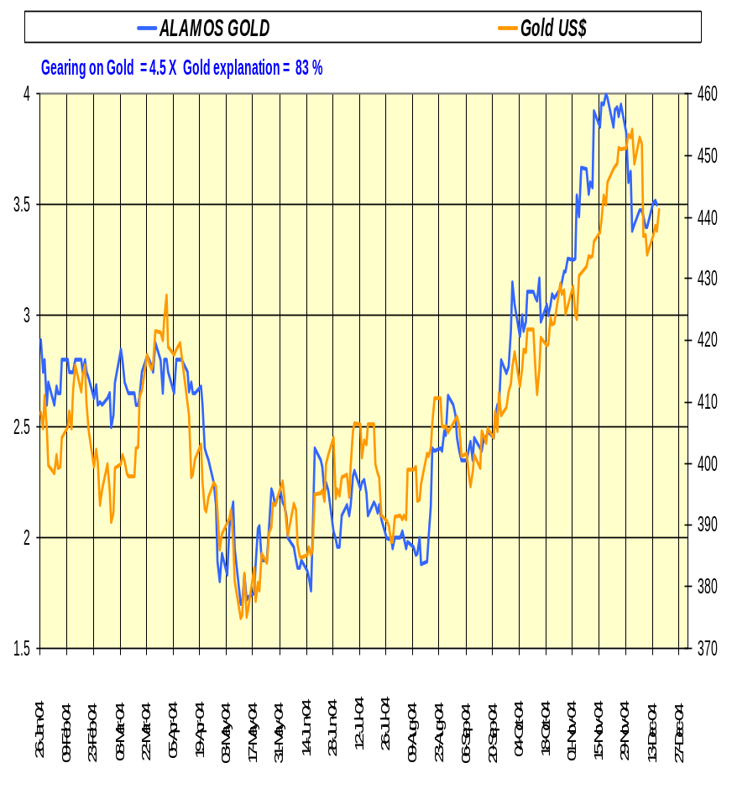
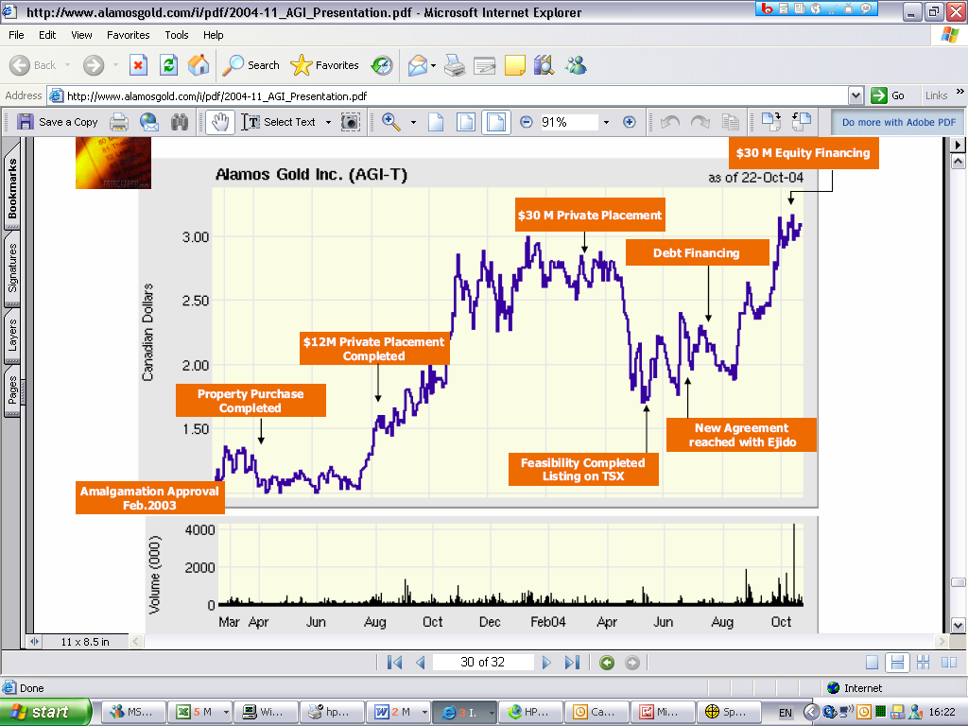
What’s Interesting Today
Gold & Miners: Where Are We in The Cycle?
Don’t fall for BS (Broker Stories)

Slide 34
What’s Interesting Today
Gold & Miners: Where Are We in The Cycle?
Only ONE thing mattered. The gold price. Not
        Earnings forecasts, analysts opinions
        Technology/ techniques
        New discoveries
        Depreciation policies
        Management changes
        Royalty and tax regimes
        Takeovers
        Rumours and chit chat
        Political factors

Slide 35
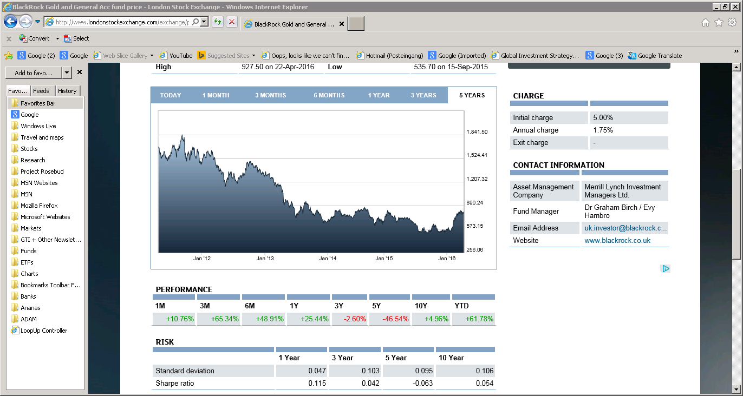
What I’m Buying Today
BlackRock Gold & General Fund

Slide 36
Important Notice
This document has been issued in a private capacity by Iain Little, an employee of European Wealth (Switzerland) SA, a member of the European Wealth Group Limited, for the information of experienced investors only. It is not and should not be construed as an offer to sell or the solicitation of an offer to purchase or subscribe for any investment.
Iain Little, an employee of European Wealth (Switzerland) SA, has based this document on information obtained from sources he believes to be reliable but which he has not independently verified; European Wealth (Switzerland) SA therefore makes no guarantee, representation or warranty and accepts no responsibility or liability as to its accuracy or completeness.

