Slide 1
A More Challenging Environment
For Global Investors But Not
Without Opportunities
April 25th 2016
The Markets Now
by David Fuller
fullertreacymoney.com
The East India Club – 16 St James’s Square
London SW1Y 4LH, UK

Slide 2
Thanks to technology
the energy price bubble is over forever,
at least for countries with sensible energy policies,
including fracking, new nuclear and renewables

Slide 3
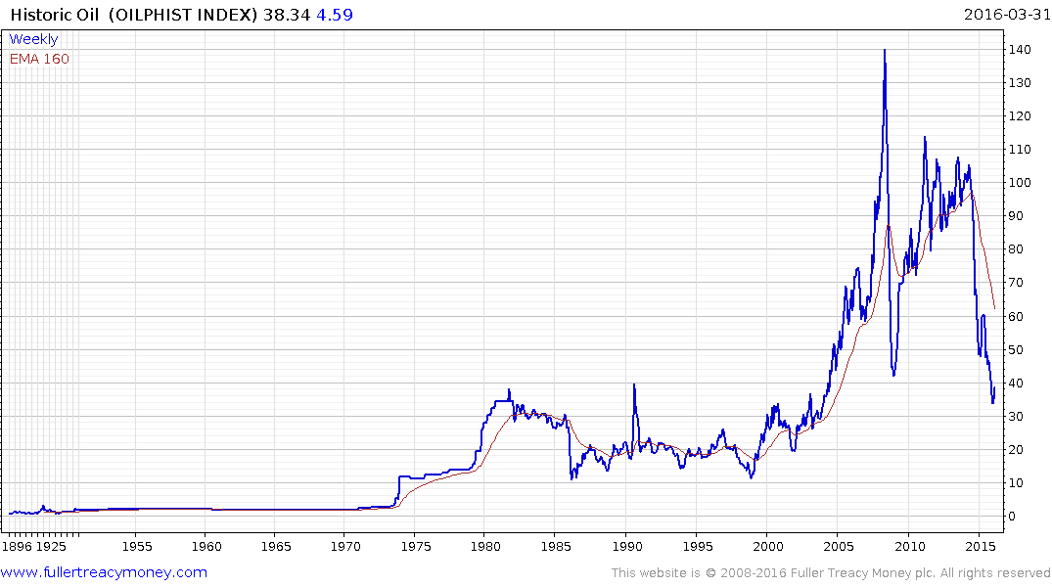
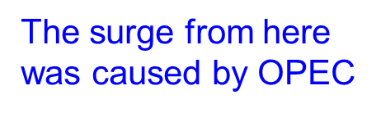
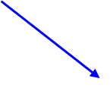
Historic oil since 1968
(Oilphist Index)
updated monthly

Slide 4
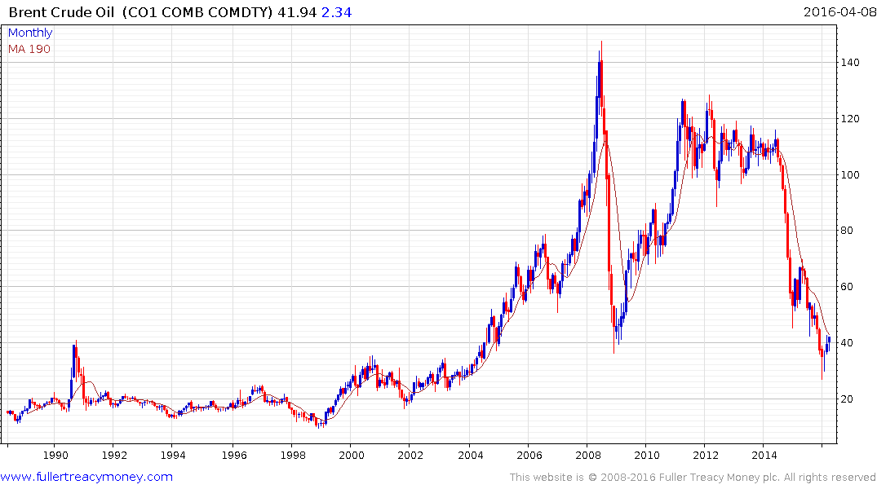
Brent crude since 1968
The oil bubble is over
forever and these levels
will not be seen again
Oil has bottomed
for at least the
lengthy medium term

Slide 5
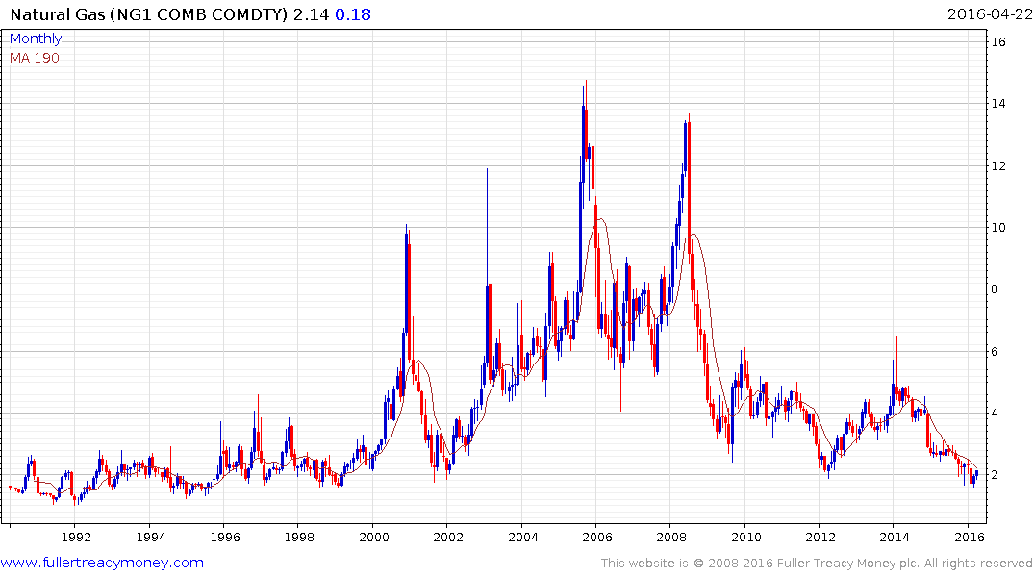
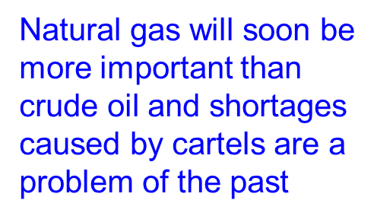

Slide 6
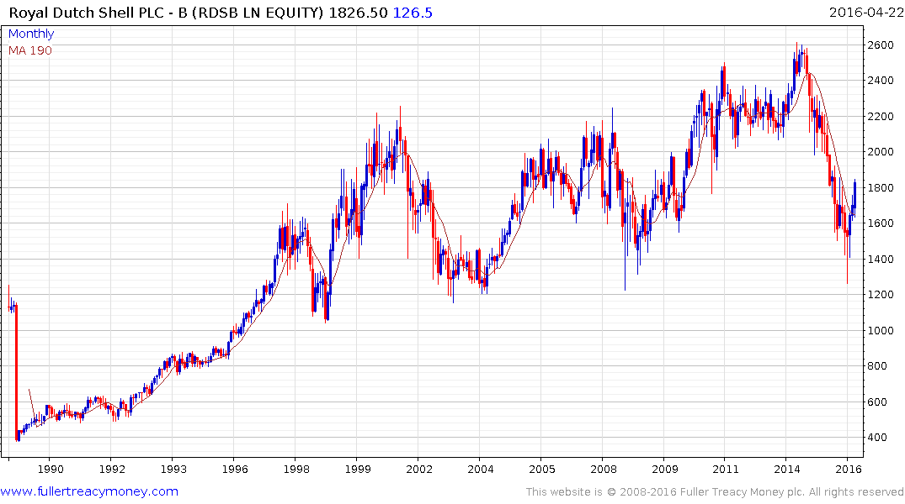

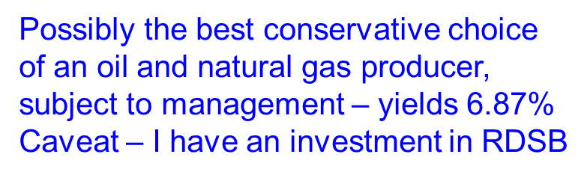

Slide 7
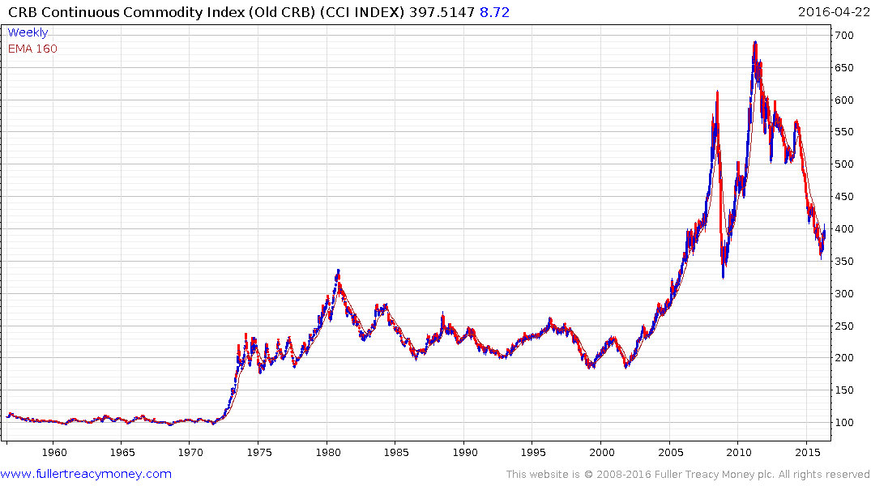

Continuous Commodity Index
monthly since 1955

Slide 8
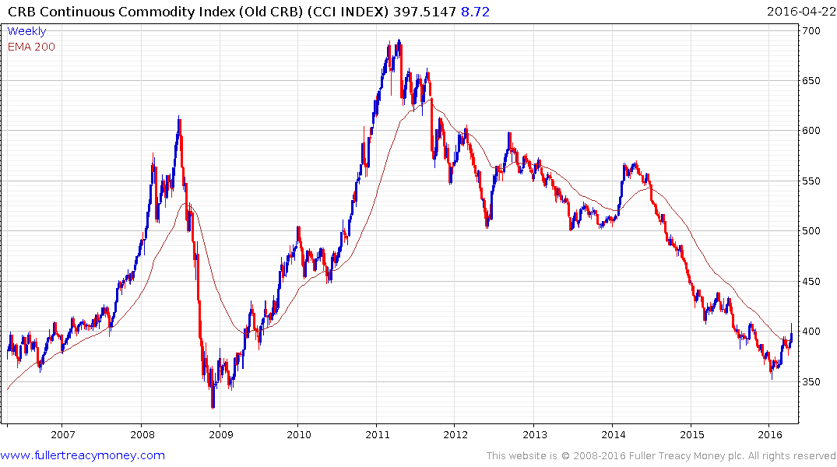

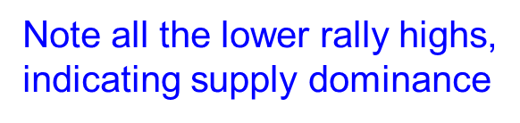








Biggest rally since first half 2014
indicating the beginning of a recovery
now that supply cutbacks are occurring

Slide 9
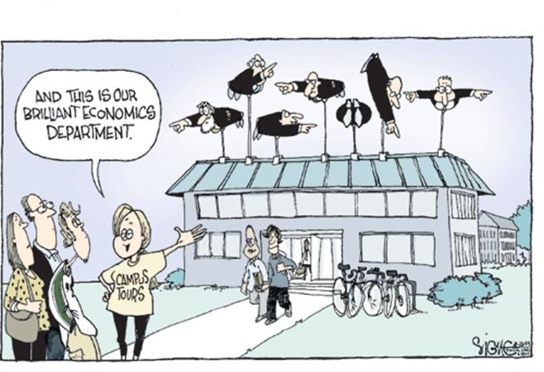

Slide 10
Gold often rises temporarily on fear
but is now slowly being remonetized
in the eyes of international investors.
In recent years, investors shunned
gold due to the Dollar’s strength and deflation fears. Today, the $ is weaker
and gradually rising commodity prices
will revive inflationary expectations.

Slide 11
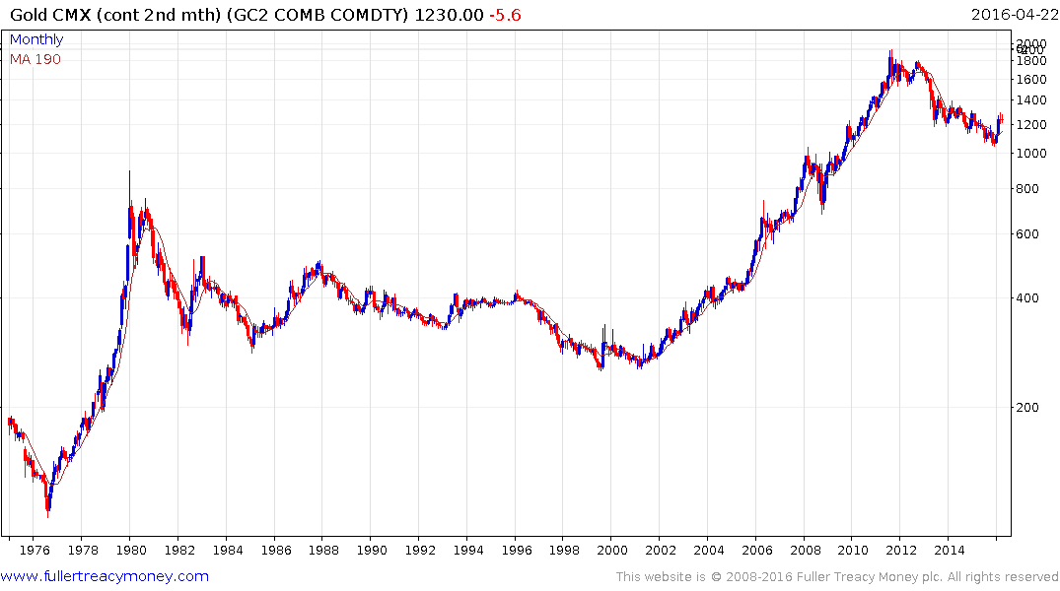


Slide 12
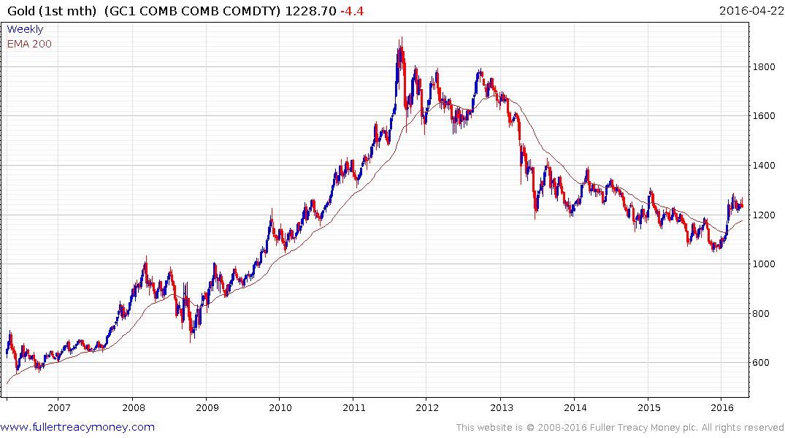
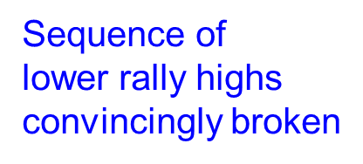




Slide 13
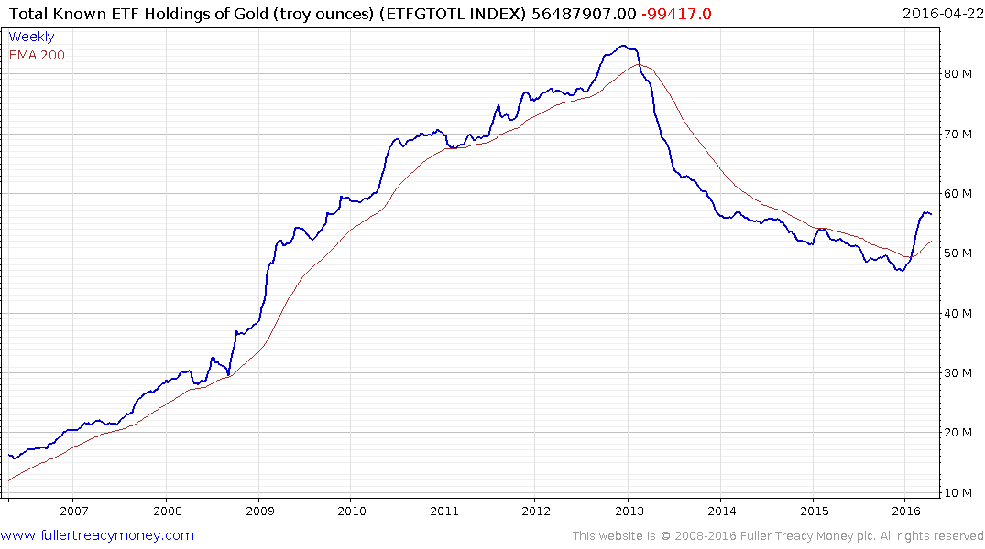
Total Known ETF Holdings
of Gold (troy ounces)
A lagging indicator as it reflects investor sentiment but clearly the
downtrend has been broken

Slide 14
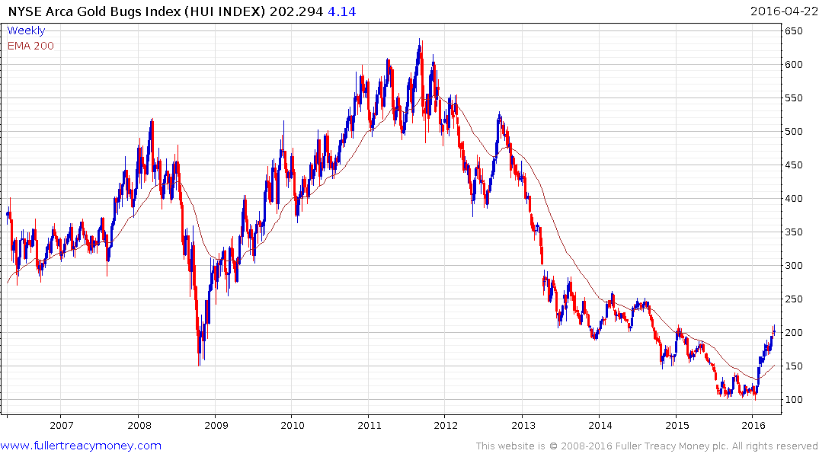



Biggest rally since 2012
Short-term overbought

Slide 15
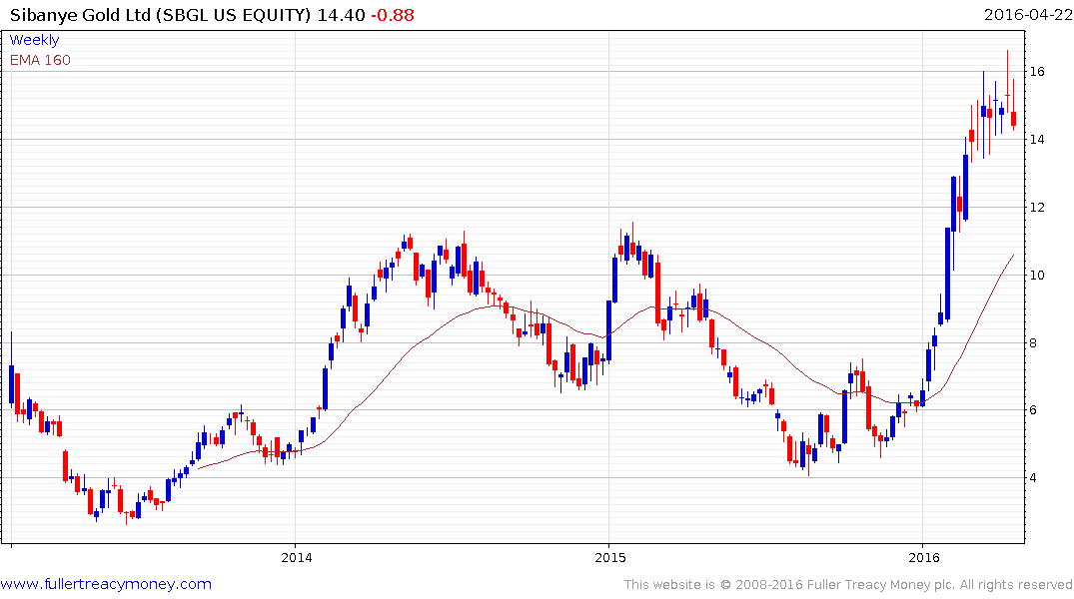
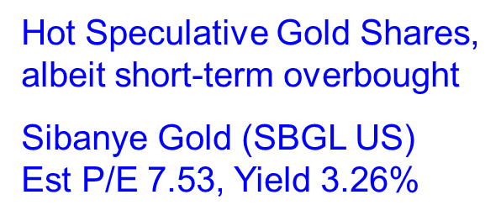

Slide 16
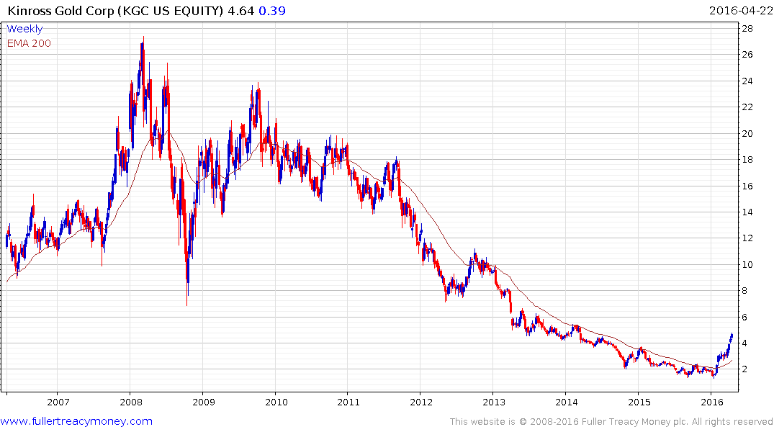
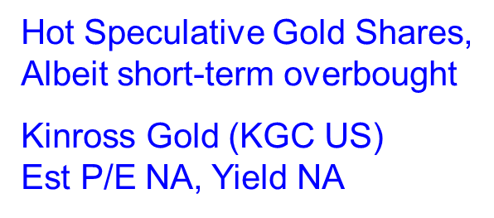

Slide 17
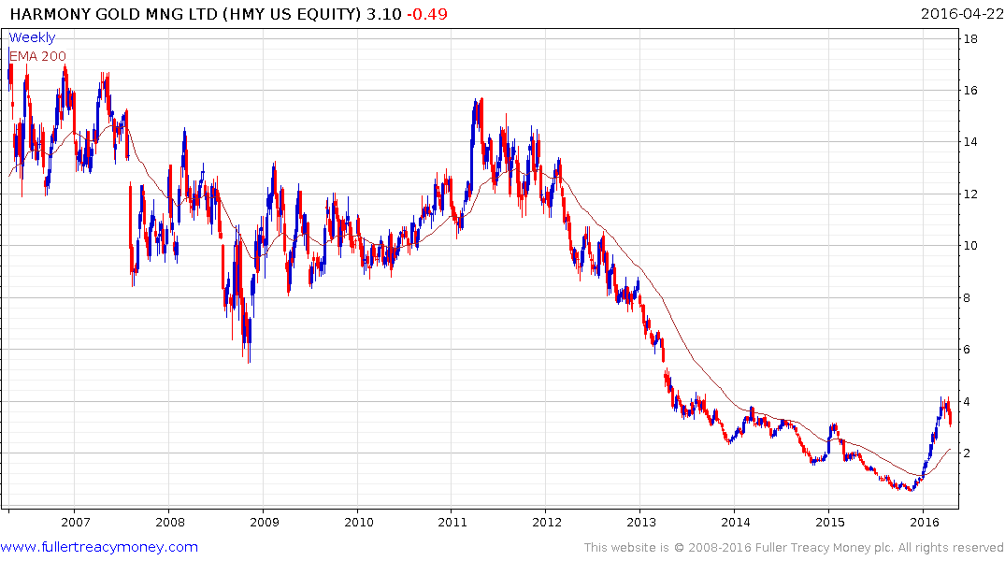
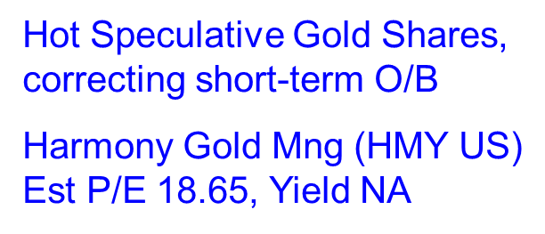

Slide 18
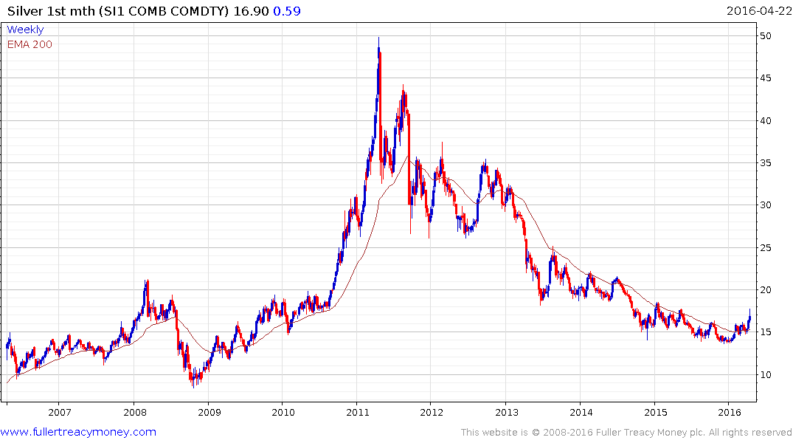
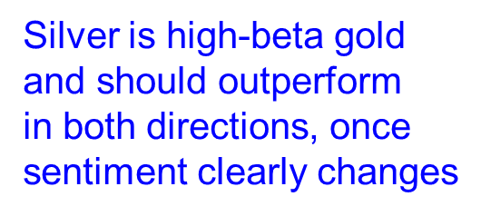
Currently correcting
short-term overbought
condition, prior to
further gains

Slide 19
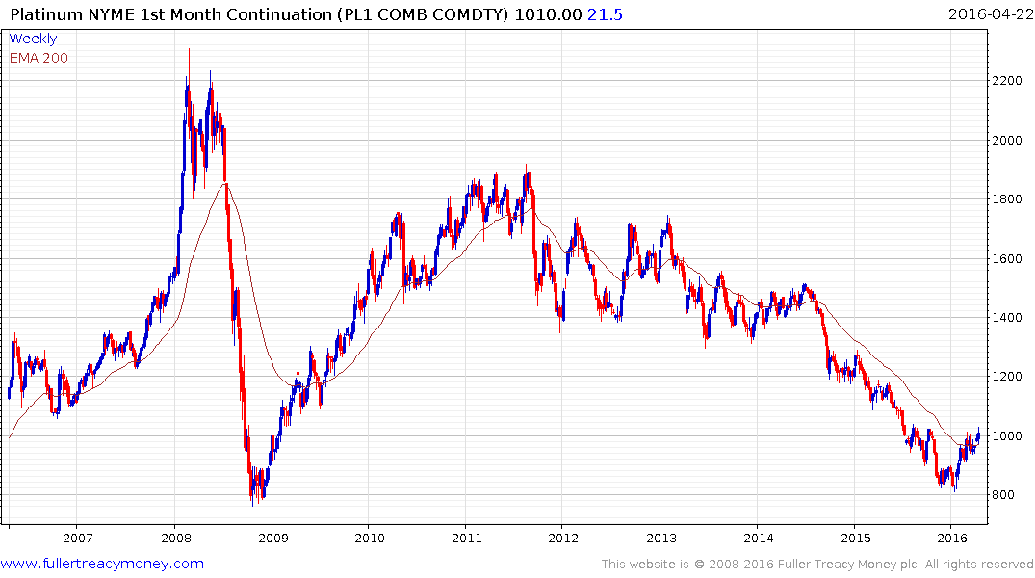

Historically, platinum has usually
traded at a premium to gold but is clearly lagging this time, but for how long?

Slide 20
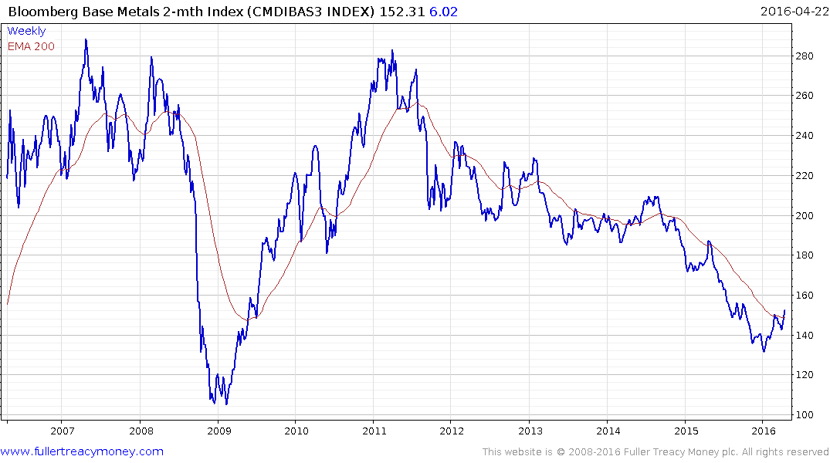

A higher low and push above
MA provides further evidence
that a significant recovery is
underway

Slide 21
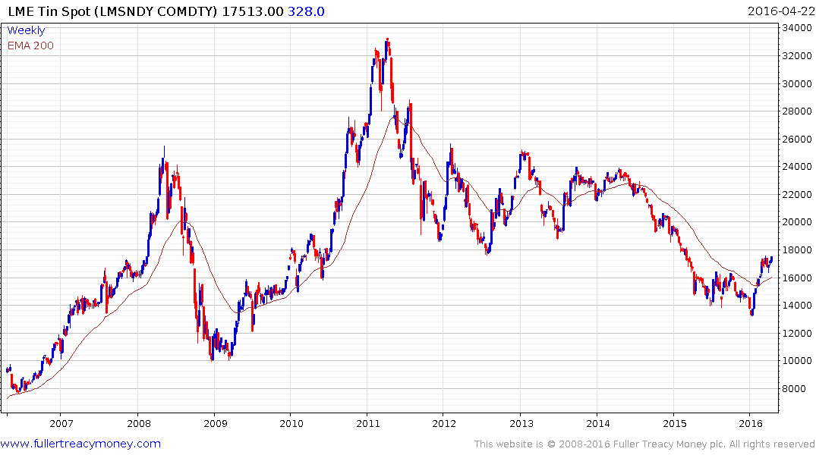
LME Tin shows the best recovery
to date among base metals

Slide 22
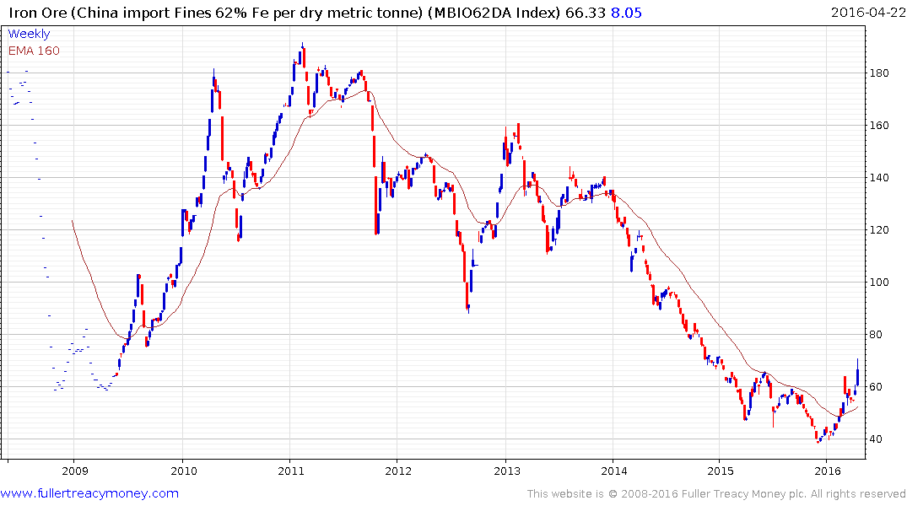
Iron ore shows best rally since 2013,
providing further evidence of base
formation development

Slide 23
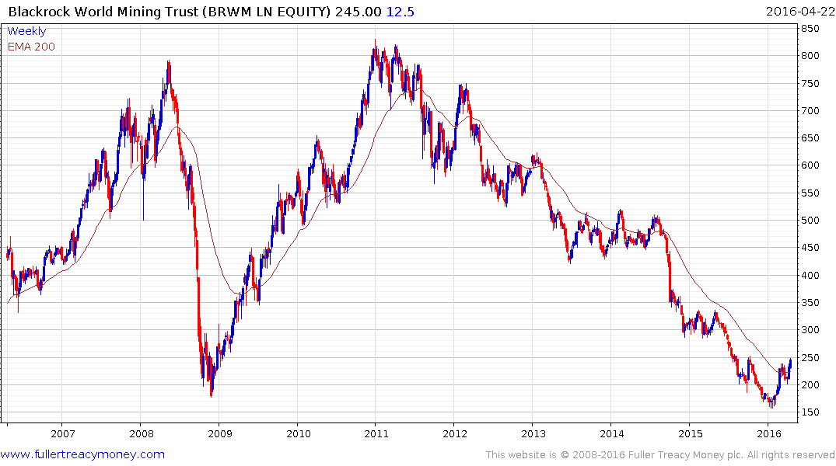

Speculative recovery candidate
which has not formed an uptrend
Caveat: I have a small PA position

Slide 24
Are US 10-year Treasury Bonds a bubble?
No, if you expect deflation and minimal GDP growth to
persist for many more years.
Yes, if you think global GDP growth and/or inflationary
pressures will rise over the next few years.
Common sense suggests government bond yields will not sustain record low yields beyond the lengthy medium term.

Slide 25
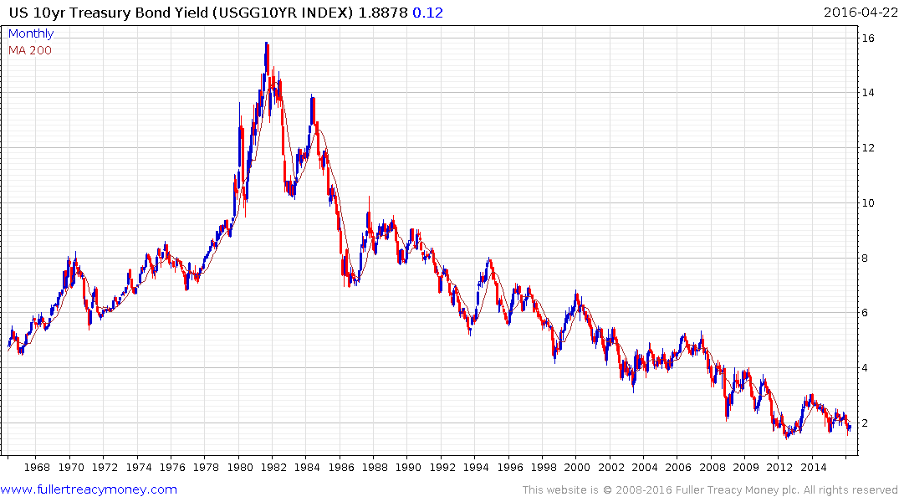
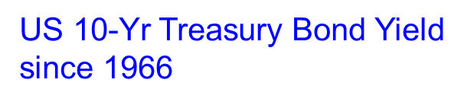
Needs to break progression of
lower rally highs to question
long-term downtrend

Slide 26
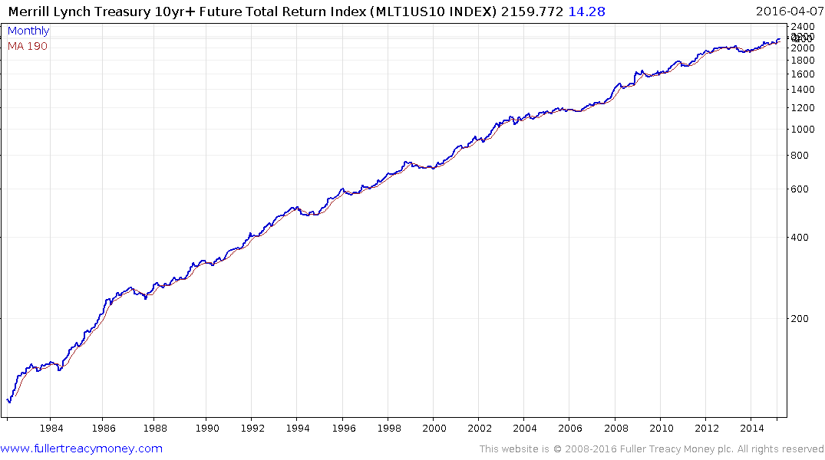
Merrill Lynch Treasury 10-Yr
Future Total Return Index
since 1982 (semi-log scale)

Slide 27
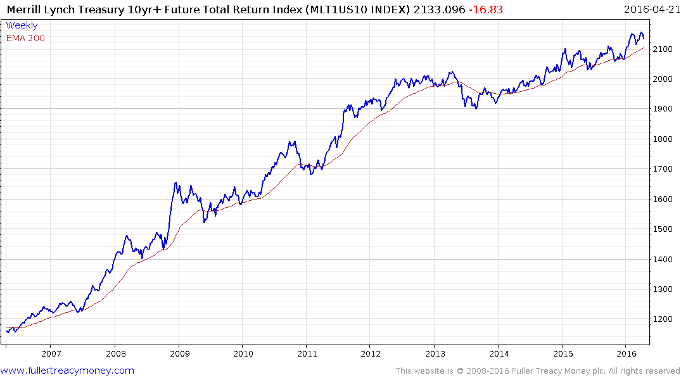
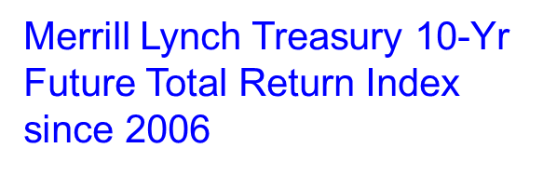
?
Watch for an eventual correction
which clearly exceeds the last three biggest reactions, as evidence of
capitulation

Slide 28
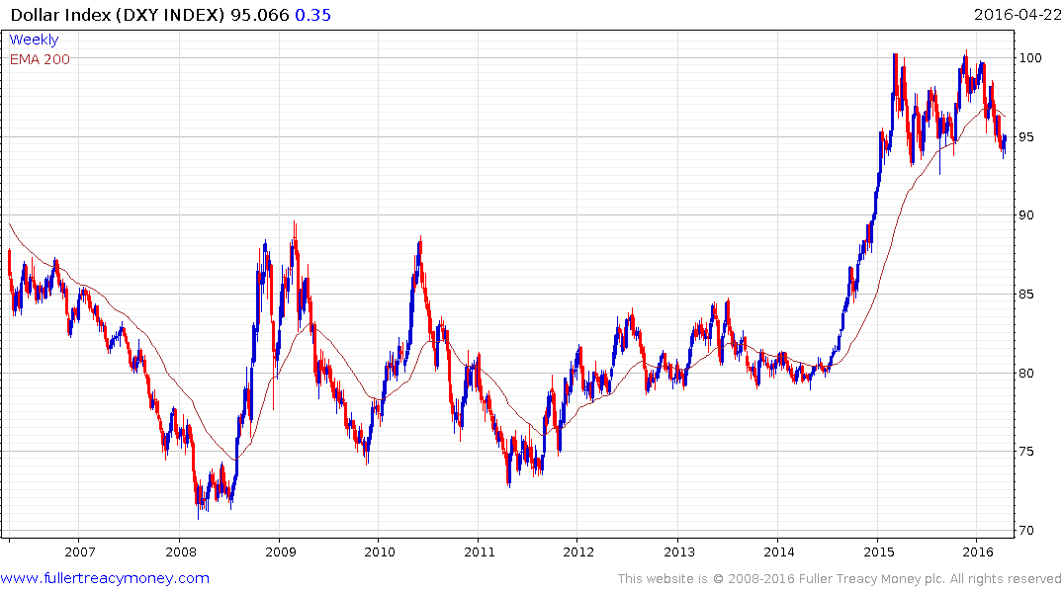
Dollar Index (DXY)
Advance checked at 100,
boosting stock markets but
this pattern is a lengthy
Consolidation prior to further
gains

Slide 29
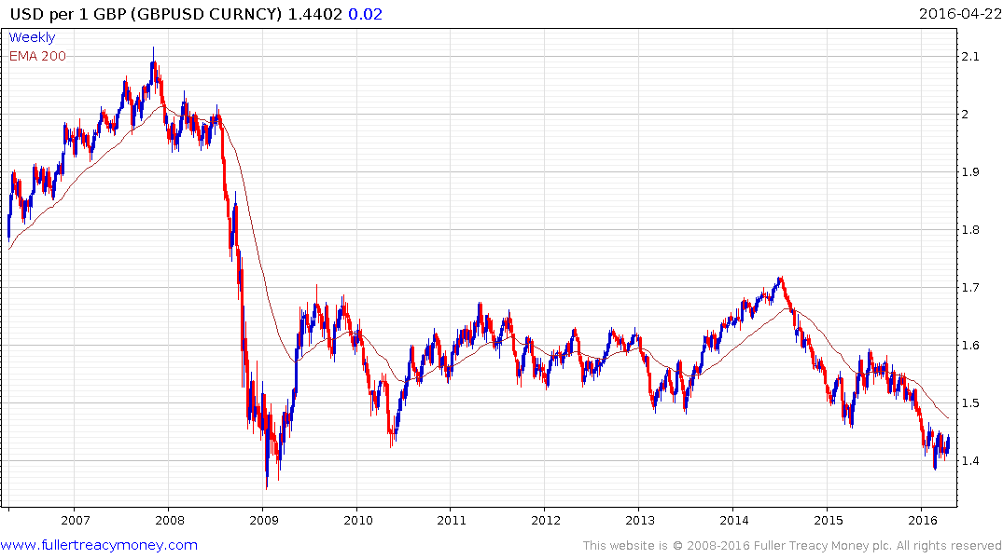
USD per 1 BBP (GBPUSD)
Sterling weakened by BoE
and Brexit uncertainty but
steading near 2009 lows

Slide 30
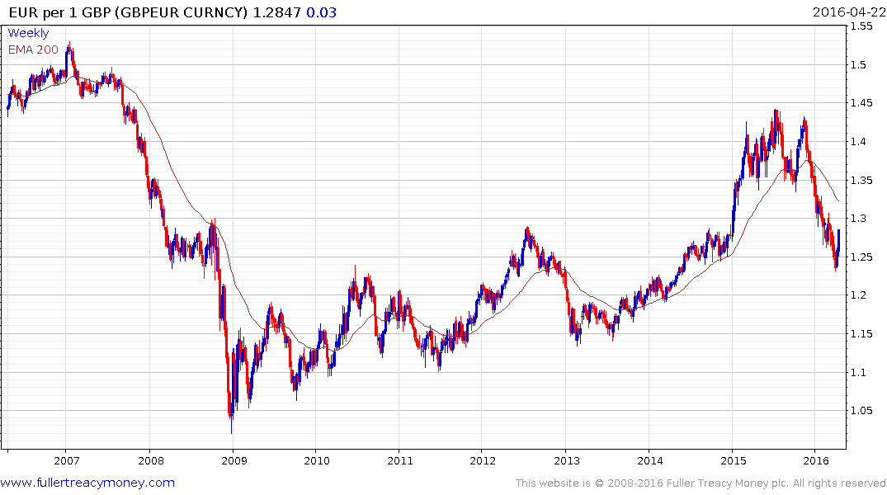
EUR per 1 GBP
Sterling competitiveness
improved at €1.25 but has
broken short-term downtrend

Slide 31
Global Stock Markets
A number of recoveries from earlier bear market lows, but …
Wall Street is short-term overbought in upper side of ranges
A number of other stock markets are short-term overbought
US corporate profits are declining, on average, for a third quarter and valuations are not cheap, but softer $ may help
US momentum leading Autonomies show some loss of form
Contra-cyclical commodity shares are now outperforming, as
we often see late in stock market cycles
Seasonal factors turn less favourable in May for six months

Slide 32
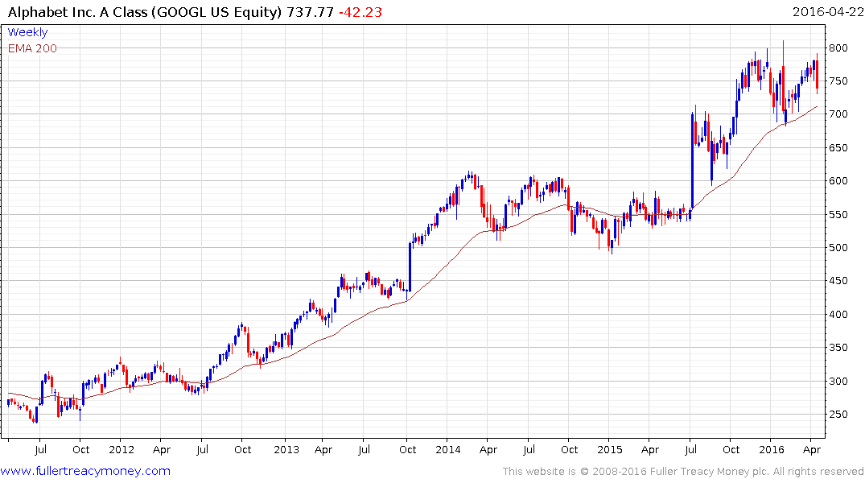
Alphabet (GOOGL) - Est P/E 21.86, Yield N.A.
Note downward dynamics in current range

Slide 33
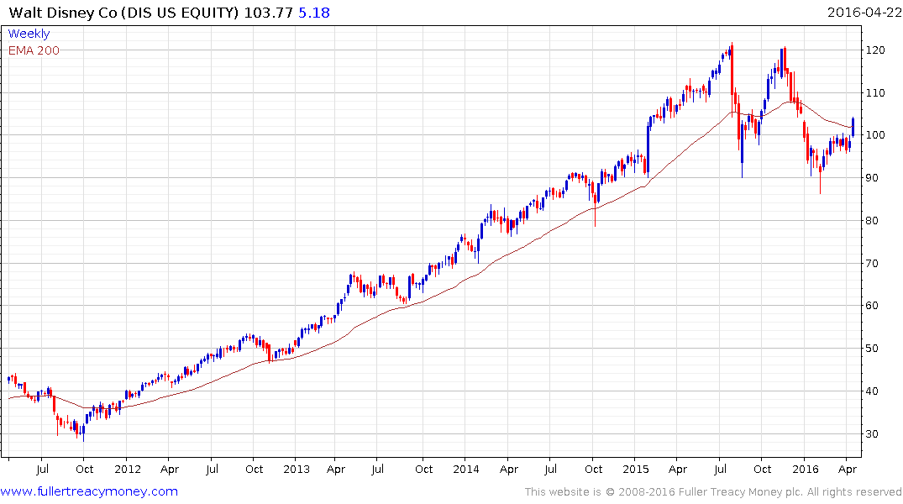
Walt Disney - Est P/E 17.77, Yield 1.37%
Note downward dynamics in current range

Slide 34
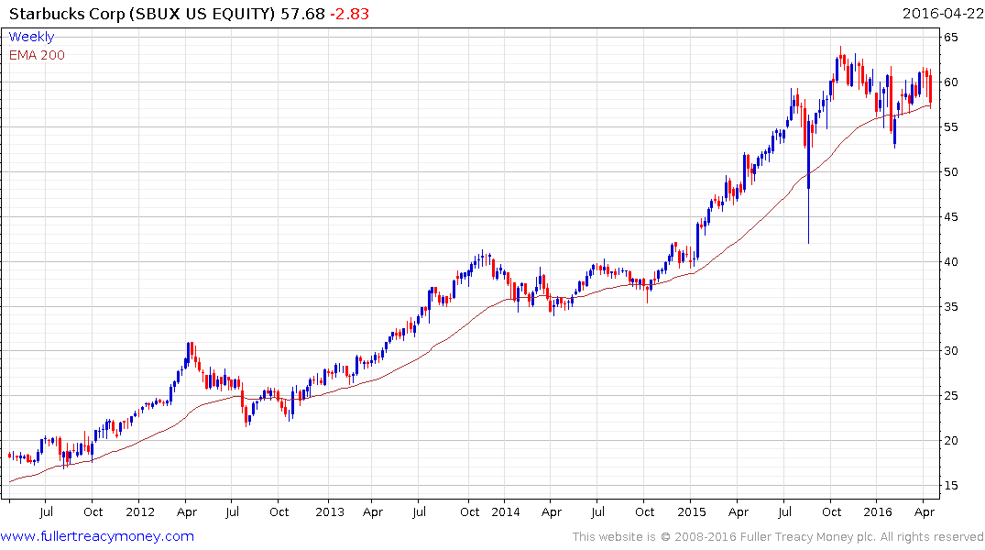
Starbucks - Est P/E 30.45 & Yield 1.39%
Note downward dynamics in current range

Slide 35
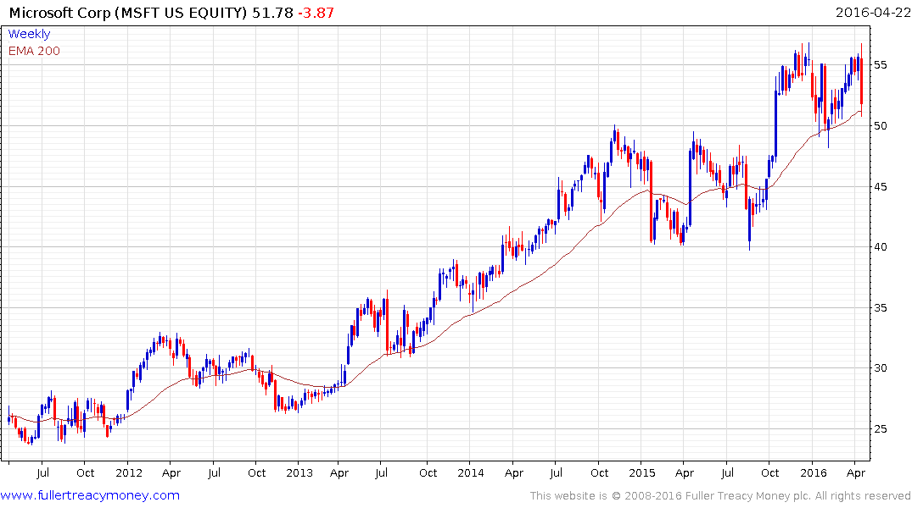
Microsoft (MSFT)
Est P/E 19.28, Yield 2.78%
Note recent downward dynamics

Slide 36
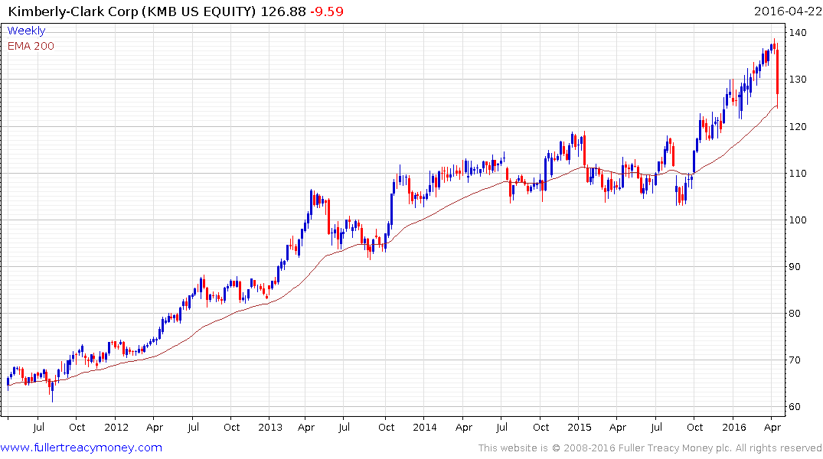
Kimberly-Clark (KMB)
Est P/E 20.64, Yield 2.89%

Slide 37
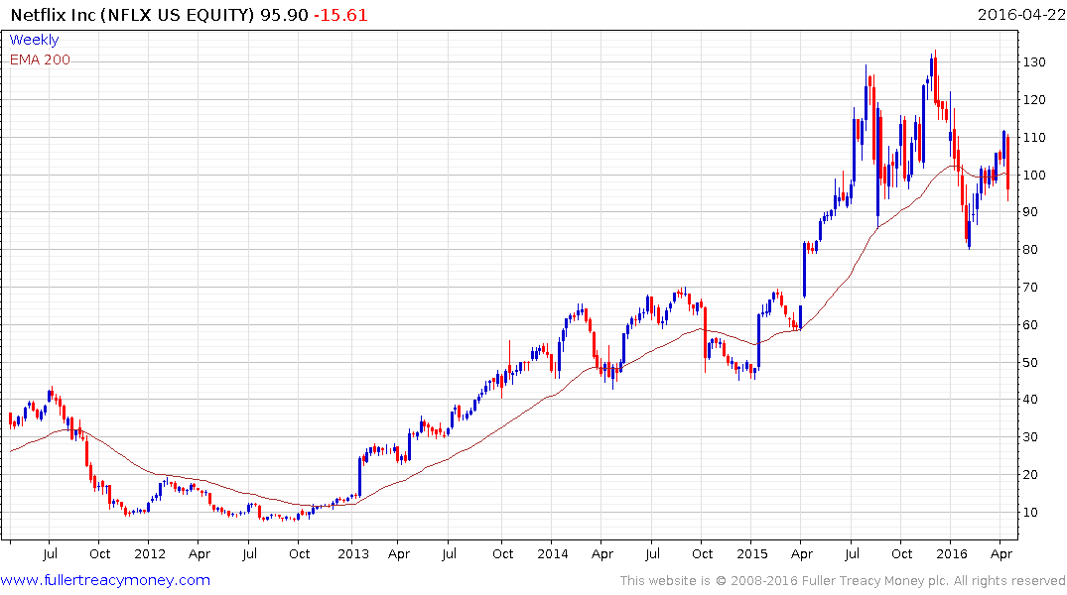
Netflix (NFLX)
Est P/E 335, Yield N.A.

Slide 38
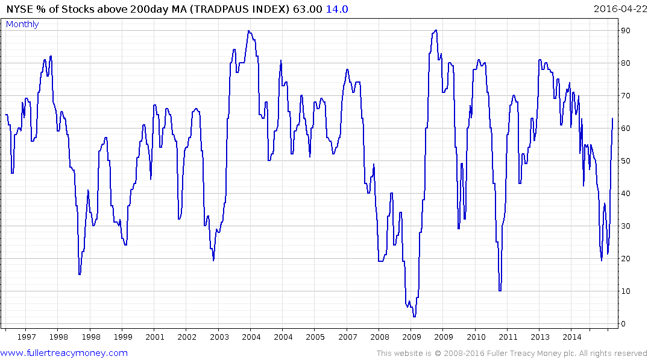
TRADEPAUS Index
NYSE% Stocks
Above 200 Day MA
Consider buying near 20 and selling near 80

Slide 39
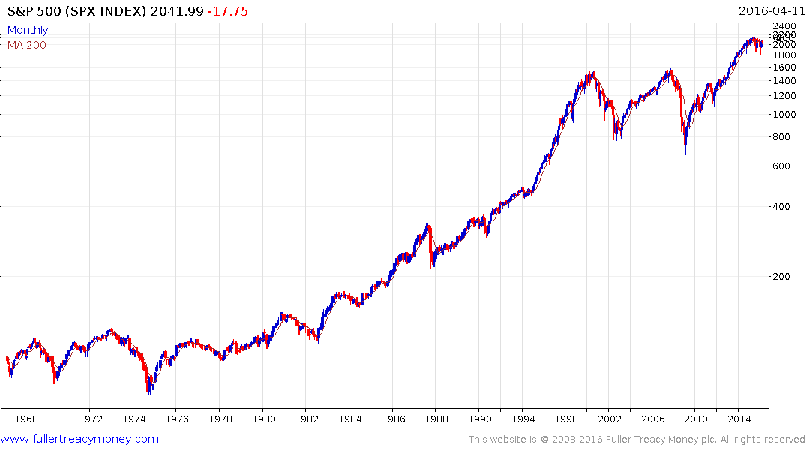
S&P 500 (SPX Index)
Is this cycle
repeating above?
If so, the S&P will
first move somewhat
lower, with valuations
improving, before
eventually resuming
the secular uptrend

Slide 40
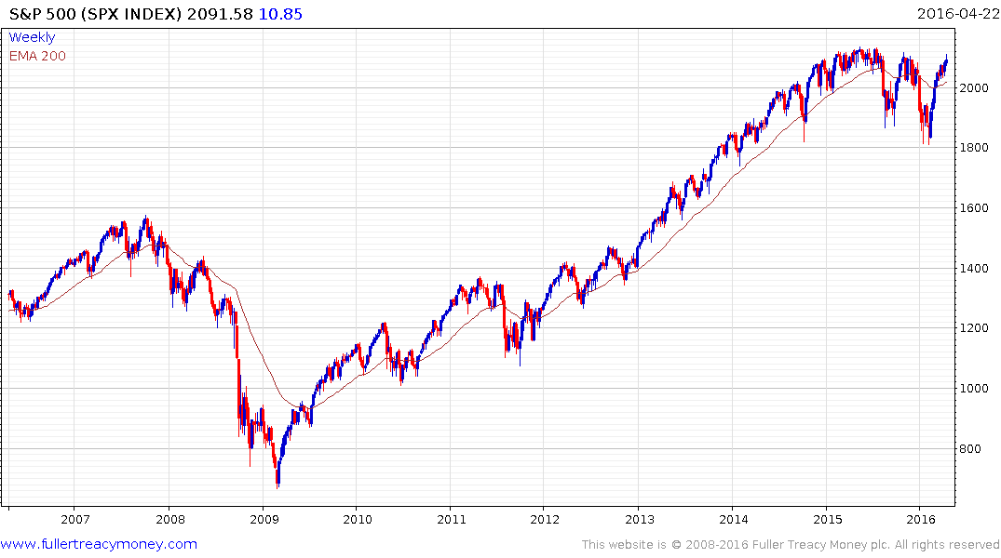
S&P 500 Index
P/E 19.18, Yield 2.16%
Testing resistance in
upper side of lengthy
trading range

Slide 41
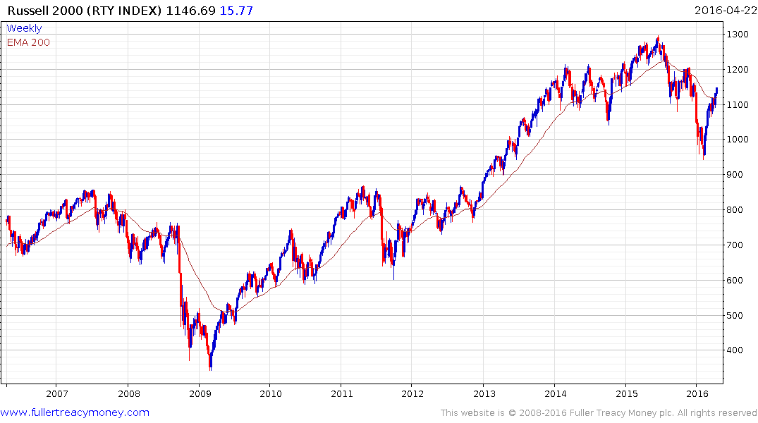
Russell 2000 Index
P/E 19.75, Yield 1.56%
A good indicator of US
stock market breadth, now
testing overhead supply

Slide 42
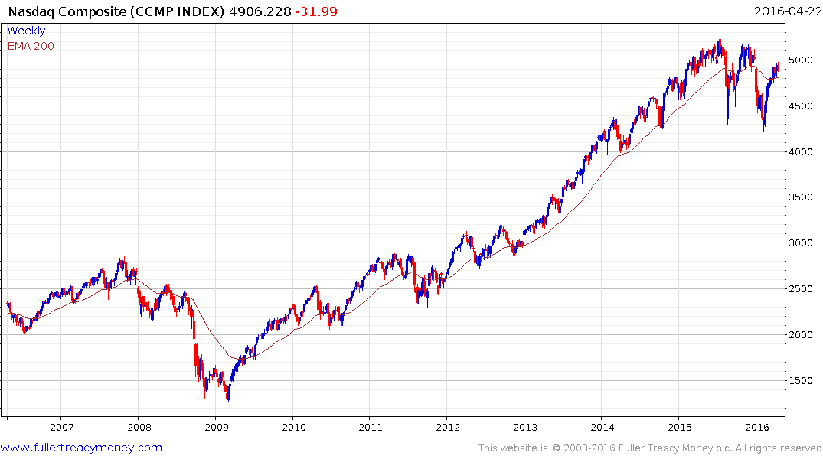
Nasdaq Composite Index (CCMP)
P/E 31.55, Yield 1.29%
Testing overhead resistance,
short-term overbought and no
longer leading on the upside

Slide 43
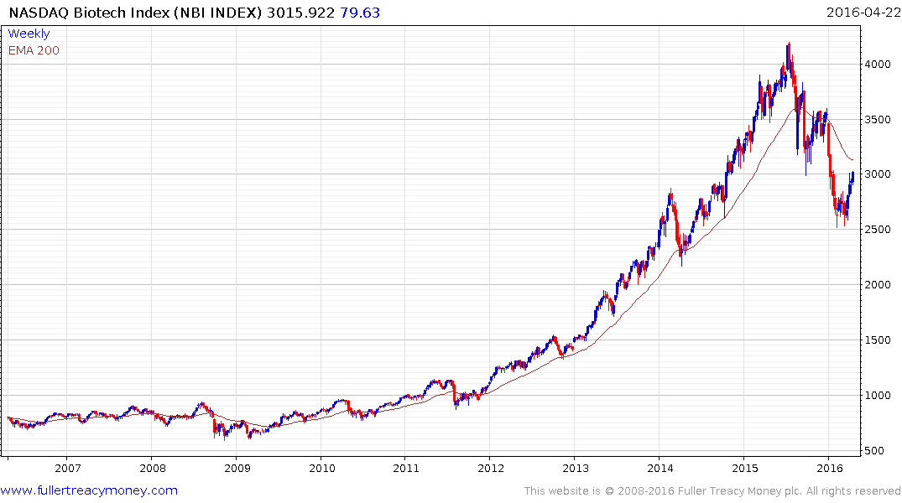
Nasdaq Biotech Index (NBI)
P/E 594.28, Yield 0.37%
Led on the upside - lengthy
medium-term peak but dips
are now creating long-term
buying opportunities in this
very promising sector

Slide 44


China Shanghai Composite(SHCOMP)
P/E 15.79, Yield 2.07%

Slide 45

Japan Nikkei 225 (NKY)
P/E 19.74, Yield 1.73%
Enigmatic but building
support after cyclical
bear trend

Slide 46

Fanuc Ltd (6954 JT)
Est P/E 23.86, Yield 4.09%
Global leader for industrial
robotics and no debt
Caveat: I have a long-term
investment in Fanuc

Slide 47

India Mumbai (Sensex)
P/E 19.50, Yield 1.58%
Currently world’s fastest
growing economy
Potentially
significant floor
Good governance at the top -
N Modi & R Ragan - but
cumbersome political system
below

Slide 48

UK FTSE 100
P/E 30.88, Yield 4.44%
Good rebound from 5500
but plenty of overhead
supply and now Brexit
uncertainty
Caveat: I have a short position

Slide 49


Slide 50
Many thanks for your interest!
Any questions?
Please visit our site:
www.fullertreacymoney.com

Slide 52


Slide 53


Slide 54
Technical warning signs to watch for among indices
Trend acceleration relative to 200-day moving averages
Declining market breadth (fewer shares rising)
Failed upside breakouts from trading ranges
Loss of uptrend consistency characteristics
Churning price action relative to recent trading ranges
Breaks of 200-day moving averages
Broadening patterns for trading ranges following uptrends
200-day moving averages turn downwards
Resistance is encountered beneath declining 200-day MAs
Previous rising lows are replaced by lower rally highs
Indices fall faster than they rose to their highs

