Slide 1
Happy 20th Anniversary
Nordic Association of Electricity Traders

Slide 2
The Triumph of Technology and the
Exciting Evolution of Global Energy
April 14th 2016
Nordic Association of Electricity Traders
by David Fuller
fullertreacymoney.com
The Lansdowne Club – 9 Fitzmaurice Place
London W1J 5JD, UK

Slide 3
Thanks to technology
the energy price bubble is over forever,
at least for countries with sensible energy policies,
including fracking, new nuclear and renewables

Slide 4
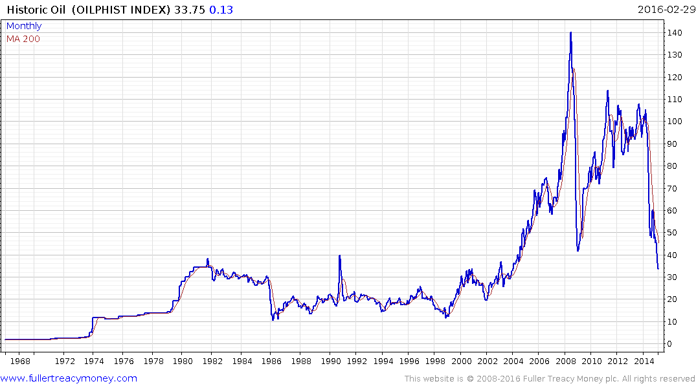
Historic oil since 1968
(Oilphist Index)
updated quarterly
The surge from here
was caused by OPEC

Slide 5
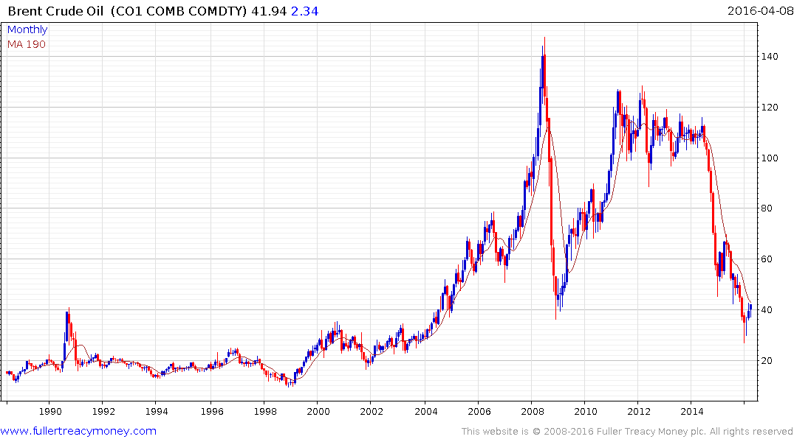
Brent crude since 1968
The oil bubble is over
forever and these levels
will not be seen again
Oil has bottomed
for at least the
lengthy medium term

Slide 6
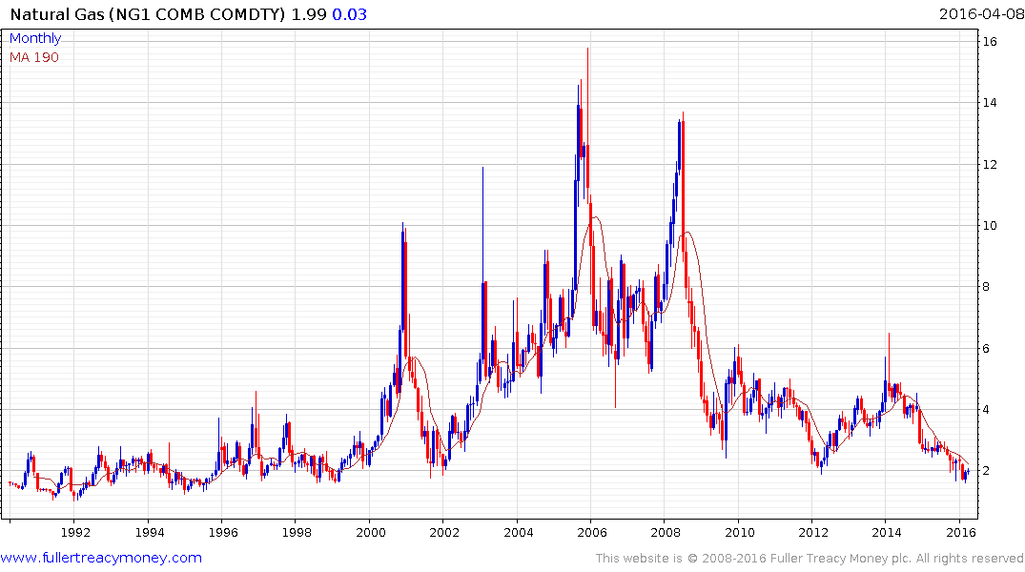
Natural gas will soon be
more important than
crude oil but shortages
caused by cartels are a
problem of the past

Slide 7
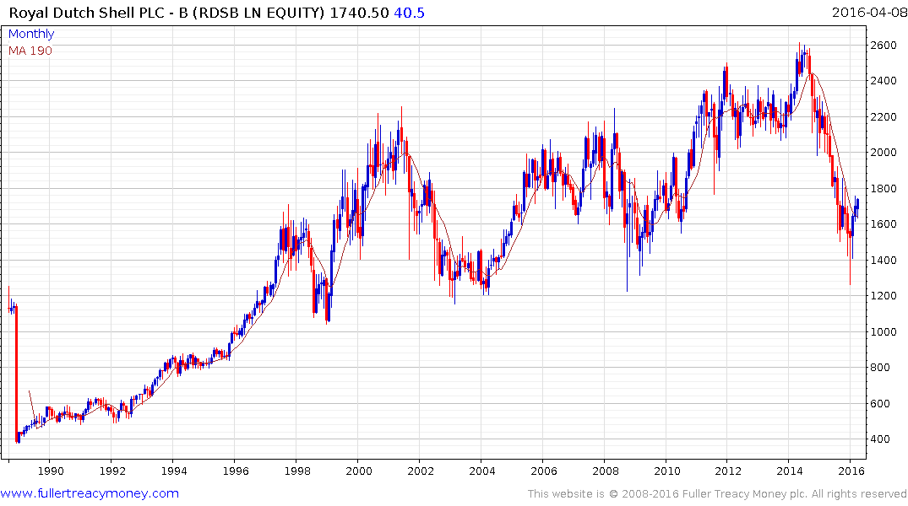
Royal Dutch Shell B (RDSB)
Possibly the best conservative choice
of an oil and natural gas producer,
subject to management – yields 7.21%
Caveat – I have an investment in RDSB

Slide 8
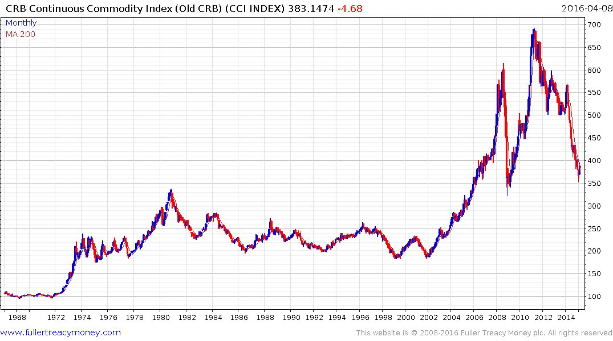
Continuous Commodity Index (CCI) (monthly)
Commodities often perform best late in
stock market cycles, being cyclical laggards

Slide 9
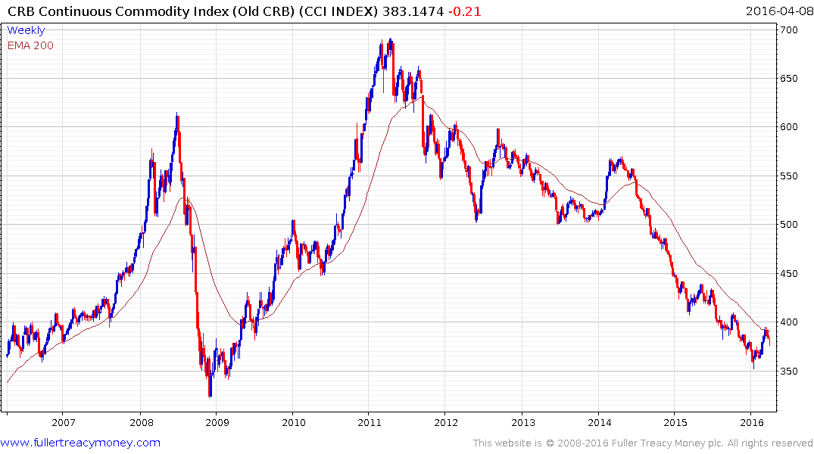
CCI Index (weekly)
Note all the lower rally highs,
indicating supply dominance
Biggest rally since first half 2014
indicating the beginning of a recovery
now that supply cutbacks are occurring

Slide 10
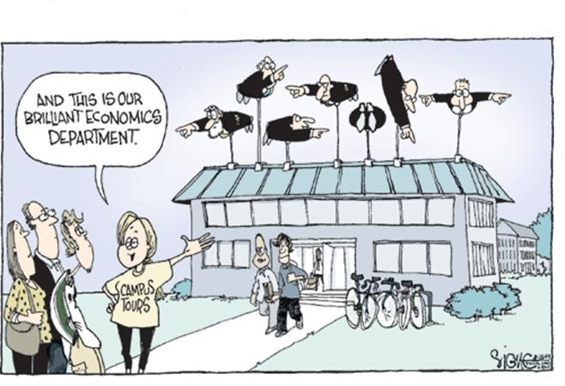

Slide 11
Gold often rises temporarily on fear
but is now slowly being remonetized
in the eyes of international investors.
In recent years, investors shunned
gold due to the Dollar’s strength and deflation fears. Today, the $ is weaker
and gradually rising commodity prices
will revive inflationary expectations.

Slide 12
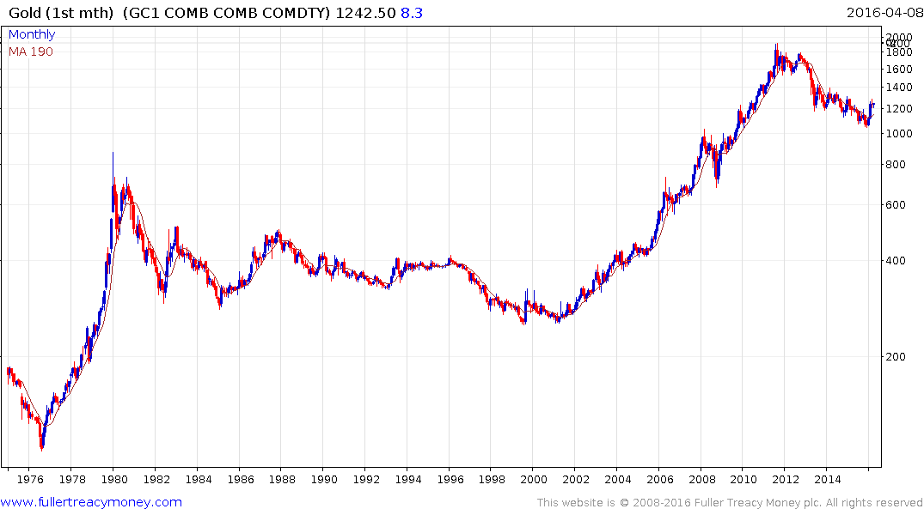
Gold semi-log since 1975

Slide 13
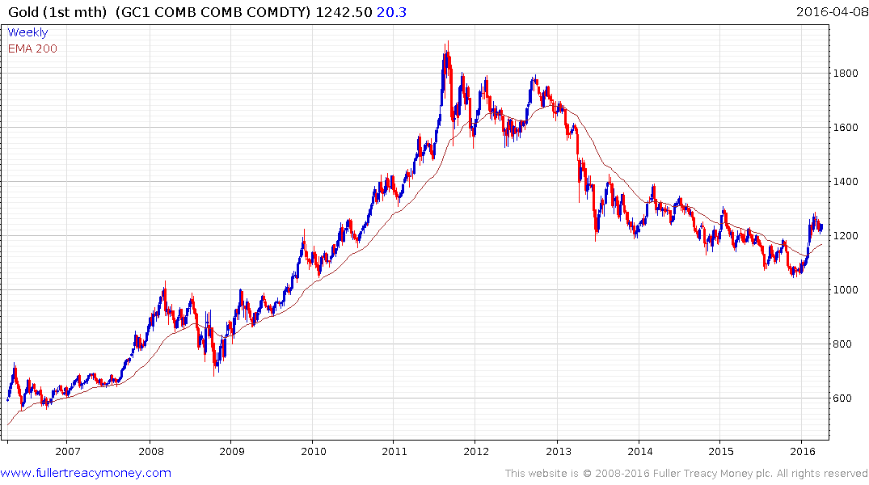
Sequence of
lower rally highs
convincingly broken
Gold (weekly, 10 years)
Biggest rally since 2013

Slide 14
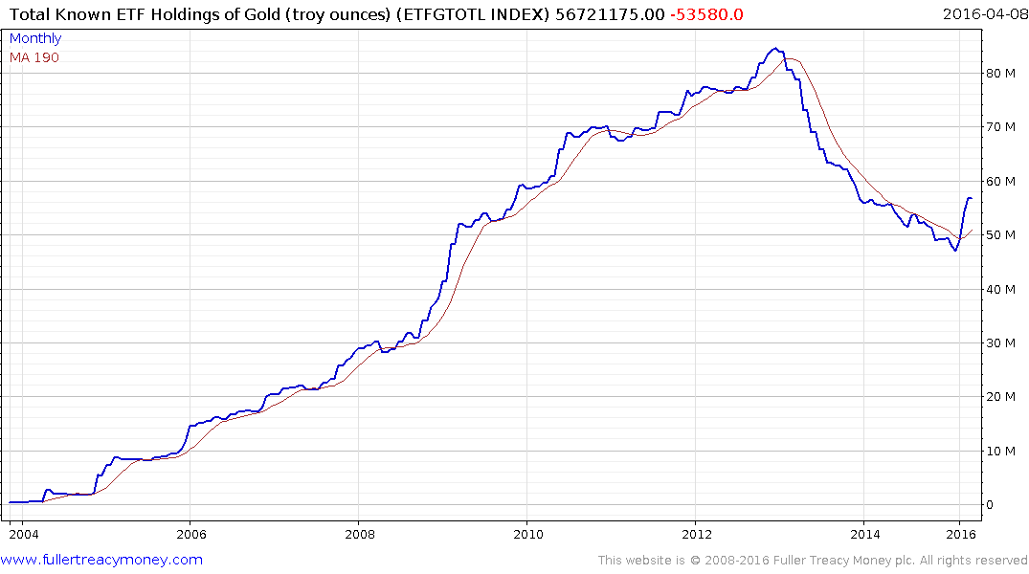
Total Known ETF Holdings
of Gold (troy ounces)
A lagging indicator as it reflects investor sentiment but clearly the
downtrend has been broken

Slide 15
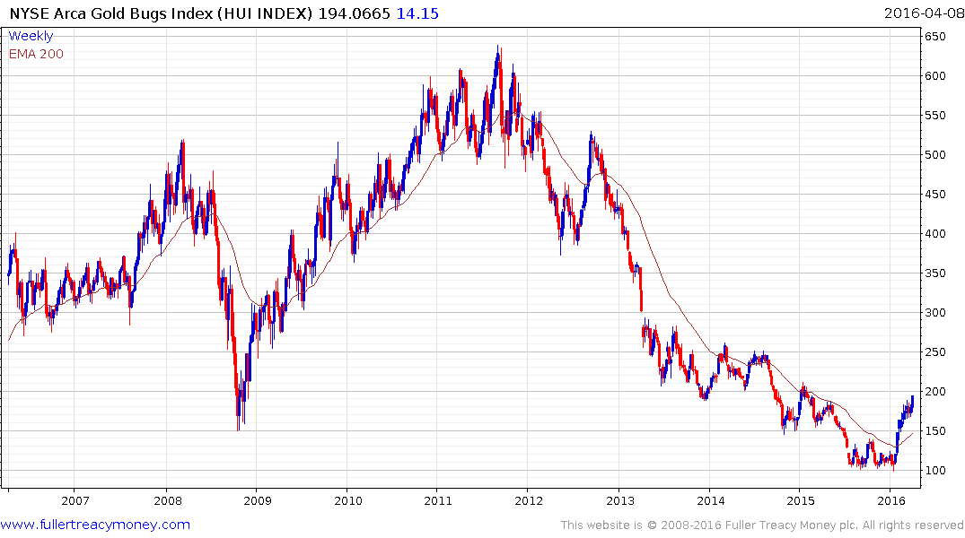
NYSE Gold Bugs Index
(HUI Index)
Downtrend clearly broken

Slide 16
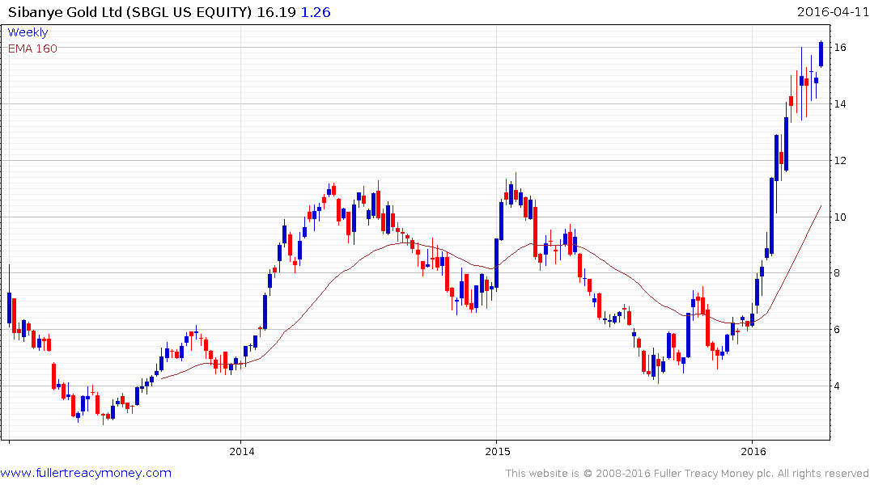
Hot Speculative Gold Shares:
Sibanye Gold (SBGL US)
Est P/E 8.68, Yield 2.89%

Slide 17
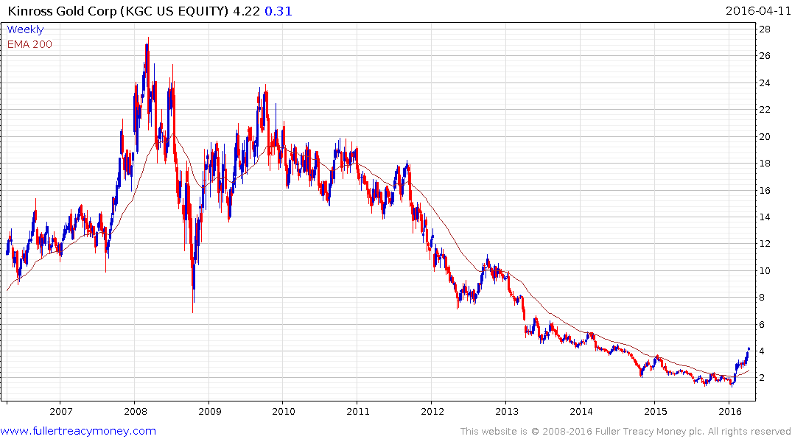
Hot Speculative Gold Shares:
Kinross Gold (KGC US)
Est P/E NA, Yield NA

Slide 18
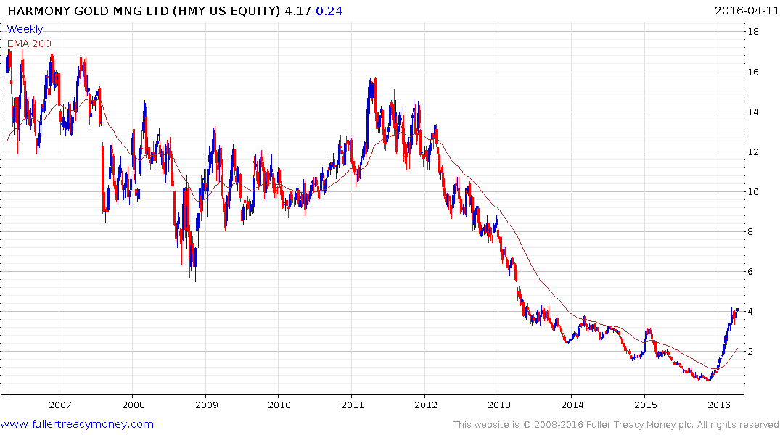
Hot Speculative Gold Shares:
Harmony Gold Mng (HMY US)
Est P/E 24.84, Yield NA

Slide 19
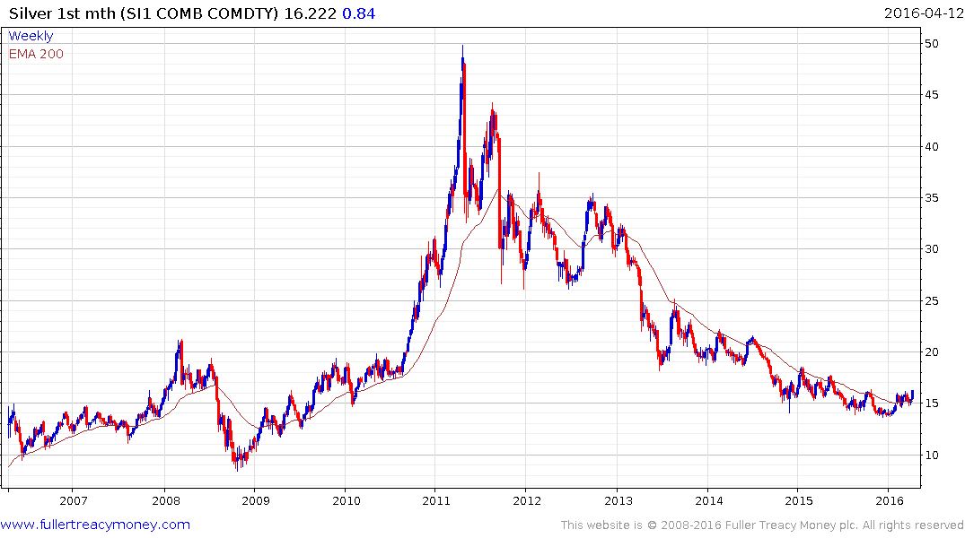
Silver is high-beta gold
and should outperform
in both directions, once
sentiment clearly changes

Slide 20
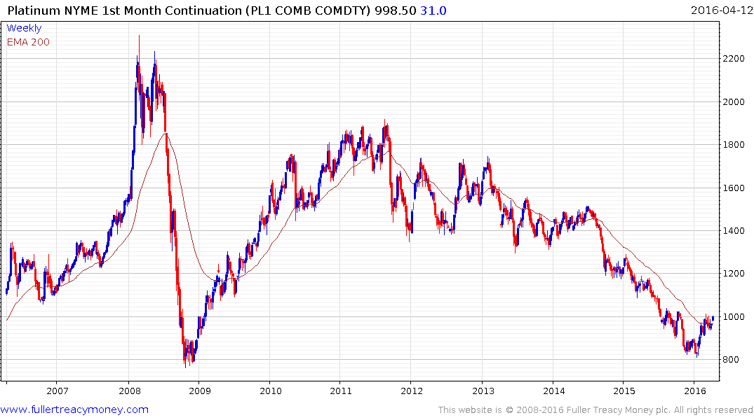
Platinum
Historically, platinum has usually
traded at a premium to gold but is clearly lagging this time, but for how long?

Slide 21
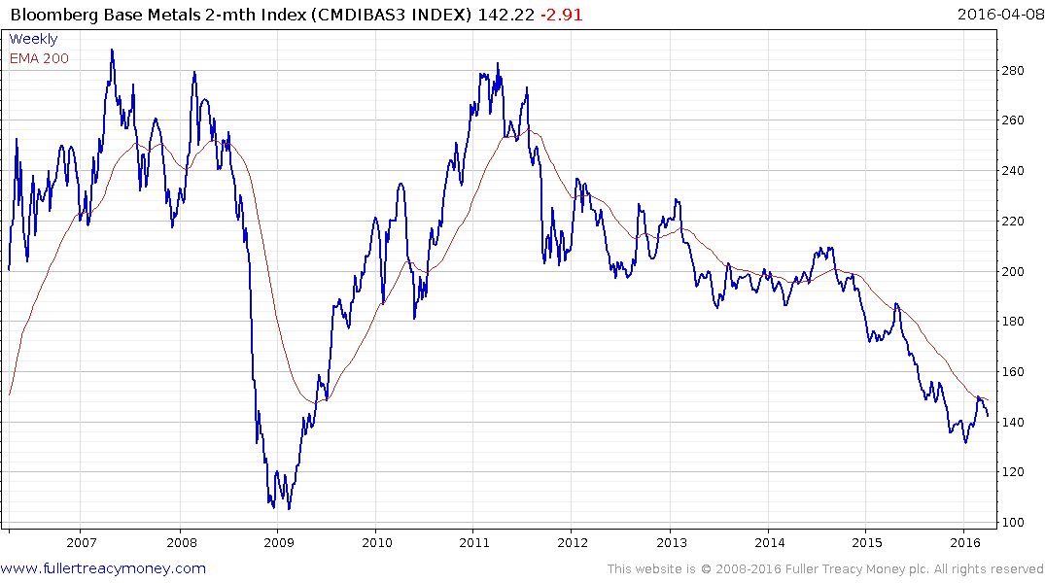
Bloomberg Base Metals Index
Needs to find support near 140
and extend recovery, turning MA
up in the process to show clearer
evidence that it has bottomed

Slide 22
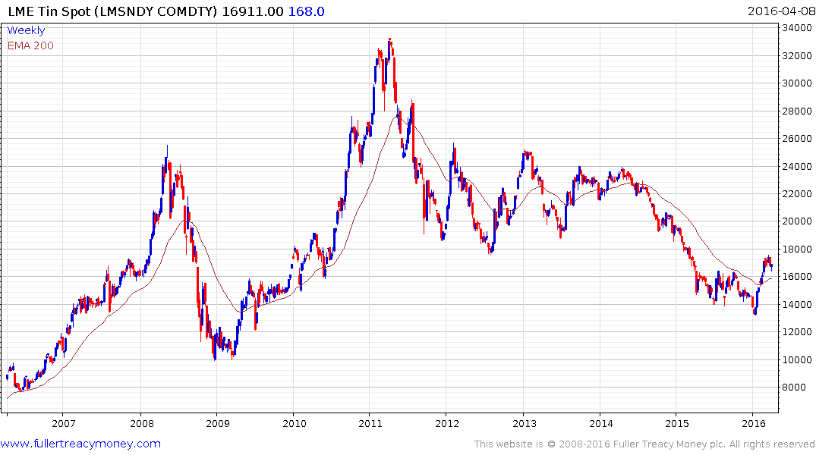
LME Tin (spot)
shows the best
recovery to date
among LME
base metals

Slide 23
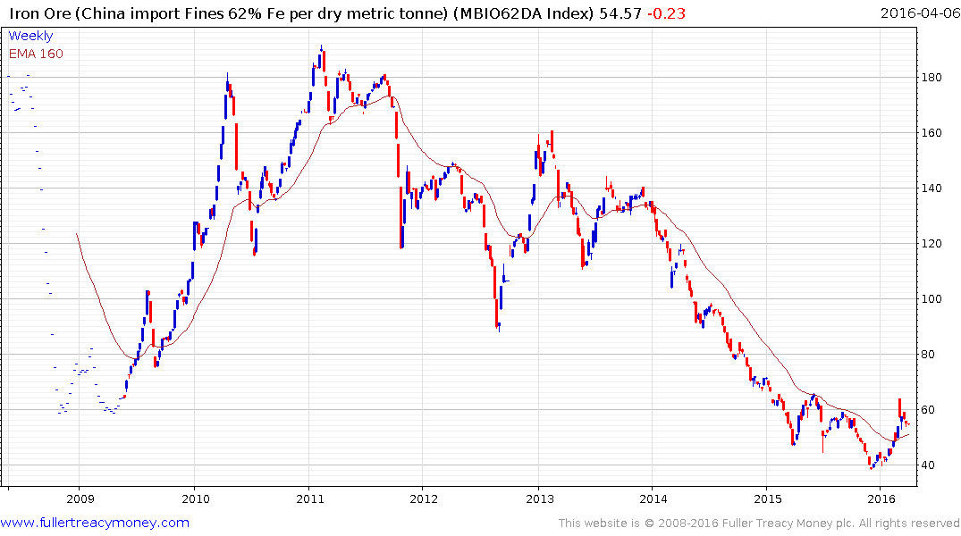
Iron Ore
shows evidence that
it is bottoming out

Slide 24
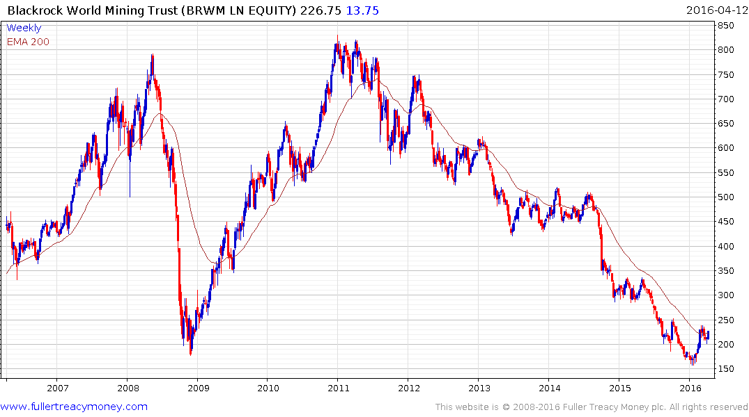
Black Rock World Mining Trust
(BRWM LN)
Speculative recovery candidate
Caveat: I have a small PA position

Slide 25
Are US 10-year Treasury Bonds a bubble?
No, if you expect deflation and minimal GDP growth to
persist for many more years.
Yes, if you think global GDP growth and/or inflationary
pressures will rise over the next few years.
Common sense suggests government bond yields will not sustain record low yields beyond the lengthy medium term.

Slide 26
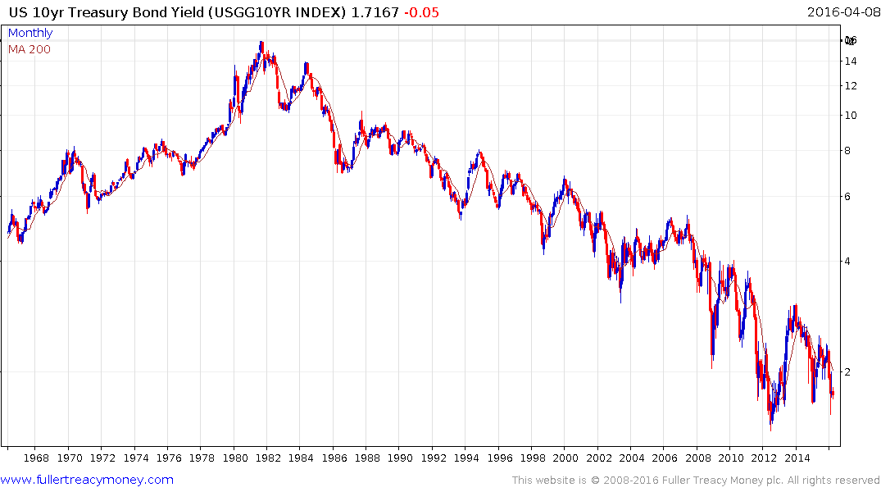
US 10-Yr Treasury Bond Yield
since 1966
Semi-log volatility
has increased.
Is this climactic activity?

Slide 27
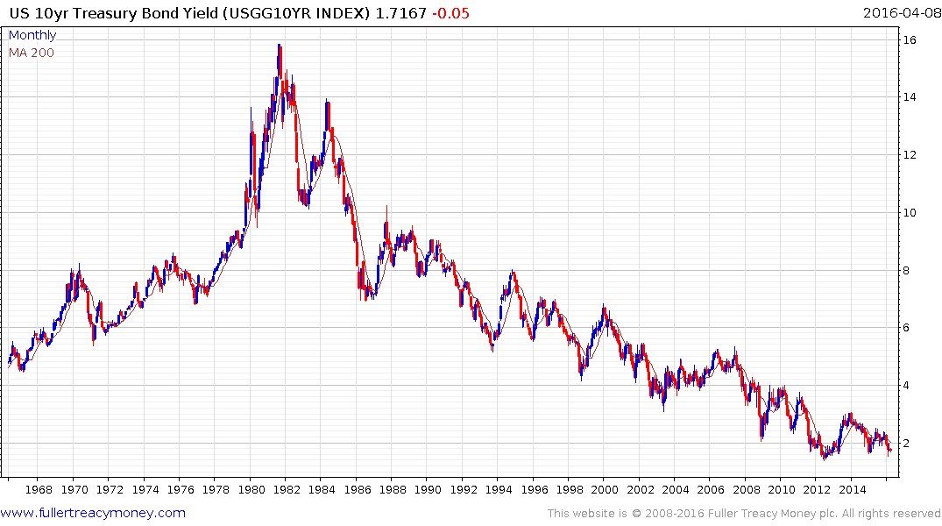
US 10-Yr Treasury Bond Yield
since 1966
Arithmetic scale does not
show increased volatility,
so not necessarily climactic

Slide 28
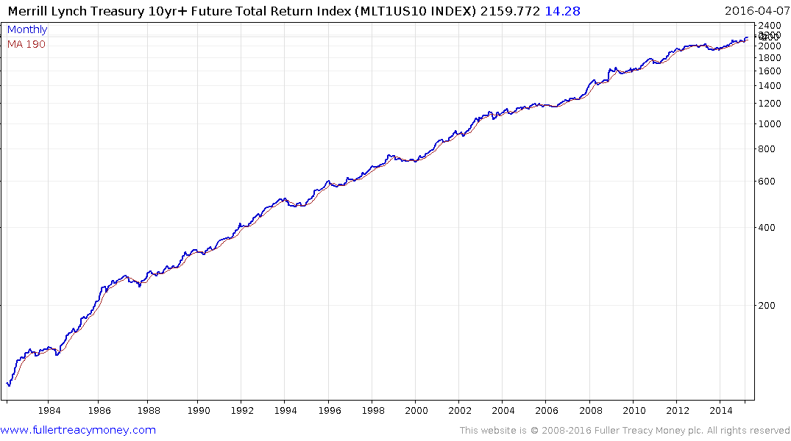
Merrill Lynch Treasury 10-Yr
Future Total Return Index
since 1982 (semi-log scale)

Slide 29
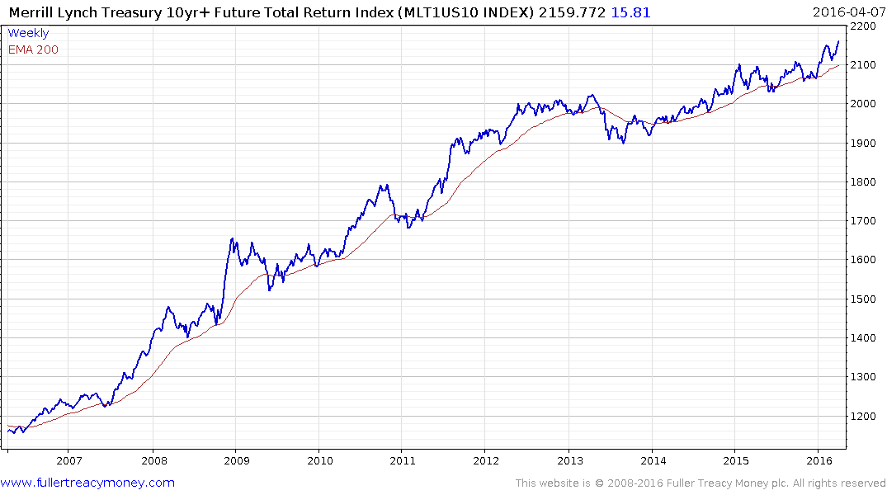
Merrill Lynch Treasury 10-Yr
Future Total Return Index
since 2006, (arithmetic scale)
Watch for an eventual correction
which clearly exceeds the last three biggest reactions, as evidence of
capitulation

Slide 30
Global Stock Markets
A number of recoveries from bear market lows
Wall Street is short-term overbought in upper side of ranges
A number of other stock markets are short-term overbought
US corporate profits are declining, on average, for a third straight quarter and valuations are not cheap
Contra-cyclical commodity shares are now outperforming

Slide 31
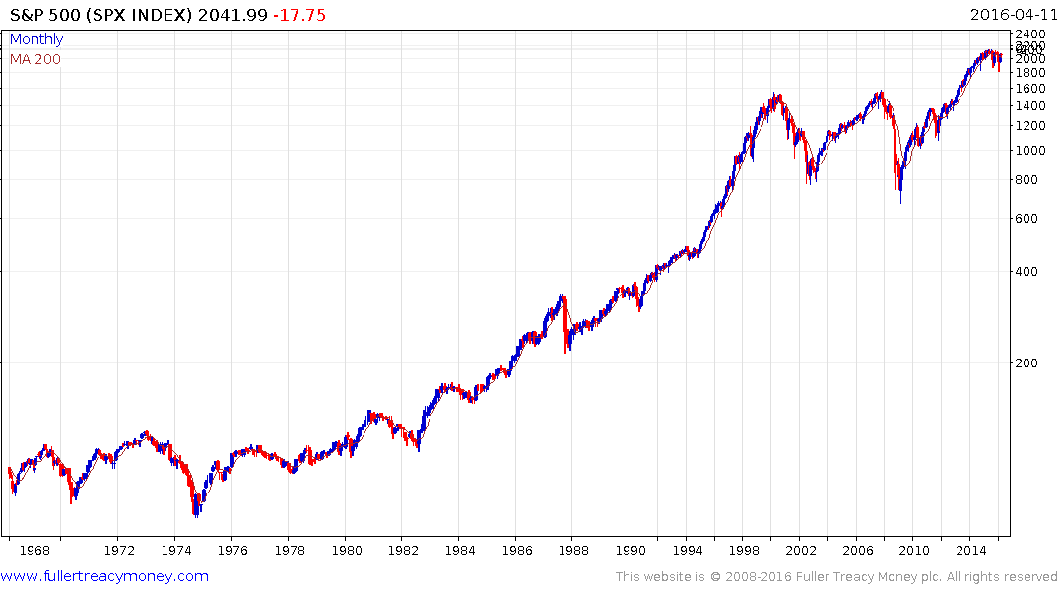
S&P 500 (SPX Index)
P/E 18.74, Yield 2.19%
Is this cycle
repeating above?
If so, the S&P will
first move somewhat
lower, with valuations
improving, before
eventually resuming
the secular uptrend

Slide 32
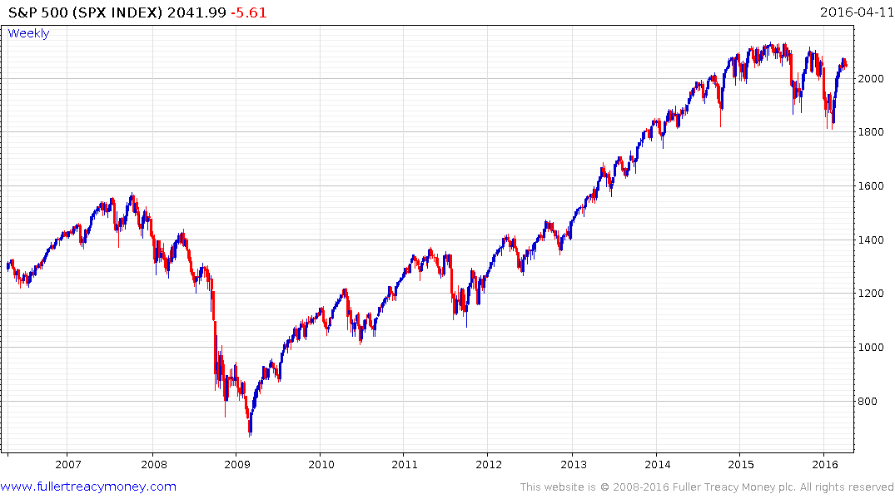
S&P 500 Index
Testing resistance in
upper side of lengthy
trading range

Slide 33
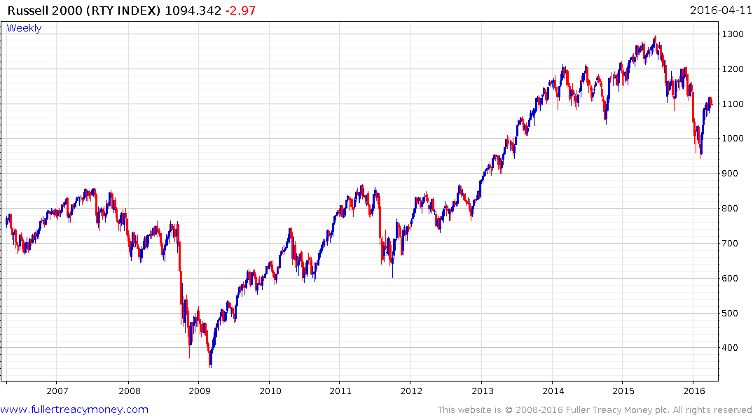
Russell 2000 Index
P/E 19.50, Yield 1.60%
A good indicator of US
stock market breadth, now
testing overhead supply

Slide 34
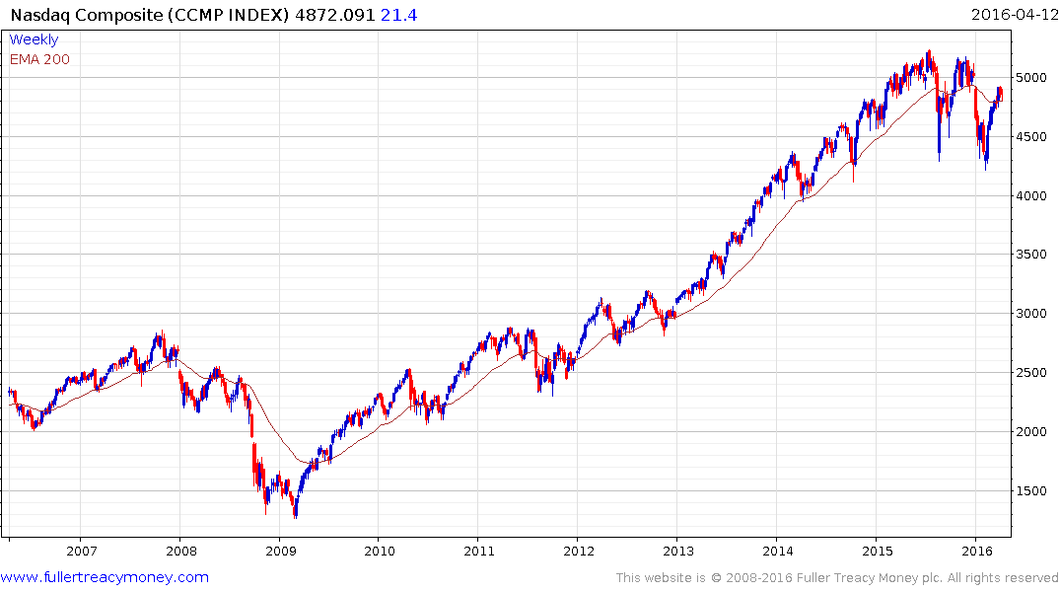
Nasdaq Composite Index (CCMP)
P/E 31.39, Yield 1.28%
Testing overhead resistance,
short-term overbought and no
longer leading on the upside

Slide 35
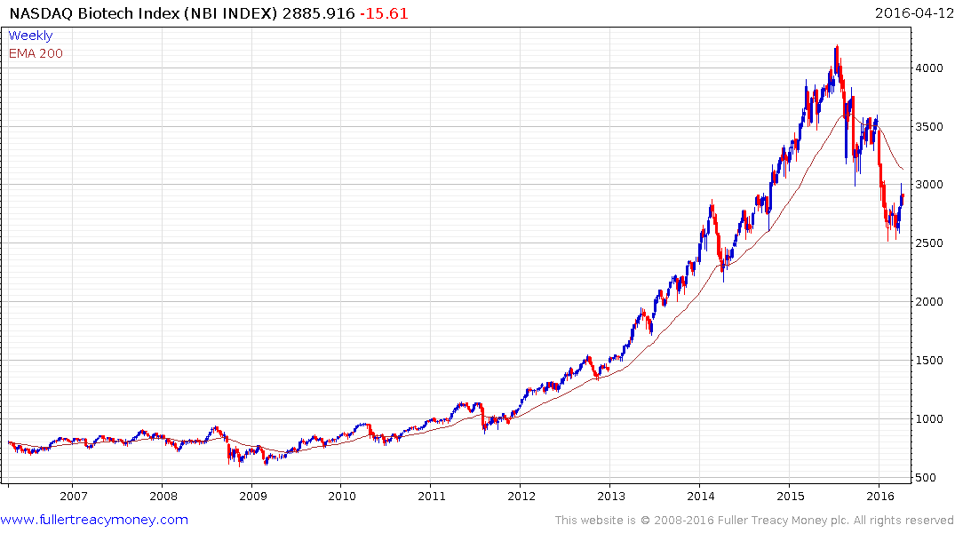
Nasdaq Biotech Index (NBI)
P/E 594.28, Yield 0.38%
Led on the upside, lengthy
medium-term peak but this
is creating long-term buying
opportunities in this very
promising sector

Slide 36
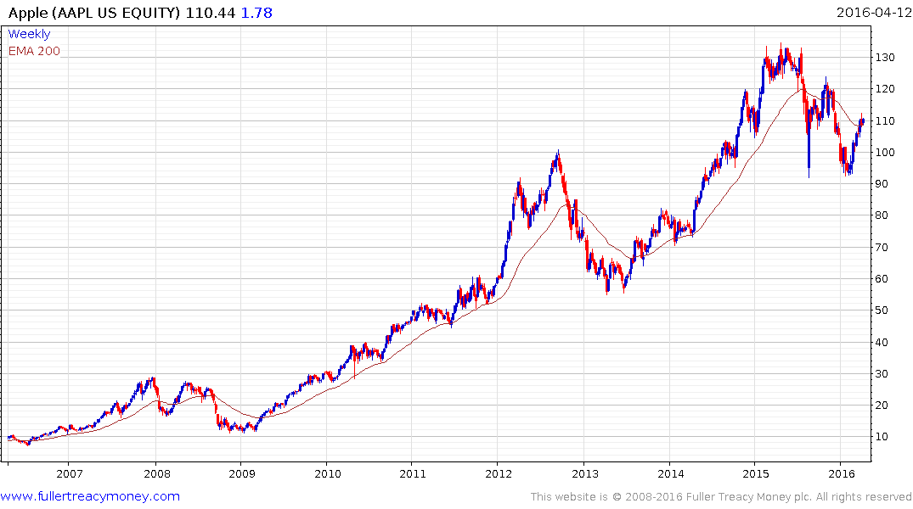
‘Iconic’ Apple (AAPL)
Est P/E 12.28, Yield 1.86
Medium-term peak and
currently underperforming
but not expensive

Slide 37
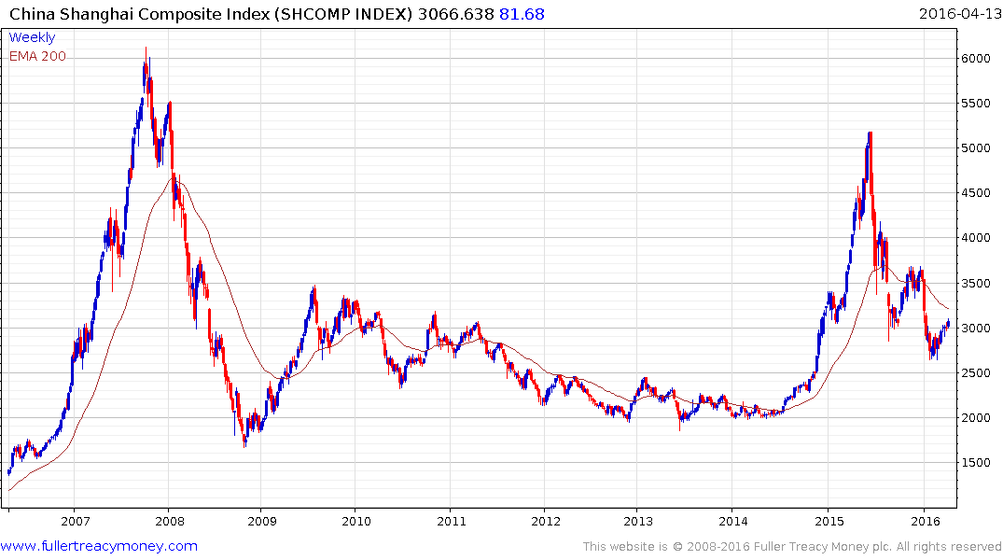
China Shanghai Composite (SHCOMP)
P/E 16.21, Yield 1.99%
Government currently providing support;
facing oxymoron of command capitalism
while creating a developed economy

Slide 38
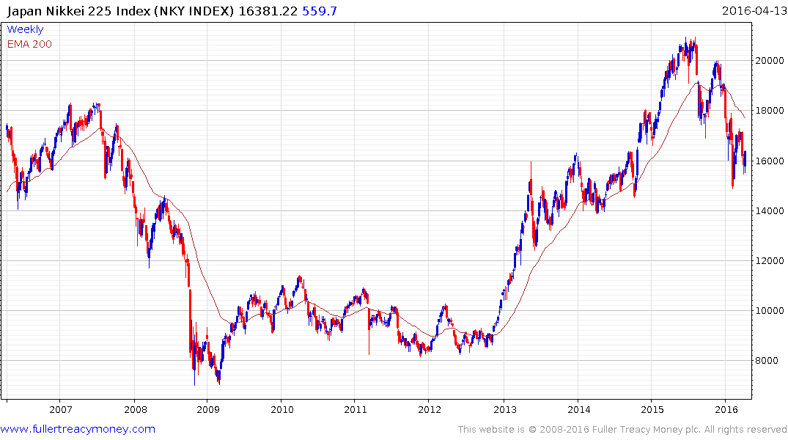
Japan Nikkei 225 (NKY)
P/E 18.54, Yield 1.85%
Enigmatic but attempting to
build support after cyclical
bear trend

Slide 39
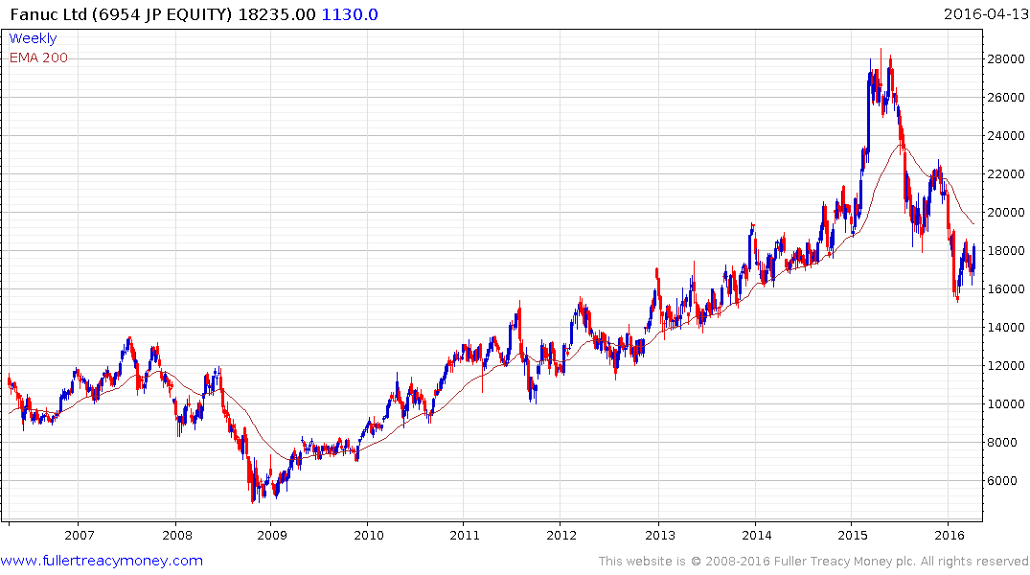
Fanuc Ltd (6954 JT)
Est P/E 22.99, Yield 4.24%
Global leader for industrial
robotics and no debt
Caveat: I have a long-term
Investment in Fanuc

Slide 40
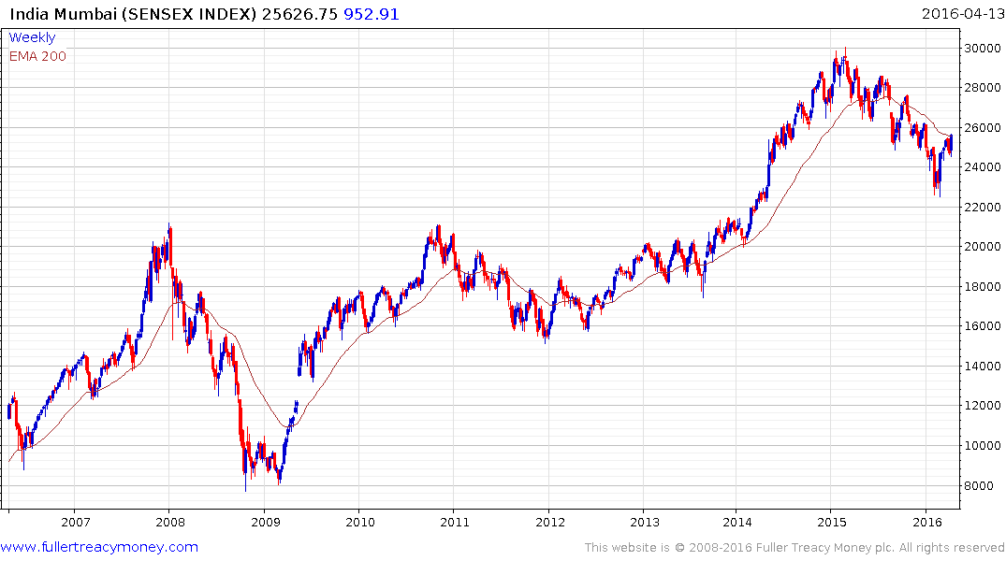
India Mumbai (Sensex)
P/E 19.68, Yield 1.59%
Currently world’s fastest
growing economy
Probable floor
Good governance at the top -
N Modi & R Ragan - but
chaotic political system below

Slide 41
Nordic Stock Markets

Slide 42
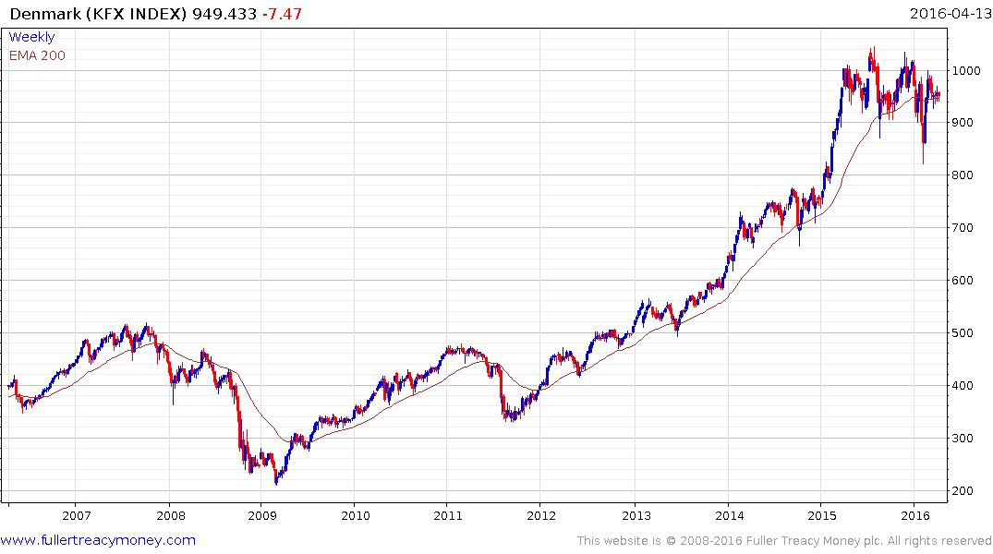
Denmark (KFX)
P/E 28, Yield 2.17%
Relative outperformance
but not cheap and still in
lengthy ranging phase

Slide 43
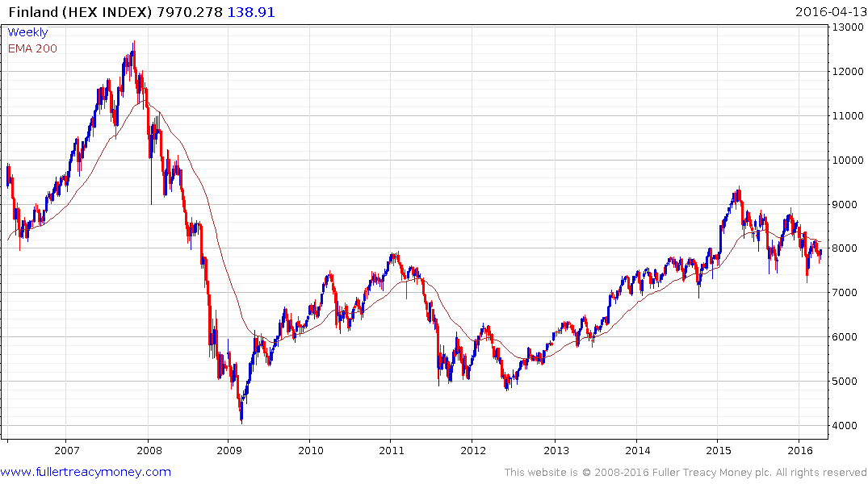
Finland (HEX)
P/E 17.31, Yield 4.09%
Possibly recovering, needs
to confirm by breaking
above last high

Slide 44
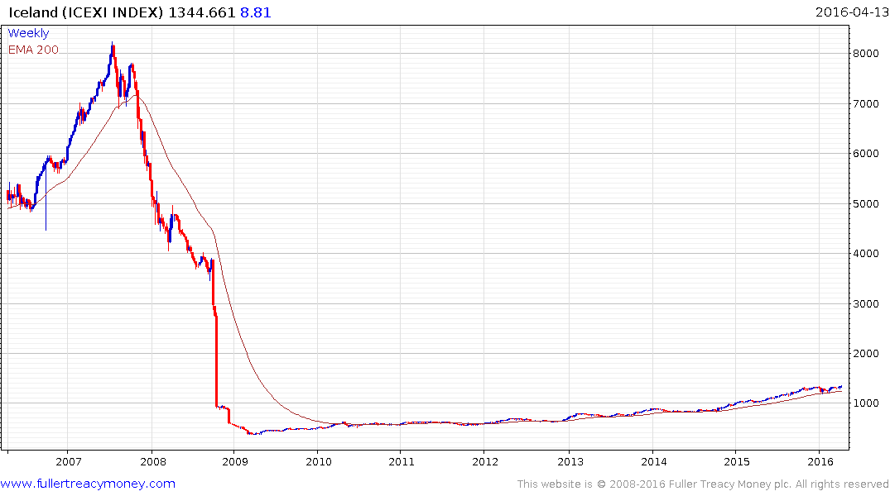
Iceland (ICEXI)
P/E 16.11, Yield 2.55%
Impressive, consistent
recovery following the
crash

Slide 45
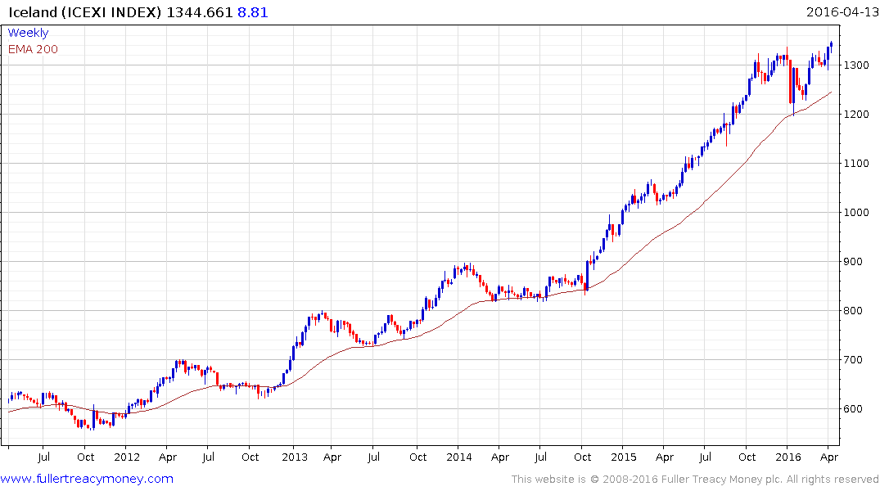
Iceland (ICEXI)
resuming uptrend

Slide 46
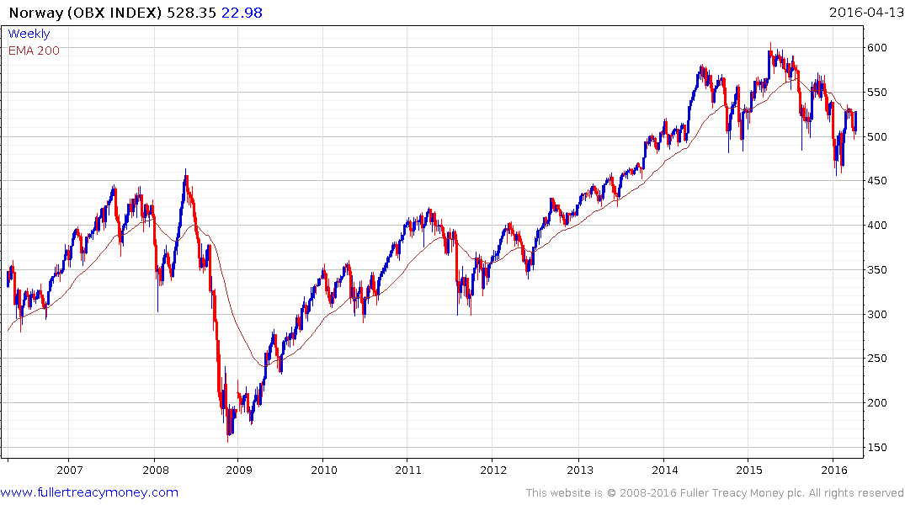
Norway (OBX)
P/E 44.35, Yield 4.04%
Recovering, needs to
hold above 500

Slide 47
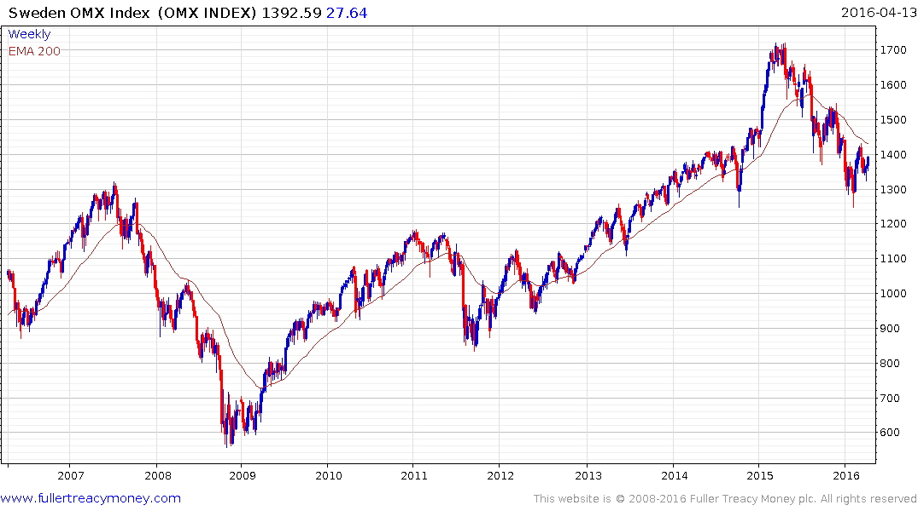
Sweden (OMX)
P/E 17.23, Yield 4.53%
Close above last high would
confirm recovery underway

Slide 48
Many thanks for your interest!
Any questions?
Please visit our site:
www.fullertreacymoney.com

Slide 50
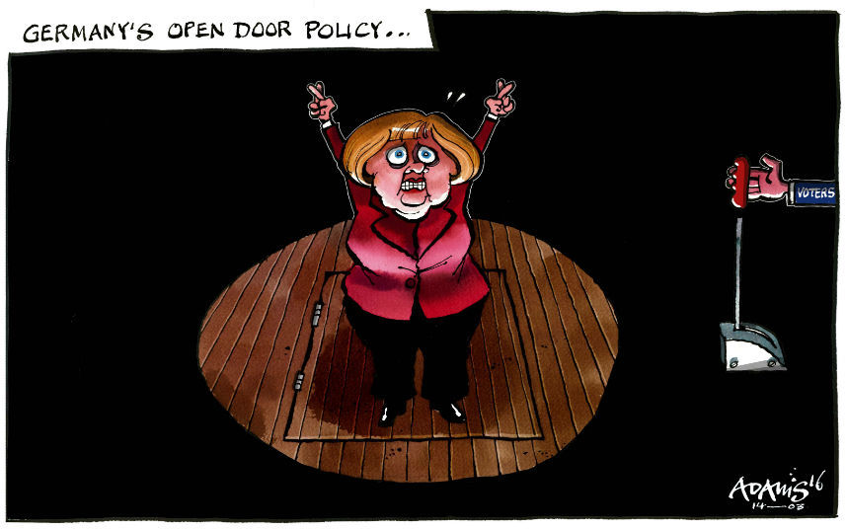

Slide 51
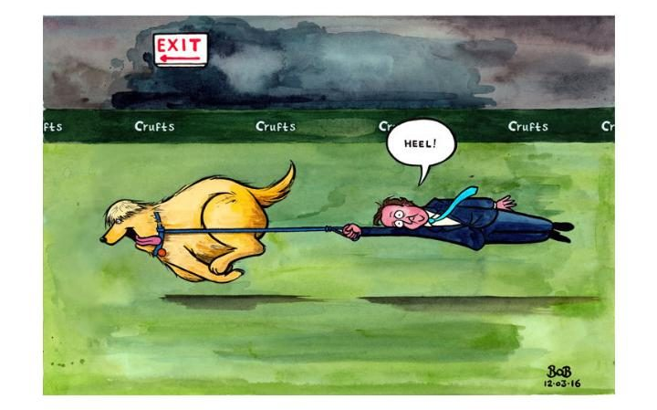

Slide 52
Technical warning signs to watch for among indices
Trend acceleration relative to 200-day moving averages
Declining market breadth (fewer shares rising)
Failed upside breakouts from trading ranges
Loss of uptrend consistency characteristics
Churning price action relative to recent trading ranges
Breaks of 200-day moving averages
Broadening patterns for trading ranges following uptrends
200-day moving averages turn downwards
Resistance is encountered beneath declining 200-day MAs
Previous rising lows are replaced by lower rally highs
Indices fall faster than they rose to their highs

