Slide 1
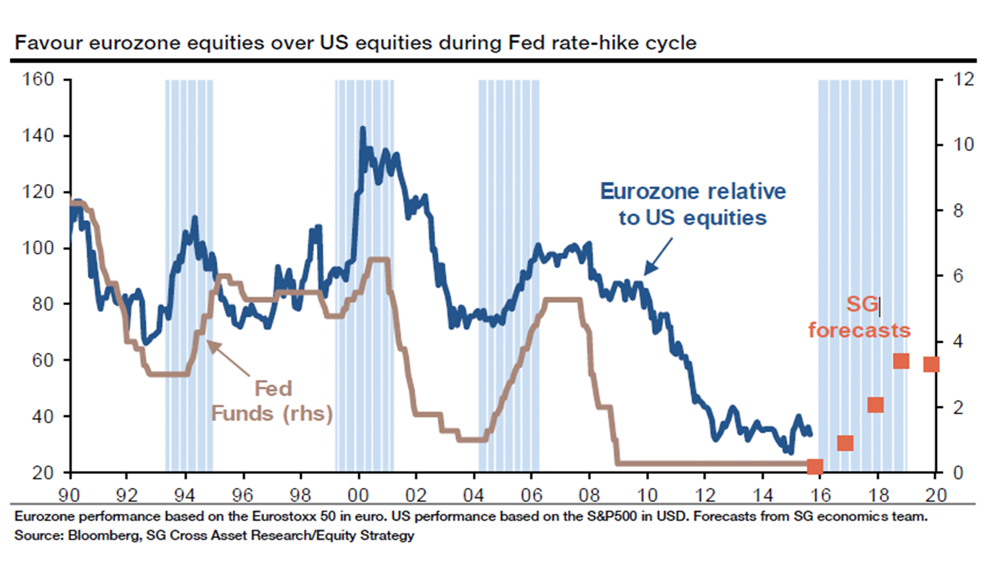
MARKETS NOW 28th SEPTEMBER 2015
David Fuller, Dr Paul Jourdan, Iain Little

Slide 2



What is “Markets Now”?
A Lively Forum for Sharing Investment Ideas
Big Picture Strategy (DF, BA)
“Private client”high quality, long term ideas (IL)
Our promise:
  INDEPENDENT, GLOBAL INVESTMENT ADVICE
  NO SALES, NO HYPE, NO MARKETING
  NO PRODUCT PUSHING
Please contribute with:
  QUESTIONS
  CONCERNS
  IDEAS

Slide 3
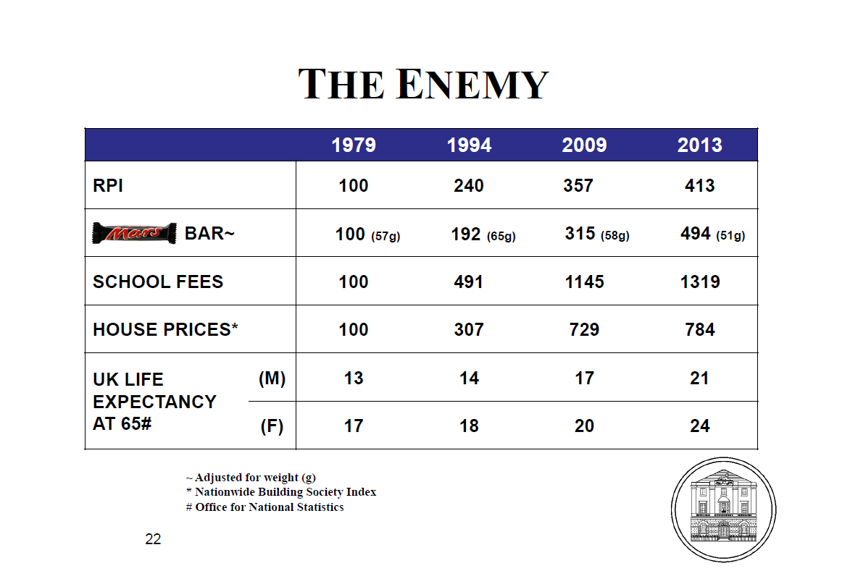
What Is The Biggest Risk for Private Investors?
Don’t believe a word of it! Your number is 1000+
That’s inflation too
Tell me about it!
21+24=45
45 x £50,000 pa = £2.25mn
50% healthcare costs last 2 yrs of life

Slide 4
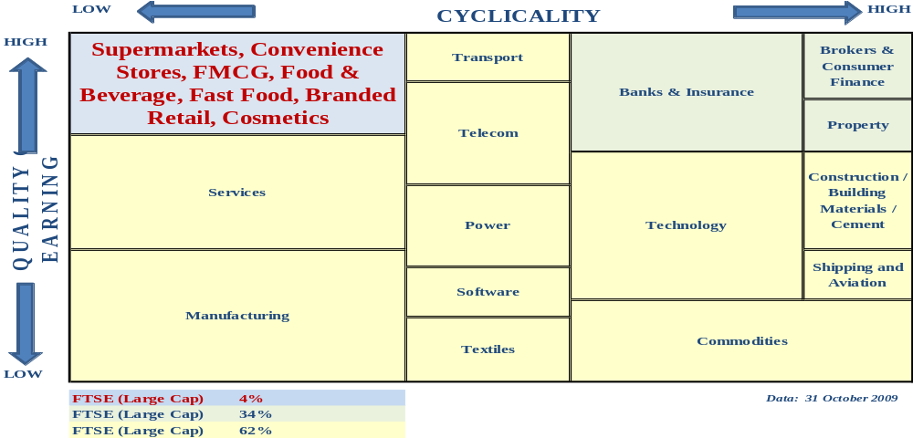
What Is The Perfect Investment (Equities)?
Source: Arisaig Partners
Quality Private Client investments mainly found Top Left Hand Corner: simple businesses, high cash flow, investor friendly

Slide 5
What Is The Perfect Investment (Funds)?
    Long-term (does better than…..)
    Leverage, but only if needed
    Discounts to real asset value («Leverage at a discount»)
    Governance: proper auditing, proper board, transparency
    Know-How proven over 100+ years
    Liquid, but… (real time trading on SE)
    Low management costs (1/4 to 1/2 the cost of rivals)
    New money non-dilutive (if successful /at discount)
    Global but can be specialist?
    Daily valuations, daily reporting
    Yield. Growing dividend stream payable out of «Reserves»
    Elected management, retail participation, proper AGMs
    Information inefficiencies. Hated by brokers

Slide 6
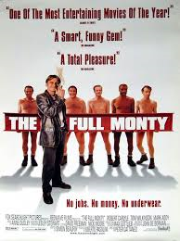
Trusts In Focus (TIF) SERVICE
Universe c300 closed end (mainly UK) investment trusts monitored
Up to 15 equally-weighted trusts held in Trusts In Focus (TIF)
If we sell an investment trust, we must replace it
Changes to trusts recorded (1.25% trading costs B/S)
Research available to «Markets Now» attendees
    3rd party adviser research referenced
    FullerTreacy Money one of 20+ 3rd party advisers
    In-House Cooking/ P&C research
Performance review / indecent striptease every «Markets Now»

Slide 7
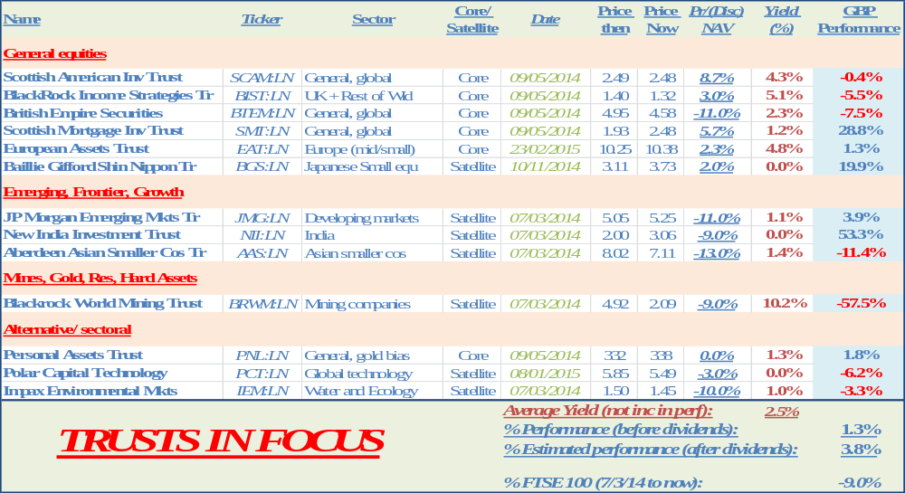
How Are We Doing: Trusts In Focus?
Performance So Far (since 7/3/14)
O’perf +13%

Slide 8
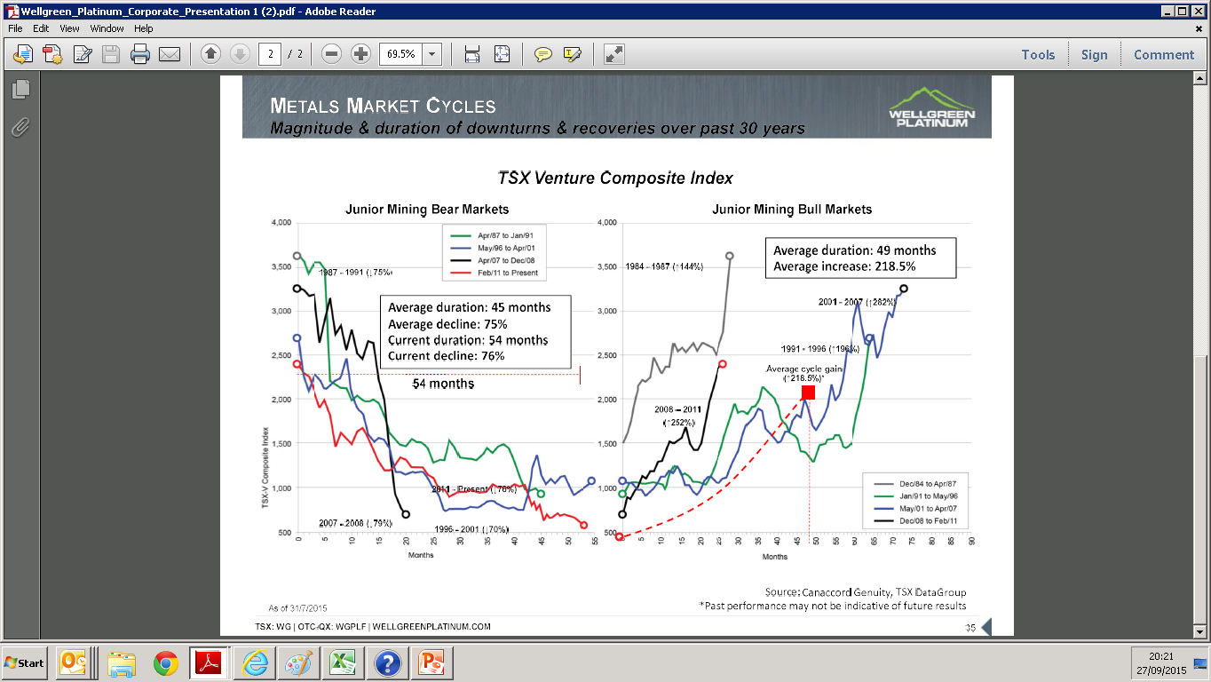
What’s Interesting Today
Miners: Where Are We in The Cycle?

Slide 9
What’s Interesting Today
Miners: Where Are We in The Cycle?
Current junior mining bear almost longest ever
96/2001 bear down 70%, lasted 59 mths
2011 bear down now 76%, lasted 55 mths
If it goes to 59 mths this takes us to January 2016
Average increase +218% after end bear market
Likely within 4 mths of start major move up
Time to add exposure GDXJ and junior mines?

Slide 10
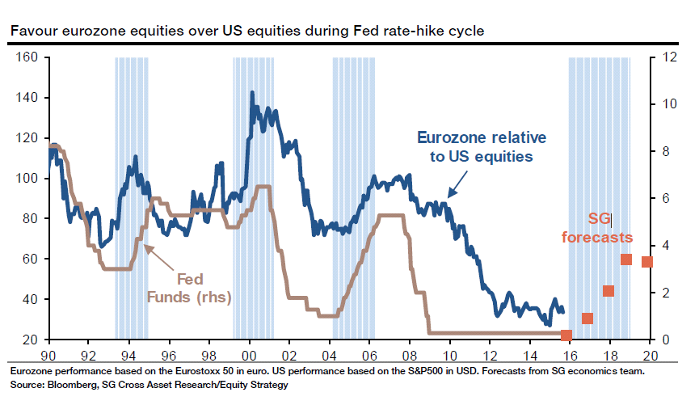
What I’m Buying Today (CORE)
Europe

Slide 11
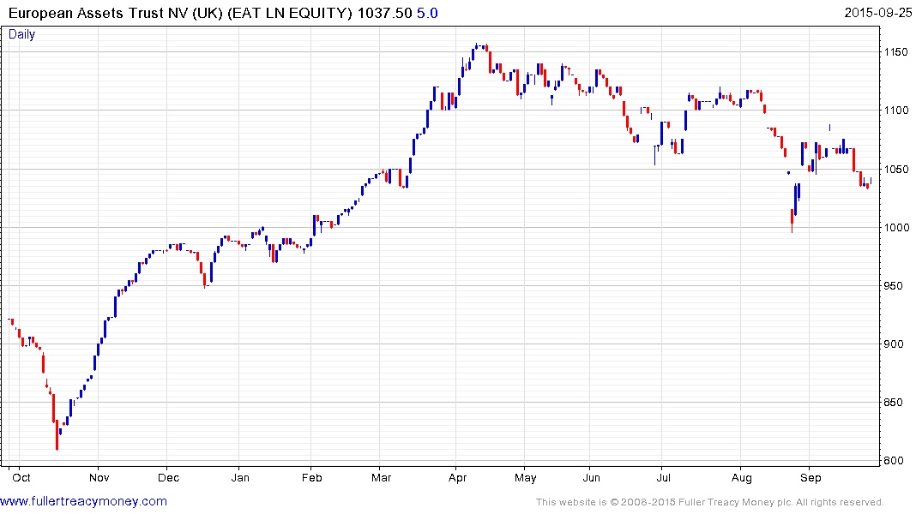
What I’m Buying Today (CORE)
European Assets Trust (10.38p)
Bt 23/2 at 10.25

Slide 12
What I’m Buying Today (CORE)
European Assets Trust (10.38p)
+2% premium to NAV, GBP 300mn Mkt Cap
5.5% -6.0% yield (paid 3x pa) 2015
Gearing 1% (can be 20%)
Objective: 100% smaller European cos (no UK)
Bogey: Euromoney Smaller European Cos Ind
Mgr F&C (Sam Cosh), fees 0.8% (TER 1.6%)
40-60 names, concentrated, diversified by sector

Slide 13
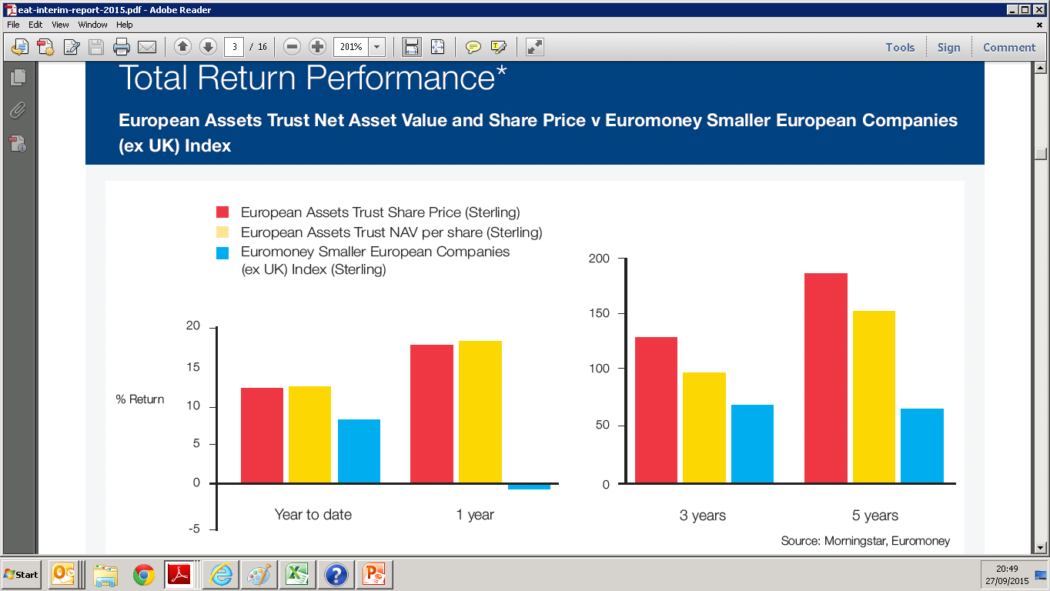
What I’m Buying Today (CORE)
European Assets Trust (10.38p)

Slide 14
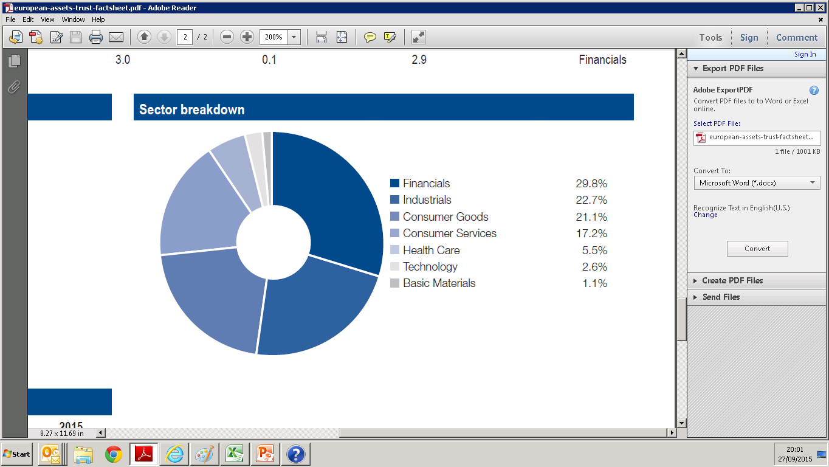
What I’m Buying Today (CORE)
European Assets Trust (10.25p)

Slide 15
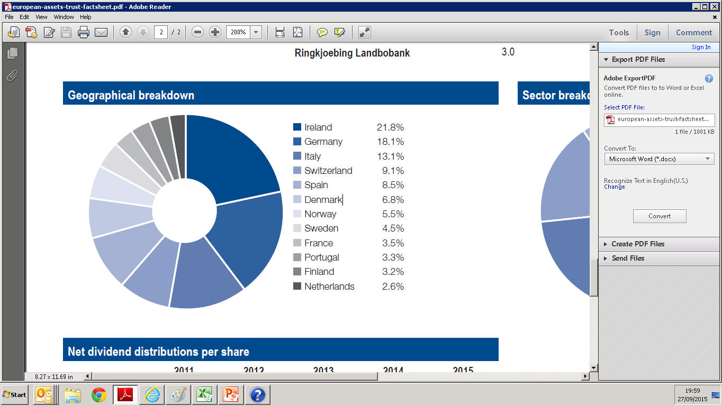
What I’m Buying Today (CORE)
European Assets Trust (10.38p)

Slide 16
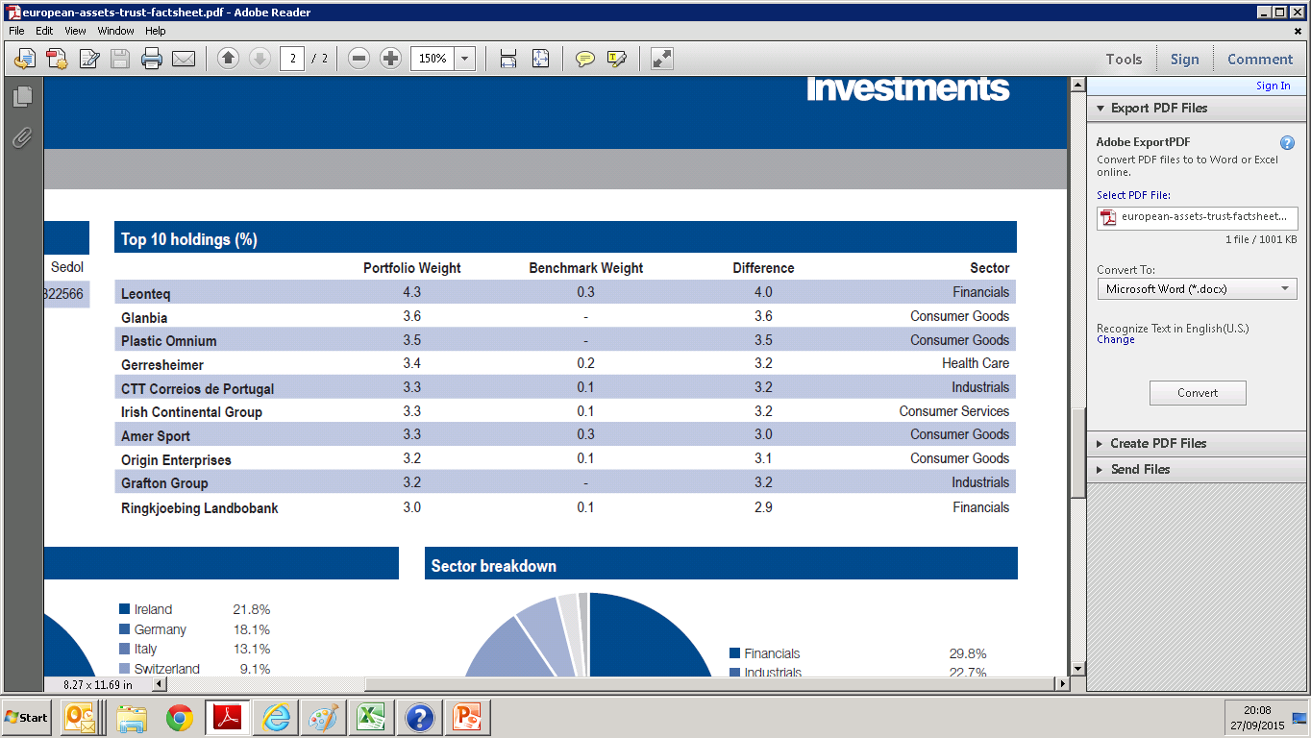
What I’m Buying Today (CORE)
European Assets Trust (10.38p)

Slide 17
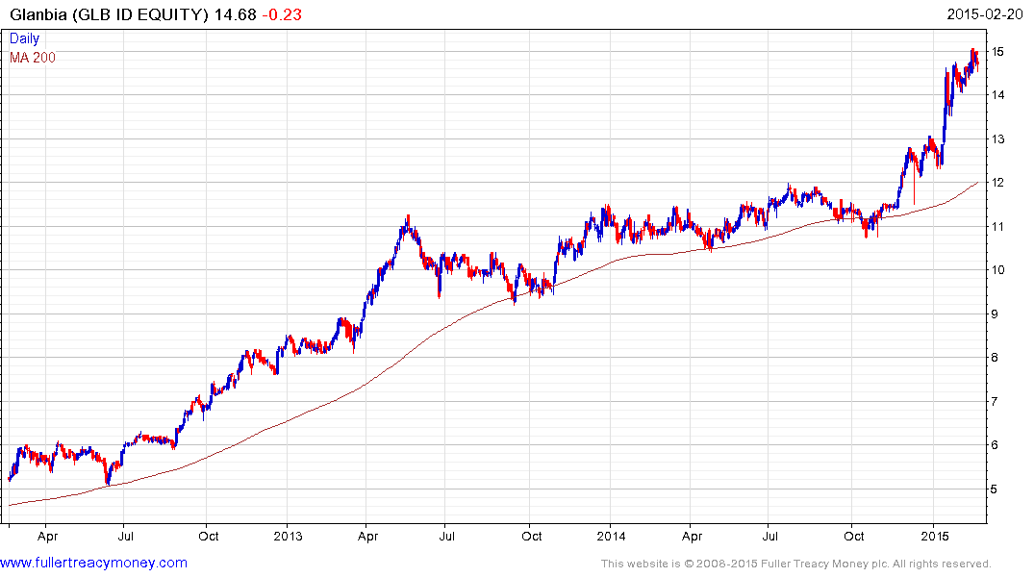
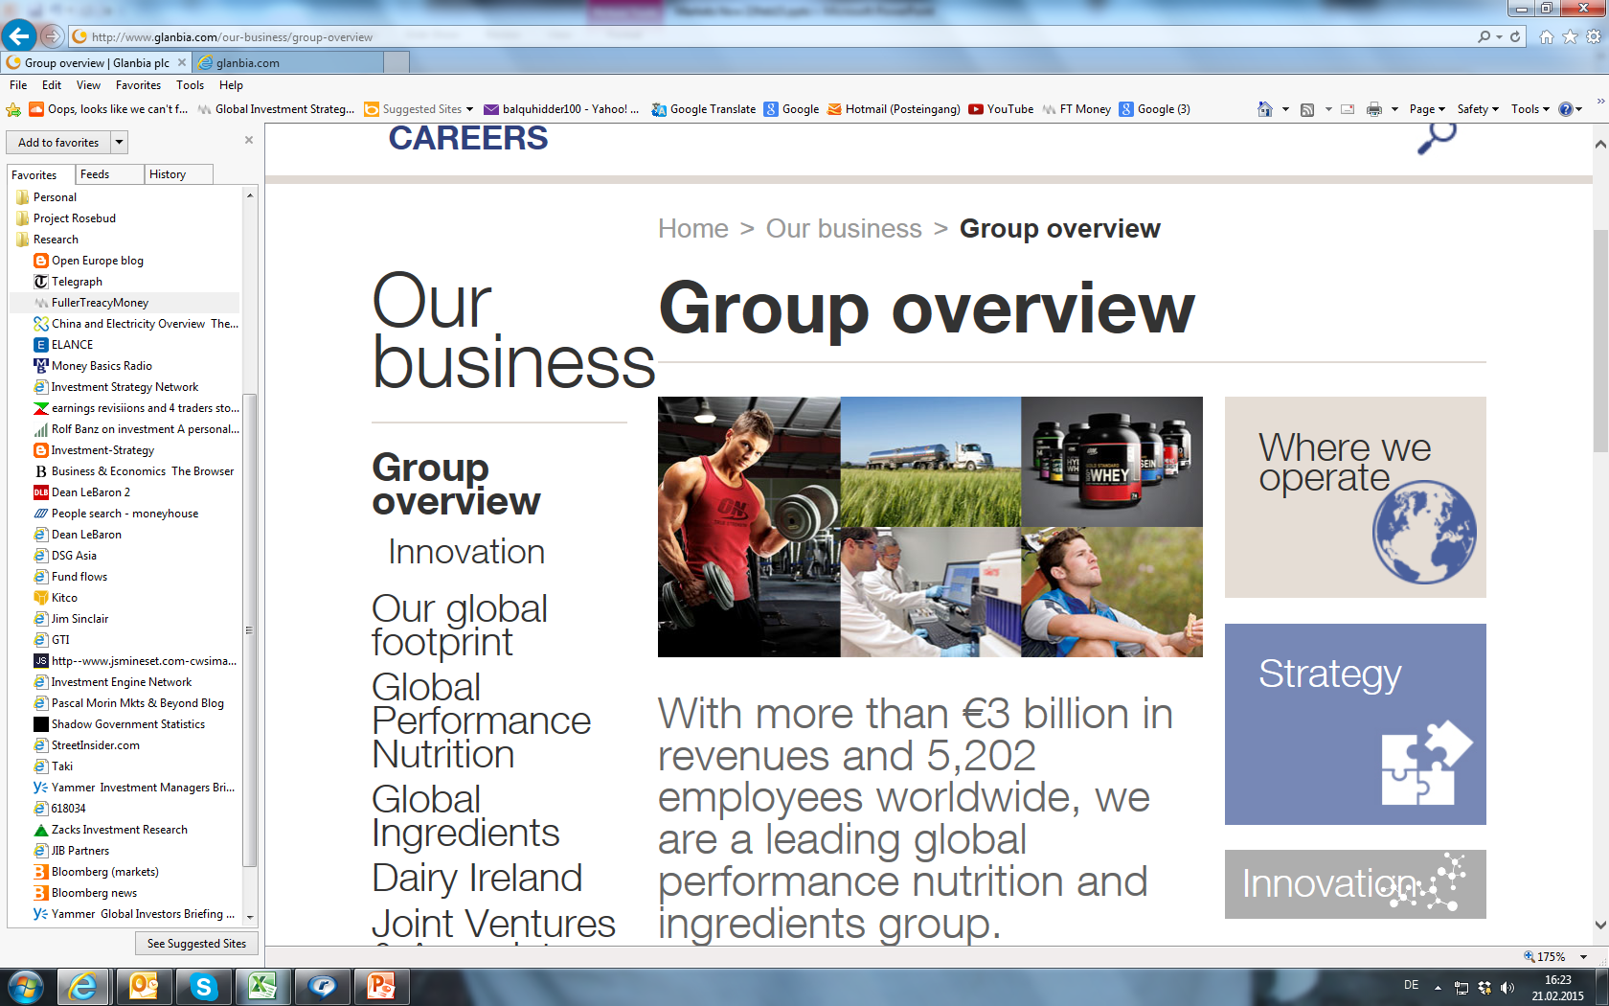
What I’m Buying Today (CORE)
European Assets Trust (10.38p)
Irish global performance nutrition

Slide 18
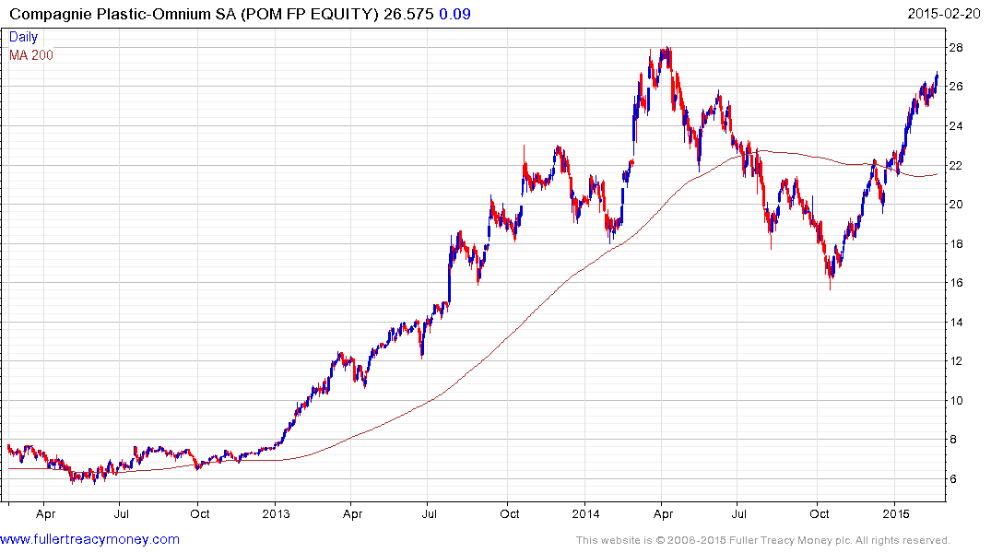
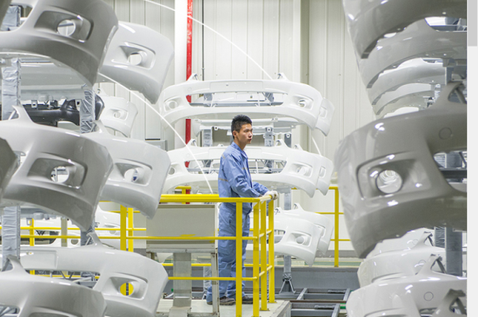
What I’m Buying Today (CORE)
European Assets Trust (10.38p)
French car body component modules, fuel storage, distribution systems

Slide 19
Important Notice
This document has been issued in a private capacity by Iain Little, an employee of European Wealth (Switzerland) SA, a member of the European Wealth Group Limited, for the information of experienced investors only. It is not and should not be construed as an offer to sell or the solicitation of an offer to purchase or subscribe for any investment.
Iain Little, an employee of European Wealth (Switzerland) SA, has based this document on information obtained from sources he believes to be reliable but which he has not independently verified; European Wealth (Switzerland) SA therefore makes no guarantee, representation or warranty and accepts no responsibility or liability as to its accuracy or completeness.

