Slide 1
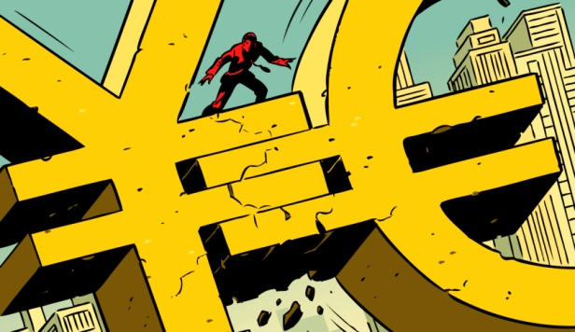
Round-The-Clock-Trader
May 20th 2015
Eoin Treacy
FullerTreacyMoney.com
Currencies Matter

Slide 2
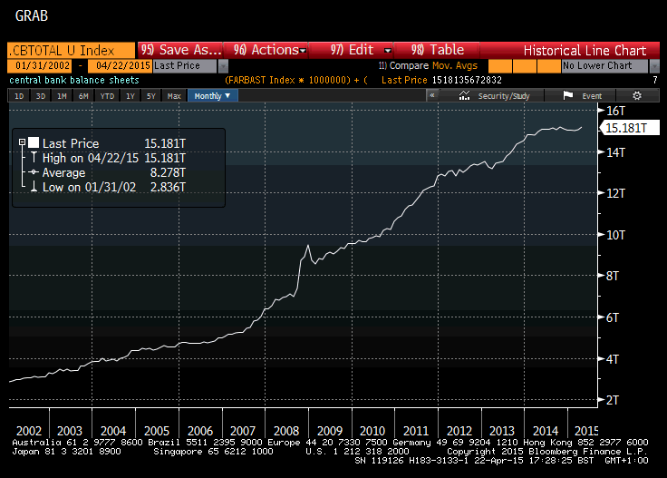
The combined Fed, ECB, BOJ, BoE and PBOC Balance Sheets rebased to US Dollars

Slide 3
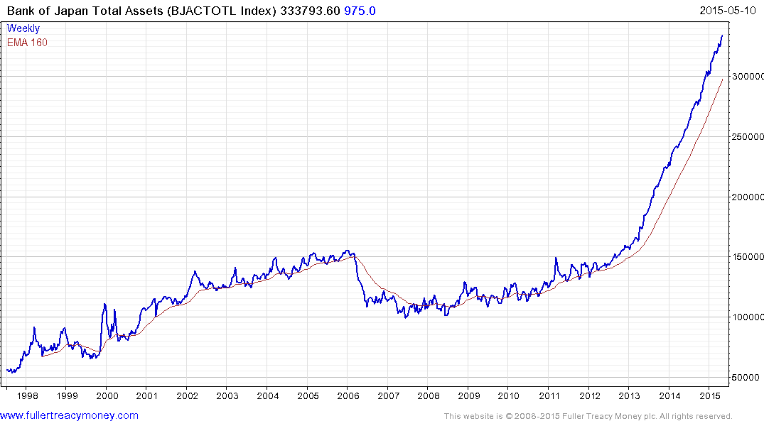
Bank of Japan Total Assets.

Slide 4
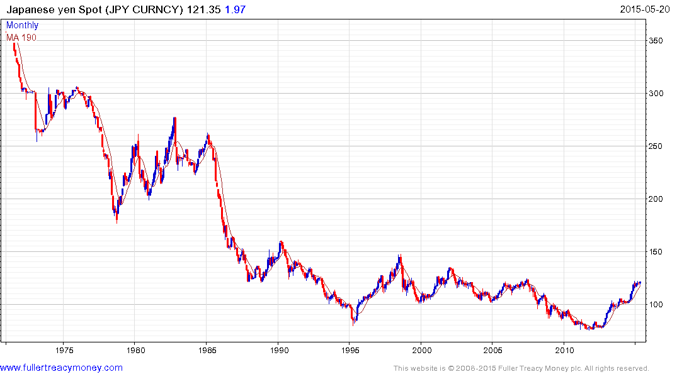
The Dollar is recovering against the Yen.

Slide 5
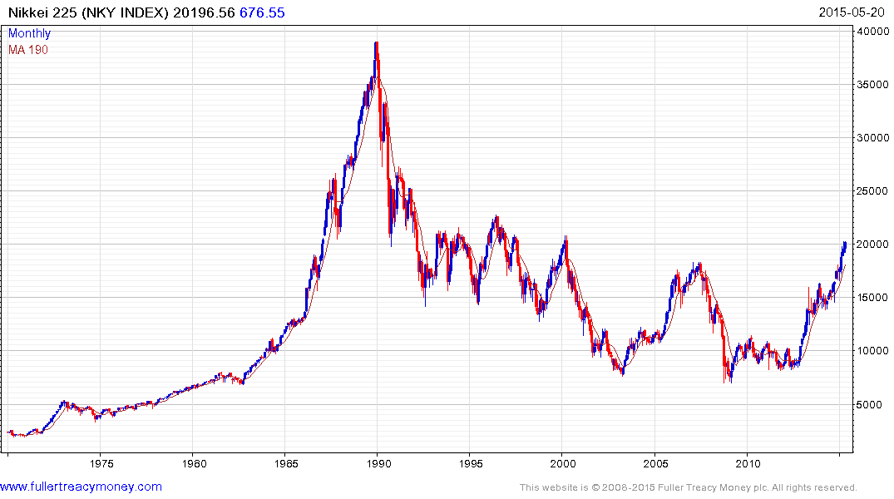
The Nikkei us moving through the psychological 20000 level.

Slide 6
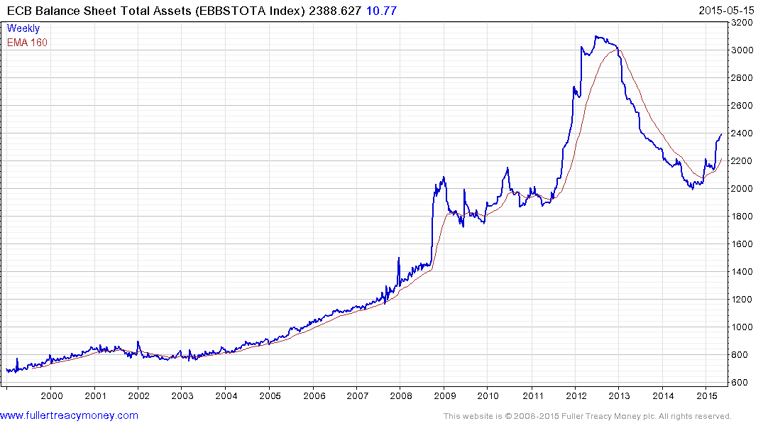
ECB’s Balance Sheet

Slide 7
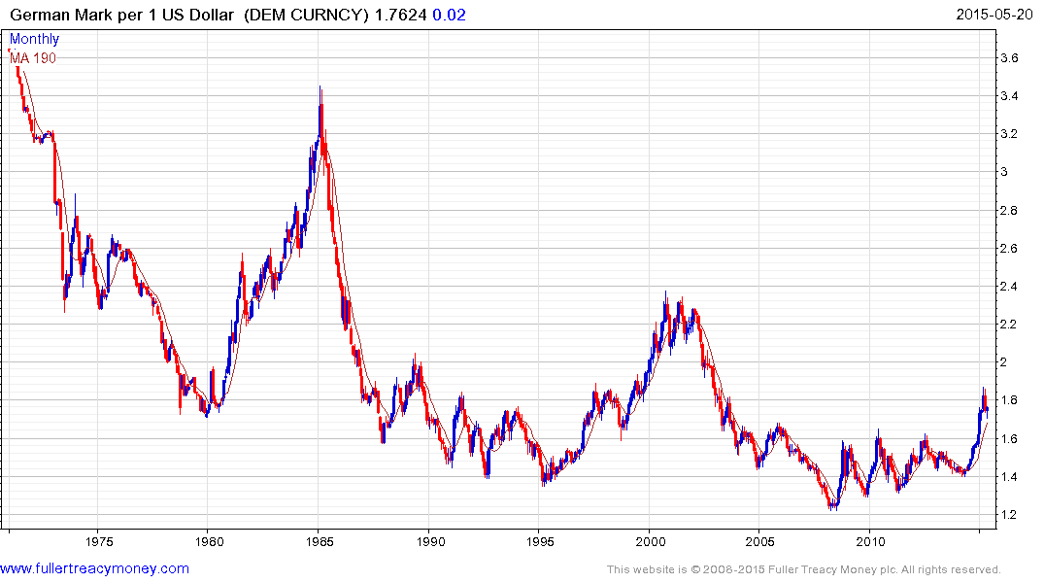
The Dollar is bouncing from the region of the trend mean.

Slide 8
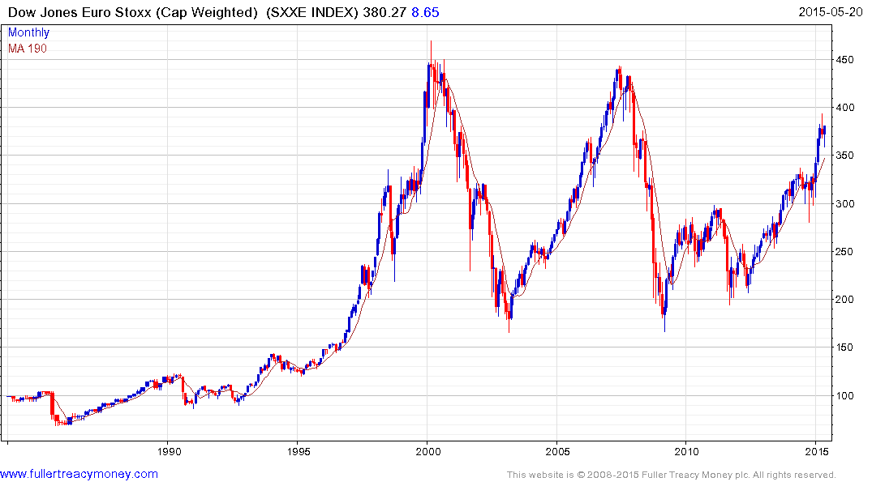
European Markets are rallying impressively in nominal terms.

Slide 9
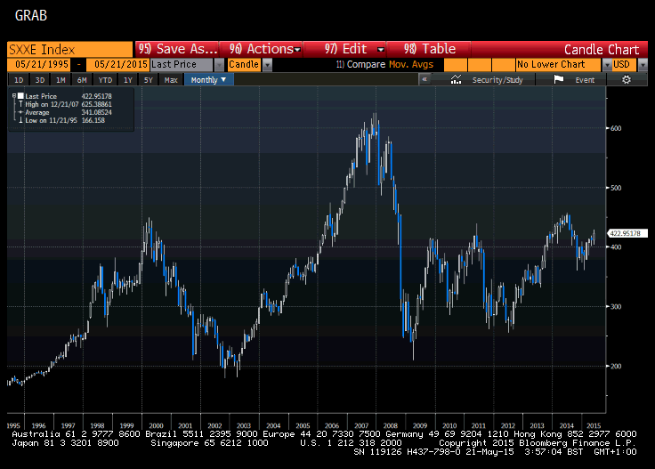
European Markets are rallying impressively in nominal terms.
Rebased to US Dollars European markets are less impressive

Slide 10
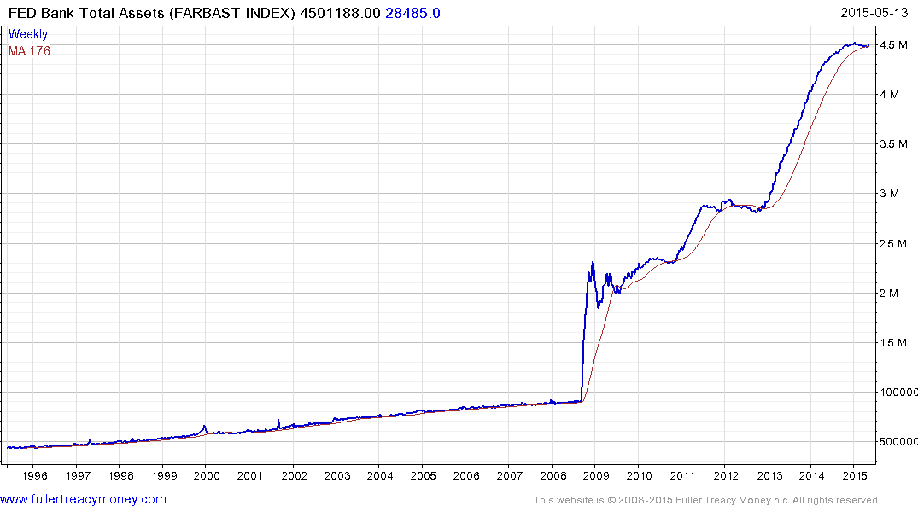
Fed’s Balance Sheet

Slide 11
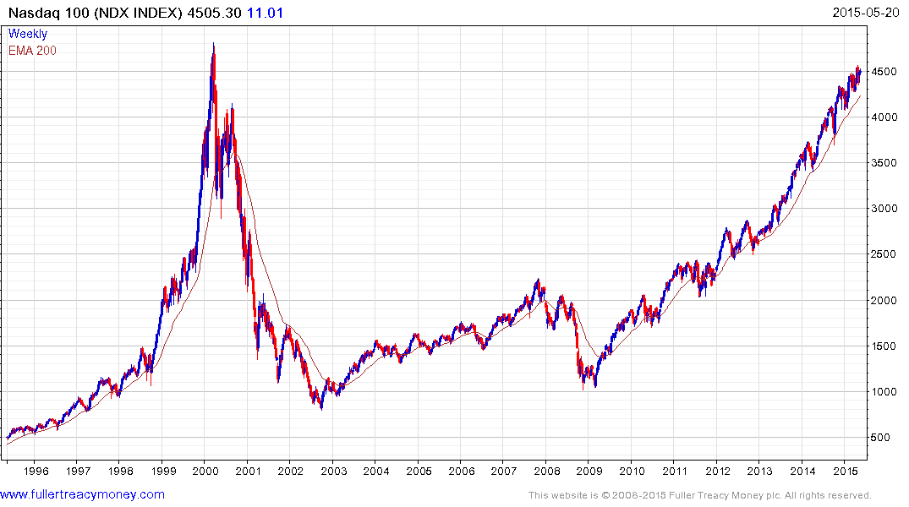
The Nasdaq is the relative strength leader.

Slide 12
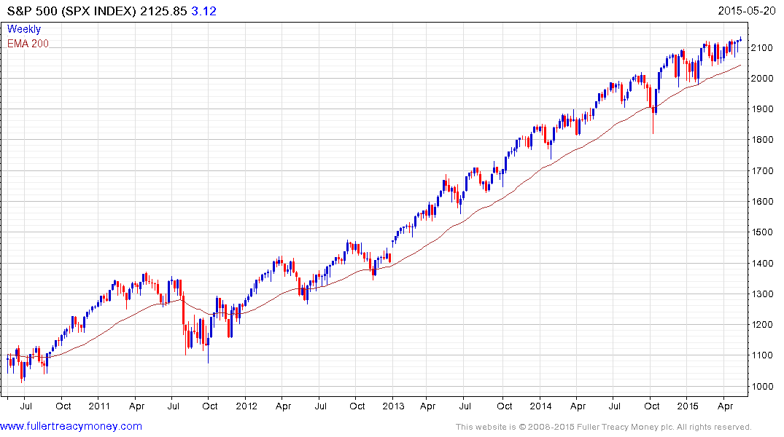
The S&P 500 is trending reasonably consistently

Slide 13
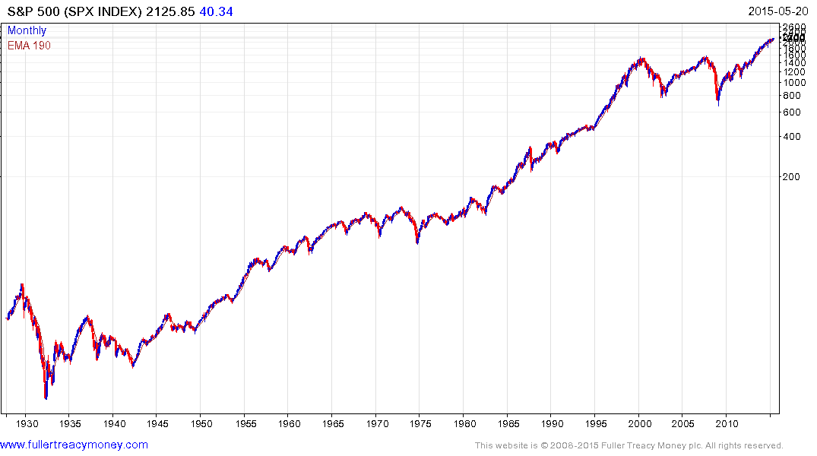
Over the last 90 years there have been a series of major bull and bear markets.

Slide 14
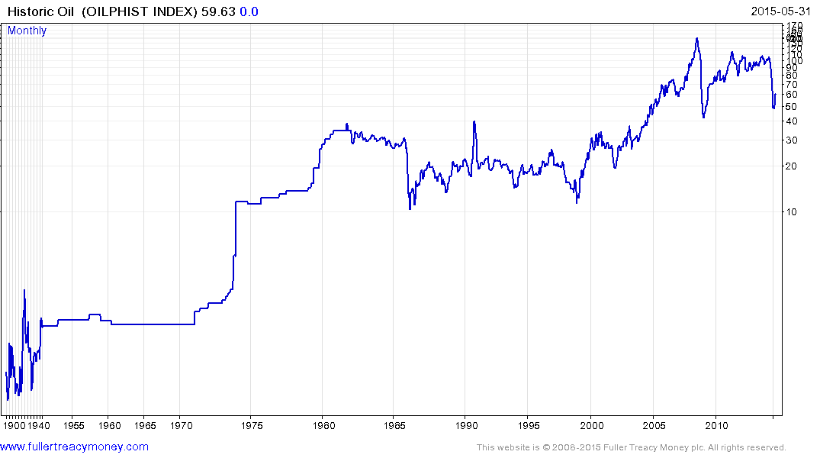
Equities aren’t the only market to exhibit long-term cyclicality

Slide 15
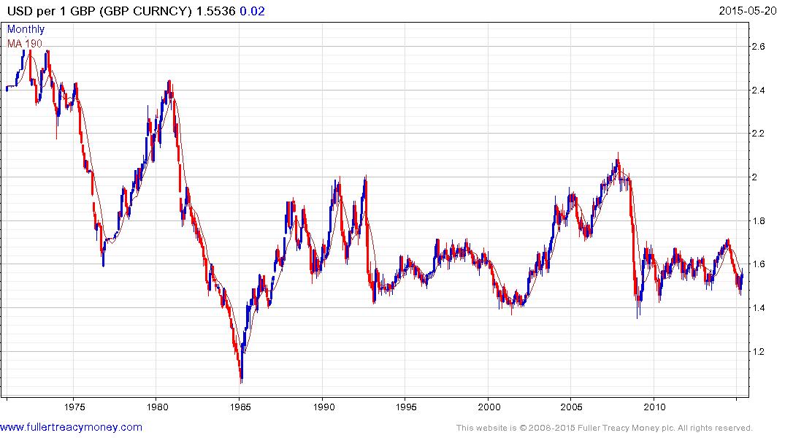
Currency devaluation is less of a threat for the British Pound.

Slide 16
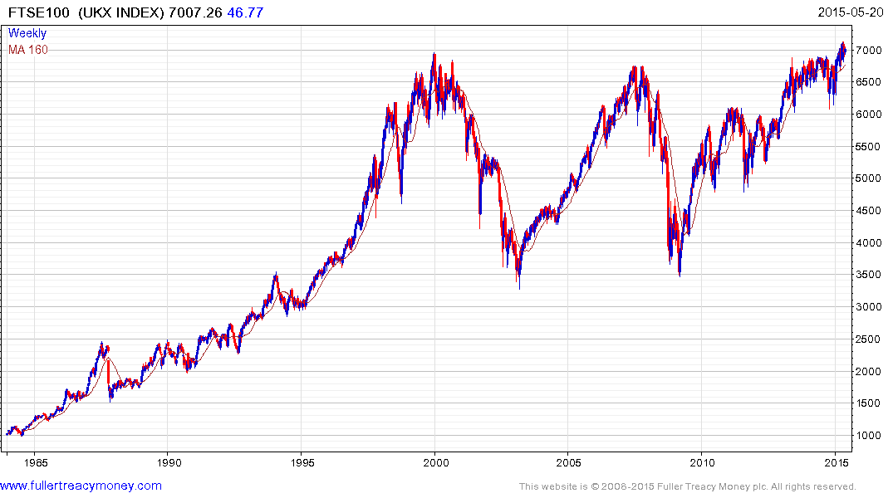
The FTSE-100 is only now breaking out.

Slide 17
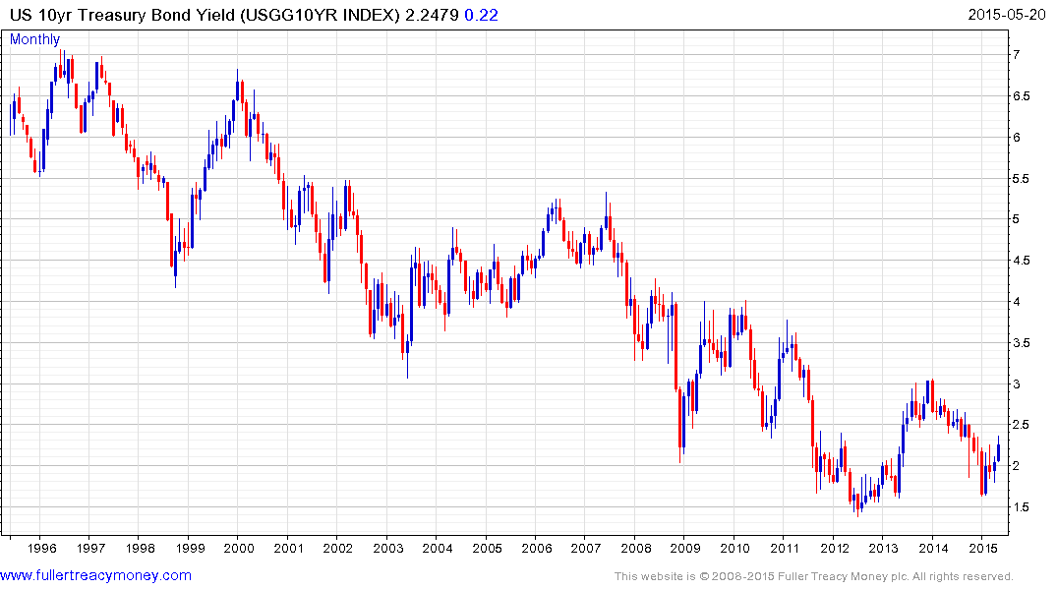
Treasury yields are rising from the lower side of a three-year range.

Slide 18
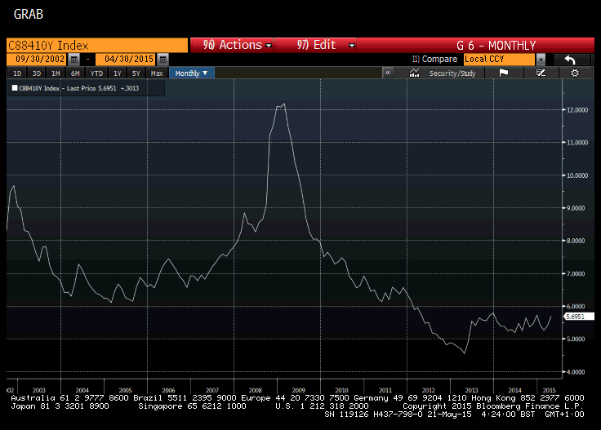
BB yields are no longer contracting.

Slide 19
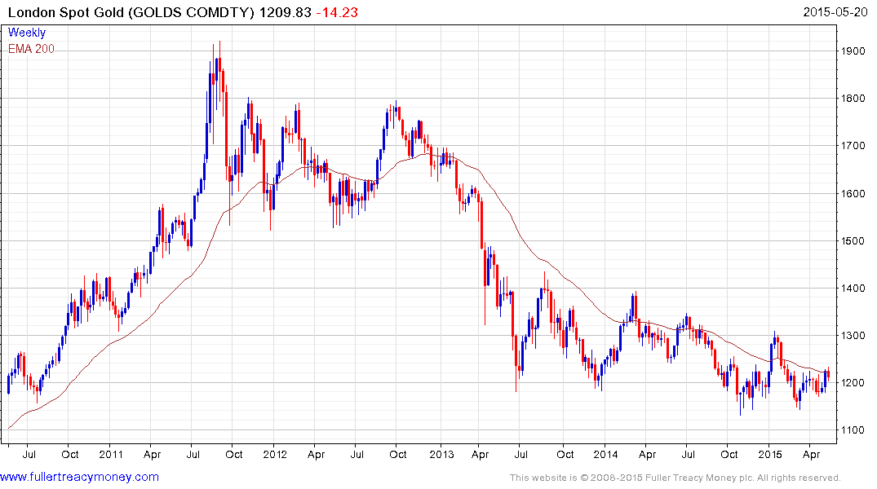
Gold is at an interesting juncture.

Slide 20
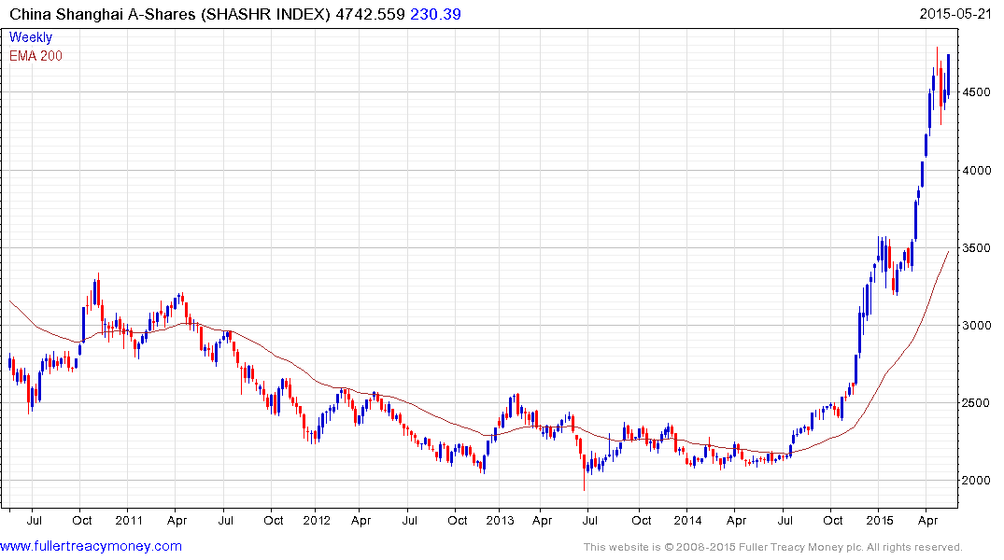
China rallying within another similarly sized range.

Slide 21
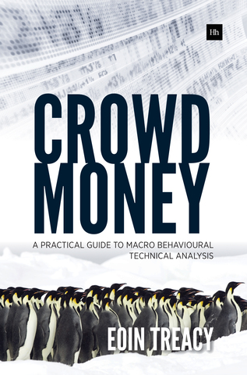
Please visit us on Fullertreacymoney.com and sign up for our FREE Comment of the Day.
Please email Sarah Barnes at sarah@fullertreacymoney.com for a one-month free trial.
Crowd Money – A Practical Guide to Macro Behavioural Technical Analysis is available on Amazon.

