Slide 1
David Fuller, David Brown, Iain Little
”MARKETS NOW”
15th JUNE 2015
How is «Trusts In Focus» Doing?
How Do Investors Play Bonds In a Rising Yield World?

Slide 2

Important Notice
THIS IS AN IMPORTANT PERSONAL ANNOUNCEMENT MADE BY IAIN LITTLE. THE OPINIONS, DATA AND INFORMATION IN THIS DOCUMENT AND PRESENTATION ARE MINE AND MINE ALONE.
EUROPEAN WEALTH GROUP PLC AND P&C GLOBAL WEALTH MANAGERS SA IN SWITZERLAND, MY EMPLOYERS, HAVE NOTHING TO DO WITH THE PERSONAL IDEAS EXPRESSED.

Slide 3
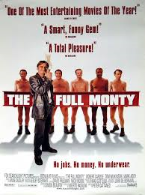
The Trusts In Focus («TIF») Service
Universe c300 closed end (mainly UK) investment trusts monitored
Approx 12 equally-weighted trusts in Trusts In Focus (TIF)
If we sell an investment trust, we must replace it, so fully invested
Changes to 12 MP trusts recorded (1.25% trading costs B/S)
Research available to «Markets Now» attendees
    3rd party adviser research
    FullerTreacy Money one of 20+ 3rd party advisers
    In-House Cooking/ P&C research
Performance review / indecent striptease every «Markets Now»

Slide 4
How Is Trusts In Focus Doing?
Beat bogey by +10% over one year

Slide 5
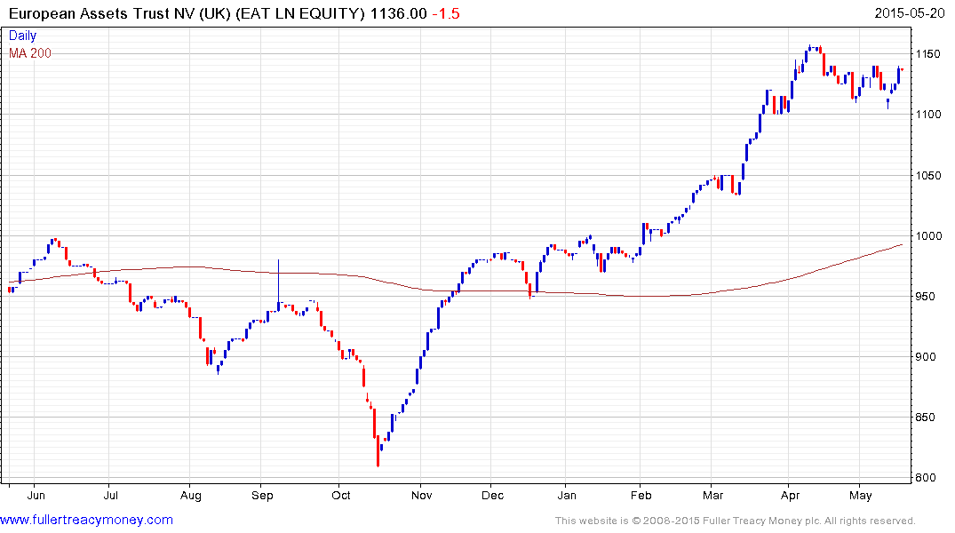
Most recent action (Jan 12th) we…..
…..Added European Assets Trust
Paid 10.25p
Draghi «Printathon»
Undervalued Europe versus outperforming USA
Geared performance through «small cap effect»
5.1% yield (bought on 23/2/15 on a 5.8% yield)

Slide 6
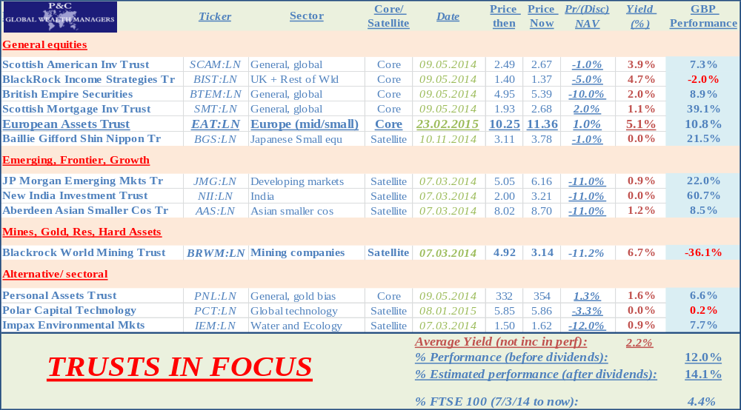
How Are We Doing: Trusts In Focus?
Performance So Far (since 7/3/14)

Slide 7
«How Do Investors Play Bonds In a Rising Yield World?»
PERSONAL THOUGHTS FROM A NON SPECIALIST…

Slide 8
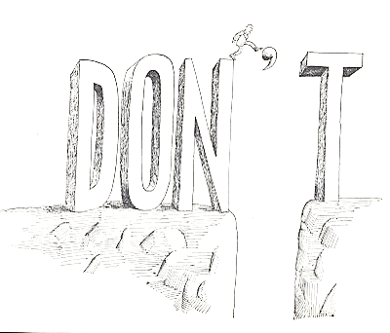
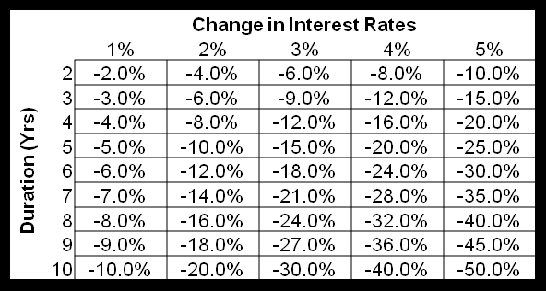
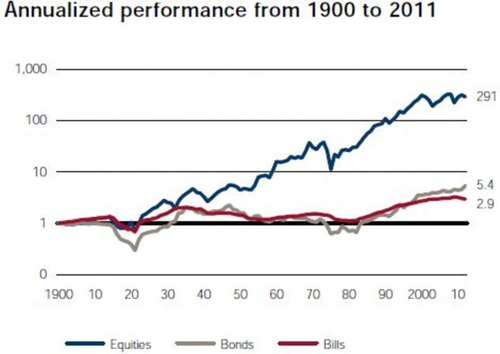
Bonds in a rising yield world
The Problem…
Lose half my money?

Slide 9
Bonds in a rising yield world
The Problem…
Why Hold Bonds At All?
Portfolio income (future liabilities)
Portfolio insurance. Largest fall last 30 years:
    100% UK bond portfolio -6.27% 1994
    100% UK equity portfolio -29.93% 2008
Portfolio diversification (co-variance matrix)
But….. “Bonds promoted as offering risk-free returns are now priced to deliver return-free risk.”

Slide 10

Bonds in a rising yield world
The Problem…
Bonds have 6 major types of risk:
RISK | TYPE OF RISK | YIELD RISE?
Interest rate | Capital | Capital Loss
Reinvestment (Call) | Income | Income Gain (no calls)
Inflation | Capital, Income | Capital, Income Loss
Credit/default | Capital, Income | Increased Risk
Rating downgrade | Capital | Increased Risk
Liquidity | Capital | Increased Risk
Holding bonds to maturity reduces most risks

Slide 11
Bonds in a rising yield world
The Problem…
Most fixed income investments lose out….
FIXED INCOME TYPE | YIELD RISE?
Short term sovereign bonds | Small capital loss
Long term sovereign bonds | Large capital loss
Corporate and EM bonds | Small capital loss (high yield) but large credit risk
Bond Funds | Duration fixed; no safe harbour, forced sales bad
Cash | Low returns or none (but «$ Averaging» pick up)
Index-linked bonds | OK if inflation rises or cheap v theoretical price
No easy solutions

Slide 12
Bonds in a rising yield world
3 Solutions…Defined Maturity Bd Fund
Bonds In Drag
Bonds dressed in fund «drag»!
Future maturity date fixed (pref <5 years)
6.2% p.a. for 3 year corporate high yield debt
Pick up yield (eg +4-5%) via corporate bonds
Yet…reduced credit risk via 70-100 holdings
Some small reinvestment risk exists, but…..
…«Laddering»: investors can plan redemptions

Slide 13
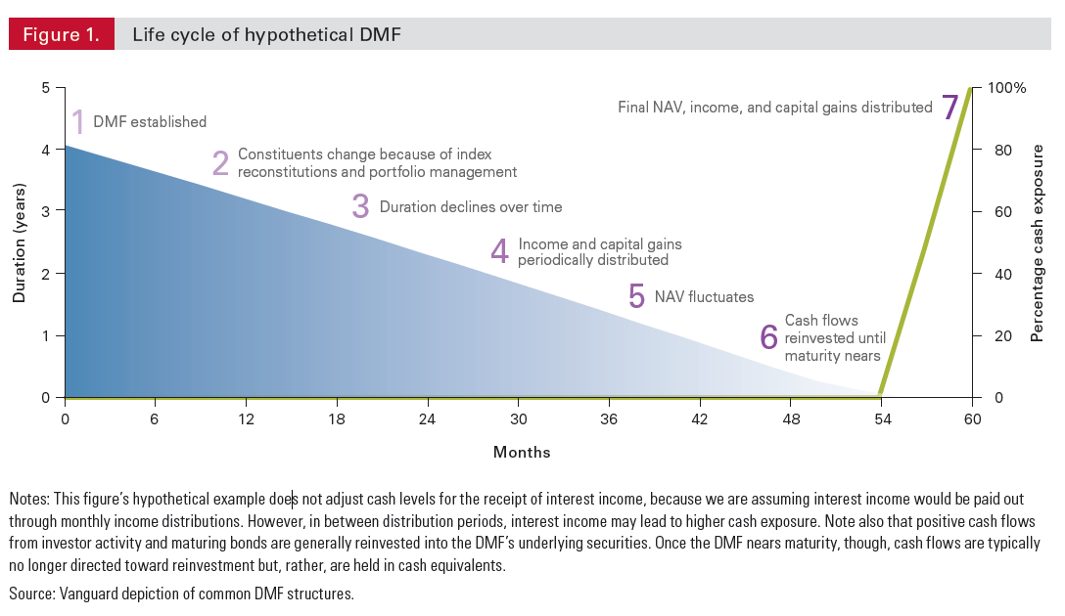
Bonds in a rising yield world
3 Solutions…Defined Maturity Bd Fund

Slide 14
Bonds in a rising yield world
3 Solutions…Defined Maturity Bd Fund
Major Risks
Yields lower for longer => reinvestment risk
Yield return exceeded by fund costs
Bad deflation, à la 1930s => corporate defaults
  NB if a portfolio of 80 bonds yields 3% > conventionals (6% v 3%), 2 bonds (2-3% of total) must default to reduce yield to conventional bond yields
  Our fund manager: no history of bond defaults at all

Slide 15
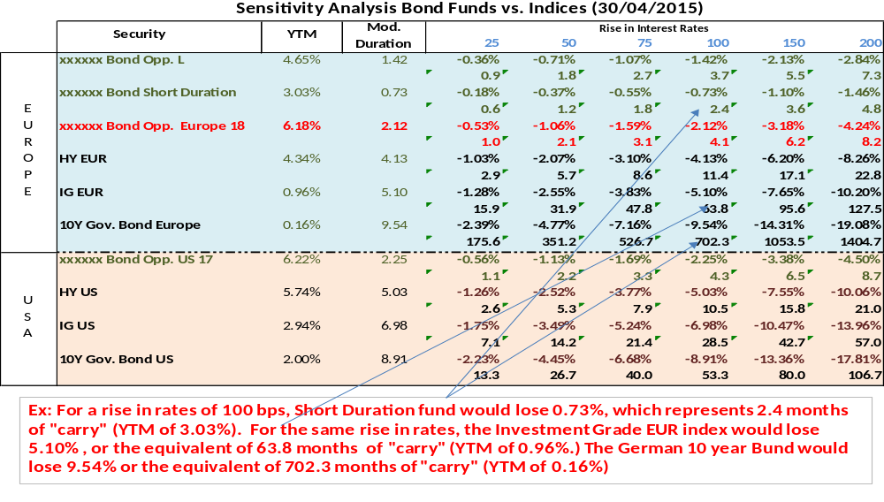
Bonds in a rising yield world
3 Solutions…Defined Maturity Bd Fund
Defined Maturity
6.18%

Slide 16

Bonds in a rising yield world
3 Solutions…Cash
Cash
Dollar averaging cash deposits, eg
    Year 1: 1% pa
    Year 2: 3% pa
    Year 3: 5% pa
=>3 Year avg: 3.1% pa
5%
1%
3%

Slide 17
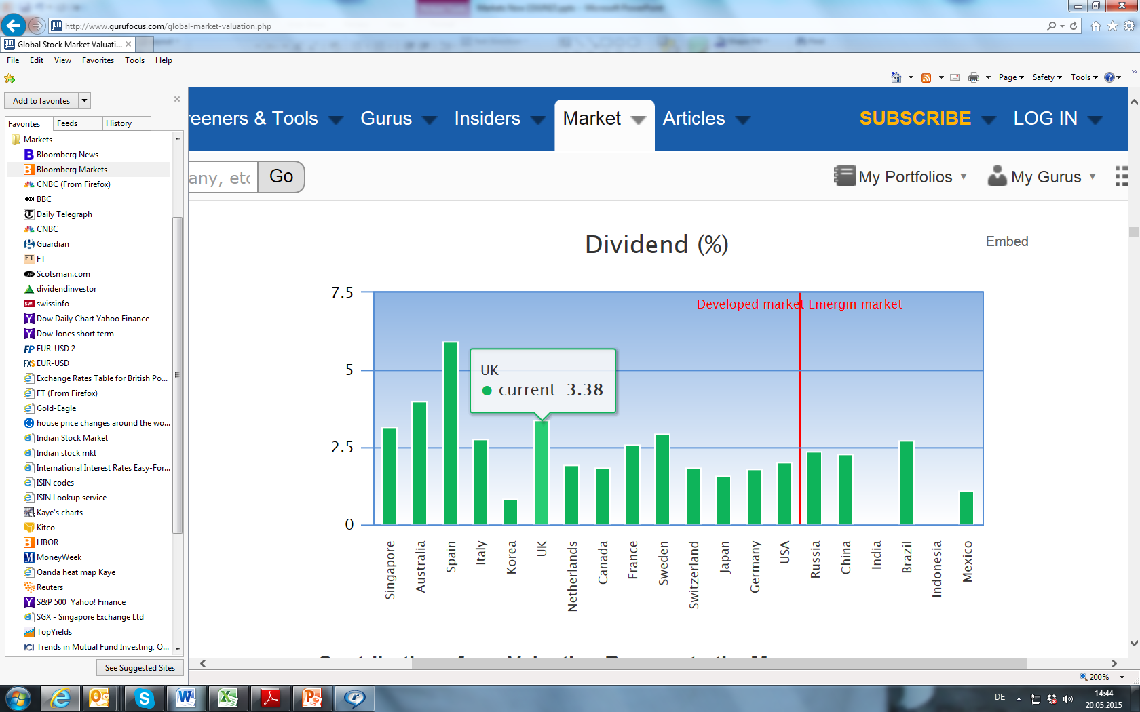
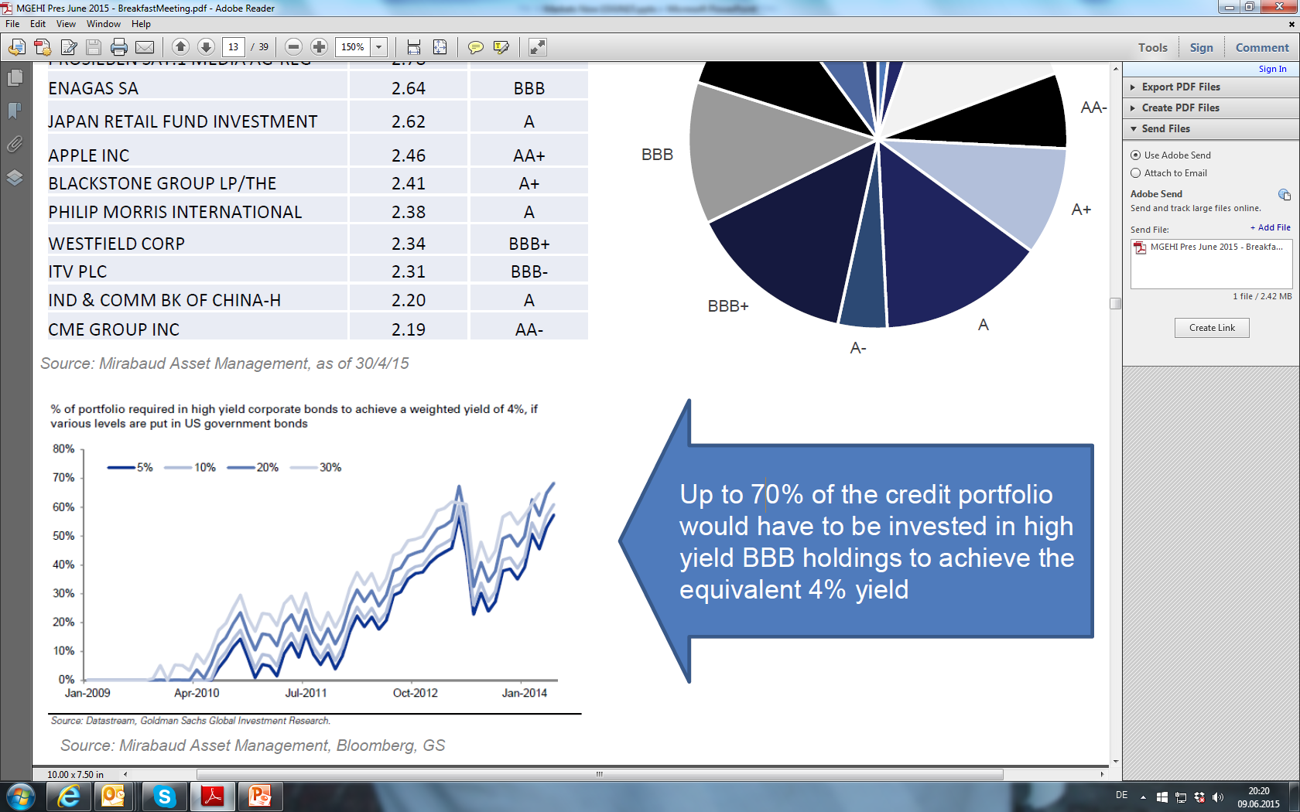
Bonds in a rising yield world
3 Solutions…Equities
Equities

Slide 18
P&C People

Slide 19
The P&C Investment Team: 75 years global experience and research expertise
Bruce Albrecht (Investment Manager and Partner P&C)
40 years experience asset allocating and managing global institutional equity and bond portfolios. Ex CIO Pictet London and Global CIO Rothschilds, Senior Manager Abu Dhabi Investment Authority, Group Head of Asset Management Butterfield Bank Group. Work experience includes London, Abu Dhabi. Special interest:: quantitative / systematic analysis. Educated: Emory University, Manchester Business School.
Iain Little (Investment Manager and Partner of P&C).
35 years experience managing global private client portfolios and ex head Pictet London UK private clients (asset allocation / fund selection). Recently MD Butterfield Asset Management (Switzerland). Work experience includes Tokyo, Geneva, London, Edinburgh, “French-speaking Africa” and Hong Kong. Special interest: undervalued frontier markets and undiscovered managers. Educated: Cambridge University (MA)

Slide 20
P&C and Contact Details:
For further information, please contact:
P&C
P&C
Iain Little
Partner
Bruce Albrecht
Partner
P&C Global Wealth Managers S.A.
Tel: +41-44-390-1561
Fax: +41-44-390-1562
Email: iain.little@pandc.ch
P&C Global Wealth Managers S.A.
Tel: +41-44-390-1561
Fax: +41-44-390-1562
Email: Bruce@brucealbrecht.com

