Slide 1
The Markets Now
●US T-Bonds have ended their secular bull market
● Global stock markets are experiencing a corrective phase due to seasonal factors, ‘Grexit’ fears, and rising Treasury yields
● However, stock markets are also cushioned by
QE in Japan and the EU, plus China’s stimulus.
David Fuller – 15th June 2015
fullertreacymoney.com
East India Club – 16 St. James Square
London SW1Y 4LH, UK

Slide 2
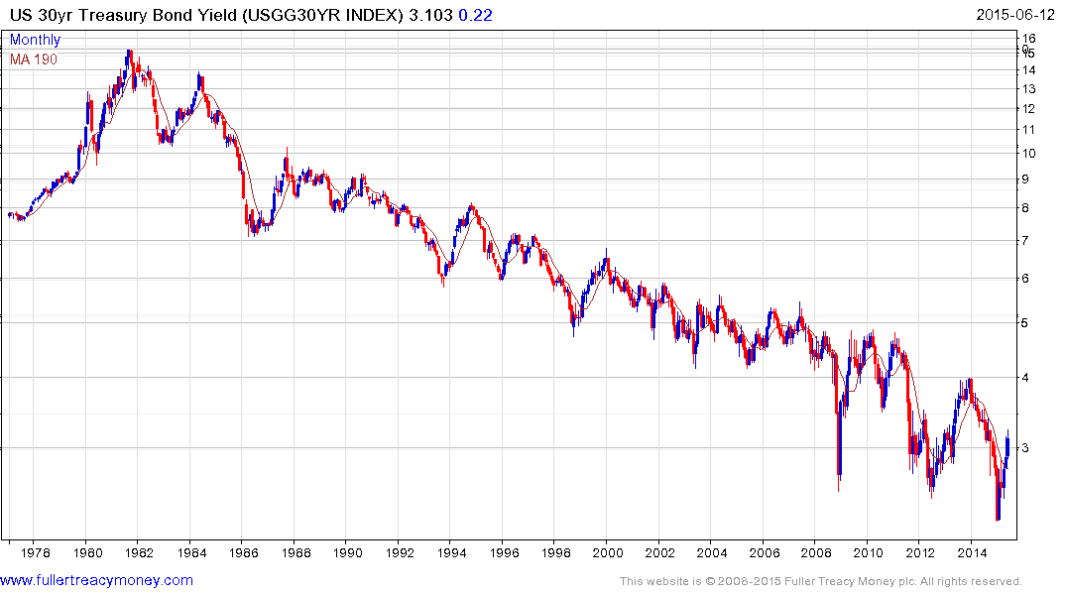
US T-Bond bull market extended by
credit crisis recession and QE

Slide 3
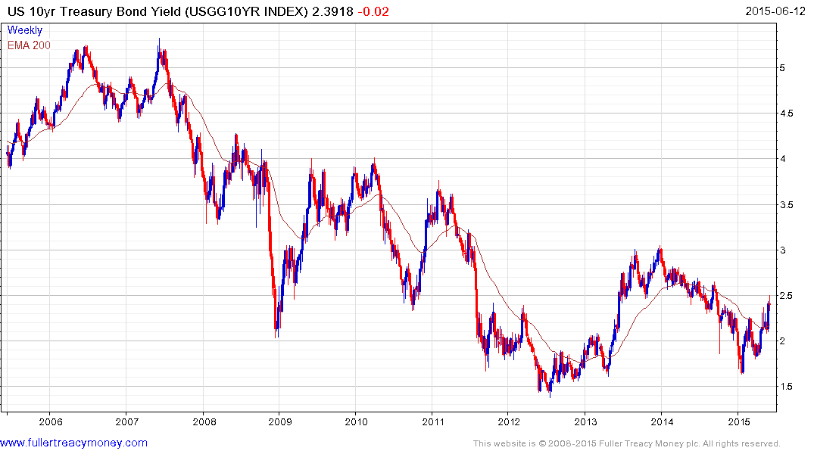
10-Yr T-Bond over last 10 years

Slide 4
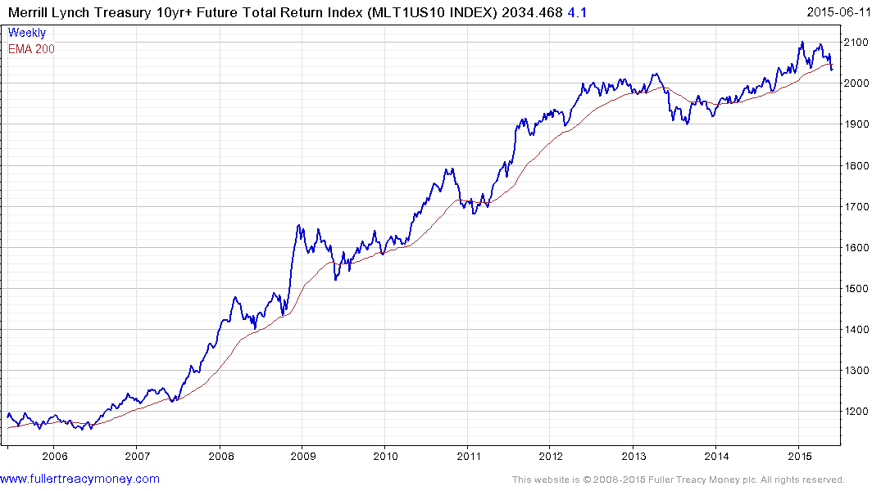
Lower high and lower low
Risk of panic selling
When it exceeds
Last three declines

Slide 5
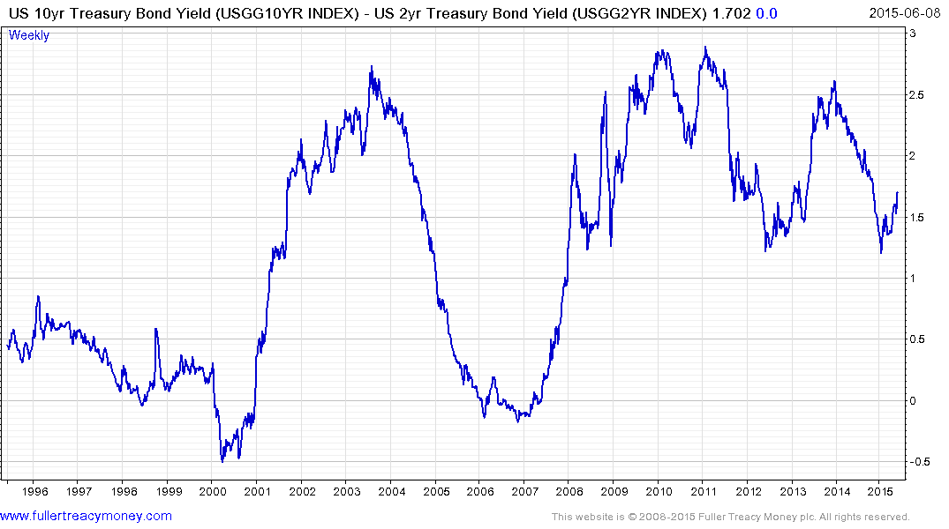
Yield curve over 20 years
The bear market danger line is below zero

Slide 6
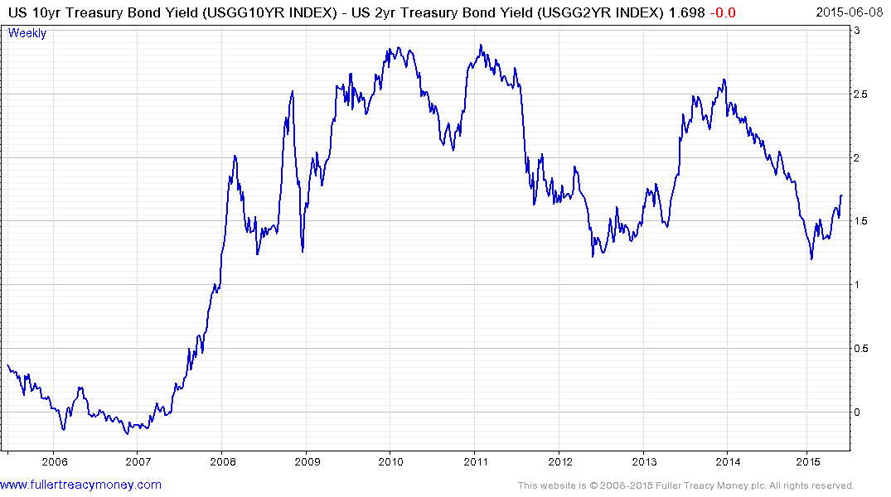
Yield Curve over 10 years
While the inverted yield curve does predict bear markets, the lead time can be a problem, as seen with the 2006-2007 signals.

Slide 7
Europe
European stock markets have corrected the previous
overbought condition and are currently oversold.
However, the ‘Grexit’ threat needs to be removed by
an acceptable agreement between Greece and its three creditors: the International Monetary Fund, the
European Central Bank and the European Commission,
before Mario Draghi’s €60bn per month QE programme
produces another strong rally. Actual ‘Grexit’ would temporarily deepen the correction.
Seasonal factors are less favourable from May through October.

Slide 8
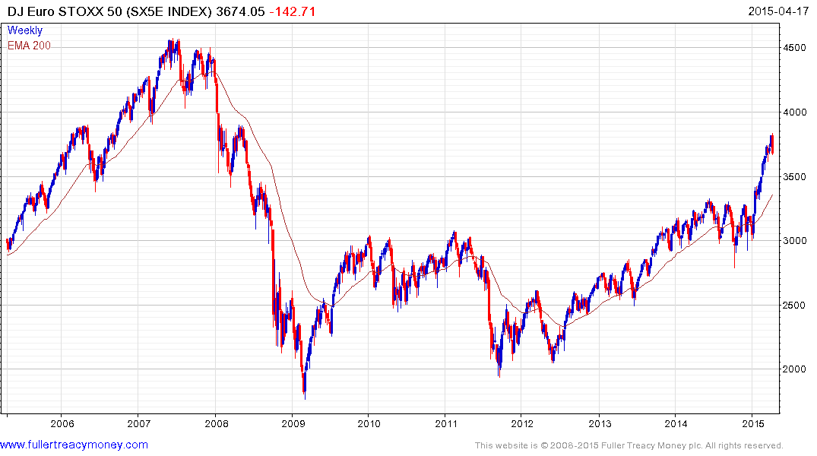
Ten-year chart of SX5E
Note: this slide is
from the April 17th
presentation
Temporarily overextended,
weekly key reversal indicates beginning
of a corrective phase

Slide 9
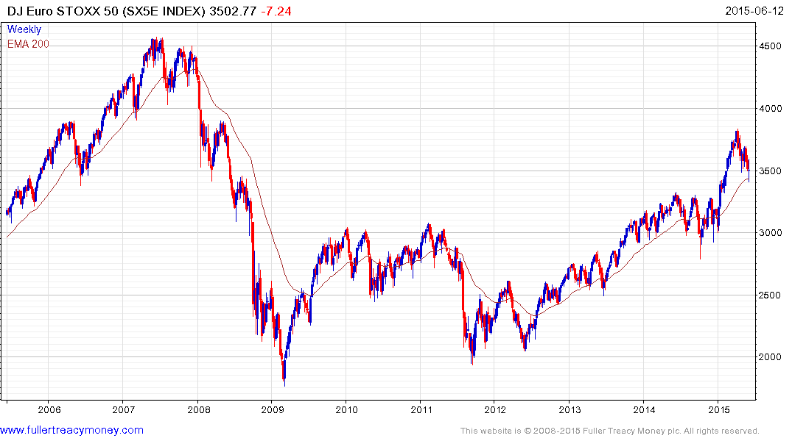
DJ Euro STOXX 50
Oversold and near support
but needs successful resolution
to Greek crisis before a strong
rally occurs
Valuation improving
p/e 20.06 & yield 3.48%

Slide 10
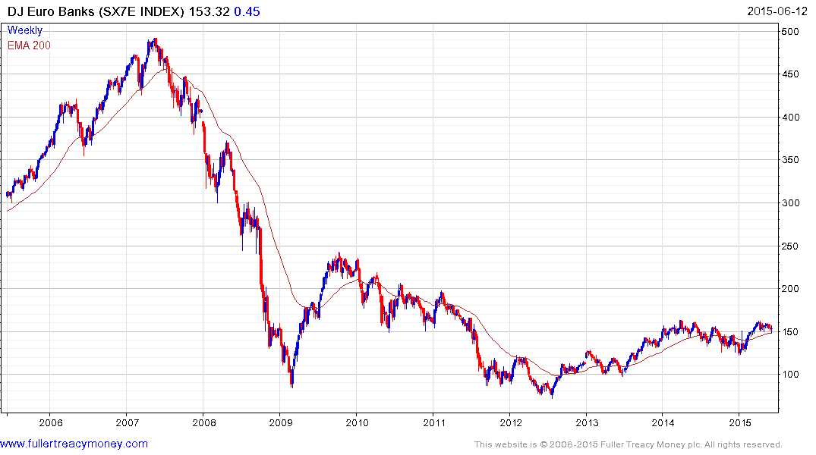
DJ Euro Banks
Steady in consolidation
of year’s earlier gains but
held in check by Grexit
concerns
Valuation improving
p/e 24.41 & yield 3.40%

Slide 11
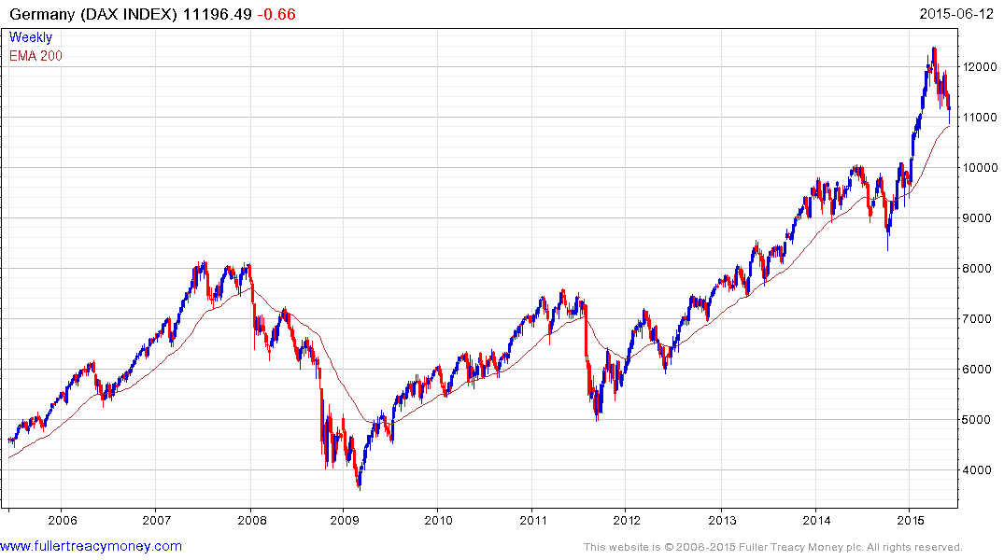
German DAX
Valuations have improved
during correction and
oversold near MA
p/e 18:00 & yield 2.67%

Slide 12
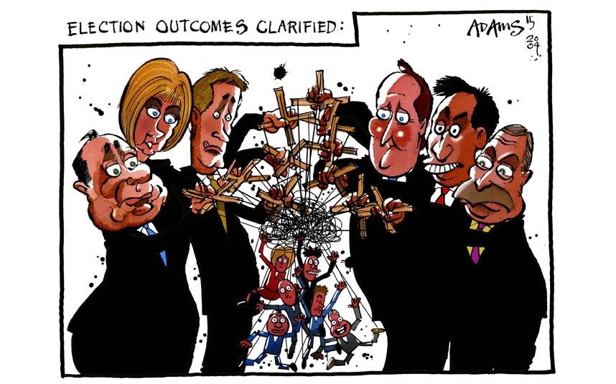
Remember this concern?

Slide 13
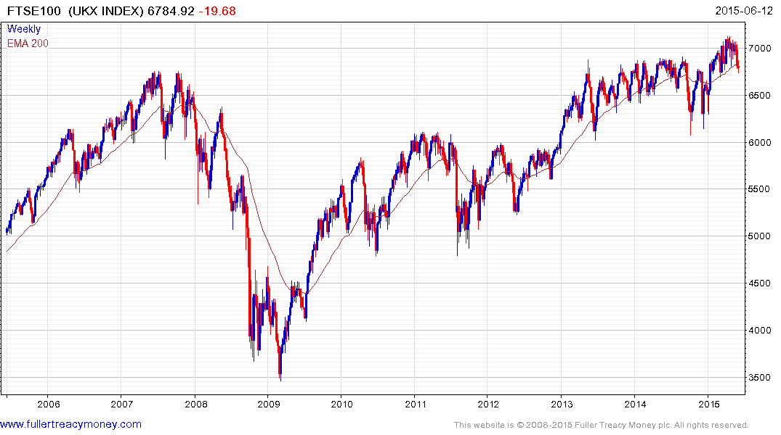
UK FTSE 100
Now we can worry about the
EU Referendum
Valuations have improved
during correction
p/e 21.31 & yield 3.84%

Slide 14
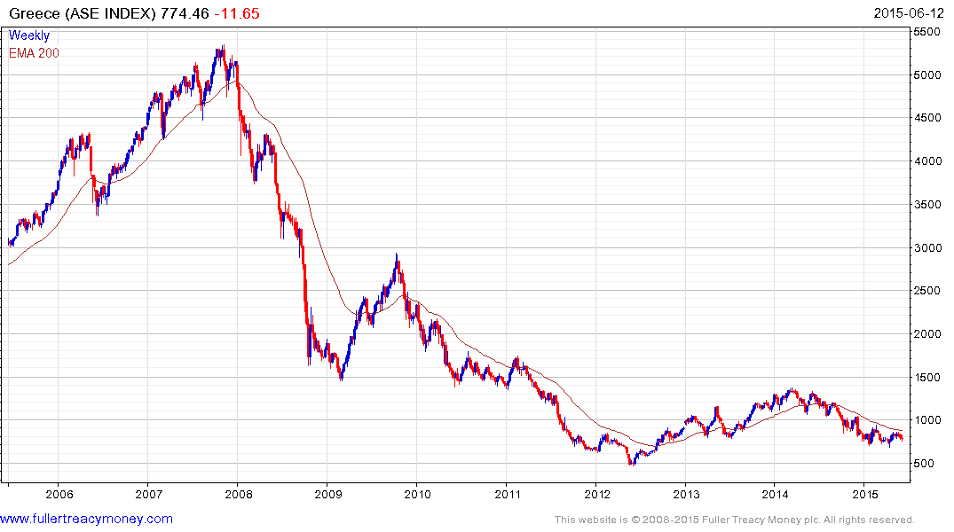
Greece
What future do delegates
see for Greece?

Slide 15

Is this Greece’s
Future
Outside the
Eurozone?

Slide 16
USA
Pre-Presidential Election year usually ends on a bullish note
However, valuations are now on the higher side of average
The US stock market is way overdue a 10% plus correction
The US Dollar’s sharp rise since June 2014 is a headwind
Fracking slowdown and cold winter slowed GDP growth
Bearish forecasts continue to abound - contrary indicator?
Pre-Fed rate hike jitters but this should not be a problem
US Election result in 2016 should be bullish

Slide 17
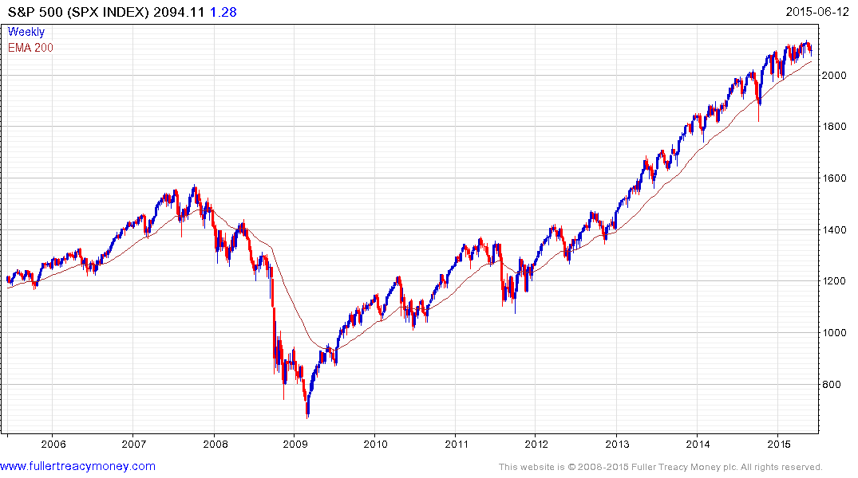
S&P 500
Would have to break 1970
to confirm upside failure
p/e 18.50
yield 2.01%

Slide 18
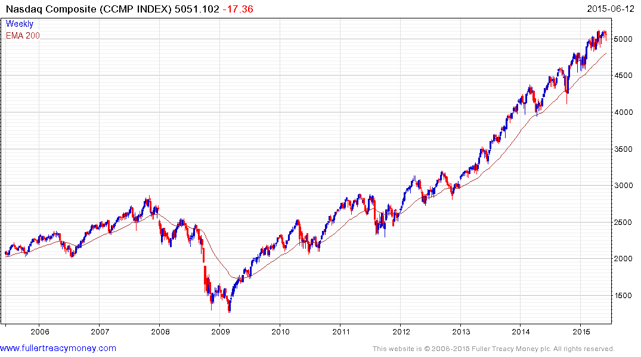
Nasdaq Composite
Tech-led Nasdaq Composite is not
cheap (p/e 30.16 & yield 1.21%)
but still consistent near
psychological 5000 level
Would have to
close beneath
4500 to indicate
significant technical
deterioration

Slide 19
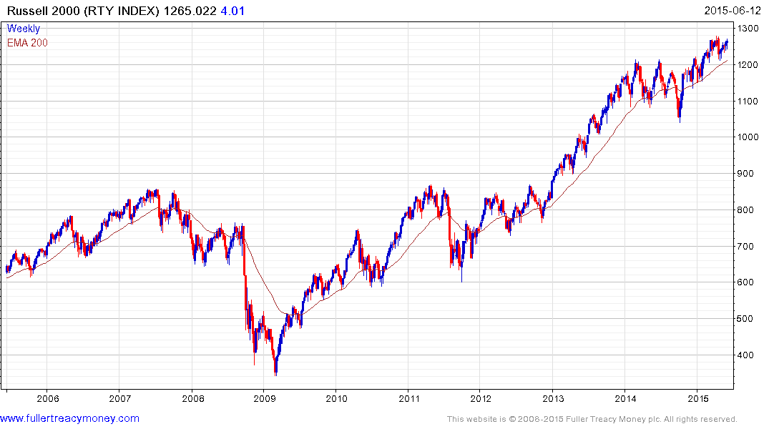
Russell 2000
Russell 2000 shows that small
cap breadth has improved
p/e 20.74 & yield 1.37&
Would have to
close beneath
1200 to suggest
upside failure

Slide 20
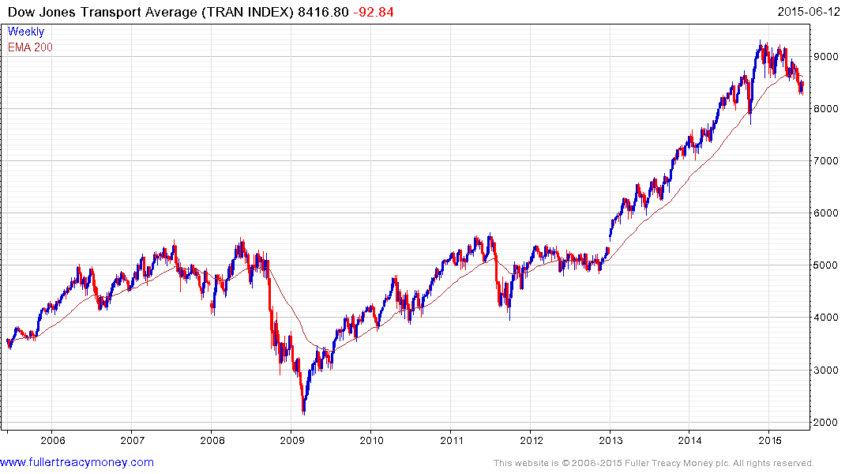
Transport Average
TRAN shows a loss of upside momentum and further pattern deterioration – needs rally above 9000, at minimum, to reduce risk
p/e 17.27
yield 1.31%

Slide 21
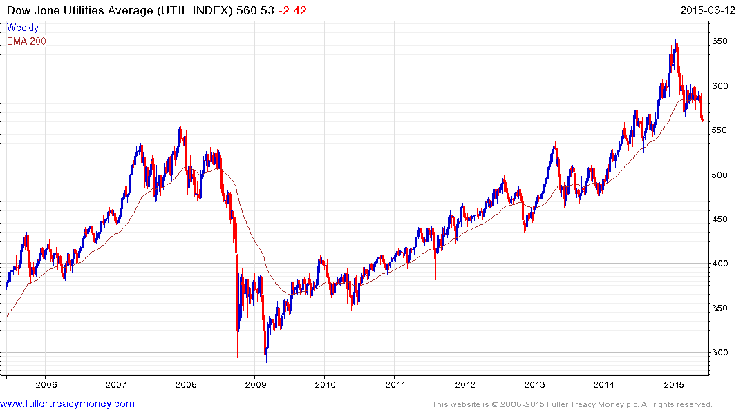
Utilities
UTIL has seen further pattern deterioration
and needs a rally back above 600, at minimum, to indicate that demand is
regaining the upper hand
p/e 16.06
yield 3.61%

Slide 22
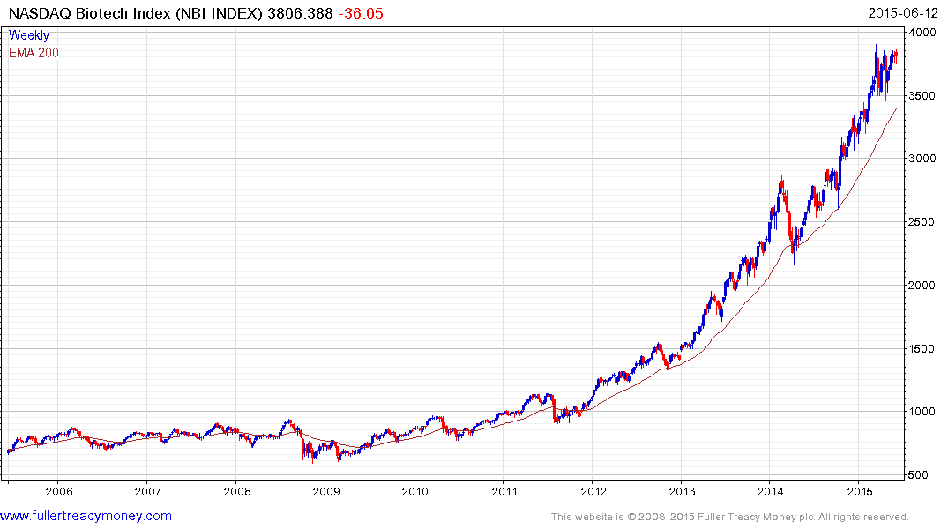
Biotech Index
Wall Street’s top performing sector
Near higher side of range following
overextension - some loss of momentum
and bubbly – needs new closing high to
reaffirm uptrend
p/e 87.20
yield 0.22%

Slide 23
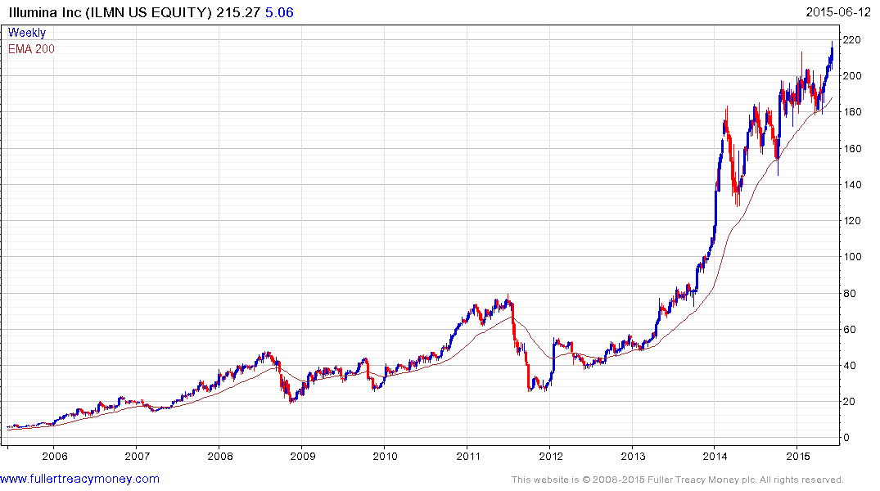
Illumina
Systems for large scale analysis of genetic variation and biological function
Reaffirmed uptrend last week and would
need to close beneath $180 to indicate
significant pattern deterioration
Est p/e 62.82

Slide 24
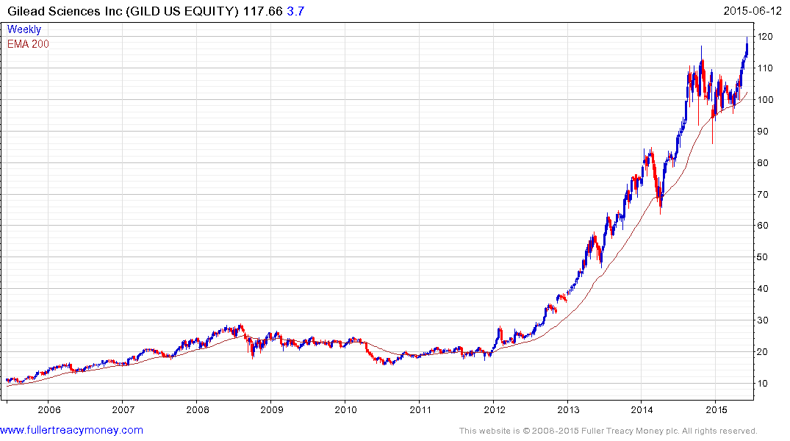
Gilead Sciences
Discovers, develops, and commercialises
therapeutics to advance the care of patients
from life-threatening diseases
Reaffirmed uptrend last week, would
need close beneath $100 to indicate
significant pattern deterioration
Est p/e 10.92
Gross yield 1.46%
Cash yield 0.43%

Slide 25
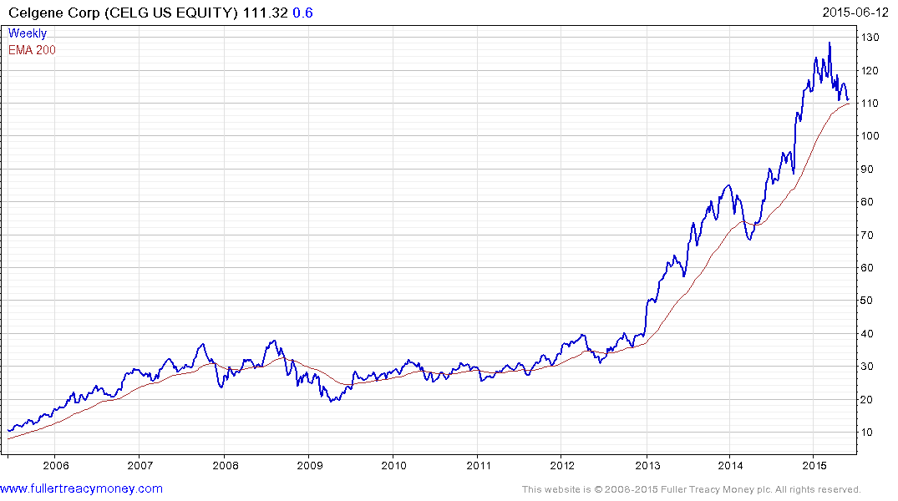
Celgene
Discovery and development of therapies designed
to treat cancer and immune-inflammatory diseases
Loss of momentum and testing MA, need $120, at
minimum, to signal renewed demand
Est p/e 23.40

Slide 26
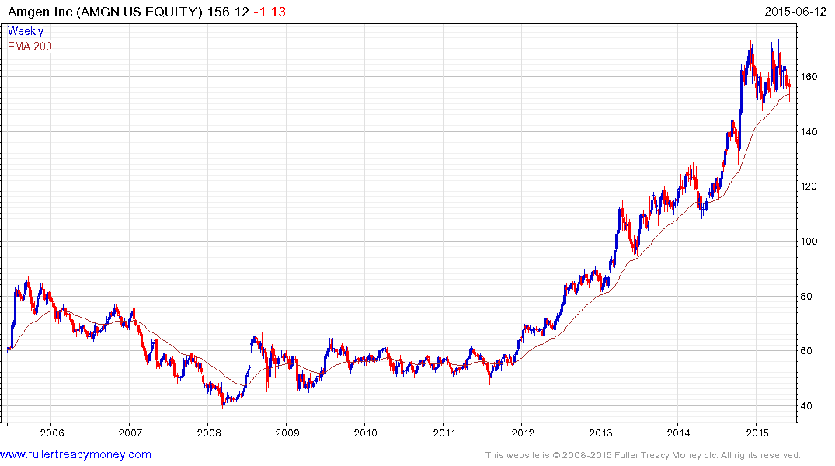
Amgen
Human therapeutics for grievous illnesses
based on cellular and molecular biology
Loss of momentum in pullback to MA, needs
close above $170 to reaffirm uptrend
Est p/e 16.31
Ind gross yield 2.02%
Cash 0.79%

Slide 27
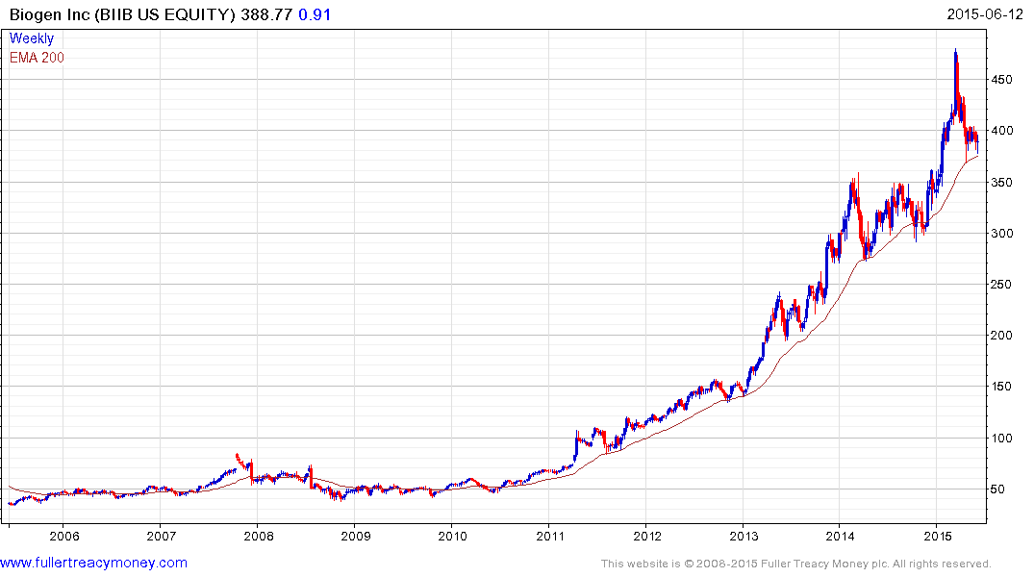
Biogen
Neurology, oncology, and immunology for
multiple sclerosis, non-Hodgkin’s lymphoma,
rheumatoid arthritis, Crohn’s disease and
psoriasis
Pullback to MA following overextension, needs
at least $410 to indicate renewed demand
Est ple 23.28

Slide 28
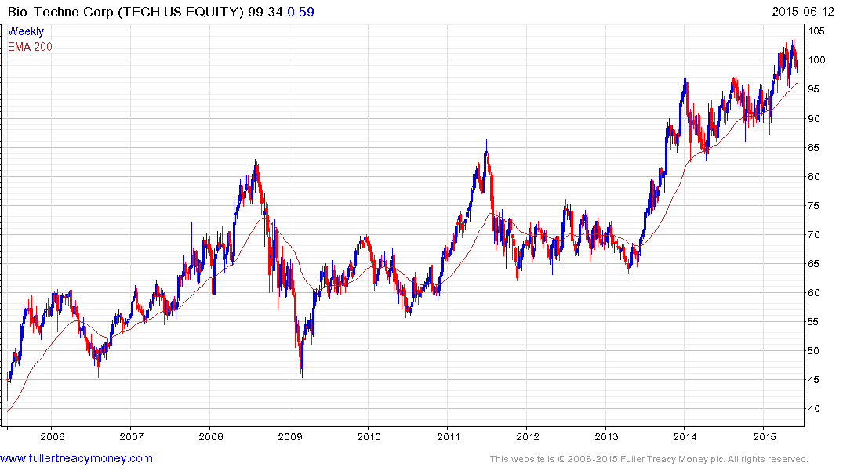
Bio-Techne
Specialises in proteins, cytokines, growth factors
immunoassays and small molecules
Smaller move, needs to hold near initial support
near $95
Est p/e 29.11
Ind gross yield 1.29%
Cash 0.32

Slide 29
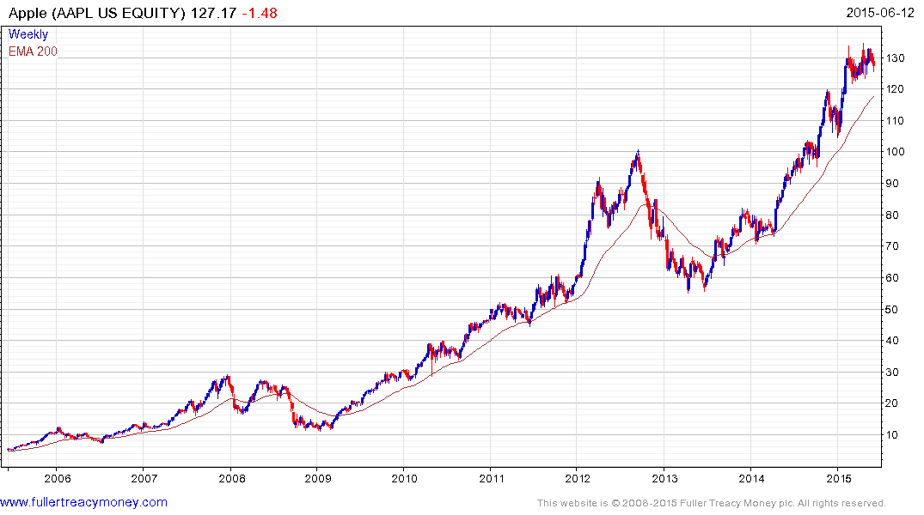
Apple
Keep an eye on this iconic bellwether for the
industrial tech sector and Wall St generally –
currently a little overextended but not expensive
Est p/e 14.12
Yield 1.64%
Watch the rising lows
for uptrend consistency

Slide 30
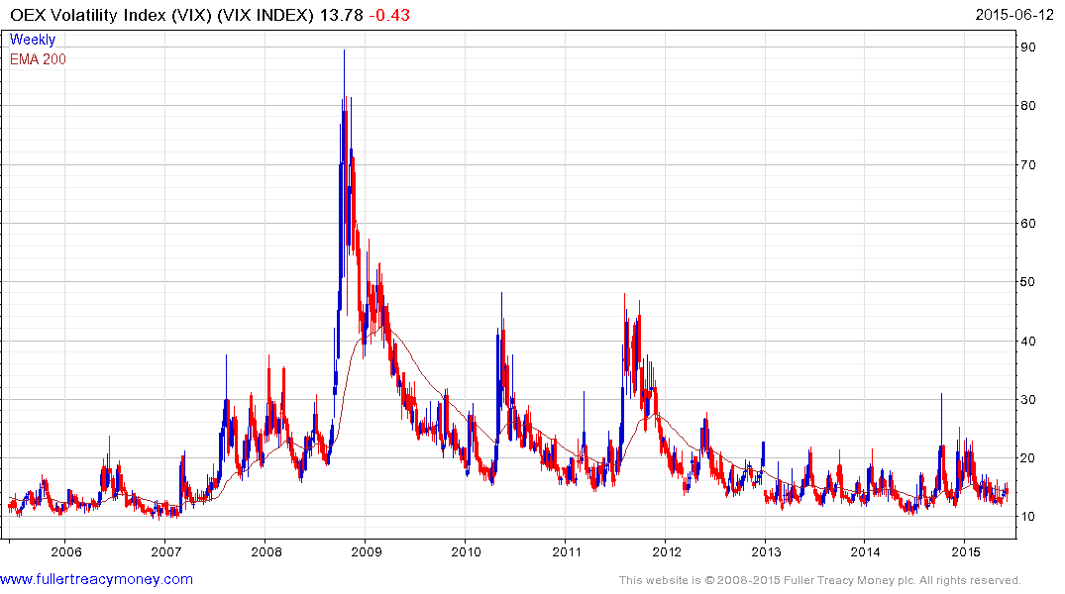
OEX Volatility Index (VIX)
So far, not affected
by ‘Grexit’

Slide 31
Shinzo Abe and the BoJ
have the right policies
for Japan’s economic recovery
and a long-term bull market

Slide 32
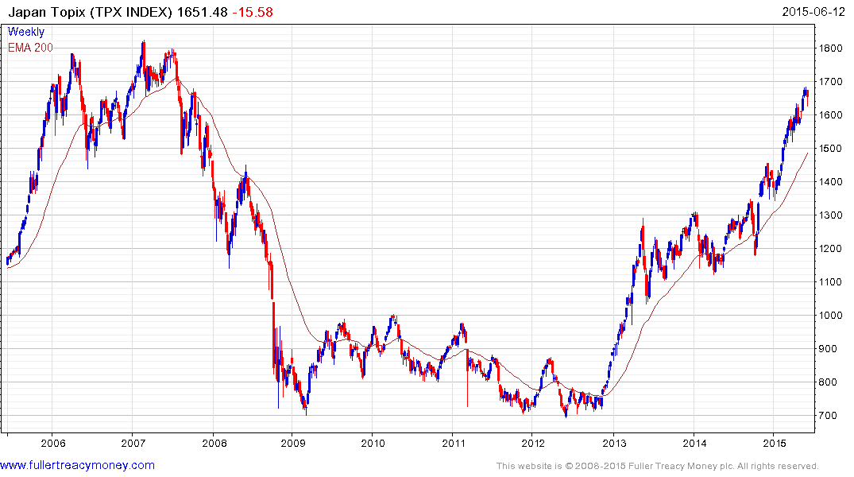
Topix
BoJ still
deploying QE
p/e 18.74
yield 1.62%
Re-elected
Shinzo Abe
Elected PM

Slide 33
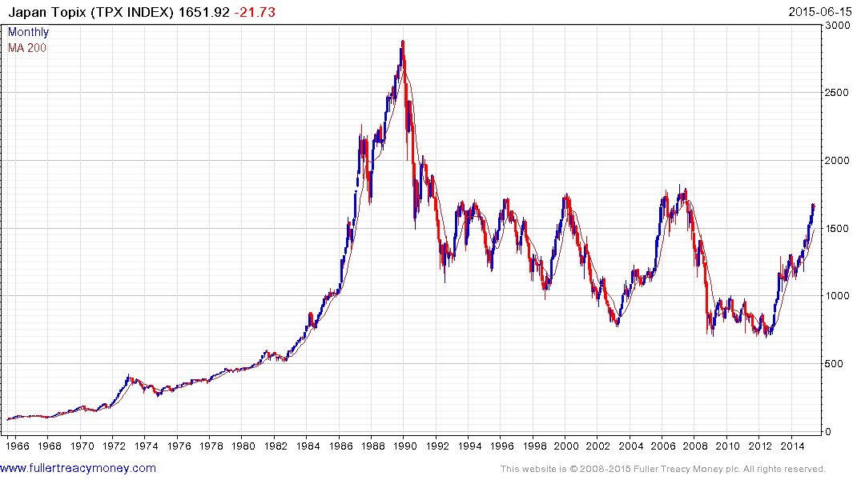
Topix
Should test this region near1800 possibly this year

Slide 34
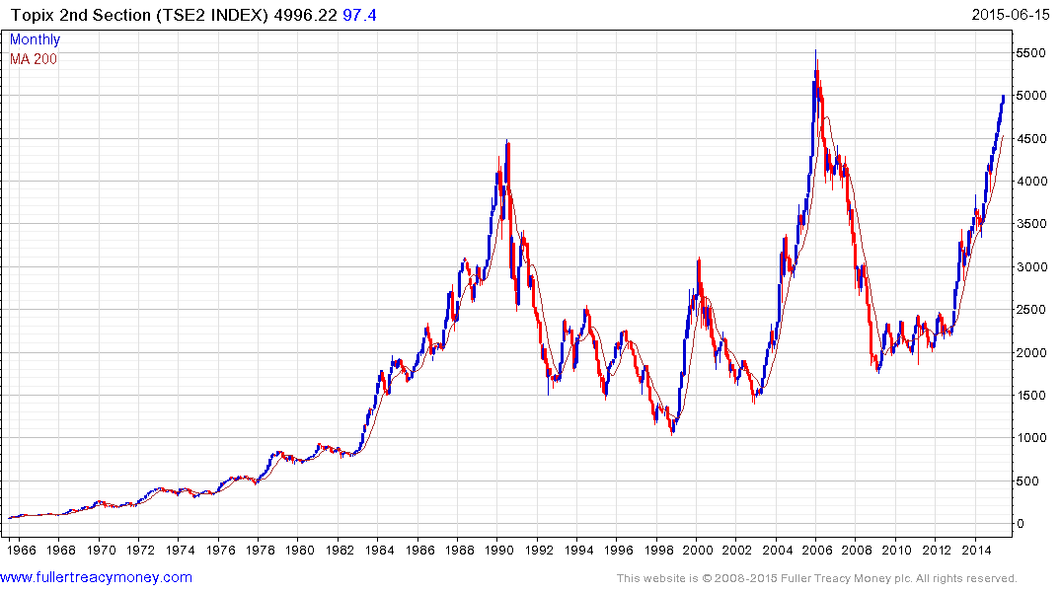
Topix 2nd Section
Topix 2nd Section
often leads
TSE2
p/e 17.08
yield 1.38%

Slide 35
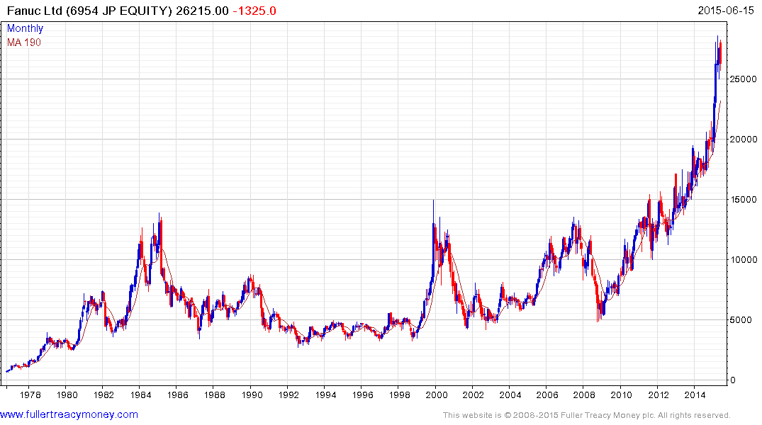
Fanuc
A share for this era
Fanuc leading Japan’s Indices
est p/e 25.96
est 12m yield 2.43%

Slide 36
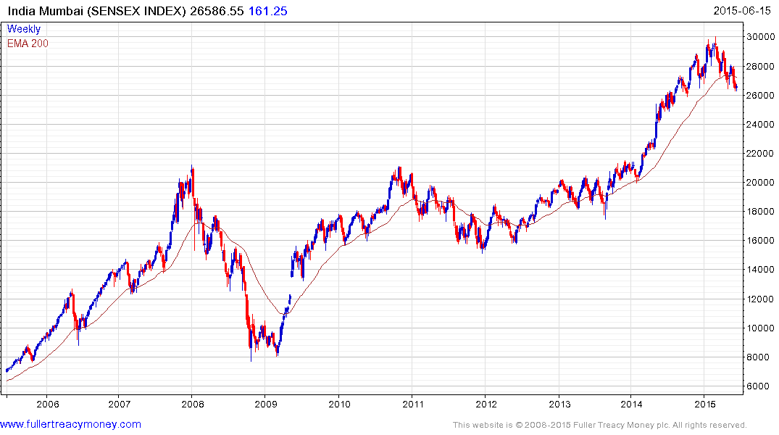
India Mumbai Sensex
Still a favourite of mine
over the next few years but
a lengthy consolidation of
earlier gains is underway
Monsoon
concerns
Loss of uptrend consistency
But back in a buying range –
alternatively after break back above 28000 signals
renewed demand

Slide 37
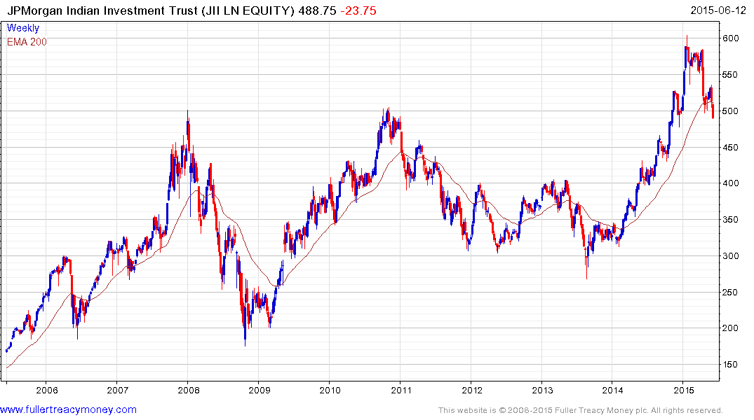
JII
Back in a buying range
break above 540p will
signal renewed demand
Discount to NAV
currently -10.982%

Slide 38
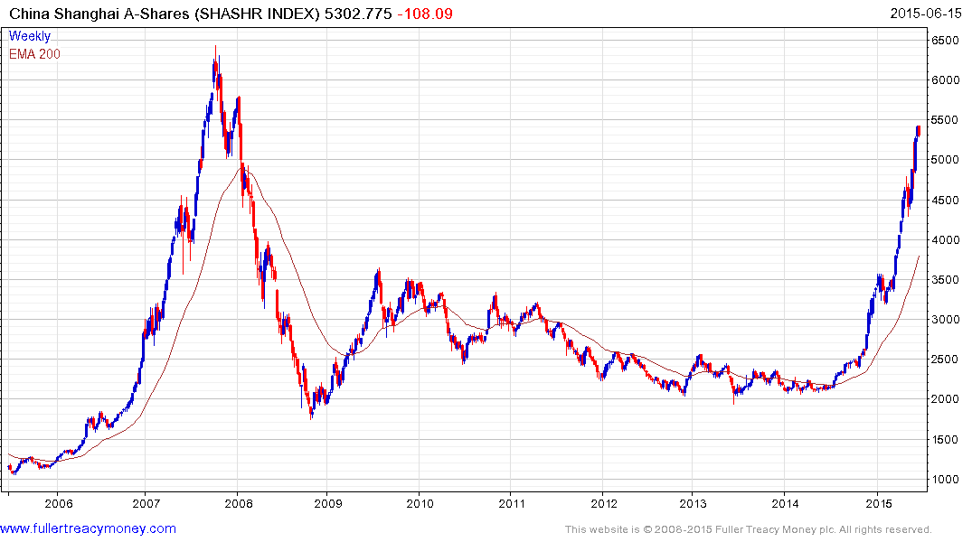
SHASHR
Susceptible to a lengthy
corrective phase
p/e 25.22
yield 1.32%

Slide 39
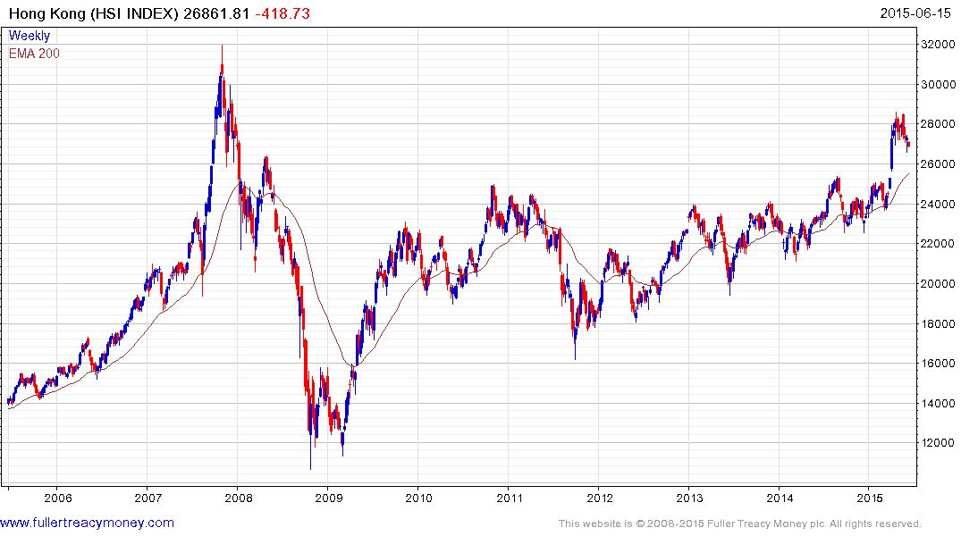
Hong Kong HSI
Consolidating upside breakout
– probable buying range
p/e 11.16
yield 3.07

Slide 40
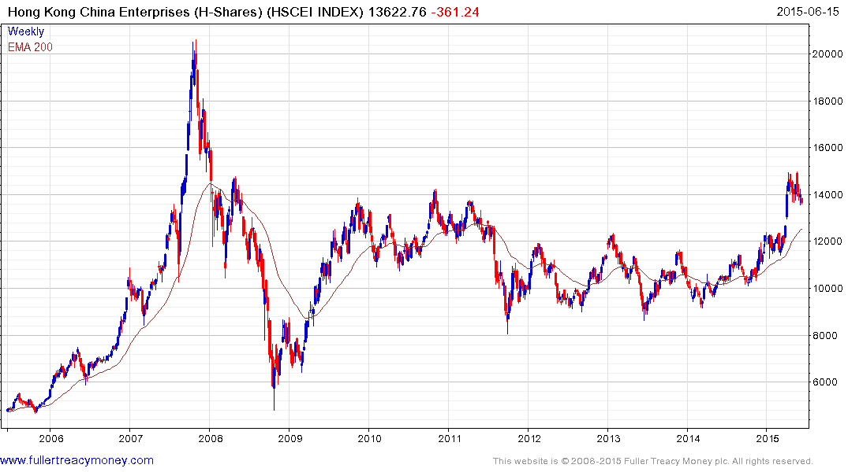
Hong Kong HSCEI
Consolidating earlier gains
– probable buying range
p/e 9.91
yield 3.02

Slide 41
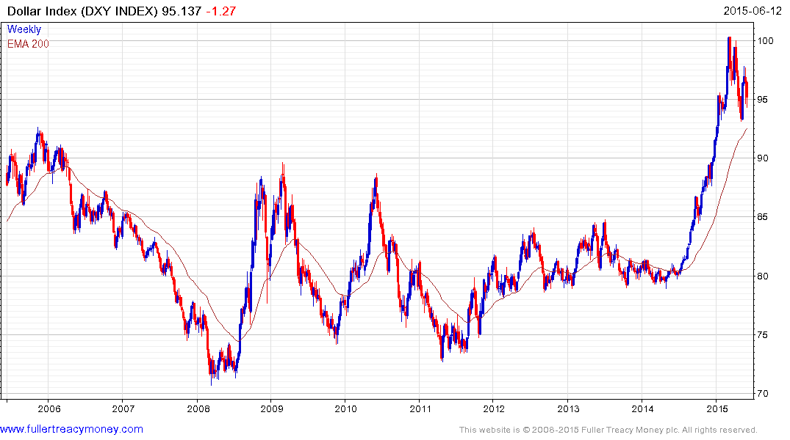
Dollar Index
A very lengthy consolidation
phase, triggered by probable
Fed intervention, following first stage
of DXY’s secular bull market

Slide 42
Many thanks for your interest!
Any questions?
Please visit our site:
www.fullertreacymoney.com

Slide 44
Technical warning signs to watch for among indices
Trend acceleration relative to 200-day moving averages
Declining market breadth (fewer shares rising)
Failed upside breakouts from trading ranges
Loss of uptrend consistency characteristics
Churning price action relative to recent trading ranges
Breaks of 200-day moving averages
Broadening patterns relative the last several trading ranges
200-day moving averages turn downwards
Resistance is encountered beneath declining 200-day MAs
Previous rising lows are replaced by lower rally highs
Indices fall faster than they rose to their highs

Slide 45
Deflation?
● My view: Much of today’s deflation is largely positive, at least for corporations, because it is caused by technological innovation. For instance, better technology enables companies to produce improved products, at lower prices, in greater volume, while increasing profits due to increased sales.
● Destructive deflation is generally described as a vicious cycle of falling prices, wages and output. It is particularly bad for indebted governments, corporations and people who lose jobs or scope for salary increases.

Slide 46
Bullish Points for Stock Markets
S&P up15.3% on average 6 months after mid-term election
Global monetary policy is still extremely accommodative
Central banks are worried about deflation, not inflation
Capitalism increasingly dominates on a global basis
Globalisation spurs rapid emerging market development
Growth in middleclass consumers surges, led by Asia-Pac

Slide 47
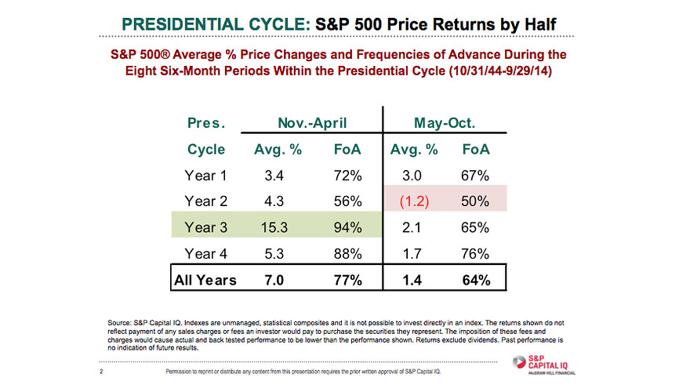

Slide 48
Long-term bull factors for stock markets
Accommodative monetary policies, until growth accelerates
An accelerating rate of technological innovation
Lower energy prices in real terms, thanks to innovation
The triumph of capitalism, both democratic & authoritarian
Globalisation, hastening development of emerging markets
Middleclass growth in emerging markets
Continued growth in the global population

Slide 49
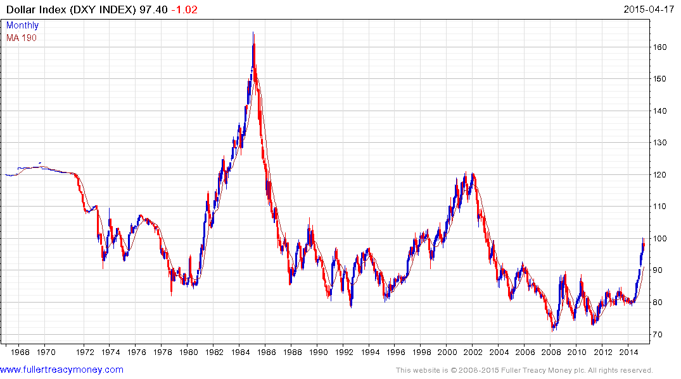
US Dollar Index has completed a base formation
driven by energy independence & tech lead
Fed & Treasury will control speed of $ recovery

Slide 50
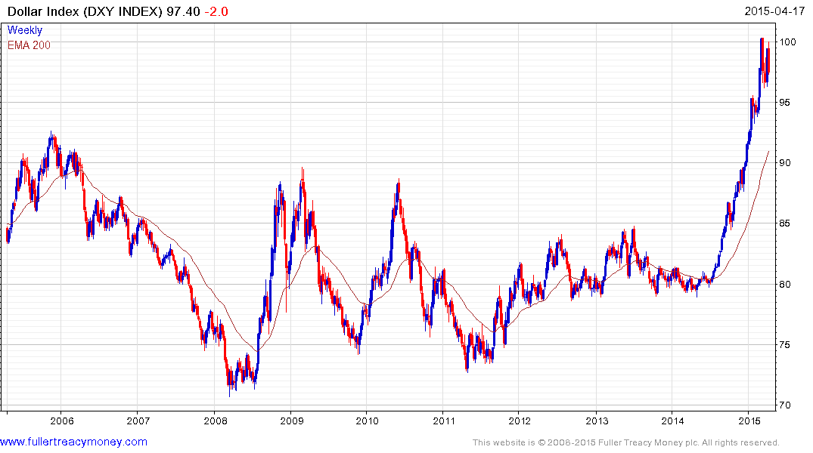
Currently a headwind for
US economy and intervention
may have commenced

Slide 51
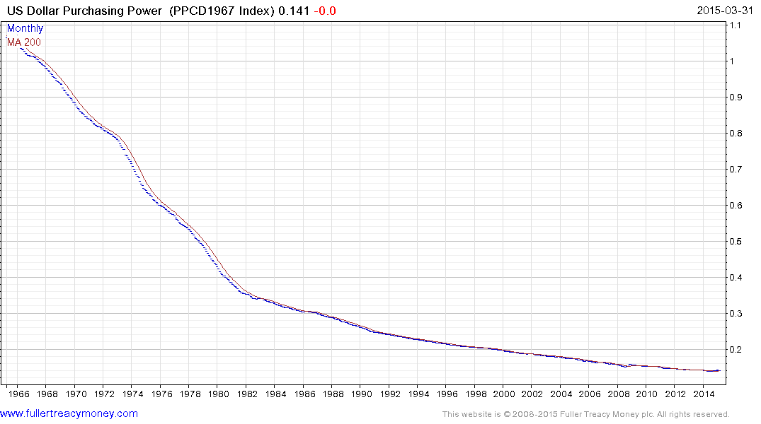
Nevertheless the US dollar is still a fiat currency, which
has lost most of its purchasing power since only 1968

Slide 52
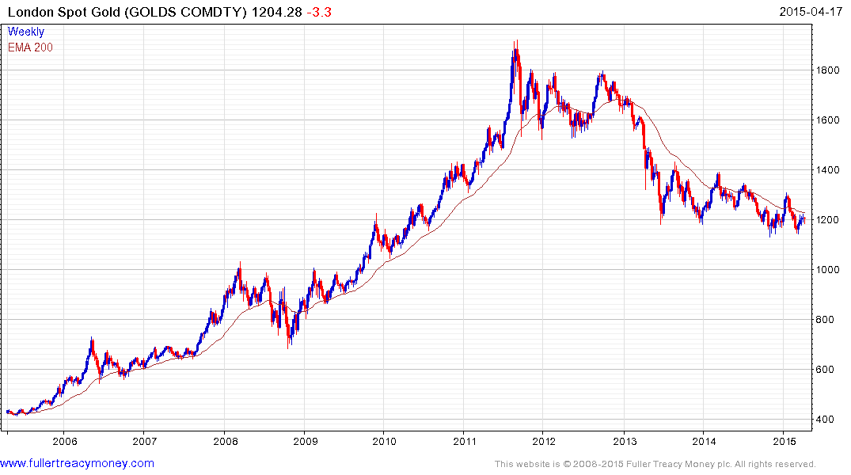
Gold is hard money, albeit with
a fluctuating price, just like
anything else which can be
bought or sold.
1. Traders mostly short
2. ETF long holds of gold still
liquidating
3. Indians & Chinese buying
4. Testing range lows
5. Gold needs a weaker Dollar

Slide 53
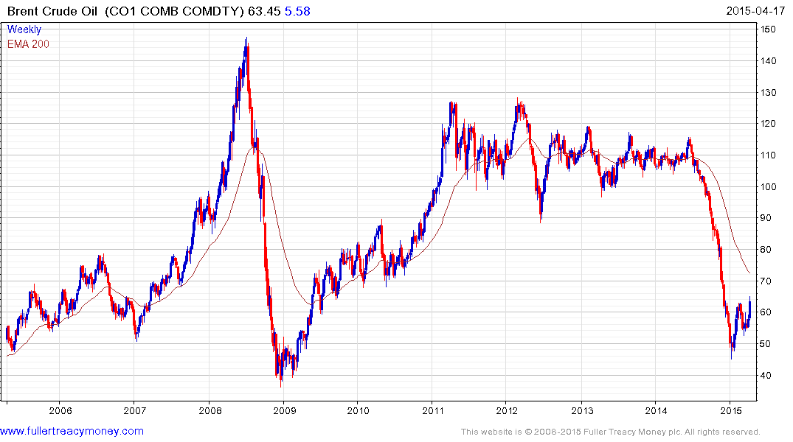
The end of an era for producers of crude oil
who have lost price control of this market
Now basing but no more
price spikes such as 2008,
despite turmoil in many
producer regions and an
eventual global economic
recovery

Slide 54
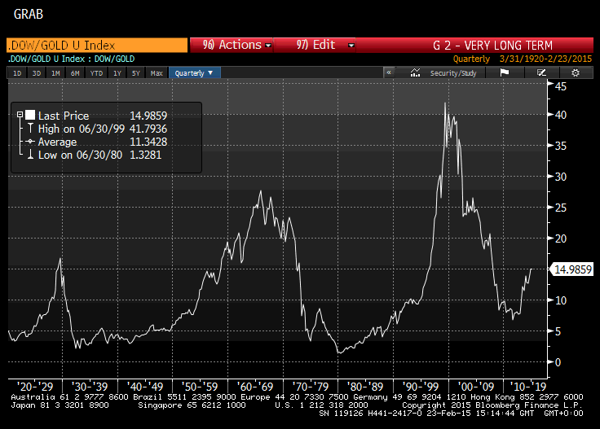
Gold remains
out of favour
with Western
Investors who
are mainly in
stocks & bonds

Slide 55

Is this what
a bear market
feels like?
We are not there yet;
in Wall Street terms
this cyclist is about to
resume climbing the
hill, exercising his pet
bear in the process

