Slide 1
The Markets Now
Stock Market Uptrends Reaffirmed
for Most of EU, Japan & USA, but
Valuations are Rising
David Fuller – 23rd February 2015
fullertreacymoney.com
East India Club – 16 St. James Square
London SW1Y 4LH, UK

Slide 2
Mario Draghi saves EU once again -
this time with €60bn per month QE -
totalling at least €1.1 trillion to end-Sep ’16
This QE starts in March -
‘Grexit’ over for at least 4 months -
stock market catch-up underway

Slide 3
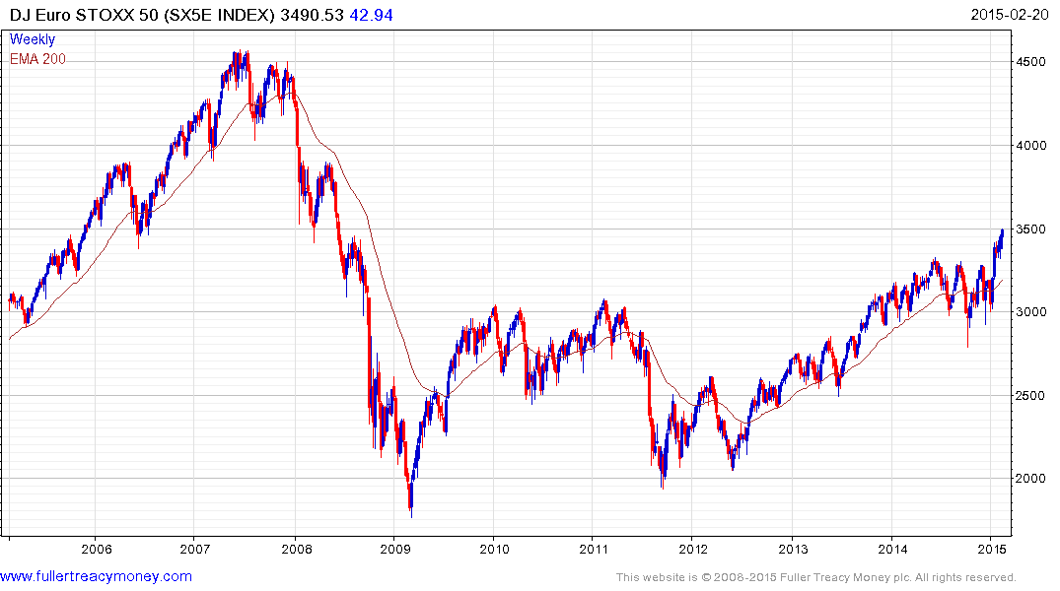
SX5E
P/E 22.55
Yield 3.35%

Slide 4
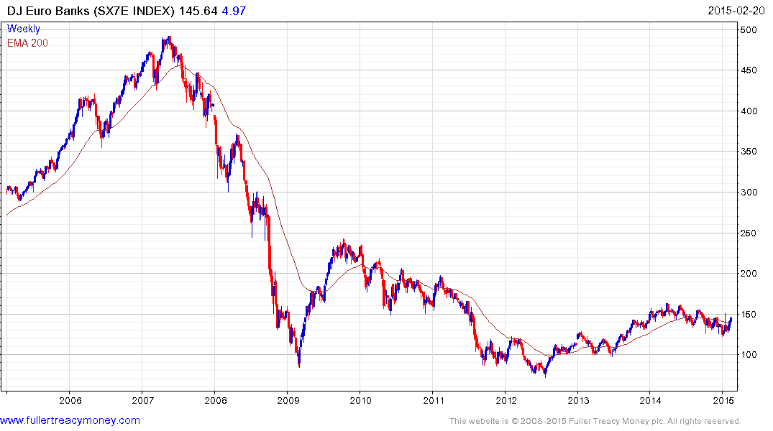
SX7E
P/E 50.61
Yield 3.12%

Slide 5
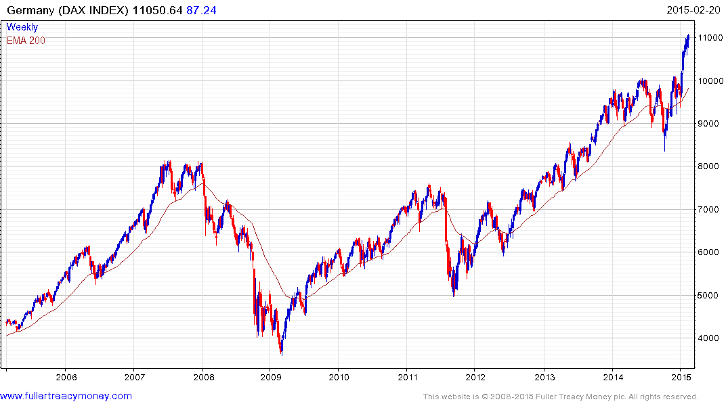
DAX
P/E 18.79
Yield 2.48

Slide 6
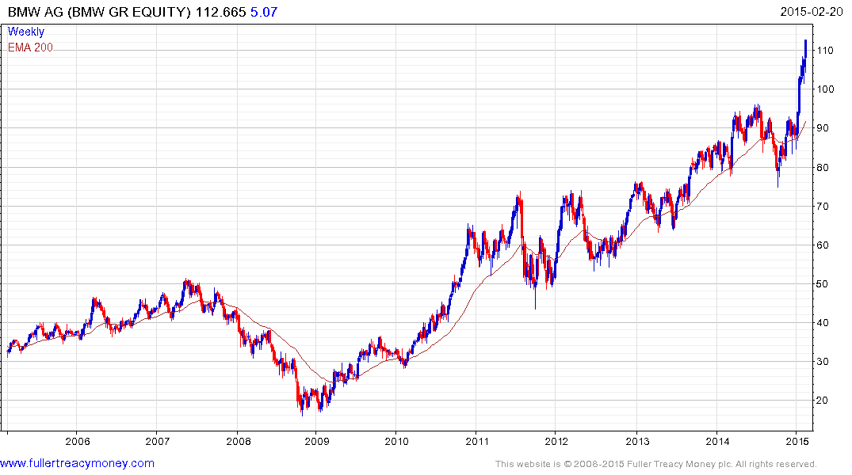
BMW
Est P/E 12.30
Yield 2.33%
Temporarily
overextended

Slide 7
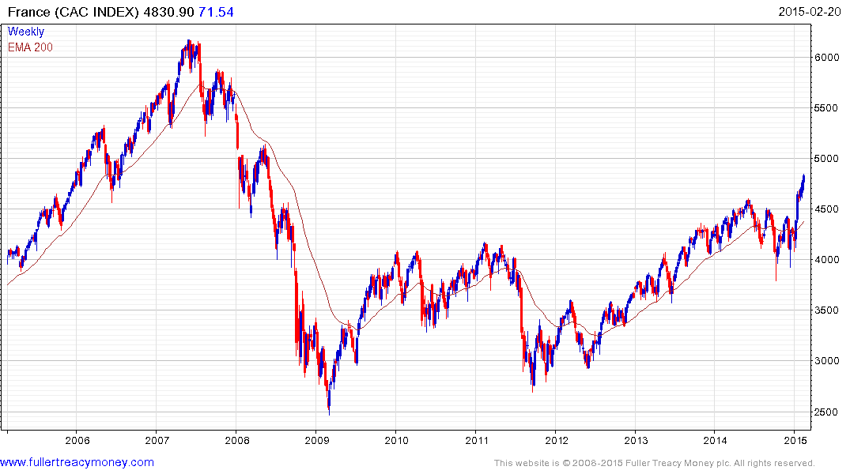
CAC
P/E 31.15
Yield 2.93%

Slide 8
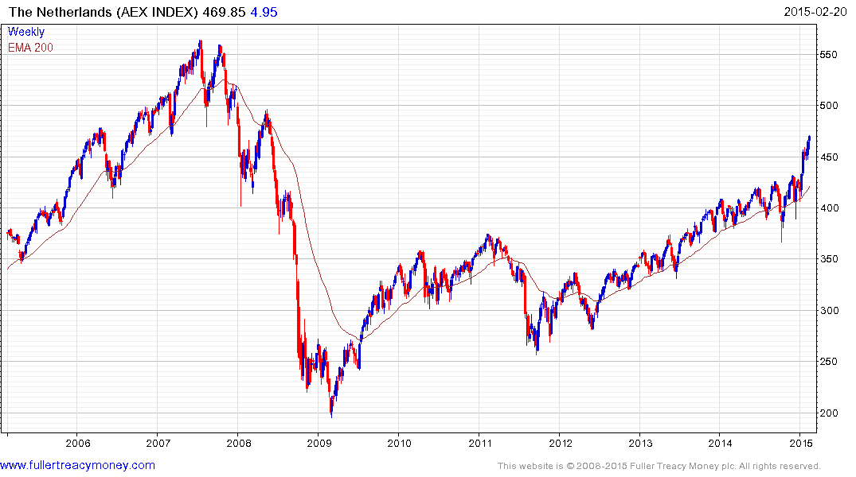
AEX
P/E 22.69
Yield 2.64%

Slide 9
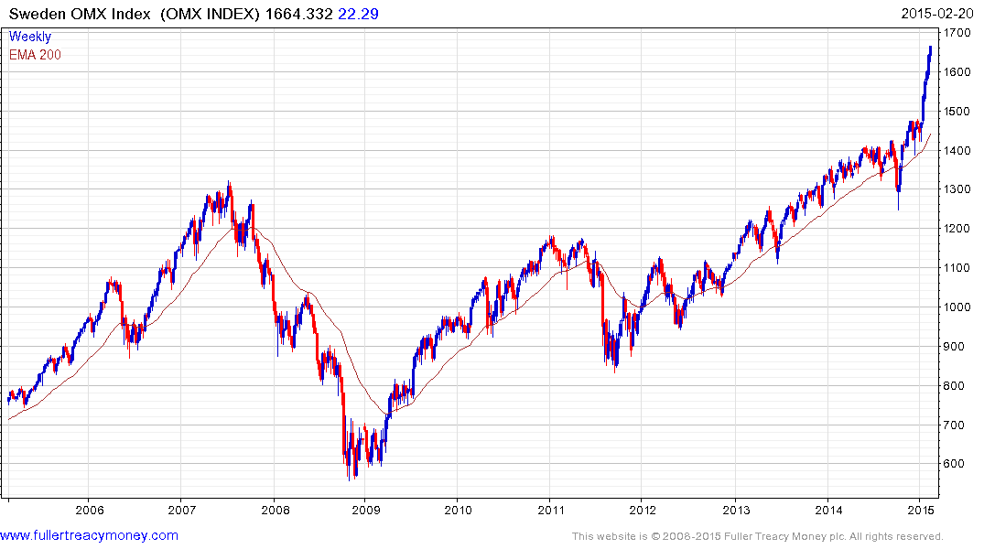
OMX
P/E 17.99
Yield 3.11%

Slide 10
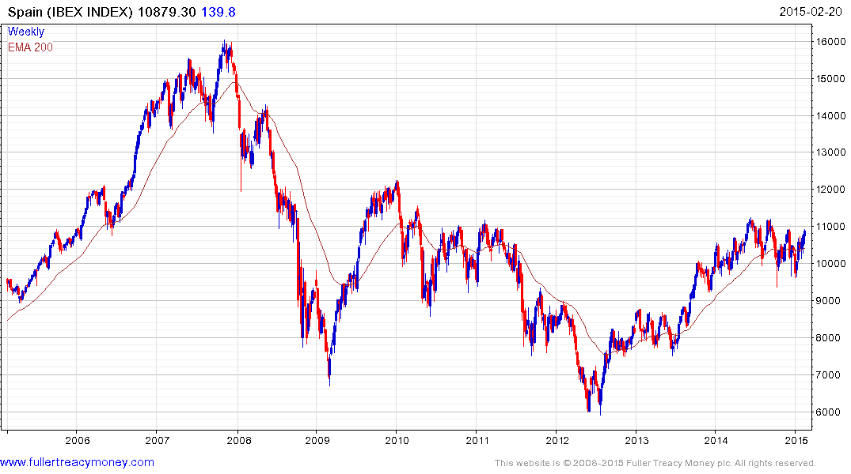
IBEX
P/E 21.71
Yield 5.86%*
*Exaggerated by
Banco Santander

Slide 11
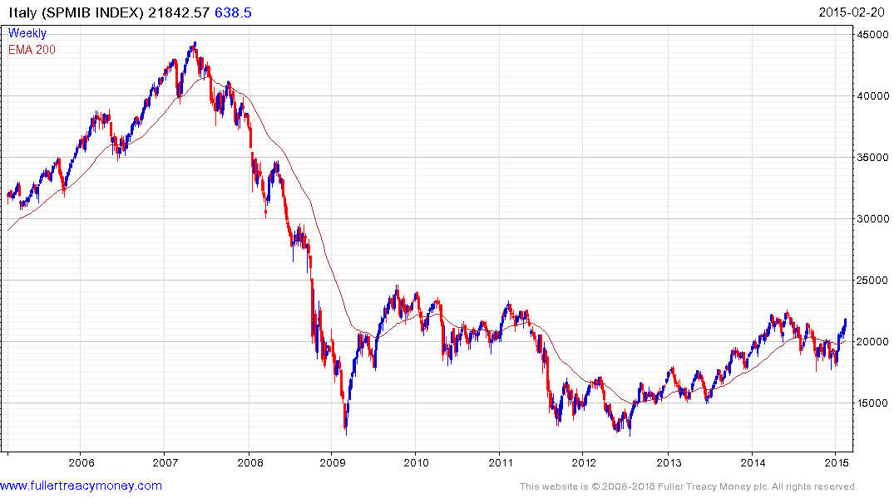
FTSEMIB
P/E 64.59
Yield 2.65%

Slide 12
Some non-Euro or non-EU
European markets which are
potential beneficiaries of Draghi’s QE

Slide 13
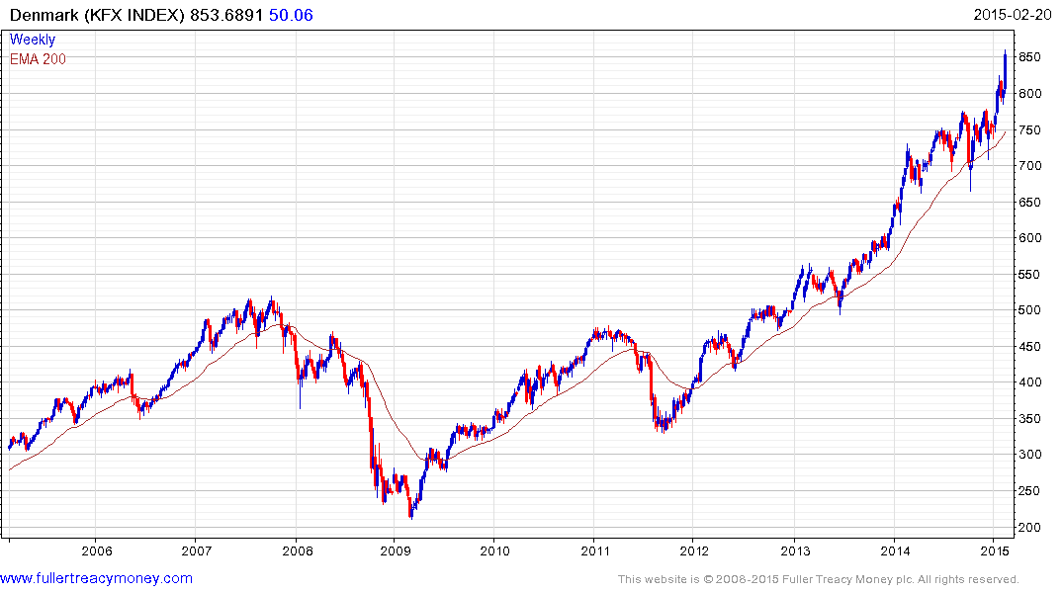
KFX
P/E 26.58
Yield 1.50%
Denmark is trying to hold its Euro peg

Slide 14
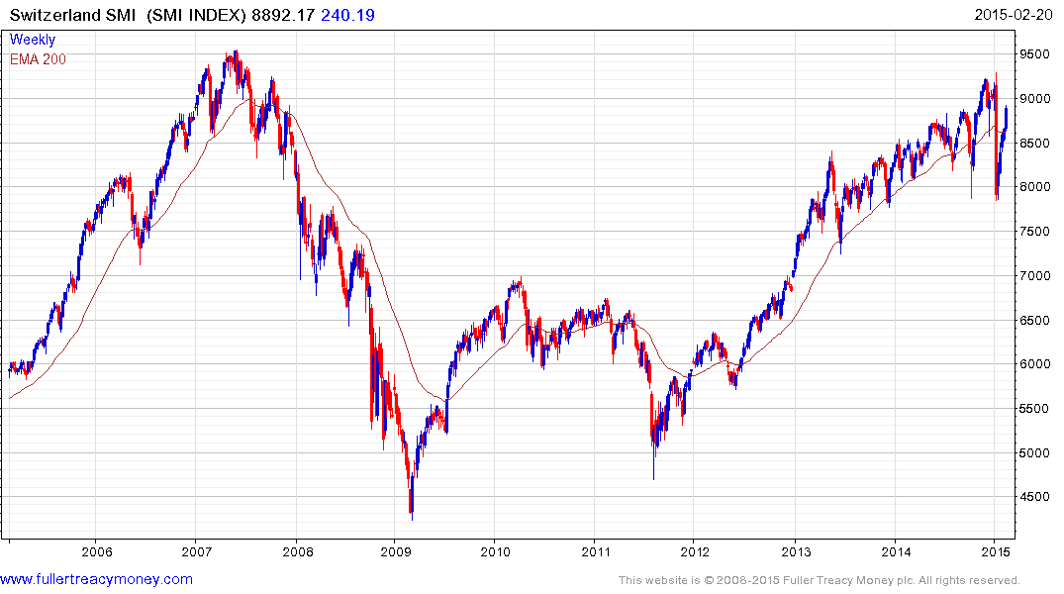
SMI
P/E 18.76
Yield 3.07%
Switzerland
unable to
maintain
peg to Euro

Slide 15
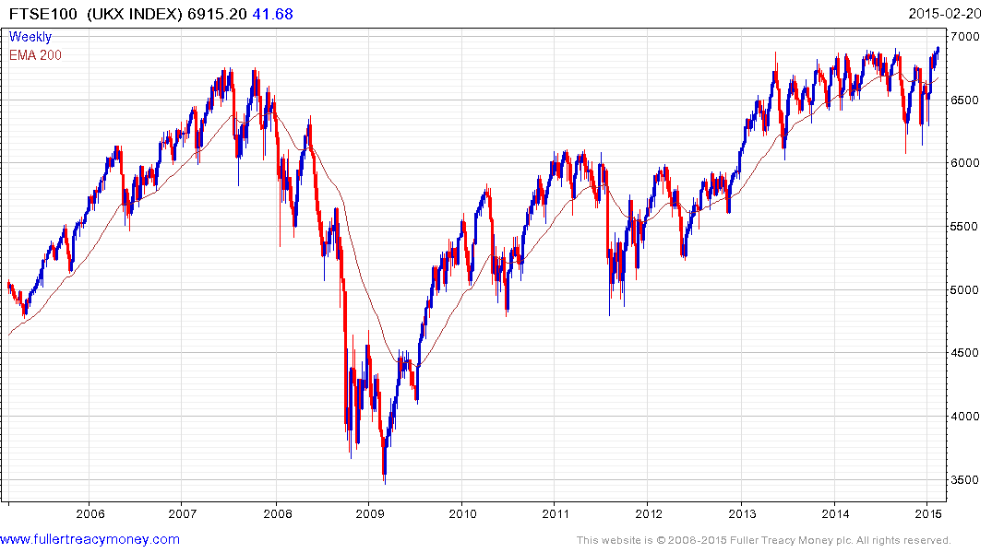
UKX
P/E 23.28
Yield 4.46%

Slide 16
Shinzo Abe and the BoJ
have the right policies
for Japan’s economic recovery
and a long-term bull market

Slide 17
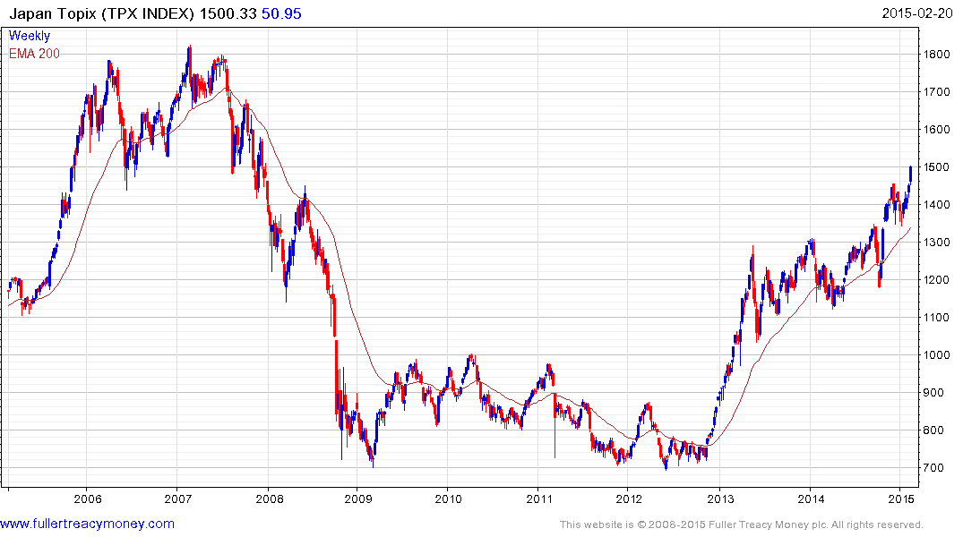
BoJ still
deploying QE
TPX
P/E 17.05
Yield 1.65%
Re-elected
Shinzo Abe
Elected PM

Slide 18
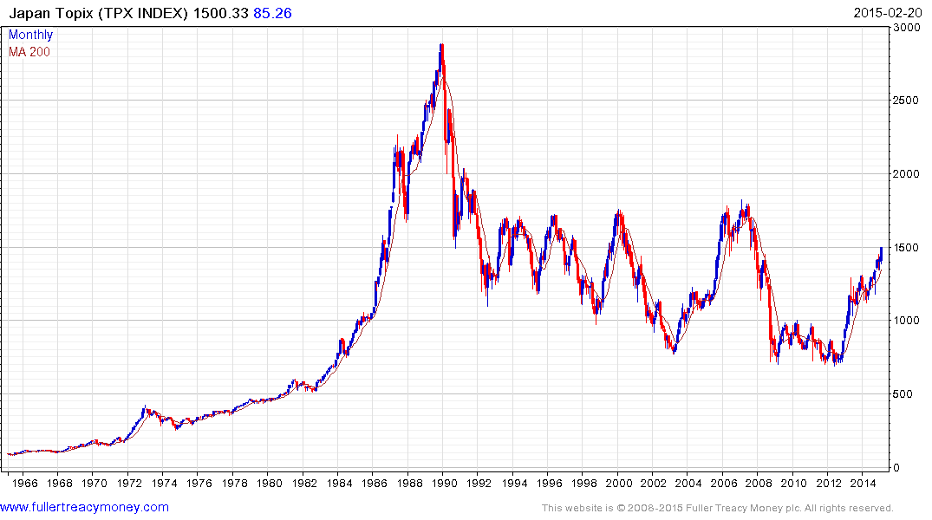
Should test this region, near 1800
possibly this year

Slide 19
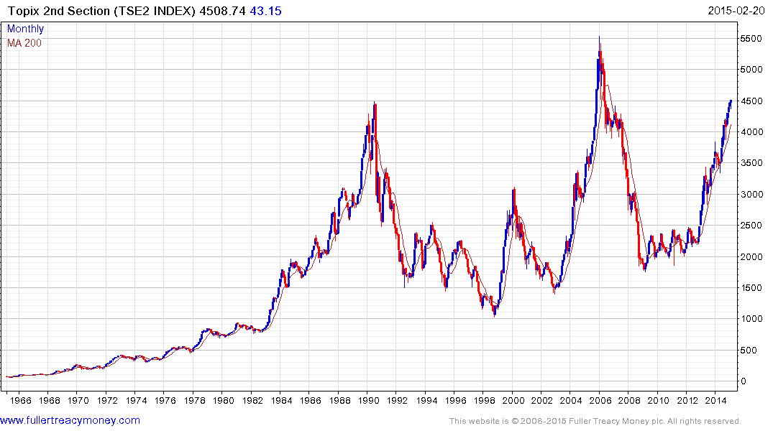
Topix 2nd Section
often leads
TSE2
P/E 15.22
Yield 1.43%

Slide 20
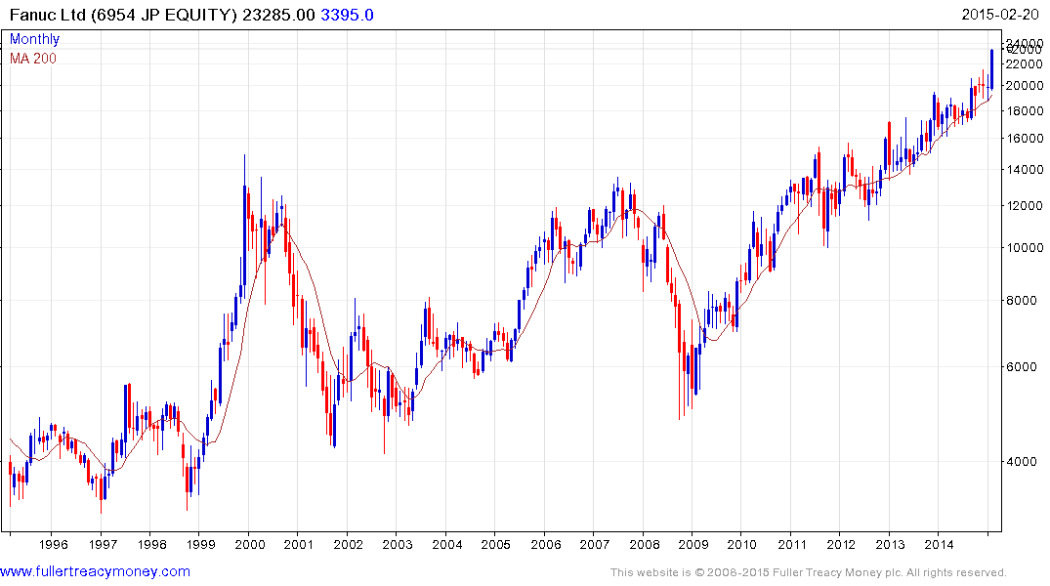
A share for this era
Fanuc leading Japan’s Indices
Fanuc
Est p/e 23.52
Yield 1.02%

Slide 21
Wall Street influences everything
Fortunately, most US indices
have reaffirmed bull market trends

Slide 22
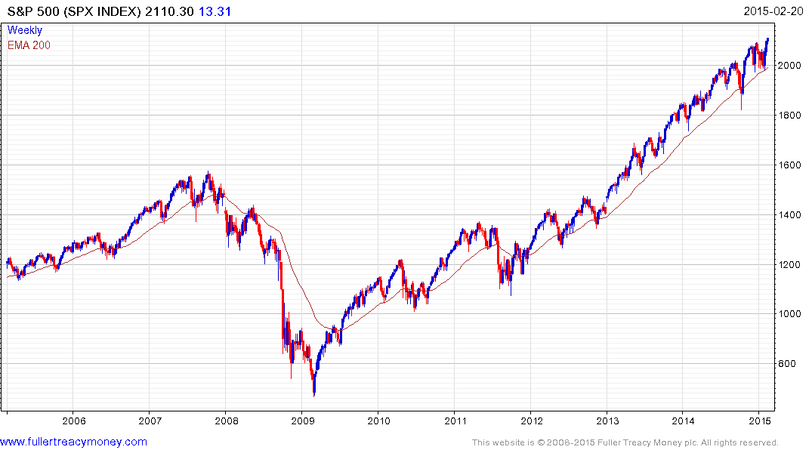
SPX
P/E 18.62
Yield 1.94%
Would have to break1970
to confirm upside failure

Slide 23
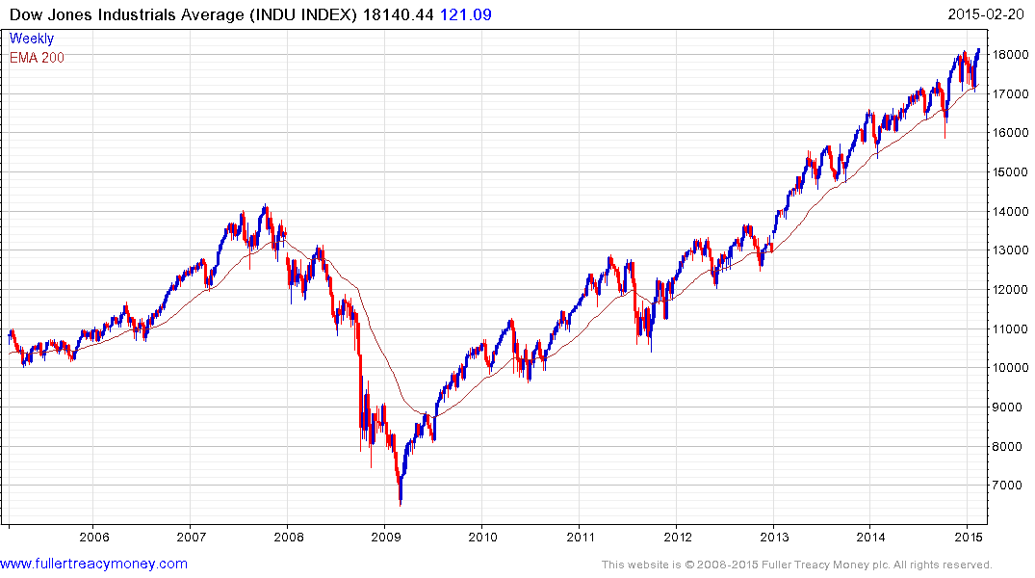
INDU
P/E 16.41
Yield 2.18%
Would have
to break 17000
to confirm
upside failure

Slide 24
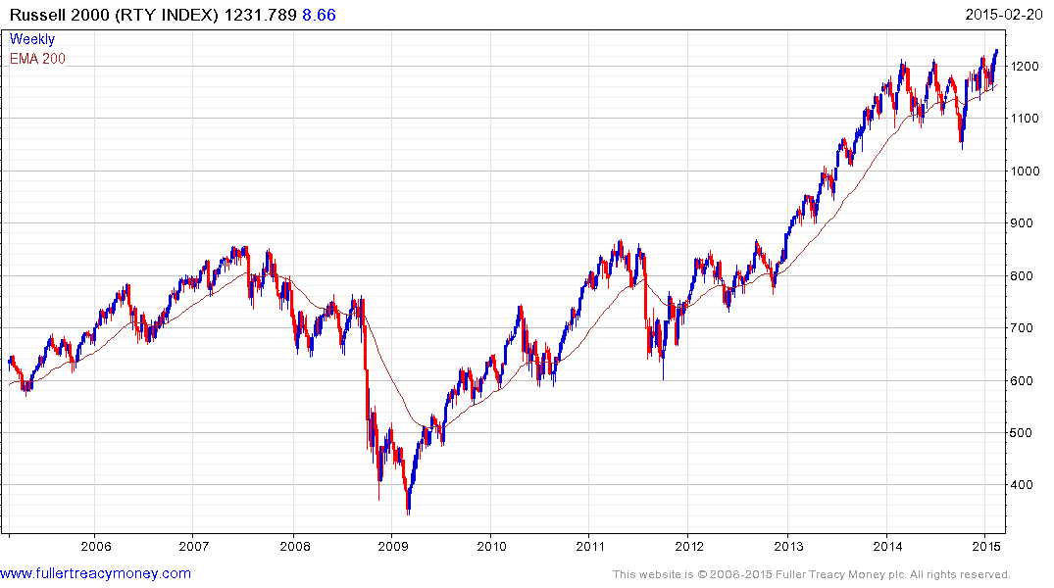
RTY
P/E 20.03
Yield 1.33%
This ‘canary
in the coalmine’
is still singing

Slide 25
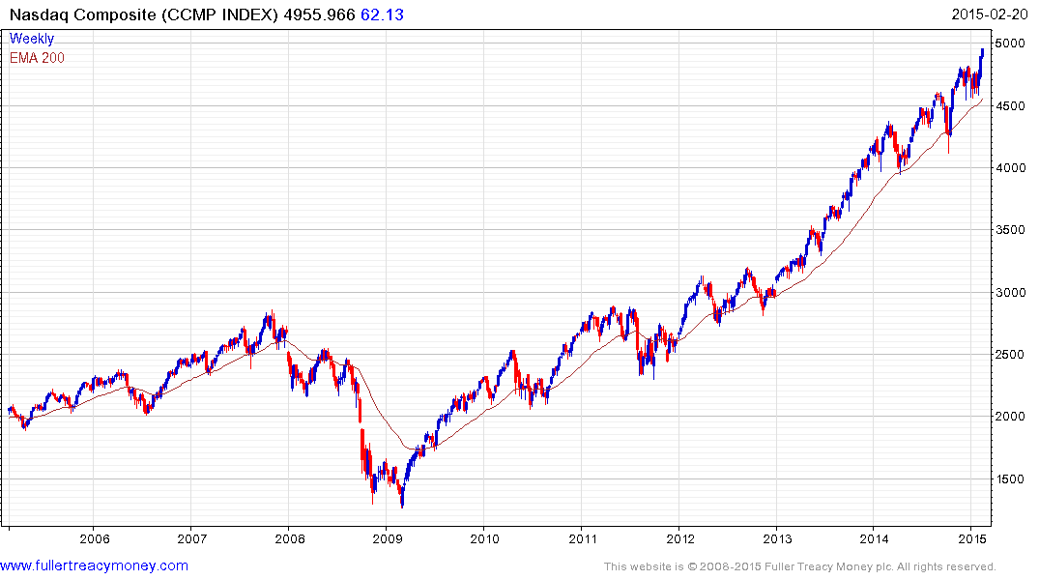
CCMP
P/E 31.85
Yield 1.28%
Would have
to close
beneath 4500
to confirm
upside failure

Slide 26
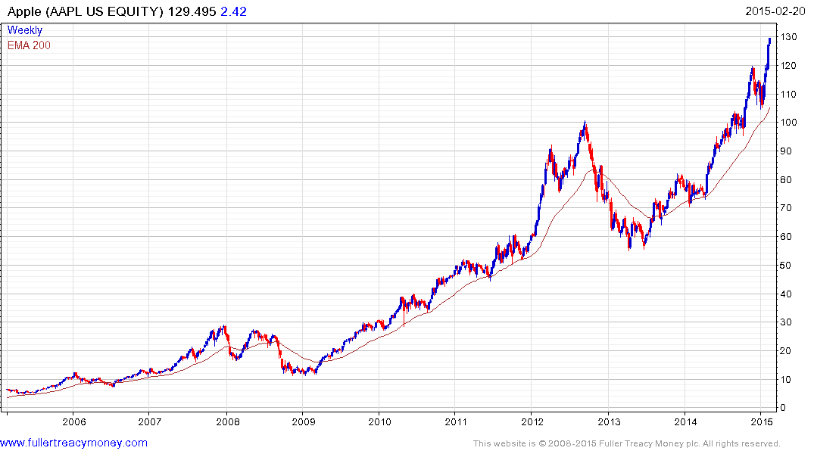
Keep an eye on this iconic bellwether for the
tech sector and Wall St generally - currently
a little overextended but not expensive
AAPL
Est P/E 15.09
Yield 1.45%
Watch the rising lows
for uptrend consistency

Slide 27
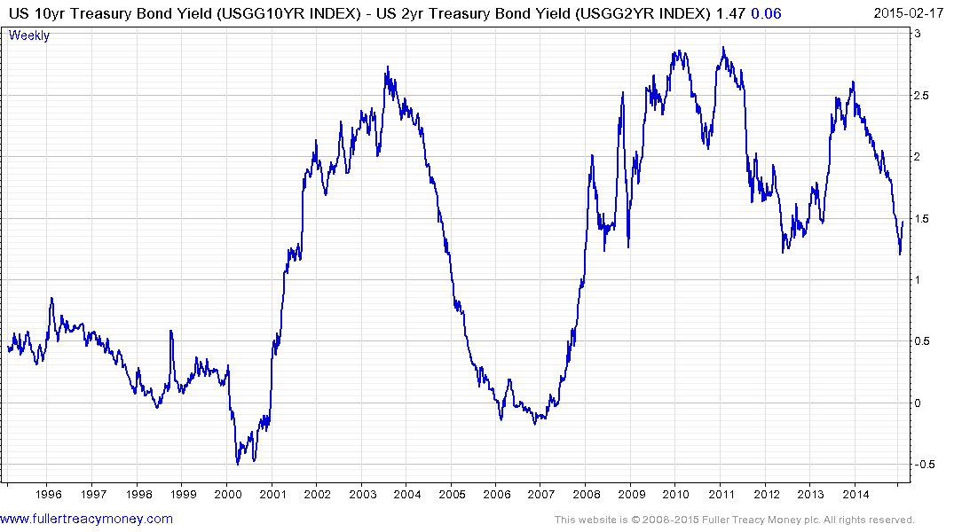
Alarmists keep talking
about a Wall St crash but unlikely while yield curve remains positive

Slide 28
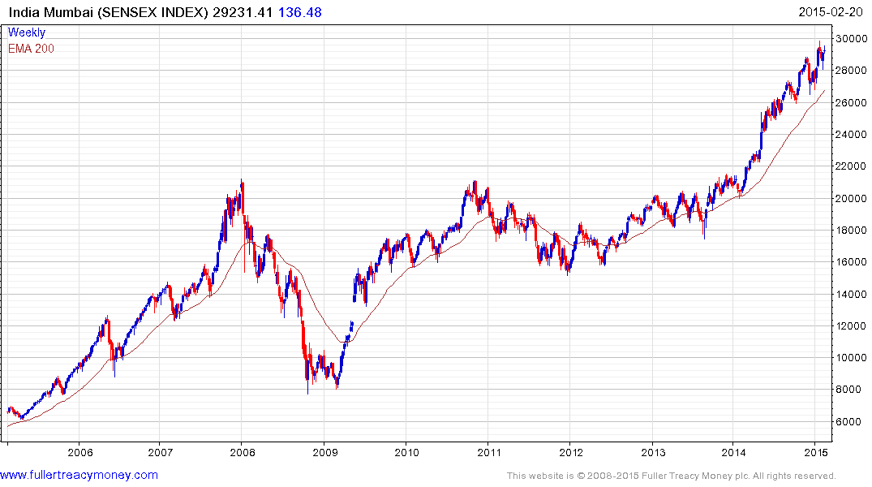
Sensex
P/E 20.59
Yield 1.38%
Still a favourite of mine
over the next few years
India
Watch the rising lows
for uptrend consistency

Slide 29
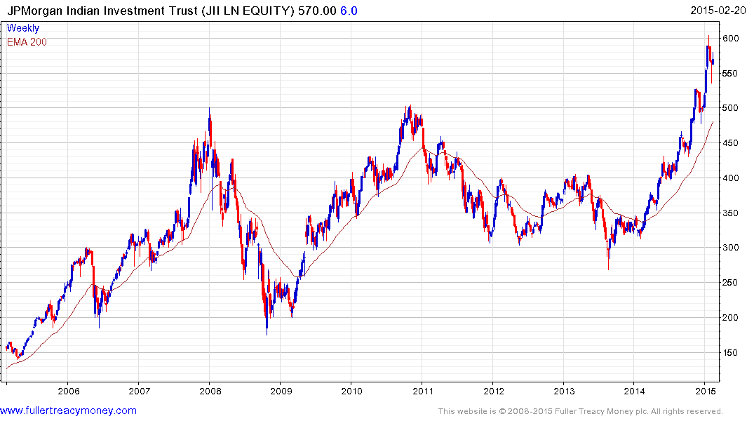
Discount to NAV
currently -9.061%

Slide 30
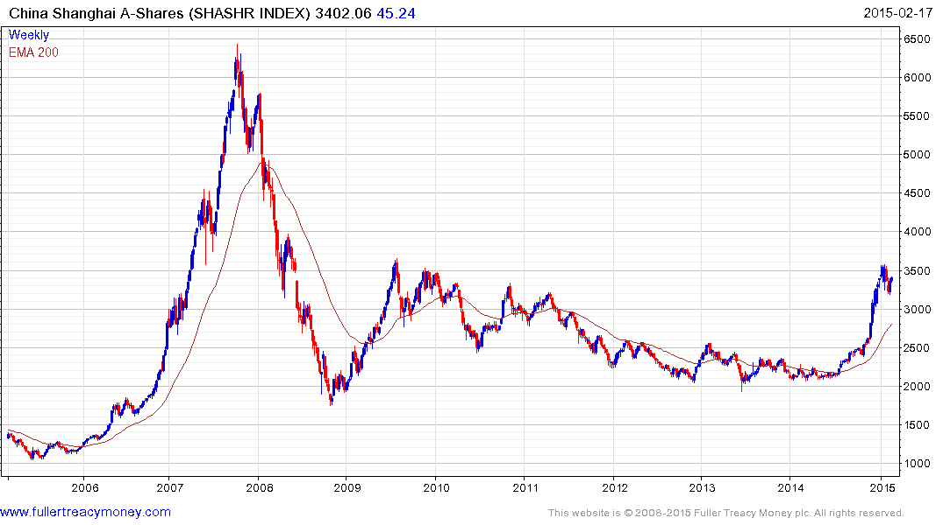
SHASHR
P/E 15.61
Yield 2.03
China
Consolidating first stage of bull market

Slide 31
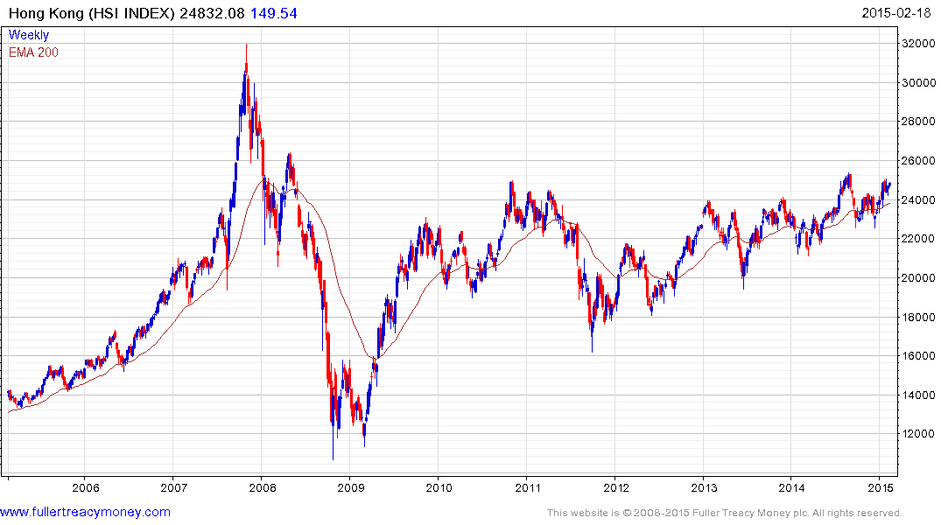
HSI
P/E 10.51
Yield 3.60%

Slide 32
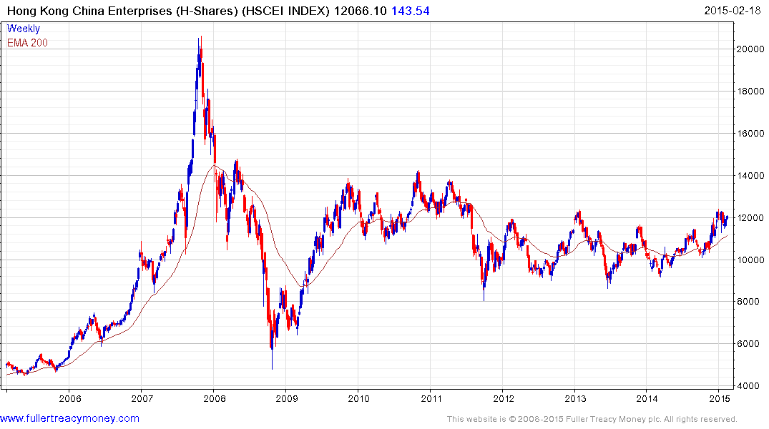
HSCEI
P/E 8.50%
Yield 3.56%

Slide 33
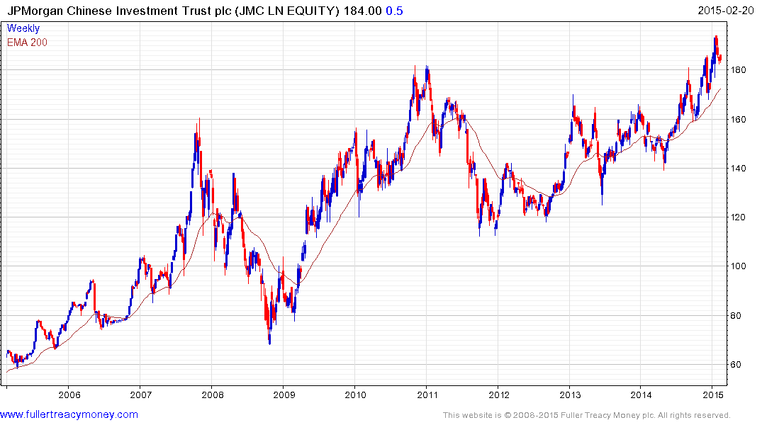
JMC
discount to NAV
currently -11.865%

Slide 34
Most investors remain cautious…
● Is it all about oil?
● Or is it about deflation?
● Political or algorithmic risks?
● What about leverage?

Slide 35
● My view: Oil near today’s price of Brent $60 is very bullish globally, oil producers excepted.
● However, the benefits are diffuse. People may not increase spending initially. Countries such as India reduce energy subsidies.
● In contrast, the pain for oil producers is seen and felt much more quickly.
● Investors should fear high oil prices because previous upside spikes are a major cause of global recessions as last saw in 2008.

Slide 36
Deflation?
● My view: Much of today’s deflation is largely positive, at least for corporations, because it is caused by technological innovation. For instance, better technology enables companies to produce improved products, at lower prices, in greater volume, while increasing profits due to increased sales.
● Destructive deflation is generally described as a vicious cycle of falling prices, wages and output. It is particularly bad for indebted governments, corporations and people who lose jobs or pay rises.

Slide 37
● Dangerous political risks are influential but usually regional events - Putin
● Excessive leverage and algorithmic risks often increase in maturing bull markets as speculators gamble more, but their economic impact is usually limited

Slide 38
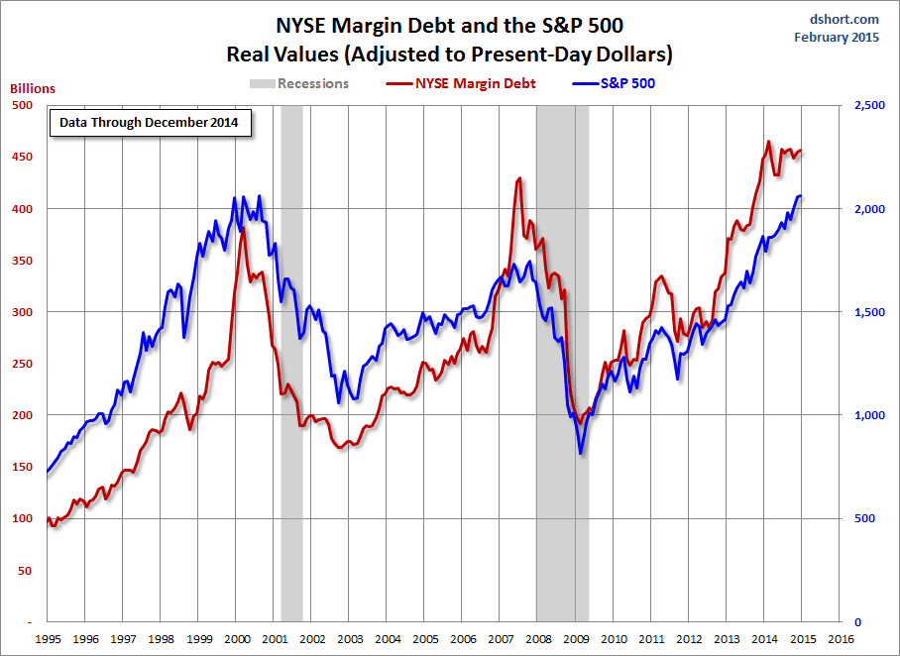
The long versus short
balance is important

Slide 39
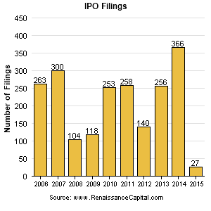
But this does not
show the size of
these filings

Slide 40
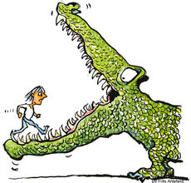
Surging new
issues are a
characteristic
of expensive
markets and
coincide with
tops because
they devour
buying power
We are not
there yet
but this is
a potential
problem for
the future

Slide 41
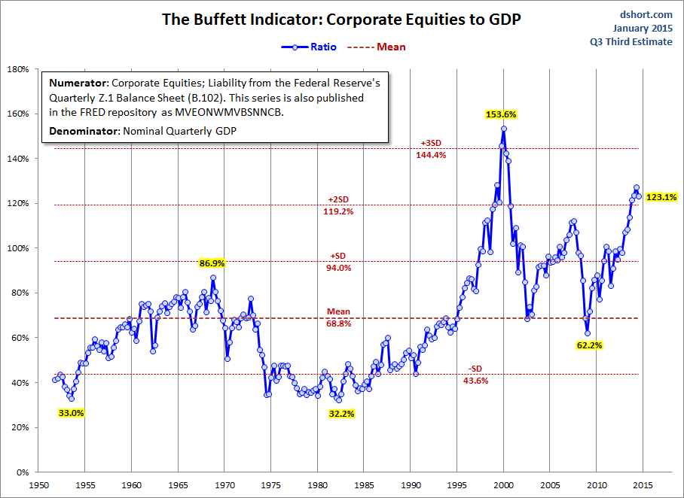

Slide 42
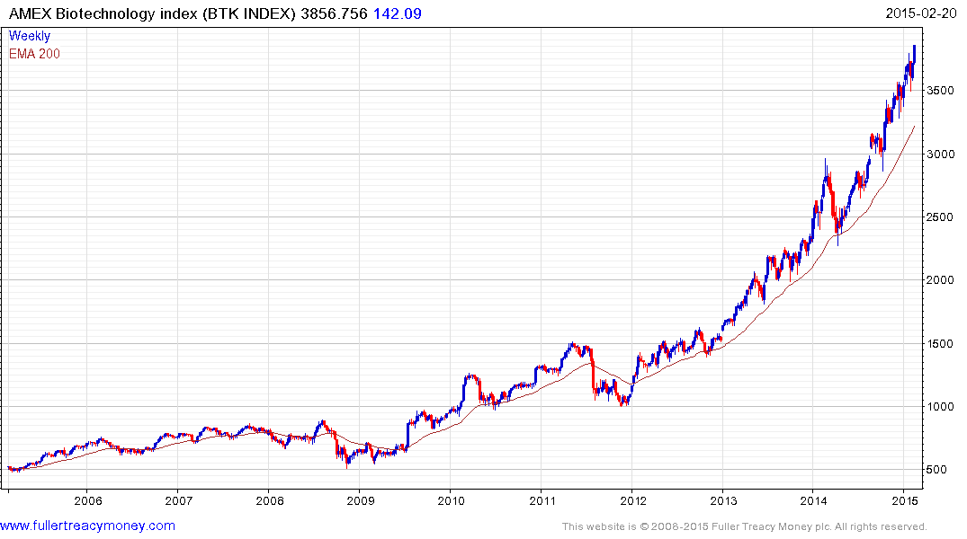
Biotechnology is currently a leading indicator
and increasingly overextended relative to the MA,
but the uptrend still consistent – watch the rising lows

Slide 43
Technical warning signs to watch for among indices
Trend acceleration relative to 200-day moving averages
Declining market breadth (fewer shares rising)
Failed upside breakouts from trading ranges
Loss of uptrend consistency characteristics
Churning price action relative to recent trading ranges
Breaks of 200-day moving averages
Broadening patterns relative the last several trading ranges
200-day moving averages turn downwards
Resistance is encountered beneath declining 200-day MAs
Previous rising lows are replaced by lower rally highs
Indices fall faster than they rose to their highs

Slide 44
Bullish Points for Stock Markets
S&P up15.3% on average 6 months after mid-term election
Global monetary policy is still extremely accommodative
Central banks are worried about deflation, not inflation
Capitalism increasingly dominates on a global basis
Globalisation spurs rapid emerging market development
Growth in middleclass consumers surges, led by Asia-Pac

Slide 45
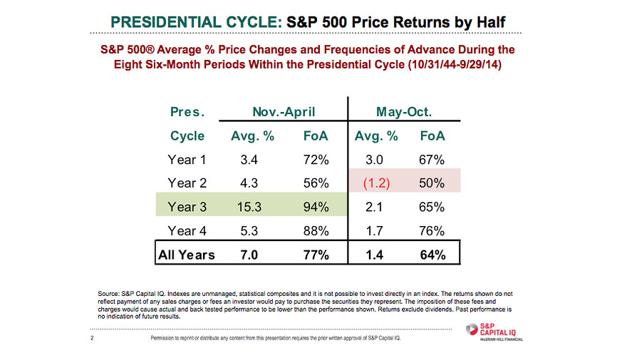

Slide 46
Long-term bull factors for stock markets
Accommodative monetary policies, until growth accelerates
An accelerating rate of technological innovation
Lower energy prices in real terms, thanks to innovation
The triumph of capitalism, both democratic & authoritarian
Globalisation, hastening development of emerging markets
Middleclass growth in emerging markets
Continued growth in the global population

Slide 47
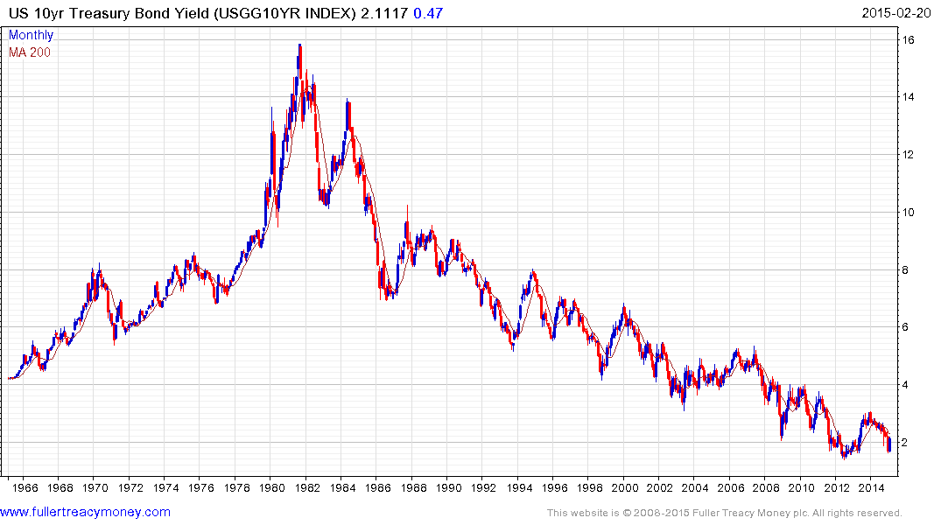
1) Probable lengthy base building
2) Above 3% base maturing
3) Above 4% probable base completion

Slide 48
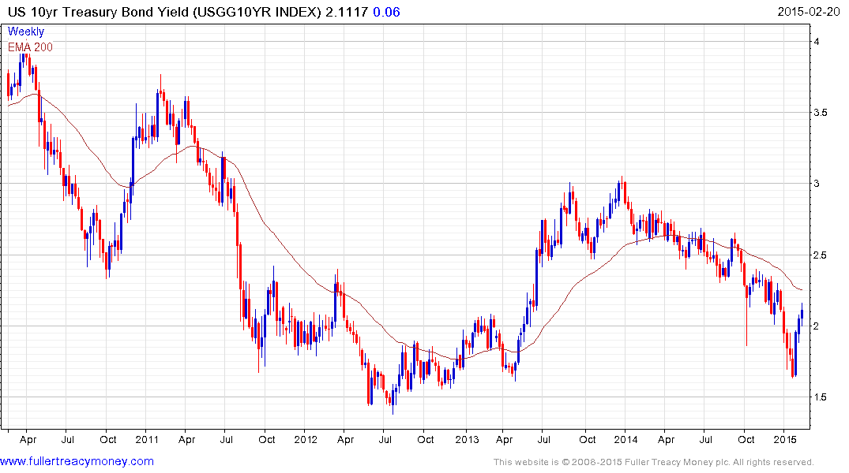
Government bonds where yields have
been compressed by QE are a bubbles,
with lengthy medium-term fuses

Slide 49
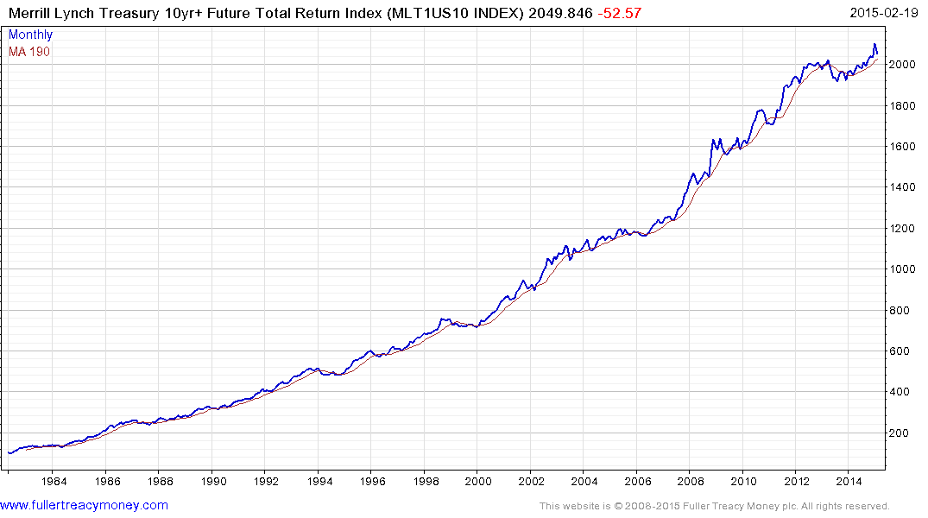
US bondholders are still making money
but top completion occurs when this
total return pattern breaks downwards

Slide 50
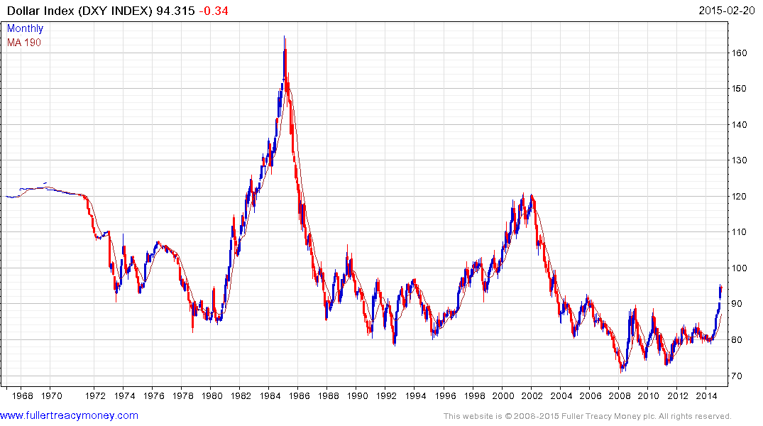
US Dollar Index has completed a base formation
driven by energy independence & tech lead
Fed & Treasury will control speed of $ recovery

Slide 51
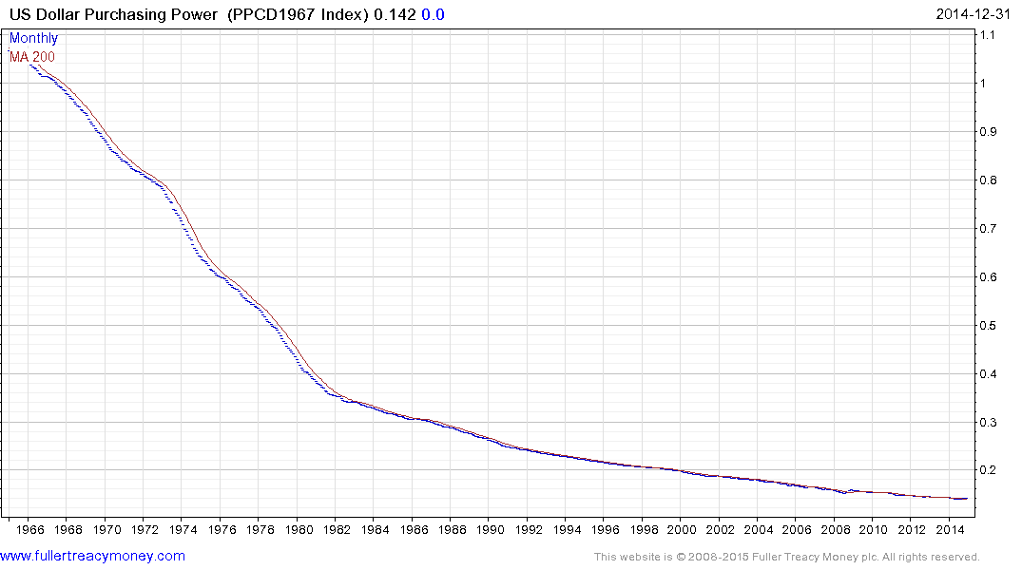
Nevertheless the US dollar is still a fiat currency, which
has lost most of its purchasing power since only 1968

Slide 52
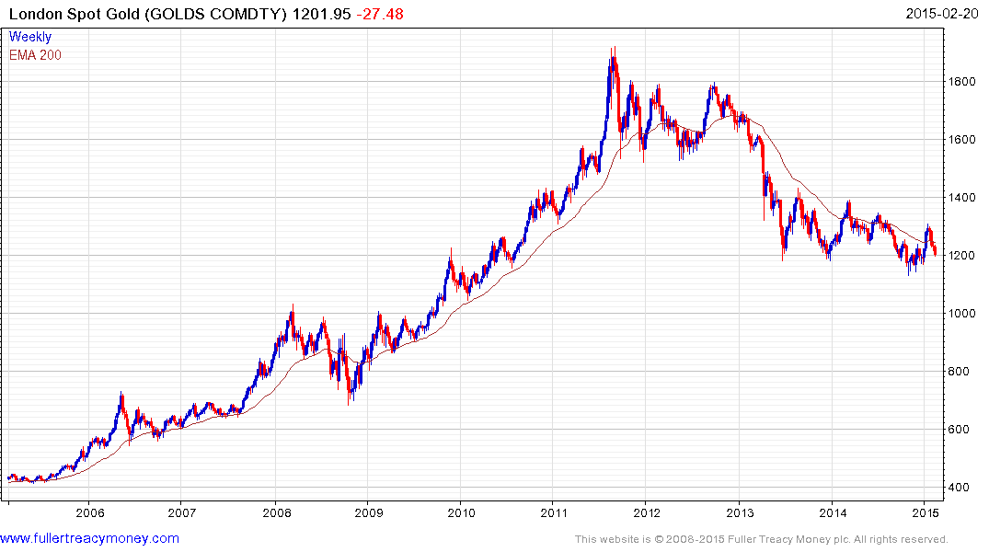
Gold is hard money, albeit with
a fluctuating price, just like
anything else which can be
bought or sold.
1. Traders mostly short
2. ETF long holds of gold still
liquidating
3. Indians & Chinese buying
4. Testing range lows

Slide 53
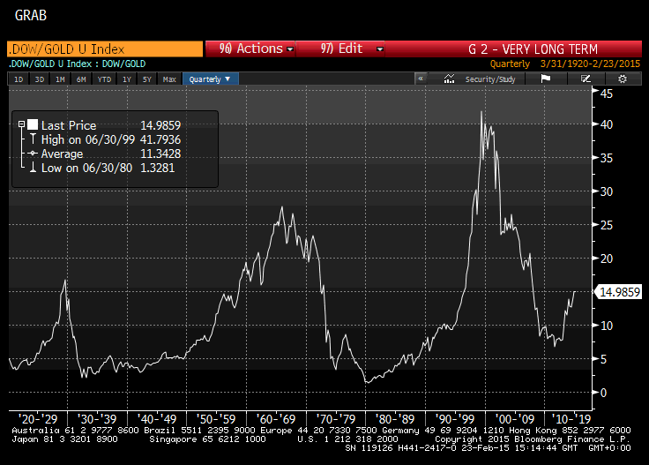
Gold remains
out of favour
with Western
Investors who
are mainly in
stocks & bonds

Slide 54
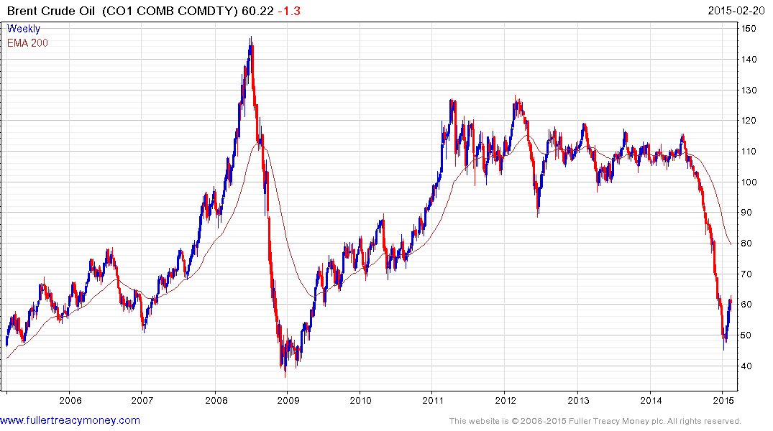
The end of an era for producers of crude oil
who have lost price control of this market
Now basing but no more price spikes such as 2008, despite turmoil in many producer regions and an eventual global economic recovery

Slide 55
Many thanks for your interest!
Any questions?
Please visit our site:
www.fullertreacymoney.com

