Slide 1


THE BIG PICTURE AND THE AUTONOMIES
CHRIS MOORE & EOIN TREACY

Slide 2
AGENDA
INTRODUCTION- Chris Moore
THE BIG PICTURE AND THE AUTONOMIES-Eoin Treacy
THE FP WM GLOBAL CORPORATE AUTONOMIES FUND-Chris Moore
Please ask Questions throughout the presentation!
THE BIG PICTURE AND THE AUTONOMIES
THE BIG PICTURE AND THE AUTONOMIES

Slide 3
The Big Picture and the Autonomies
Eoin Treacy – 10th February 2015
fullertreacymoney.com
East India Club – 16 St. James Square
London SW1Y 4LH, UK

Slide 4
Full Disclosure: I’m an optimist…
I believe the world will be a better place to live than it has been. Our best days are not only ahead of us but will always be ahead of us because of humanity’s capacity for innovation.

Slide 5
3 REALLY Big Themes
The rise of the Global Middle Class
The exponential pace of technological innovation.
Lower energy prices in real terms are not a short term phenomenon.

Slide 6
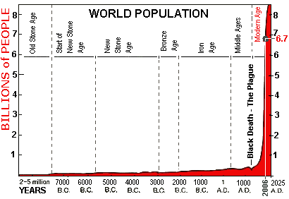
Global population growth panics some people

Slide 7
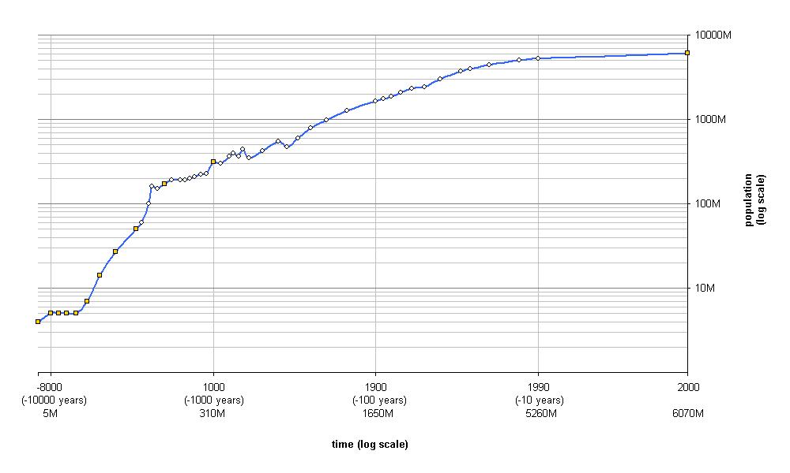
Global population growth on a log scale.

Slide 8
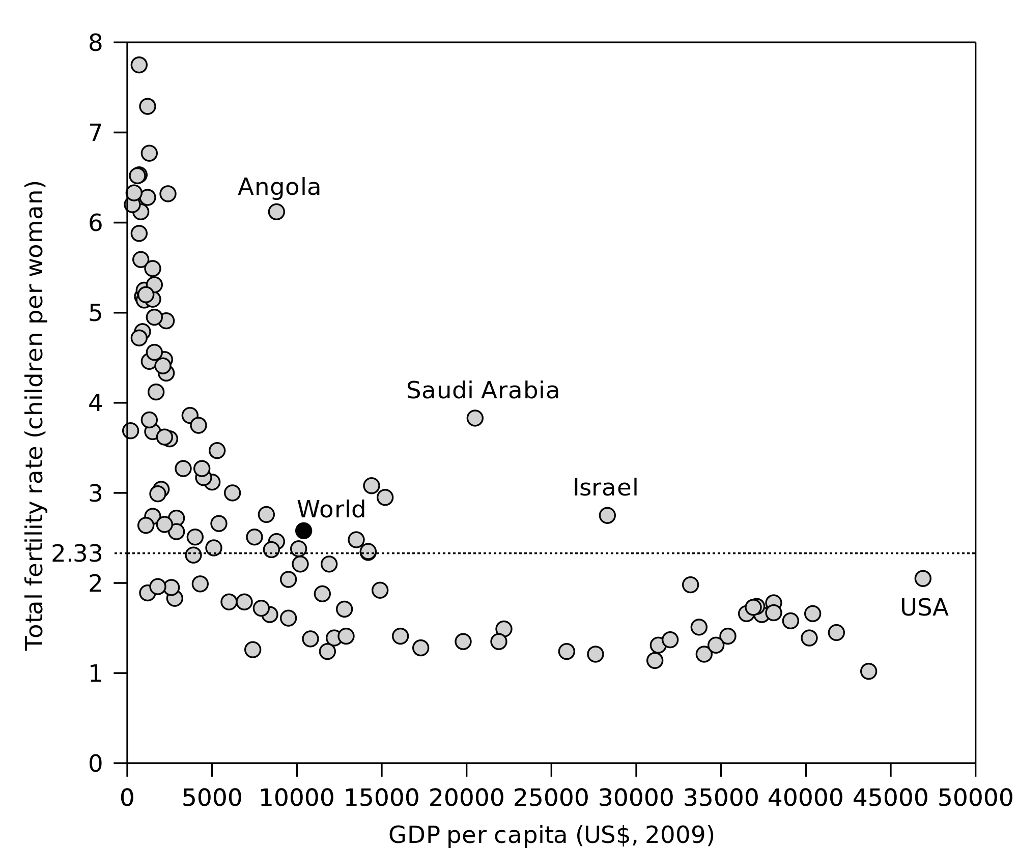
Population trends lower as incomes increase. If you want to save the world show people how to improve their living standards.

Slide 9
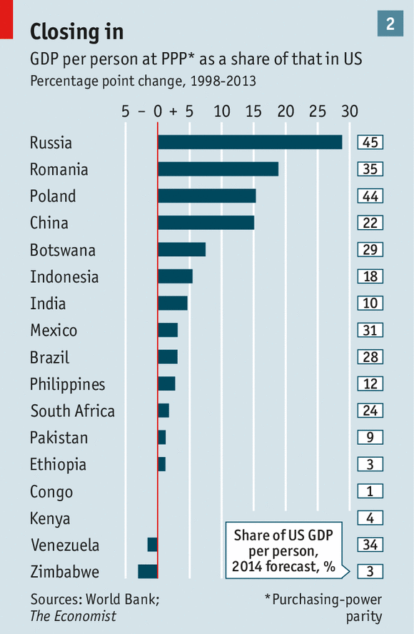
So what?
Governance is Everything and the trend is positive.
Standards of Economic and Corporate Governance are improving.
Governance is Relative not Absolute.

Slide 10
The accelerating rate of technological innovation is the single most bullish factor for the long term
Tools, methodology and tech we take for granted is going global as governance improves.
The pace of innovation is also creating the potential for productivity growth not least in energy, high tech and healthcare.

Slide 11

Let’s think a little differently

Slide 12

Let’s think a little differently

Slide 13

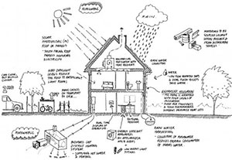
The Internet of Everything is a major roll out of existing technology to everywhere.

Slide 14
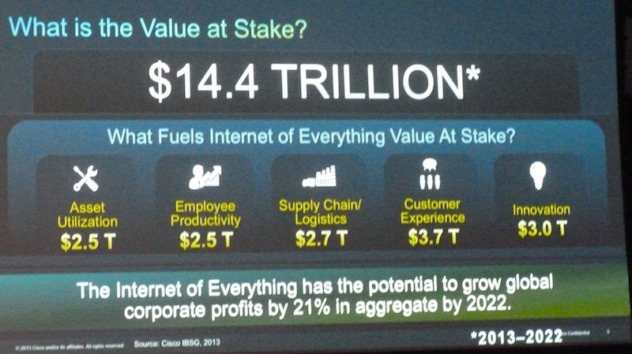
The Internet of Everything is a major roll out of existing technology to everywhere.

Slide 15
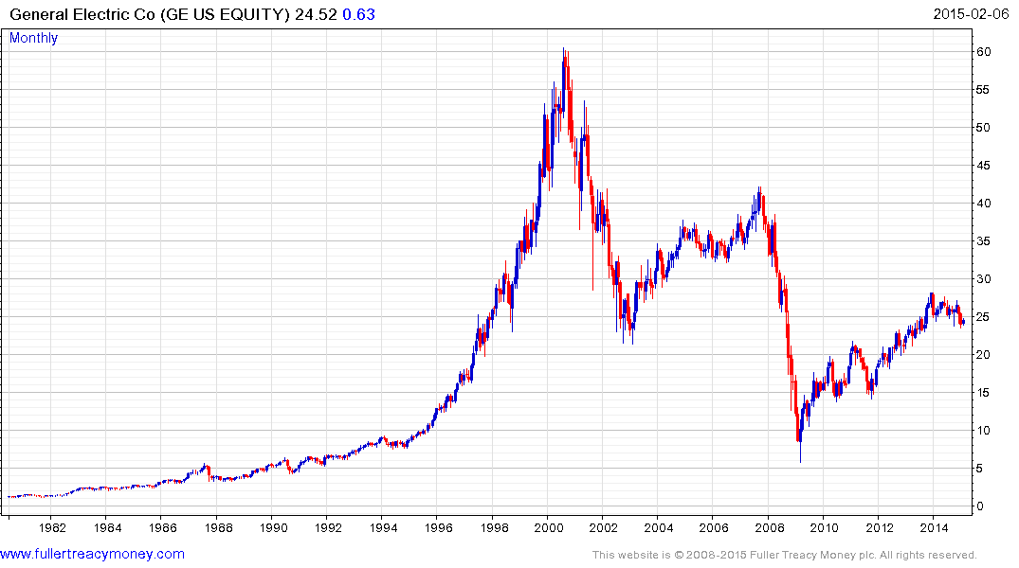
A company doesn’t have to manufacture 3-D printers to benefit from them.

Slide 16

Constant connectivity will help usher in personalised medicine for the first time.
The Apple Watch and other wearables will act as the tools to enable who new services.

Slide 17
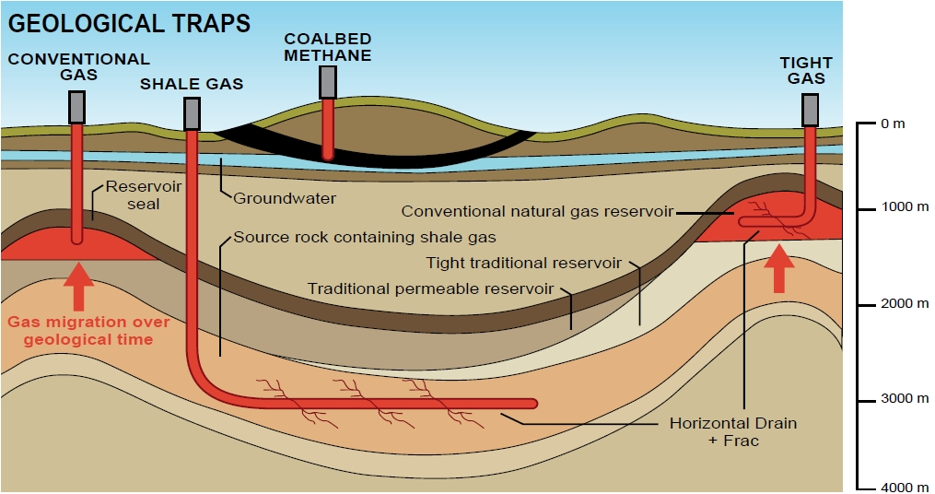
This is how we tend to think of energy

Slide 18
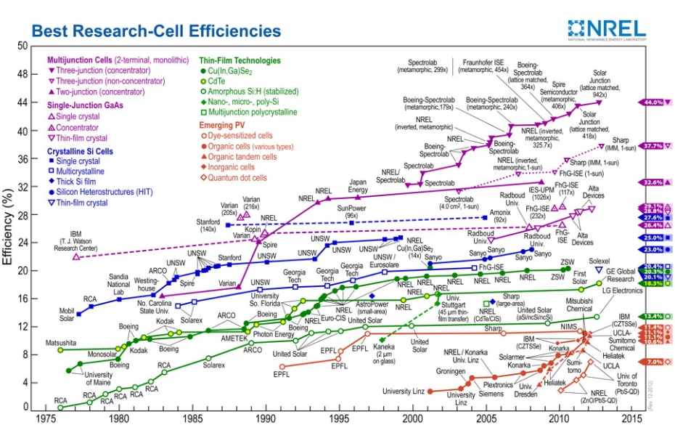
This is how we tend to think of energy

Slide 19

Nuclear Fusion is getting closer to reality.

Slide 20
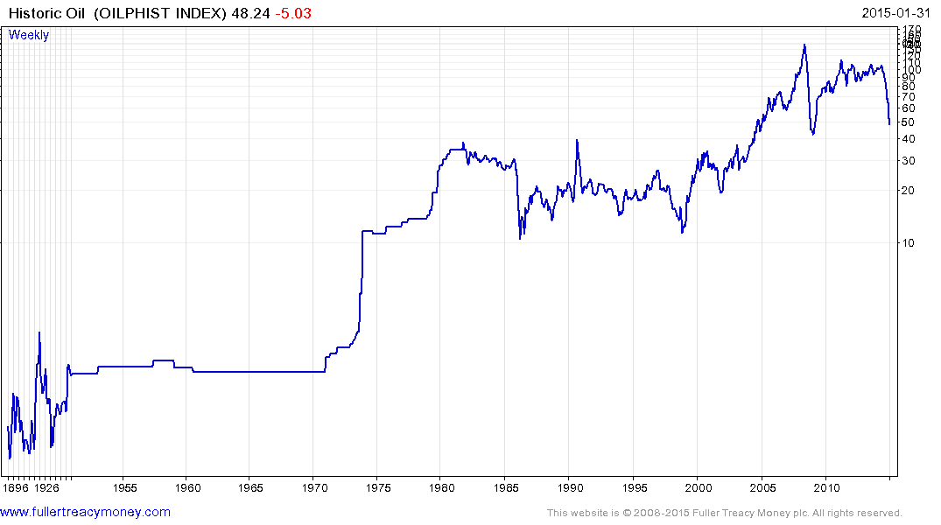
Oil prices tend to be highly cyclical interspersed with occasions major bull markets.

Slide 21
Where do the Autonomies fit?
Simply put, they are the companies we believe most likely to benefit from a developing secular bull market.
They are big, truly international and dominate their respective niche. This contributes to generally strong balance sheets and many have long records of increasing dividends?

Slide 22
How did the idea of the Autonomies evolve?
In the aftermath of the credit crisis, David Fuller and I observed that the world’s major population centres, primarily in Asia had bounced back emphatically. They had experienced contagion during the sell-off but were first to hit new highs. Internationally diversified companies were benefitting as a result.
Clicking through various international indices of shares the number of such companies completing decade long base formations was startling. When I put the list together they all shared the characteristics we now use to define the Autonomies.

Slide 23
How do to decide on what qualifies as an Autonomy?
40% of revenue has to generated outside its country of origin so the company qualifies as a truly global company.
It has to be a leader in its sector. There are a lot of global companies but capitalism trends towards concentration and those that dominate their respective niche have global brand recognition.
Dividends are important not least because of their contribution to total return over time. However we did not make dividends a qualification for membership of the Autonomies because so many strong international technology companies do not have sufficient dividend growth history to qualify.

Slide 24
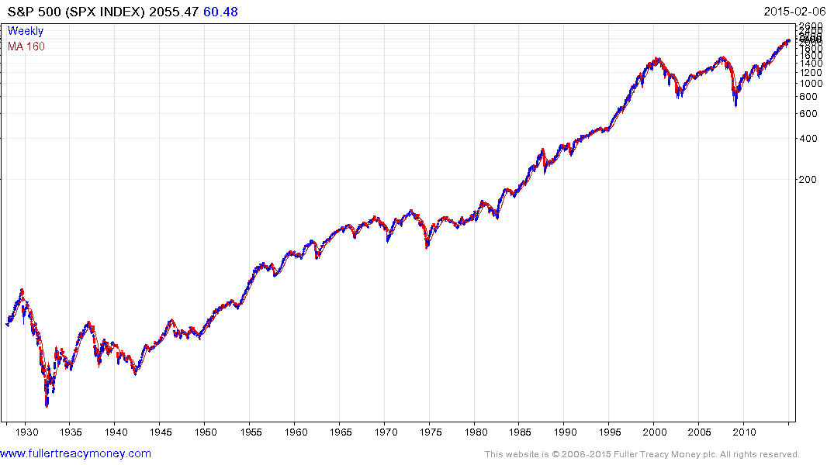
Major bull markets follow major bear markets.

Slide 25
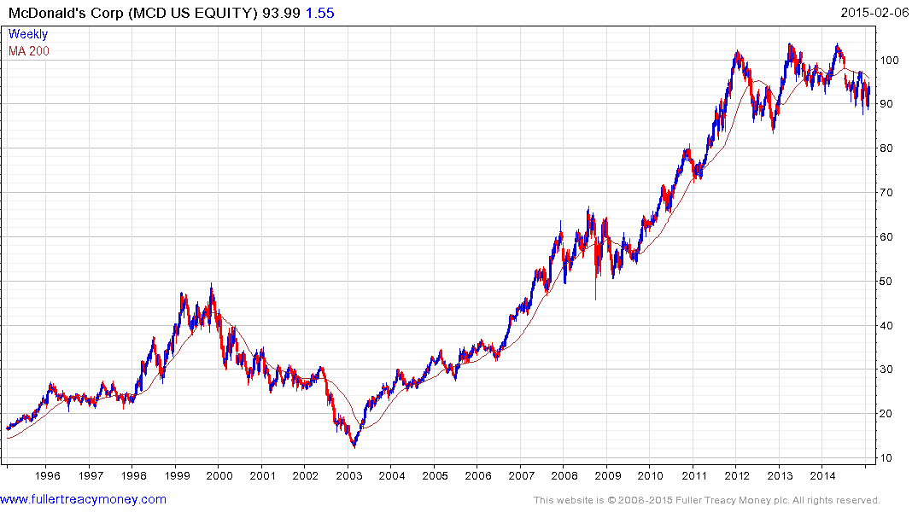
McDonalds has been raising dividends annually for decades and is one of the most internationally recognisable brands.

Slide 26
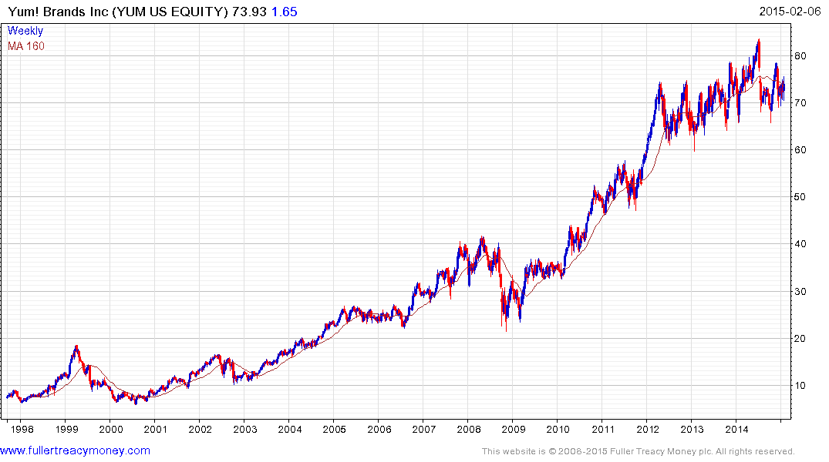
Yum Brands has a similar business is even more exposed to international markets but does not have as long a record of dividend increases. Therefore it is an Autonomy but not a Dividend Aristocrat.

Slide 27
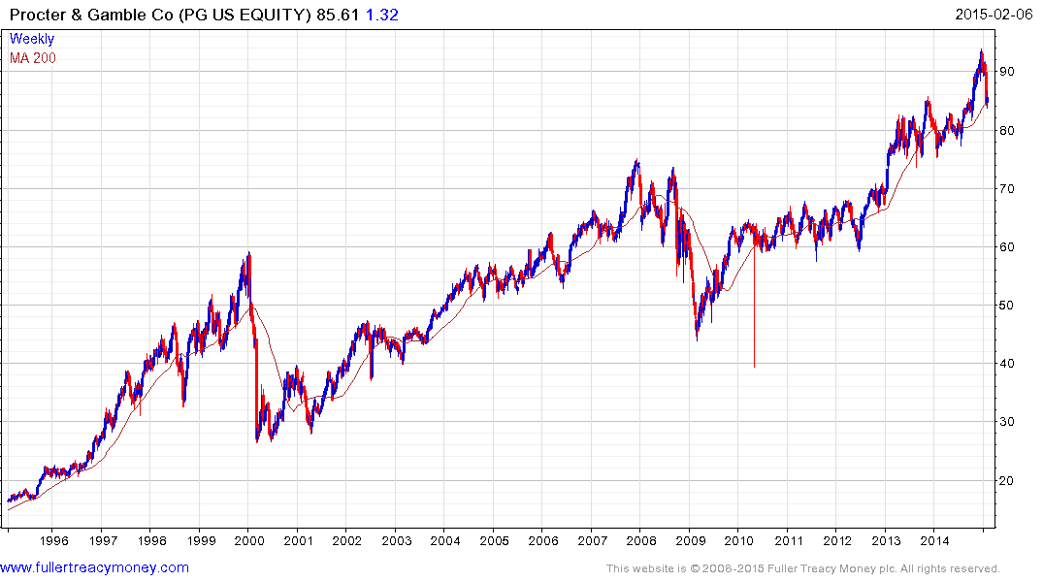
P&G has an enviable suite of brands which is

Slide 28
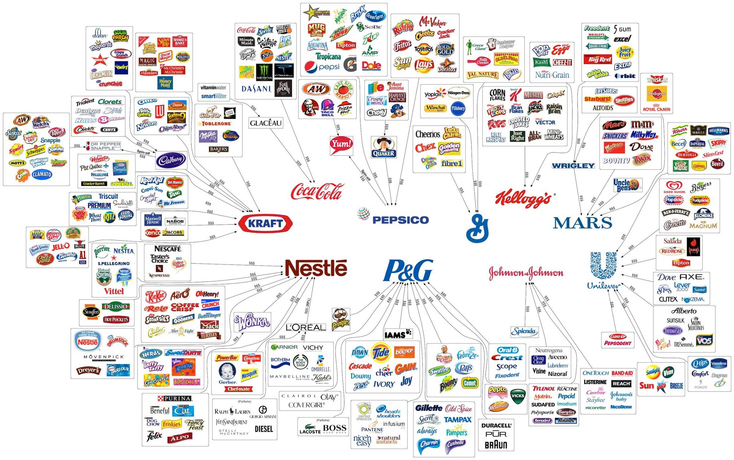
Capitalism Trends towards Concentration

Slide 29
By betting on leaders, the Autonomies is in many respects a fund of oligarchies.
Praxair, Air Liquide and Linde dominate compressed gases
WPP, Publicis and Omnicom dominate conventional advertising
Facebook and Google dominate the web
Amazon dominated online retail.
Nestle, Danone and Mondelez International dominate processed foods
L’Oreal, Estee Lauder dominate cosmetics
Wal-Mart, Tesco, Casino Guichard dominate global food retail.
Bayer, DuPont,
Experian, Mastercard & Visa dominate credit cards and credit checks.
Rexam, Brambles, Amcor, 3M dominate packaging.
AXA, Prudential, AIA, AIG, Chubb dominate global insurance
Boeing, Airbus dominate aerospace.
There are similar lists for consumer staples, consumer electronics, alcoholic and sugary beverages, software, toys, computer game, microprocessors, industrial machinery, biotechnology, pharmaceuticals, automotive etc.

Slide 30
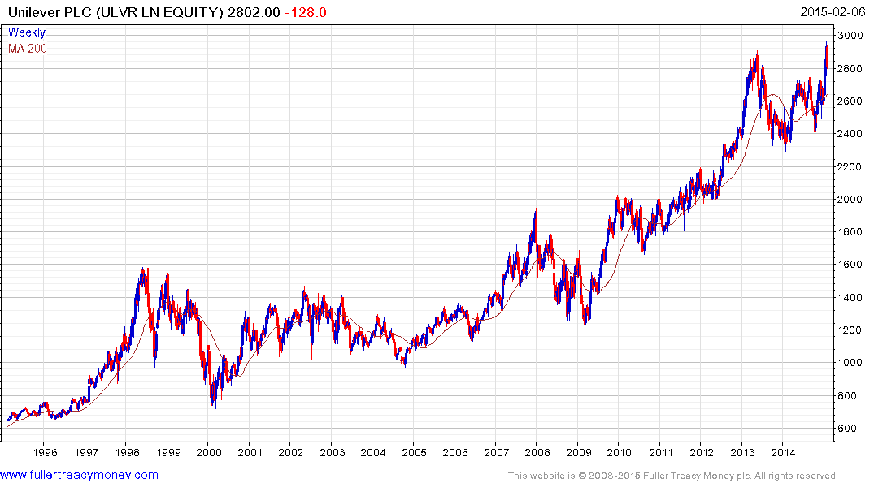
One of the first things people buy when they do from $1 a day to $2 is soap. Unilever is a prime beneficiary.

Slide 31
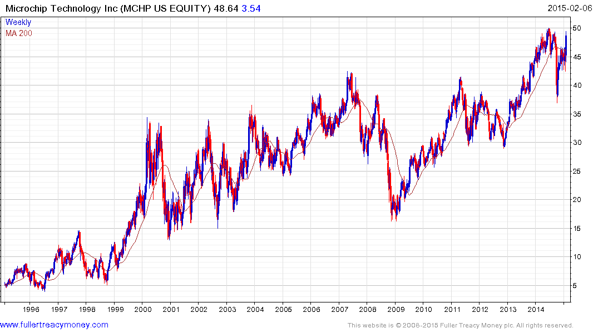
Microchip Technology is one of the most internationally diversified technology companies and a leader within its sector.

Slide 32
Microchip Technology is one of the most internationally diversified technology companies and a leader within its sector.

Slide 33
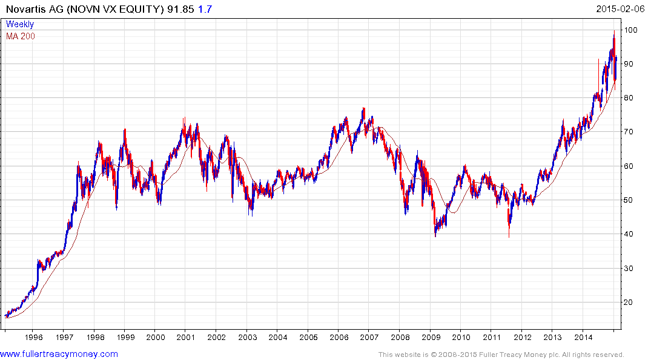
Novartis is an European Dividend Aristocrat and is a leader in pharmaceuticals, ophthamology and generics.

Slide 34
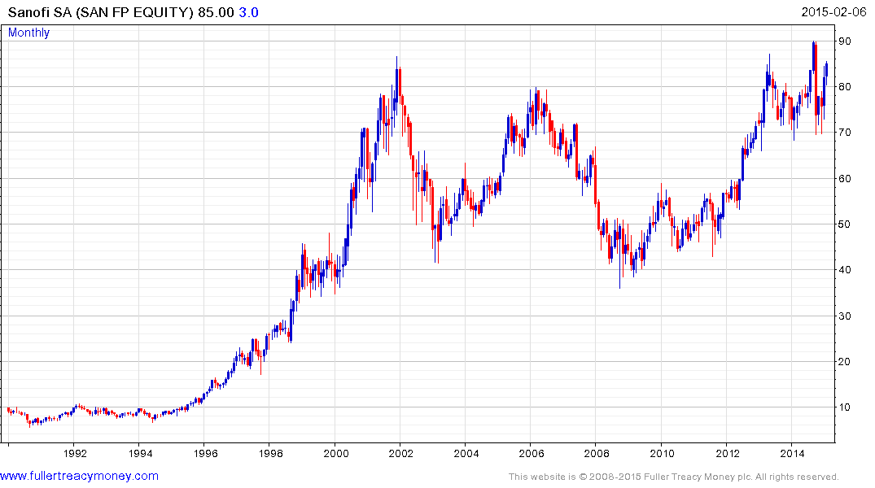
Sanofi continues to test the upper side of a 13-year range.

Slide 35
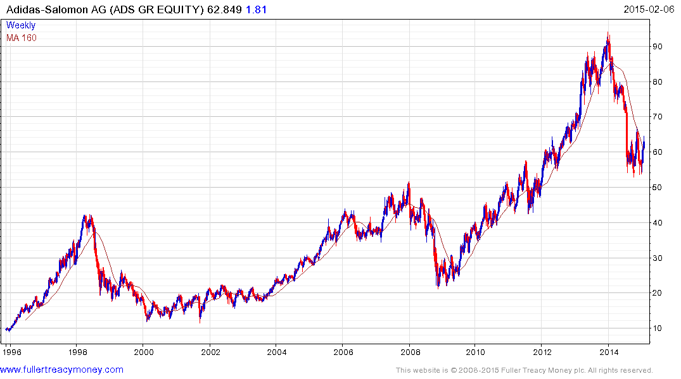
Adidas is the number 2 in sports apparel and footwear and is back in a buying range.

Slide 36
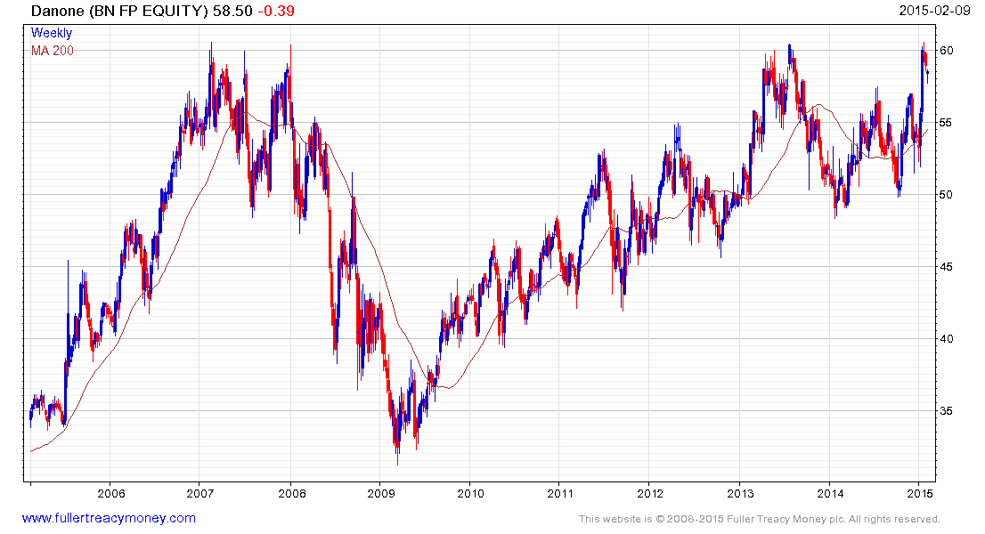
Danone is only now testing its 2008 peak.

Slide 37
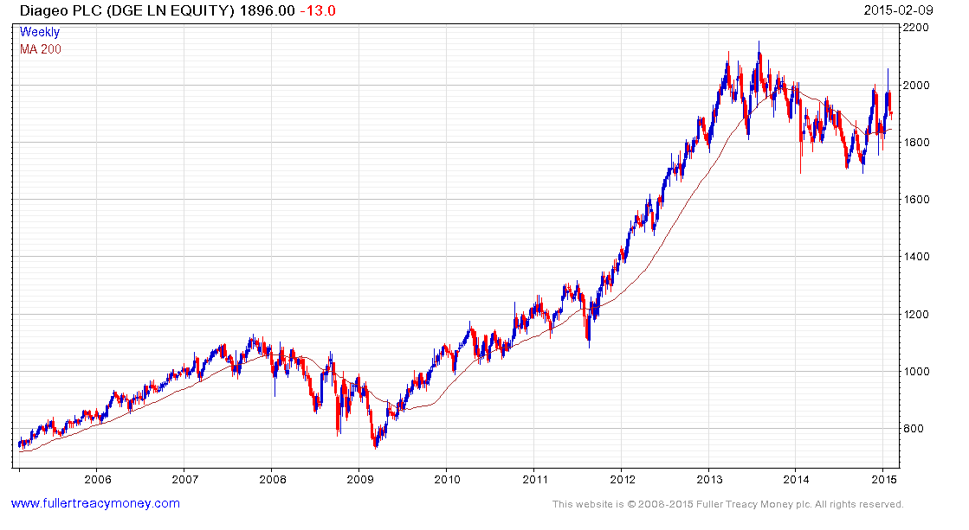
Diageo has been investing heavily in Asia and Africa.

Slide 38
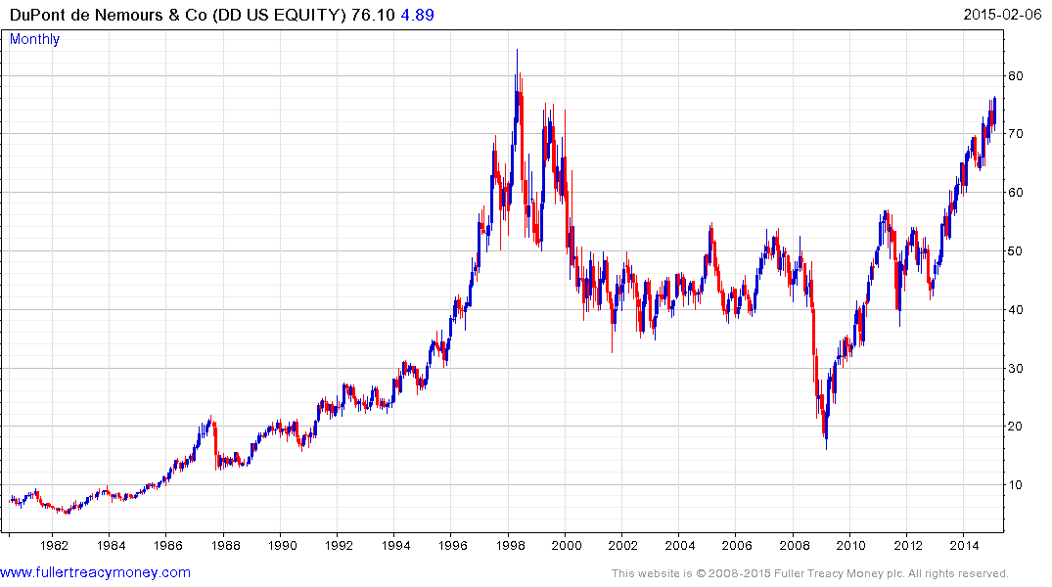
DuPont completed a 13-year range in 2013.

Slide 39
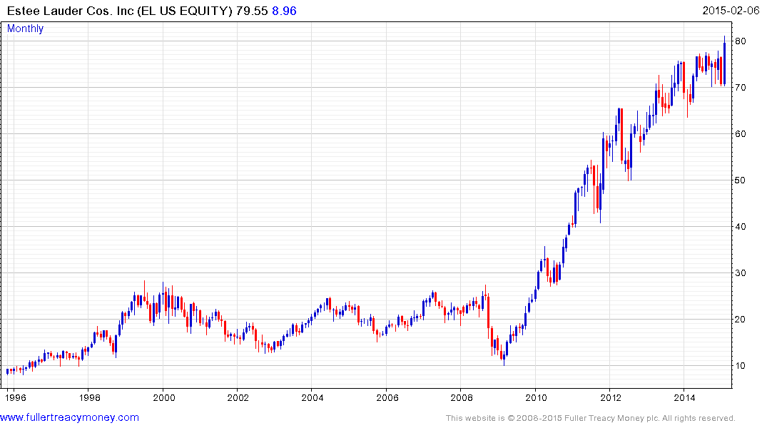
Estee Lauder is reasserting to the upside.

Slide 40
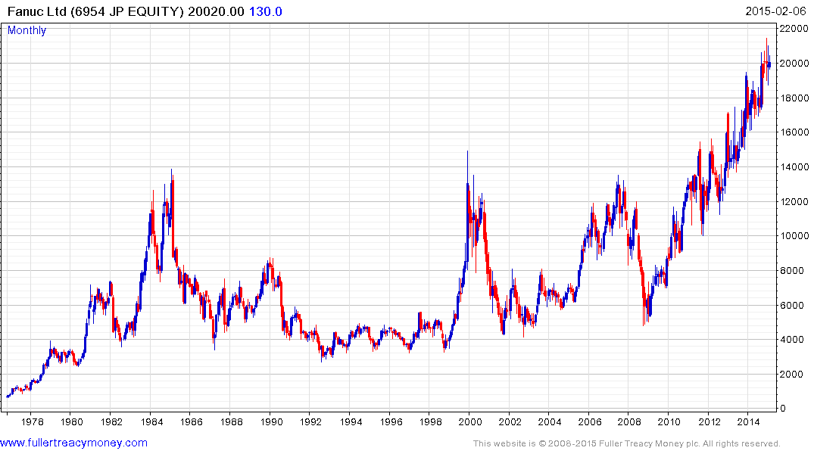
Fanuc is the global leader in robotics.

Slide 41
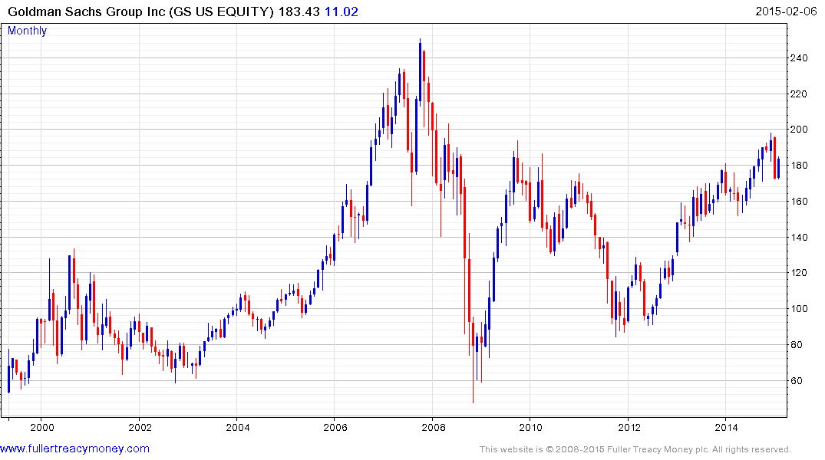
Goldman Sachs is still a cheap stock.

Slide 42
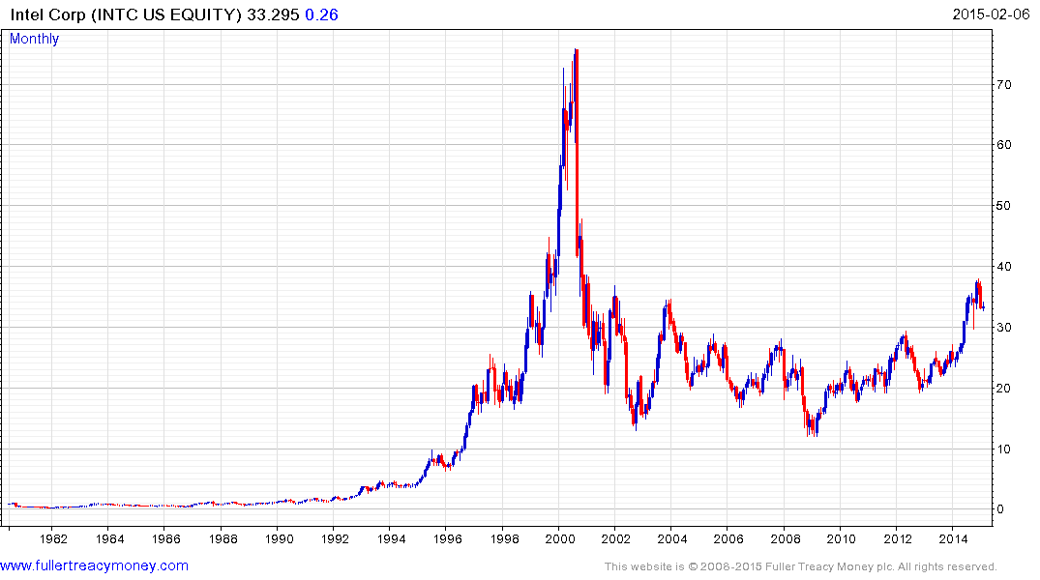
Intel completed a 12-year base six months ago.

Slide 43
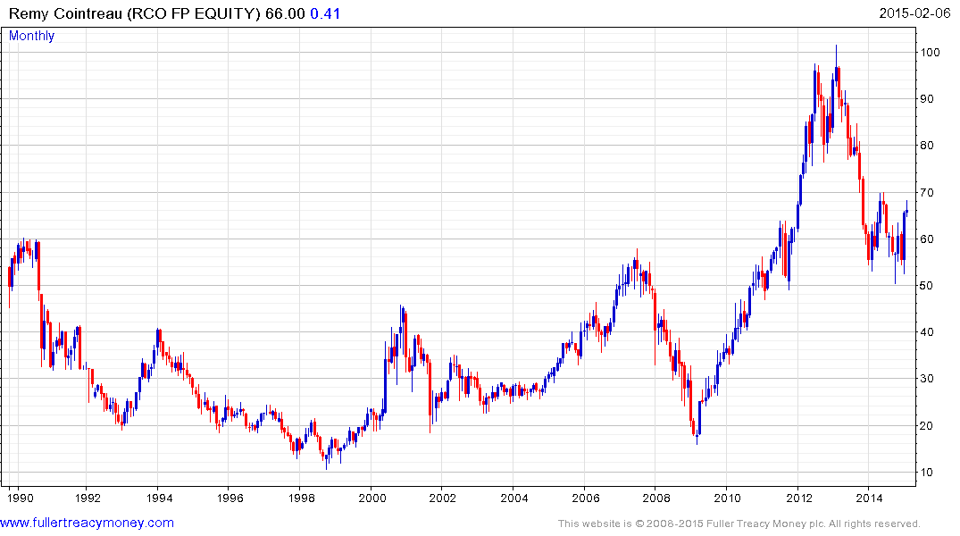
Remy Cointreau has been through a difficult time but is stabilising at the upper side of its base.

Slide 44
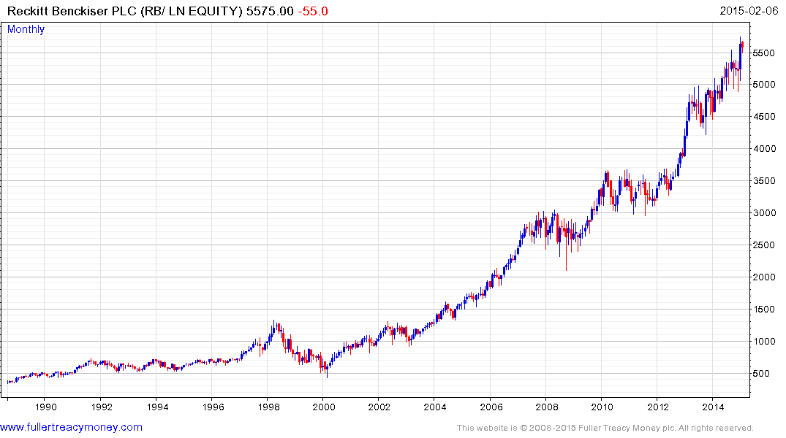
Reckitt Benckiser is still trending consistently higher and a trend running strategy has not given a sell signal.

Slide 45
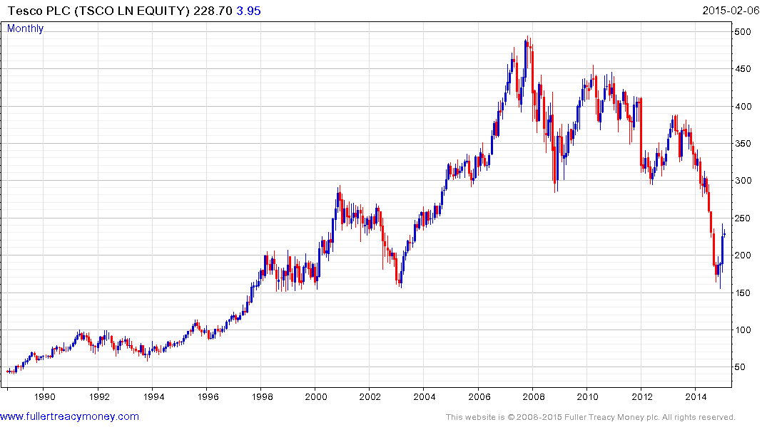
Tesco is back in a buying range.

Slide 46
Over to Chris

Slide 47
WM Capital Management
THE FP WM GLOBAL CORPORATE AUTONOMIES FUND
WM Capital Management
Provides "intelligent investment solutions" that are based on academic research and significant specialist experience.
Professors Steve Thomas & Andrew Clare from the Cass Business school on the investment committee (monkeys beat fund managers!).
£110 million under management (end of Feb).
Embrace Smart Beta, back tested strategies, Trend Following and intellectual themes.
Clients are IFA’s, Wealth managers and sophisticated investors

Slide 48






















THE FP WM GLOBAL CORPORATE AUTONOMIES FUND
“An equally weighted portfolio of 100 large, well-established, multi-national companies, many of which have proven track records in maintaining and increasing their dividends, share price and profits.”

Slide 49
THE FP WM GLOBAL CORPORATE AUTONOMIES FUND
THE FP WM GLOBAL CORPORATE AUTONOMIES FUND
What do we want in a fund?
A Process to identify a Theme
Diversification-both regionally and sectors
Captures Smart Beta
Minimise Risk
Intelligent Fund manager oversight but not the driver of returns
Value for Money
Buy & Forget

Slide 50
THE FP WM GLOBAL CORPORATE AUTONOMIES FUND
THE FP WM GLOBAL CORPORATE AUTONOMIES FUND
THE BULLET POINTS
Launch by 1st April
100 Autonomies
Equal Weighted (ish)
Rebalanced Quarterly
Eoin creates the Autonomy Universe and advises on the “Best” 100 each quarter
Max 3 companies per sector (except Banks)
0.55% Annual Management Charge
Max additional expenses 0.3%
Authorised Corporate Director (ACD): Fund Partners
Depositary: Northern Trust
Where to Invest-Various Platforms (eg Hargreaves Lansdown) & www.fundpartners.com
GLOBAL CORPORATE AUTONOMIES INC - ISIN : GB00BV0LRY25 – Sedol : BV0LRY2
GLOBAL CORPORATE AUTONOMIES ACC - ISIN : GB00BV0LRZ32 – Sedol : BV0LRZ3

Slide 51
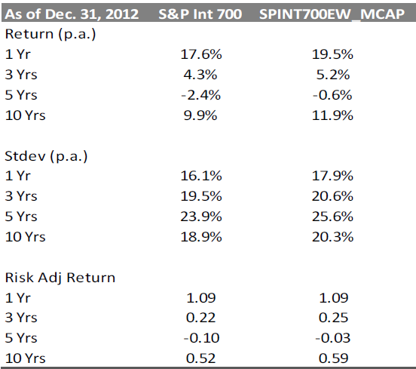


CAPTURING SMART BETA-EQUAL WEIGHTING
Source: S&P DOW JONES INDICES | 10 YEARS LATER: WHERE IN THE WORLD IS WEIGHT INDEXING NOW?

Slide 52
SMART BETA-EQUALISH WEIGHTING
SMART BETA-EQUALISH WEIGHTING
Latest academic Research (not yet published) shows that running with your winners for a period of time is better than frequently rebalancing your winners
We therefore only rebalance when a stock goes above a 1.2% or below 0.8%
SELL HIGHER, BUY LOWER

Slide 53
FUND MANAGER OVERSIGHT
Only 100 Autonomies are selected each Quarter which means we must remove 50
Process
1/ Remove any 30% over extended against the 200 dma
2/ Limit the amount in any one sector to 3 except banks to 6
3/ Ensure diversification i.e wont just select US companies
4/ Reduce exposure to those industries experiencing “a downtrend” commonality
eg all automobile companies falling at same time
5/ Reduce exposure to those companies in long term ranges
6/ Lastly subjectivity

Slide 54
ARE AUTONOMIES EXPENSIVE?
Autonomies Msci World
PE Ratio 18.79 17.88
Forward PE 16.25 16.72
Yield 2.25% 2.44%
But Big Outliers eg Facebook, Amazon
Source: WM Capital Management, 9th February 2015

Slide 55
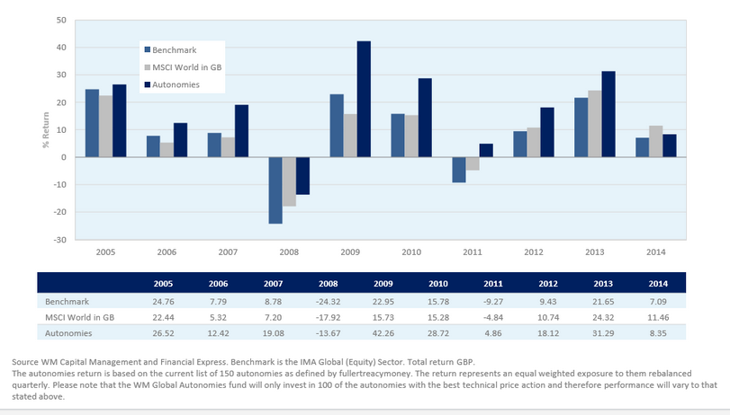
AUTONOMY PERFORMANCE
£100,000 pension fund
£500 per month income
Blue=FTSE 100
Red=FTSE 100 Trend Line
Trend Following-invest only when the blue line is above the red line
Source: WM Capital Management, December 2000 to August 2014

Slide 56
AUTONOMY PERFORMANCE-To 1st January 2015
 | Autonomies % | Msci World %
1 Year | 8.35 | 11.46
3 Years | 68.03 | 53.45
5 Years | 226.76 | 68.33
10 Years | 371.11 | 121.08
10 Years | Autonomies | Msci World
Ave Return | 17.79 | 8.97
Ave Volatility | 15.11 | 15.37
Ave Sharpe | 1.32 | 0.51
Source: WM Capital Management, January 2015, Past Performance not a guide to future performance, Returns in GBP

Slide 57
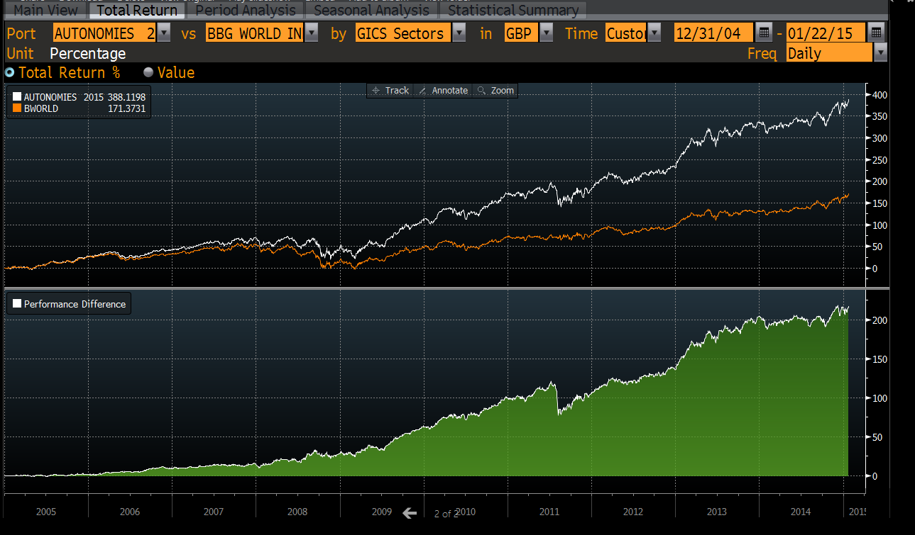
AUTONOMY PERFORMANCE
£100,000 pension fund
£500 per month income
Blue=FTSE 100
Red=FTSE 100 Trend Line
Trend Following-invest only when the blue line is above the red line
Source: WM Capital Management, January 2015

Slide 58
PROTECTION FROM THE NEXT CRASH
DIVERSIFICATION
53% USA, 34% Europe, 13% Asia
40% of earnings are overseas
Global Leader
Max 3 in any sector, except 6 banks
or
Ftse100-The Top 10 Stocks represent 40% of the Index ,The First 30 Stocks represent 72% of the index
REMOVING THE OVEREXTENDED COMPANIES
Any company that is 30% over extended from trend line is removed at rebalance
PERFORMANCE - 2008 & 2011
EARNINGS RISING FASTER THAN MSCI WORLD

Slide 59
QUESTIONS
THANK YOU FOR YOUR TIME & WE LOOK FORWARD TO YOU BECOMING INVESTORS IN THE FUND
ANY QUESTIONS?
JOIN US IN THE BAR!

Slide 60
Risks
IMPORTANT INFORMATION
This document has been produced for information only and represents the views of the investment manager at the time of writing. It should not be construed as Investment Advice. No investment decisions should be made without first seeking advice.
RISK WARNINGS
The value of your clients investment and the income derived from it can go down as well as up, and your client may not get back the money that they invested. Investments in overseas equities may be effected by changes in exchange rates, which could cause the value of your clients investment to increase or diminish. Your client should regard their investment as medium to long term. Past performance is not a guide to future performance. Every effort is taken to ensure the accuracy of this data, but no warranties are given.
WM Capital Management offers you an alternative to the traditional way of investing.
www.wmcapitalmanagement.com chris@wmcapitalmanagement.com

