Slide 1
Are we in a Biotech Bubble?
David Pinniger, CFA
Biotechnology Fund Manager, Polar Capital
East India Club, 20 April 2015

Slide 2

Bull vs Bear
Framing the Bull-Bear debate on Biotech
    Bulls
      Biotech’s scientific innovation is delivering
      Industry’s R&D productivity is improving
      Empowered FDA is rewarding innovation
      New product cycle reinvigorating growth
      Strong, robust, and rare defensive growth
      Demand inelasticity, pricing insensitivity
      EPS growth underpinned by margin flexibility
      High barriers to entry, long product cycles
      Drug industry structure driving M&A activity

Slide 3
Bull vs Bear
Framing the Bull-Bear debate on Biotech
    Bulls
      Biotech’s scientific innovation is delivering
      Industry’s R&D productivity is improving
      Empowered FDA is rewarding innovation
      New product cycle reinvigorating growth
      Strong, robust, and rare defensive growth
      Demand inelasticity, pricing insensitivity
      EPS growth underpinned by margin flexibility
      High barriers to entry, long product cycles
      Drug industry structure driving M&A activity
    Bears
      Biotech valuations are becoming stretched
      IPO activity suggests irrational exuberance
      Growth and profitability is not sustainable
        Large-caps now facing challenges of scale
        Recent R&D productivity is an anomaly
        Specialty drug pricing power unsustainable
        Biosimilars are a major threat to growth
      Rising interest rates will create a headwind

Slide 4
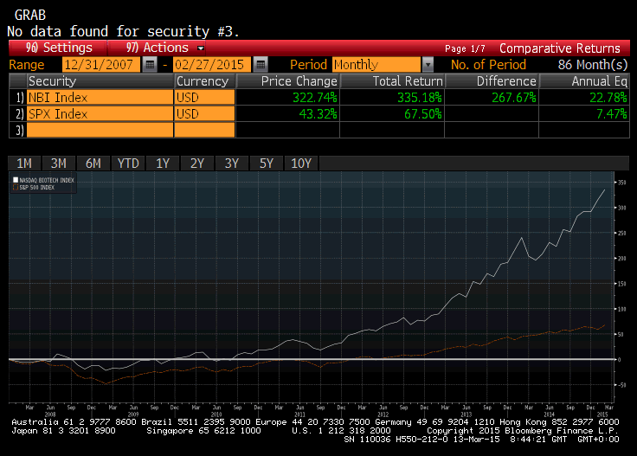
Biotech Since Global Financial Crisis in 2008
The new product cycle has driven recent sector resurgence
Source: Bloomberg, 13 March 2015. NBI = NASDAQ Biotechnology Index. Past performance is not indicative or a guarantee of future results.
Notes:
4

Slide 5
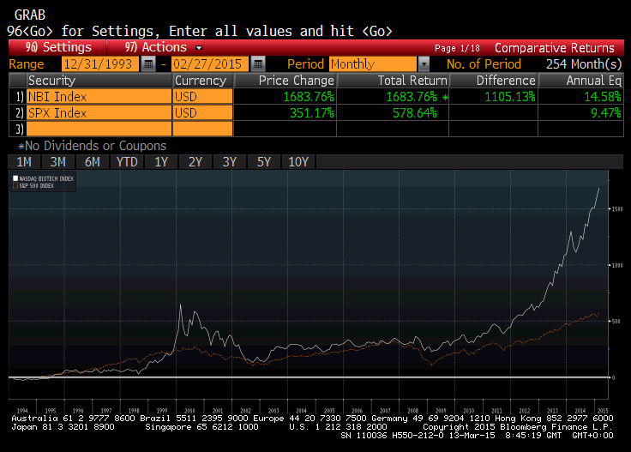
Fundamentals Profoundly Stronger Than In 2000
Recent years have seen the “release” of pent-up value
Source: Bloomberg, 13 March 2015. NBI = NASDAQ Biotechnology Index. Past performance is not indicative or a guarantee of future results.
Notes:
5

Slide 6
Real Products Are Driving The Renaissance
Biotech drugs to generate ~$300bn cumulative sales 2015-19
Cumulative revenue opportunity for the Top 20 new biotechnology drugs
by Bloomberg consensus 2019 sales estimates (US$bn)
Source: Polar Capital, using Bloomberg data compiled from sell-side analyst consensus product revenue estimates, at 30 January 2015. It should not be assumed that recommendations made in future will be profitable or will equal performance of the securities in this document. A list of all recommendations made since inception is available upon request.
Notes:
6

Slide 7
Sector Is Moving Towards Self-sustainability
Index $961bn value¹ supported by >$70bn in revenues
US Public Biotech Industry Statistics: 1994-2013
1. Market value of NASDAQ Biotechnology Index constituents by index weight, 28 February 2015. Source: Ernst & Young LLP, annual biotechnology industry reports.
Notes:
7

Slide 8
Putting Valuations In Historical Context
Performance of recent years has been earnings-driven
Historical NTM PE (x)
Source: ISI Group, January 2015.

Slide 9
Biotech Valuations Versus Pharma
Leading biotechs still look cheaper, with better growth
Company | 2014 P/E | 2015 P/E | 2016 P/E | 2017 P/E | Rev CAGR ‘14-‘17(%) | EPS CAGR ‘14-’17(%)
AMGN | 18.5X | 17.2x | 15.5x | 13.6x | 2.9% | 10.9%
BIIB | 26.0x | 23.1x | 20.0x | 17.6x | 8.8% | 13.8%
CELG | 31.5x | 23.7x | 17.9x | 14.4x | 20.2% | 29.6%
GILD | 13.7x | 13.4x | 12.1x | 11.9x | 4.3% | 4.8%
Large-Cap Biotech Average | 22.4x | 19.3x | 16.4x | 14.4x | 9.0% | 14.8%
ALXN | 35.6x | 31.1x | 24.8x | 19.4x | 23.6% | 22.4%
REGN | 123.4x | 59.3x | 40.5x | 30.8x | 19.4% | 58.8%
ATLN | 18.5x | 21.6x | 23.0x | 20.5x | 2.5% | -3.3%
UTHR | 21.8x | 14.6x | 12.9x | 10.9x | 10.8% | 25.9%
Expanded Biotech Average | 36.1x | 25.5x | 20.8x | 17.4x | 11.6% | 20.4%
US Pharma Average | 21.8x | 20.7x | 17.6x | 16.0x | 4.0% | 11.6%
EU Pharma Average | 19.9x | 18.4x | 16.9x | 16.3x | 3.9% | 7.6%
S&P 500 | 17.6x | 16.3x | 15.0x | 14.9x | 5.3% | 5.6%
Source: Credit Suisse Research; Biotechnology Information Toolkit, 12 January 2015. *For the four largest companies in each sector. It should not be assumed that recommendations made in future will be profitable or will equal performance of the securities in this document. A list of all recommendations made within the immediately preceding 12 months is available upon request. Past performance is not indicative or a guarantee of future results.
Notes:
9

Slide 10
Biotech Interest Not Yet Exuberant
Earlier-stage technology valuations appear unstretched
Unprofitable US Biotechnology companies $0-1bn market-cap
Source: ISI Group, January 2015.

Slide 11

Bull vs Bear
Framing the Bull-Bear debate on Biotech
    Bulls
      Biotech’s scientific innovation is delivering
      Industry’s R&D productivity is improving
      Empowered FDA is rewarding innovation
      New product cycle reinvigorating growth
      Strong, robust, and rare defensive growth
      Demand inelasticity, pricing insensitivity
      EPS growth underpinned by margin flexibility
      High barriers to entry, long product cycles
      Drug industry structure driving M&A activity
    Bears
      Biotech valuations are becoming stretched
      IPO activity suggests irrational exuberance
      Growth and profitability is not sustainable
        Large-caps now facing challenges of scale
        Recent R&D productivity is an anomaly
        Specialty drug pricing power unsustainable
        Biosimilars are a major threat to growth
      Rising interest rates will create a headwind

Slide 12
Biotech IPO Window Attracting Controversy
2013 and 2014 have seen the release of the log-jam
Number of IPOs
Source: Credit Suisse Research, 11 December 2014

Slide 13
Capital Raised Doesn’t Seem Excessive
Amounts raised and valuations seem normal
The average raise and post IPO valuation are lower for the recent class of IPOs (200-2014 YTD) than for the class of 2000
Billions of Dollars ($)
Millions of Dollars ($)
Source: Credit Suisse Research, 11 December 2014

Slide 14
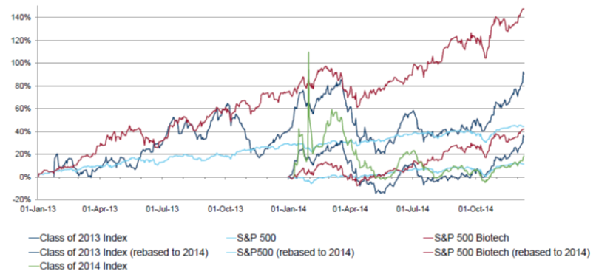
IPOs Have Generally Underperformed
Performance suggests enthusiasm rather than exuberance
Source: Credit Suisse Research, 11 December 2014. Note: The index is calculated by taking the un-weighted return if one dollar was invested in each of the IPO’s.

Slide 15
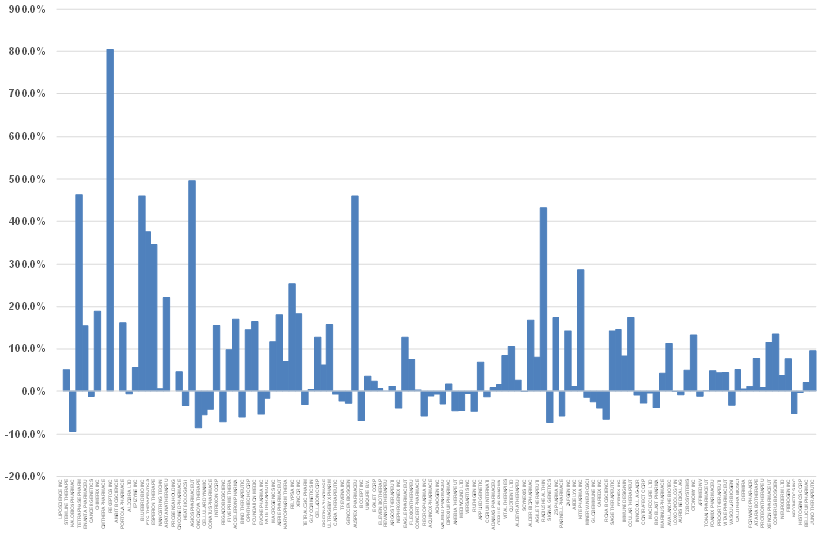
Significant Dispersion Of IPO Returns
The average IPO stock has returned 17% less than the NBI
Source: Polar Capital & Bloomberg. For illustrative purposes only, shows performance of all U.S. Biotechnology company IPOs since 1 January 2013 – return from respective IPO date to 28 February 2015. It should not be assumed that recommendations made in future will be profitable or will equal performance of the securities in this document. A list of all recommendations made within the immediately preceding 12 months is available upon request.

Slide 16
Bull vs Bear
Framing the Bull-Bear debate on Biotech
    Bulls
      Biotech’s scientific innovation is delivering
      Industry’s R&D productivity is improving
      Empowered FDA is rewarding innovation
      New product cycle reinvigorating growth
      Strong, robust, and rare defensive growth
      Demand inelasticity, pricing insensitivity
      EPS growth underpinned by margin flexibility
      High barriers to entry, long product cycles
      Drug industry structure driving M&A activity
    Bears
      Biotech valuations are becoming stretched
      IPO activity suggests irrational exuberance
      Growth and profitability is not sustainable
        Large-caps now facing challenges of scale
        Recent R&D productivity is an anomaly
        Specialty drug pricing power unsustainable
        Biosimilars are a major threat to growth
      Rising interest rates will create a headwind

Slide 17
Big-Cap Biotech Growth To Moderate In 2015
Still strong, but exceptional 2014 makes Y-Y comps tougher
Revenues (YoY Growth) |  |  |  |  | EPS (YoY Growth)
Sector* | 2014 | 2015 | 2016 | 2017 |  | 2014 | 2015 | 2016 | 2017
Biotechnology | 43% | 11% | 11% | 6% |  | 87% | 14% | 17% | 13%
Consumer Discretionary | 22% | 20% | 18% | 13% |  | 76% | 15% | 91% | 41%
Telecom | 7% | 2% | 2% | 1% |  | 21% | 20% | 14% | -9%
IT | 5% | 11% | 6% | 12% |  | 6% | 11% | 14% | 13%
Utilities | 4% | 6% | 3% | 0% |  | 5% | 6% | 5% | 4%
Materials | 3% | 2% | 4% | 8% |  | 22% | 7% | 22% | 9%
S&P 500 | 3% | 2% | 4% | 8% |  | 8% | 8% | 8% | 1%
Industrials | 3% | 2% | 3% | 10% |  | 8% | 10% | 8% | 9%
Financials | 0% | 3% | 5% | 6% |  | -3% | 40% | 10% | 11%
Consumer Staples | -1% | 0% | 3% | 4% |  | 0% | 0% | 9% | 11%
Pharmaceuticals | -2% | -2% | 5% | 5% |  | 3% | -1% | 15% | 11%
Energy | -2% | -10% | 14% | 7% |  | 3% | -28% | 32% | 24%
Source: Credit Suisse Research; Biotechnology Information Toolkit, 12 January 2015.
*For the four largest companies in each sector. Past performance is not indicative or a guarantee of future results.
Notes:
17

Slide 18
Market Cautious On Sustainability Of Growth
Market waiting for visibility of growth beyond 2016?
Revenue growth from 2013-2022: DB base case models
EPS growth from 2013-2022: DB base case models
Source: Deutsche Bank and Company Reports. It should not be assumed that recommendations made in future will be profitable or will equal performance of the securities in this document. A list of all recommendations made since inception is available upon request.
Notes:
18

Slide 19
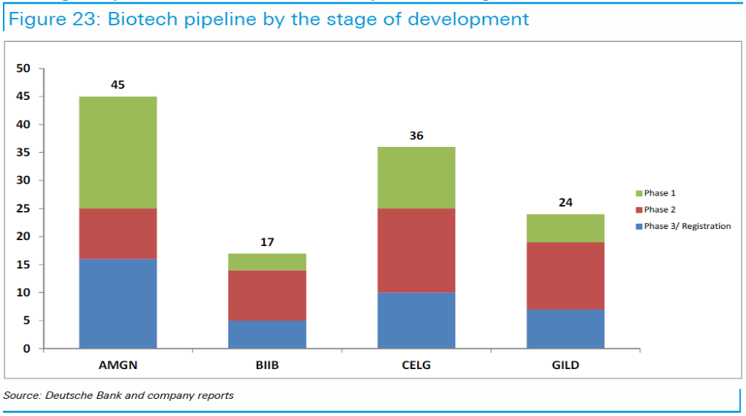
Long-Term Growth Hidden In R&D Pipelines
EPS estimates 2016> don’t reflect success for R&D pipelines
Biotech pipeline by the stage of development
Source: Deutsche Bank. It should not be assumed that recommendations made in future will be profitable or will equal performance of the securities in this document. A list of all recommendations made since inception is available upon request.
Notes:
19

Slide 20
What Happens When The Pipeline Delivers
When the invisible becomes visible (over the next 12-18m)
EPS CAGR in 2017-2022 (when growth is expected to slow)
Source: Deutsche Bank. It should not be assumed that recommendations made in future will be profitable or will equal performance of the securities in this document. A list of all recommendations made since inception is available upon request.
Notes:
20

Slide 21




Strong Near-Term Cash Flow Generation
$170bn FCF 2014-19 used for buybacks, dividends, M&A
 | Free Cash Flow (FCF) ($B) | Yield (% of Mkt Cap) | Free Cash Flow (FCF) ($B) | Yield (% of Mkt Cap) | Cumulative Free Cash Flow ($B) | Market Cap ($B) | Yield (% of Mkt Cap)
 | 2014 | 2014 | 2019 | 2019 | 2014-19 |  | 2014-19
 | $9.2 | 7.6% | $8.7 | 7.2% | $49.4 | $121.6 | 41%
 | $2.5 | 3.1% | $4.8 | 6.0% | $23.6 | $80.7 | 29%
 | $2.0 | 2.2% | $7.3 | 8.0% | $30.8 | $90.7 | 34%
 | $8.7 | 6.1% | $9.3 | 6.5% | $66.9 | $143.2 | 47%
 |  |  |  |  |  | Average | 38%
Source: Credit Suisse Research, Global Biotechnology – An Outlook for 2015, 6 January 2015. It should not be assumed that recommendations made in future will be profitable or will equal performance of the securities in this document. A list of all recommendations made since inception is available upon request. Mkt Cap = Market Capitalisations as at 6 January 2015.
Notes:
21

Slide 22
Bull vs Bear
Framing the Bull-Bear debate on Biotech
    Bulls
      Biotech’s scientific innovation is delivering
      Industry’s R&D productivity is improving
      Empowered FDA is rewarding innovation
      New product cycle reinvigorating growth
      Strong, robust, and rare defensive growth
      Demand inelasticity, pricing insensitivity
      EPS growth underpinned by margin flexibility
      High barriers to entry, long product cycles
      Drug industry structure driving M&A activity
    Bears
      Biotech valuations are becoming stretched
      IPO activity suggests irrational exuberance
      Growth and profitability is not sustainable
        Large-caps now facing challenges of scale
        Recent R&D productivity is an anomaly
        Specialty drug pricing power unsustainable
        Biosimilars are a major threat to growth
      Rising interest rates will create a headwind

Slide 23
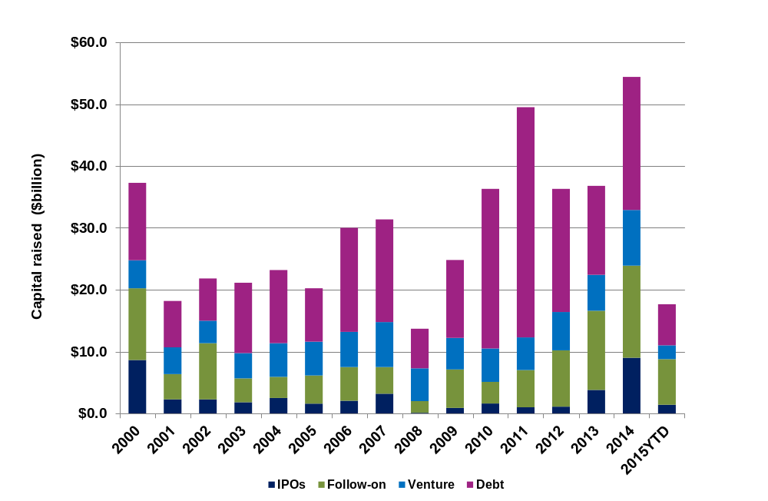
Major Investment Into Biotech In Past Decade
~$475bn raised since 2000 invested in Biotech R&D
Source: BioCentury, 2015YTD at 10 March 2015.
Notes:
23

Slide 24
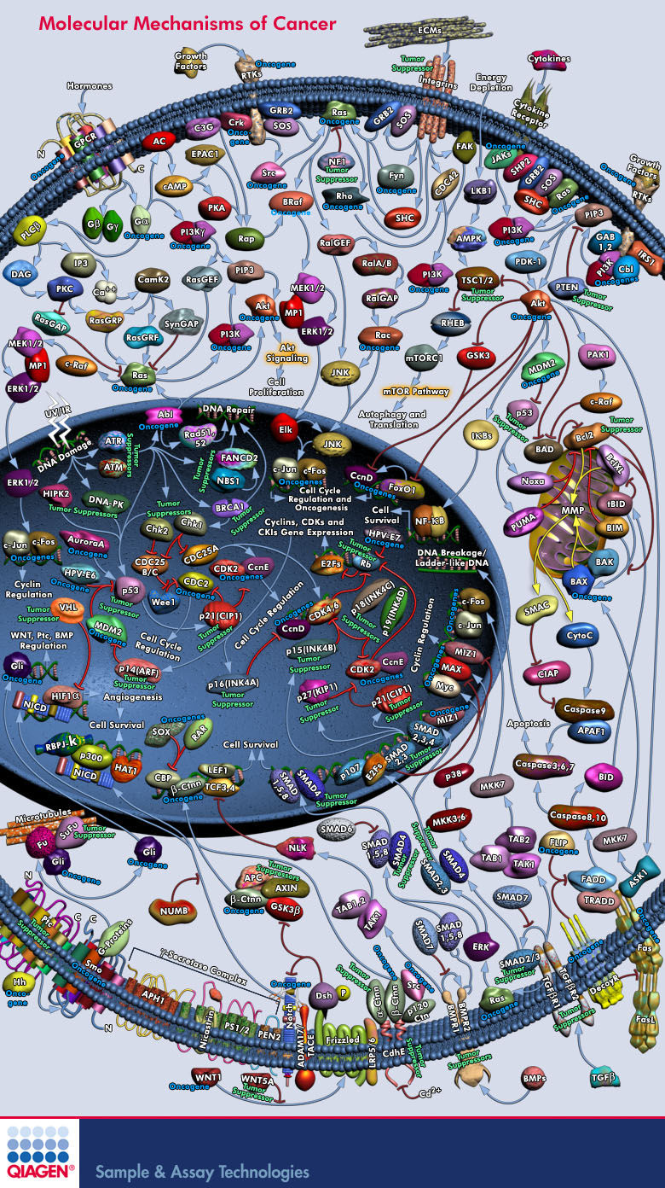
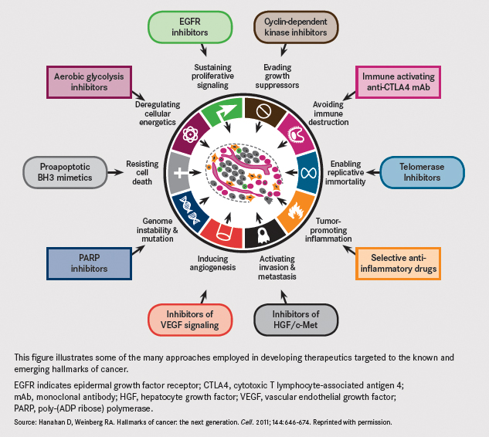
Advances In Scientific Understanding
Identifying specific molecular targets for intervention
Source: Hanahan D, Weinberg RA. Hallmarks of cancer; the next generation. Cell. 2011; 144;646-674. It should not be assumed that recommendations made in future will be profitable or will equal performance of the securities in this document. A list of all recommendations made since inception is available upon request.
Notes:
24

Slide 25
Proliferation Of Tools And Technologies
New tools are enabling innovative approaches to therapy
The medicines of tomorrow (2010>)
Stem cells
Gene therapy
sRNAi
Cancer immunotherapy
BiTEs
Antisense, aptamers
Nanobodies, antibody-drug conjugates (ADCs)
The medicines of today (1950-2010)
DNA sequencing
Microarrays
Antibodies
Protein engineering
Chemistry
Source: Polar Capital.
Notes:
25

Slide 26
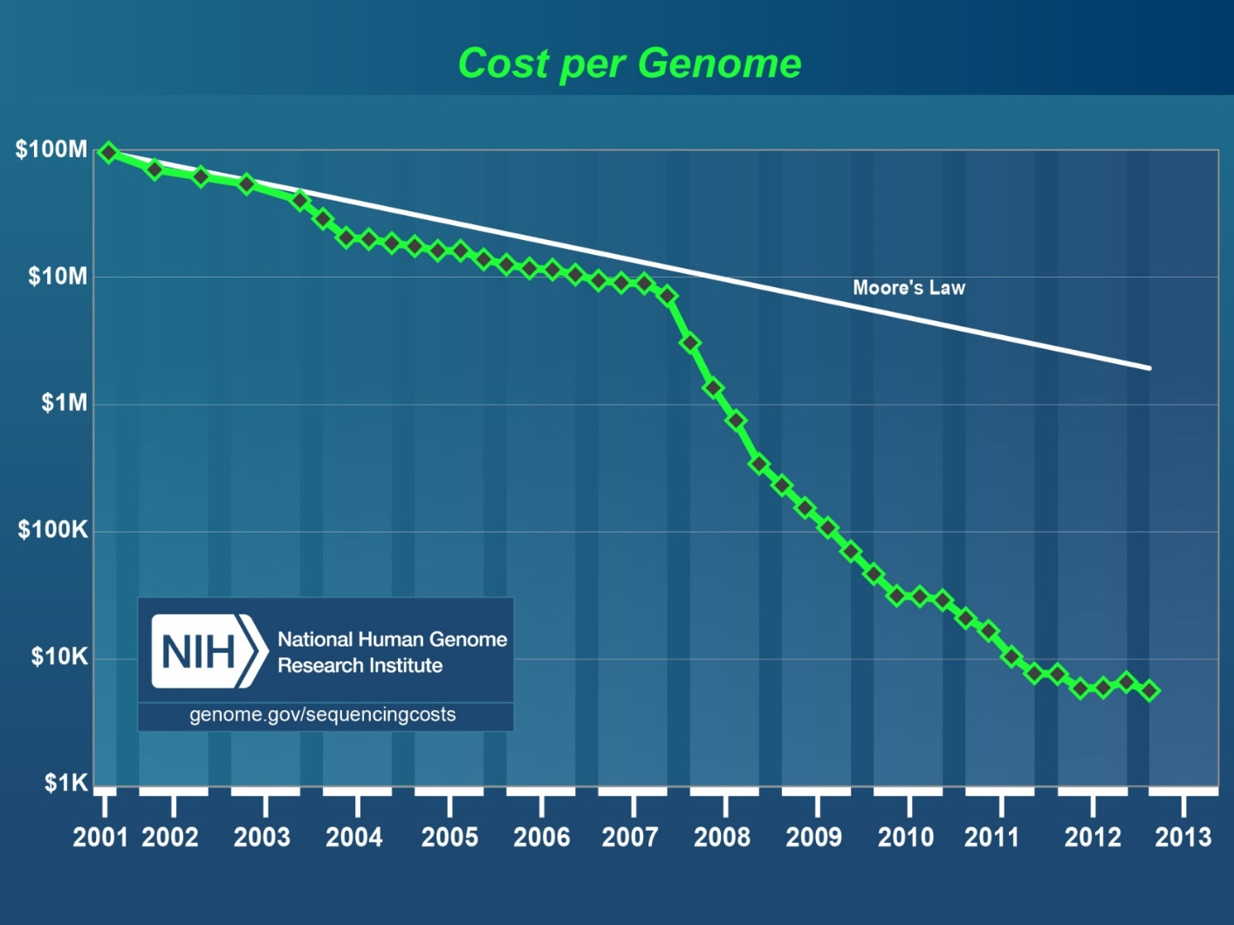
Leveraging The Power Of Information Technology
Plummeting cost of DNA sequencing is yielding “Big Data”
Source: genome.gov – The National Human Genome Research Institute.
Notes:
26

Slide 27
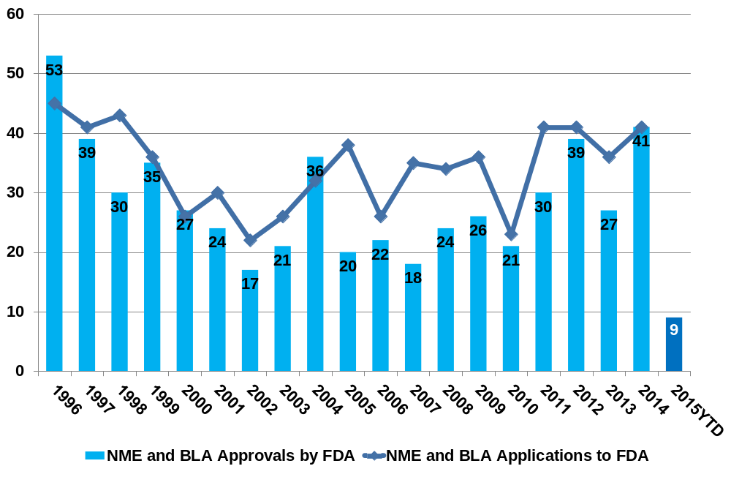
Drug Industry R&D Productivity Improving
Biotech innovation is driving 2/3rds of new drug approvals
Source: http://www.fda.gov/drugs/developmentapprovalprocess/druginnovation/default.htm; as at 10 March 2015; 2015 estimated by Polar Capital
Past performance is not indicative or a guarantee of future results.
Notes:
27

Slide 28
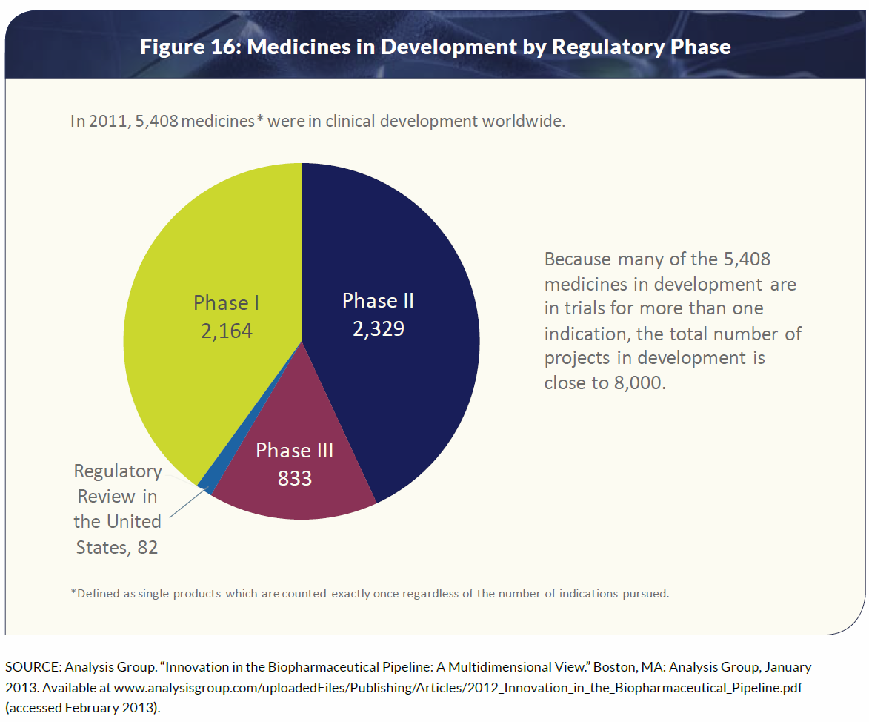
Product Cycle To Deliver Sustainable Growth
The product development pipeline is full
Source: Pharmaceutical Research and Manufacturers of America (PhRMA) 2013 industry profile page 45 (Analysis Group). “ Innovation in the Pharmaceutical Pipeline: A Multidimensional View.” Boston, MA: Analysis Group, January 2013. Available at www.analysisgroup.com/uploadedFiles/Publishing/Articles/2012_Innovation_in_the_Biopharmaceutical_Pipeline.pdf (accessed February 2013).
Notes:
28

Slide 29
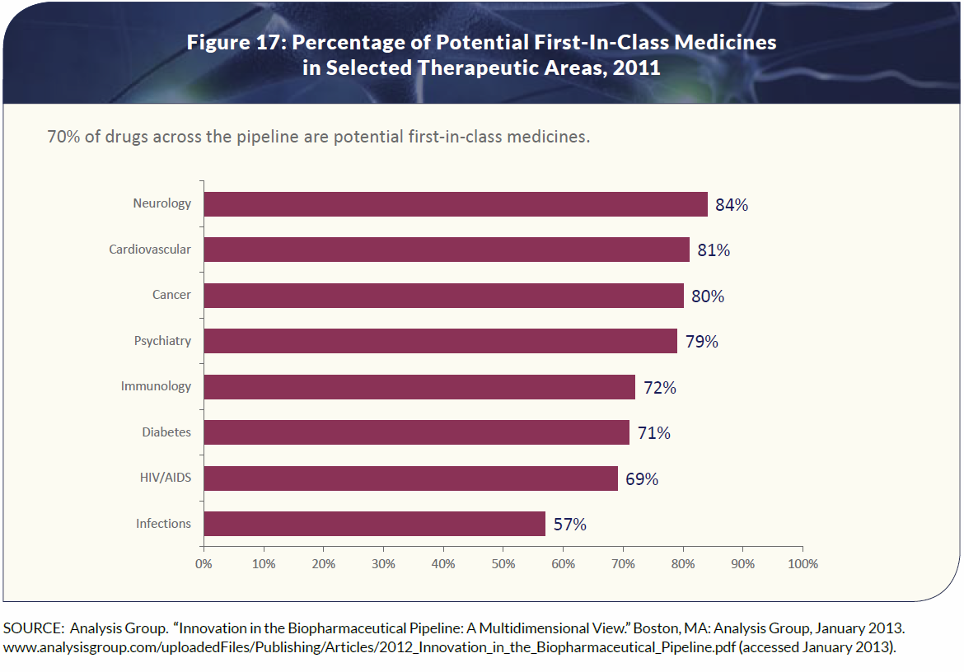
Real Innovation Across Diseases Areas
“Big Data” driving a diversity of R&D approaches
Source: Pharmaceutical Research and Manufacturers of America (PhRMA) 2013 industry profile page 46 (Analysis Group). “ Innovation in the Pharmaceutical Pipeline: A Multidimensional View.” Boston, MA: Analysis Group, January 2013. Available at www.analysisgroup.com/uploadedFiles/Publishing/Articles/2012_Innovation_in_the_Biopharmaceutical_Pipeline.pdf (accessed January 2013).
Notes:
29

Slide 30

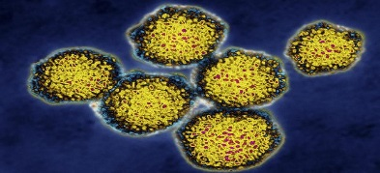
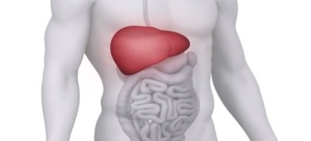


Emerging Therapeutic Mega-Categories
Biotech the driving force in major areas of R&D progress
Cancer
Immunotherapy
Hepatitis
Infection
Chronic Liver
Disease
Cardiovascular
Disease
Rare Genetic
Diseases
Bristol-Myers, Roche, Merck and AstraZeneca taking leadership in new research area of manipulating the body’s immune system to more effectively fight cancer
Gilead and Abbvie among others have developed oral antiviral drugs that cure chronic HCV infection with just a few weeks’ therapy. HBV infection is next on the industry’s hit list
Intercept has shown that chronic fibrotic liver disease (“NASH”) is addressable – an area of huge unmet medical need and a multi-billion market opportunity
Gene- and stem-cell based technologies for the regeneration of cardiac tissue, addressing chronic heart failure; and new drugs to lower dangerously high cholesterol
Moving beyond simply injecting missing enzymes/proteins to “patching” errors in the DNA code of the genome in diseases such as cystic fibrosis, DMD, SMA
Innate, Cellectis
Gilead, Alnylam
Intercept, Genfit
Amgen, Cardio3
Vertex, Summit
Source: Polar Capital. It should not be assumed that recommendations made in future will be profitable or will equal performance of the securities in this document. A list of all recommendations made since inception is available upon request.
Notes:
30

Slide 31
Bull vs Bear
Framing the Bull-Bear debate on Biotech
    Bulls
      Biotech’s scientific innovation is delivering
      Industry’s R&D productivity is improving
      Empowered FDA is rewarding innovation
      New product cycle reinvigorating growth
      Strong, robust, and rare defensive growth
      Demand inelasticity, pricing insensitivity
      EPS growth underpinned by margin flexibility
      High barriers to entry, long product cycles
      Drug industry structure driving M&A activity
    Bears
      Biotech valuations are becoming stretched
      IPO activity suggests irrational exuberance
      Growth and profitability is not sustainable
        Large-caps now facing challenges of scale
        Recent R&D productivity is an anomaly
        Specialty drug pricing power unsustainable
        Biosimilars are a major threat to growth
      Rising interest rates will create a headwind

Slide 32
Are High Biotech Drug Prices Sustainable?
“Price is what you pay; value is what you get”
    High price point of specialty drugs raises eyebrows, attracts popular criticism...
      It has become commonplace to see new oncology drugs priced from $75k to $150k in the US
      GILD’s pricing of Sovaldi (HCV) at $84k per course in late 2013 reignited drug pricing controversy
      Some specialty drugs are priced higher still – ALXN’s Soliris ($500k); VRTX’s Kalydeco ($300k)
    …But the headline “sticker” price is not necessarily what is actually paid…
      Most companies offer significant discounts and rebates to the customer – terms are often opaque
      For GILD’s Sovaldi for example the gross to net discount is as high as 46% (25-40% is typical)
      Companies selling very expensive “Orphan” drugs operate patient assistance programmes
    …and certainly doesn’t reflect the value captured from saving of downstream costs
      HCV cure with Sovaldi/Harvoni prevents progression to liver failure – transplants cost >$250,000
      INCY CEO: “80% of the costs associated with cancer care are unrelated to the cost of drugs”
      High prices are not the problem – the real issue is waste: 29-78% of patients are non-adherent¹
Source: 1. Express Scripts 2014 Drug Trend Report, March 2015. It should not be assumed that recommendations made in future will be profitable or will equal performance of the securities in this document. A list of all recommendations made within the immediately preceding 12 months is available upon request.

Slide 33
What Does NICE Think?
25 February 2015
NICE guidance recommends sofosbuvir (Sovaldi, Gilead Sciences) and simeprevir (Olysio, Janssen) for treating hepatitis C
Healthcare guidance body NICE has today published final guidance recommending sofosbuvir (Sovaldi, Gilead Sciences) and simeprevir (Olysio, Janssen) as treatment options for some people with chronic hepatitis C.
Hepatitis C is a virus that infects the liver. It is spread by contact with infected blood, for instance by using contaminated needles for injecting drugs or sharing razors or toothbrushes. The virus can cause inflammation of, and damage to, the liver, preventing it from working properly.
About a third of people infected with the hepatitis C virus will eventually develop liver cirrhosis, where normal liver tissue is replaced by scar tissue. A small number of people with chronic hepatitis C and cirrhosis also go on to develop liver cancer.
The aims of treatment are to clear the virus from the blood to prevent progression of liver disease, and to prevent the transmission of the hepatitis C virus. Sofosbuvir and simeprevir are oral antiviral drugs used to prevent hepatitis C viral replication in infected cells.
Sofosbuvir has a marketing authorisation in the UK for use in combination with other medicinal products for treating chronic hepatitis C in adults. The guidance on sofosbuvir recommends its use in combination with ribavirin, with or without peginterferon alfa, as an option for some people with genotypes 1- 6 chronic hepatitis C.
£35,000/$52,500
Source: NICE, 25 February 2015. It should not be assumed that recommendations made in future will be profitable or will equal performance of the securities in this document. A list of all recommendations made within the immediately preceding 12 months is available upon request.
Notes:
33

Slide 34
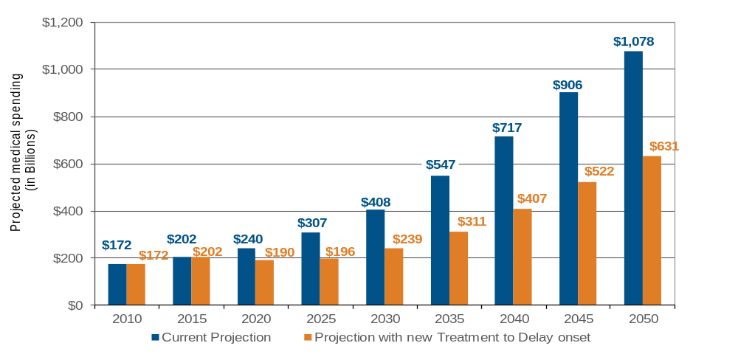
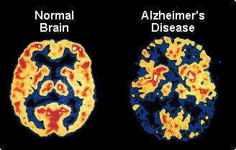
There Are Some Big Unmet Medical Needs
What if we had a drug to slow progression of Alzheimer’s?
Delaying the onset of Alzheimer’s Disease by 5 years could save US$447 billion per year by 2050 in costs to Medicare, Medicaid, private payers and patients.
Projected annual Medicare and Medicaid spending, with and without new treatment advances (US$bn)
Source: Alzheimer’s Association, May 2010.
Notes:
34

Slide 35
Is Increased Drug Spending A Bad Thing?
Increased spending could strip away bigger costs elsewhere
US Healthcare spending – greater use of innovative technology can reduce cost escalation
1960
2010
10%
9.5% CAGR
3 – 4% CAGR
$29 billion
$2,600 billion
Source: Centers for Medicare and Medicaid Services.

Slide 36
Bull vs Bear
Framing the Bull-Bear debate on Biotech
    Bulls
      Biotech’s scientific innovation is delivering
      Industry’s R&D productivity is improving
      Empowered FDA is rewarding innovation
      New product cycle reinvigorating growth
      Strong, robust, and rare defensive growth
      Demand inelasticity, pricing insensitivity
      EPS growth underpinned by margin flexibility
      High barriers to entry, long product cycles
      Drug industry structure driving M&A activity
    Bears
      Biotech valuations are becoming stretched
      IPO activity suggests irrational exuberance
      Growth and profitability is not sustainable
        Large-caps now facing challenges of scale
        Recent R&D productivity is an anomaly
        Specialty drug pricing power unsustainable
        Biosimilars are a major threat to growth
      Rising interest rates will create a headwind

Slide 37
Biosimilars Have Finally Arrived
But do they actually threaten the biotech growth story?
    Risk to key biotech franchises back in focus with first US approval of a biosimilar
      Sandoz’s Zarxio (version of Amgen’s Neupogen) approved 6 March 2015 first US biosimilar
      Available in EU for years, FDA regulatory pathway (351K) for US approval only recently in place
      Highly-priced “biologics” widely perceived to be the backbone of the biotechnology industry
    Some big numbers being thrown around over the biosimilars opportunity/threat…
      Branded biologic drugs generate ~$150bn of global branded drug sales (~25-30% of $550bn total)¹
      Analysts talk of a $70bn “land-grab” opportunity as product patents expire through to the end of 2018
      45² biosimilars identified in clinical testing – key players are Sandoz, Celltrion, Amgen, Samsung
    …but impact limited to a handful of products/companies and perhaps already in sales forecasts
      Only ~6 branded “blockbuster” biologics face competition from the entrance of biosimilars to 2018
      Just a handful of companies face growth-stifling competition - AbbVie, Amgen, Roche, JNJ
      Regulatory, legal, commercial barriers remain high – “interchangeability” central to the debate
Source: 1. Credit Suisse Research, November 2014. 2. Bernstein Research, 16 May 2014. It should not be assumed that recommendations made in future will be profitable or will equal performance of the securities in this document. A list of all recommendations made within the immediately preceding 12 months is available upon request.

Slide 38
Bull vs Bear
Framing the Bull-Bear debate on Biotech
    Bulls
      Biotech’s scientific innovation is delivering
      Industry’s R&D productivity is improving
      Empowered FDA is rewarding innovation
      New product cycle reinvigorating growth
      Strong, robust, and rare defensive growth
      Demand inelasticity, pricing insensitivity
      EPS growth underpinned by margin flexibility
      High barriers to entry, long product cycles
      Drug industry structure driving M&A activity
    Bears
      Biotech valuations are becoming stretched
      IPO activity suggests irrational exuberance
      Growth and profitability is not sustainable
        Large-caps now facing challenges of scale
        Recent R&D productivity is an anomaly
        Specialty drug pricing power unsustainable
        Biosimilars are a major threat to growth
      Rising interest rates will create a headwind

Slide 39
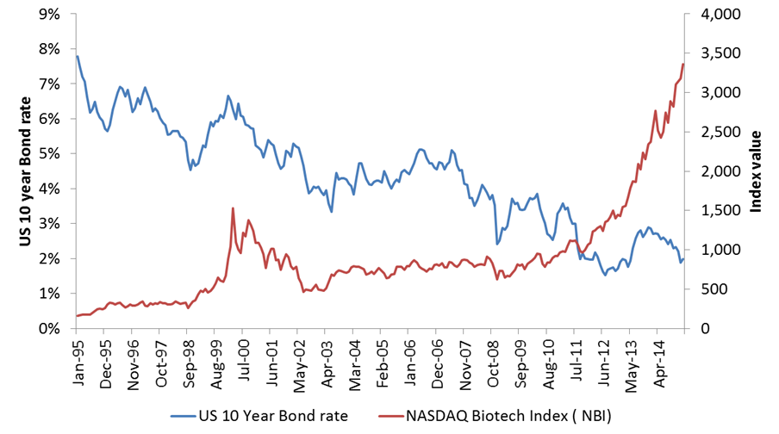
What About Interest Rate Tightening?
Unclear – macro impact overwhelmed by micro factors
Correlation -0.64
Source: Deutsche Bank Research, March 2015.

Slide 40
Bull vs Bear
Framing the Bull-Bear debate on Biotech
    Bulls
      Biotech’s scientific innovation is delivering
      Industry’s R&D productivity is improving
      Empowered FDA is rewarding innovation
      New product cycle reinvigorating growth
      Strong, robust, and rare defensive growth
      Demand inelasticity, pricing insensitivity
      EPS growth underpinned by margin flexibility
      High barriers to entry, long product cycles
      Drug industry structure driving M&A activity
    Bears
      Biotech valuations are becoming stretched
      IPO activity suggests irrational exuberance
      Growth and profitability is not sustainable
        Large-caps now facing challenges of scale
        Recent R&D productivity is an anomaly
        Specialty drug pricing power unsustainable
        Biosimilars are a major threat to growth
      Rising interest rates will create a headwind

Slide 41
Conclusions
Biotech sector offers well-priced durable defensive growth
    Performance of recent years reflects the market catching up with fundamental progress
      A major new product cycle has commenced driving revenues, earnings and strong cash flow
      Having turned the corner of profitability, this global growth industry has come of age in recent years
      Despite talk of a biotech bubble, several metrics suggests rationality rather than exuberance
    Outlook positive for further growth as innovation (supply) meets demographics (demand)
      Advances in information technology are driving better understanding of health and disease
      Proliferation of tools and technologies are enabling new ways of targeting molecular basis of disease
      Innovative revolutionary medicines without competition will continue to have strong pricing power
    In the near-term we’re focused on “domain domination”, R&D success, capital allocation
      PBMs and arrival of biosimilars more a challenge to sentiment than fundamentals in near-term
      Wary of current hot technology areas; focused on high quality teams building long-term value
Notes:
41

Slide 42
Important Information
Polar Capital
16 Palace Street
London SW1E 5JD
Important Information:
This document is provided for the sole use of the intended recipient and is not a financial promotion. It shall not and does not constitute an offer or solicitation of an offer to make an investment into any fund managed by Polar Capital. It may not be reproduced in any form without the express permission of Polar Capital and is not intended for private investors. This document is only made available to professional clients and eligible counterparties. The law restricts distribution of this document in certain jurisdictions; therefore, it is the responsibility of the reader to inform themselves about and observe any such restrictions. It is the responsibility of any person/s in possession of this document to inform themselves of, and to observe, all applicable laws and regulations of any relevant jurisdiction. It is not designed to contain information material to an investor’s decision to invest in Polar Capital Funds Plc – Biotechnology Fund. SUCH INFORMATION, INCLUDING RELEVANT RISK FACTORS, IS CONTAINED IN THE FUND’S OFFER DOCUMENT WHICH MUST BE READ BY ANY PROSPECTIVE INVESTOR.
Statements/Opinions/Views:
All opinions and estimates constitute the best judgment of Polar Capital as of the date hereof, but are subject to change without notice, and do not necessarily represent the views of Polar Capital. This material does not constitute legal or accounting advice; readers should contact their legal and accounting professionals for such information. All sources are Polar Capital unless otherwise stated.
Third-party Data: Some information contained herein has been obtained from third party sources and has not been independently verified by Polar Capital. Neither Polar Capital nor any other party involved in or related to compiling, computing or creating the data makes any express or implied warranties or representations with respect to such data (or the results to be obtained by the use thereof), and all such parties hereby expressly disclaim all warranties of originality, accuracy, completeness, merchantability or fitness for a particular purpose with respect to any data contained herein.
Holdings: Portfolio data is “as at” the date indicated and should not be relied upon as a complete or current listing of the holdings (or top holdings) of the fund. The holdings may represent only a small percentage of the aggregate portfolio holdings, are subject to change without notice, and may not represent current or future portfolio composition. Information on particular holdings may be withheld if it is in the fund’s best interest to do so. It should not be assumed that recommendations made in future will be profitable or will equal performance of the securities in this document. A list of all recommendations made within the immediately preceding 12 months is available upon request. This document is not a recommendation to purchase or sell any particular security. It is designed to provide updated information to professional investors to enable them to monitor the Fund. No other persons should rely upon it.
Benchmarks:
The following benchmark index is used: NASDAQ Biotechnology Index. This benchmark is generally considered to be representative of the Biotechnology universe. This benchmark is a broad-based index which is used for comparative/illustrative purposes only and has been selected as it is well known and easily recognizable by investors. Please refer to https://indexes.nasdaqomx.com/Index/Overview/NBI for further information on these indices. Comparisons to benchmarks have limitations as benchmarks’ volatility and other material characteristics that may differ from the fund. Security holdings, industry weightings and asset allocation made for the Fund may differ significantly from the benchmark. Accordingly, investment results and volatility of the fund may differ from those of the benchmark. The indices noted in this document are unmanaged, unavailable for direct investment, and are not subject to management fees, transaction costs or other types of expenses that the fund may incur. The performance of the indices reflects reinvestment of dividends and, where applicable, capital gain distributions. Therefore, investors should carefully consider these limitations and differences when evaluating the comparative benchmark data performance. Information regarding indices is included merely to show general trends in the periods indicated and is not intended to imply that the fund was similar to the indices in composition or risk.
Regulatory Status:
Polar Capital LLP is a limited liability partnership number OC314700. It is authorised and regulated by the UK Financial Conduct Authority (“FCA”) and is registered as an investment adviser with the US Securities & Exchange Commission (“SEC”). A list of members is open to inspection at the registered office, 16 Palace Street, London, SW1E 5JD. FCA authorized and regulated Investment Managers are expected to write to investors in funds they manage with details of any side letters they have entered into. The FCA considers a side letter to be an arrangement known to the investment manager which can reasonably be expected to provide one investor with more materially favorable rights, than those afforded to other investors. These rights may, for example, include enhanced redemption rights, capacity commitments or the provision of portfolio transparency information which are not generally available. The Fund and the Investment Manager are not aware of, or party to, any such arrangement whereby an investor has any preferential redemption rights. However, in exceptional circumstances, such as where an investor seeds a new fund or expresses a wish to invest in the Fund over time, certain investors have been or may be provided with portfolio transparency information and/or capacity commitments which are not generally available. Investors who have any questions concerning side letters or related arrangements should contact the Polar Capital Desk at the Administrator on (+353) 1 434 5007. The Fund is prepared to instruct the custodian of the Fund, upon request, to make available to investors portfolio custody position balance reports monthly in arrears.

Slide 43
Important Information Cont.
Polar Capital
16 Palace Street
London SW1E 5JD
Information Subject to Change:
The information contained herein is subject to change, without notice, at the discretion of Polar Capital and Polar Capital does not undertake to revise or update this information in any way.
Forecasts:
References to future returns are not promises or estimates of actual returns Polar Capital may achieve. Forecasts contained herein are for illustrative purposes only and does not constitute advice or a recommendation. Forecasts are based upon subjective estimates and assumptions about circumstances and events that have not and may not take place.
Performance/Investment Process/Risk:
Performance is shown net of fees and expenses and includes the reinvestment of dividends and capital gain distributions. Factors affecting fund performance may include changes in market conditions and interest rates and in response to other economic, political, or financial developments. Past performance is not a guide to or indicative of future results. Future returns are not guaranteed and a loss of principal may occur. Investments are not insured by the FDIC (or any other state or federal agency), or guaranteed by any bank, and may lose value. No investment process or strategy is free of risk and there is no guarantee that the investment process or strategy described herein will be profitable.
Allocations:
The strategy allocation percentages set forth in this document are estimates and actual percentages may vary from time-to-time. The types of investments presented herein will not always have the same comparable risks and returns. Please see the private placement memorandum for a description of the investment allocations as well as the risks associated therewith. Please note that the fund may elect to invest assets in different investment sectors from those depicted herein, which may entail additional and/or different risks. Performance of the fund is dependent on the Investment Manager’s ability to identify and access appropriate investments, and balance assets to maximize return to the fund while minimizing its risk. The actual investments in the fund may or may not be the same or in the same proportion as those shown herein.
Country Specific disclaimers:
In the United States the fund shall only be available to or for the account of U.S. persons (as defined in Regulation S under the United States Securities Act of 1933, as amended (the "Securities Act")) who are "qualified purchasers" (as defined in the United States Investment Company Act of 1940, as amended (the "Company Act")) and "accredited investors" (as defined in Rule 501(a) under the Securities Act). The fund is not, and will not be, registered under the Securities Act or the securities laws of any of the states of the United States and interests therein may not be offered, sold or delivered directly or indirectly into the United States, or to or for the account or benefit of any US person, except pursuant to an exemption from, or in a transaction not subject to, the registration requirements of such securities laws. The securities will be subject to restrictions on transferability and resale. The Fund will not be registered under the Company Act.

