Slide 1
The Markets Now
Stock markets are edgy and commencing
temporary consolidations, but cushioned by
QE in Japan, EU, & China’s stimulus.
However, valuations have risen.
David Fuller – 20th April 2015
fullertreacymoney.com
East India Club – 16 St. James Square
London SW1Y 4LH, UK

Slide 2
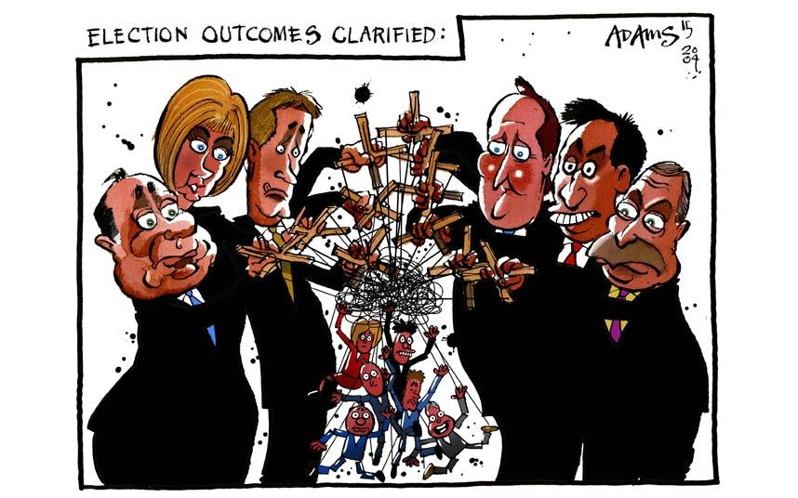

Slide 3
Europe
Mario Draghi rescued the EU once again;
this time with €60bn per month QE
which began in March and will total
at least €1.1 trillion to end-Sep ’16
Greece and Putin’s Russia remain concerns;
EU stock markets have outperformed
this year but are temporarily overextended
and a correction commenced last week

Slide 4
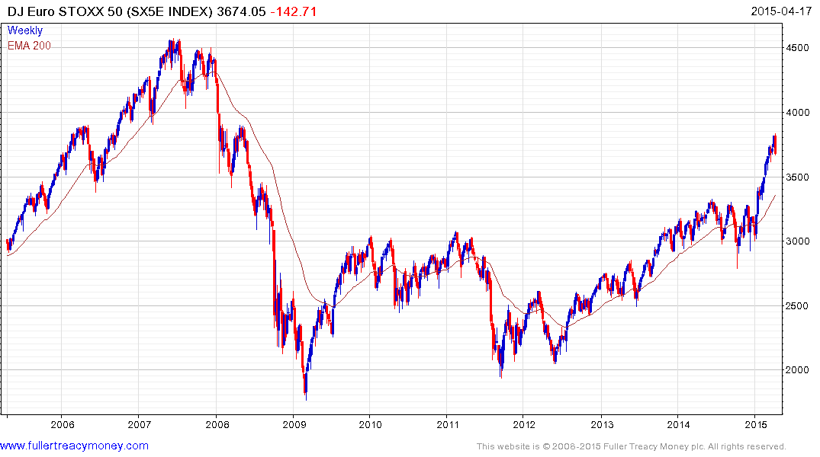
Ten-year chart of SX5E
Temporarily overextended,
weekly key reversal indicates beginning
of a corrective phase

Slide 5
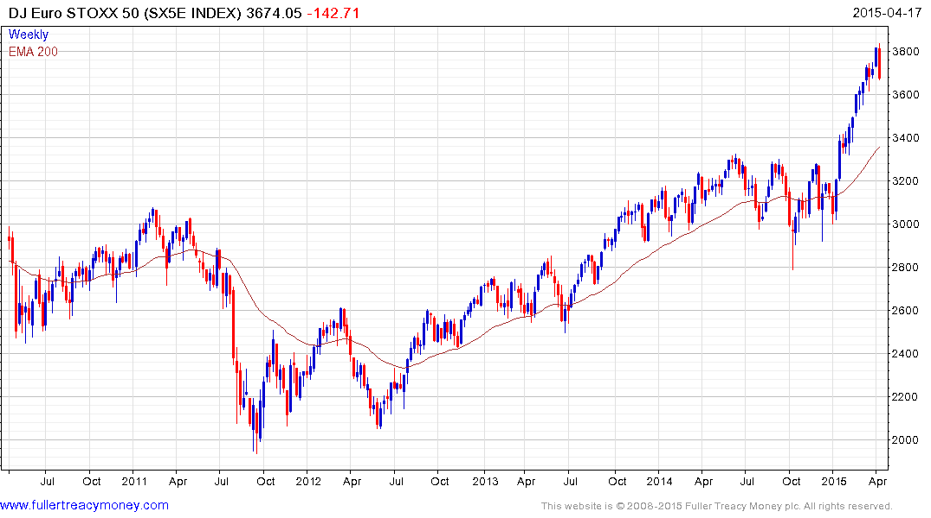
Five-year chart of SX5E
SX5E
p/e 21.49
yield 3.24%

Slide 6
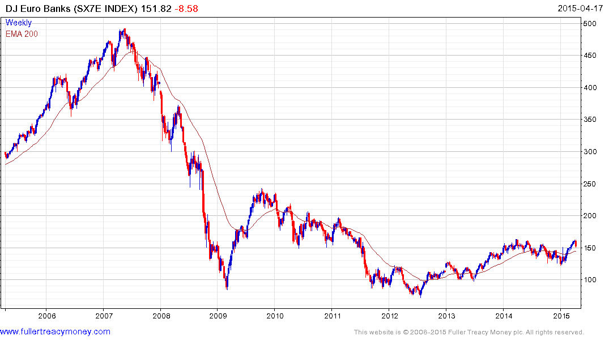
Temporary corrective phase
commencing after 10 consecutive
weeks to the upside
SX7E
p/e 33.14
yield 3.07%

Slide 7
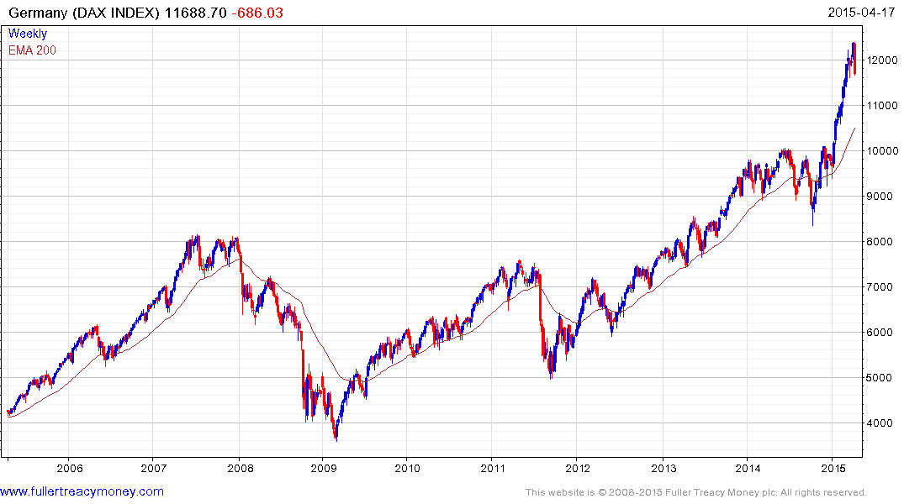
DAX p/e 19.45 & yield 2.37%
strong performer but commencing
consolidation of latest advance

Slide 8
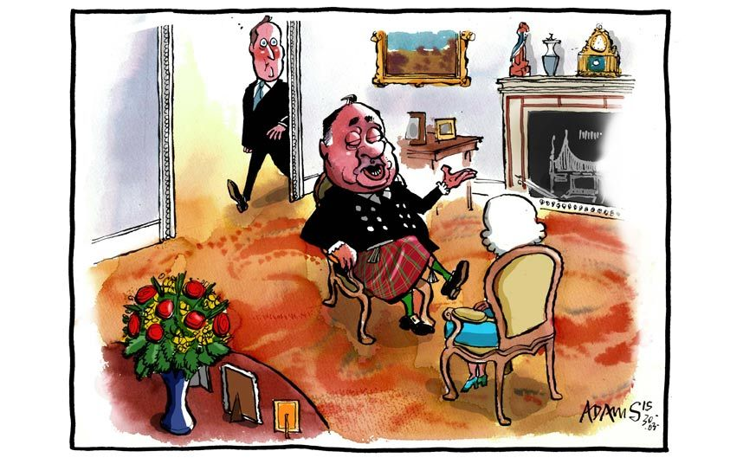
This UK General Election is the stuff of nightmares

Slide 9
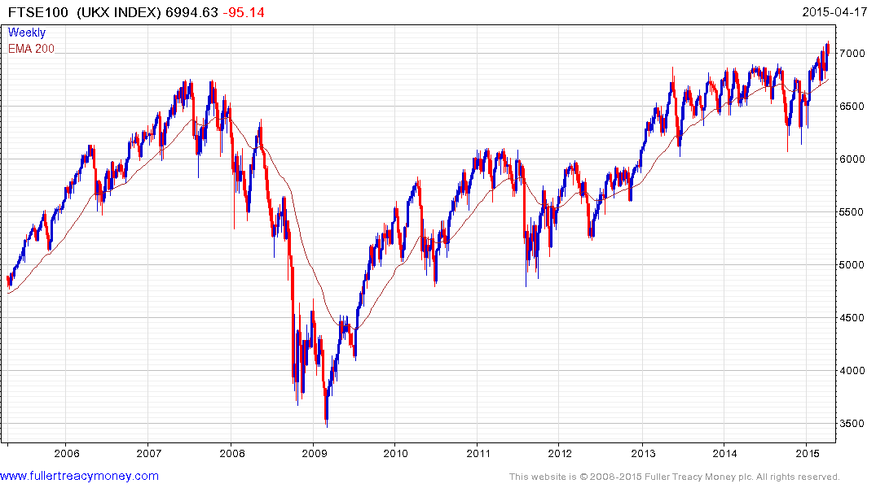
UK election risk
A Labour victory on May 7th
would be bearish
FTSE 100
p/e 23.83
yield 3.77%

Slide 10
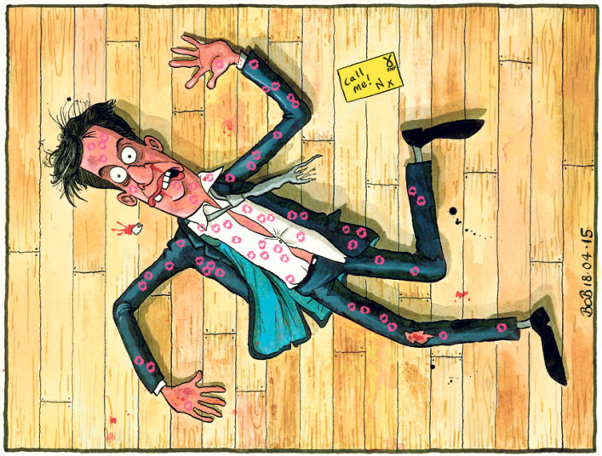
Tough love
from Nicola
Sturgeon
in Friday’s debate

Slide 11
USA
Pre-Presidential Election year usually ends on a bullish note
However, valuations are now on the higher side of average
The US stock market is way overdue a 10% plus correction
The US Dollar’s sharp rise since June 2014 is a headwind
Fracking slowdown and cold winter slowed GDP growth
There are plenty of bearish forecasts (old hedge fund guys)
Pre-Fed rate hike jitters but this should not be a problem
US Election result in 2016 should be bullish

Slide 12
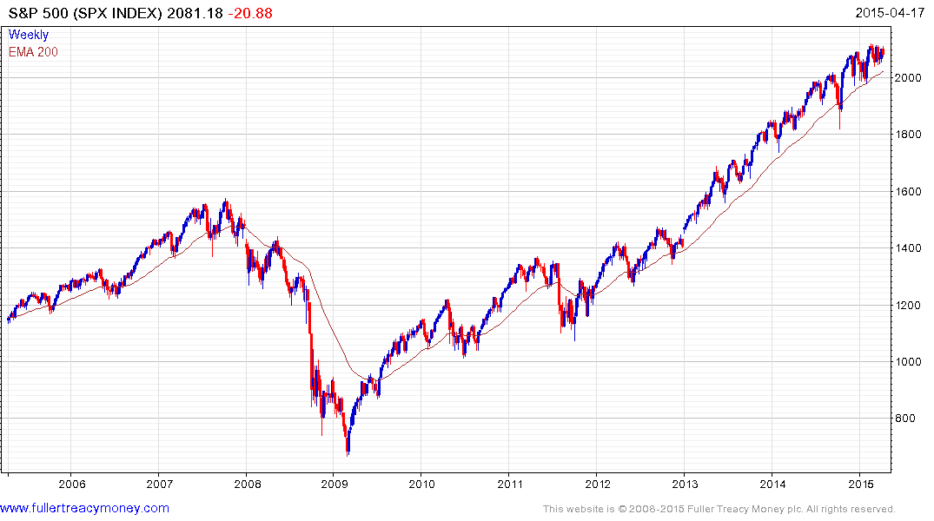
Would have to break1970
to confirm upside failure
SPX
p/e 18.06
yield 1.99%

Slide 13
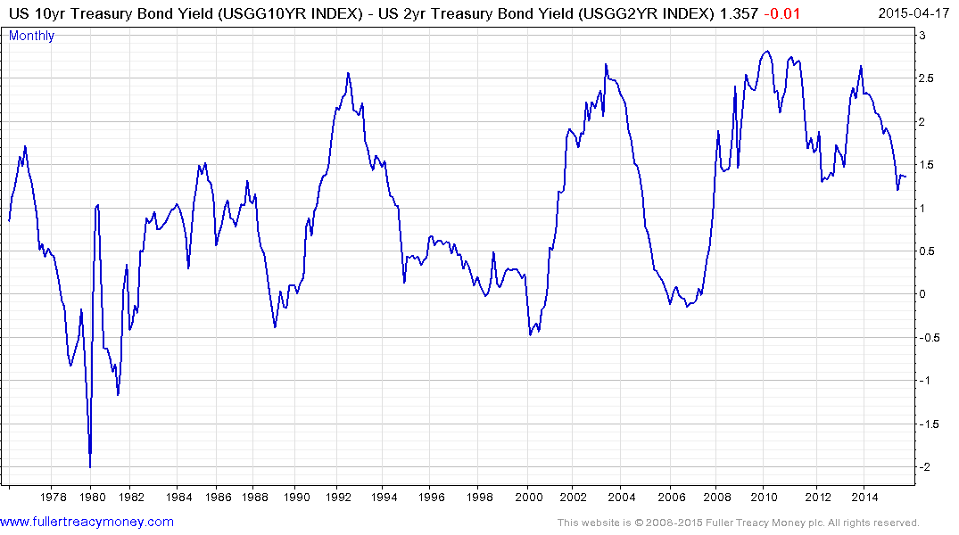
Alarmists keep talking about
a Wall St crash but
unlikely while yield curve
remains positive

Slide 14
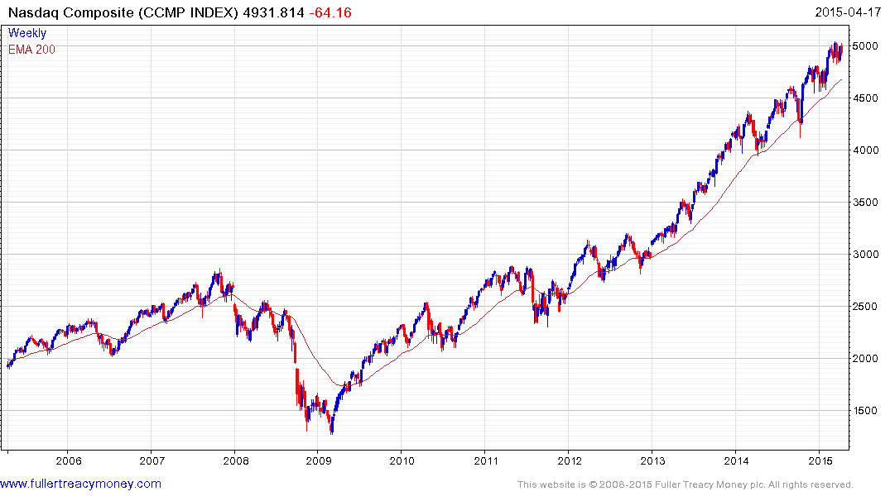
Tech-led Nasdaq Composite is not
cheap (p/e 29.32 & yield 1.22%)
but still consistent near
psychological 5000 level
Would have to
close beneath
4500 to indicate
significant technical
deterioration

Slide 15
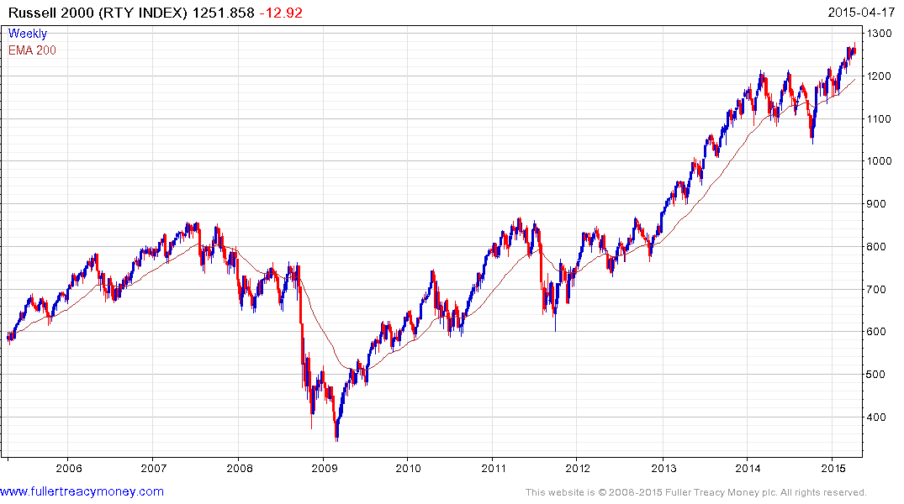
Russell 2000 shows that
market breadth has improved
p/e 20.90 & yield 1.37&
Would have to
close beneath
1200 to suggest
upside failure

Slide 16
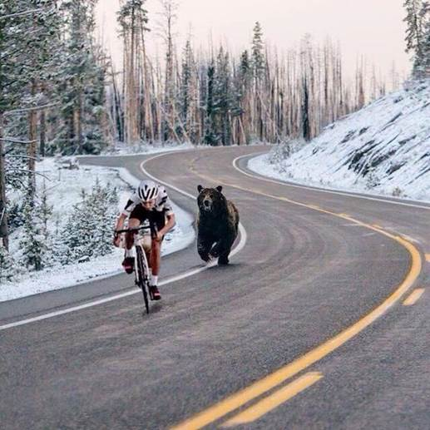
Is this what
a bear market
feels like?
We are not there yet;
in Wall Street terms
this cyclist is about to
resume climbing the
hill, exercising his pet
bear in the process

Slide 17
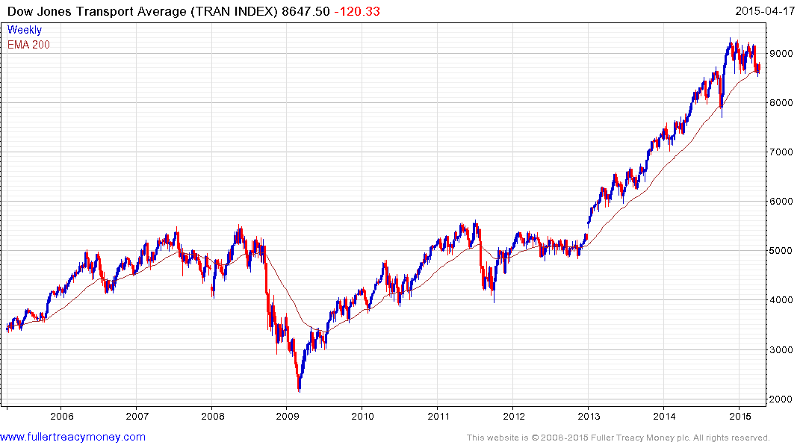
TRAN shows a loss of upside momentum
and needs a rally to prevent further pattern
deterioration and reaffirm the uptrend
p/e 18.90
yield 1.24%

Slide 18
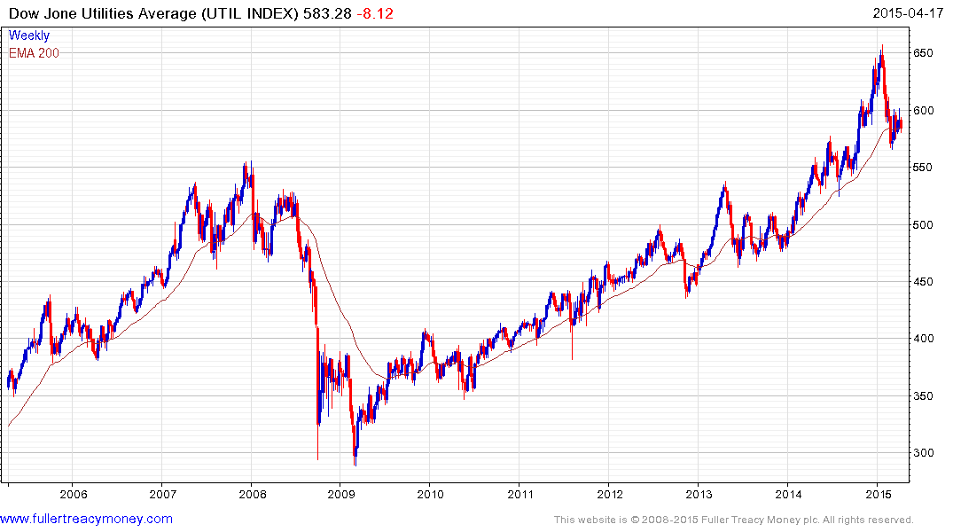
UTIL has seen pattern deterioration
and needs a rally from current levels
to revive the overall uptrend
p/e 17.11
Yield 3.43%

Slide 19
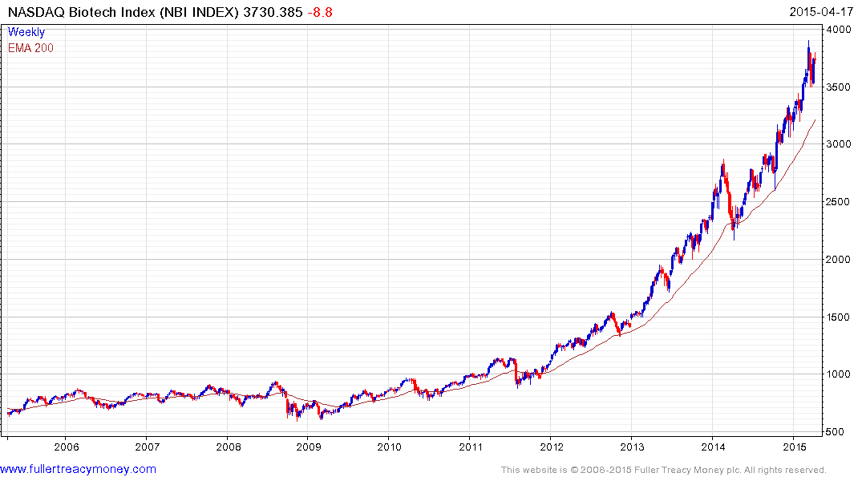
Biotech Index
Overextended relative to its rising
200-day (40-week) MA, and bubbly,
but the long-term outlook is bullish
p/e 293.8p
yield 0.17%

Slide 20
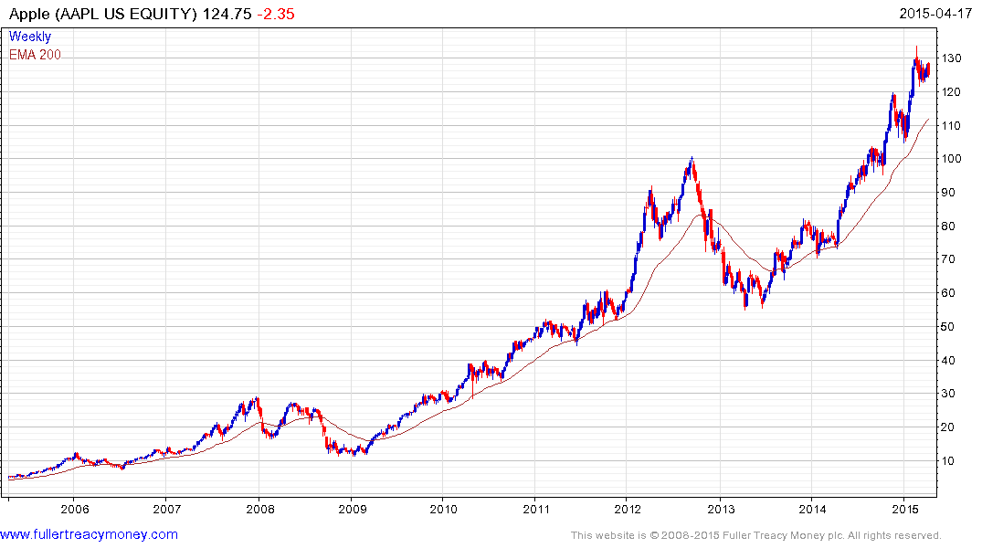
Apple
Keep an eye on this iconic bellwether for the
tech sector and Wall St generally - currently
a little overextended but not expensive
Est p/e 14.38
yield 1.51%
Watch the rising lows
for uptrend consistency

Slide 21
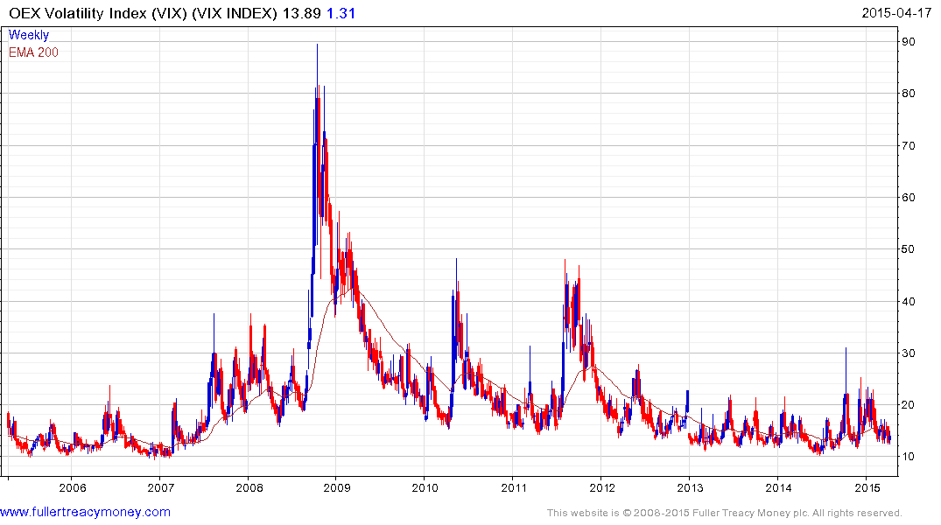
OEX Volatility Index (VIX)
So far, not affected by
last Friday’s wobble

Slide 22
Shinzo Abe and the BoJ
have the right policies
for Japan’s economic recovery
and a long-term bull market

Slide 23
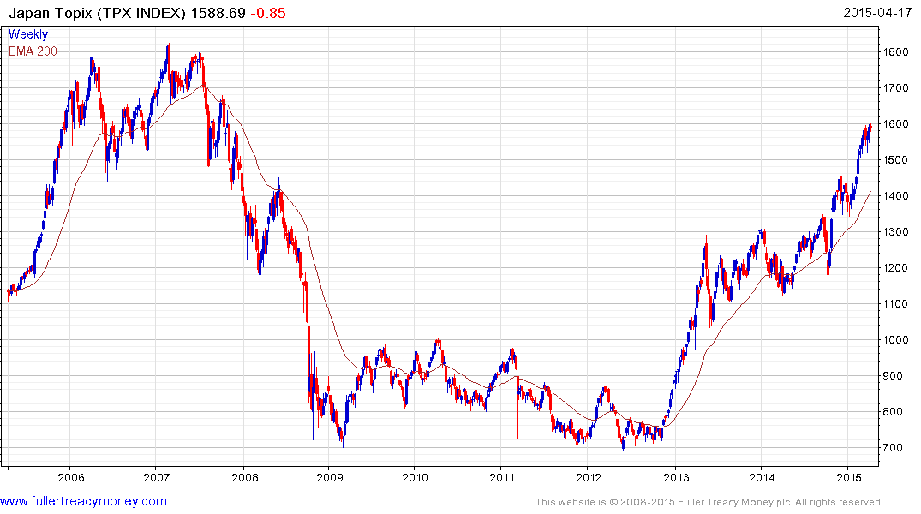
BoJ still
deploying QE
TPX
p/e 18.12
yield 1.50%
Re-elected
Shinzo Abe
Elected PM

Slide 24
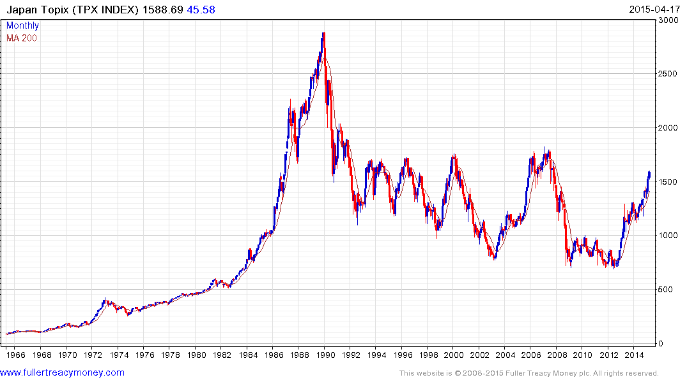
Should test this region near 1800 possibly this year

Slide 25
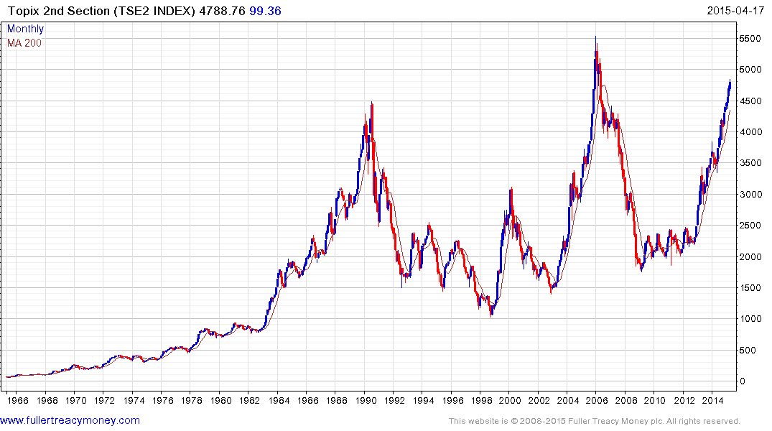
Topix 2nd Section
often leads
TSE2
p/e 16.76
yield 1.36%

Slide 26
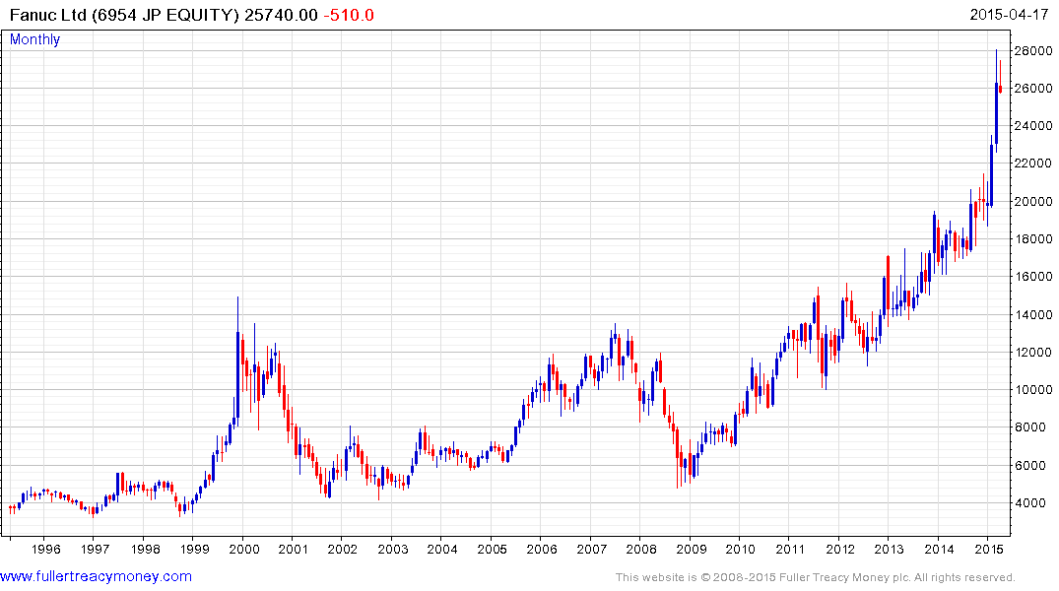
A share for this era
Fanuc leading Japan’s Indices
est p/e 25.82
yield 0.92%

Slide 27
India
Is Narendra Modi
the most capable government leader
that you can think of today?

Slide 28
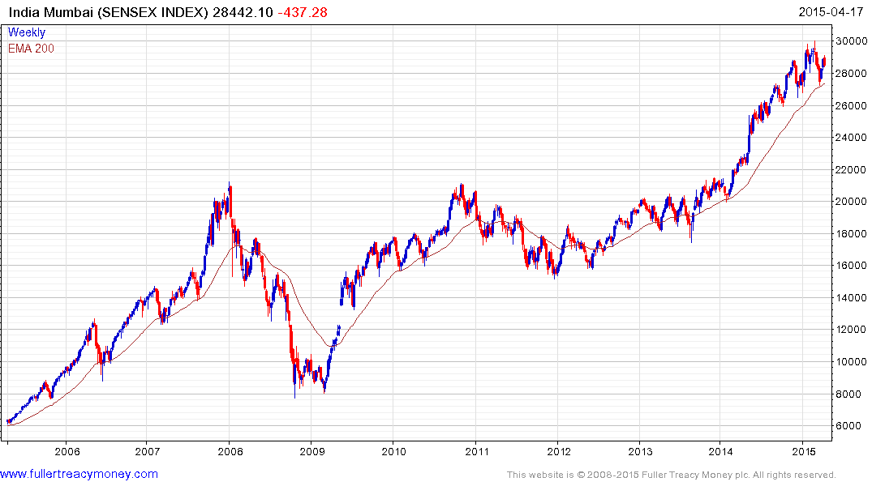
Still a favourite of mine
over the next few years but
a lengthy consolidation of
earlier gains is underway
Sensex
p/e 19.49
yield 1.39%
Watch the rising lows
for uptrend consistency

Slide 29
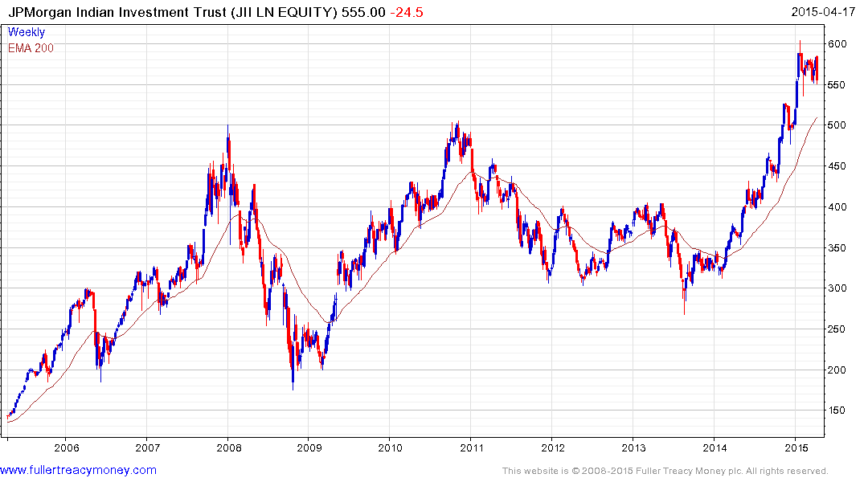
Discount to NAV
currently -15.636%

Slide 30
China
Is China a dangerous bubble
or the second fastest growing economy today?
Is it a threat or an opportunity?

Slide 31
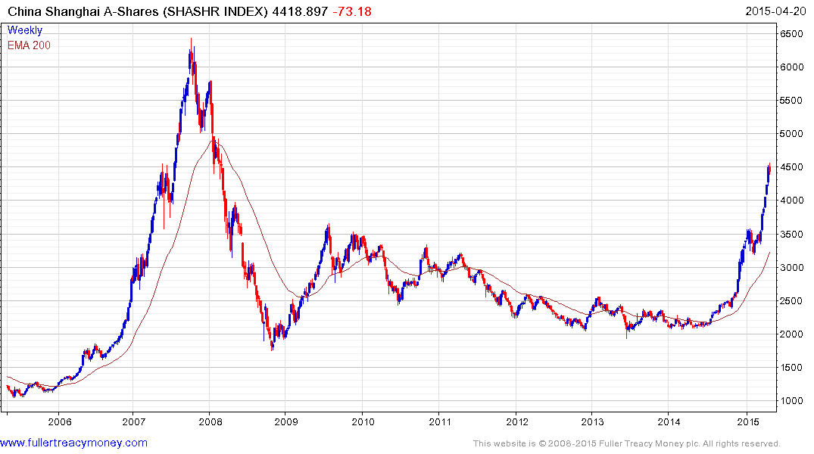
SHASHR
p/e 20.77
yield 1.55%
Now susceptible
to a lengthy consolidation

Slide 32
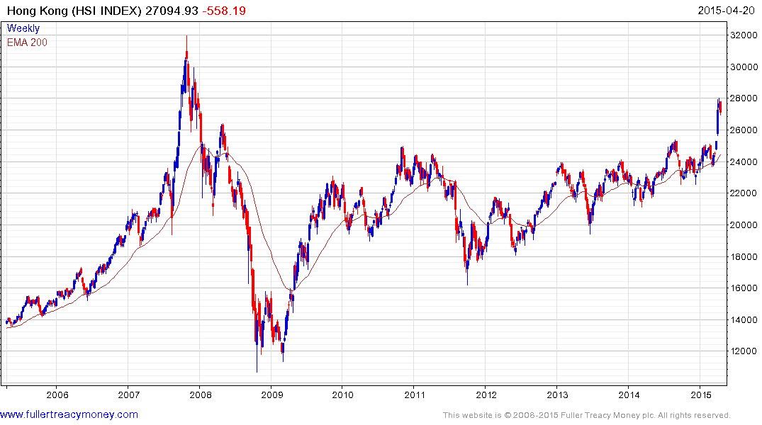
HSI
p/e 11.35
yield 3.33%
Temporarily
overextended

Slide 33
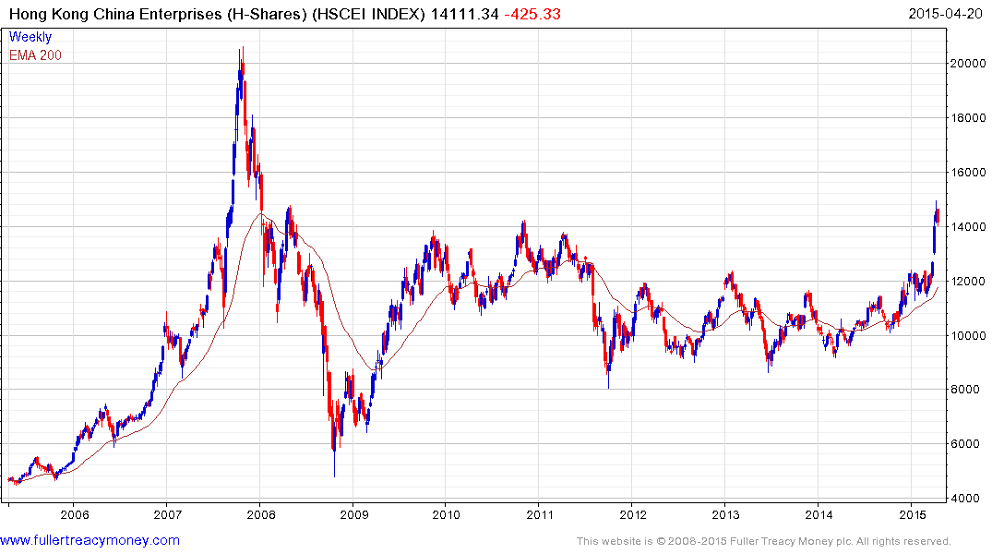
HSCEI
p/e 10.05
yield 3.05
Consolidating latest gains

Slide 34
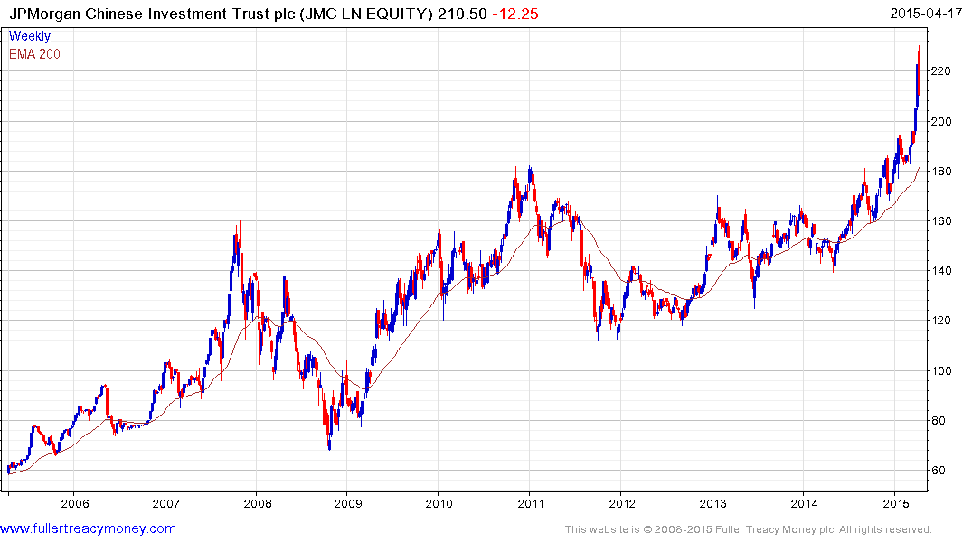
Currently overextended,
consolidation underway
JMC
discount to NAV
currently -15.344%

Slide 35
Most investors remain cautious…
● Is it all about oil?
● Or is it about deflation?
● Political (‘Grexit’ or Russia) risks?
● What about leverage?
● Are valuations too high?

Slide 36
● My view: Oil near today’s price of Brent $60 is very bullish globally, oil producers excepted.
● However, the benefits are diffuse. People may not increase spending initially. Countries such as India reduce energy subsidies.
● In contrast, the pain for oil producers is seen and felt much more quickly.
● Investors should fear high oil prices because previous upside spikes are a major cause of global recessions as we last saw in 2008.

Slide 37
Deflation?
● My view: Much of today’s deflation is largely positive, at least for corporations, because it is caused by technological innovation. For instance, better technology enables companies to produce improved products, at lower prices, in greater volume, while increasing profits due to increased sales.
● Destructive deflation is generally described as a vicious cycle of falling prices, wages and output. It is particularly bad for indebted governments, corporations and people who lose jobs or scope for salary increases.

Slide 38
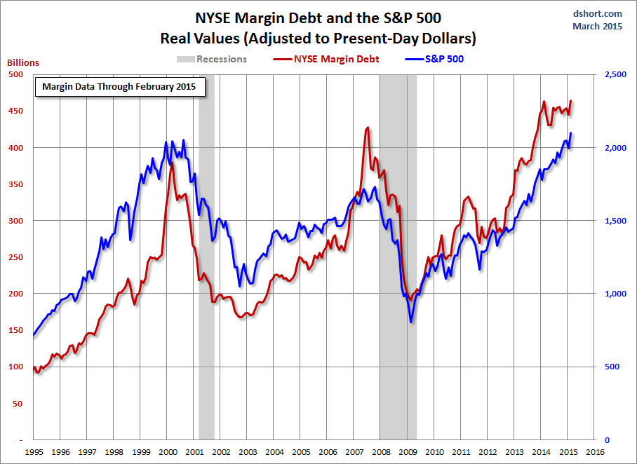
NYSE Margin Debt increased in February
but what is the long versus short ratio?

Slide 39
Technical warning signs to watch for among indices
Trend acceleration relative to 200-day moving averages
Declining market breadth (fewer shares rising)
Failed upside breakouts from trading ranges
Loss of uptrend consistency characteristics
Churning price action relative to recent trading ranges
Breaks of 200-day moving averages
Broadening patterns relative the last several trading ranges
200-day moving averages turn downwards
Resistance is encountered beneath declining 200-day MAs
Previous rising lows are replaced by lower rally highs
Indices fall faster than they rose to their highs

Slide 40
Bullish Points for Stock Markets
S&P up15.3% on average 6 months after mid-term election
Global monetary policy is still extremely accommodative
Central banks are worried about deflation, not inflation
Capitalism increasingly dominates on a global basis
Globalisation spurs rapid emerging market development
Growth in middleclass consumers surges, led by Asia-Pac

Slide 41
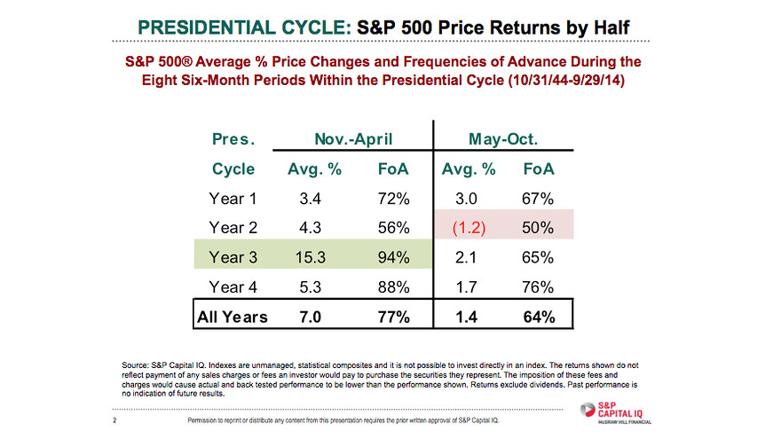

Slide 42
Long-term bull factors for stock markets
Accommodative monetary policies, until growth accelerates
An accelerating rate of technological innovation
Lower energy prices in real terms, thanks to innovation
The triumph of capitalism, both democratic & authoritarian
Globalisation, hastening development of emerging markets
Middleclass growth in emerging markets
Continued growth in the global population

Slide 43
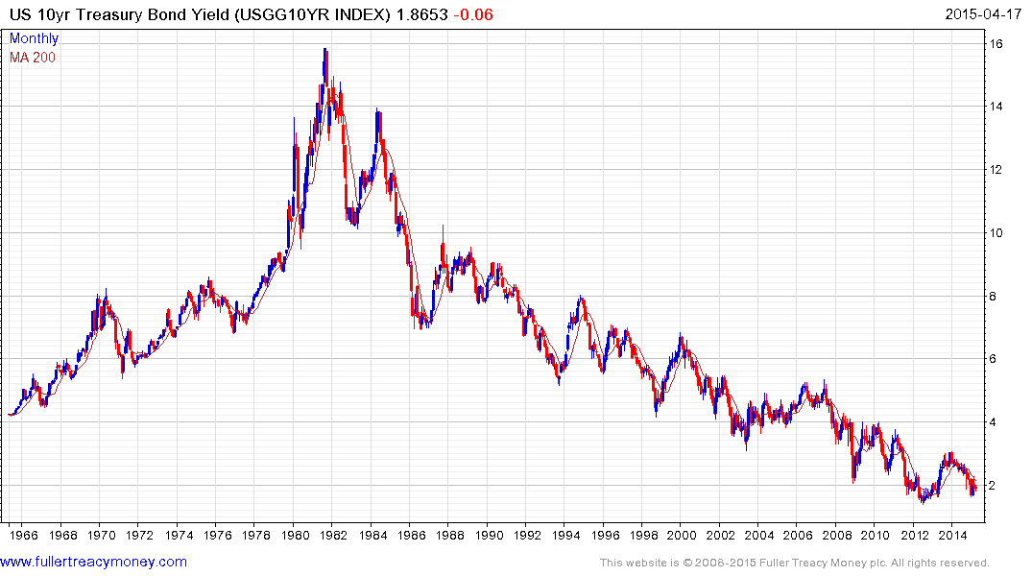
Still in long-term downtrend
since peak in 1981, but
presumably not much
further downside scope

Slide 44
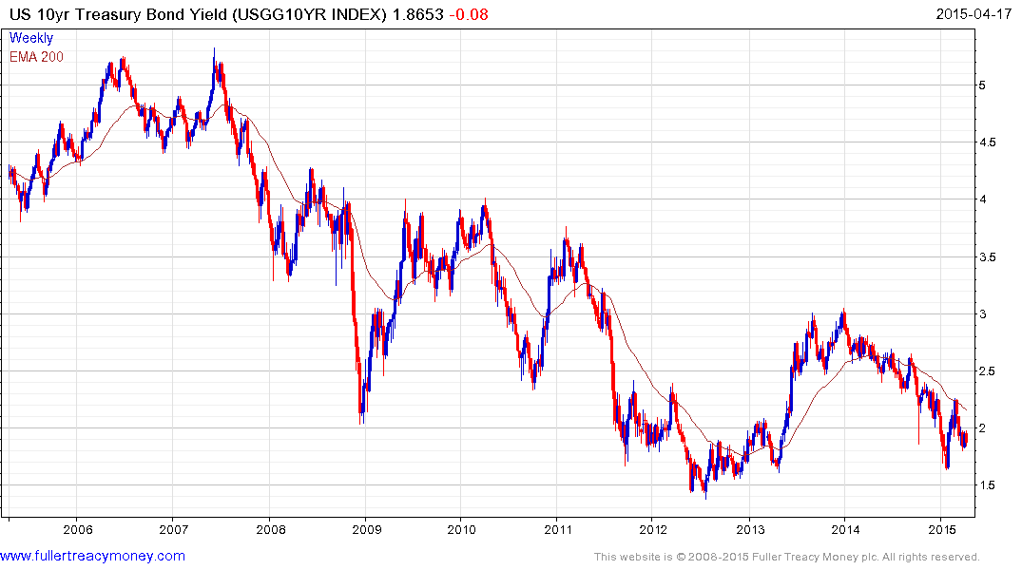
1) Probable lengthy base building
2) Above 3% base maturing
3) Above 4% probable base completion

Slide 45
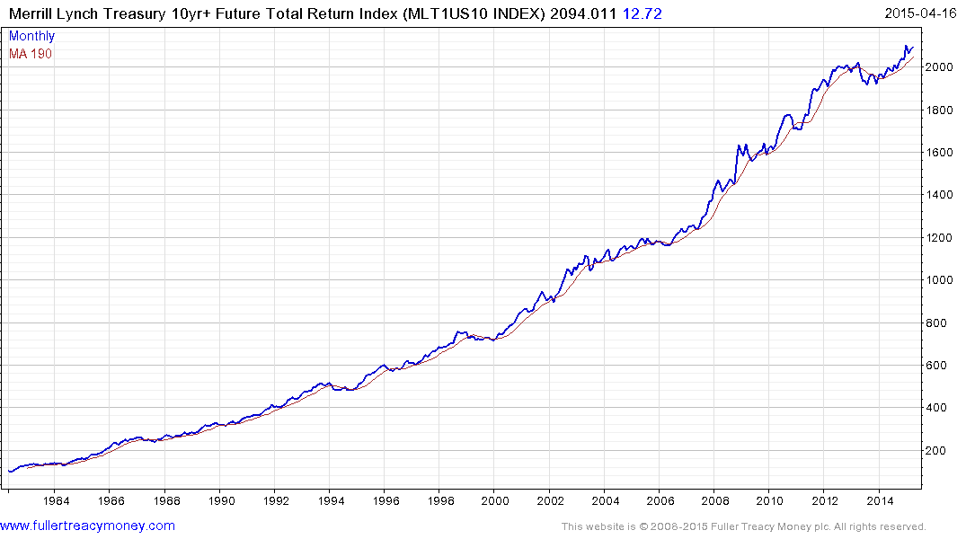
US bondholders are still making money
but top completion occurs when this
total return pattern breaks downwards

Slide 46
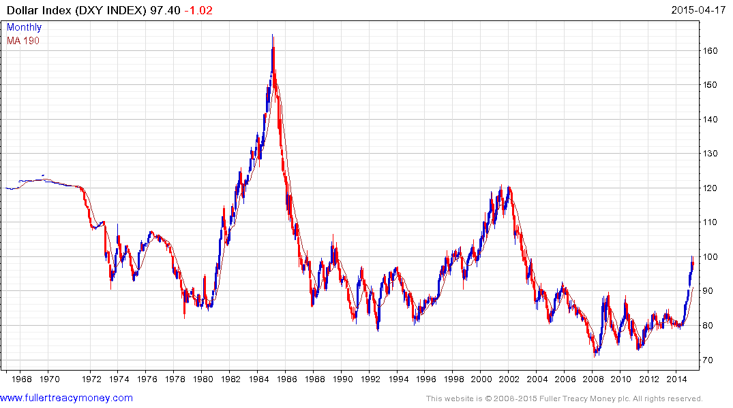
US Dollar Index has completed a base formation
driven by energy independence & tech lead
Fed & Treasury will control speed of $ recovery

Slide 47
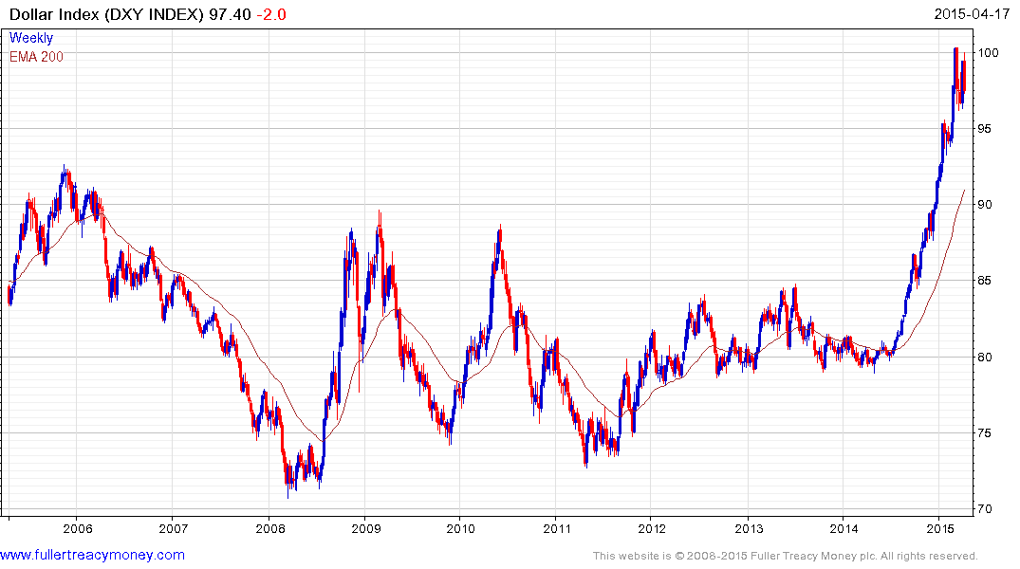
Currently a headwind for
US economy and intervention
may have commenced

Slide 48
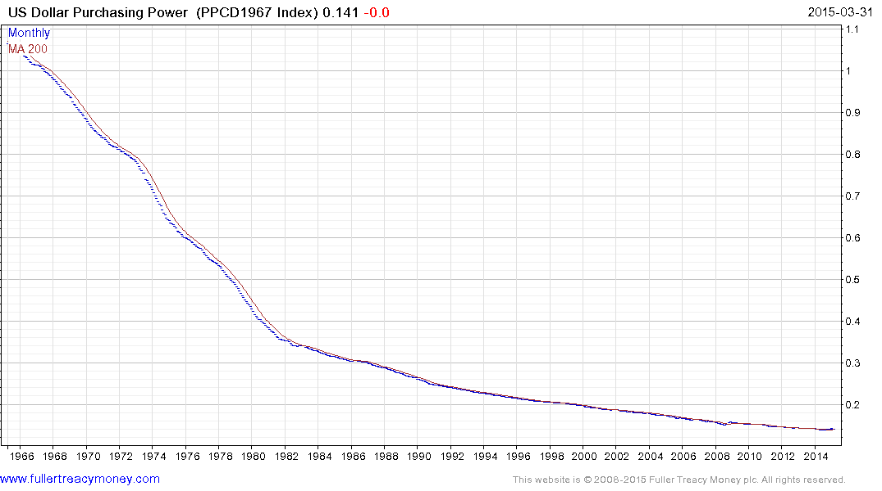
Nevertheless the US dollar is still a fiat currency, which
has lost most of its purchasing power since only 1968

Slide 49
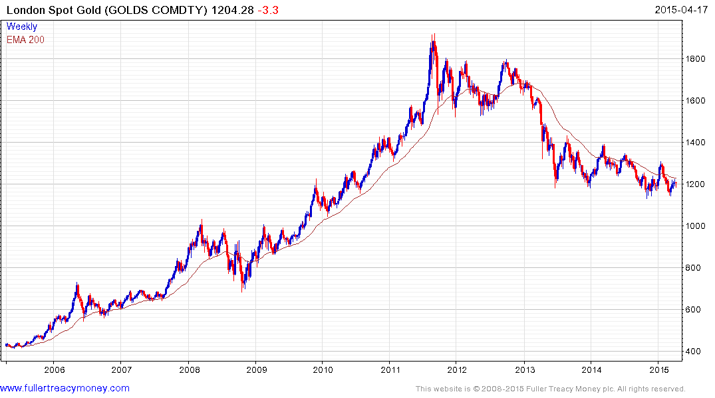
Gold is hard money, albeit with
a fluctuating price, just like
anything else which can be
bought or sold.
1. Traders mostly short
2. ETF long holds of gold still
liquidating
3. Indians & Chinese buying
4. Testing range lows
5. Gold needs a weaker Dollar

Slide 50
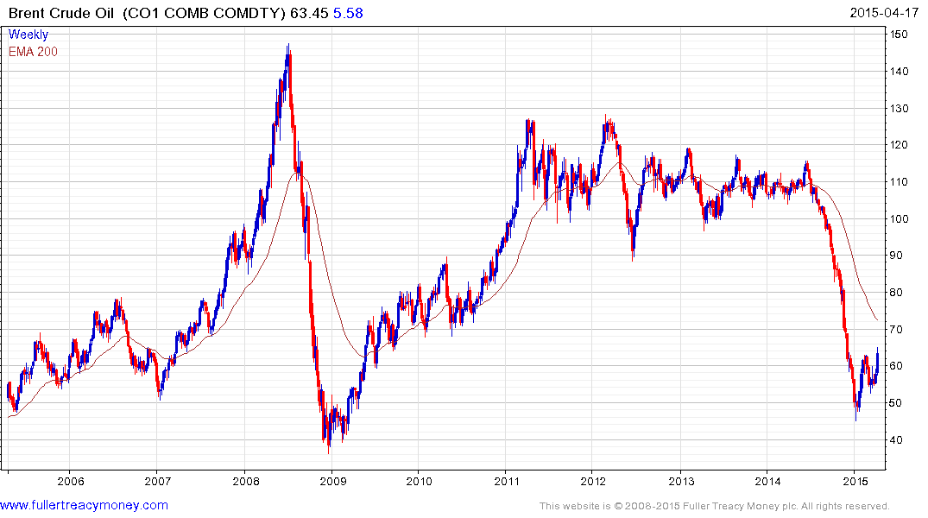
The end of an era for producers of crude oil
who have lost price control of this market
Now basing but no more
price spikes such as 2008,
despite turmoil in many
producer regions and an
eventual global economic
recovery

Slide 51
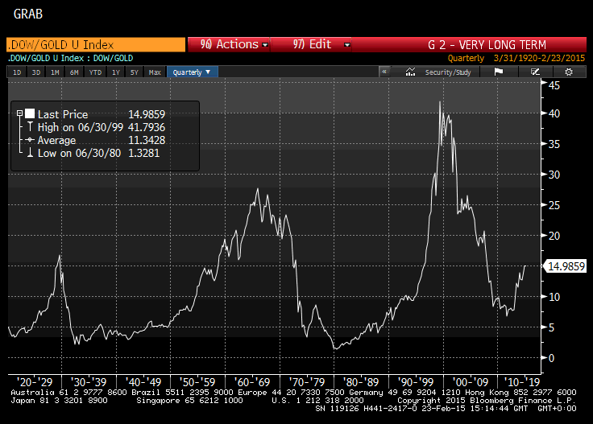
Gold remains
out of favour
with Western
Investors who
are mainly in
stocks & bonds

Slide 52
Many thanks for your interest!
Any questions?
Please visit our site:
www.fullertreacymoney.com

