Slide 1
The Markets Now
Risks and Opportunities Before
the ‘Sweet Spot’ Ends
David Fuller – 8th September 2014
fullertreacymoney.com
East India Club – 16 St. James Square
London SW1Y 4LH, UK

Slide 2
Political Risks
(not forecasts)
Celebs see more of their nude ‘selfies’ posted by hackers
Scotland votes for independence on 18th Sept
“Minds are like parachutes. They only function when they are open.” James Dewar
Islamic State creates more turmoil
Putin’s ambition is to expand Novorossiya (New Russia)
China’s arriviste military strength risks territorial aggression
Labour wins the UK General Election in 2015

Slide 3
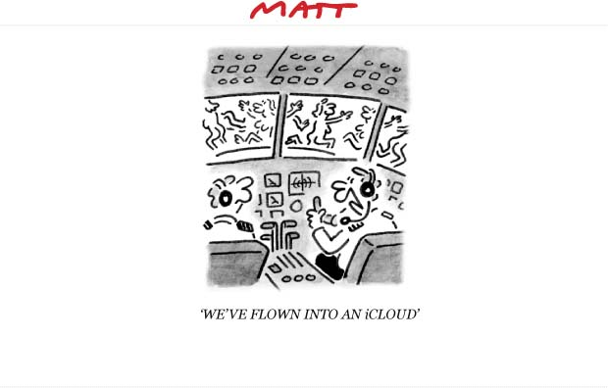

Slide 4
Economic/Market Risks
US public offerings are about to surge with Alibaba
EU risks Japan-style deflation, despite Mario Draghi
Leverage – there is plenty of it in the performing markets
Some stock market indices will accelerate sharply higher
Bond market yields will rise with GDP growth and less QE
Crude oil prices, if they spike higher

Slide 5
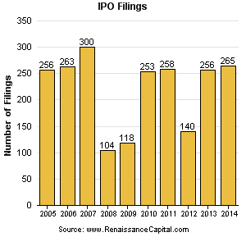

Slide 6
At this stage of the stock market cycle, I favour previous laggards as they
show relative strength

Slide 7
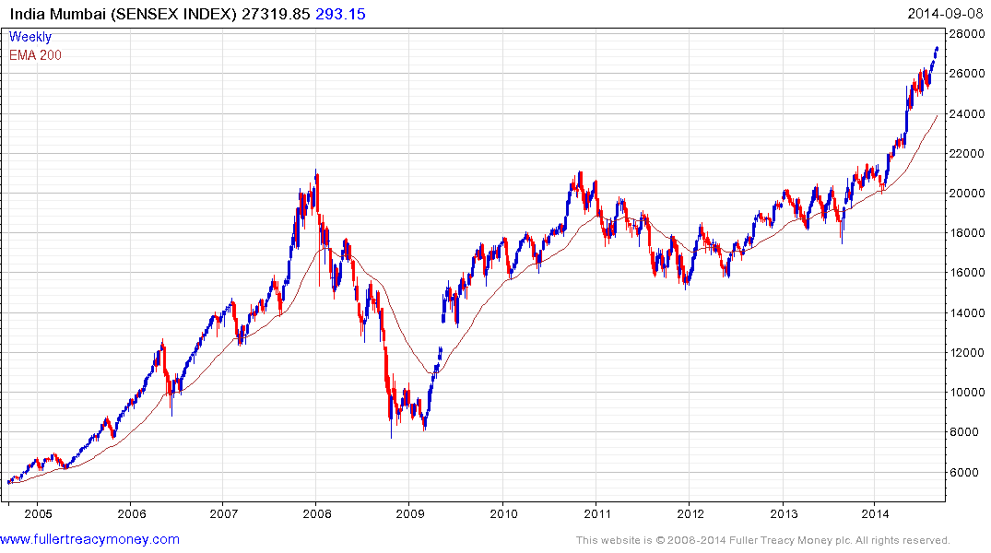

Slide 8
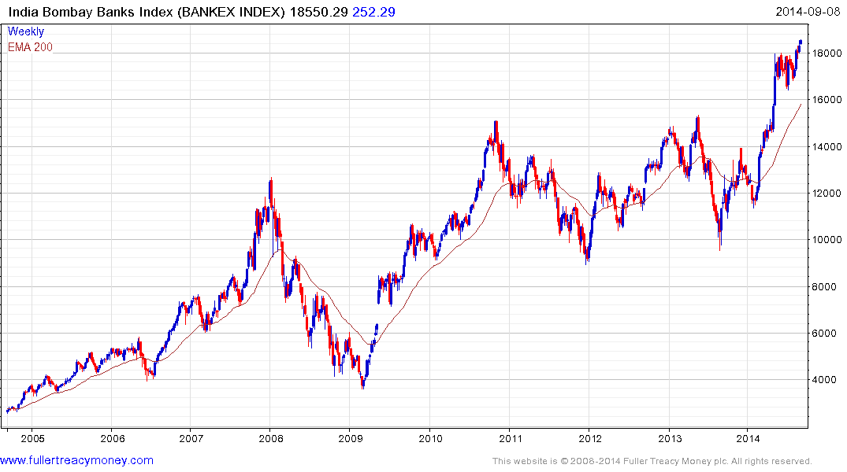

Slide 9
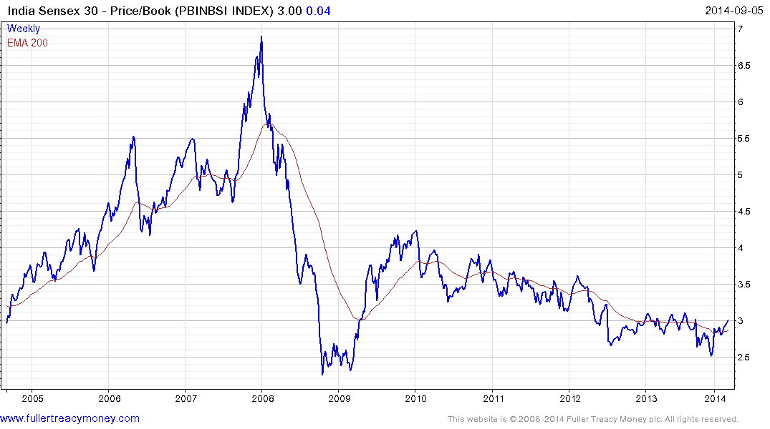

Slide 10
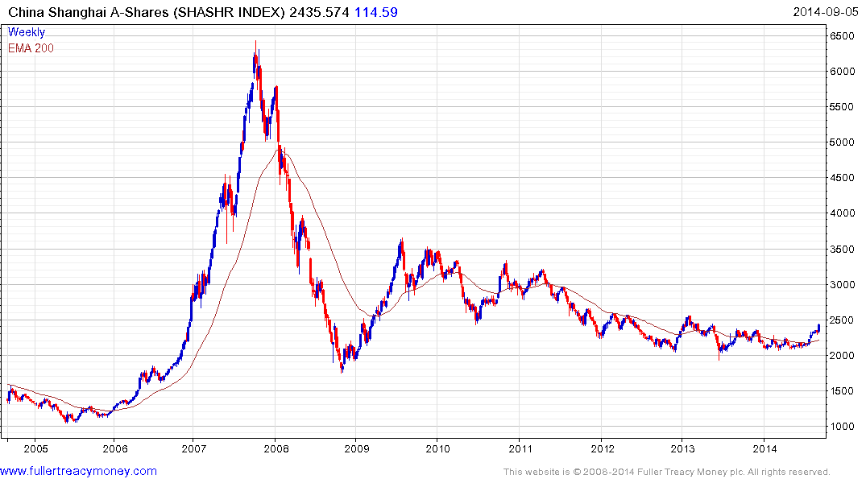

Slide 11
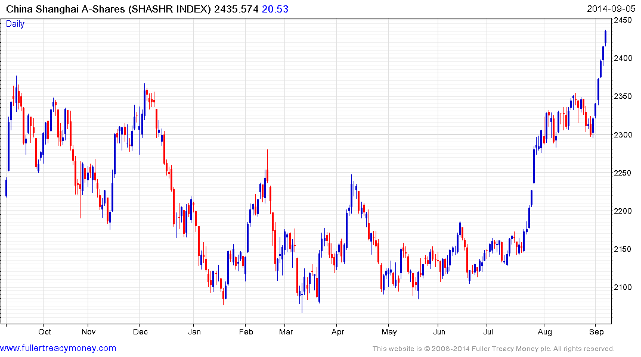

Slide 12
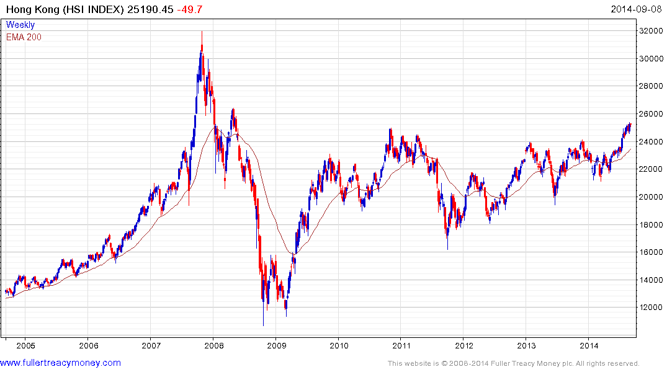

Slide 13
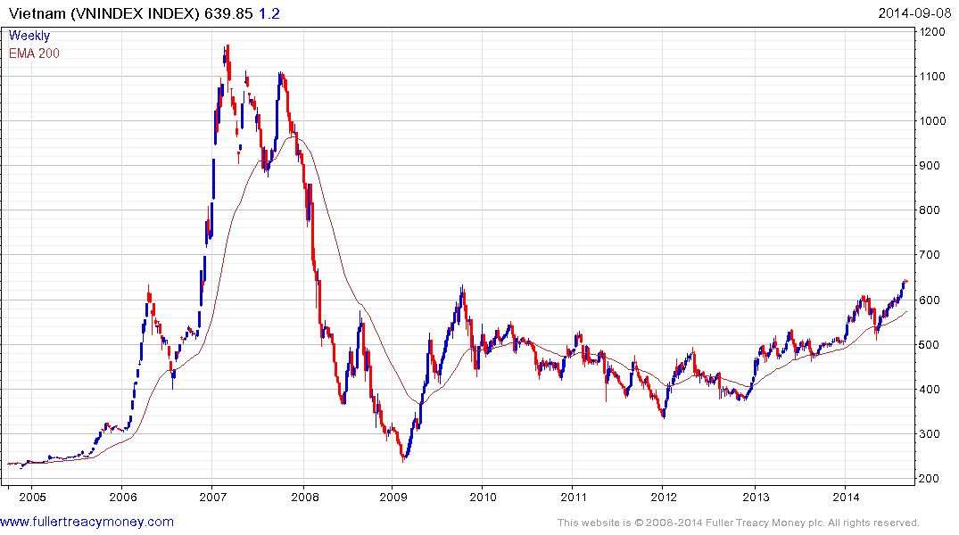
Biggest risk?
China

Slide 14
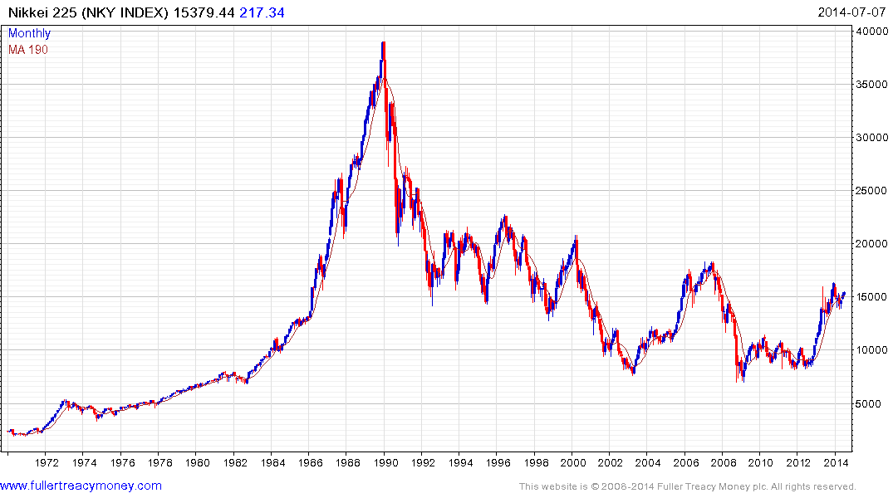
First consolidation of
recovery to date

Slide 15
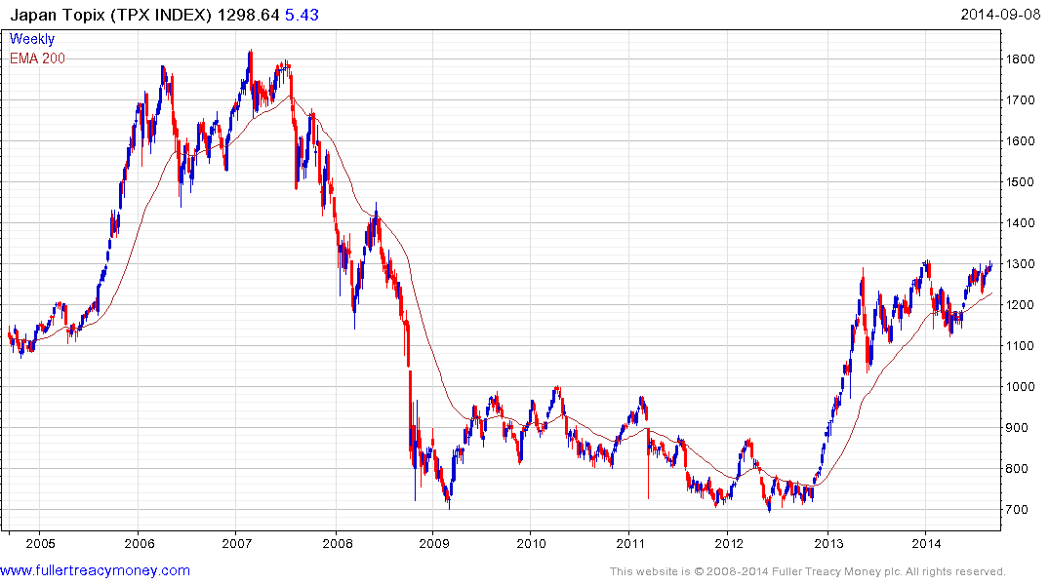

Slide 16
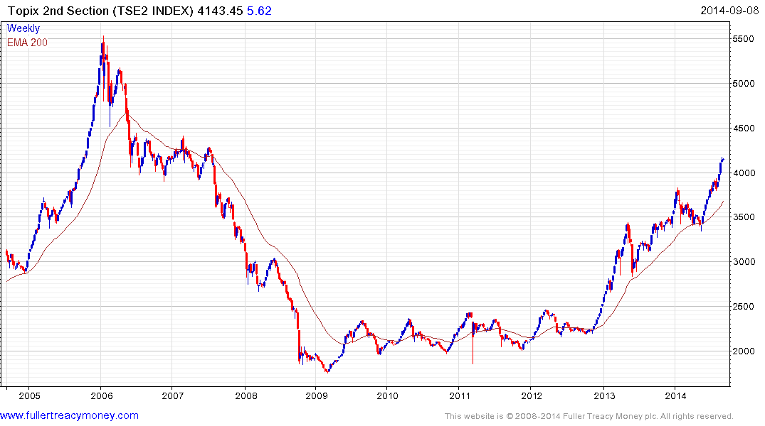
Usually a lead indicator for
Japan’s big-cap indices

Slide 17
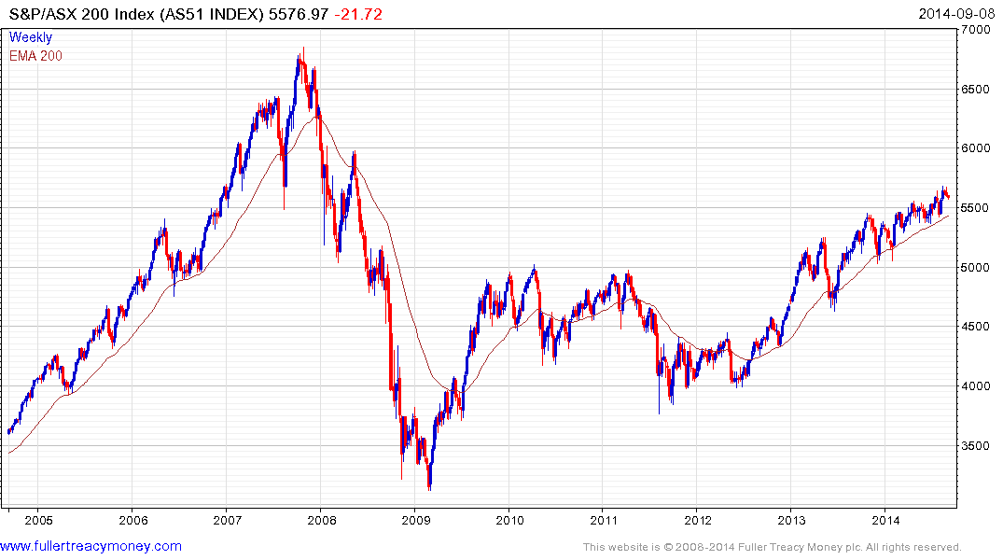
Frequent accelerations at the
latter stages of bull market cycles

Slide 18
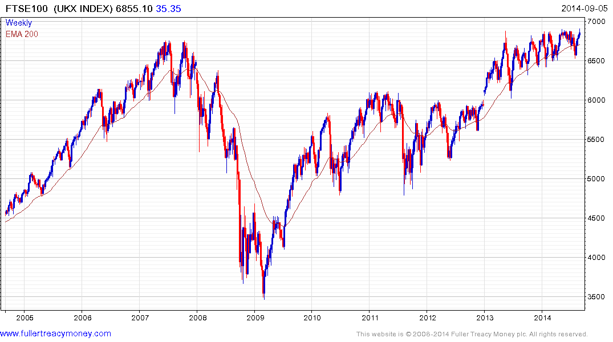

Slide 19
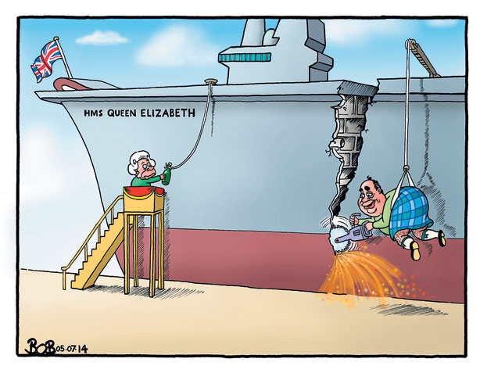

Slide 20
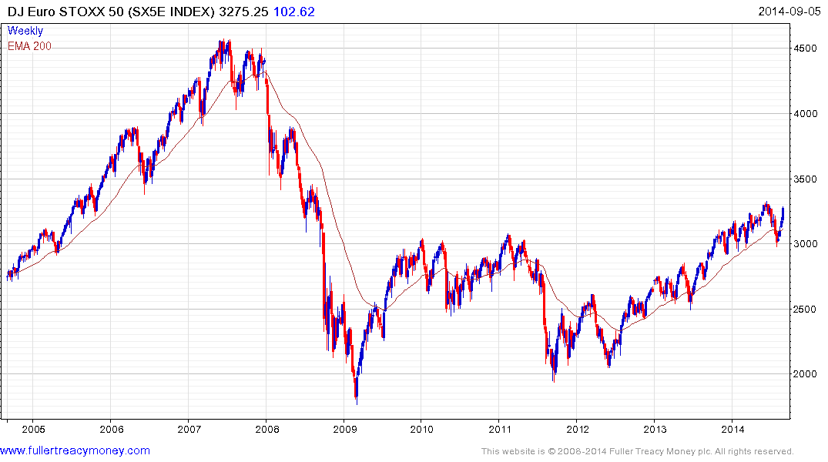

Slide 21
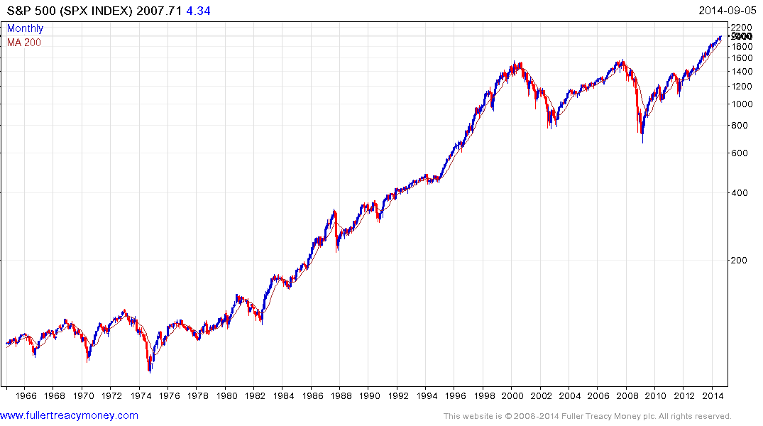
Is Wall Street’s next
secular bull market
Underway?
If so, it will be led by
Accelerated technological innovation
Lower energy costs in real terms
Worldwide acceptance of capitalism
Globalisation
An increasing global population
A rapidly growing global middleclass

Slide 22
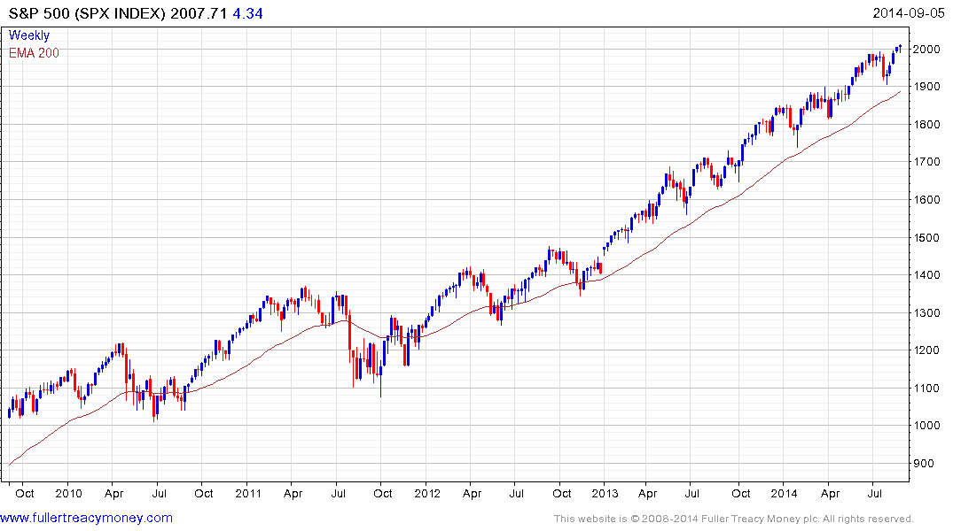
Watch for an eventual loss of
uptrend consistency in this
step sequence of
similar sized consolidations
and higher reaction lows

Slide 23
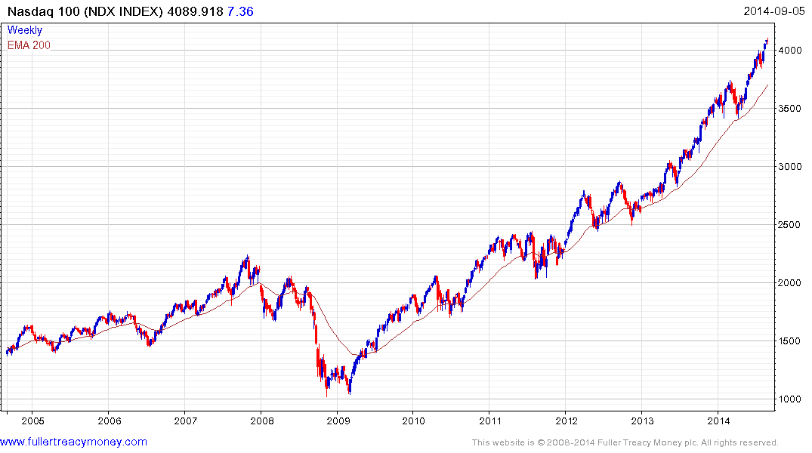
Upside leader and
acceleration candidate

Slide 24
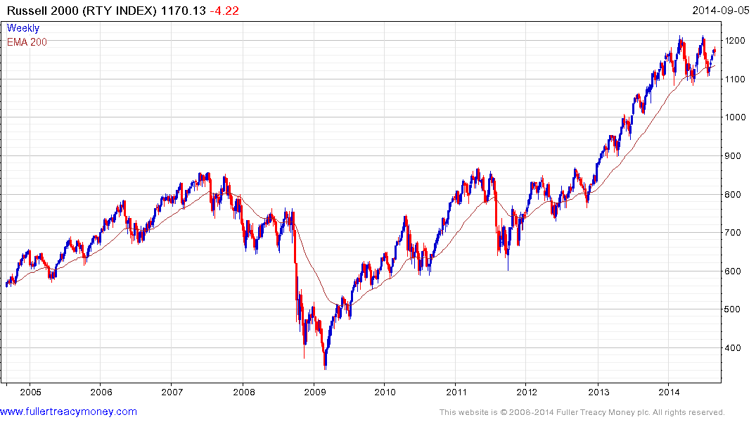
Most likely to give eventual downside lead
among major US indices

Slide 25
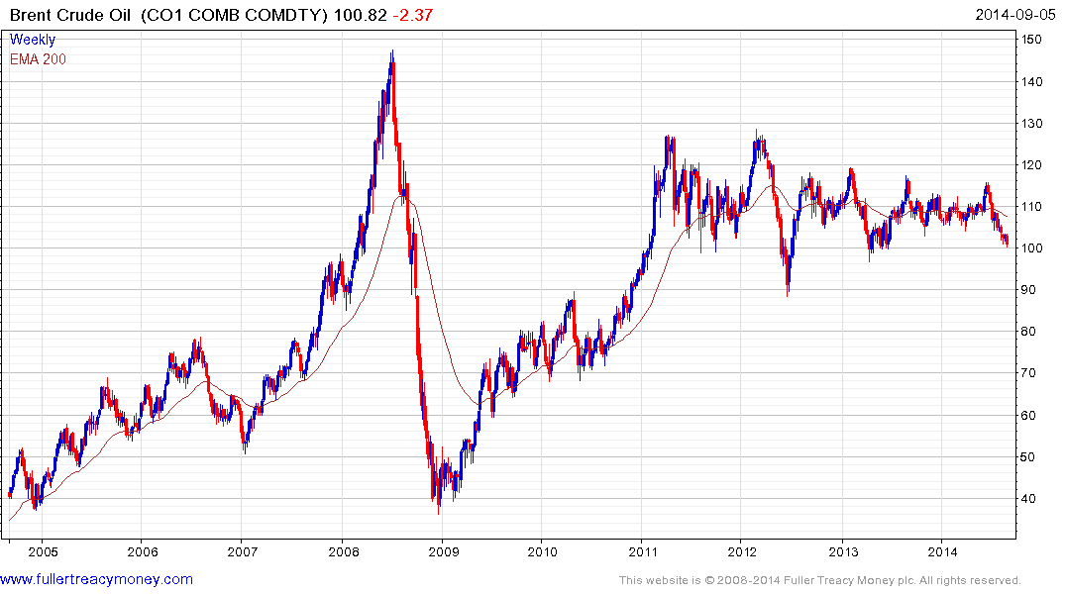
Not a problem at the moment,
but global fracking is needed,
plus more ‘new nuclear’ power
and more solar power

Slide 26
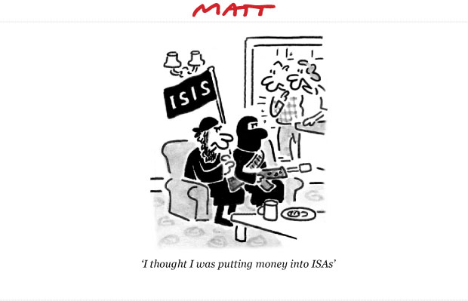

Slide 27
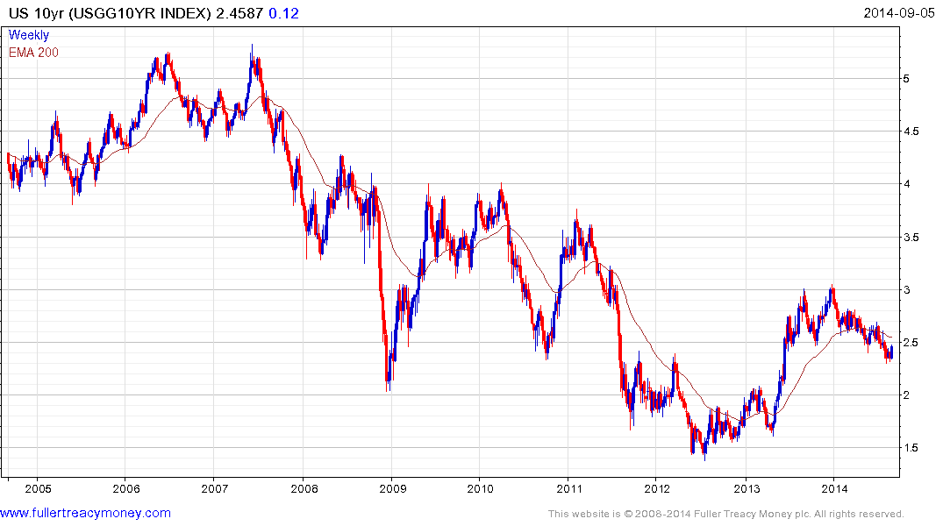
Warning levels for
stock markets

Slide 28
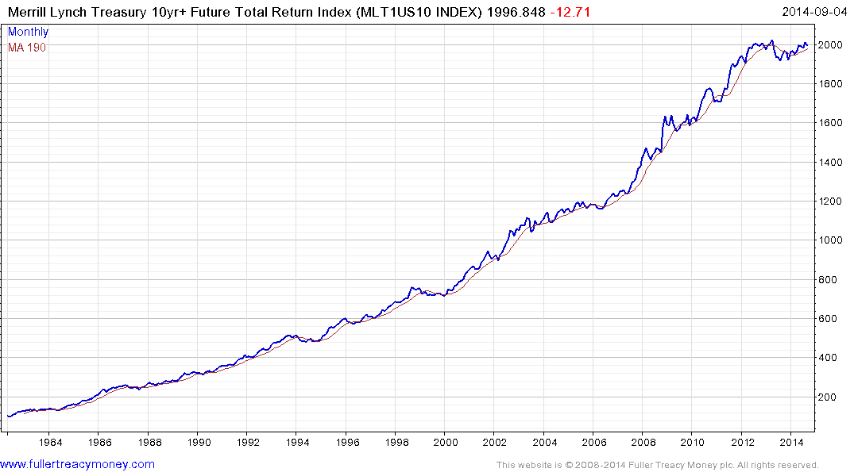
Watch for an eventual
break down below 1900

Slide 29
What about precious metals?
Still struggling, palladium excepted,
but future hedges.

Slide 30
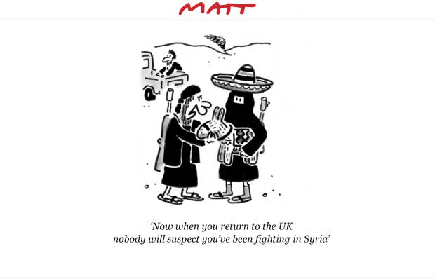

Slide 31
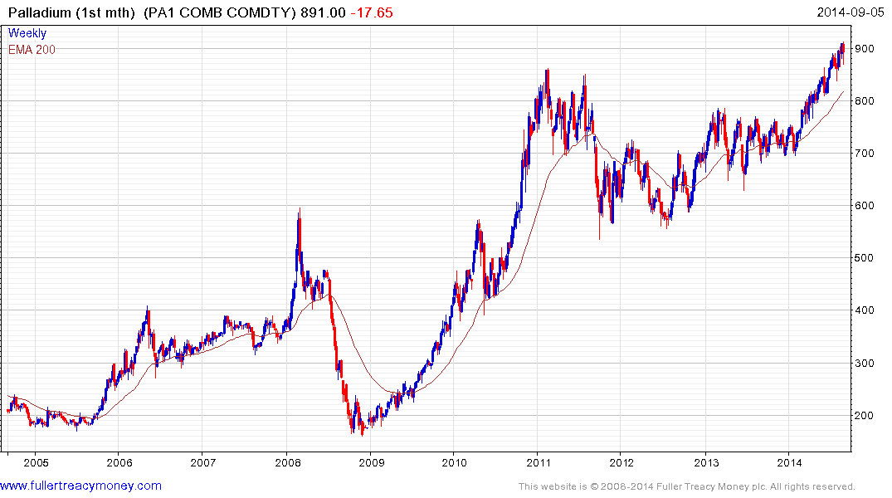

Slide 32
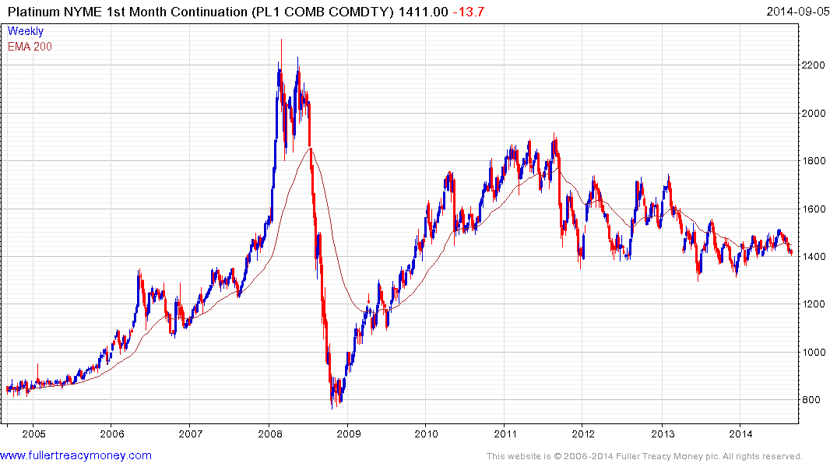

Slide 33
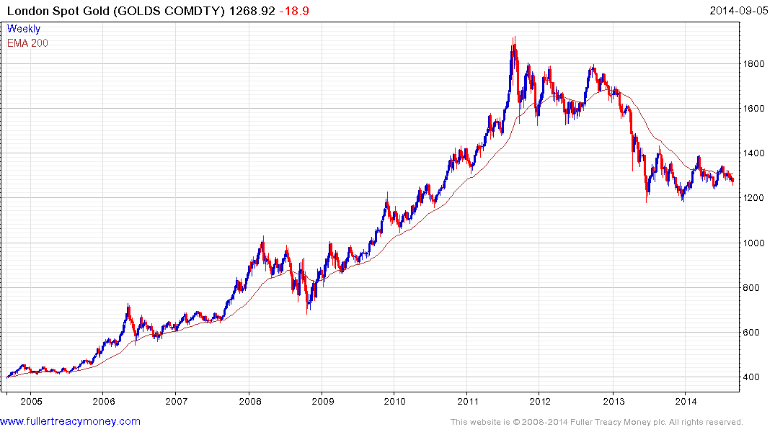

Slide 34
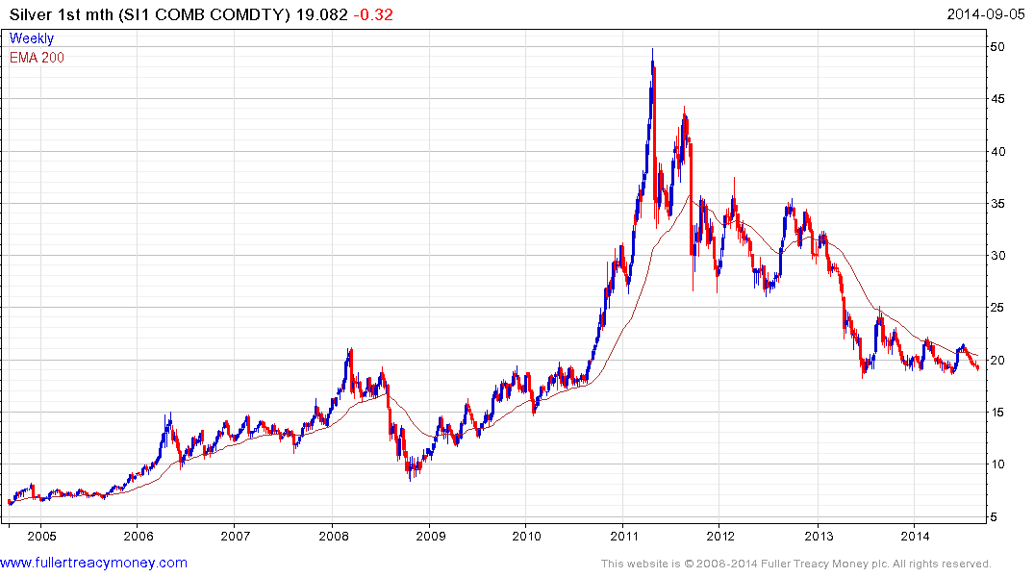

Slide 35
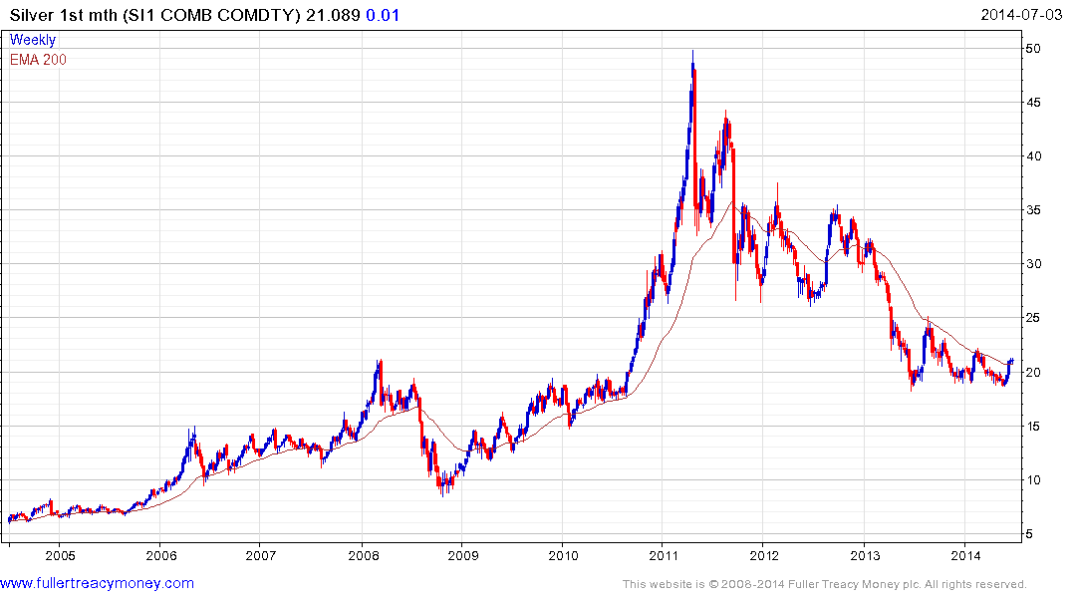

Slide 36
Many thanks for your interest!
Any more questions?
Please visit our site:
www.fullertreacymoney.com

Slide 37
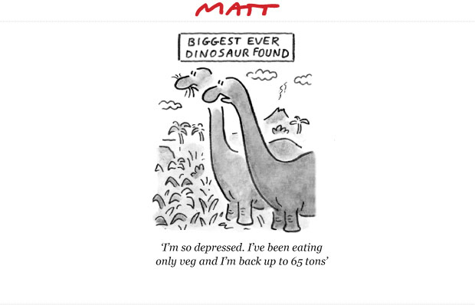

Slide 38
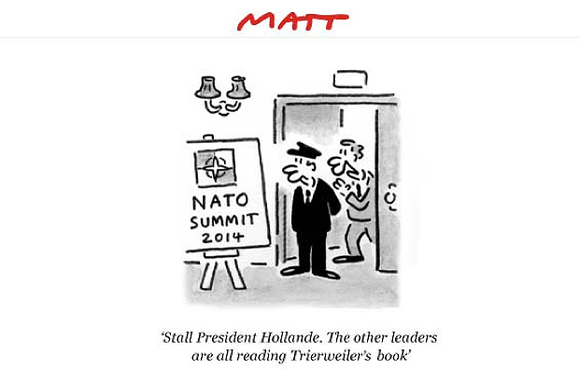

Slide 39
