Slide 1
The Markets Now
For Stock Markets,
Have Risks That the ‘Sweet Spot’
Is Ending Increased?
David Fuller – 6th October 2014
fullertreacymoney.com
East India Club – 16 St. James Square
London SW1Y 4LH, UK

Slide 2
What are the main known risks
for stock markets, in your opinion?

Slide 3
Geopolitical Political & Economic Risks
The war against ‘Islamic State’ is expensive and divisive
As are sanctions against Putin’s expansion of Novorossiya
China’s arriviste military strength risks territorial aggression
Labour could win the UK General Election in 2015
The US Dollar’s Strength for emerging market borrowers
Panic over Ebola

Slide 4
Market Risks
US public offerings are the highest in over a decade
Leverage by hedge funds & traders has soared in the USA
Leverage in other performing stock markets is high
EU risks Japan-style deflation, despite ECB’s Mario Draghi
The Fed, as it tries to normalise short-term interest rates
Crude oil prices, if they were to spike higher
Bond market yields will rise with GDP growth

Slide 5
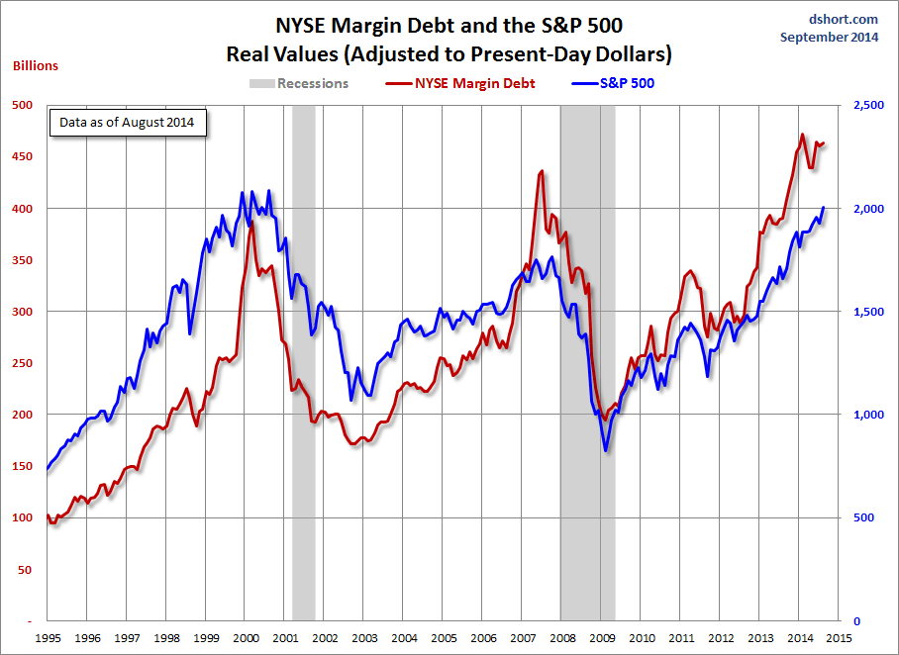

Slide 6
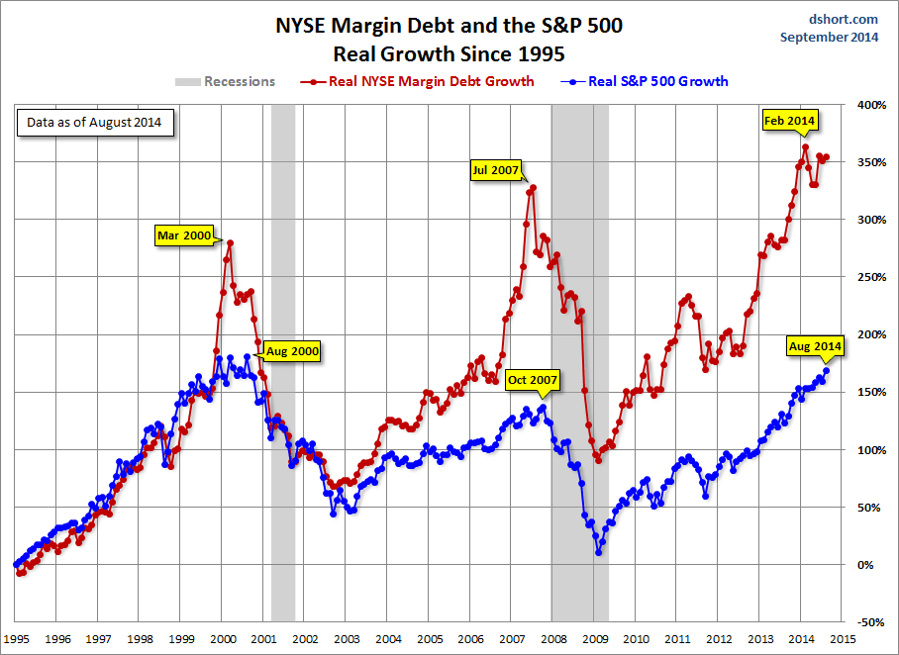

Slide 7
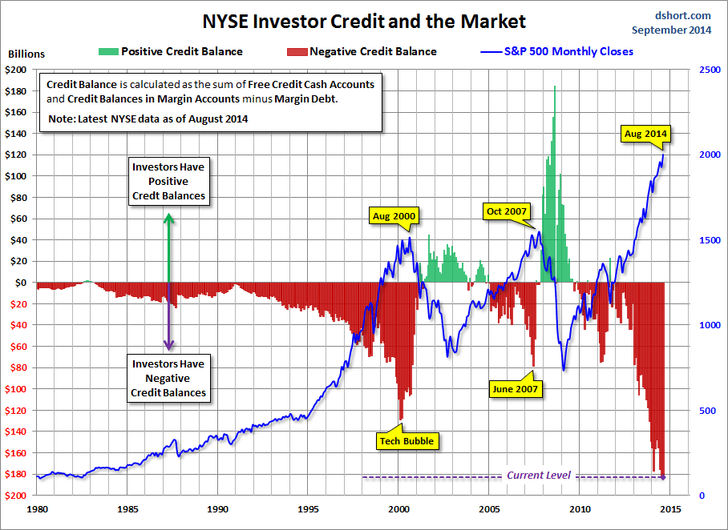

Slide 8
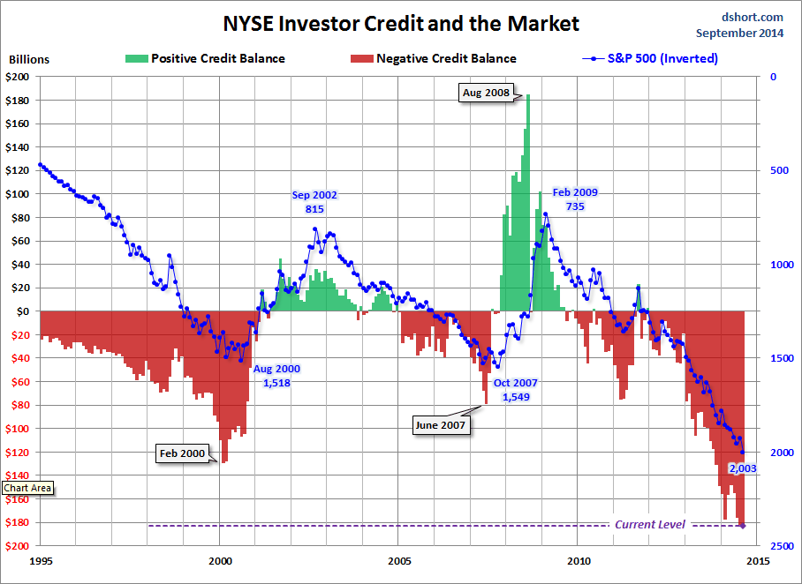

Slide 9
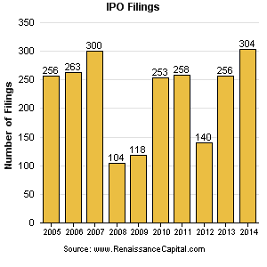

Slide 10
Technical warning signs to watch for among indices
Trend acceleration relative to 200-day moving averages
Declining market breadth (fewer shares rising)
Failed upside breakouts from trading ranges
Loss of uptrend consistency characteristics
Churning price action relative to recent trading ranges
Breaks of 200-day moving averages
Broadening patterns relative the last several trading ranges
200-day moving averages turn downwards
Resistance is encountered beneath declining 200-day MAs
Previous rising lows are replaced by lower rally highs
Indices fall faster than they rose to their highs

Slide 11
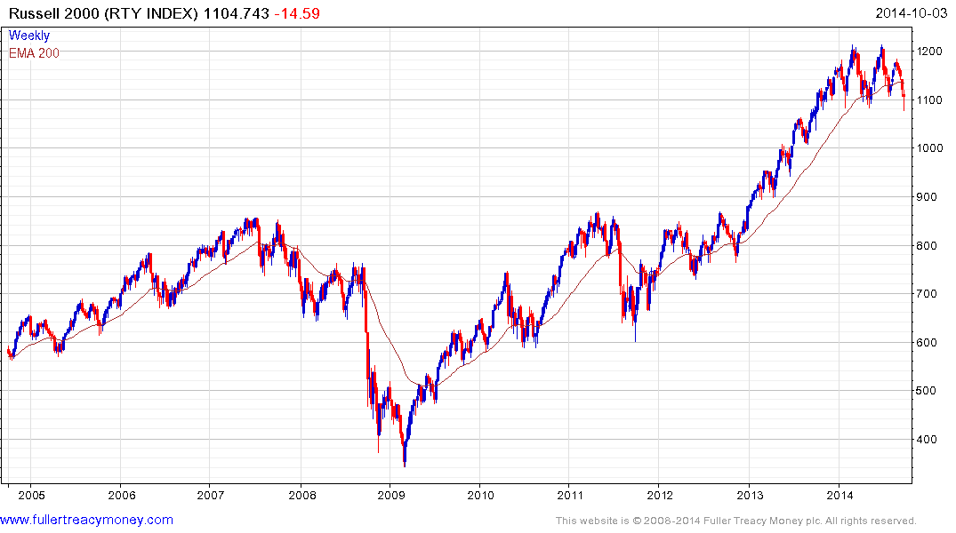
Wall Street’s canary in the coal mine

Slide 12
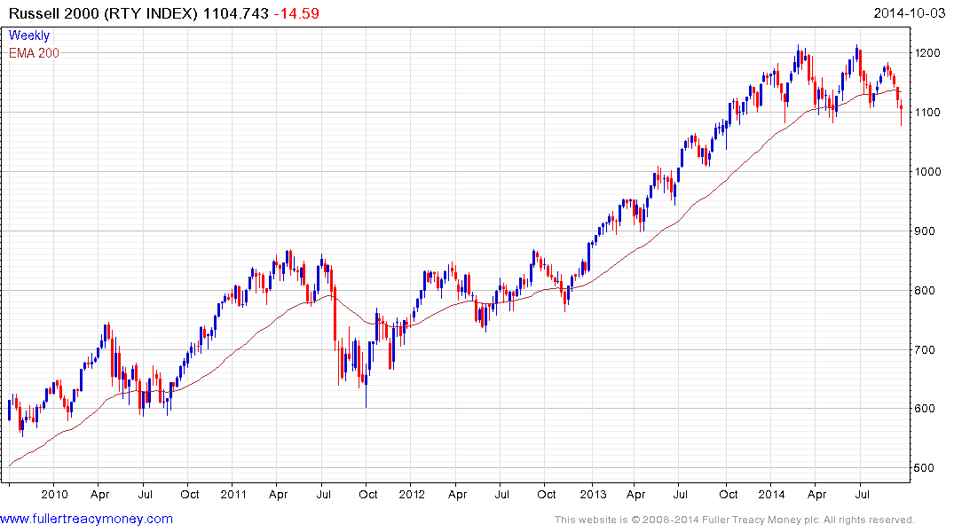
Can you identify the consistency
characteristics since 4Q 2013?

Slide 13
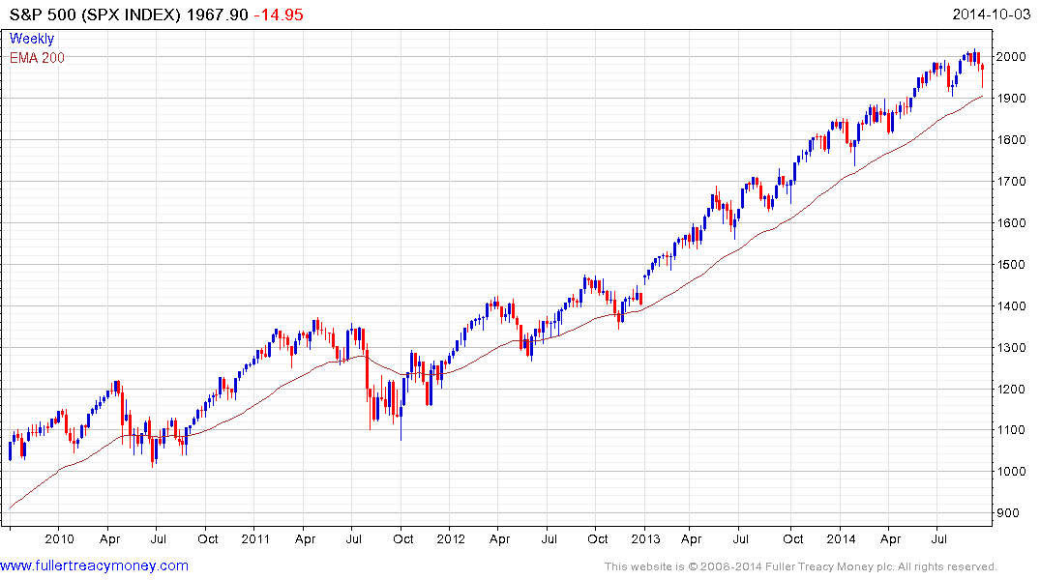
Roundophobia?
What are the consistency
characteristics from here,
and what would show change?

Slide 14
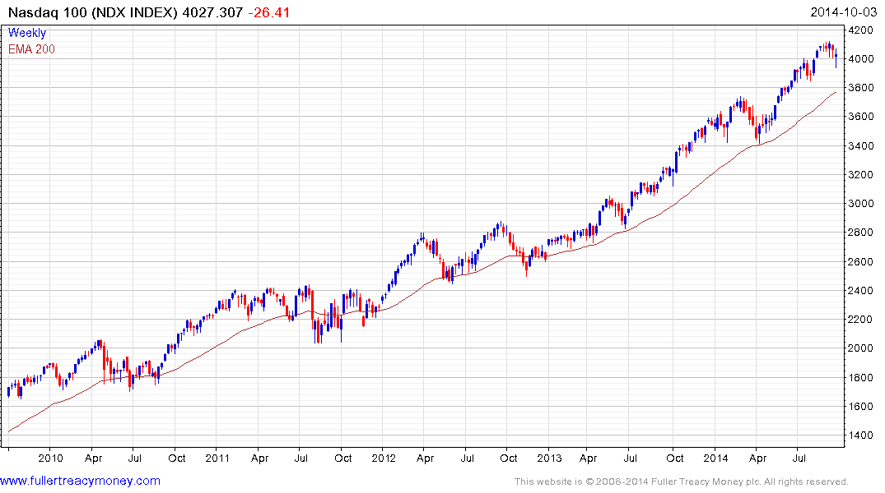

Slide 15
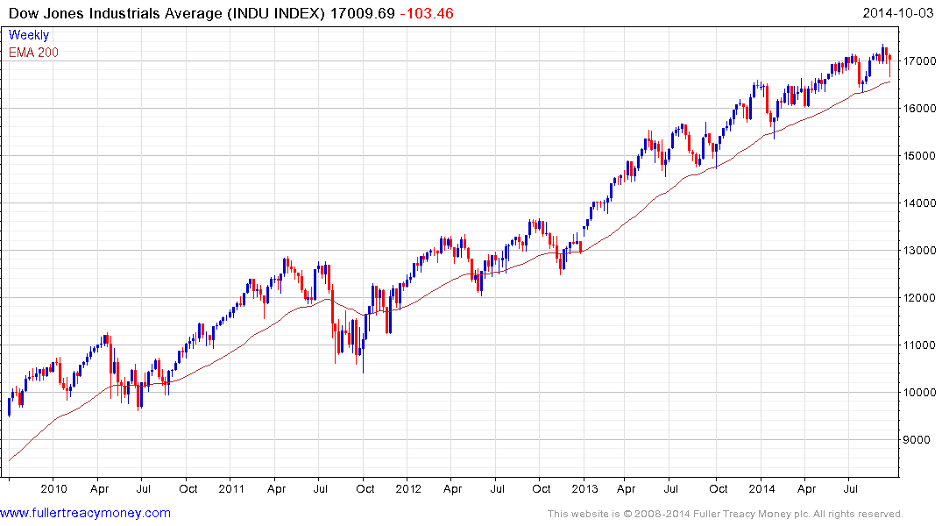

Slide 16
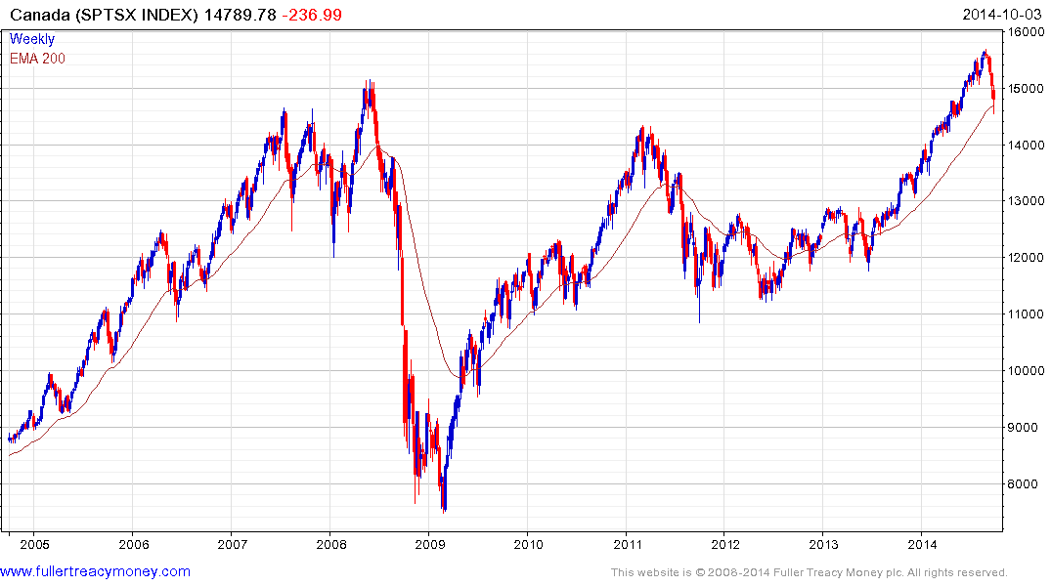
What has happened here?

Slide 17
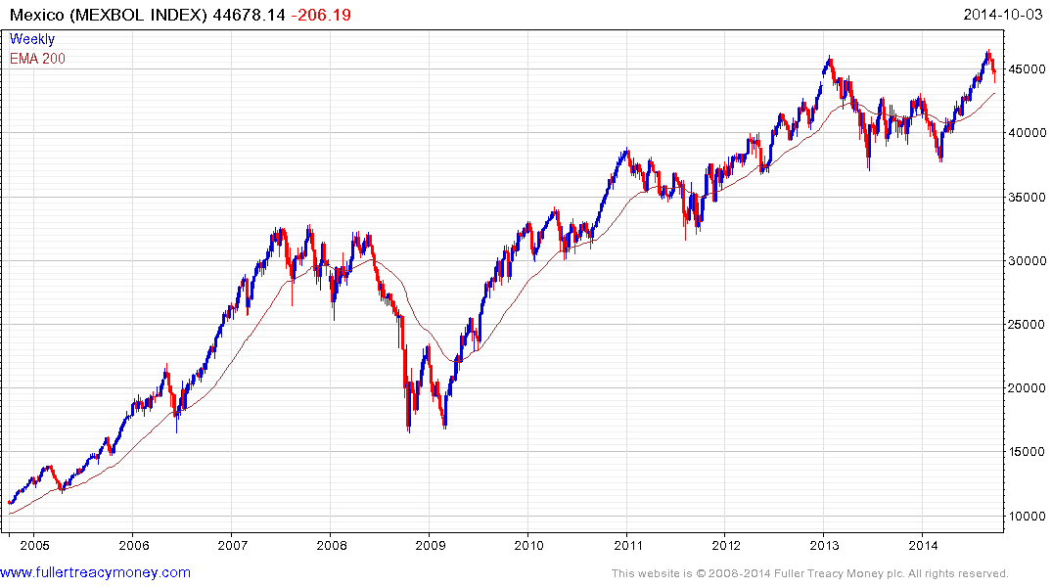
Can you see all the overextensions
and mean reversions on this chart?

Slide 18
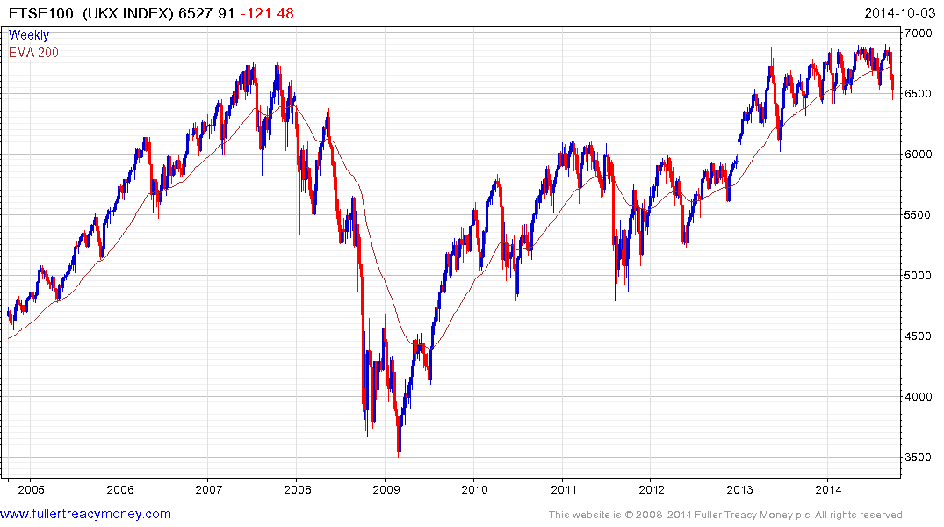
What is going on here?

Slide 19
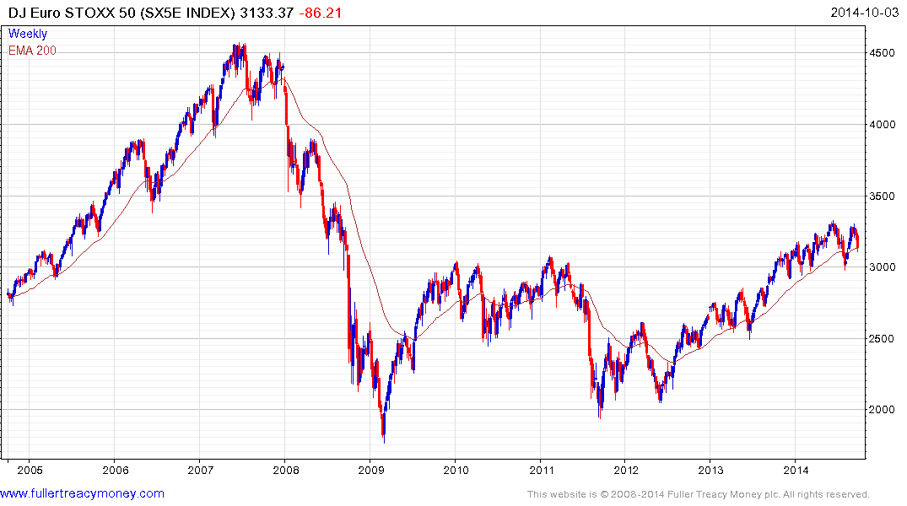
And here?

Slide 20
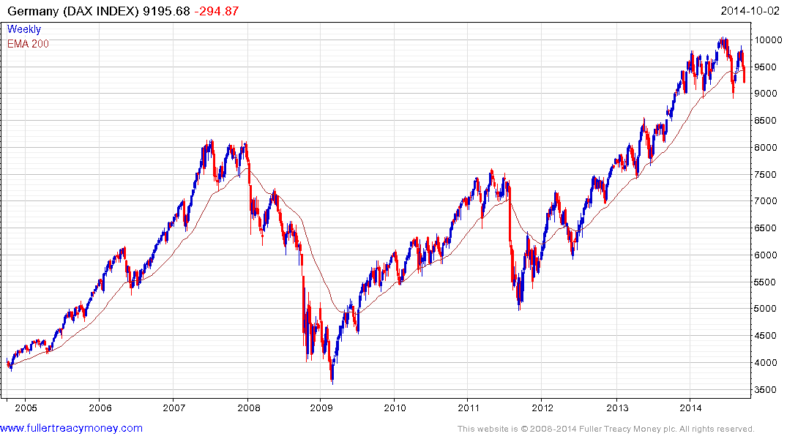
And here?

Slide 21
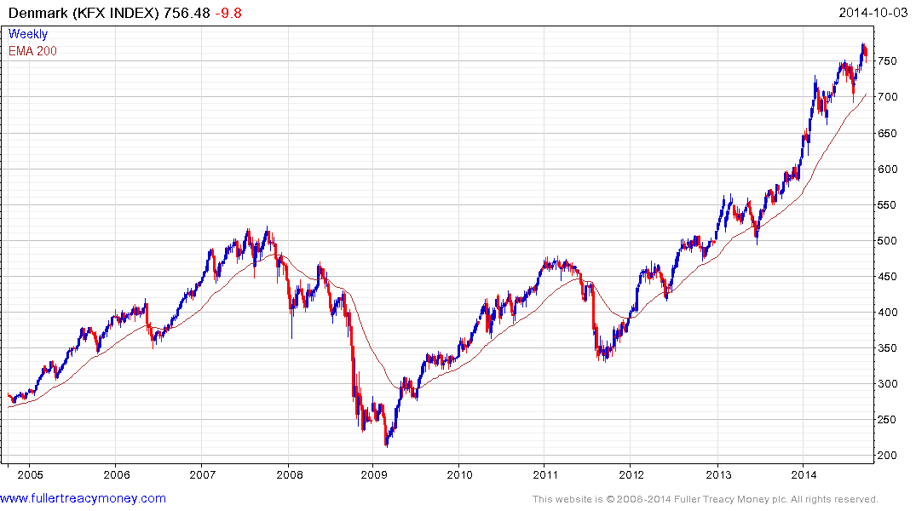
Europe’s strongest Index
and reaction lows still rising

Slide 22
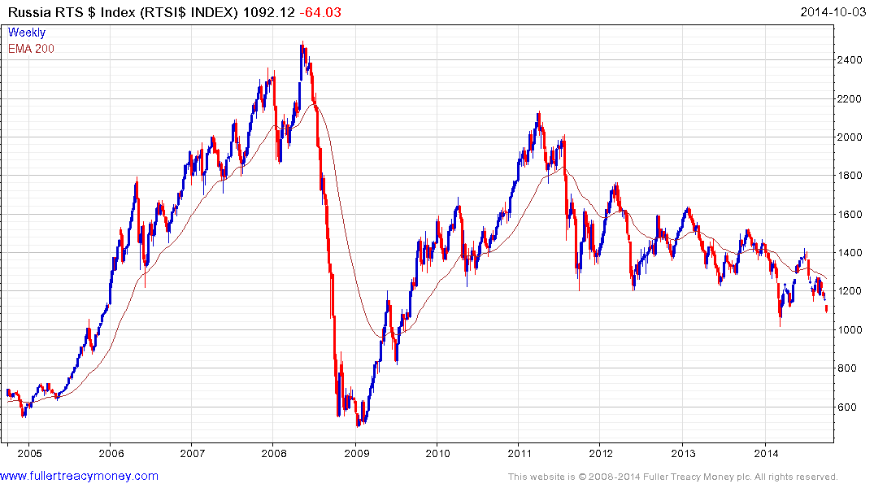
Governance is Everything - favourable
regime change would make Russia a buy

Slide 23
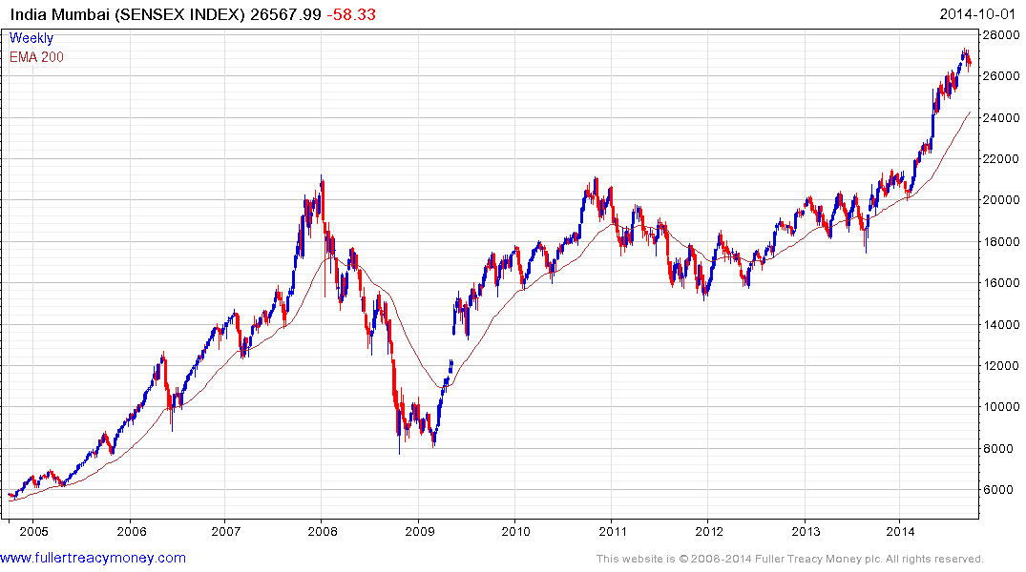
Watch the current trend’s consistency characteristics for signs of medium-term
corrections and buying opportunities
Still a 5-year+ favourite,
due to Narendra Modi

Slide 24
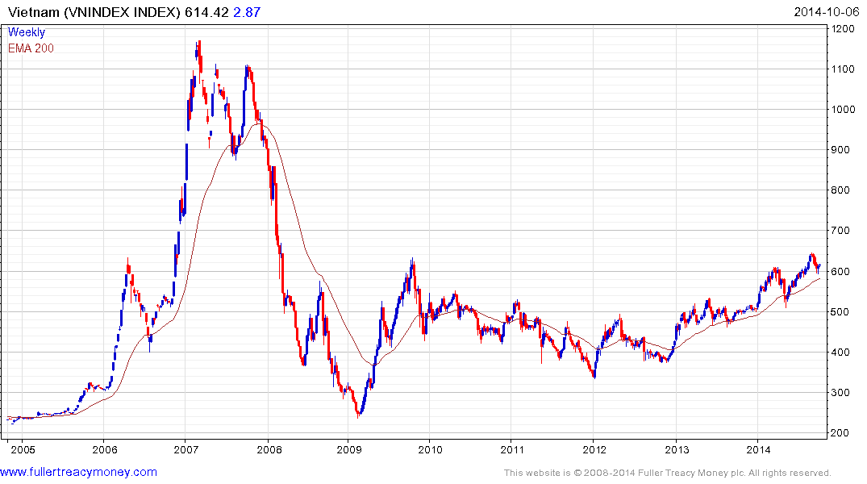
Still a longer-term favourite
Biggest risk – China’s potential aggression

Slide 25
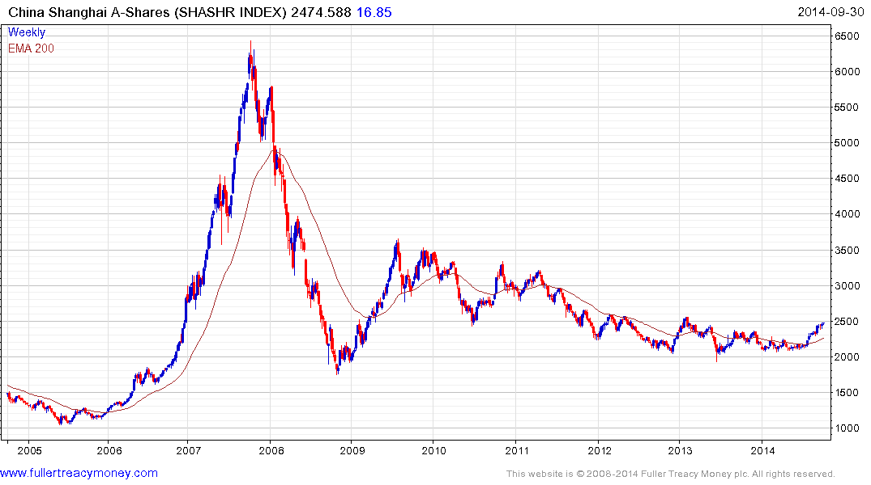
A long-term favourite

Slide 26
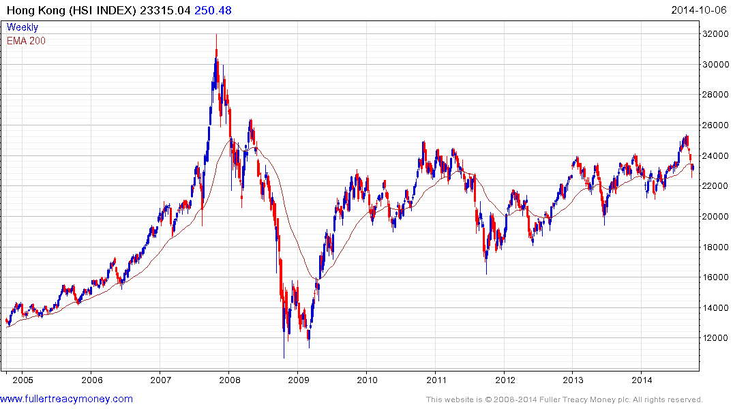
A long-term favourite
Biggest risk – if China erodes its freedoms

Slide 27
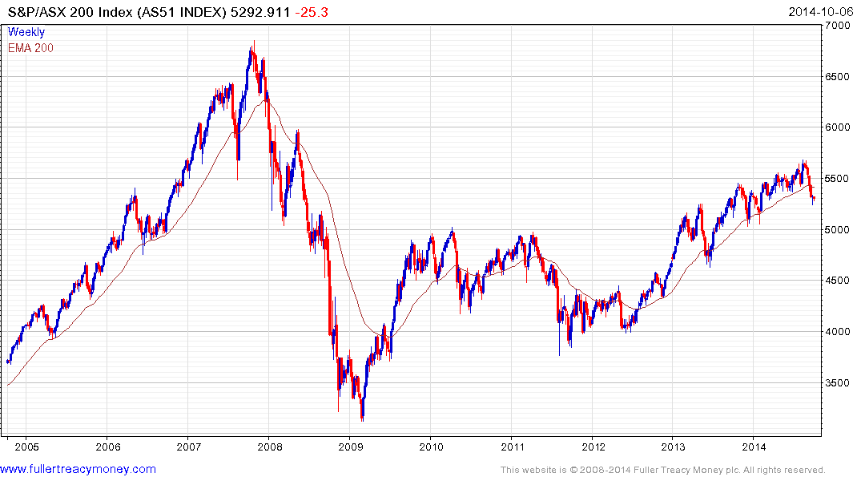
A long-term favourite

Slide 28
At this stage of the stock market cycle, I favour previous laggards as they
begin to show relative strength

Slide 29
Long-term bull factors for stock markets
Accommodative monetary policies
An accelerating rate of technological innovation
Lower energy prices in real terms, thanks to innovation
The triumph of capitalism, both democratic & authoritarian
Globalisation
Middle class growth in emerging markets
Continued growth in the global population

Slide 30
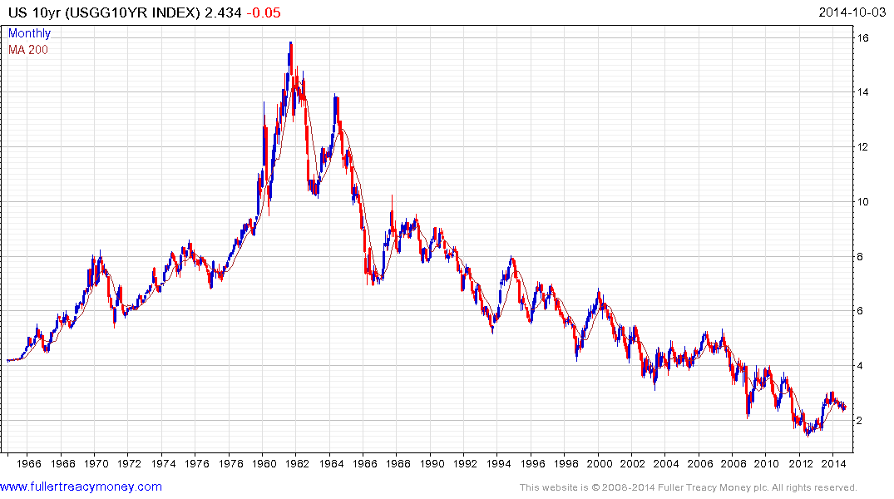
1) Probable lengthy base building
2) Above 3% base maturing
3) Above 4% probable base completion

Slide 31
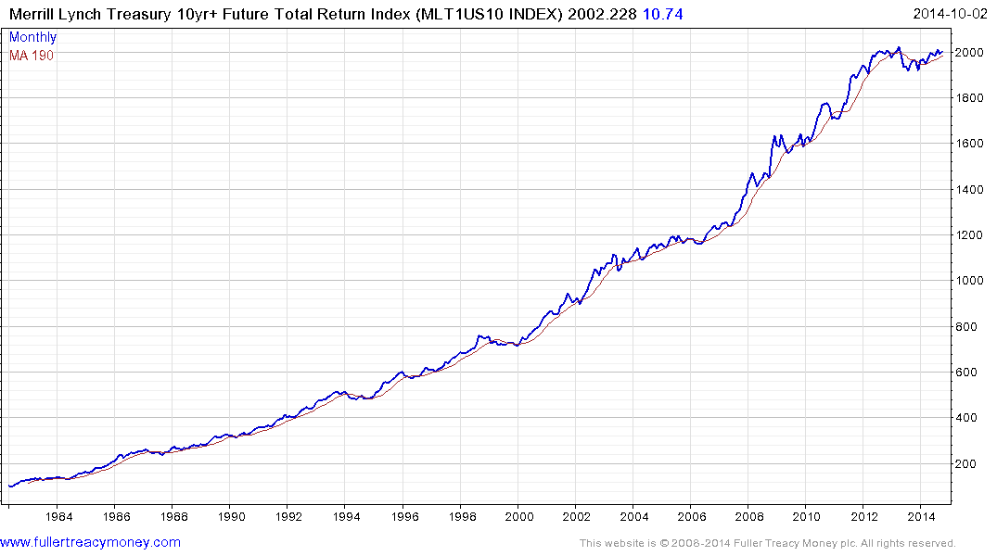
Top completion for US bondholders
when this total return
pattern breaks downwards

Slide 32
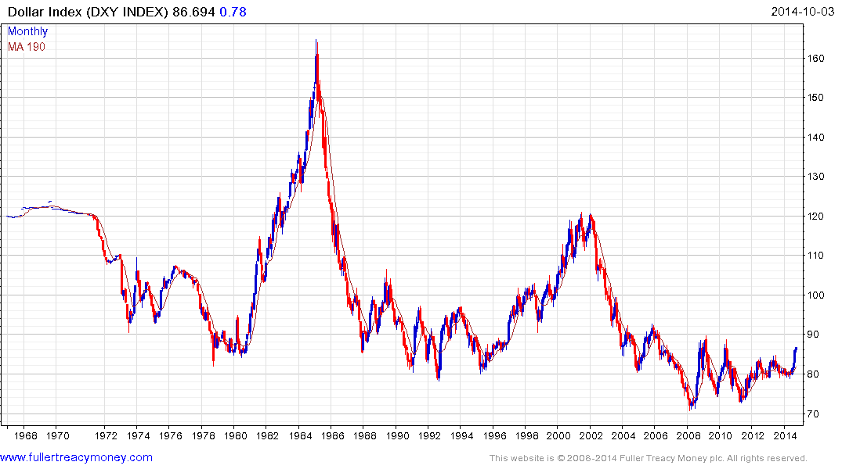
US Dollar Index completing a base formation
Driven by energy independence & tech lead
Fed & Treasury will control speed of $ recovery

Slide 33
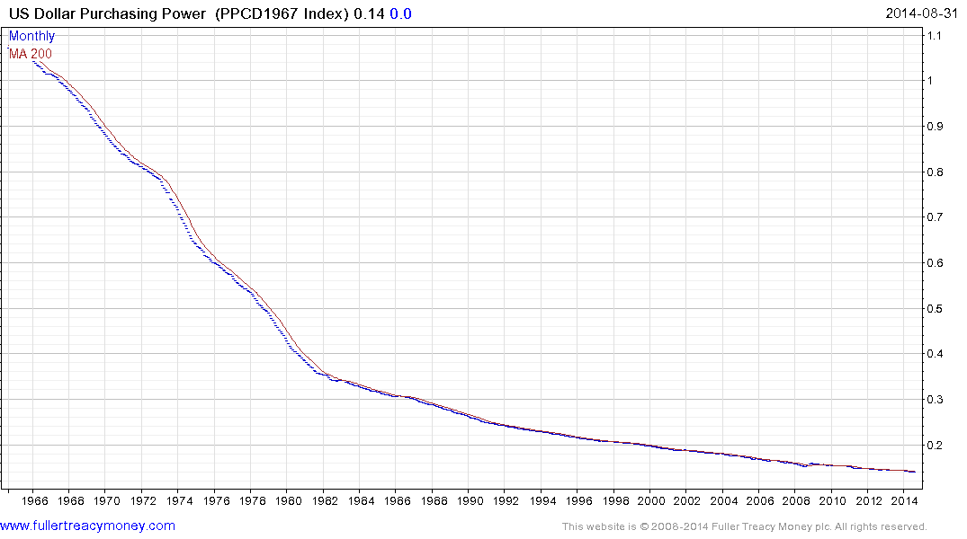
Nevertheless the US dollar is still a fiat currency, which
has lost 85 percent of its purchasing power since 1968

Slide 34
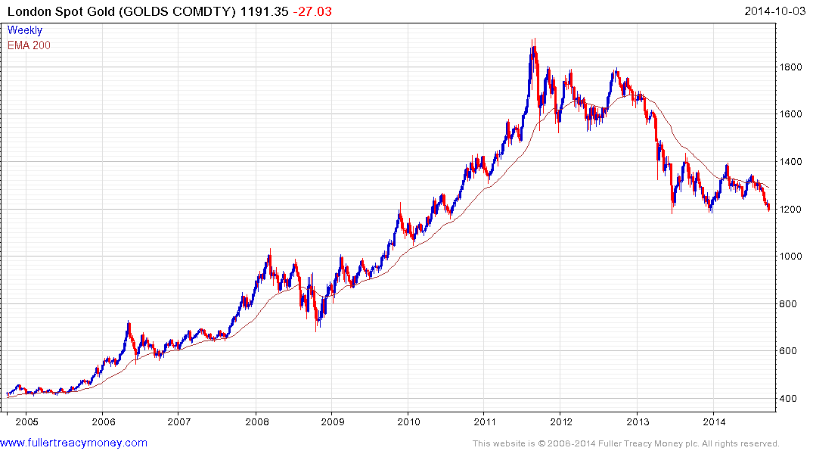
Critical juncture
Traders heavily short
Yet to reach revulsion sage
for trader longs
Indians & Chinese buying

Slide 35
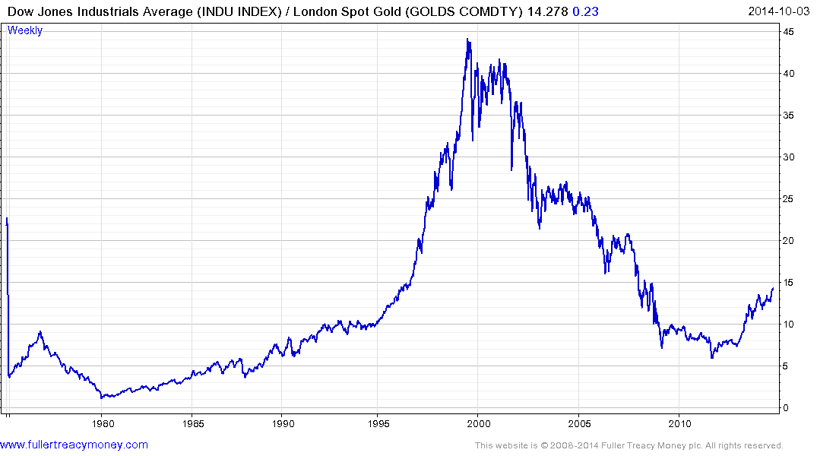
Gold is out of favour
with Western investors
who are in stocks & bonds

Slide 36
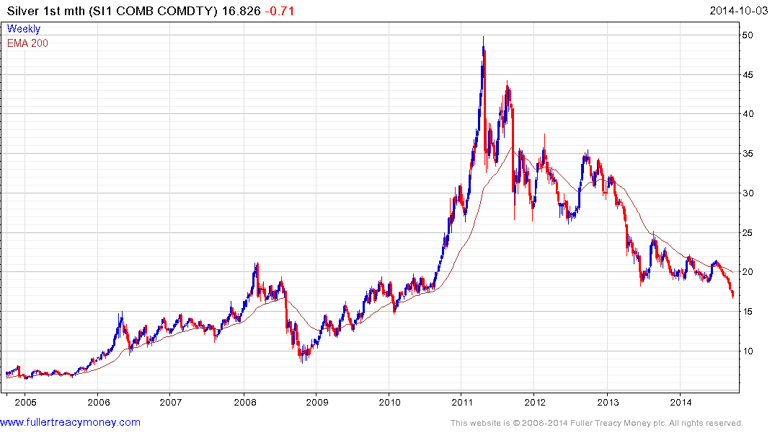
Silver is high-beta gold

Slide 37
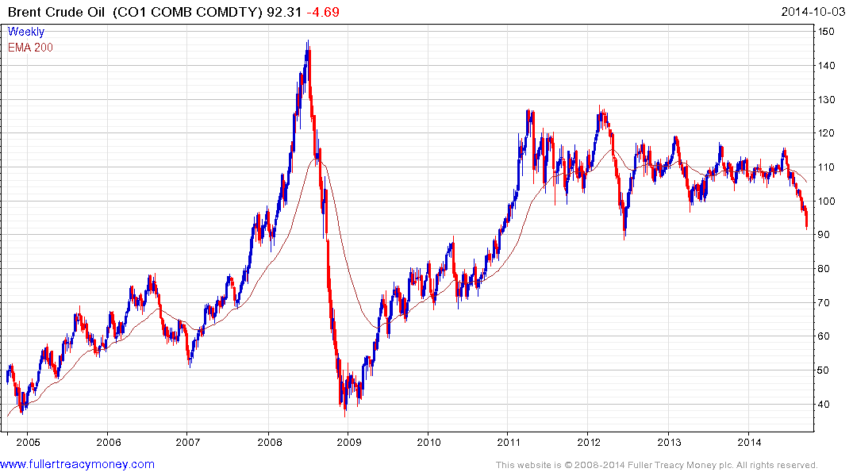
No more price spikes
such as 2008, despite
turmoil in many producer
regions and an eventual
global economic recovery

Slide 38
Many thanks for your interest!
Any more questions?
Please visit our site:
www.fullertreacymoney.com

Slide 39
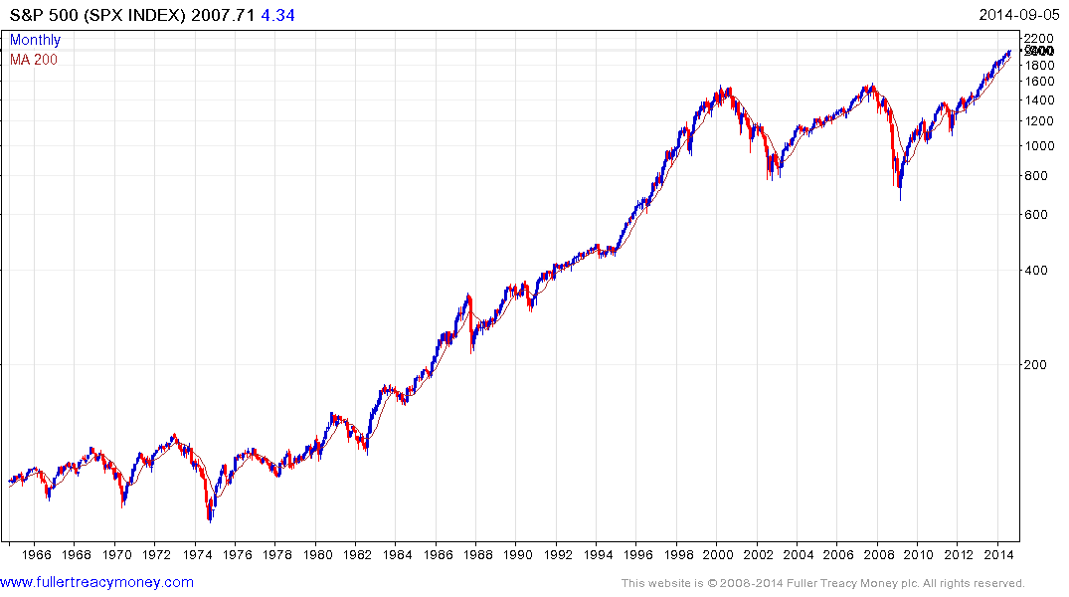
Is Wall Street’s next
secular bull market
Underway?
If so, it will be led by
Accelerated technological innovation
Lower energy costs in real terms
Worldwide acceptance of capitalism
Globalisation
An increasing global population
A rapidly growing global middleclass

